Slide 1
Chapter 7
ARP
and
RARP

Slide 2
CONTENTS
ARP
ARP PACKAGE
RARP

Slide 3
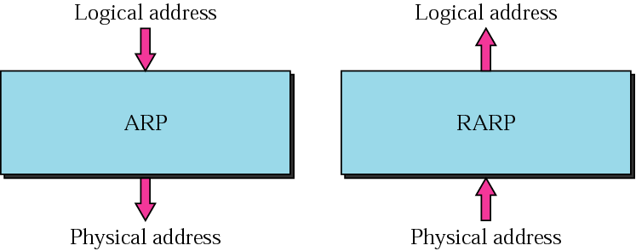
Figure 7-1
ARP and RARP

Slide 4
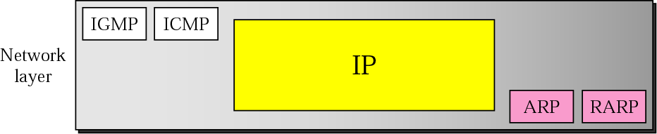
Figure 7-2
Position of ARP and RARP
in TCP/IP protocol suite

Slide 5
7.1
A R P

Slide 6
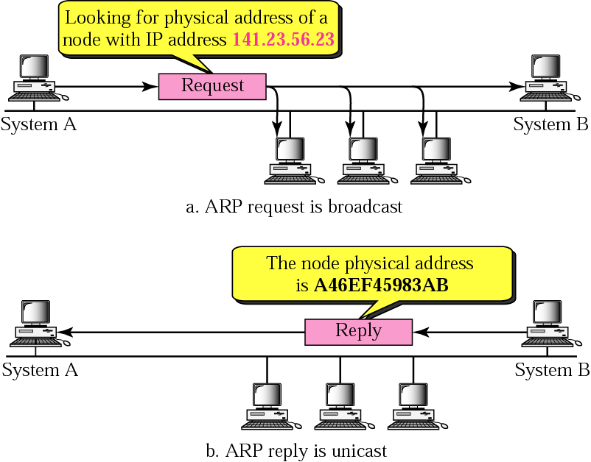
Figure 7-3
ARP operation

Slide 7
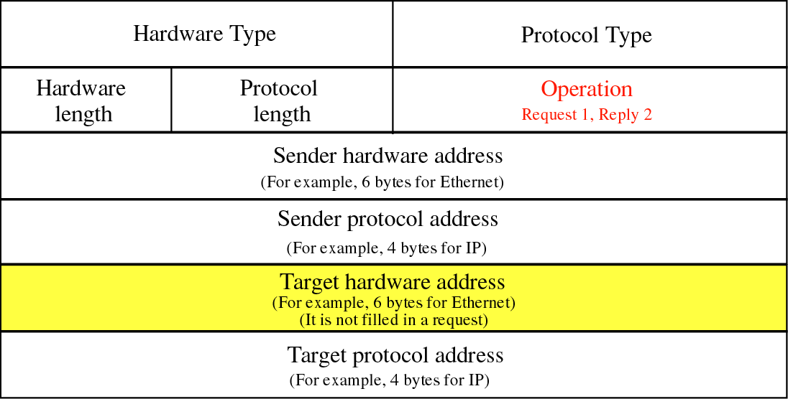
Figure 7-4
ARP packet

Slide 8
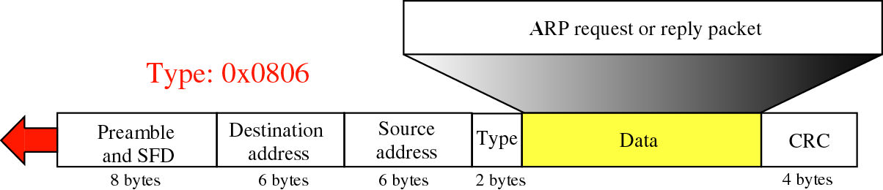
Figure 7-5
Encapsulation of ARP packet

Slide 9
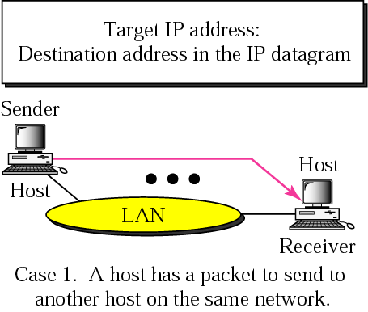
Figure 7-6:a
Four cases using ARP

Slide 10
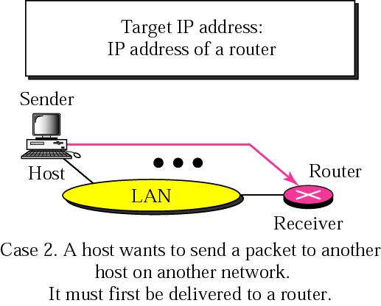
Figure 7-6:b
Four cases using ARP

Slide 11
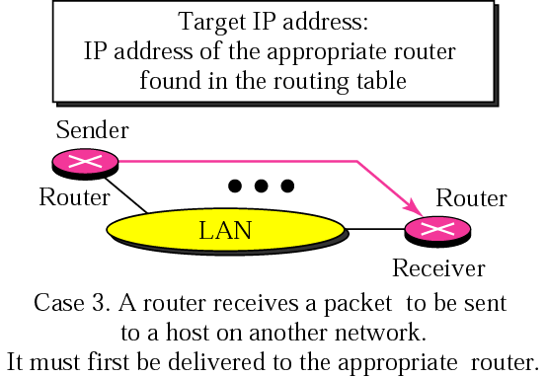
Figure 7-6:c
Four cases using ARP

Slide 12
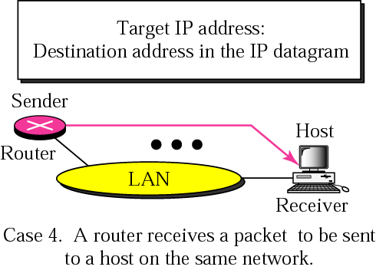
Figure 7-6:d
Four cases using ARP

Slide 13

An ARP request is broadcast;
an ARP reply is unicast.

Slide 14
Example 1
A host with IP address 130.23.43.20 and physical address 0xB23455102210 has a packet to send to another host with IP address 130.23.43.25 and physical address 0xA46EF45983AB. The two hosts are on the same Ethernet network. Show the ARP request and reply packets encapsulated in Ethernet frames.

Slide 15
Solution
Figure 7.7 shows the ARP request and reply packets. Note that the ARP data field in this case is 28 bytes, and that the individual addresses do not fit in the 4-byte boundary.

Slide 16
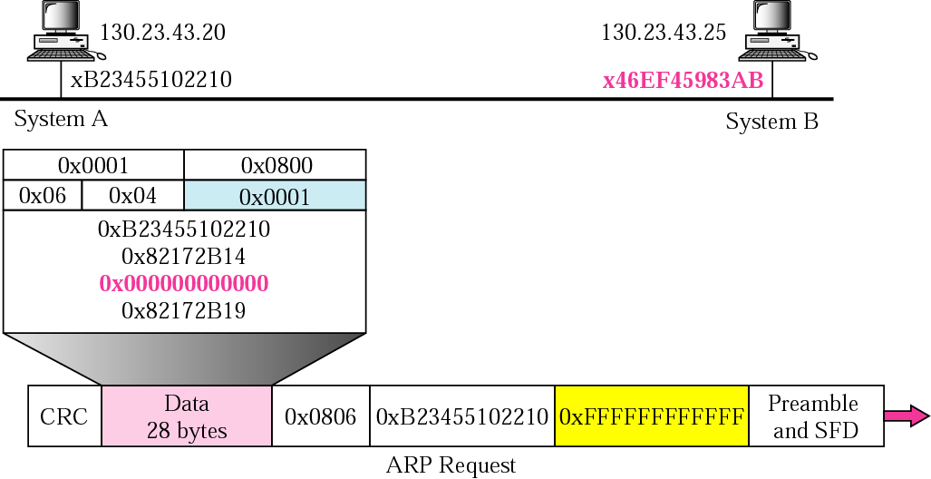
Figure 7-7: request
Example 1

Slide 17
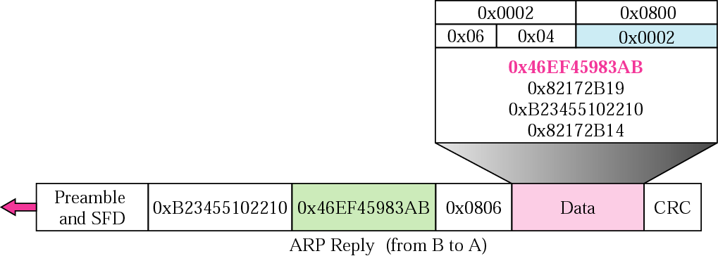
Figure 7-7: reply
Example 1 (Continued)

Slide 18
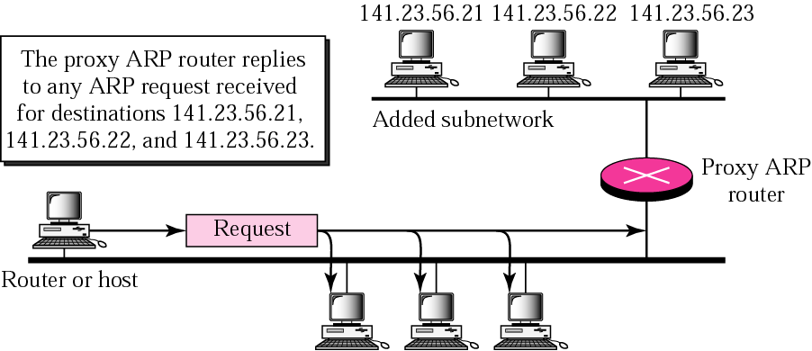
Figure 7-8
Proxy ARP

Slide 19
7.2
ARP
PACKAGE

Slide 20
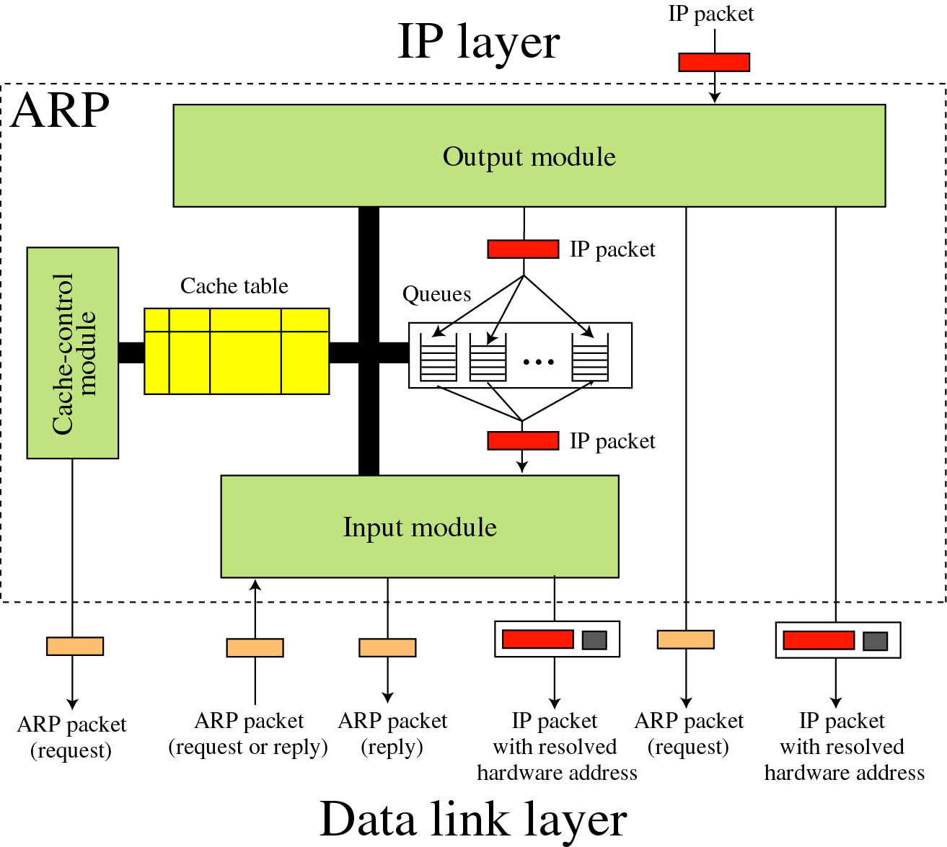
Figure 7-9
ARP
components

Slide 21
Original cache table
State Queue Attempt Time-out Protocol Addr. Hardware Addr.
R 5 900 180.3.6.1 ACAE32457342
P 2 2 129.34.4.8
P 14 5 201.11.56.7
R 8 450 114.5.7.89 457342ACAE32
P 12 1 220.55.5.7
F
R 9 60 19.1.7.82 4573E3242ACA
P 18 3 188.11.8.71

Slide 22
Example 2
The ARP output module receives an IP datagram (from the IP layer) with the destination address 114.5.7.89. It checks the cache table and finds that an entry exists for this destination with the RESOLVED state (R in the table). It extracts the hardware address, which is 457342ACAE32, and sends the packet and the address to the data link layer for transmission. The cache table remains the same.

Slide 23
Example 3
Twenty seconds later, the ARP output module receives an IP datagram (from the IP layer) with the destination address 116.1.7.22. It checks the cache table and does not find this destination in the table. The module adds an entry to the table with the state PENDING and the Attempt value 1. It creates a new queue for this destination and enqueues the packet. It then sends an ARP request to the data link layer for this destination.

Slide 24
Cache table for Example 3
State Queue Attempt Time-out Protocol Addr. Hardware Addr.
R 5 900 180.3.6.1 ACAE32457342
P 2 2 129.34.4.8
P 14 5 201.11.56.7
R 8 450 114.5.7.89 457342ACAE32
P 12 1 220.55.5.7
P 23 1 116.1.7.22
R 9 60 19.1.7.82 4573E3242ACA
P 18 3 188.11.8.71

Slide 25
Example 4
Fifteen seconds later, the ARP input module receives an ARP packet with target protocol (IP) address 188.11.8.71. The module checks the table and finds this address. It changes the state of the entry to RESOLVED and sets the time-out value to 900. The module then adds the target hardware address (E34573242ACA) to the entry. Now it accesses queue 18 and sends all the packets in this queue, one by one, to the data link layer.

Slide 26
Cache table for Example 4
State Queue Attempt Time-out Protocol Addr. Hardware Addr.
R 5 900 180.3.6.1 ACAE32457342
P 2 2 129.34.4.8
P 14 5 201.11.56.7
R 8 450 114.5.7.89 457342ACAE32
P 12 1 220.55.5.7
P 23 1 116.1.7.22
R 9 60 19.1.7.82 4573E3242ACA
R 18 188.11.8.71 E34573242ACA

Slide 27
Example 5
Twenty-five seconds later, the cache-control module updates every entry. The time-out values for the first three resolved entries are decremented by 60. The time-out value for the last resolved entry is decremented by 25. The state of the next-to-the last entry is changed to FREE because the time-out is zero. For each of the three entries, the value of the attempts field is incremented by one. After incrementing, the attempts value for one entry (the one with IP protocol address 201.11.56.7) is more than the maximum; the state is changed to FREE, the queue is deleted.

Slide 28
Cache table for Example 5
State Queue Attempt Time-out Protocol Addr. Hardware Addr.
R 5 840 180.3.6.1 ACAE32457342
P 2 3 129.34.4.8
F
R 8 390 114.5.7.89 457342ACAE32
P 12 2 220.55.5.7
P 23 2 116.1.7.22
F
R 18 874 188.11.8.71 E34573242ACA

Slide 29
7.3
RARP

Slide 30
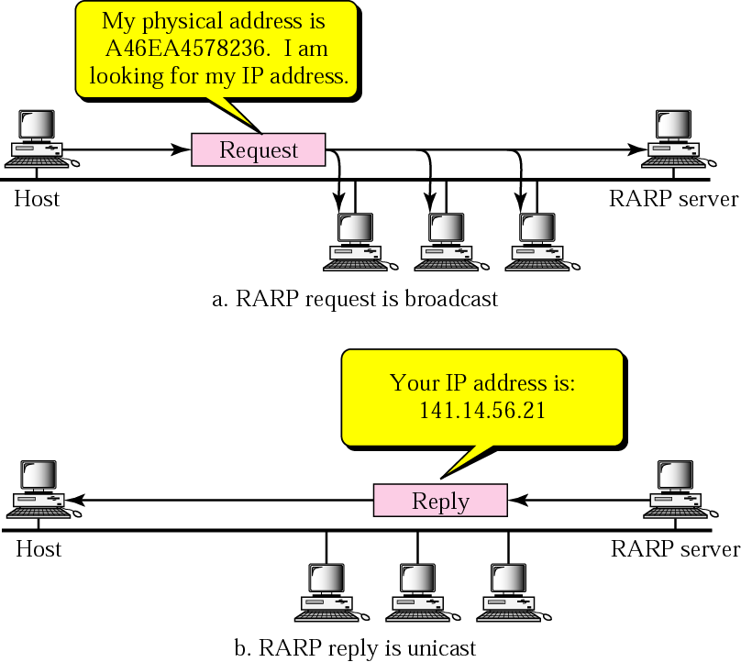
Figure 7-10
RARP
operation

Slide 31
The RARP request packets are
broadcast;
the RARP reply packets are
unicast.

Slide 32
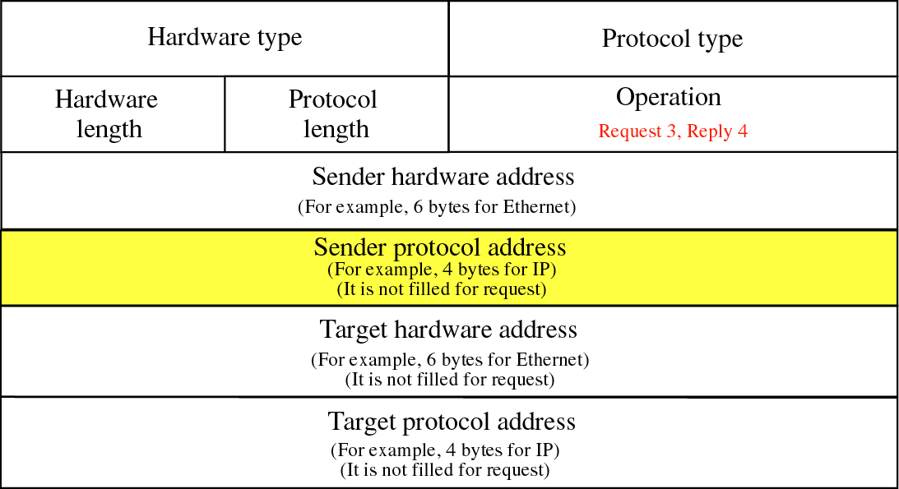
Figure 7-11
RARP packet

Slide 33
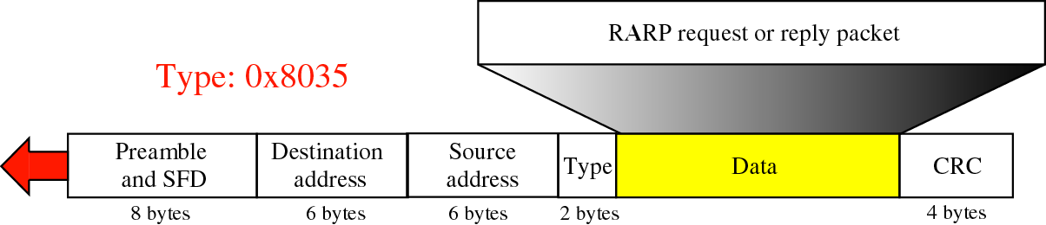
Figure 7-12
Encapsulation of RARP packet

Slide 34
Alternative Solutions to RARP
When a diskless computer is booted, it needs more information in addition to its IP address. It needs to know its subnet mask, the IP address of a router, and the IP address of a name server. RARP cannot provide this extra information. New protocols have been developed to provide this information. In Chapter 17 we discuss two protocols, BOOTP and DHCP, that can be used instead of RARP.

