Slide 1
Chapter 8
Internet Protocol
(IP)

Slide 2
CONTENTS
DATAGRAM
FRAGMENTATION
OPTIONS
CHECKSUM
IP PACKAGE

Slide 3
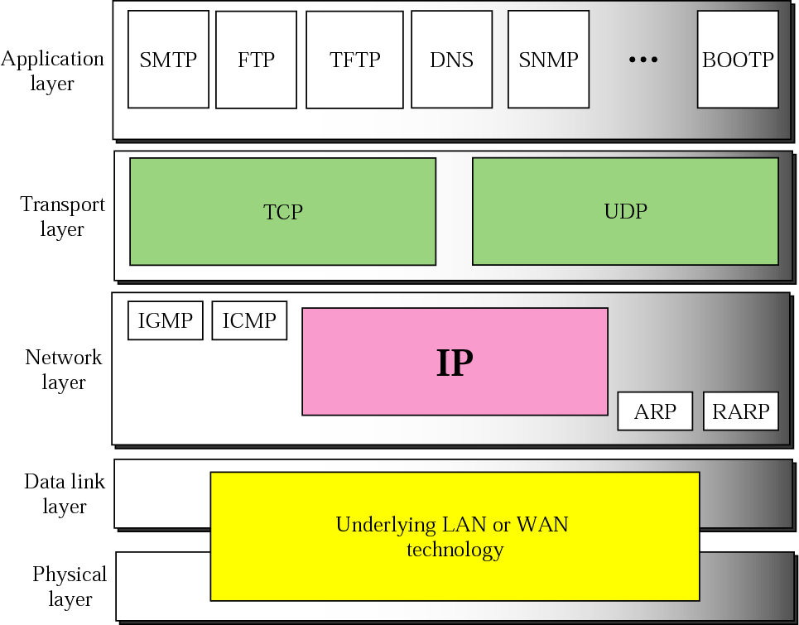
Figure 8-1
Position of IP in TCP/IP protocol suite

Slide 4
8.1
DATAGRAM

Slide 5
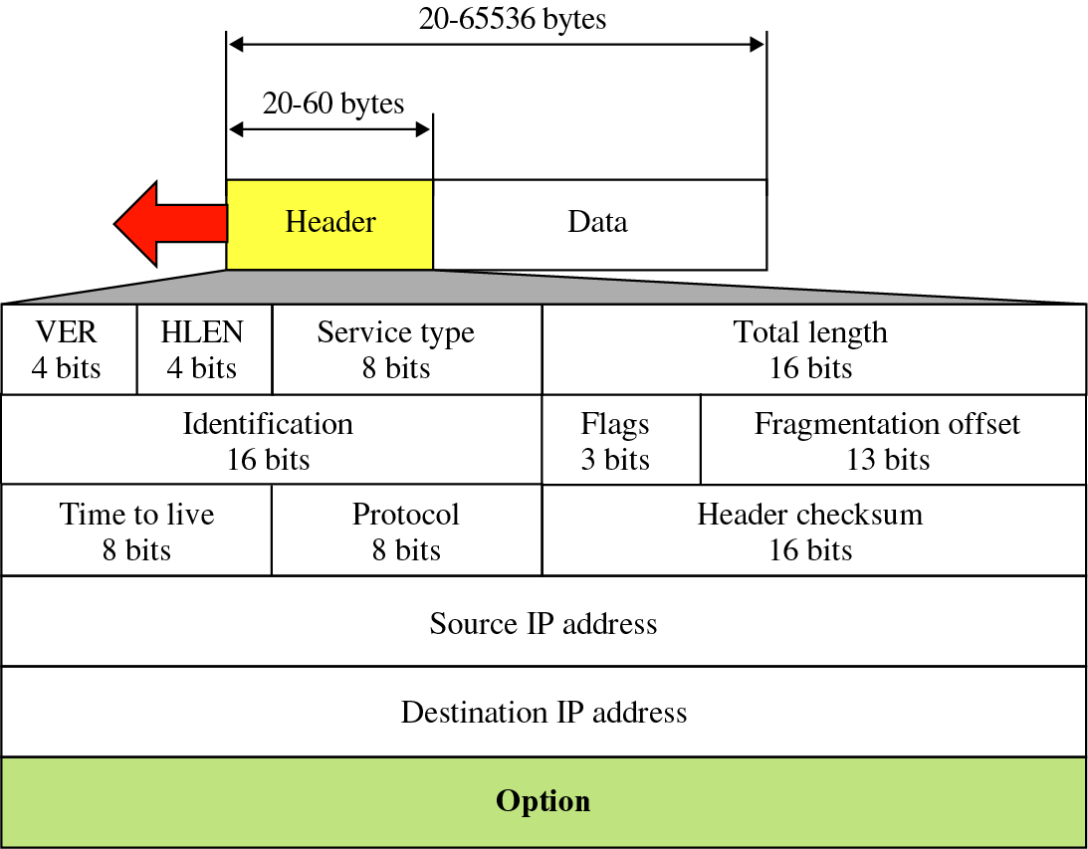
Figure 8-2
IP datagram

Slide 6
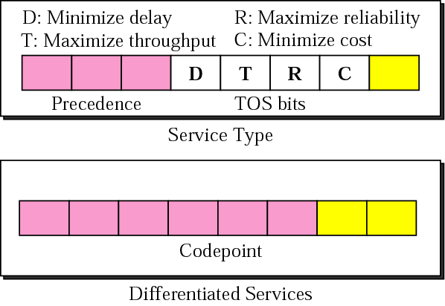
Figure 8-3
Service Type or Differentiated Services

Slide 7

The precedence subfield is
not used in version 4.

Slide 8
The total length field defines the
total length of the
datagram including the header.

Slide 9
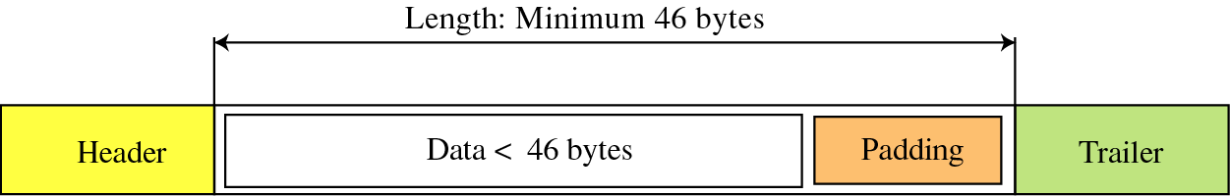
Figure 8-4
Encapsulation of a small datagram
in an Ethernet frame

Slide 10
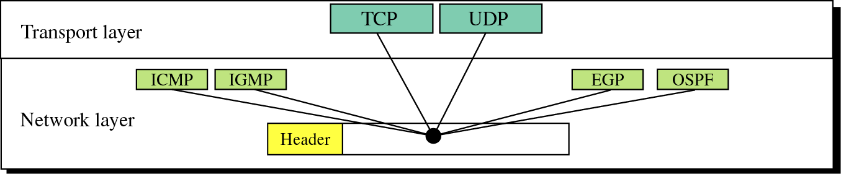
Figure 8-5
Multiplexing

Slide 11
Example 1
An IP packet has arrived with the first 8 bits as shown:
⬅ 01000010
The receiver discards the packet. Why?

Slide 12
Solution
There is an error in this packet. The 4 left-most bits (0100) show the version, which is correct. The next 4 bits (0010) show the header length, which means (2 × 4 = 8), which is wrong. The minimum number of bytes in the header must be 20. The packet has been corrupted in transmission.

Slide 13
Example 2
In an IP packet, the value of HLEN is 1000 in binary. How many bytes of options are being carried by this packet?

Slide 14
Solution
The HLEN value is 8, which means the total number of bytes in the header is 8 × 4 or 32 bytes. The first 20 bytes are the main header, the next 12 bytes are the options.

Slide 15
Example 3
In an IP packet, the value of HLEN is 5₁₆ and the value of the total length field is 0028₁₆. How many bytes of data are being carried by this packet?

Slide 16
Solution
The HLEN value is 5, which means the total number of bytes in the header is 5 × 4 or 20 bytes (no options). The total length is 40 bytes, which means the packet is carrying 20 bytes of data (40−20).

Slide 17
Example 4
An IP packet has arrived with the first few hexadecimal digits as shown below:
⬅ 45000028000100000102...................
How many hops can this packet travel before being dropped? The data belong to what upper layer protocol?

Slide 18
Solution
To find the time-to-live field, we should skip 8 bytes (16 hexadecimal digits). The time-to-live field is the ninth byte, which is 01. This means the packet can travel only one hop. The protocol field is the next byte (02), which means that the upper layer protocol is IGMP.

Slide 19
8.2
FRAGMENTATION

Slide 20
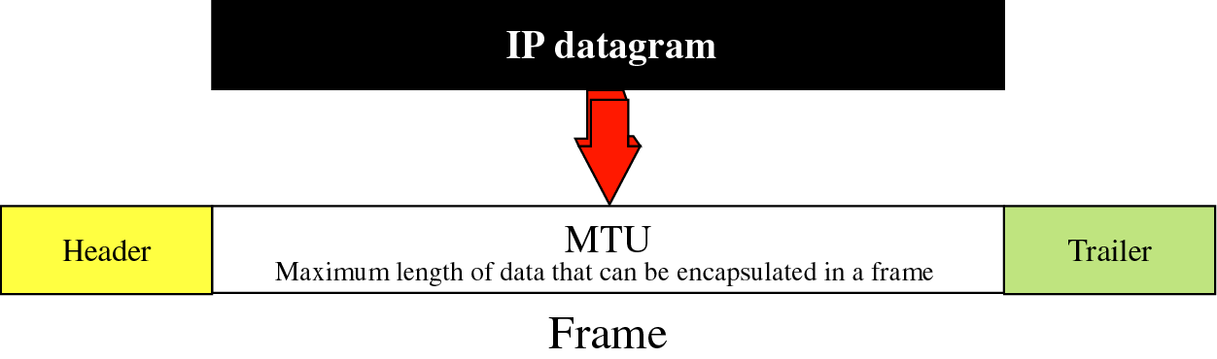
Figure 8-6
MTU

Slide 21
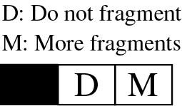
Figure 8-7
Flag field

Slide 22
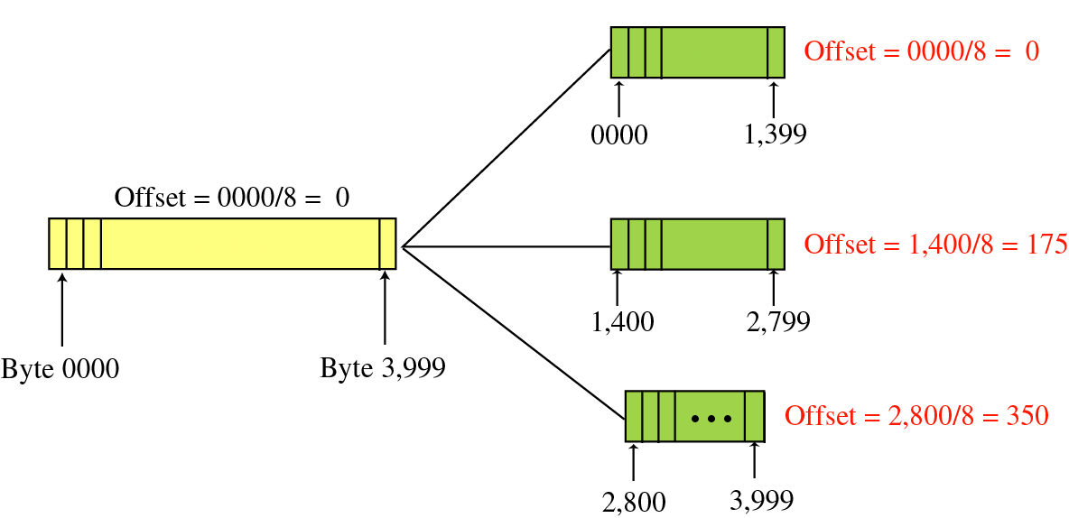
Figure 8-8
Fragmentation example

Slide 23
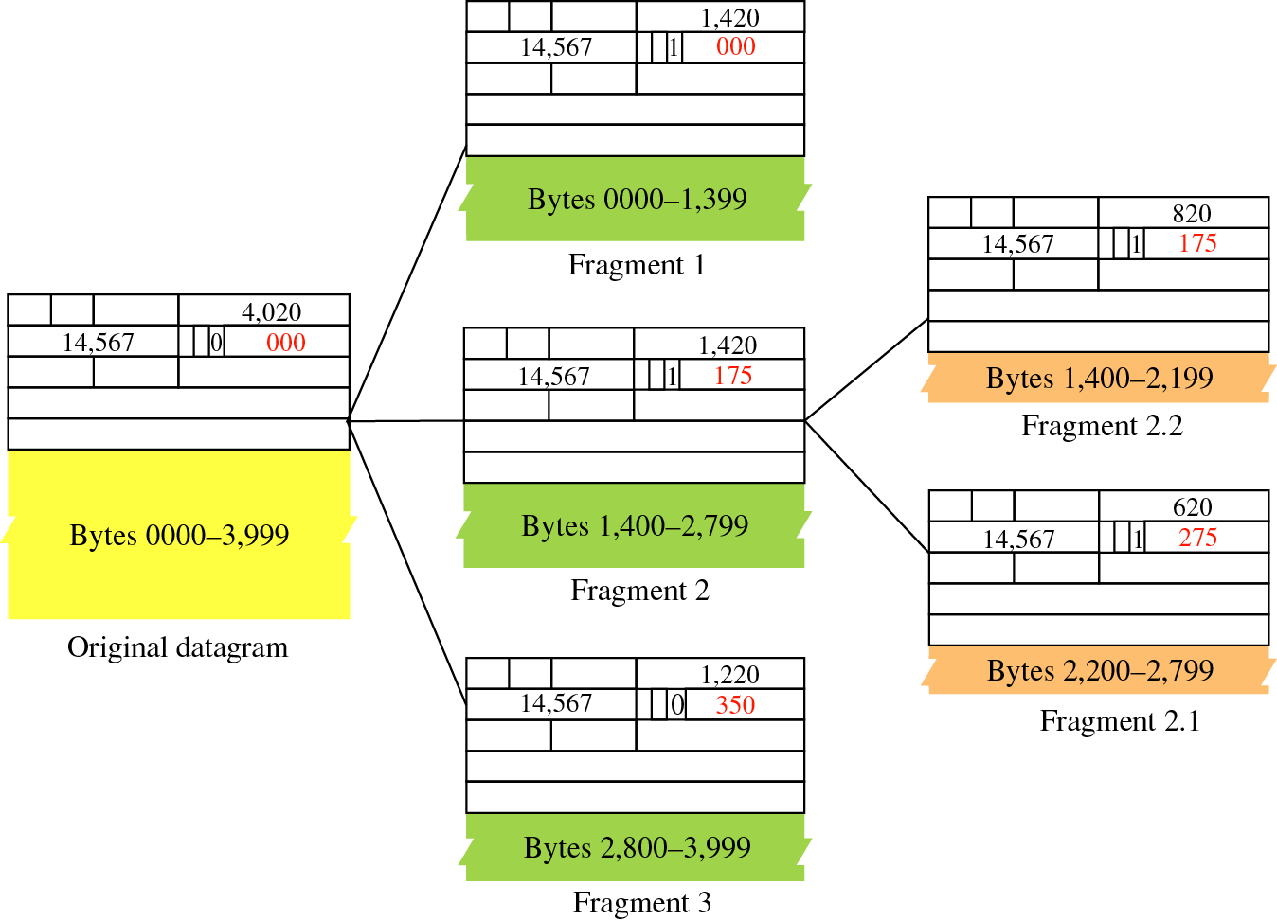
Figure 8-9
Detailed
example

Slide 24
Example 5
A packet has arrived with an M bit value of 0. Is this the first fragment, the last fragment, or a middle fragment? Do we know if the packet was fragmented?

Slide 25
Solution
If the M bit is 0, it means that there are no more fragments; the fragment is the last one. However, we cannot say if the original packet was fragmented or not. A nonfragmented packet is considered the last fragment.

Slide 26
Example 6
A packet has arrived with an M bit value of 1. Is this the first fragment, the last fragment, or a middle fragment? Do we know if the packet was fragmented?

Slide 27
Solution
If the M bit is 1, it means that there is at least one more fragment. This fragment can be the first one or a middle one, but not the last one. We don’t know if it is the first one or a middle one; we need more information (the value of the fragmentation offset). However, we can definitely say the original packet has been fragmented because the M bit value is 1.

Slide 28
Example 7
A packet has arrived with an M bit value of 1 and a fragmentation offset value of zero. Is this the first fragment, the last fragment, or a middle fragment?

Slide 29
Solution
Because the M bit is 1, it is either the first fragment or a middle one. Because the offset value is 0, it is the first fragment.

Slide 30
Example 8
A packet has arrived in which the offset value is 100. What is the number of the first byte? Do we know the number of the last byte?

Slide 31
Solution
To find the number of the first byte, we multiply the offset value by 8. This means that the first byte number is 800. We cannot determine the number of the last byte unless we know the length of the data.

Slide 32
Example 9
A packet has arrived in which the offset value is 100, the value of HLEN is 5 and the value of the total length field is 100. What is the number of the first byte and the last byte?

Slide 33
Solution
The first byte number is 100 × 8 = 800. The total length is 100 bytes and the header length is 20 bytes (5 × 4), which means that there are 80 bytes in this datagram. If the first byte number is 800, the last byte number must 879.

Slide 34
8.3
OPTIONS

Slide 35
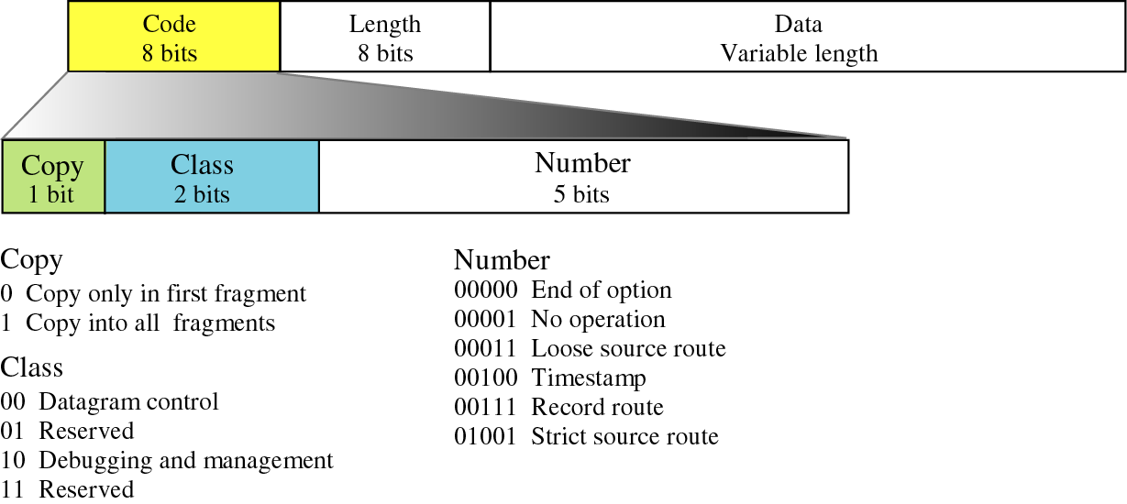
Figure 8-10
Option format

Slide 36
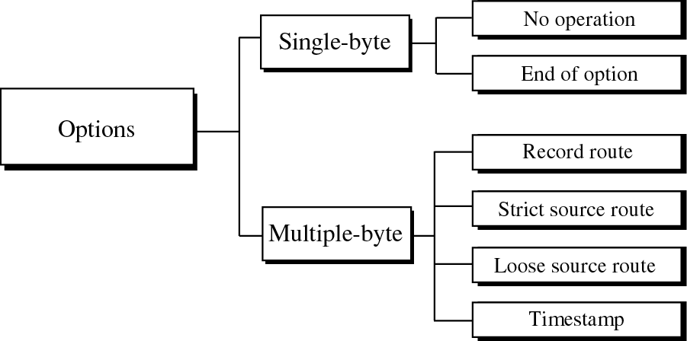
Figure 8-11
Categories of options

Slide 37
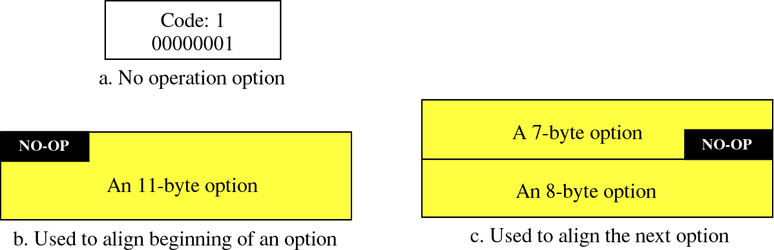
Figure 8-12
No operation option

Slide 38
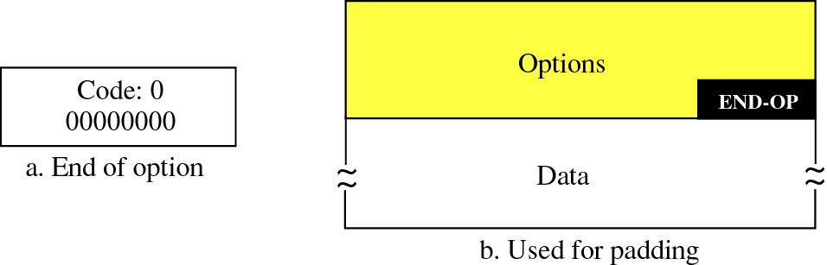
Figure 8-13
End of option option

Slide 39
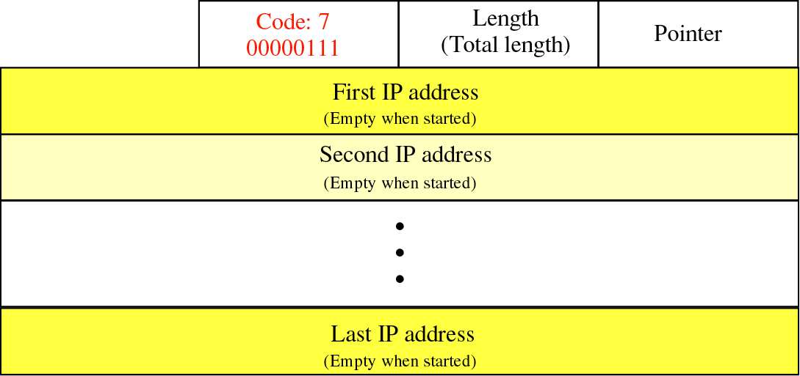
Figure 8-14
Record route option

Slide 40
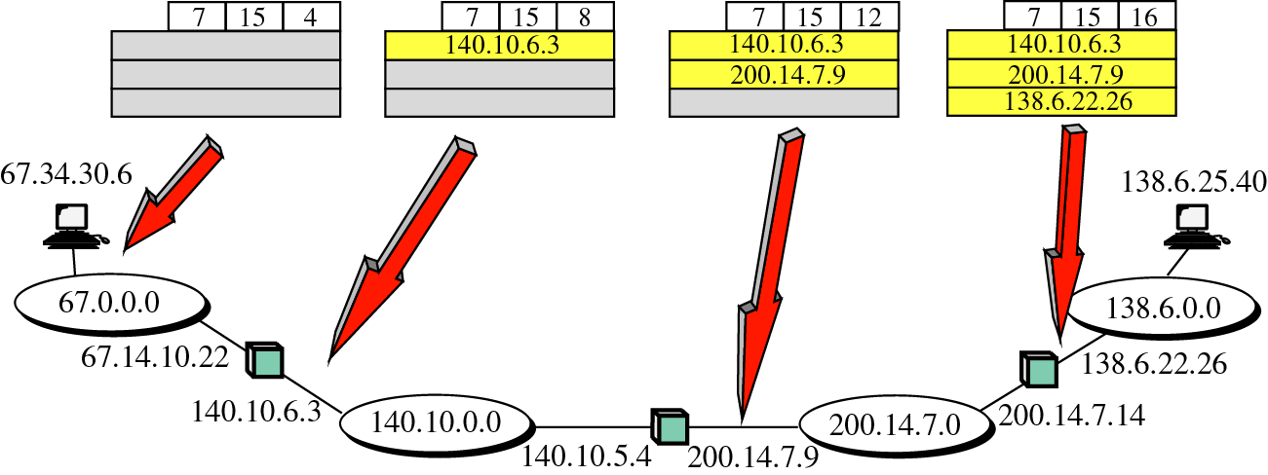
Figure 8-15
Record route concept

Slide 41
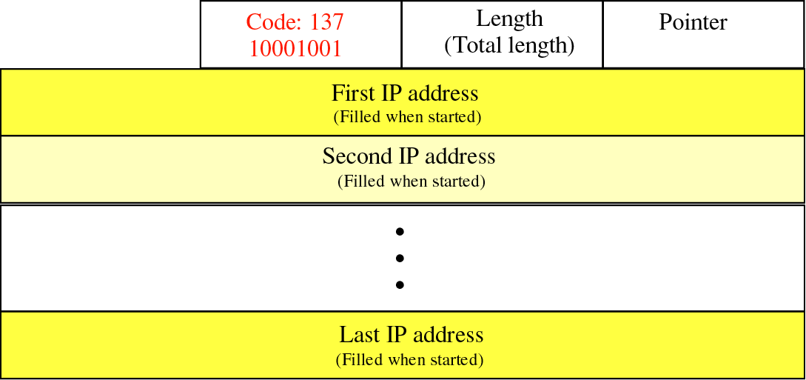
Figure 8-16
Strict source route option

Slide 42
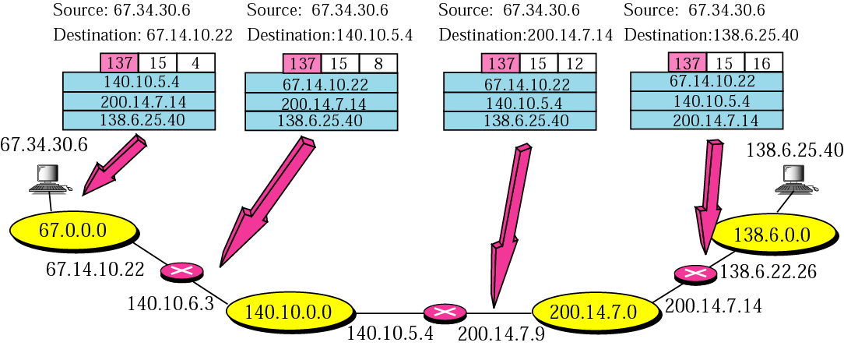
Figure 8-17
Strict source route concept

Slide 43
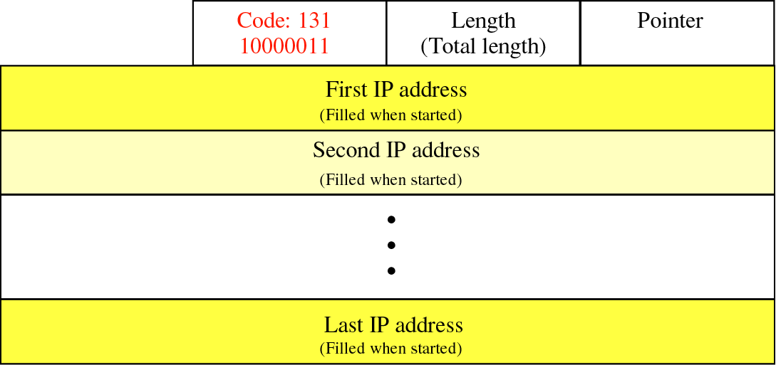
Figure 8-18
Loose source route option

Slide 44
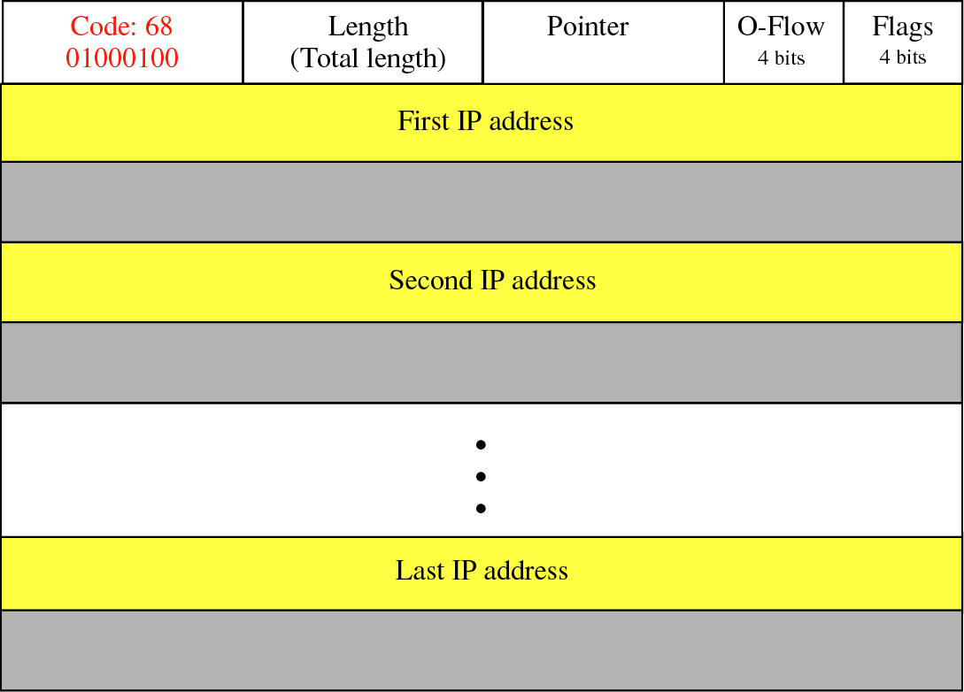
Figure 8-19
Timestamp option

Slide 45
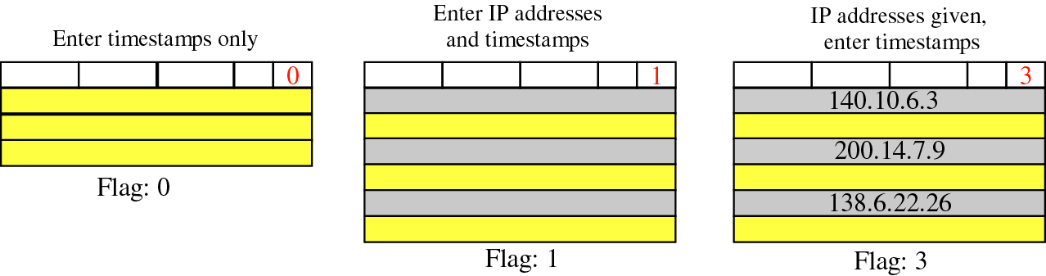
Figure 8-20
Use of flag in timestamp

Slide 46
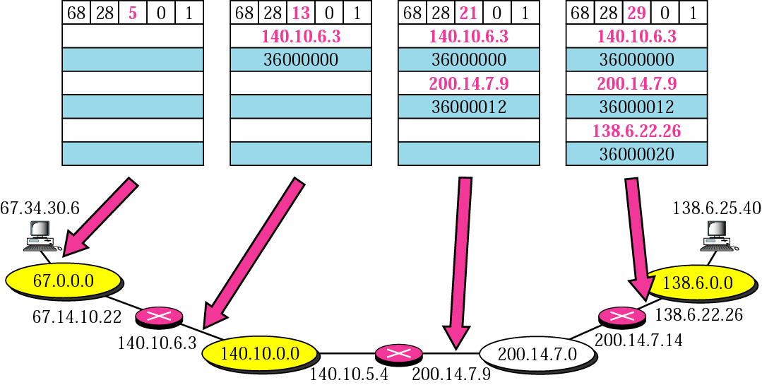
Figure 8-21
Timestamp concept

Slide 47
Example 10
Which of the six options must be copied to each fragment?

Slide 48
Solution
We look at the first (left-most) bit of the code for each option.
No operation: Code is 00000001; no copy.
End of option: Code is 00000000; no copy.
Record route: Code is 00000111; no copy.
Strict source route: Code is 10001001; copied.
Loose source route: Code is 10000011; copied.
Timestamp: Code is 01000100; no copy.

Slide 49
Example 11
Which of the six options are used for datagram control and which are used for debugging and management?

Slide 50
Solution
We look at the second and third (left-most) bits of the code.
No operation: Code is 00000001; control.
End of option: Code is 00000000; control.
Record route: Code is 00000111; control.
Strict source route: Code is 10001001; control.
Loose source route: Code is 10000011; control.
Timestamp: Code is 01000100; debugging

Slide 51
8.4
CHECKSUM

Slide 52
To create the checksum the sender does
the following:
    1. The packet is divided into k sections,
    each of n bits.
    2. All sections are added together using
    one’s complement arithmetic.
    3. The final result is complemented
    to make the checksum.

Slide 53
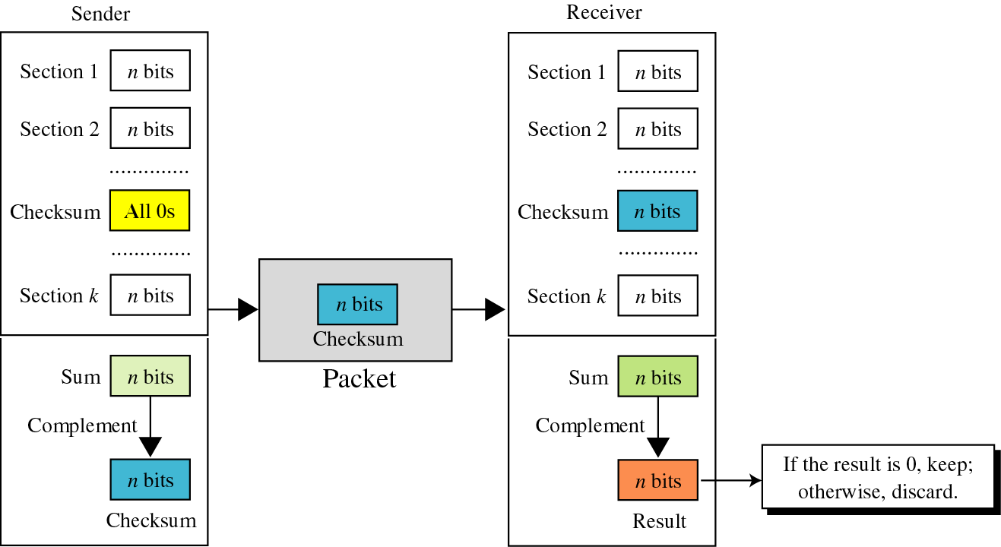
Figure 8-22
Checksum concept

Slide 54
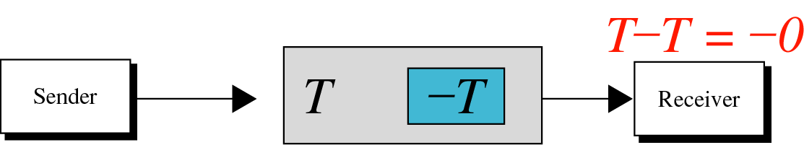
Figure 8-23
Checksum in one’s complement arithmetic

Slide 55
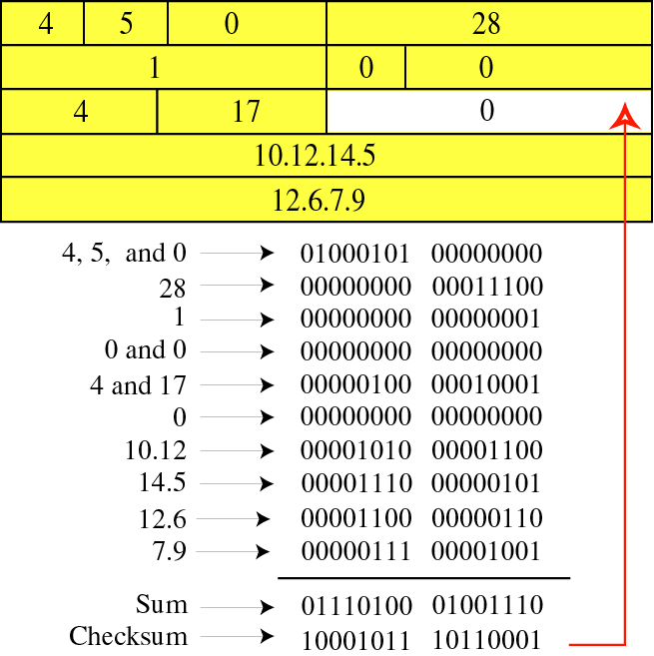
Figure 8-24
Example of
checksum
calculation
in binary

Slide 56
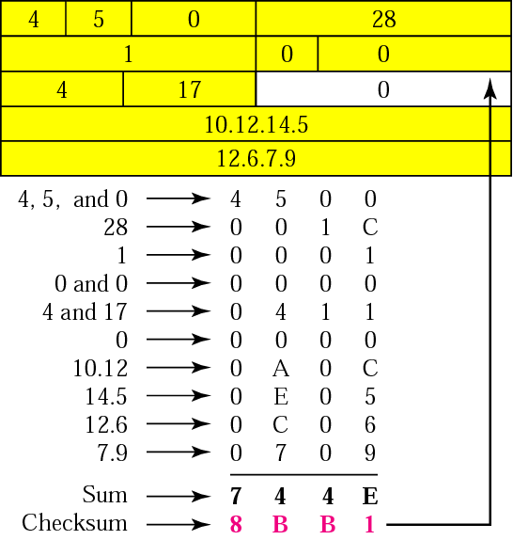
Figure 8-25
Example of
checksum
calculation
in
hexadecimal

Slide 57
Check Appendix C for a detailed
description of checksum calculation
and the handling of carries.

Slide 58
8.5
IP PACKAGE

Slide 59
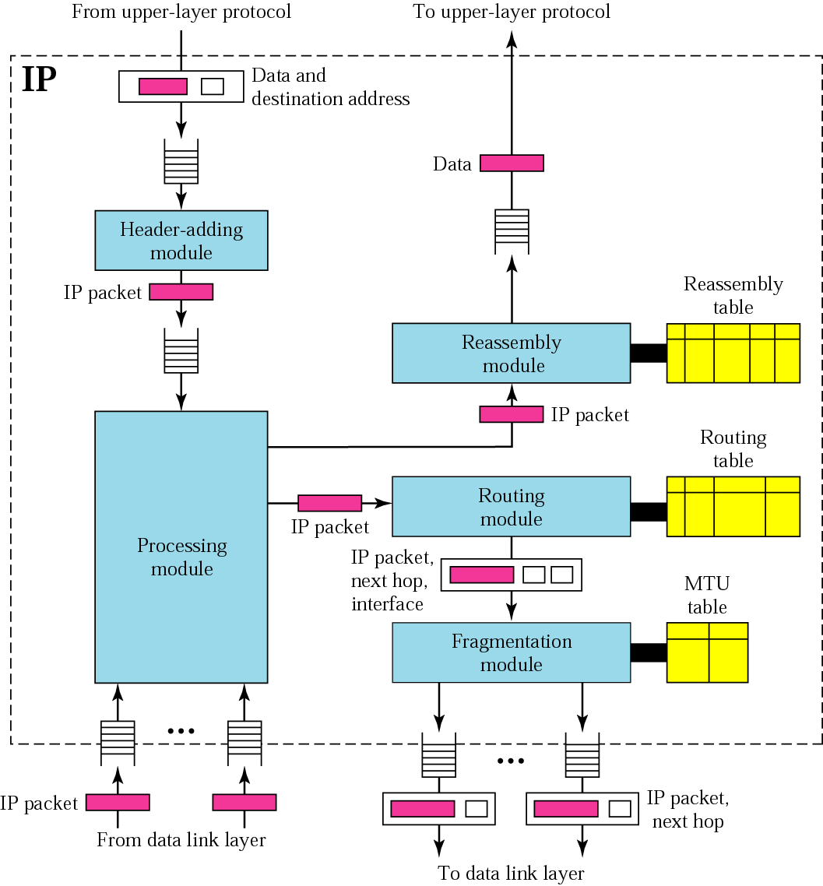
Figure 8-26
IP
components

Slide 60
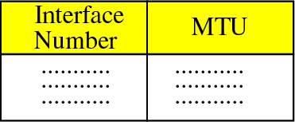
Figure 8-27
MTU table

Slide 61
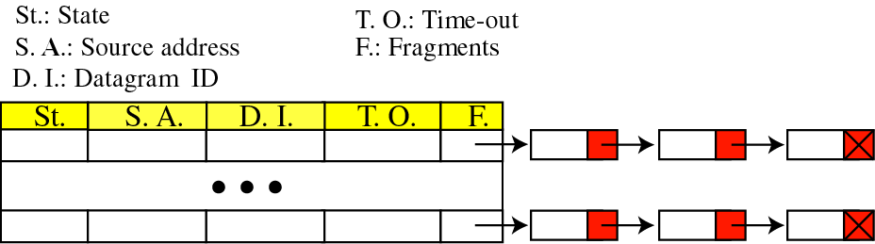
Figure 8-28
Reassembly table

