Slide 1
Chapter 9
Internet Control
Message Protocol
(ICMP)

Slide 2
CONTENTS
TYPES OF MESSAGES
MESSAGE FORMAT
ERROR REPORTING
QUERY
CHECKSUM
ICMP PACKAGE

Slide 3
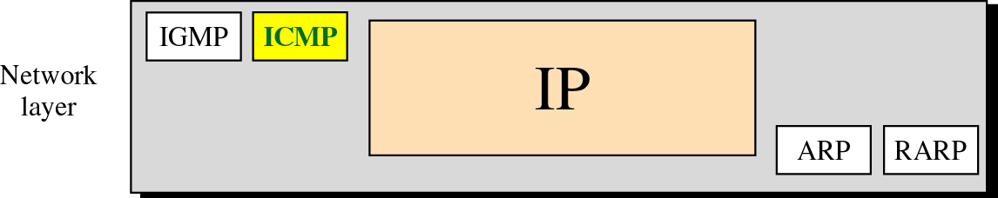
Figure 9-1
Position of ICMP in the network layer

Slide 4
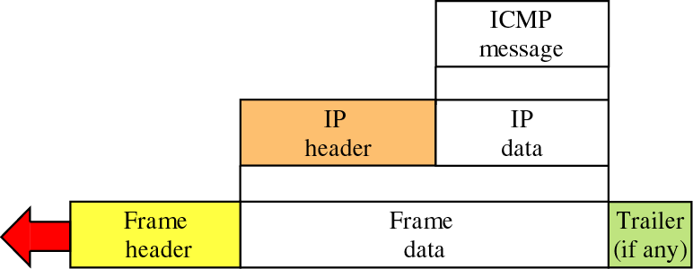
Figure 9-2
Encapsulation of ICMP packet

Slide 5
9.1
TYPES
OF
MESSAGES

Slide 6
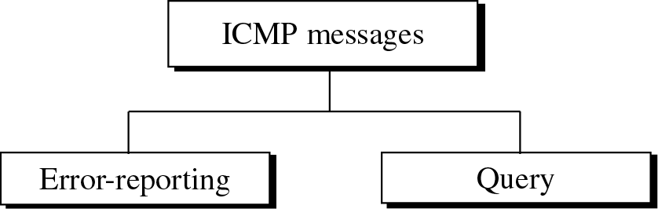
Figure 9-3
ICMP messages

Slide 7
9.2
MESSAGE
FORMAT

Slide 8
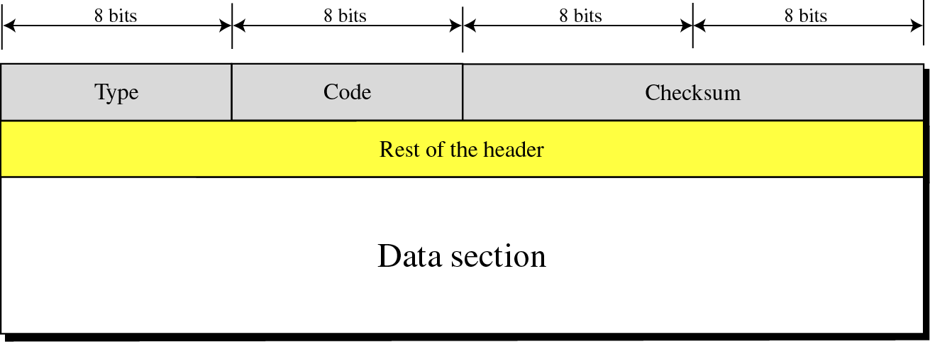
Figure 9-4
General format of ICMP messages

Slide 9
9.3
ERROR
REPORTING

Slide 10

ICMP always reports
error messages
to the original source.

Slide 11
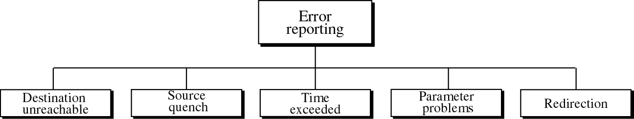
Figure 9-5
Error-reporting messages

Slide 12
Important points about ICMP error messages:
1. No ICMP error message for a datagram
carrying an ICMP error message.
2. No ICMP error message for a fragmented
datagram that is not the first fragment.
3. No ICMP error message for a datagram
having a multicast address.
4. No ICMP error message for a datagram
with a special address such as 127.0.0.0
or 0.0.0.0.

Slide 13
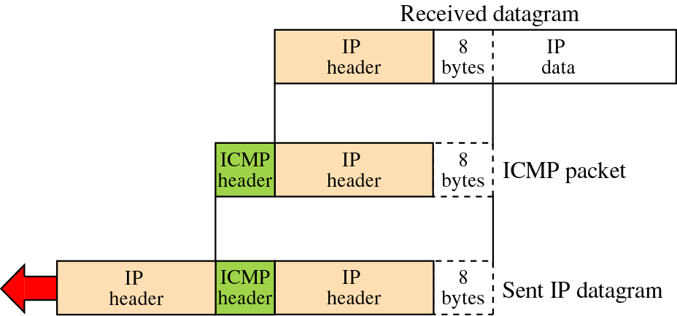
Figure 9-6
Contents of data field for error messages

Slide 14
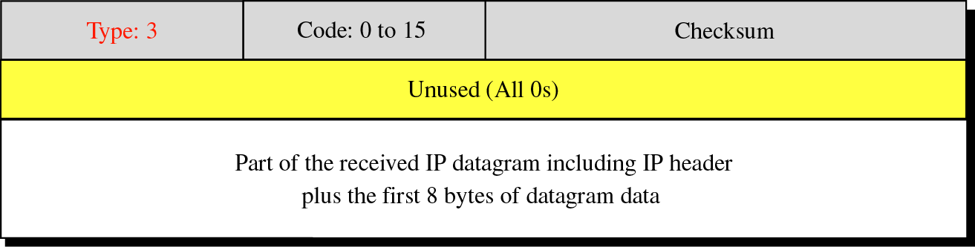
Figure 9-7
Destination-unreachable format

Slide 15
Destination-unreachable messages with
codes 2 or 3 can be created only
by the destination host.
Other destination-unreachable
messages can
be created only by routers.

Slide 16
A router cannot detect all
problems that prevent
the delivery of a packet.

Slide 17
There is no flow-control mechanism
in the IP protocol.

Slide 18
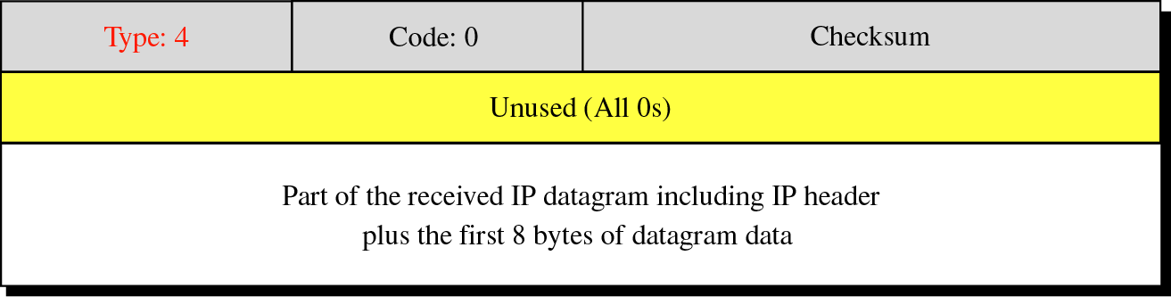
Figure 9-8
Source-quench format

Slide 19
A source-quench message informs
the source that a datagram has been
discarded due to congestion
in a router or the destination host.
The source must slow down the sending
of datagrams until the congestion
is relieved.

Slide 20
One source-quench message should
be sent for each
datagram that is discarded due
to congestion.

Slide 21
Whenever a router receives a datagram
with a time-to-live value of zero,
it discards the datagram and
sends a time-exceeded message to
the original source.

Slide 22
When the final destination does not receive
all of the fragments in a set time,
it discards the received
fragments and sends
a time-exceeded message
to the original source.

Slide 23
In a time-exceeded message,
code 0 is used only by routers
to show that the value of
the time-to-live field is zero.
Code 1 is used only by the destination
host to show that not all of the
fragments have arrived within a set time.

Slide 24
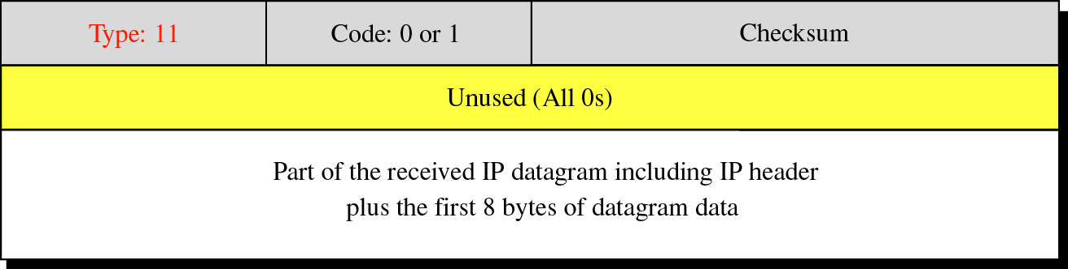
Figure 9-9
Time-exceeded message format
Code 0: Time to live
Code 1: Fragmentation

Slide 25
A parameter-problem message can
be created by
a router or the destination host.

Slide 26
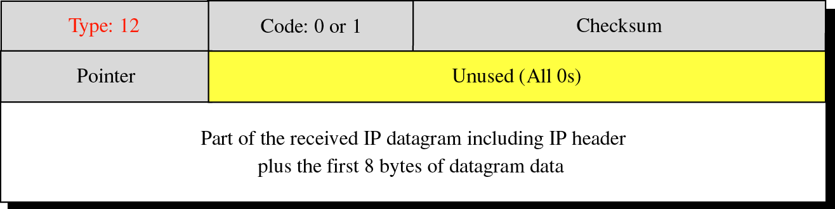
Figure 9-10
Parameter-problem message format
Code 0: Main header problem
Code 1: Problem in the option field

Slide 27
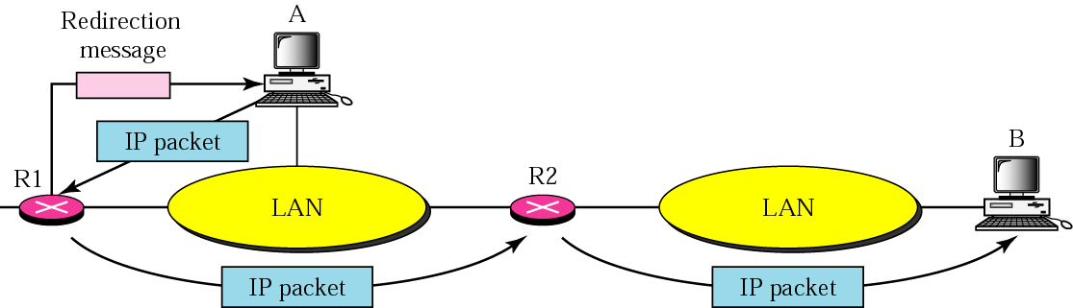
Figure 9-11
Redirection concept

Slide 28
A host usually starts with a small
routing table that is gradually
augmented and updated.
One of the tools to accomplish
this is the redirection message.

Slide 29
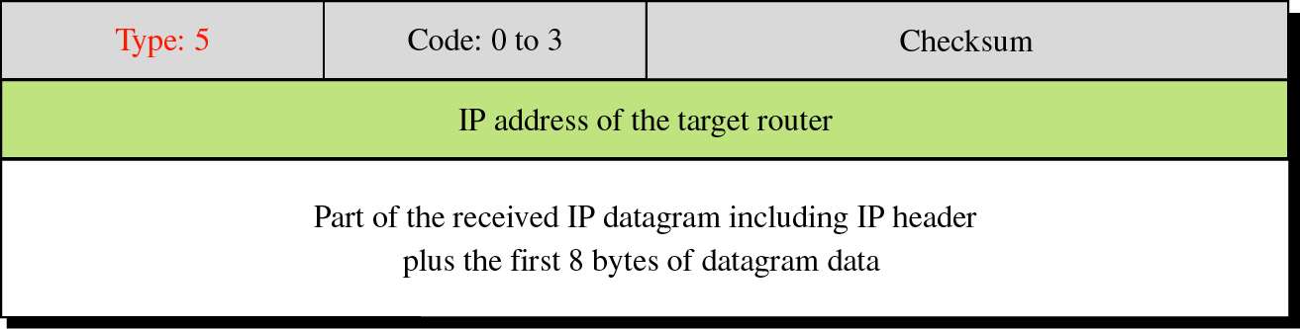
Figure 9-12
Redirection message format
Code 0: Network specific
Code 1: Host specific
Code 2: Network specific (specified service)
Code 3: Host specific (specified service)

Slide 30
A redirection message is
sent from a router to
a host on the same local network.

Slide 31
9.4
QUERY

Slide 32
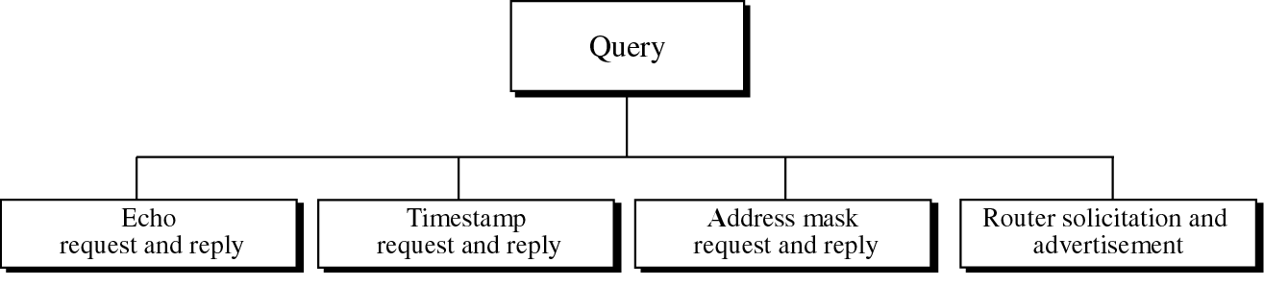
Figure 9-13
Query messages

Slide 33
An echo-request message can be
sent by a host or router.
An echo-reply message is sent by the
host or router which receives
an echo-request message.

Slide 34
Echo-request and echo-reply messages
can be used by network managers
to check the operation of the IP protocol.

Slide 35
Echo-request and echo-reply messages
can test the
reachability of a host.
This is usually done by
invoking the ping command.

Slide 36
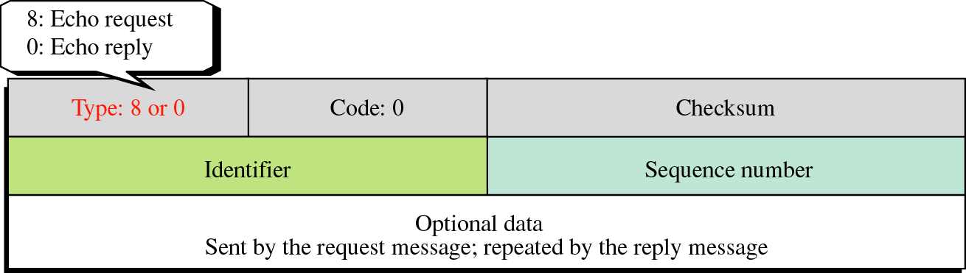
Figure 9-14
Echo-request and echo-reply message format
Ping command can use
theses messages.

Slide 37
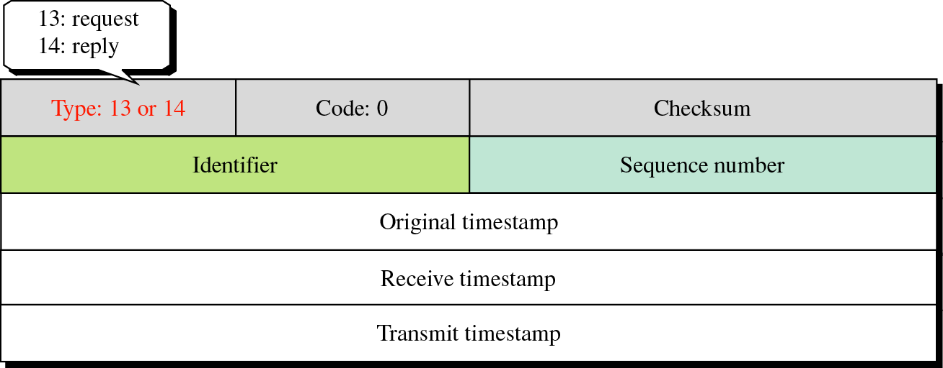
Figure 9-15
Timestamp-request and
timestamp-reply message format

Slide 38
Sending time = value of receive timestamp −
value of original timestamp
Receiving time = time the packet returned −
value of transmit timestamp
Round-trip time = sending time +
receiving time

Slide 39
Timestamp-request and
timestamp-reply messages can be used to
calculate the round-trip time
between a source and a destination
machine even if their
clocks are not synchronized.

Slide 40
Given the following information:
Value of original timestamp: 46
Value of receive timestamp: 59
Value of transmit timestamp: 60
Time the packet arrived: 67

Slide 41
We can calculate:
Sending time = 59 − 46 = 13 milliseconds
Receiving time = 67 − 60 = 7 milliseconds
Round-trip time = 13 + 7 = 20 milliseconds

Slide 42
Given the actual one-way time,
Time difference = receive timestamp −
(original timestamp field
+ one-way time duration)

Slide 43
We have:
Time difference = 59 − (46 + 10) = 3

Slide 44
The timestamp-request and
timestamp-reply messages
can be used to synchronize two
clocks in two machines if the
exact one-way time duration is known.

Slide 45
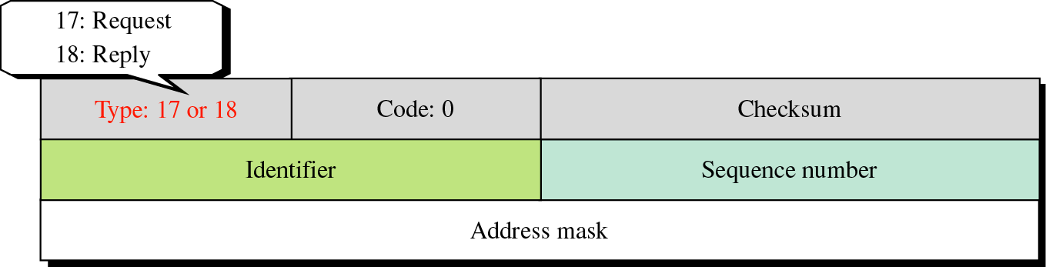
Figure 9-16
Mask-request and mask-reply message format

Slide 46
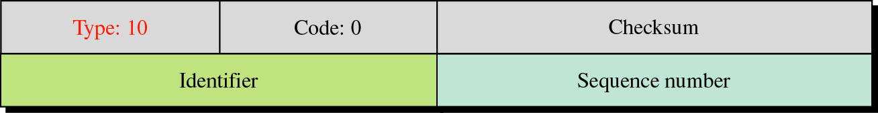
Figure 9-17
Router solicitation message format

Slide 47
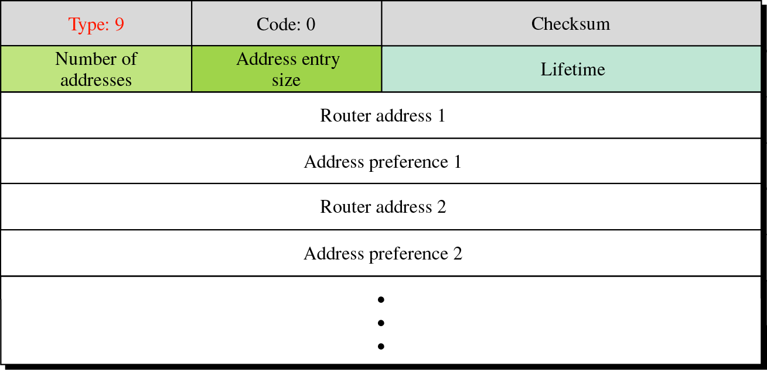
Figure 9-18
Router advertisement message format

Slide 48
9.5
CHECKSUM

Slide 49
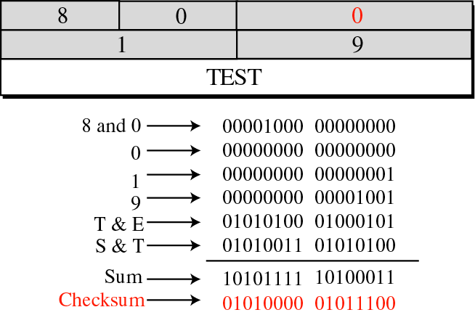
Figure 9-19
Example of checksum calculation

Slide 50
9.6
ICMP
PACKAGE

Slide 51
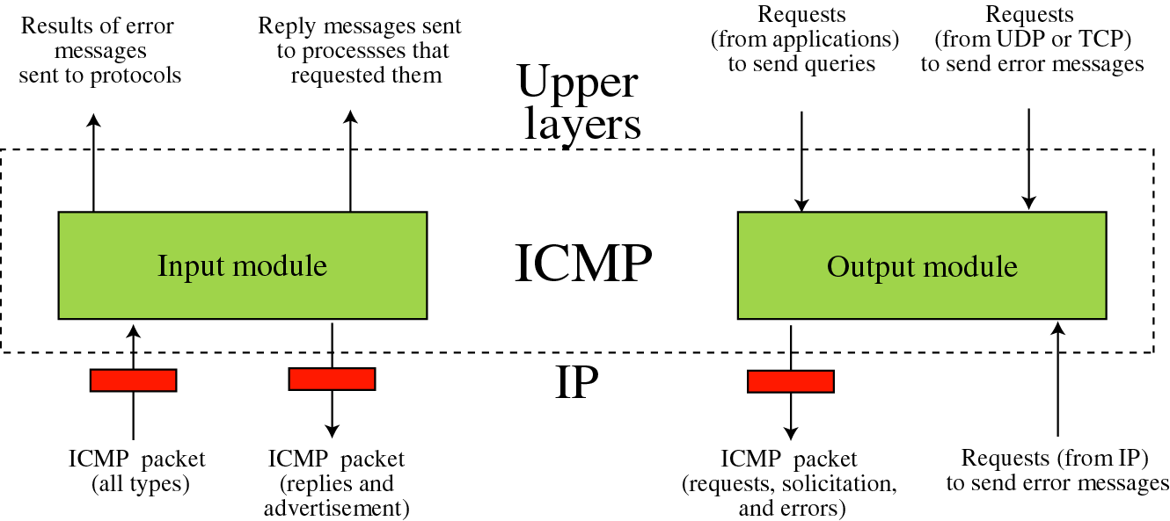
Figure 9-20
ICMP package

