Slide 1
Chapter 10
Internet Group
Management Protocol
(IGMP)

Slide 2
CONTENTS
GROUP MANAGEMENT
IGMP MESSAGES
IGMP OPERATION
ENCAPSULATION
IGMP PACKAGE

Slide 3
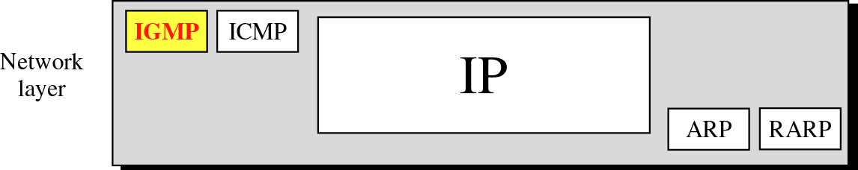
Figure 10-1
Position of IGMP in the network layer

Slide 4
10.1
GROUP
MANAGEMENT

Slide 5
10.2
IGMP
MESSAGES

Slide 6

IGMP is a group management
protocol. It helps a multicast router
create and update a list of loyal
members related to
each router interface.

Slide 7
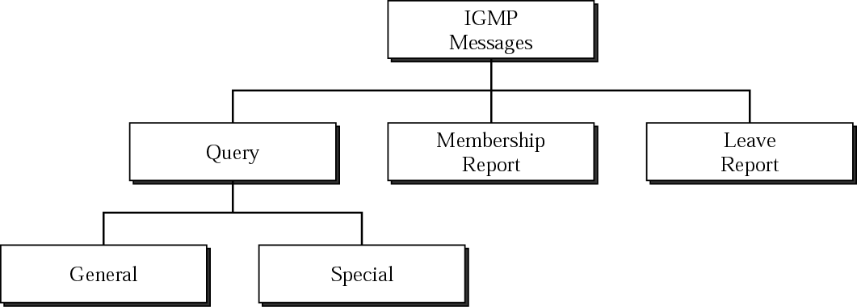
Figure 10-2
IGMP message types

Slide 8
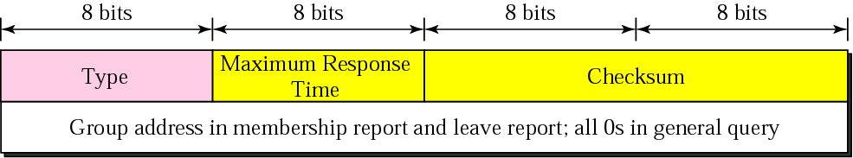
Figure 10-3
IGMP message format

Slide 9
10.3
IGMP
OPERATION

Slide 10
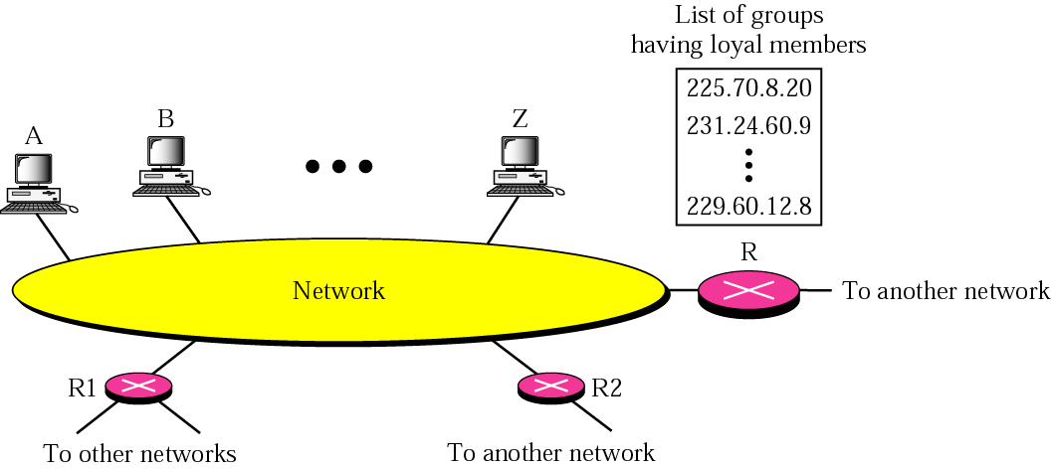
Figure 10-4
IGMP operation

Slide 11
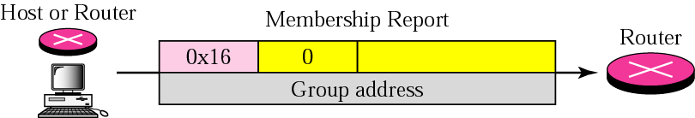
Figure 10-5
Membership report

Slide 12
In IGMP, a membership report
is sent twice,
one after the other.

Slide 13
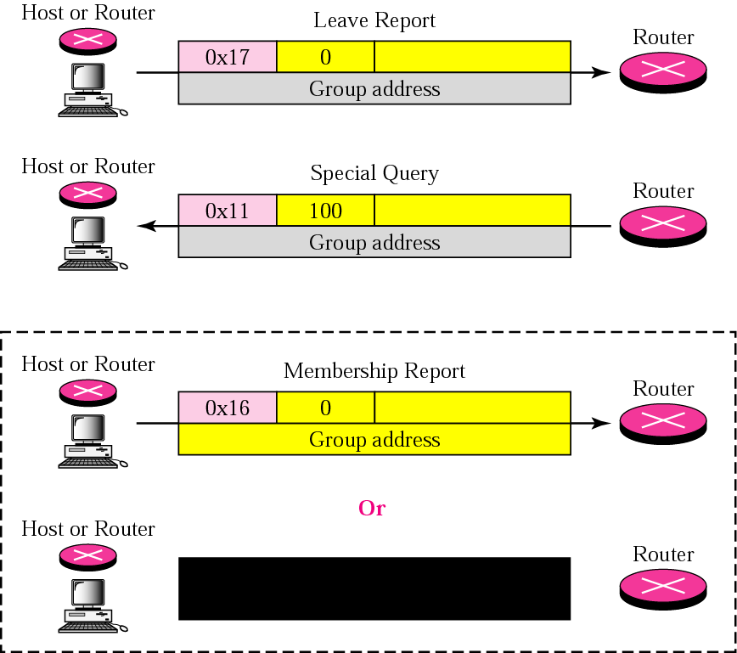
Figure 10-6
Leave report

Slide 14
The general query message does
not define a particular group.

Slide 15
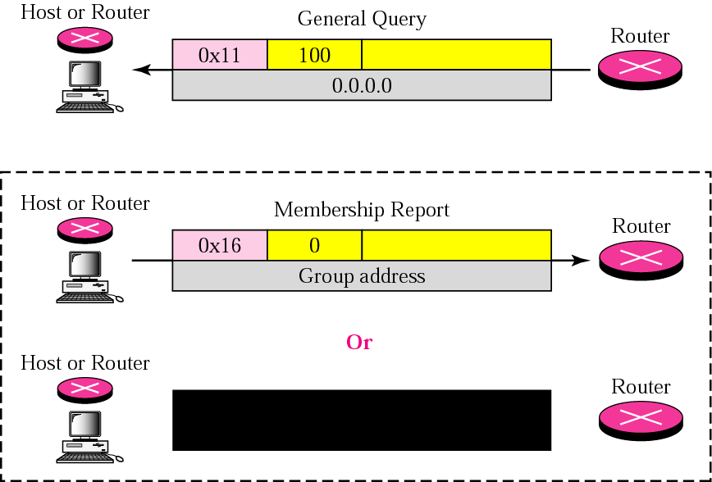
Figure 10-7
General query message

Slide 16
Example 1
Imagine there are three hosts in a network as shown in Figure 10.8 (next slide).
Imagine there are three hosts in a network as shown in Figure 10.8 (next slide).
A query message was received at time 0; the random delay time (in tenths of seconds) for each group is shown next to the group address. Show the sequence of report messages.

Slide 17
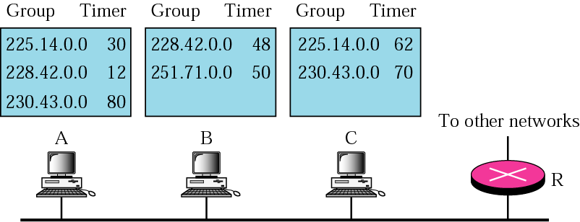
Figure 10-8
Example 1

Slide 18
Solution
The events occur in this sequence:
Time 12: The timer for 228.42.0.0 in host A expires and a membership report is sent, which is received by the router and every host including host B which cancels its timer for 228.42.0.0.
Time 30: The timer for 225.14.0.0 in host A expires and a membership report is sent, which is received by the router and every host including host C which cancels its timer for 225.14.0.0.

Slide 19
Solution (Continued)
Time 50: The timer for 251.70.0.0 in host C expires and a membership report is sent, which is received by the router and every host.
Time 70: The timer for 230.43.0.0 in host A expires and a membership report is sent, which is received by the router and every host including host A which cancels its timer for 230.43.0.0.
Note that if each host had sent a report for every group in its list, there would have been seven reports; with this strategy only four reports are sent.

Slide 20
10.4
ENCAPSULATION

Slide 21
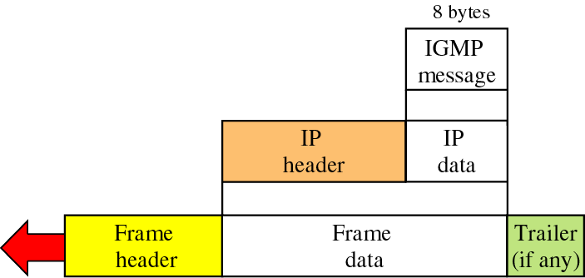
Figure 10-9
Encapsulation of IGMP packet

Slide 22
The IP packet that carries
an IGMP packet has a value of
2
in its protocol field.

Slide 23
The IP packet that carries
an IGMP packet has a value of
1
in its TTL field.

Slide 24
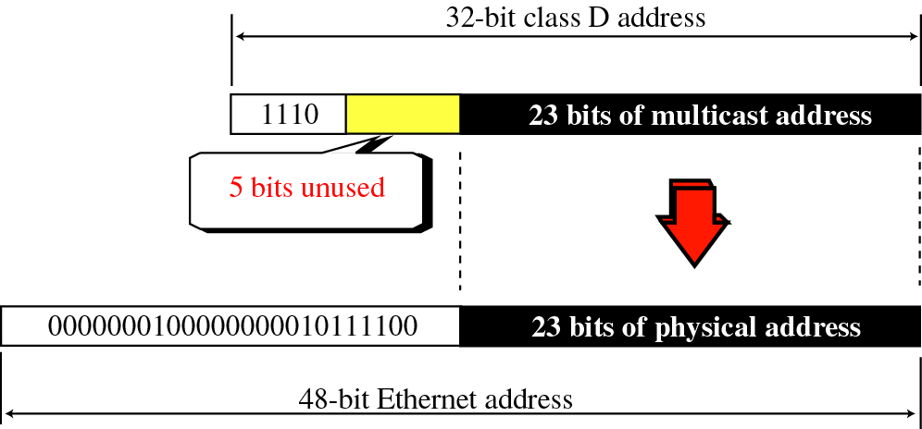
Figure 10-10
Mapping class D to Ethernet physical address

Slide 25
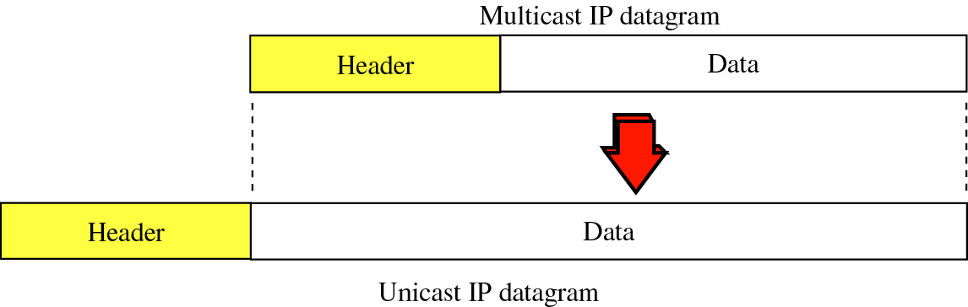
Figure 10-11
Tunneling

Slide 26
10.5
IGMP
PACKAGE

Slide 27
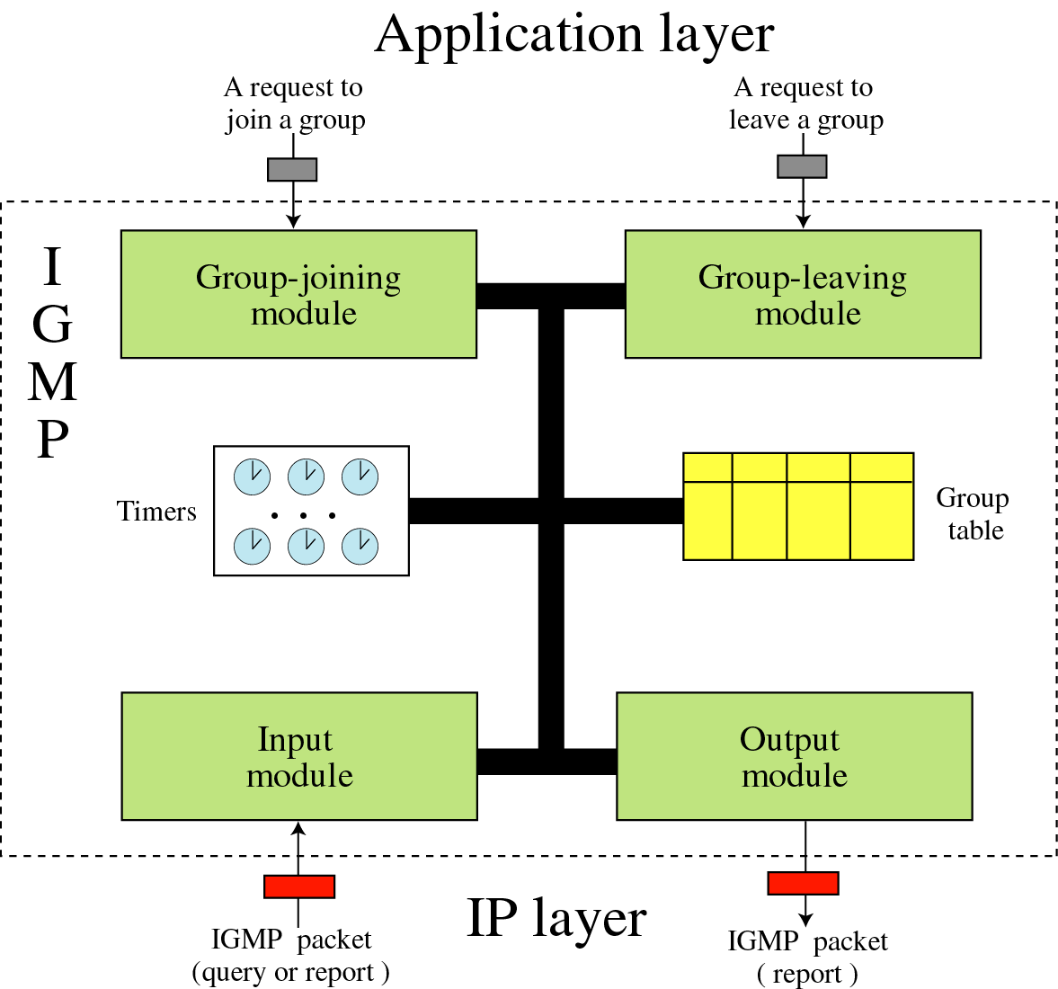
Figure 10-12
IGMP
package

Slide 28
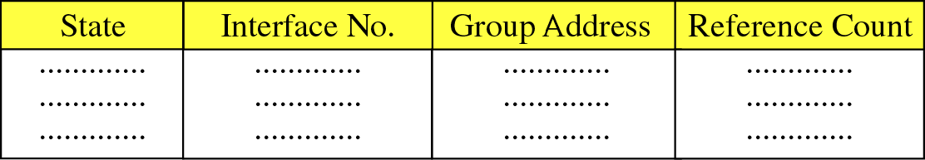
Figure 10-13
Group table
State: Free, Delaying, Idle
Reference Count: Number of processes interested

