Slide 1
Chapter 11
User Datagram
Protocol
(UDP)

Slide 2
CONTENTS
PROCESS-TO-PROCESS COMMUNICATION
USER DATAGRAM
CHECKSUM
UDP OPERATION
USE OF UDP
UDP PACKAGE

Slide 3
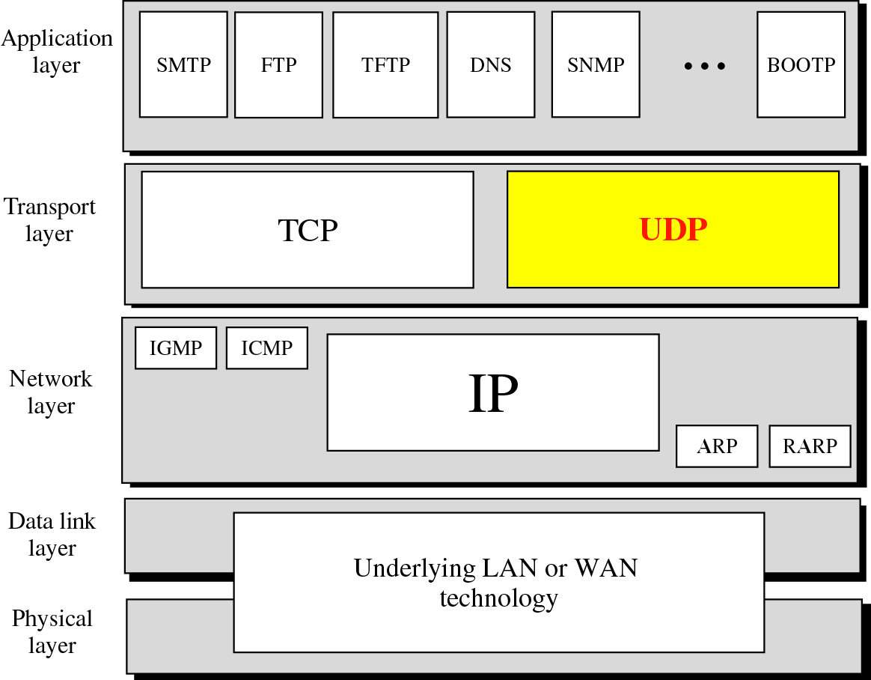
Figure 11-1
Position of UDP in the TCP/IP protocol suite

Slide 4
11.1
PROCESS
TO
PROCESS
COMMUNICATION

Slide 5
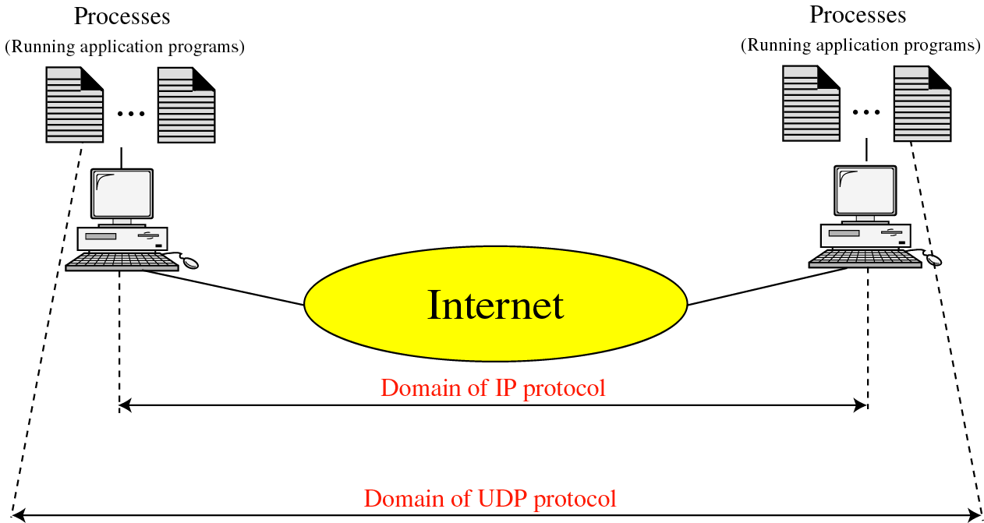
Figure 11-2
UDP versus IP

Slide 6
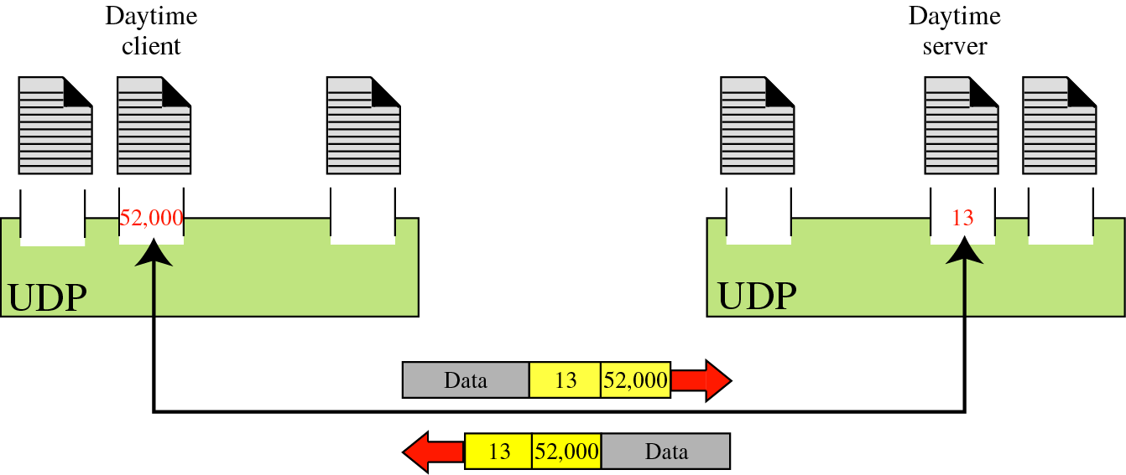
Figure 11-3
Port numbers

Slide 7
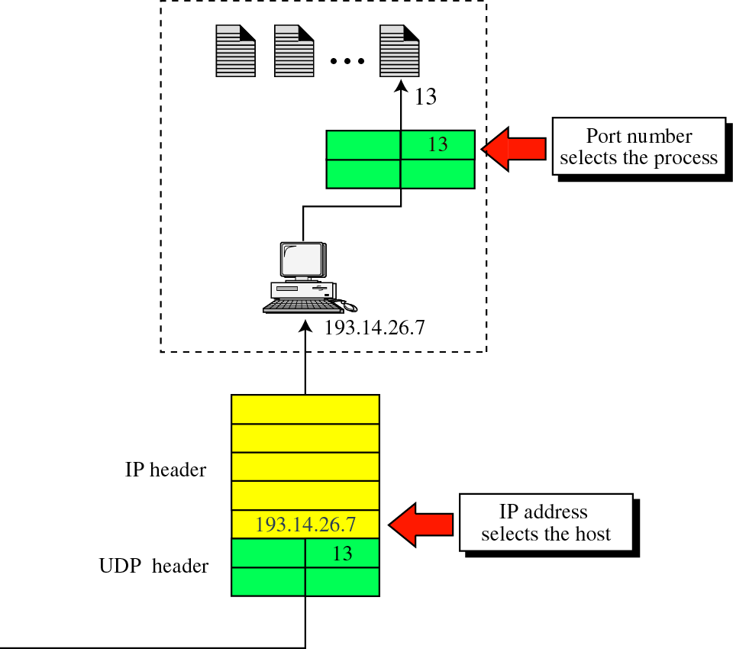
Figure 11-4
IP addresses versus port numbers

Slide 8
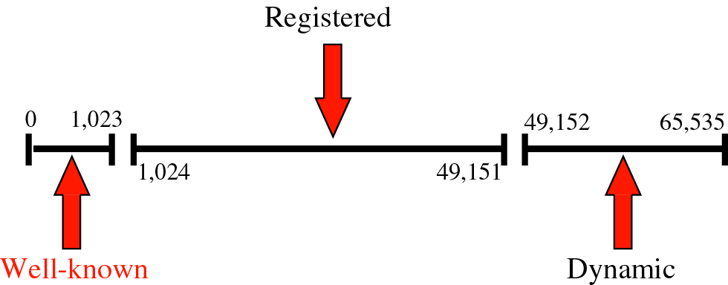
Figure 11-5
IANA ranges

Slide 9
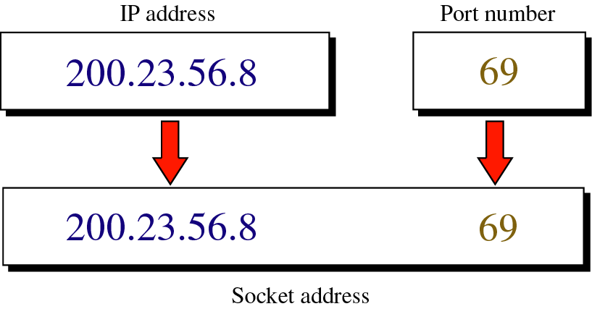
Figure 11-6
Socket addresses

Slide 10
11.2
USER
DATAGRAM

Slide 11
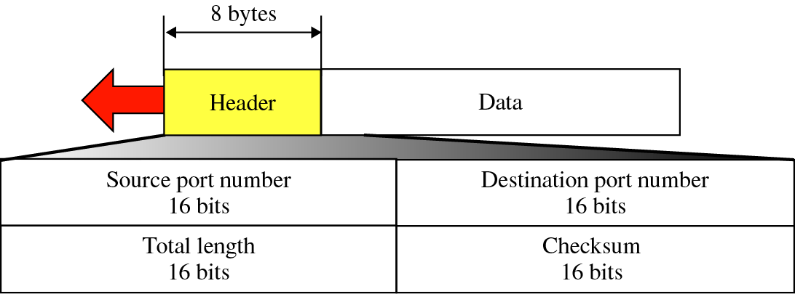
Figure 11-7
User datagram format

Slide 12

UDP length =
IP length − IP header’s length

Slide 13
11.3
CHECKSUM

Slide 14
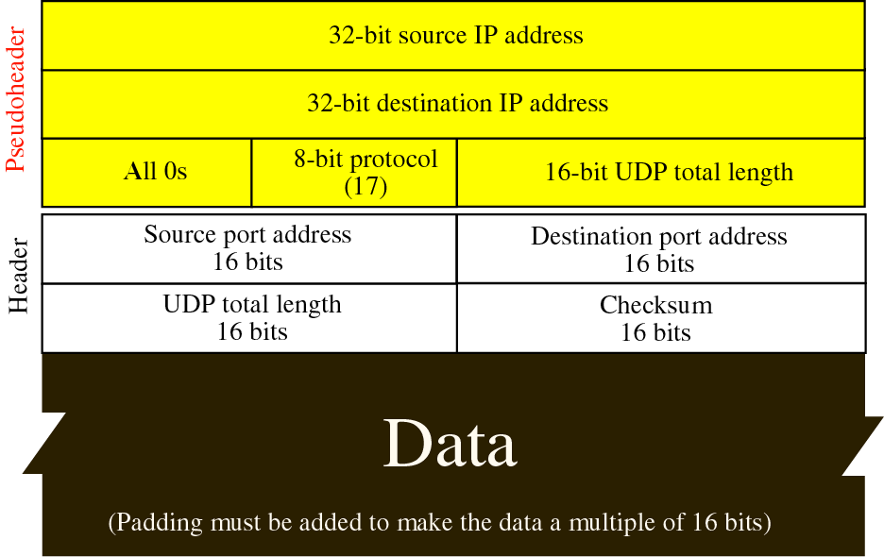
Figure 11-8
Pseudoheader added to the UDP datagram

Slide 15
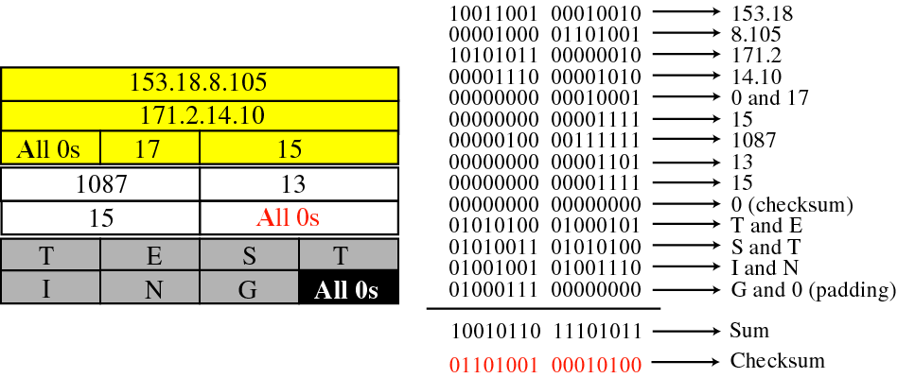
Figure 11-9
Checksum calculation of a
simple UDP user datagram

Slide 16
11.4
UDP
OPERATION

Slide 17
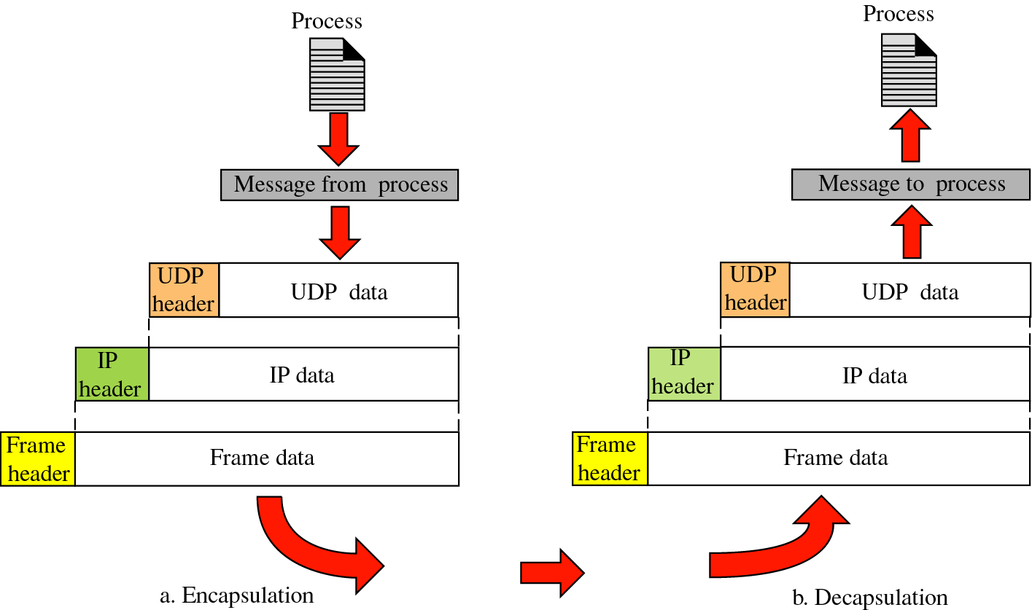
Figure 11-10
Encapsulation and decapsulation

Slide 18
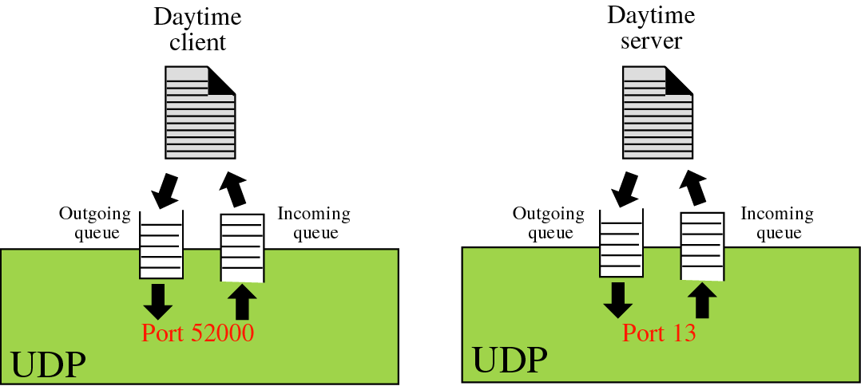
Figure 11-11
Queues in UDP

Slide 19
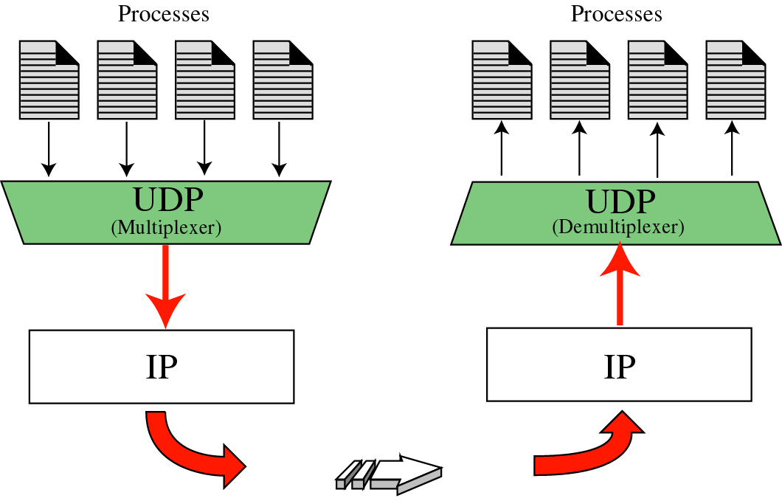
Figure 11-12
Multiplexing and demultiplexing

Slide 20
11.5
USE
OF UDP

Slide 21
11.6
UDP
PACKAGE

Slide 22
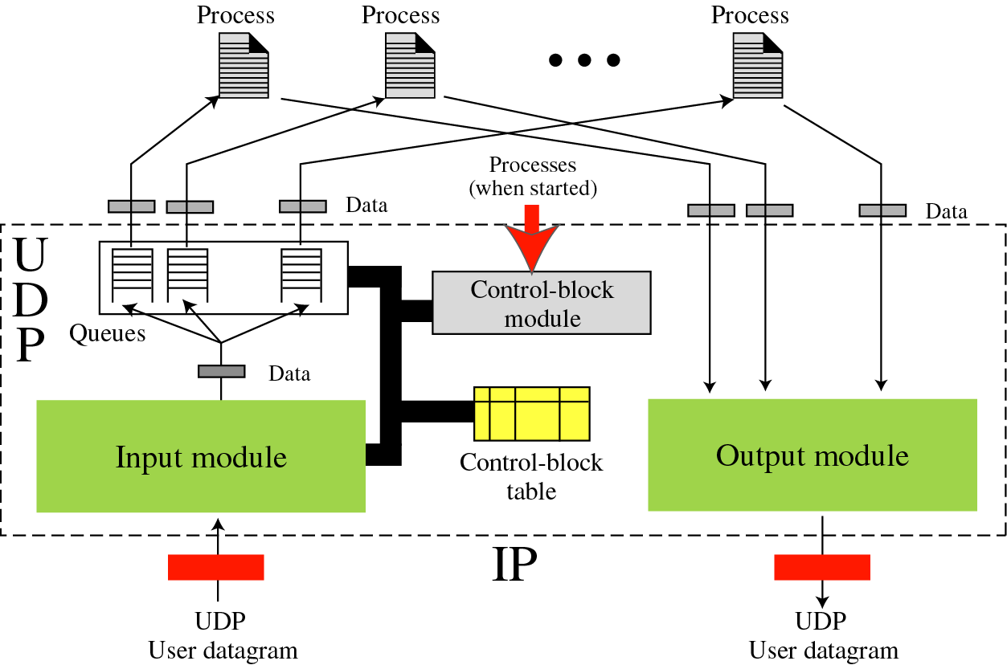
Figure 11-13
UDP package

Slide 23
Control-block table at the beginning
State Process ID Port Number Queue Number
-------- ------------ -------------- ------------------
IN-USE 2,345 52,010 34
IN-USE 3,422 52,011
FREE
IN-USE 4,652 52,012 38
FREE

Slide 24
Example 1
The first activity is the arrival of a user datagram with destination port number 52,012. The input module searches for this port number and finds it. Queue number 38 has been assigned to this port, which means that the port has been previously used. The input module sends the data to queue 38. The control-block table does not change.

Slide 25
Example 2
After a few seconds, a process starts. It asks the operating system for a port number and is granted port number 52,014. Now the process sends its ID (4,978) and the port number to the control-block module to create an entry in the table. The module does not allocate a queue at this moment because no user datagrams have arrived for this destination

Slide 26
Modified table after Example 2
State Process ID Port Number Queue Number
-------- ------------ -------------- ------------------
IN-USE 2,345 52,010 34
IN-USE 3,422 52,011
IN-USE 4,978 52,014
IN-USE 4,652 52,012 38
FREE

Slide 27
Example 3
A user datagram now arrives for port 52,011. The input module checks the table and finds that no queue has been allocated for this destination since this is the first time a user datagram has arrived for this destination. The module creates a queue and gives it a number (43).

Slide 28
Modified table after Example 3
State Process ID Port Number Queue Number
-------- ------------ -------------- ------------------
IN-USE 2,345 52,010 34
IN-USE 3,422 52,011 43
IN-USE 4,978 52,014
IN-USE 4,652 52,012 38
FREE

Slide 29
Example 4
After a few seconds, a user datagram arrives for port 52,222. The input module checks the table and cannot find the entry for this destination. The user datagram is dropped and a request is made to ICMP to send an “unreachable port” message to the source.

Slide 30
Example 5
After a few seconds, a process needs to send a user datagram. It delivers the data to the output module which adds the UDP header and sends it.

