Slide 1
Chapter 12
Transmission
Control Protocol
(TCP)

Slide 2
CONTENTS
PROCESS-TO-PROCESS COMMUNICATION
TCP SERVICES
NUMBERING BYTES
FLOW CONTROL
SILLY WINDOW SYNDROME
ERROR CONTROL
TCP TIMERS

Slide 3
CONTENTS (continued)
CONGESTION CONTROL
SEGMENT
OPTIONS
CHECKSUM
CONNECTION
STATE TRANSITION DIAGRAM
TCP OERATION
TCP PACKAGE

Slide 4
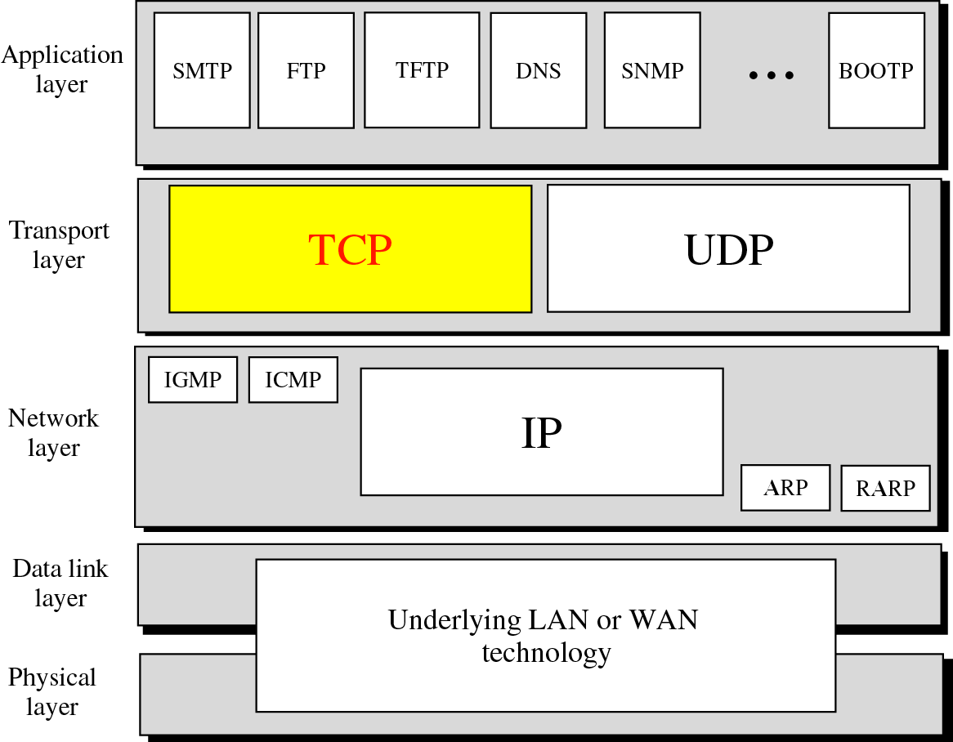
Figure 12-1
Position of TCP in TCP/IP protocol suite

Slide 5
12.1
PROCESS
TO
PROCESS
COMMUNICATION

Slide 6
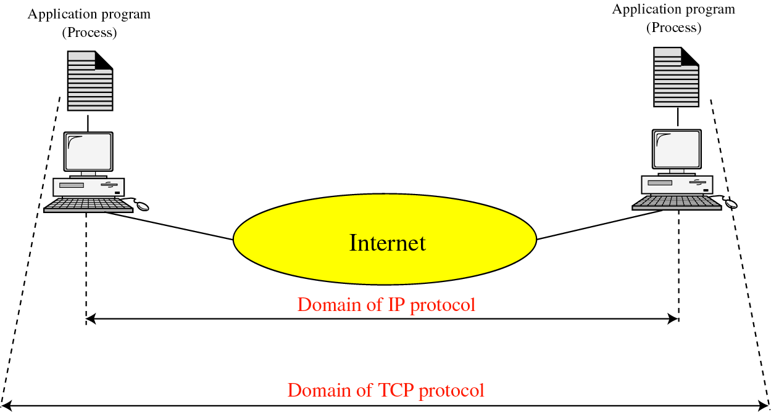
Figure 12-2
TCP versus IP

Slide 7
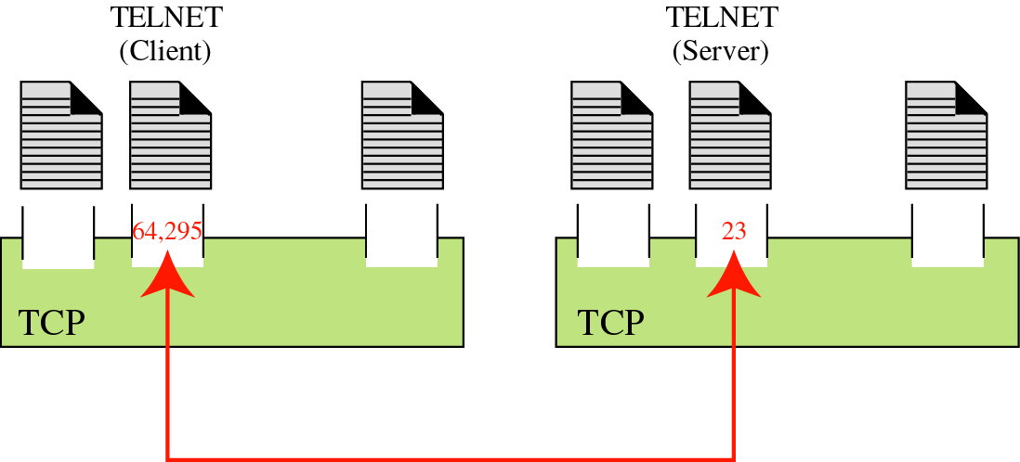
Figure 12-3
Port numbers

Slide 8
12.2
TCP
SERVICES

Slide 9
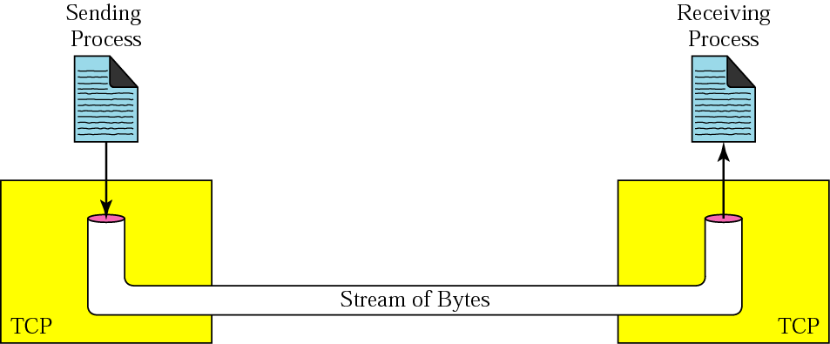
Figure 12-4
Stream delivery

Slide 10
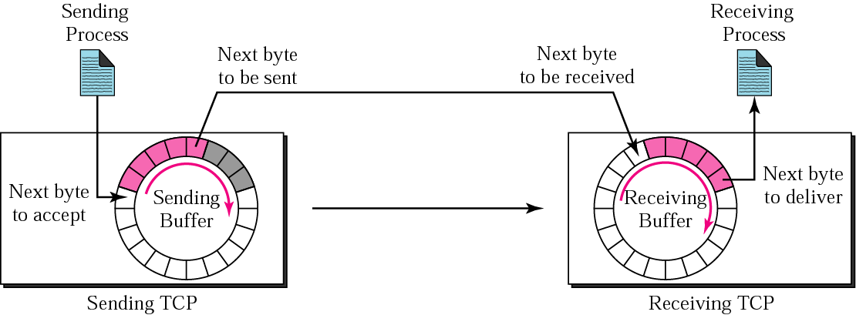
Figure 12-5
Sending and receiving buffers

Slide 11
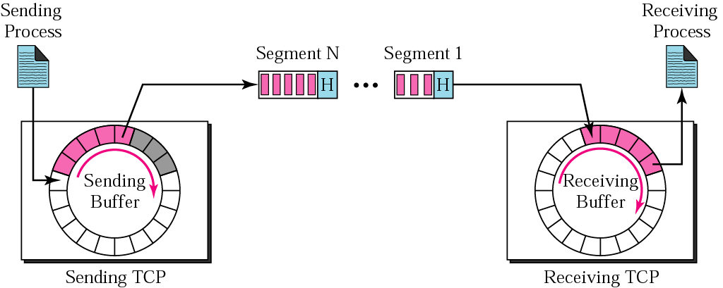
Figure 12-6
TCP segments

Slide 12
12.3
NUMBERING
BYTES

Slide 13

The bytes of data being transferred
in each connection are numbered by TCP.
The numbering starts with
a randomly generated number.

Slide 14
Example 1
Imagine a TCP connection is transferring
a file of 6000 bytes. The first byte is
numbered 10010. What are the sequence
numbers for each
segment if data is sent in five segments
with the first four segments carrying
1,000 bytes and the last
segment carrying 2,000 bytes?

Slide 15
Solution
The following shows the sequence number for each segment:
Segment 1 ➔ 10,010 (10,010 to 11,009)
Segment 2 ➔ 11,010 (11,010 to 12,009)
Segment 3 ➔12,010 (12,010 to 13,009)
Segment 4 ➔13,010 (13,010 to 14,009)
Segment 5 ➔ 14,010 (14,010 to 16,009)

Slide 16
The value of the sequence number field in
a segment defines the number
of the first data byte
contained in that segment.

Slide 17
The value of the acknowledgment field in a
segment defines the number of the
next byte a party expects to receives.
The acknowledgment number is cumulative.

Slide 18
12.4
FLOW
CONTROL

Slide 19
A sliding window is used to make
transmission more
efficient as well as to control the flow of
data so that the destination
does not become overwhelmed with data.
TCP’s sliding windows are byte oriented.

Slide 20
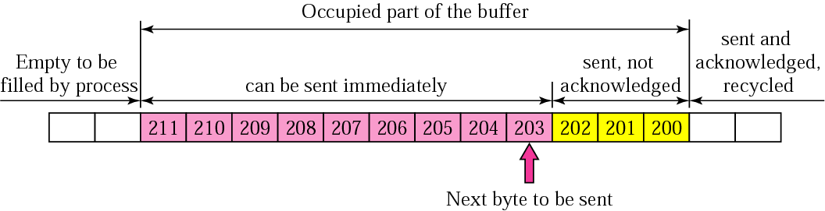
Figure 12-7
Sender buffer

Slide 21
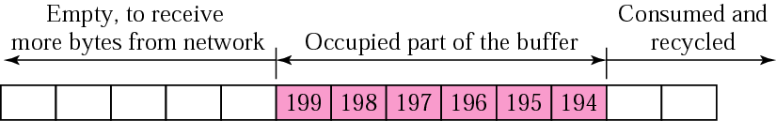
Figure 12-8
Receiver window

Slide 22
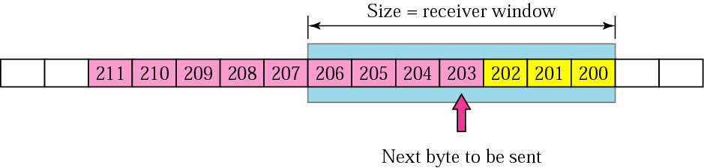
Figure 12-9
Sender buffer and sender window

Slide 23
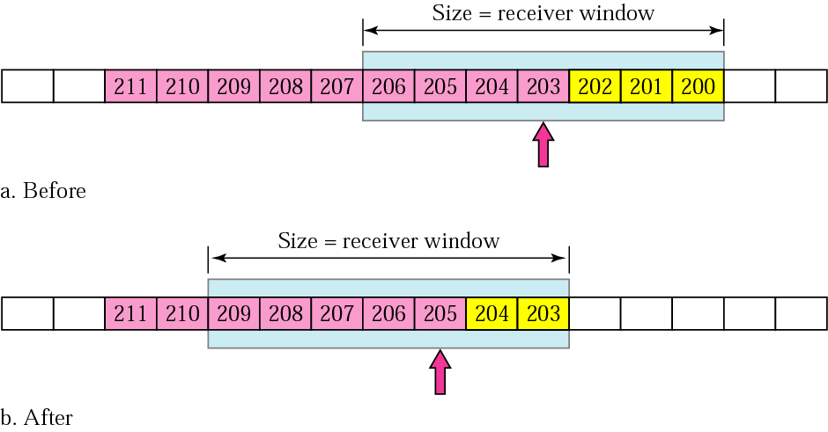
Figure 12-10
Sliding the sender window

Slide 24
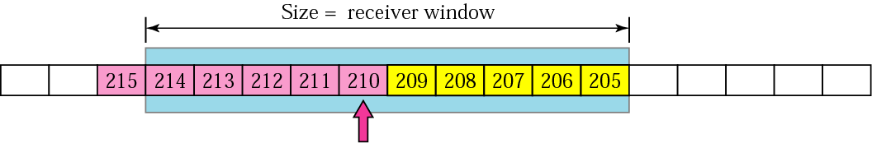
Figure 12-11
Expanding the sender window

Slide 25
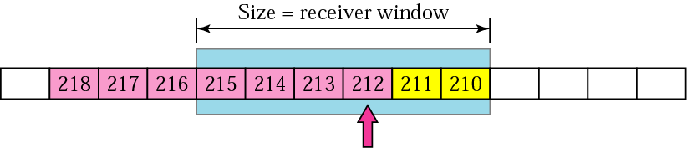
Figure 12-12
Shrinking the sender window

Slide 26
In TCP, the sender window
size is totally controlled
by the receiver window value.
However, the actual window size
can be smaller if there is
congestion in the network.

Slide 27
Some Points about TCP’s Sliding Windows:
1. The source does not have to send a
full window’s worth of data.
2. The size of the window can be increased
or decreased by the destination.
3. The destination can send an
acknowledgment at any time.

Slide 28
12.5
SILLY
WINDOW
SYNDROME

Slide 29
12.6
ERROR
CONTROL

Slide 30
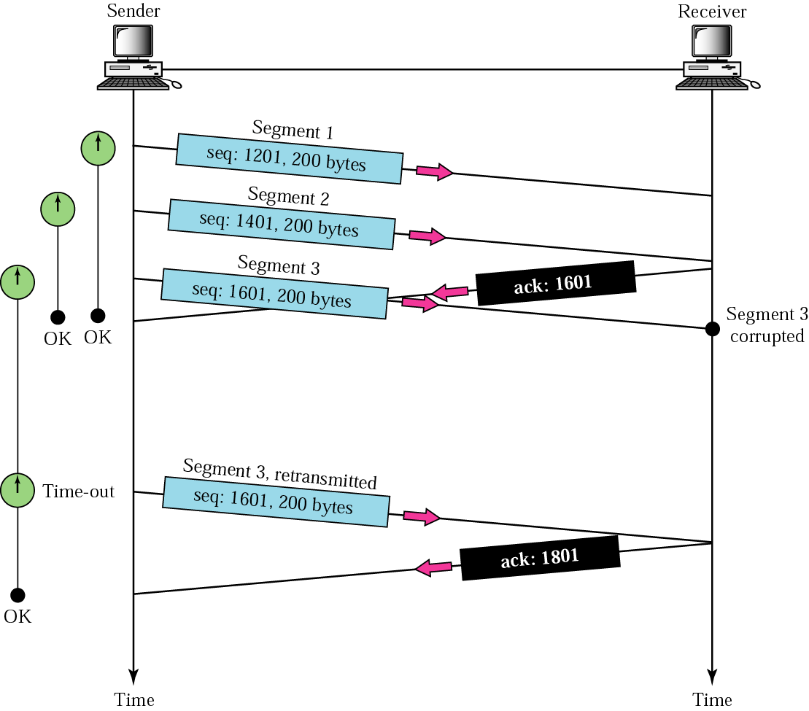
Figure 12-13
Corrupted segment

Slide 31
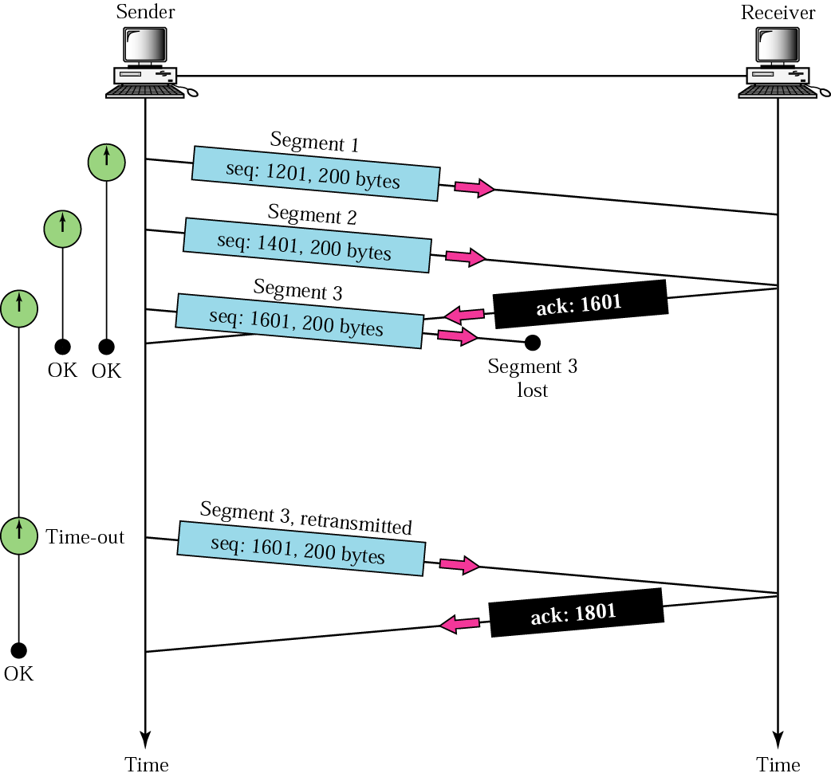
Figure 12-14
Lost segment

Slide 32
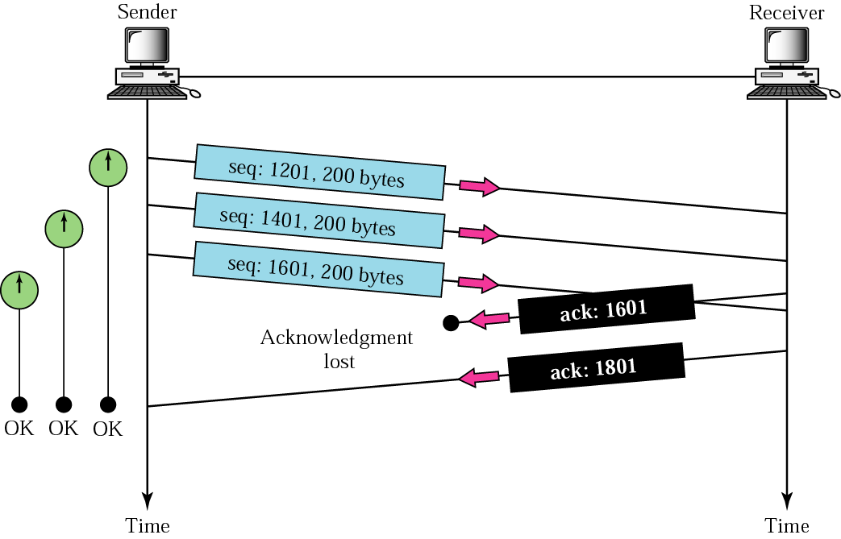
Figure 12-15
Lost acknowledgment

Slide 33
12.7
TCP
TIMERS

Slide 34
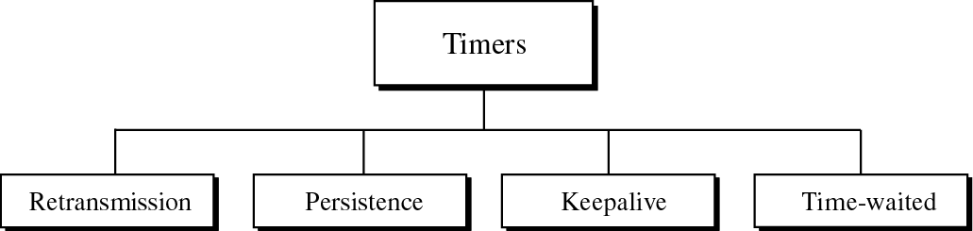
Figure 12-16
TCP timers

Slide 35
12.8
CONGESTION
CONTROL

Slide 36
TCP assumes that the cause of
a lost segment is due to
congestion in the network.

Slide 37
If the cause of the lost segment
is congestion,
retransmission of the segment
not only does not remove the cause,
it aggravates it.

Slide 38
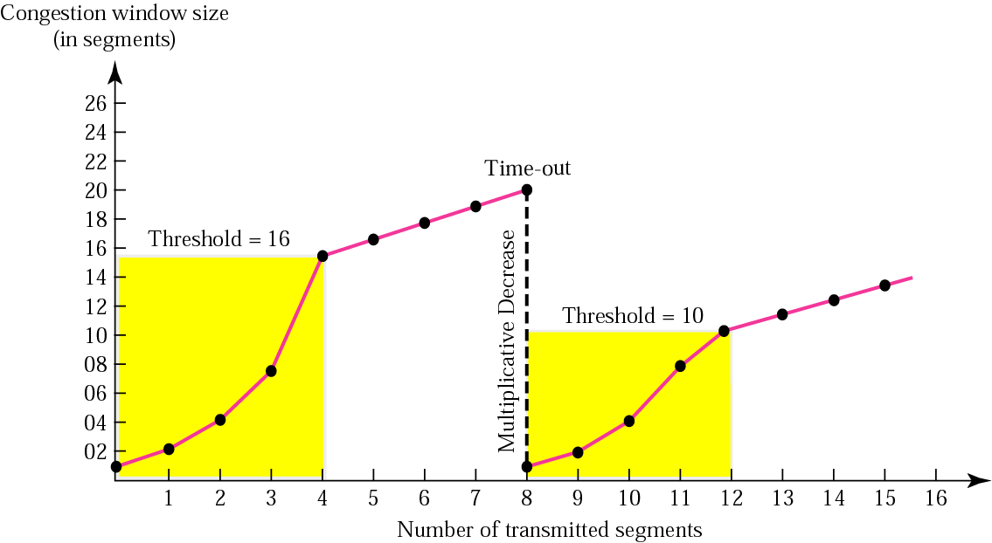
Figure 12-17
Multiplicative decrease

Slide 39
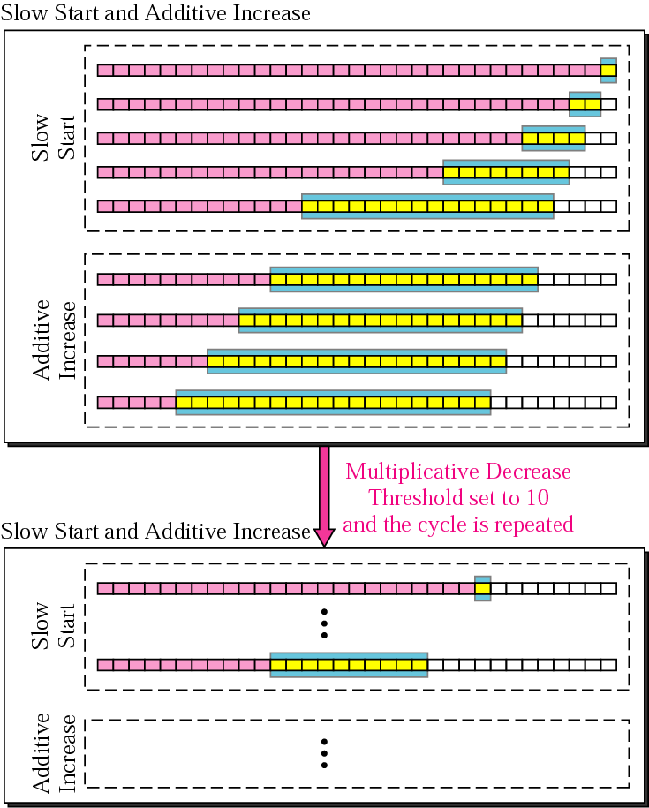
Figure 12-18
Congestion avoidance strategies

Slide 40
12.9
SEGMENT

Slide 41
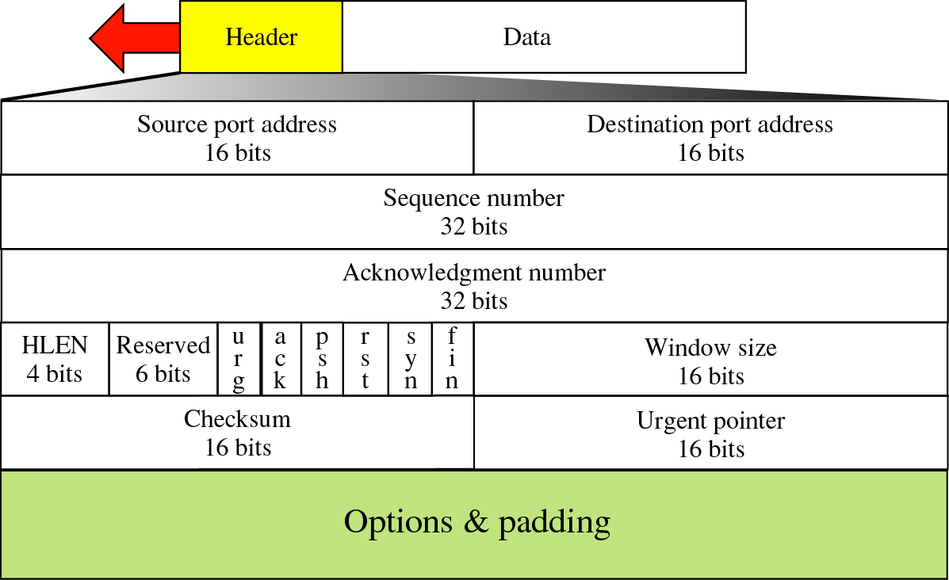
Figure 12-19
TCP segment format

Slide 42
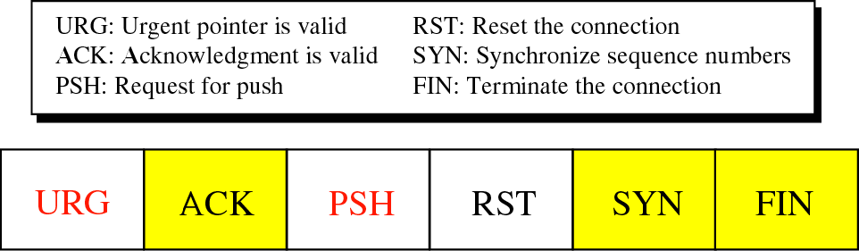
Figure 12-20
Control field

Slide 43
12.10
OPTIONS

Slide 44
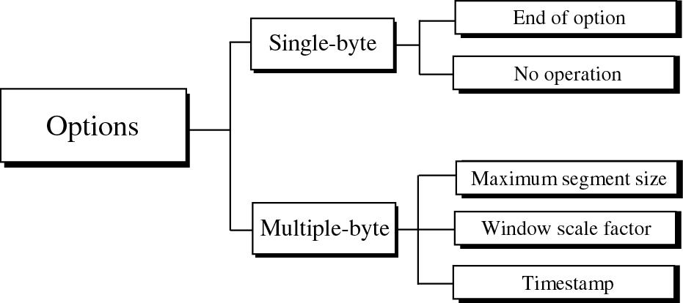
Figure 12-21
Options

Slide 45
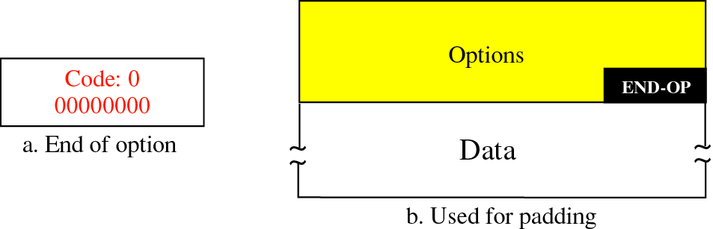
Figure 12-22
End of option option

Slide 46
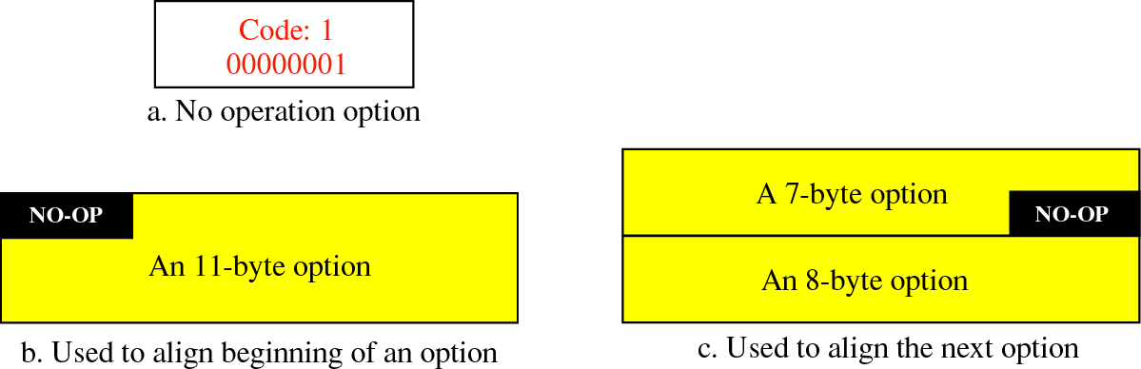
Figure 12-23
No operation option

Slide 47
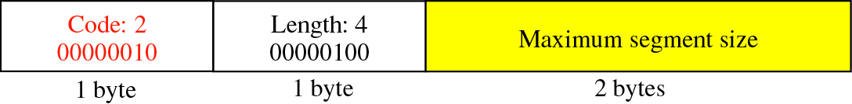
Figure 12-24
Maximum segment size option

Slide 48
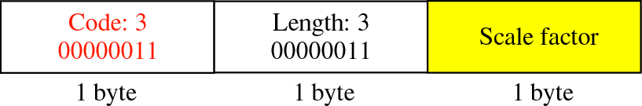
Figure 12-25
Window scale factor option

Slide 49
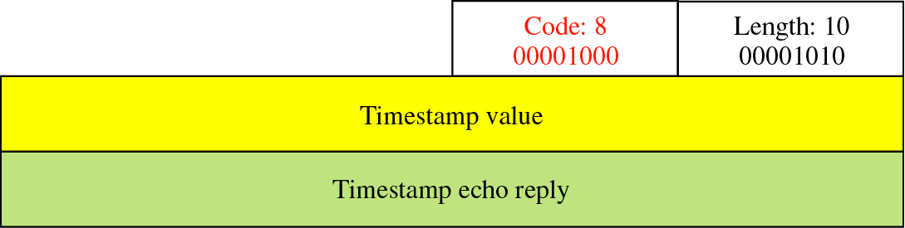
Figure 12-26
Timestamp option

Slide 50
12.11
CHECKSUM

Slide 51
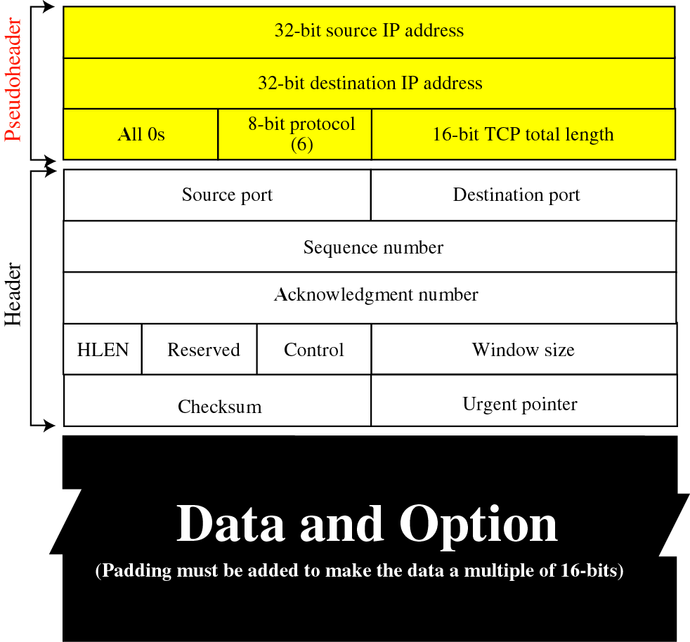
Figure 12-12
Pseudoheader added to the TCP datagram

Slide 52
12.12
CONNECTION

Slide 53
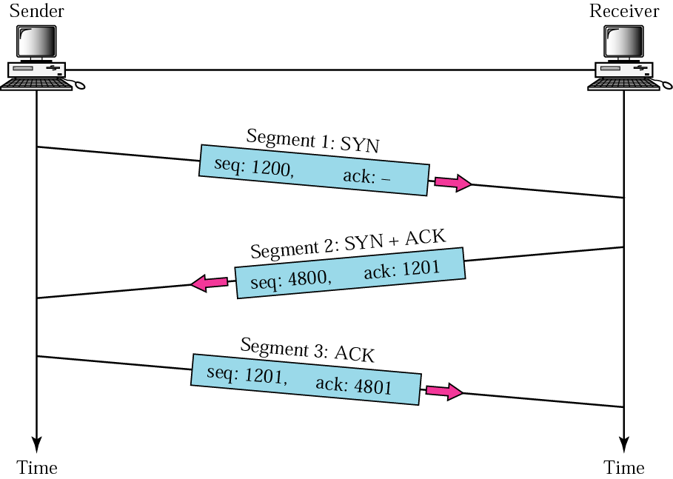
Figure 12-28
Three-way handshaking

Slide 54
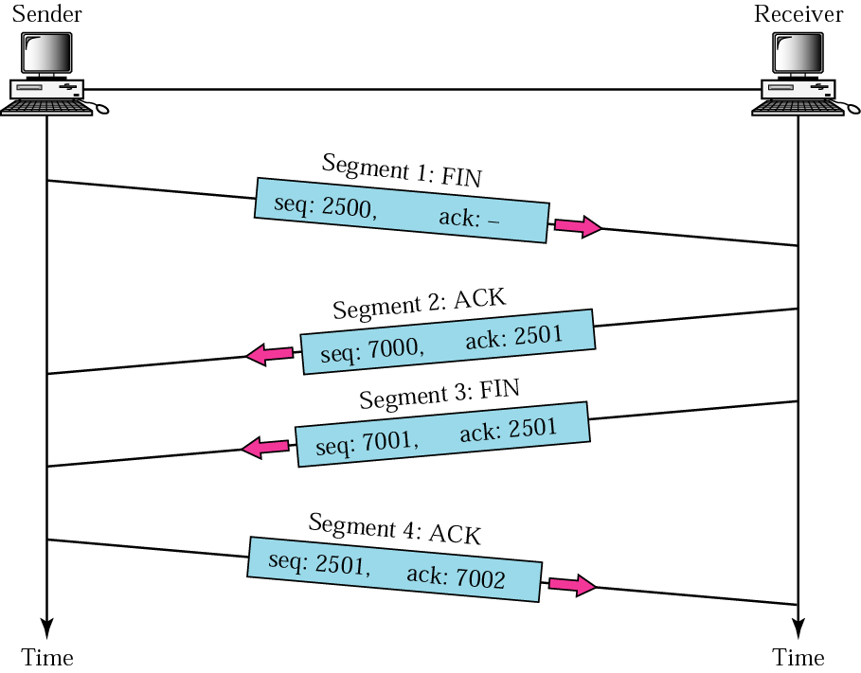
Figure 12-29
Four-way handshaking

Slide 55
12.13
STATE
TRANSITION
DIAGRAM

Slide 56
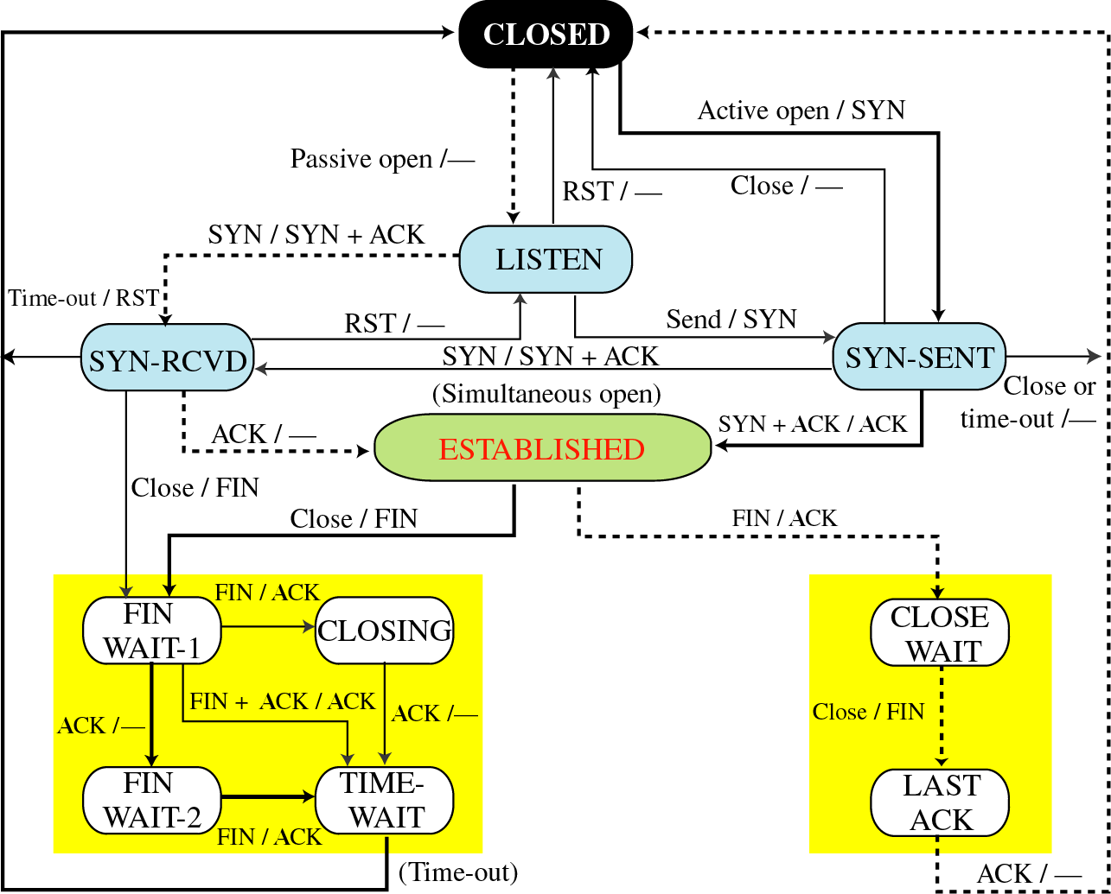
Figure 12-30
State transition diagram

Slide 57
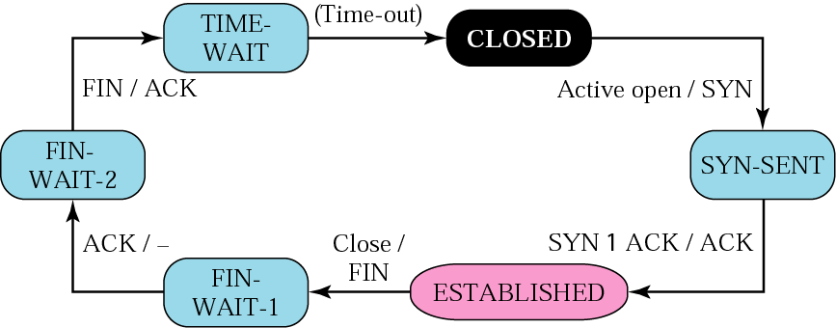
Figure 12-31
Client states

Slide 58
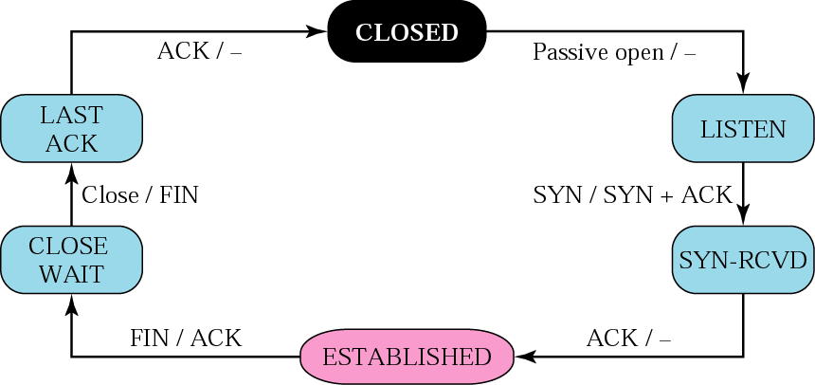
Figure 12-32
Server states

Slide 59
12.14
TCP
OPERATION

Slide 60
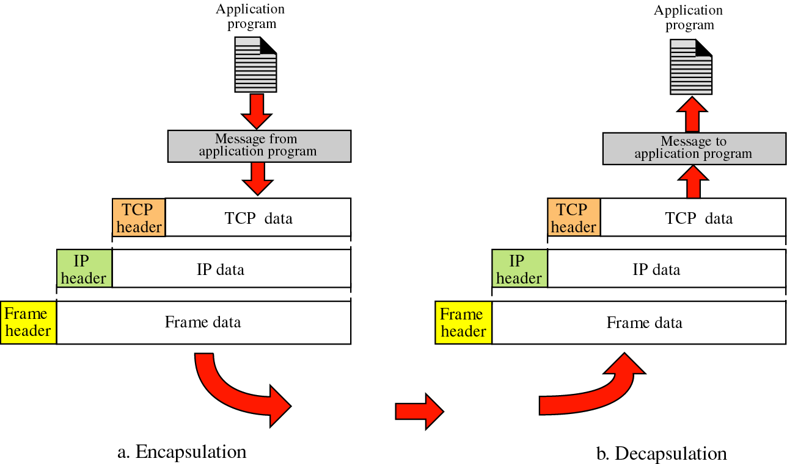
Figure 12-33
Encapsulation and decapsulation

Slide 61
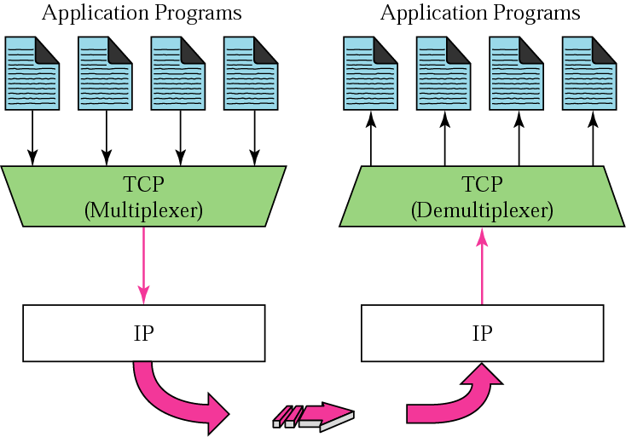
Figure 12-34
Multiplexing and demultiplexing

Slide 62
12.15
TCP
PACKAGE

Slide 63
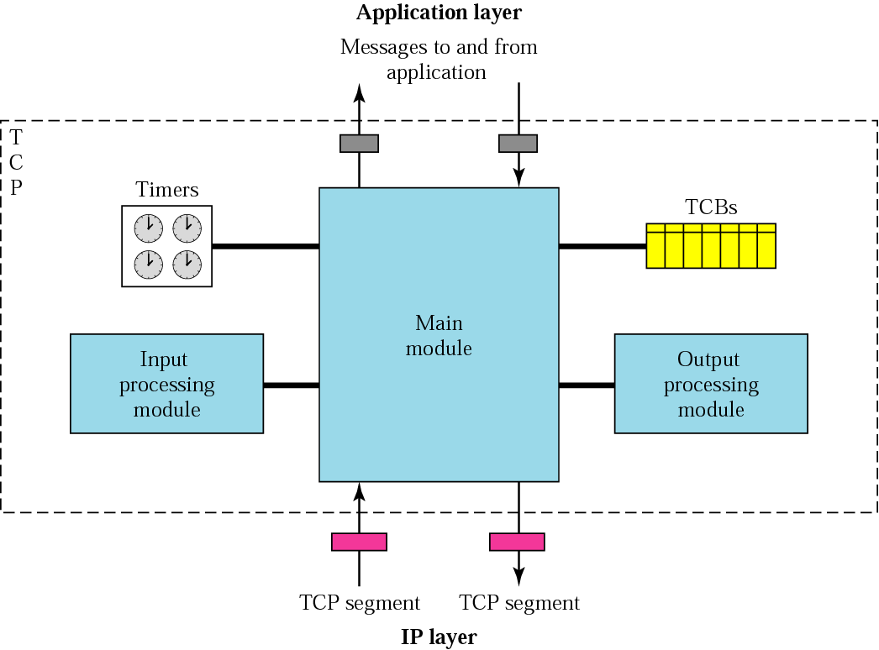
Figure 12-35
TCP package

Slide 64
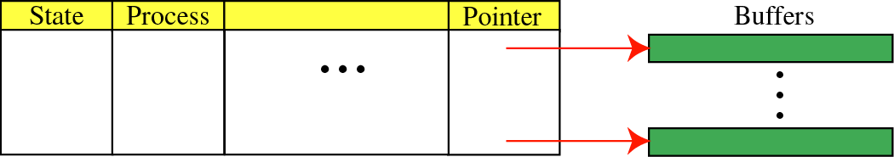
Figure 12-36
TCBs
Transmission control blocks

