Slide 1
Chapter 15
Application Layer
and
Client-Server
Model

Slide 2
CONTENTS
CLIENT-SERVER MODEL
CONCURRENCY
PROCESSES

Slide 3
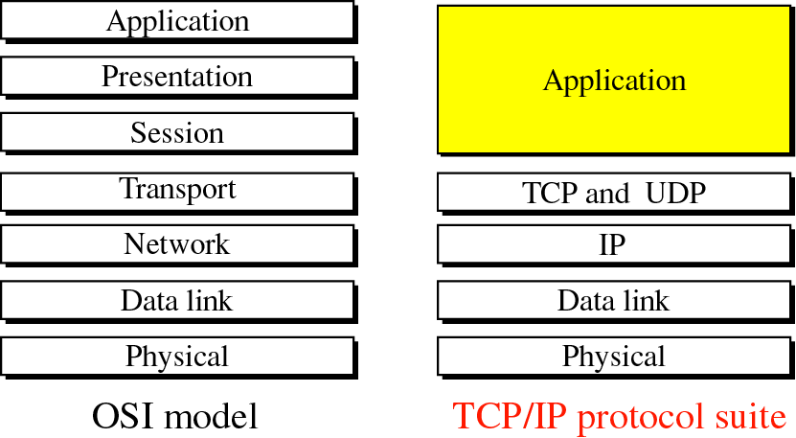
Figure 15-1
Comparison between OSI and TCP/IP

Slide 4
15.1
CLIENT-SERVER
MODEL

Slide 5
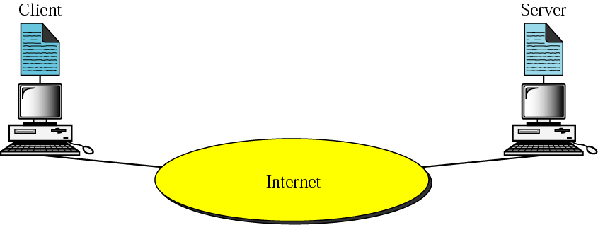
Figure 15-2
Client-server model

Slide 6
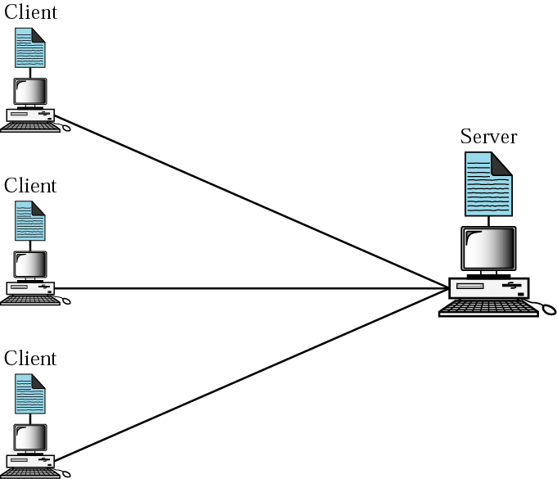
Figure 15-3
Client-server relationship

Slide 7
15.2
CONCURRENCY

Slide 8
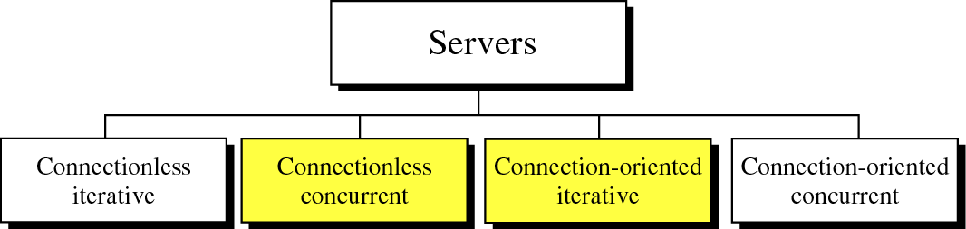
Figure 15-4
Server types

Slide 9
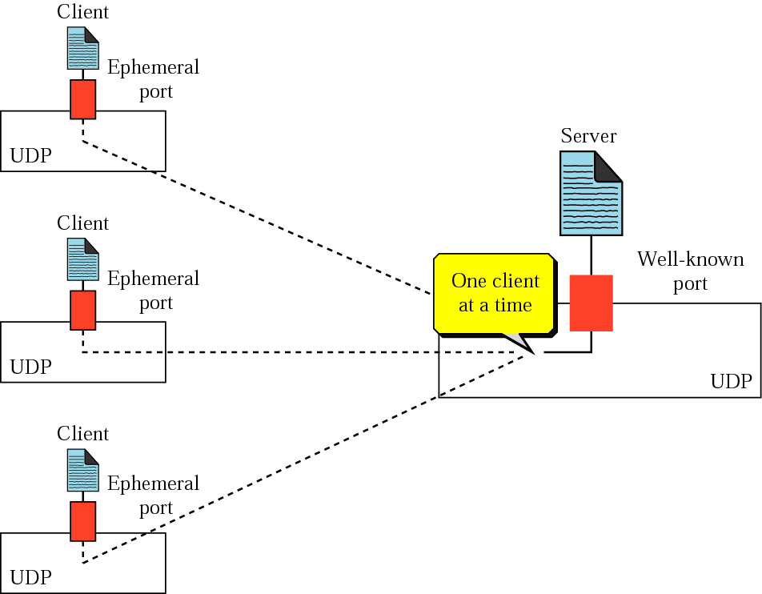
Figure 15-5
Connectionless iterative server

Slide 10
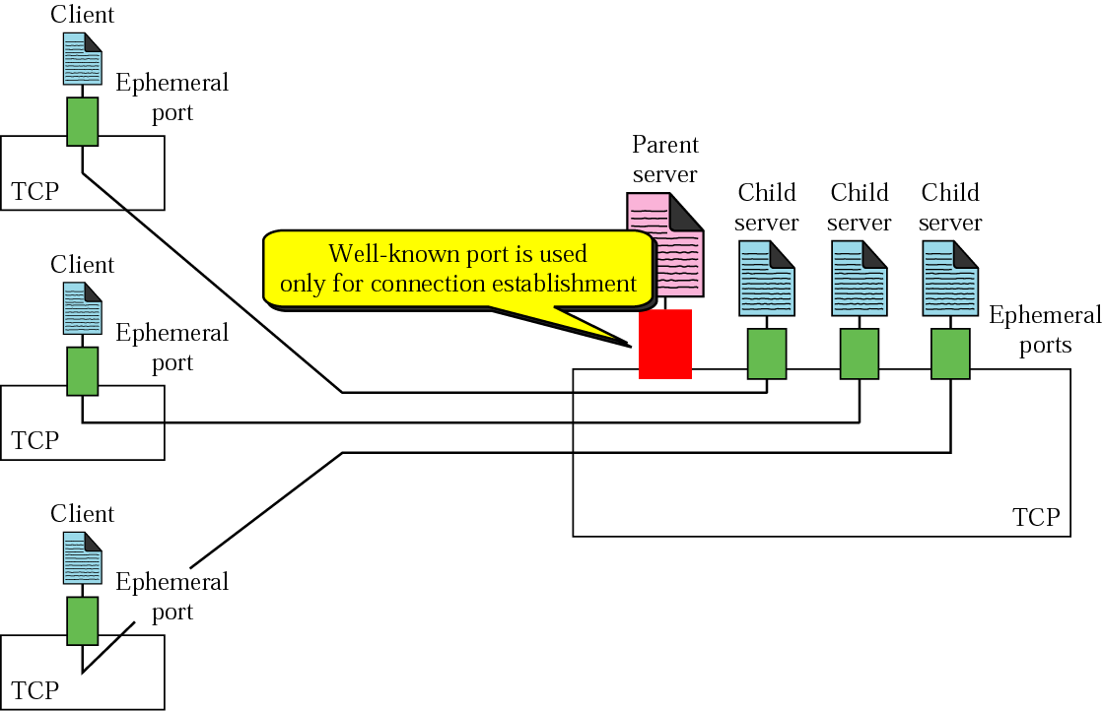
Figure 15-6
Connection-oriented concurrent server

Slide 11
15.3
PROCESSES

Slide 12
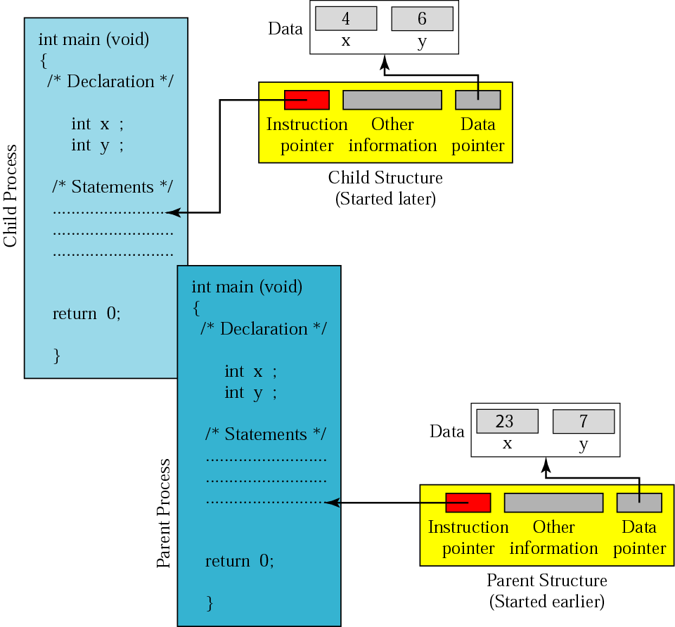
Figure 15-7
Programs and processes

Slide 13

Figure 14-8
Prototype for the getpid function

Slide 14
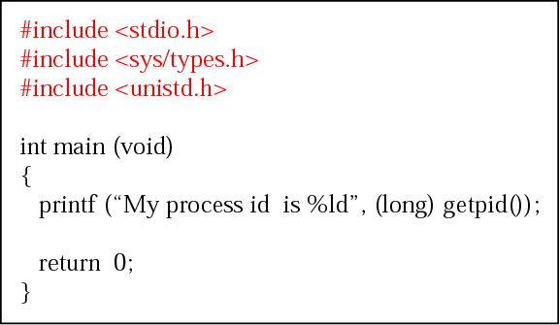
Figure 15-9
A program that prints its own processid

Slide 15

Figure 14-10
Prototype for the fork function

Slide 16
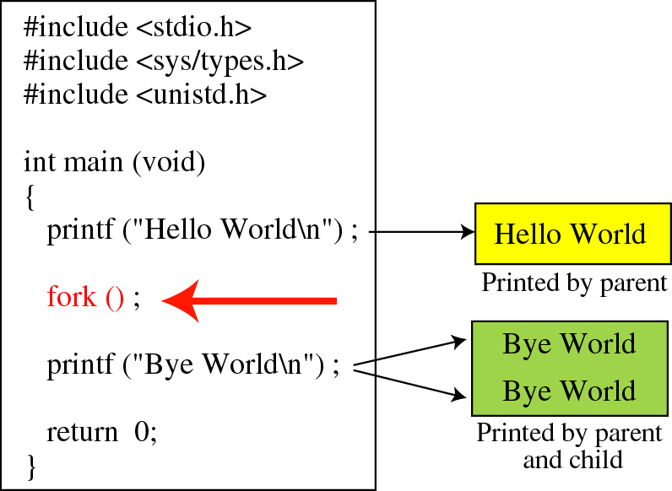
Figure 14-11
A program with one parent and one child

Slide 17
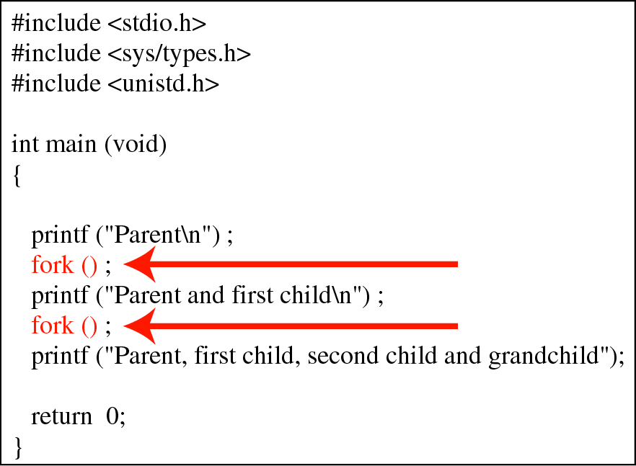
Figure 15-12
A program with two fork functions

Slide 18
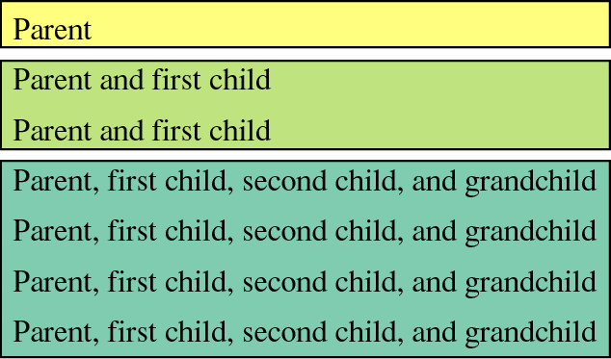
Figure 15-13
The output of the program in Figure 15.12

Slide 19
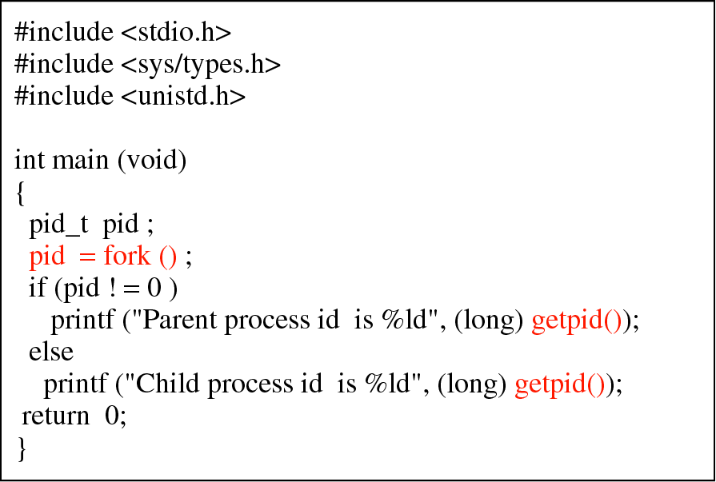
Figure 15-14
A program that prints the processids
of the parent and the child

Slide 20
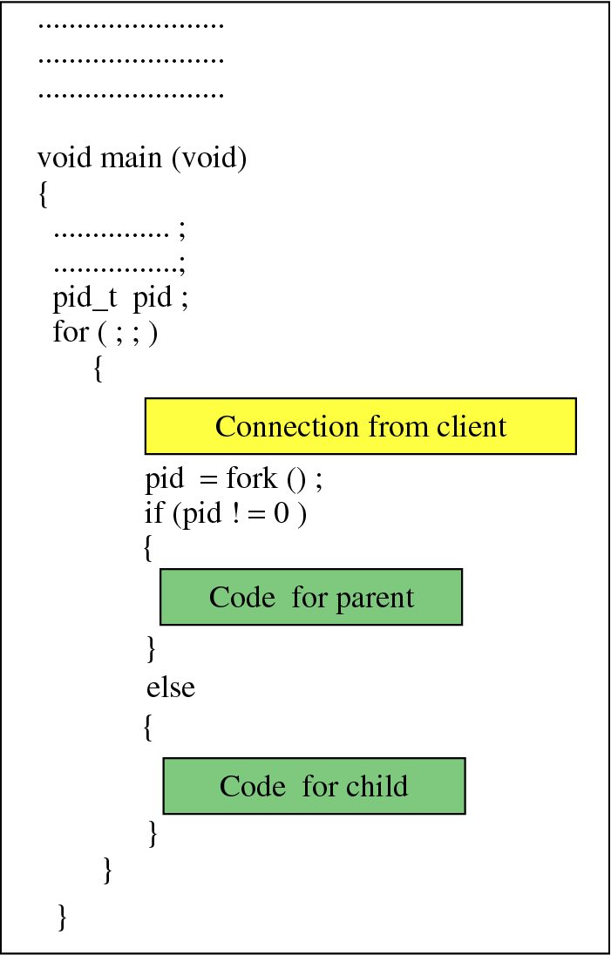
Figure 15-15
Example of a server program
with parent and child processes

