Slide 1
Chapter 16
Socket
Interface

Slide 2
CONTENTS
SOME DEFINITIONS
SOCKETS
BYTE ORDERING
ADDRESS TRANSFORMATION
BYTE MANIPULATION FUNCTIONS
INFORMATION ABOUT REMOTE HOST
SOCKET SYSTEM CALLS
CONNECTIONLESS ITERATIVE SERVER

Slide 3
CONTENTS (continued)
UDP CLIENT-SERVER PROGRAMS
CONNECTION-ORIENTED CONCURRENT
SERVER
TCP CLIENT-SERVER PROGRAMS

Slide 4
16.1
SOME DEFINITIONS

Slide 5
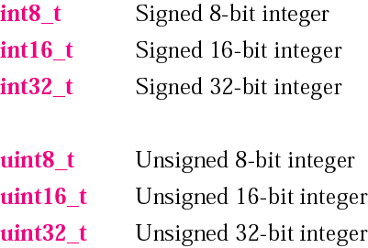
Figure 16-1
Data types

Slide 6
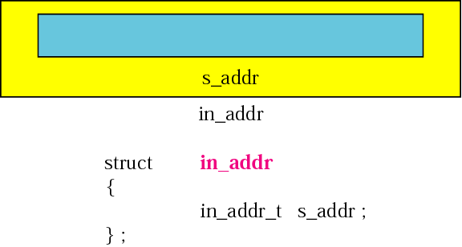
Figure 16-2
Internet address structure

Slide 7
16.2
SOCKETS

Slide 8
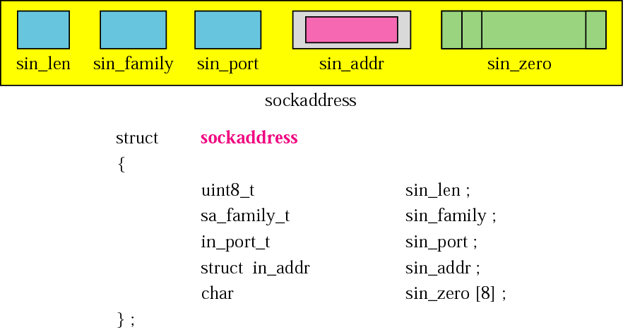
Figure 16-3
Socket address

Slide 9
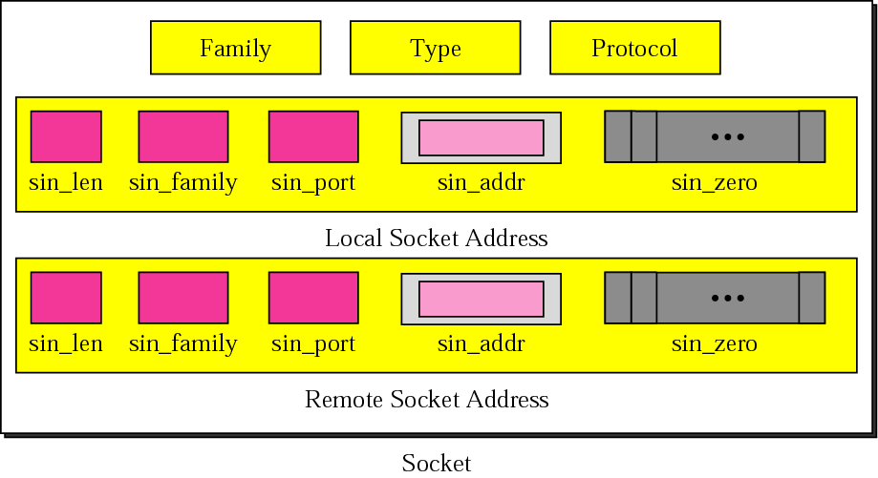
Figure 16-4
Socket structure

Slide 10
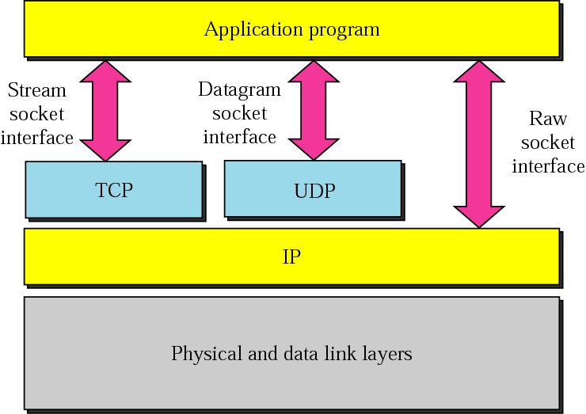
Figure 16-5
Socket types

Slide 11
16.3
BYTE ORDERING

Slide 12
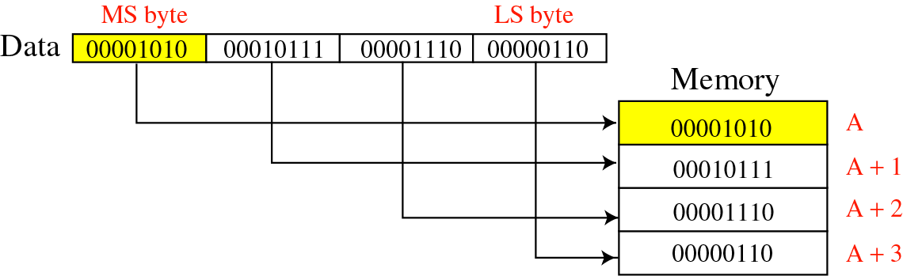
Figure 16-6
Big-endian byte order

Slide 13
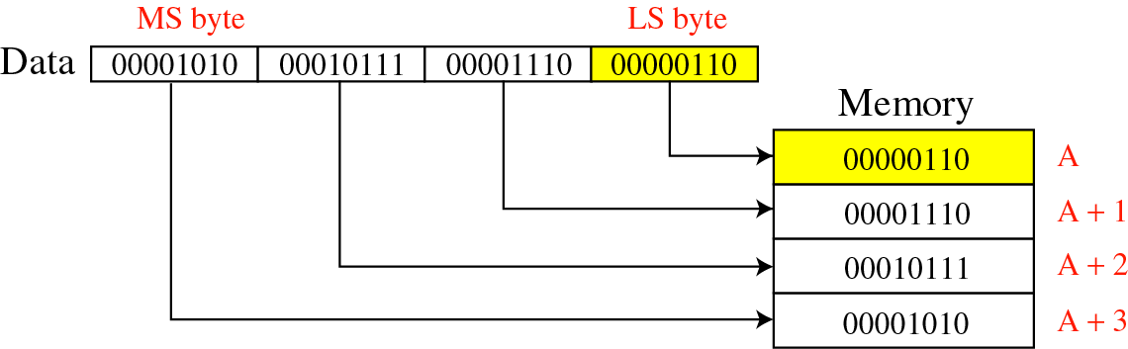
Figure 16-7
Little-endian byte order

Slide 14

The byte order for the TCP/IP
protocol suite is big endian.

Slide 15
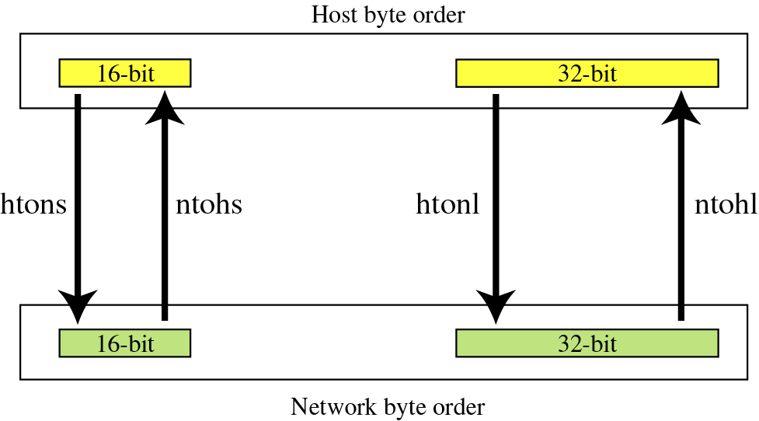
Figure 16-8
Bite-order transformation

Slide 16
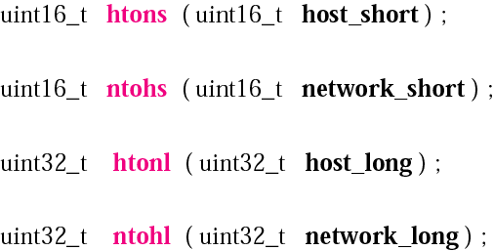
Figure 16-9
Declarations for byte-order transformation

Slide 17
16.4
ADDRESS
TRANSFORMATION

Slide 18
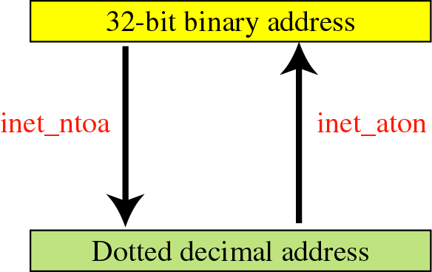
Figure 16-10
Address transformation

Slide 19

Figure 16-11
Declarations for address
transformation functions

Slide 20
16.5
BYTE
MANIPULATION
FUNCTIONS

Slide 21
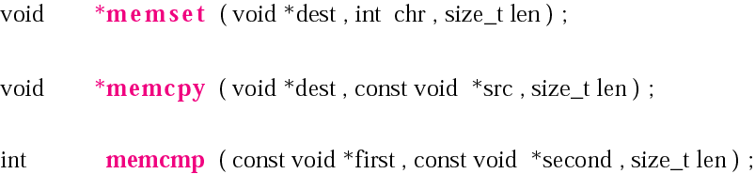
Figure 16-12
Declarations for byte-manipulation
functions

Slide 22
16.6
INFORMATION
ABOUT REMOTE
HOST

Slide 23
Figure 16-13
Declaration for gethostbyname

Slide 24
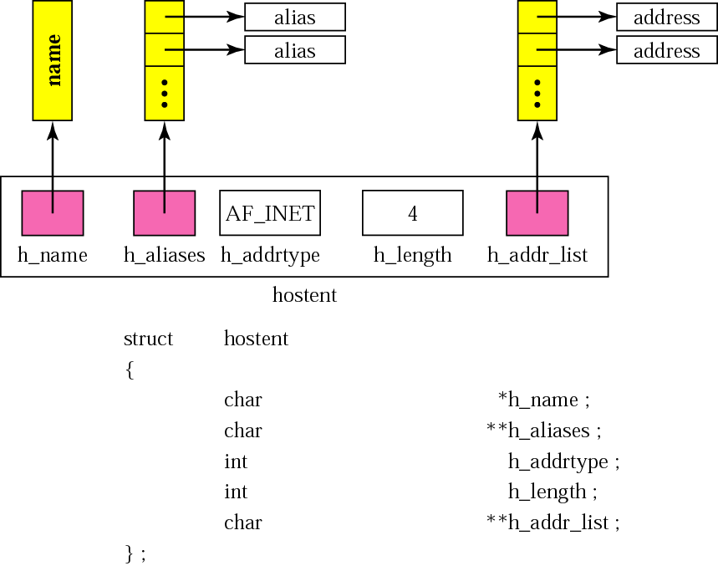
Figure 16-14
Hostent structure

Slide 25
16.7
SOCKET SYSTEM
CALLS

Slide 26
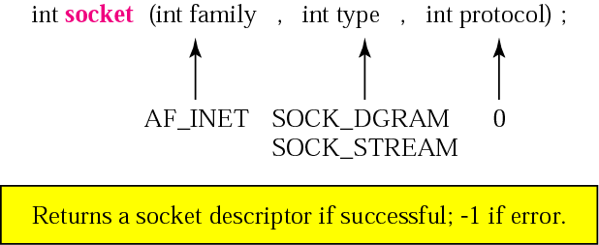
Figure 16-15
Declaration for socket function

Slide 27
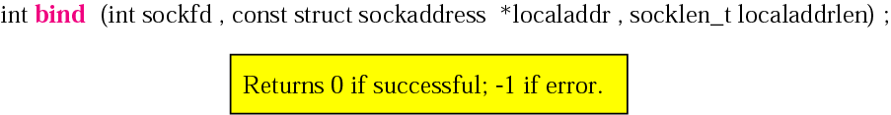
Figure 16-16
Declaration for bind function

Slide 28
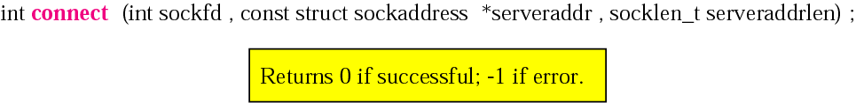
Figure 16-17
Declaration for connect function

Slide 29
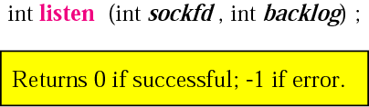
Figure 16-18
Declaration for listen function

Slide 30
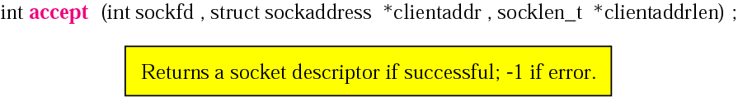
Figure 16-19
Declaration for accept function

Slide 31
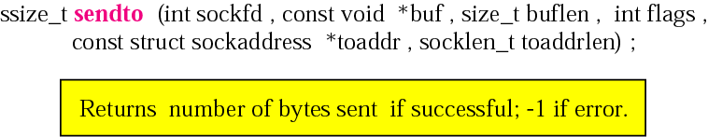
Figure 16-20
Declaration for sendto function

Slide 32
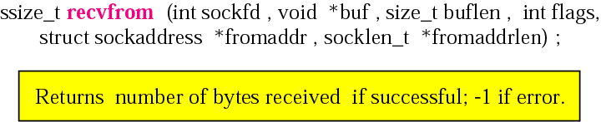
Figure 16-21
Declaration for recvfrom function

Slide 33
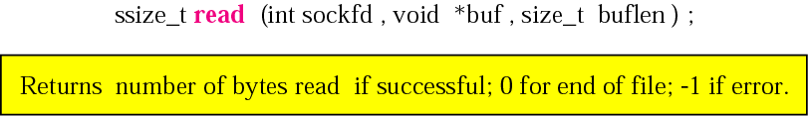
Figure 16-22
Declaration for read function

Slide 34
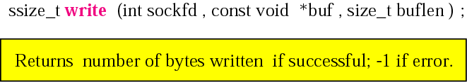
Figure 16-23
Declaration for write function

Slide 35
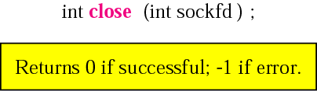
Figure 16-24
Declaration for close function

Slide 36
16.8
CONNECTIONLESS
ITERATIVE
SERVER

Slide 37
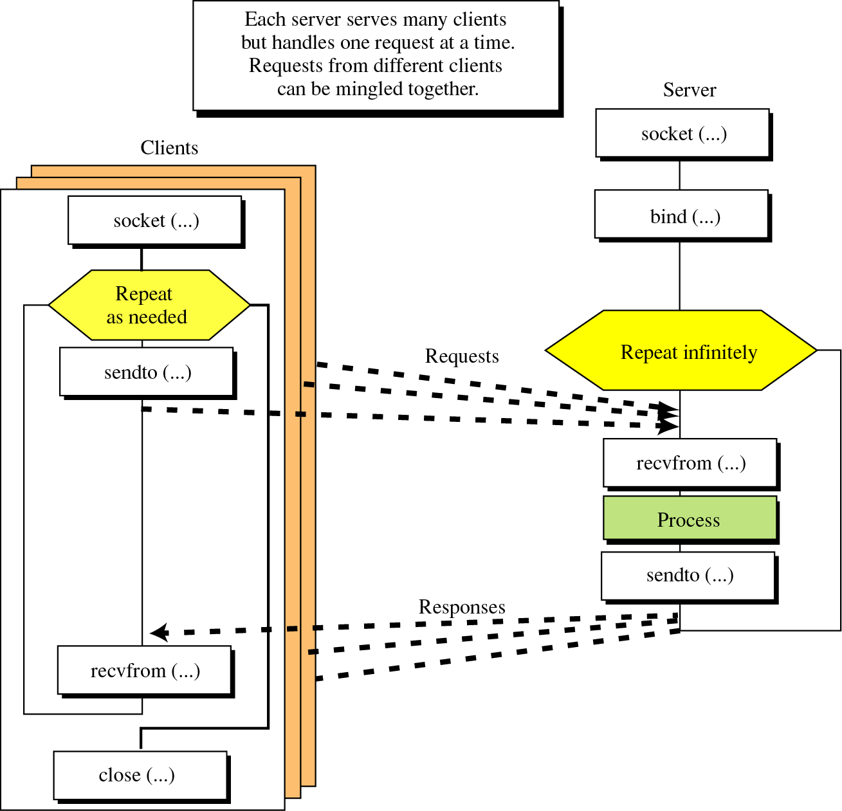
Figure 16-25
Socket interface
for connectionless
iterative server

Slide 38
16.9
UDP CLIENT-SERVER
PROGRAMS

Slide 39
16.10
CONNECTION-ORIENTED
CONCURRENT SERVER

Slide 40
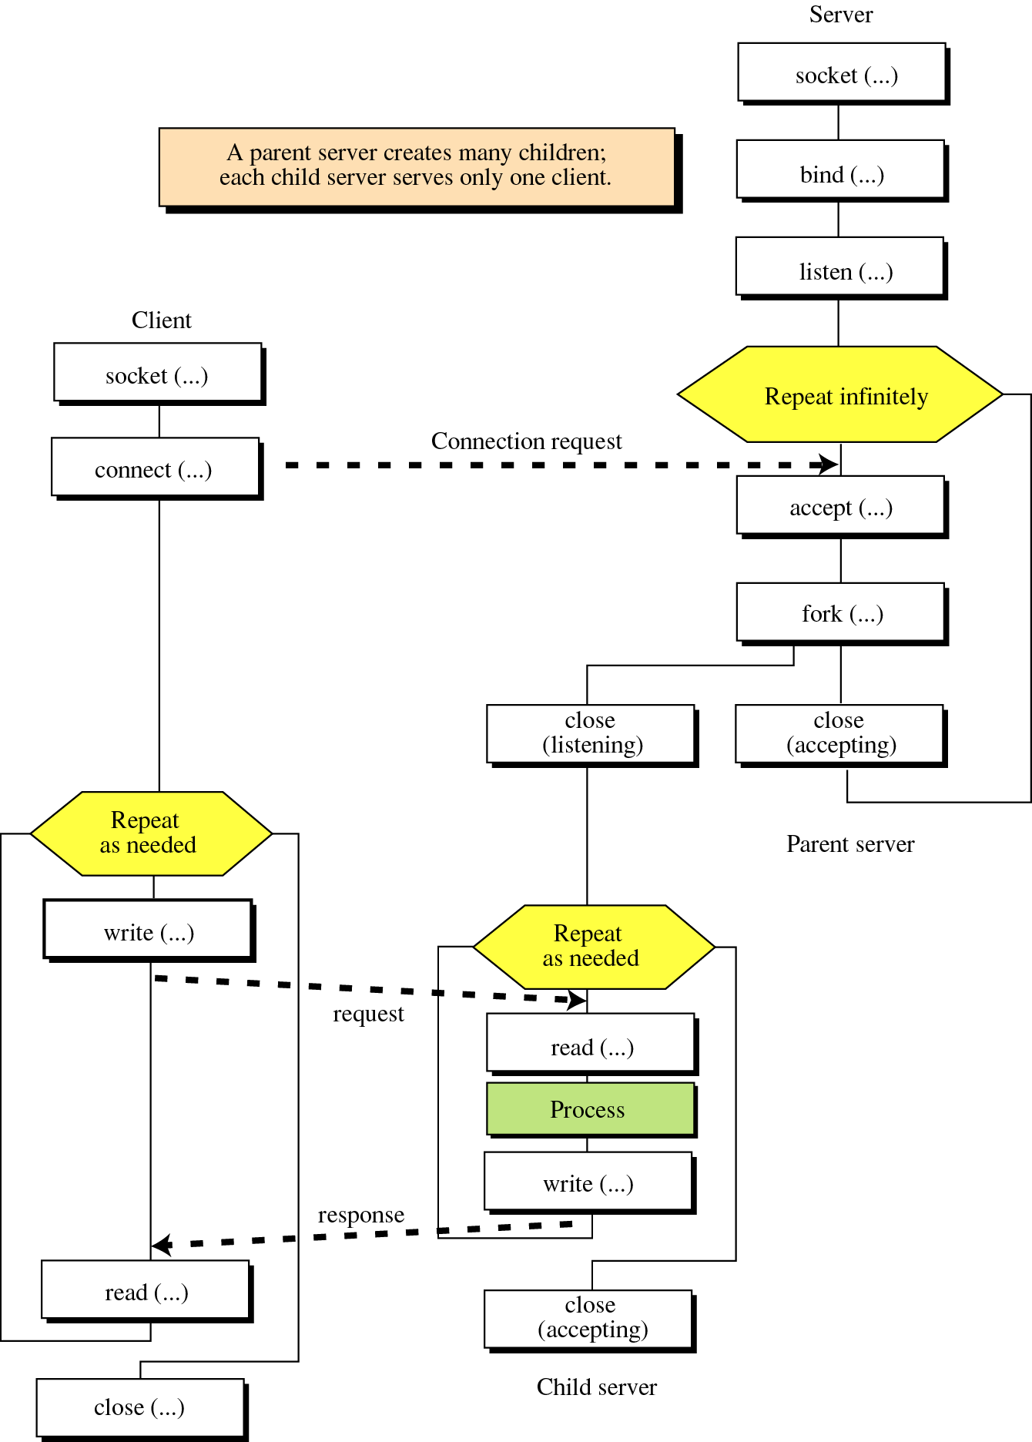
Figure 16-26
Socket interface
for connection-oriented
concurrent server

Slide 41
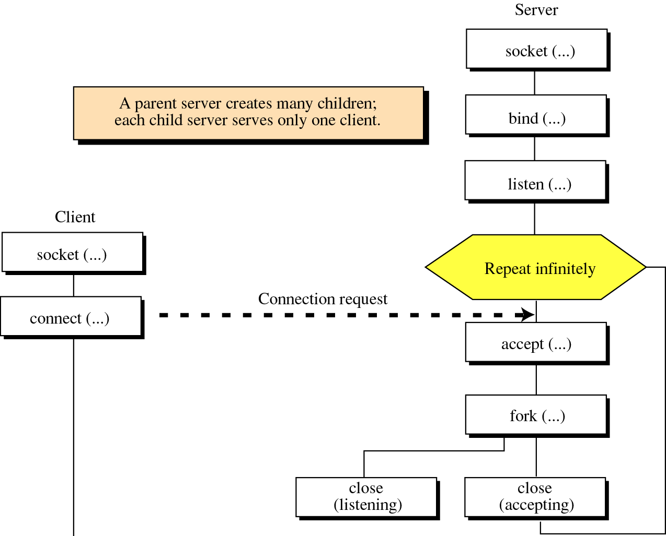
Figure 16-26 (repeated), Part I

Slide 42
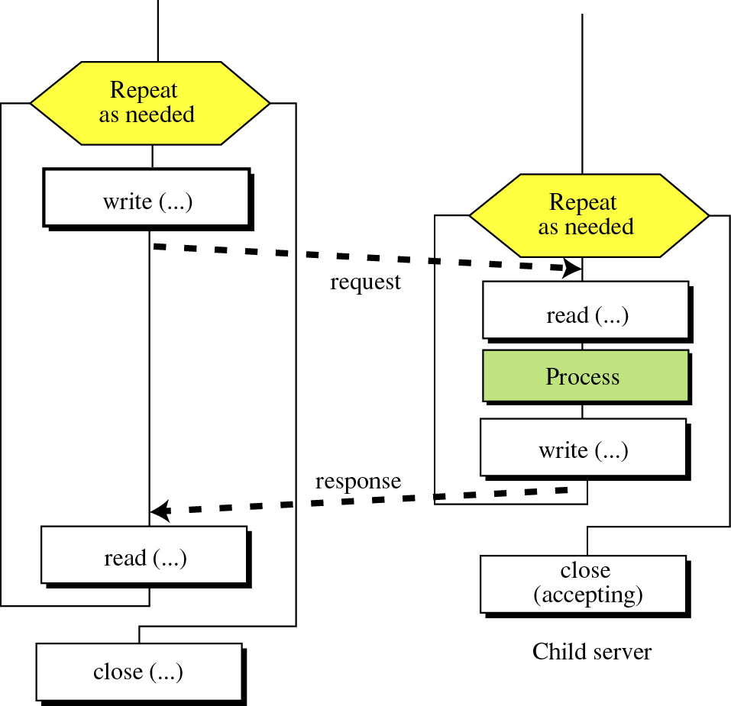
Figure 16-26 (repeated), Part II

Slide 43
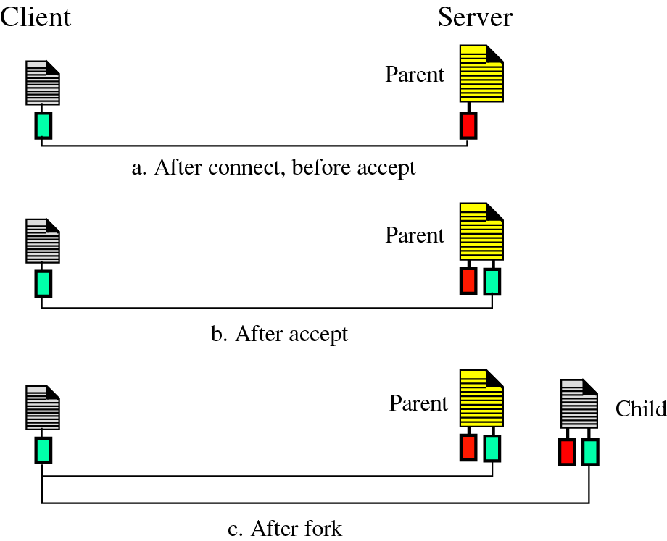
Figure 16-27, Part I
Client
and
Server

Slide 44
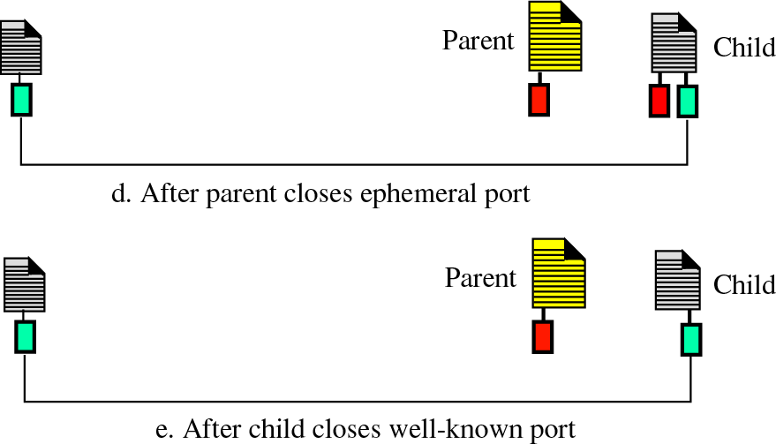
Figure 16-27, Part II

