Slide 1
Chapter 22
Simple Mail
Transfer Protocol
(SMTP)

Slide 2
CONTENTS
USER AGENT (UA)
ADDRESSES
DELAYED DELIVERY
ALIASES
MAIL TRANSFER AGENT (MTA)
COMMANDS AND RESPONSES
MAIL TRANSFER PHASES
MIME
MAIL DELIVERY
MAIL ACCESS PROTOCOLS

Slide 3
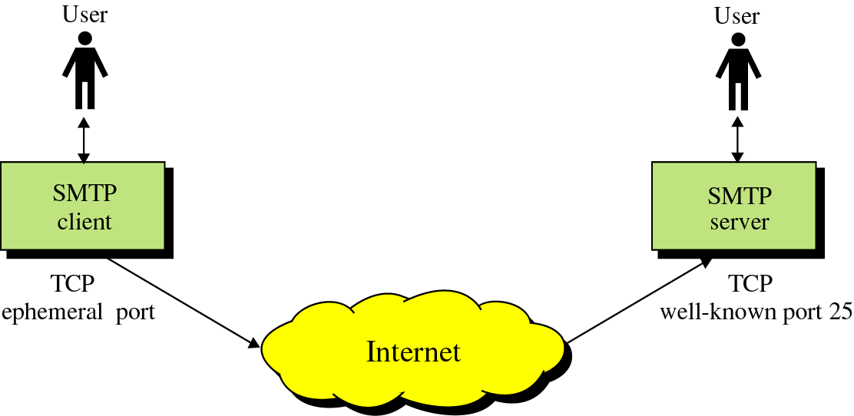
Figure 22-1
SMTP concept

Slide 4
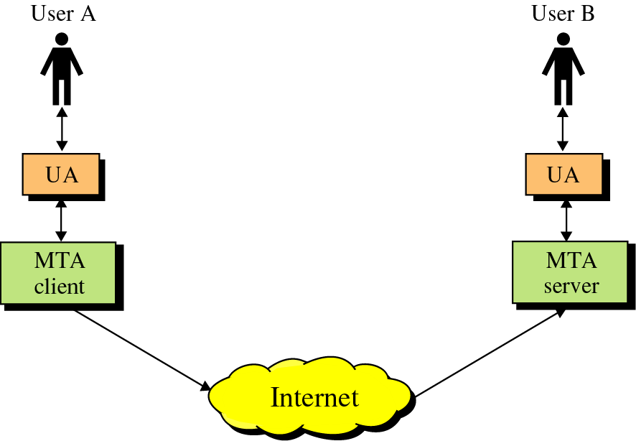
Figure 22-2
UAs and MTAs

Slide 5
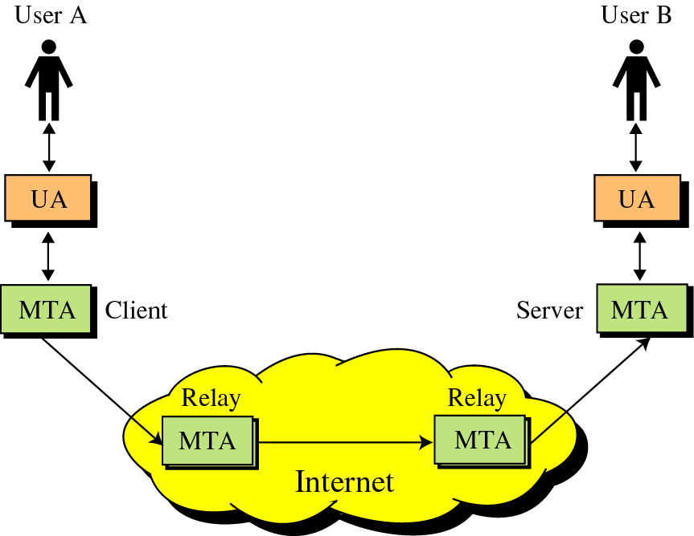
Figure 22-3
Relay MTAs

Slide 6
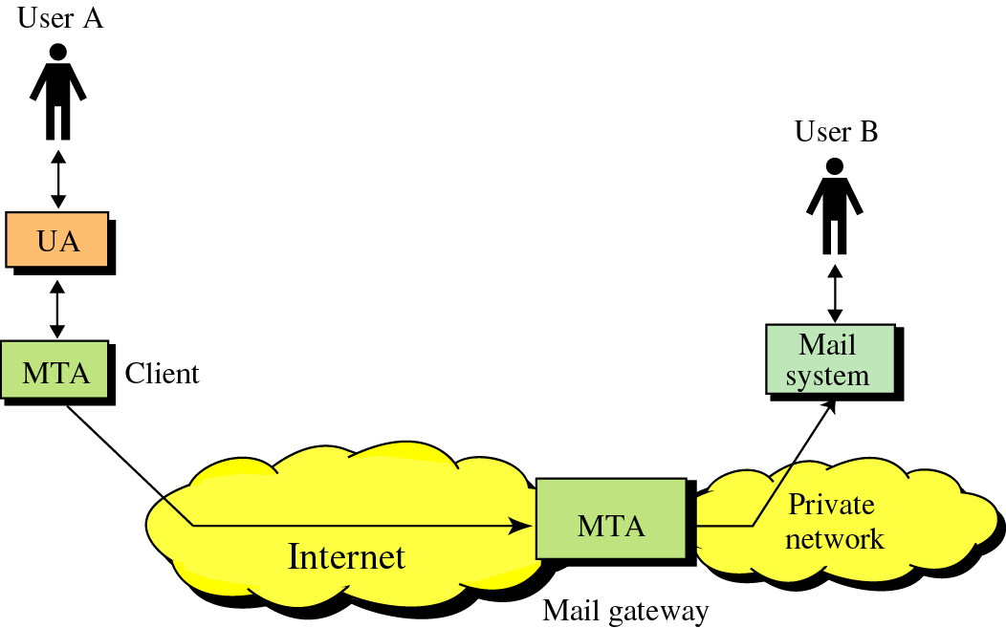
Figure 22-4
Mail gateway

Slide 7
22.1
USER
AGENT
(UA)

Slide 8
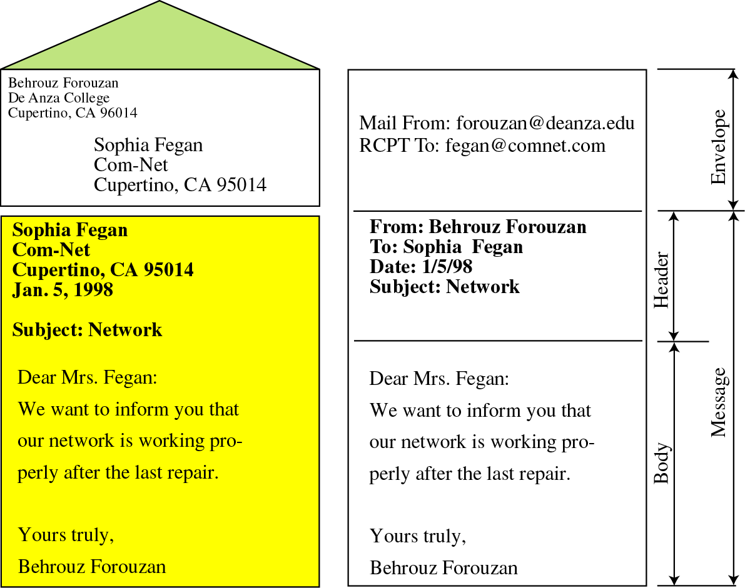
Figure 22-5
Format

Slide 9
22.2
ADDRESSES

Slide 10
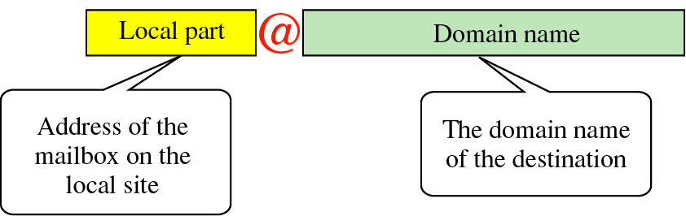
Figure 22-6
Address

Slide 11
22.3
DELAYED
DELIVERY

Slide 12
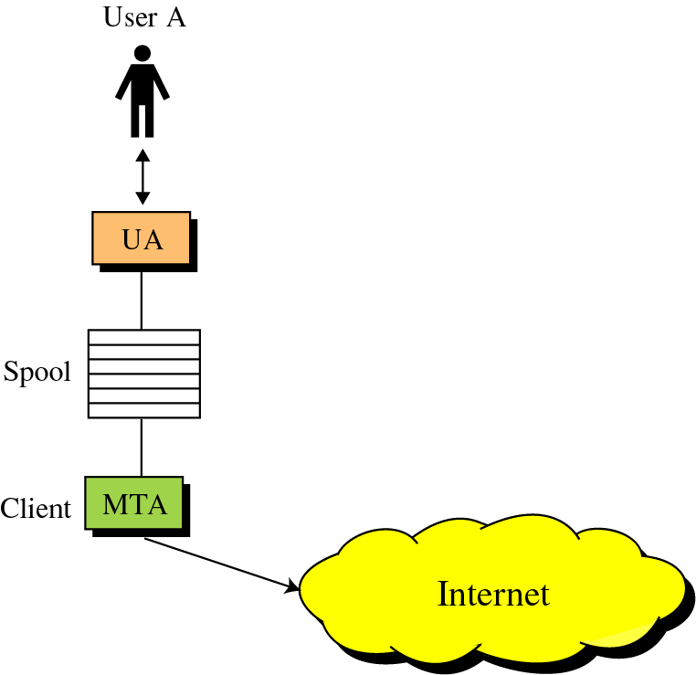
Figure 22-7
Sender-site
delay

Slide 13
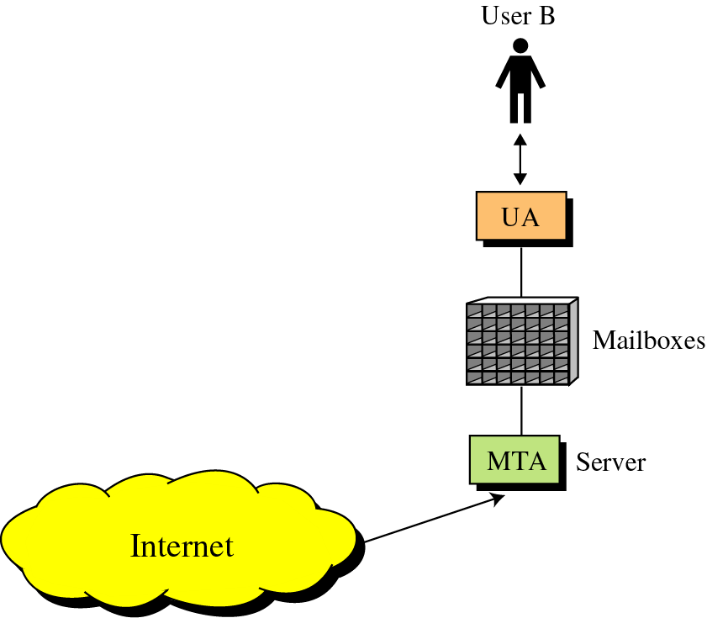
Figure 22-8
Receiver-site
delay

Slide 14
22.4
ALIASES

Slide 15
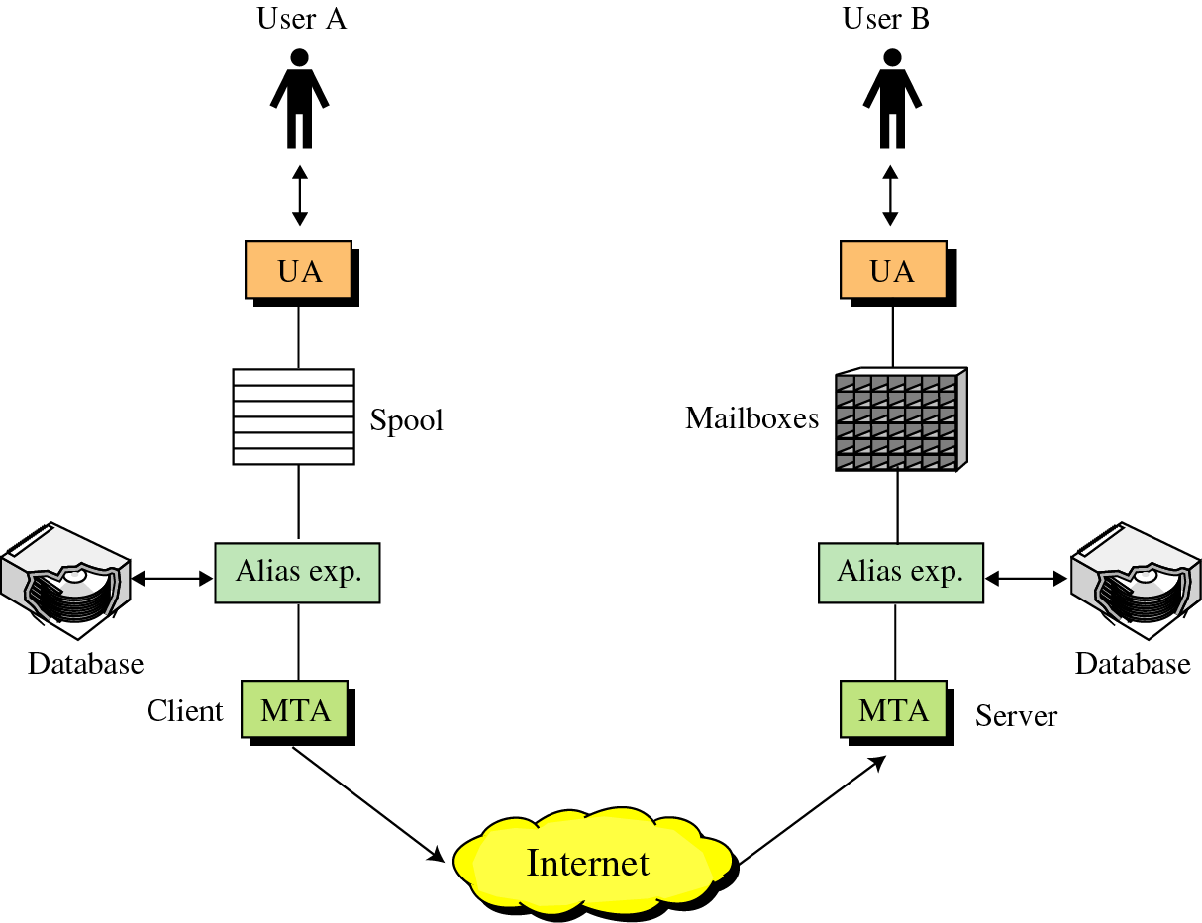
Figure 22-9
Alias expansion

Slide 16
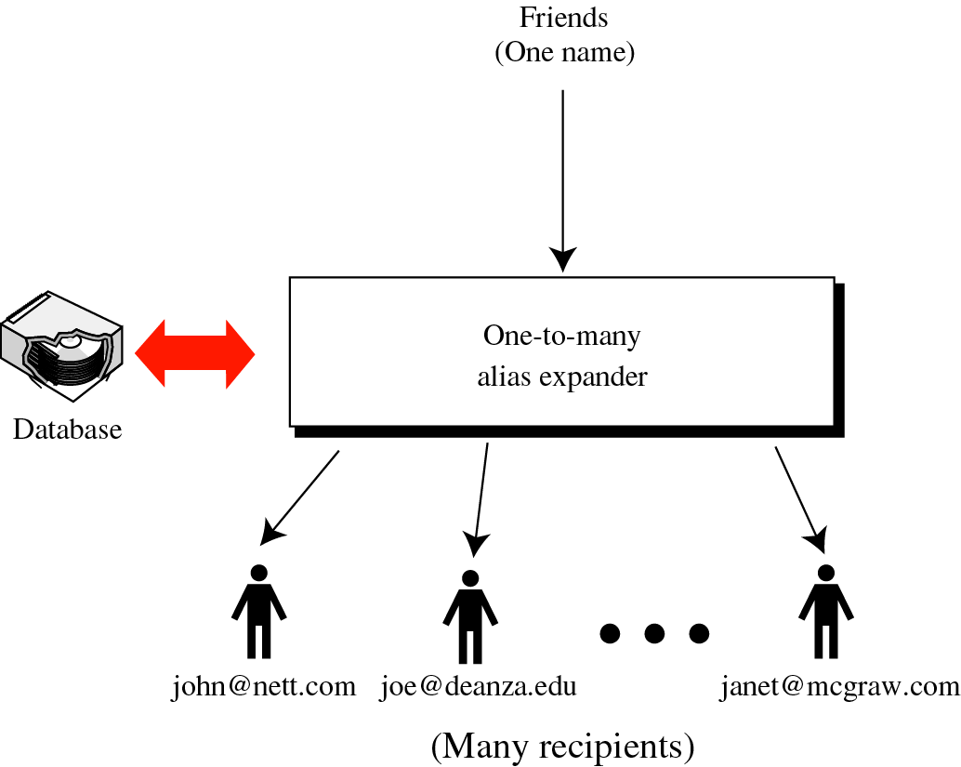
Figure 22-10
One-to-many
expansion

Slide 17
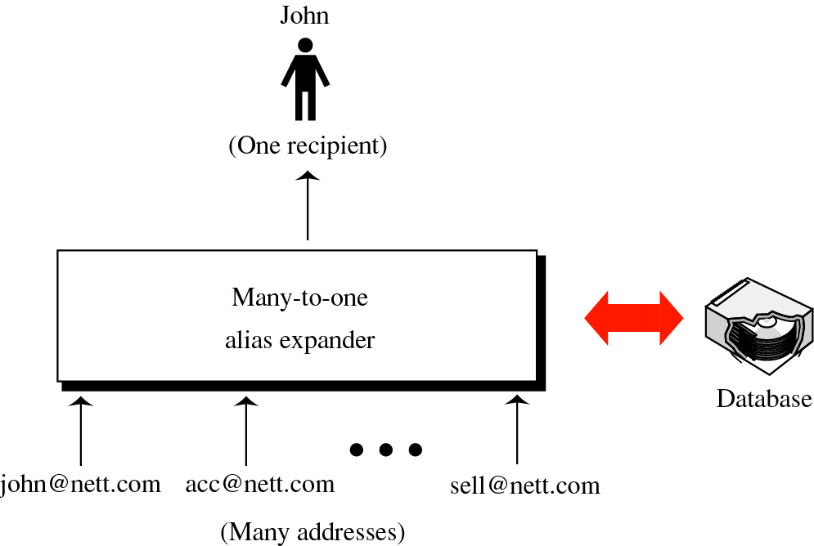
Figure 22-11
Many-to-one
expansion

Slide 18
22.5
MAIL
TRANSFER
AGENT

Slide 19
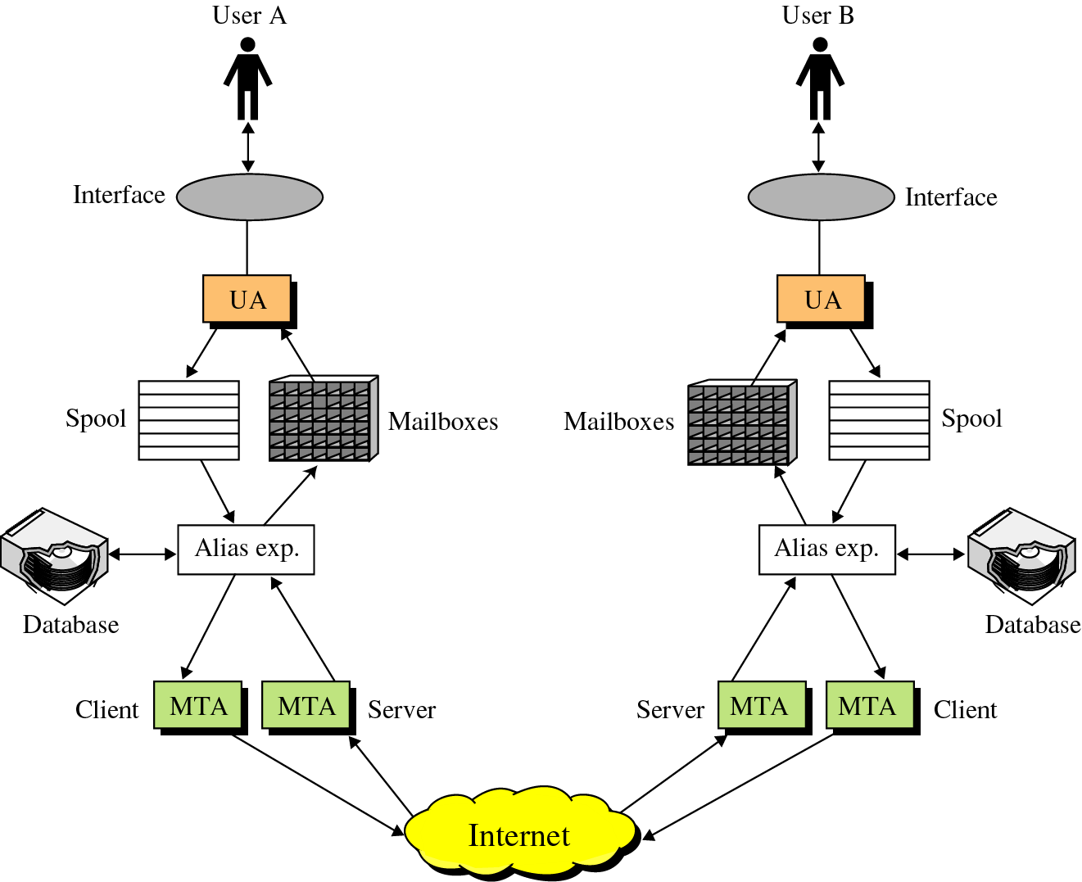
Figure 22-12
Email system

Slide 20
22.6
COMMANDS
AND
RESPONSES

Slide 21
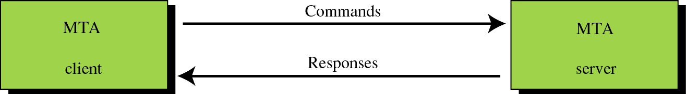
Figure 22-13
Commands and responses

Slide 22
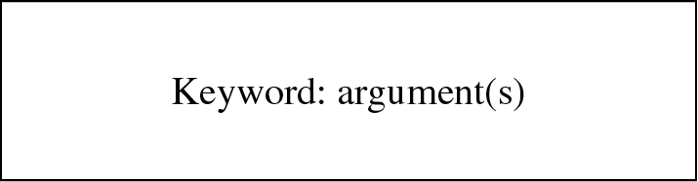
Figure 22-14
Command format

Slide 23
22.7
MAIL
TRANSFER
PHASES

Slide 24
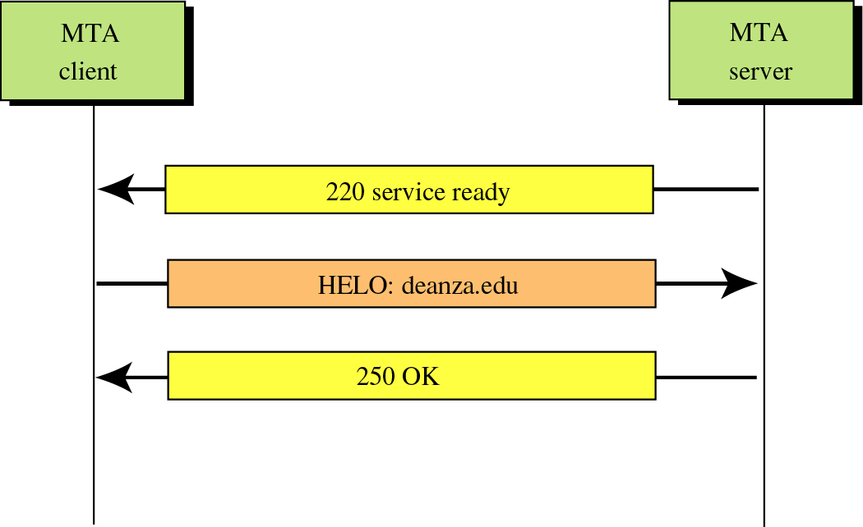
Figure 22-15
Connection establishment

Slide 25
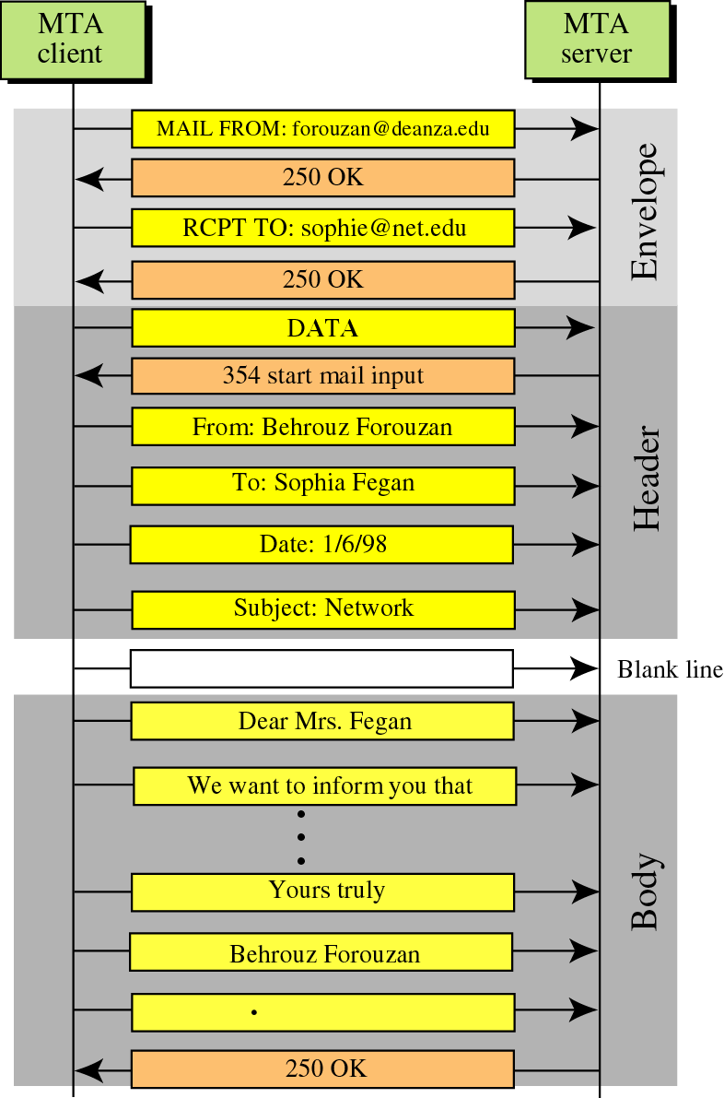
Figure 22-16
Message
transfer

Slide 26
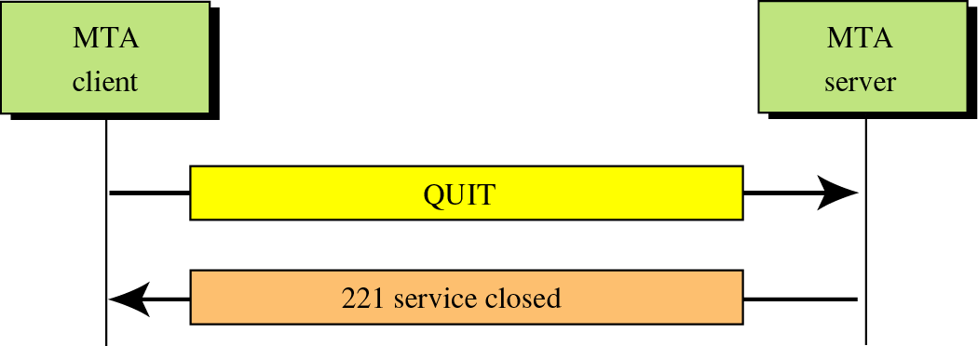
Figure 22-17
Connection termination

Slide 27
22.8
MULTIPURPOSE
INTERNET
MAIL EXTENSIONS
(MIME)

Slide 28
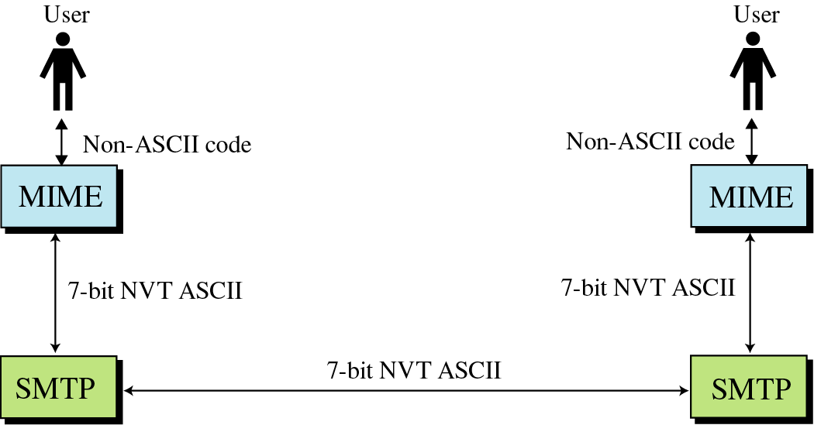
Figure 22-18
MIME

Slide 29
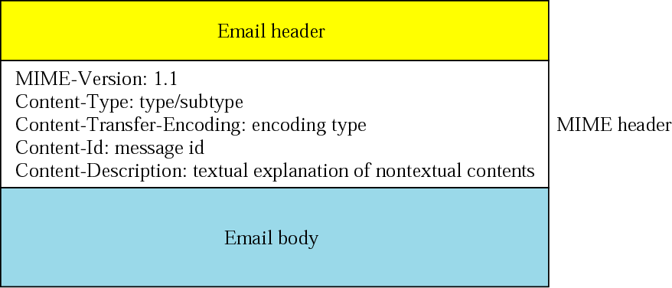
Figure 22-19
MIME header

Slide 30
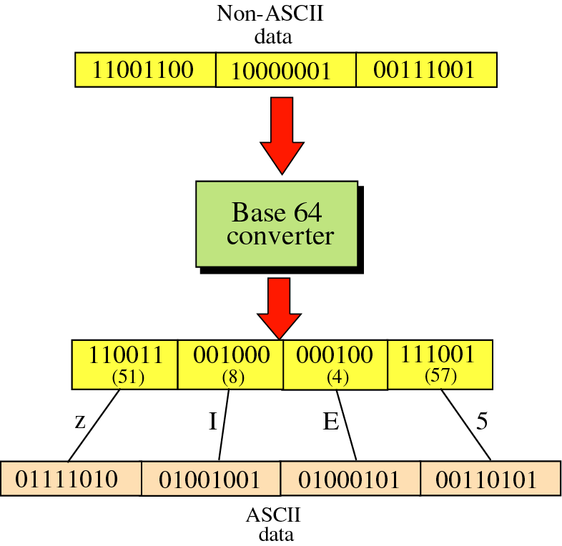
Figure 22-20
Base64

Slide 31
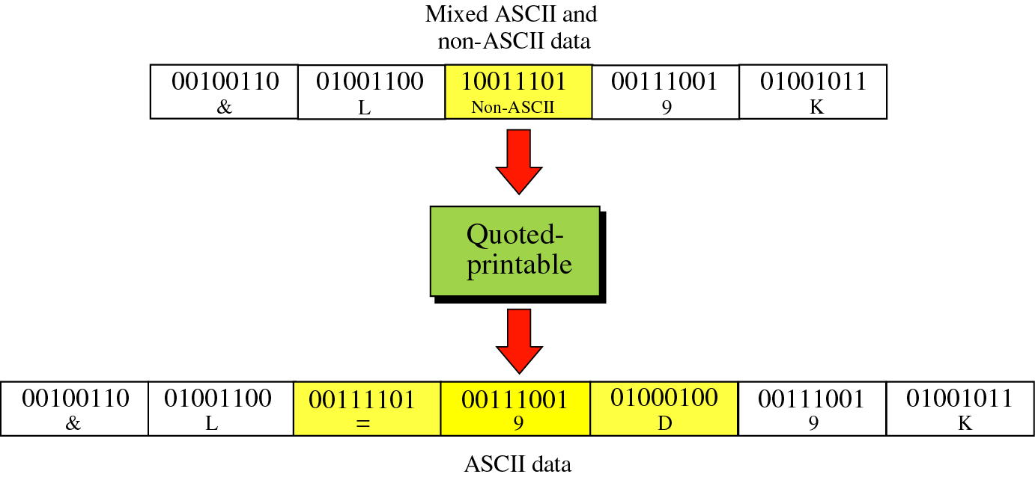
Figure 22-21
Quoted-printable

Slide 32
22.9
MAIL
DELIVERY

Slide 33
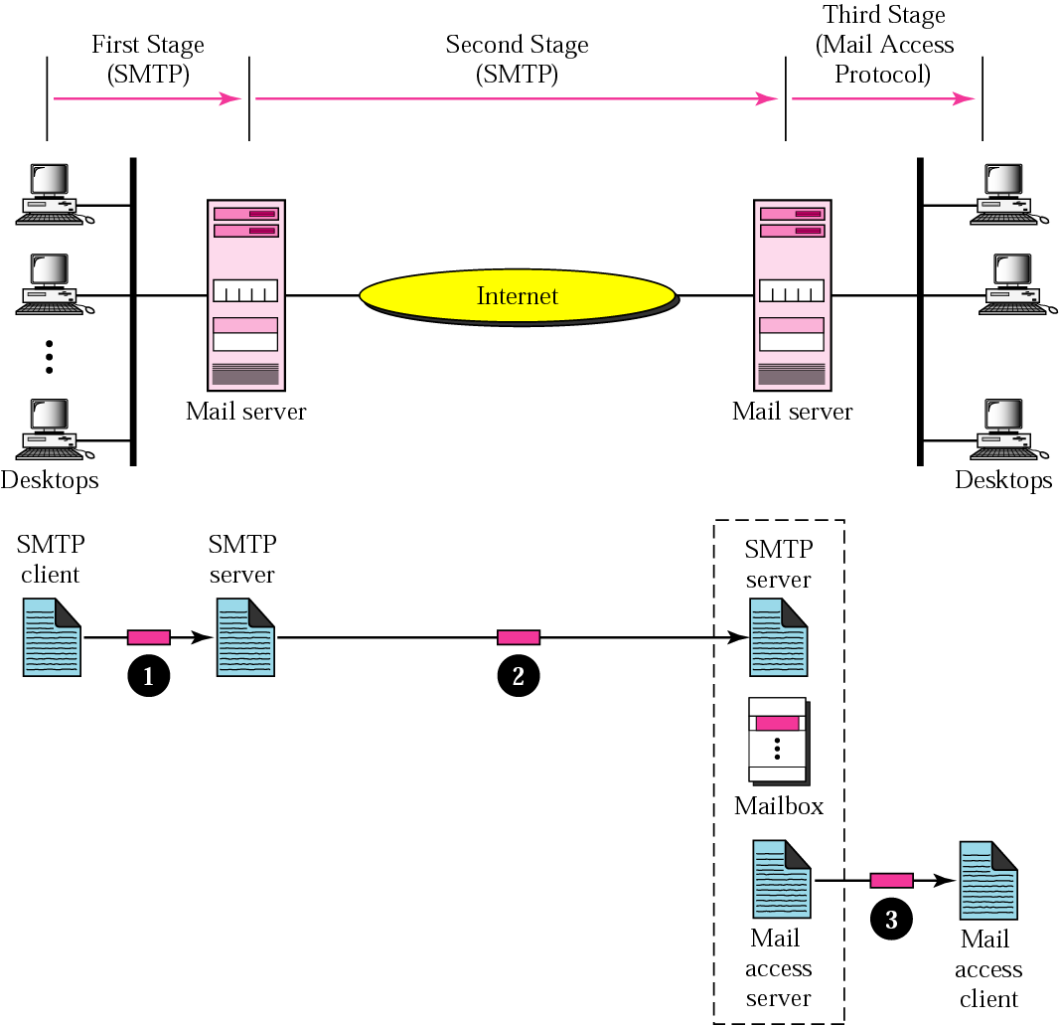
Figure 22-22
Email delivery

Slide 34
22.10
MAIL ACCESS
PROTOCOLS

Slide 35
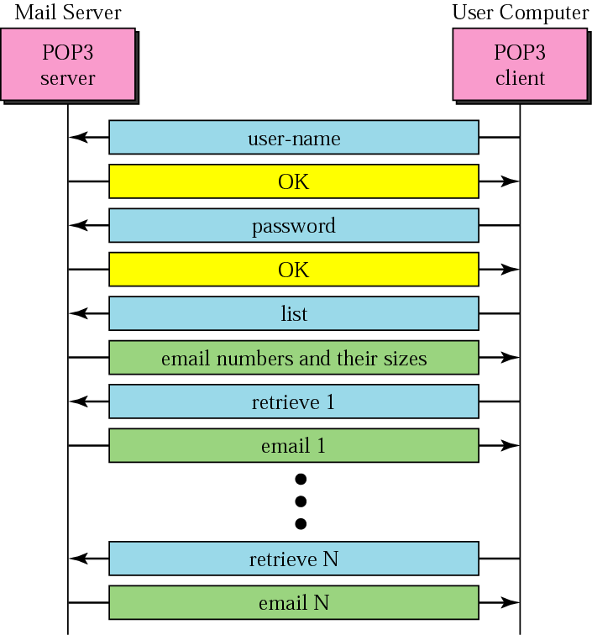
Figure 22-22
POP3

