Slide 1
Chapter 25
World Wide Web
(WWW)

Slide 2
CONTENTS
HYPERTEXT AND HYPERMEDIA
BROWSER ARCHITECTURE
STATIC DOCUMENTS
HTML
DYNAMIC DOCUMENTS
CGI
ACTIVE DOCUMENTS
JAVA

Slide 3
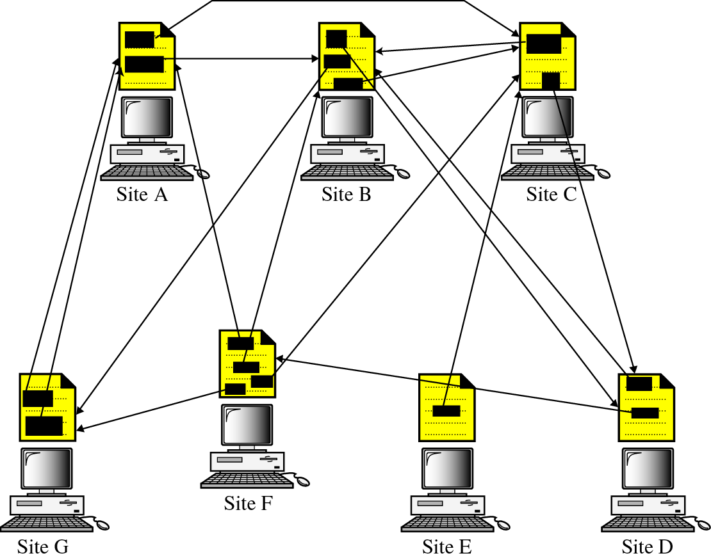
Figure 25-1
Distributed services

Slide 4
25.1
HYPERTEXT
AND
HYPERMEDIA

Slide 5
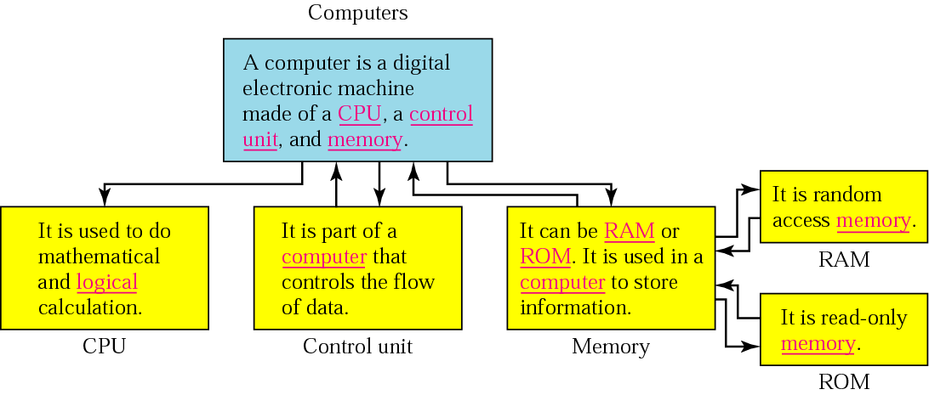
Figure 25-2
Hypertext

Slide 6
25.2
BROWSER
ARCHITECTURE

Slide 7
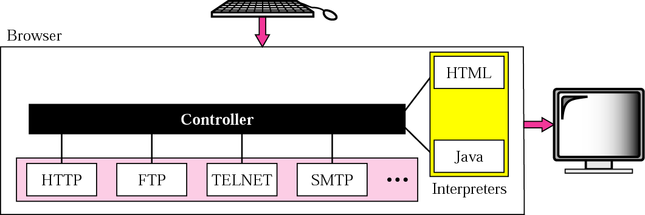
Figure 25-3
Browser architecture

Slide 8
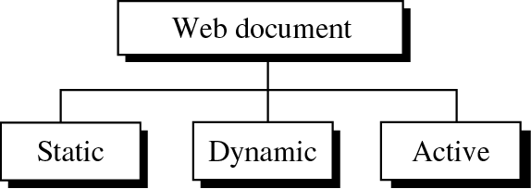
Figure 25-4
Categories of Web documents

Slide 9
25.3
STATIC
DOCUMENTS

Slide 10
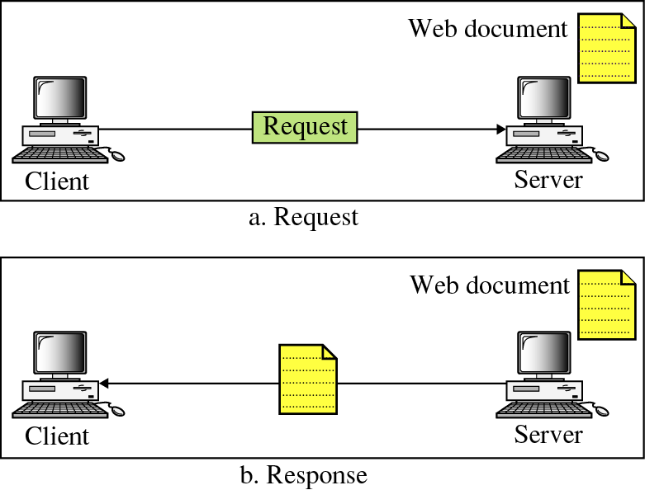
Figure 25-5
Static document

Slide 11
25.4
HTML

Slide 12
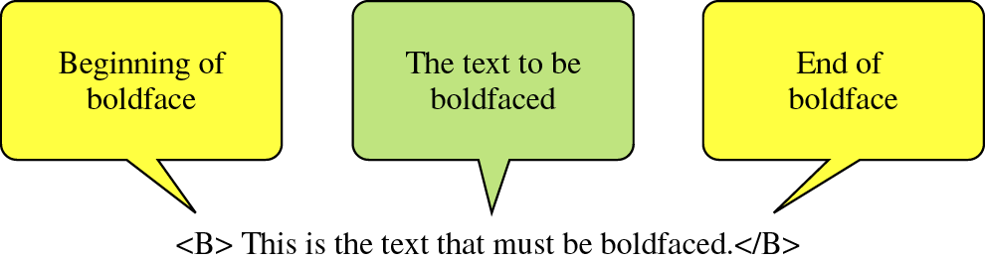
Figure 25-6
Boldface tags

Slide 13
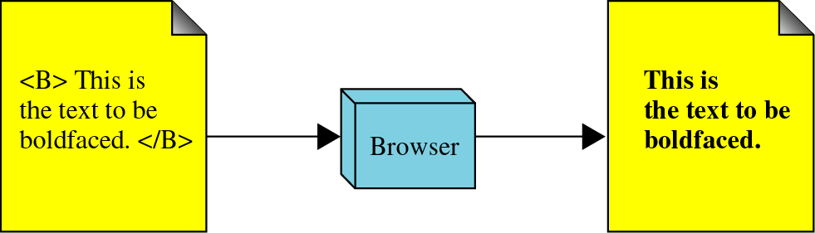
Figure 25-7
Effect of boldface tags

Slide 14
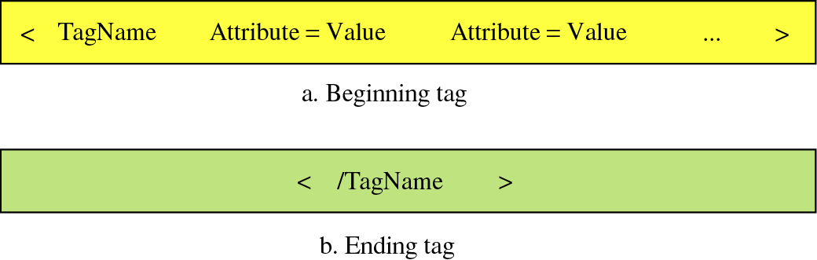
Figure 25-8
Beginning and ending tags

Slide 15
25.5
DYNAMIC
DOCUMENTS

Slide 16
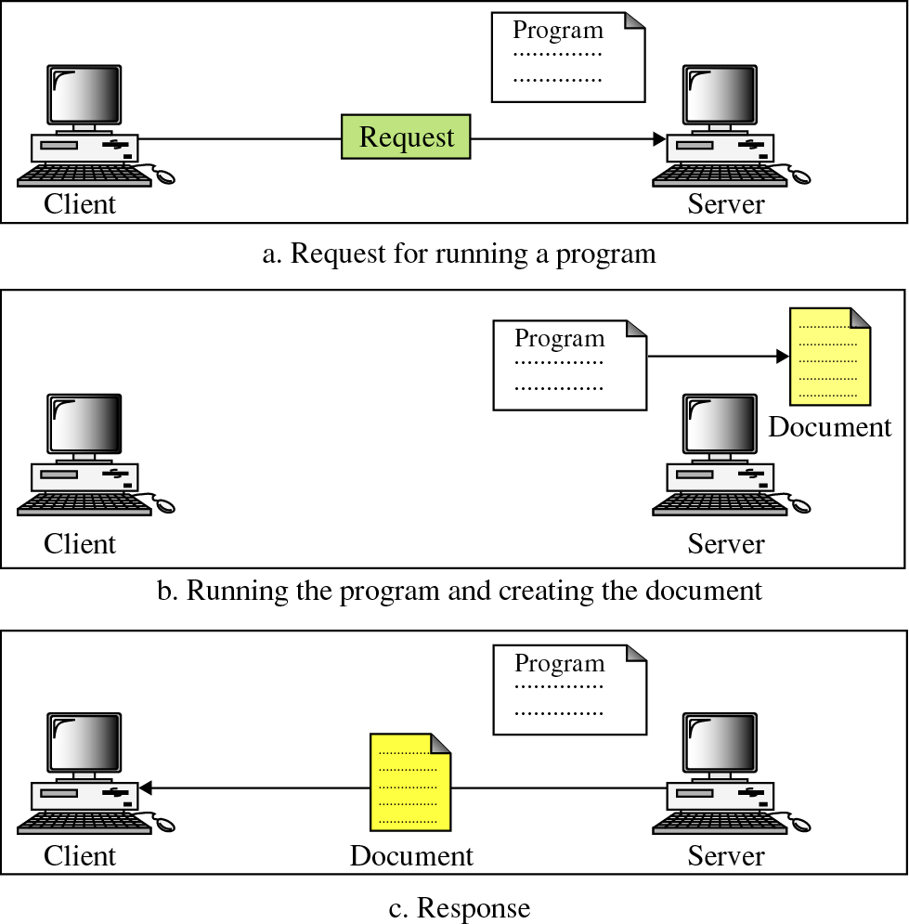
Figure 25-9
Dynamic
document

Slide 17
25.6
COMMON
GATEWAY
INTERFACE
(CGI)

Slide 18
25.7
ACTIVE
DOCUMENTS

Slide 19
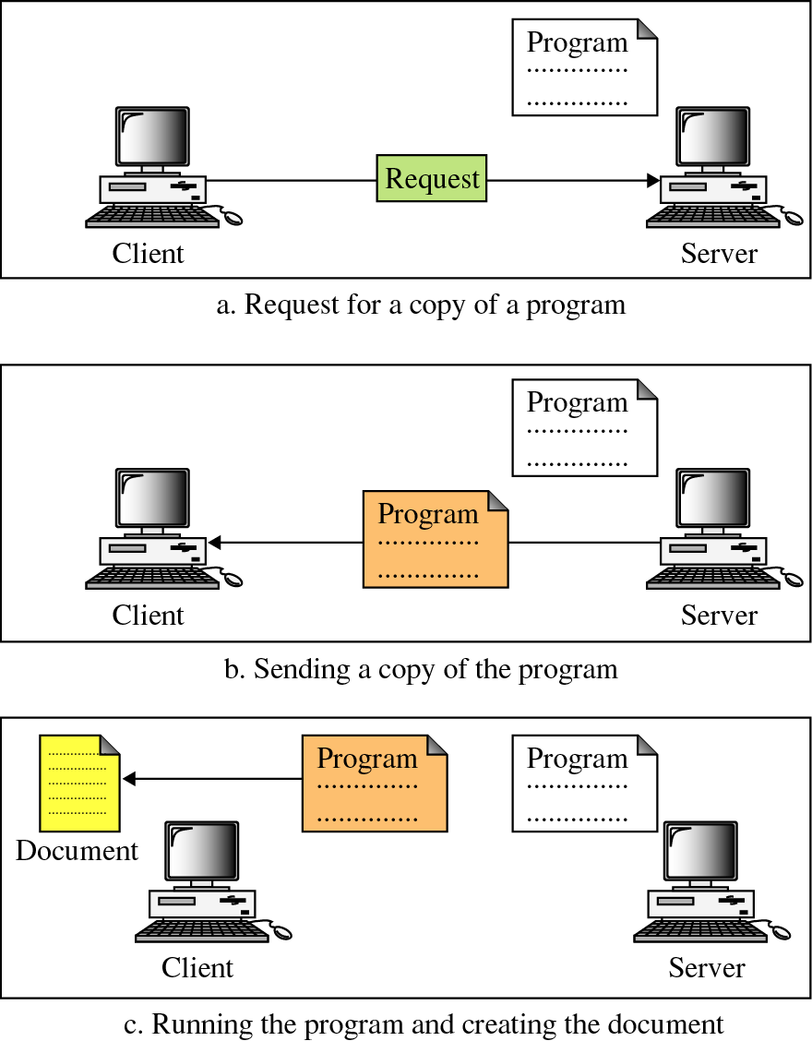
Figure 25-10
Active
document

Slide 20
25.8
JAVA

Slide 21
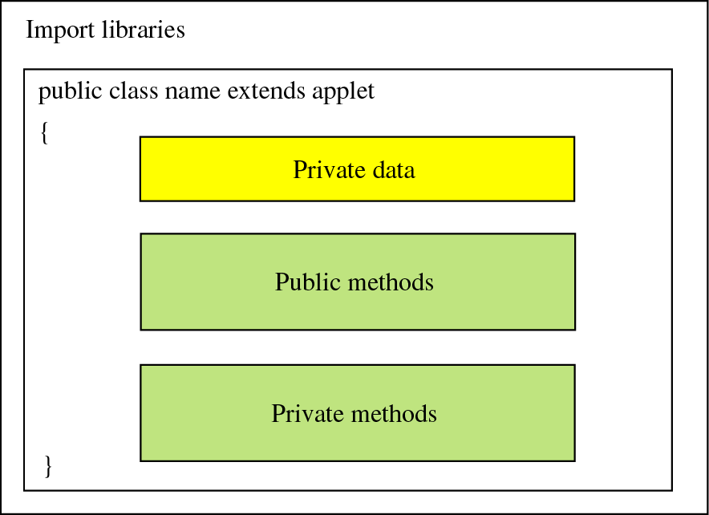
Figure 25-11
Skeleton of an applet

Slide 22
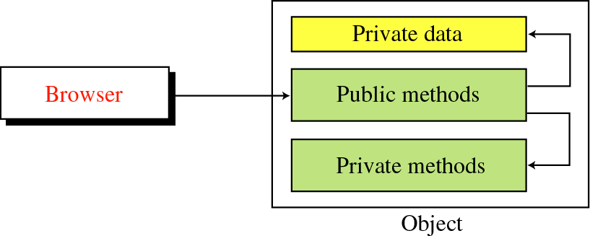
Figure 25-12
Instantiation

Slide 23
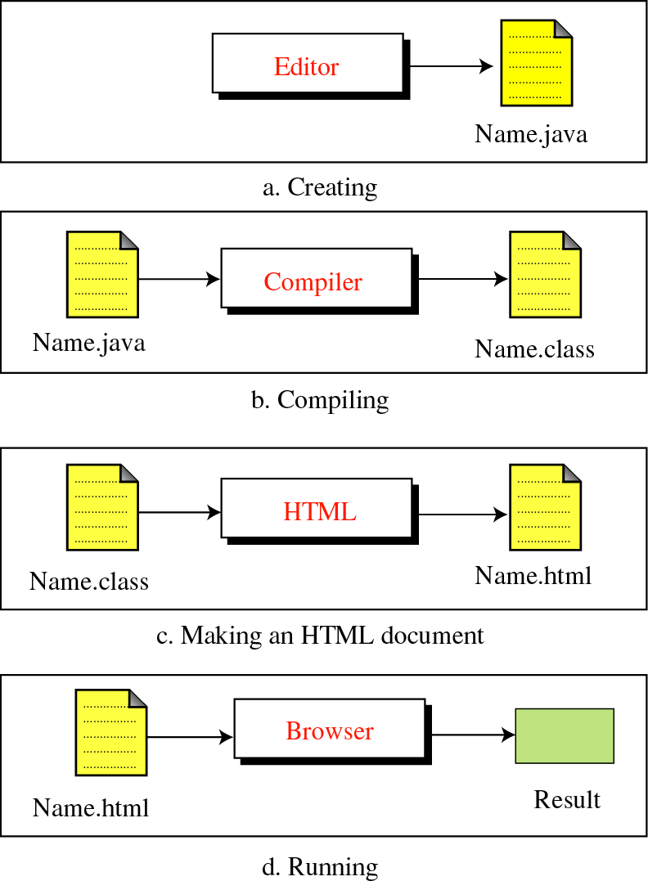
Figure 25-13
Creation and
compilation

Slide 24
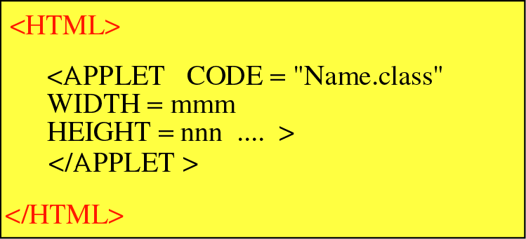
Figure 25-14
HTML document carrying
an applet

