Slide 1
Chapter 26
IP
over
ATM

Slide 2
CONTENTS
ATM WANS
CARRYING A DATAGRAM IN CELLS
ROUTING THE CELLS
ATMARP
LOGICAL IP SUBNET (LIS)

Slide 3
26.1
ATM WANS

Slide 4
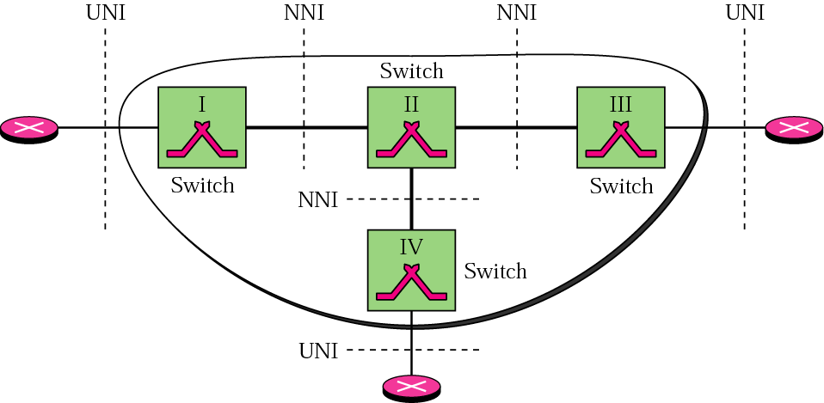
Figure 26-1
An ATM WAN in the Internet

Slide 5
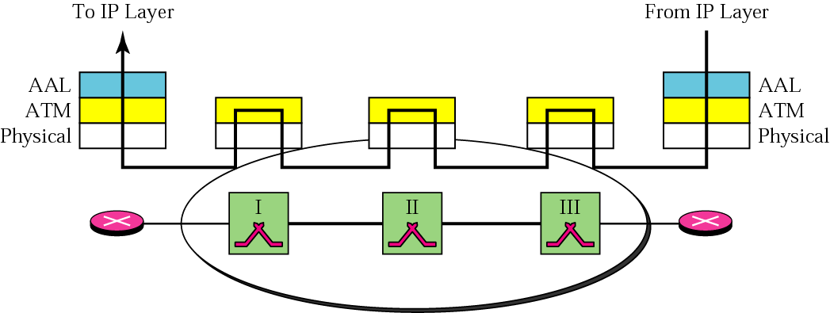
Figure 26-2
ATM layers in routers and switches

Slide 6

End devices such as routers use all
three layers, while switches use
only the bottom two layers.

Slide 7
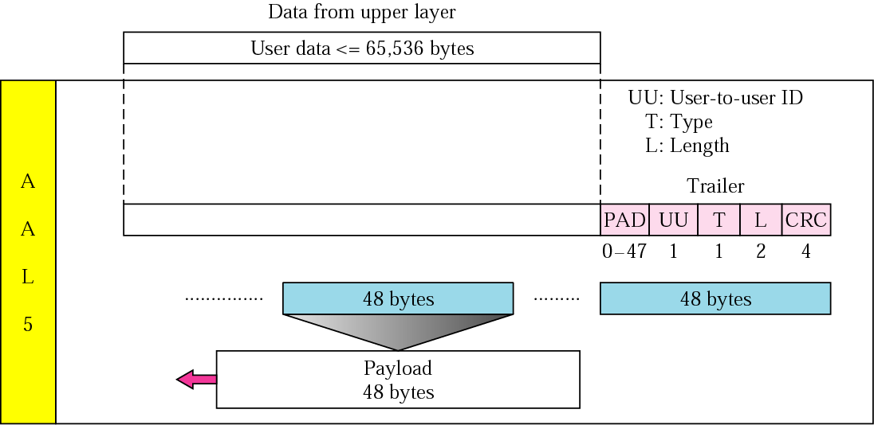
Figure 26-3
AAL5

Slide 8
The AAL layer used by the
IP protocol is AAL5.

Slide 9
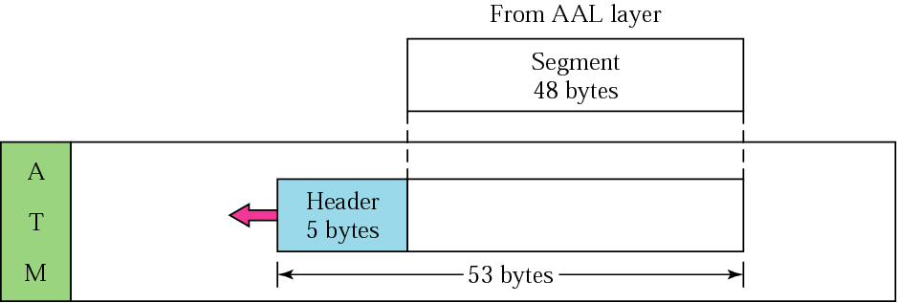
Figure 26-4
ATM layer

Slide 10
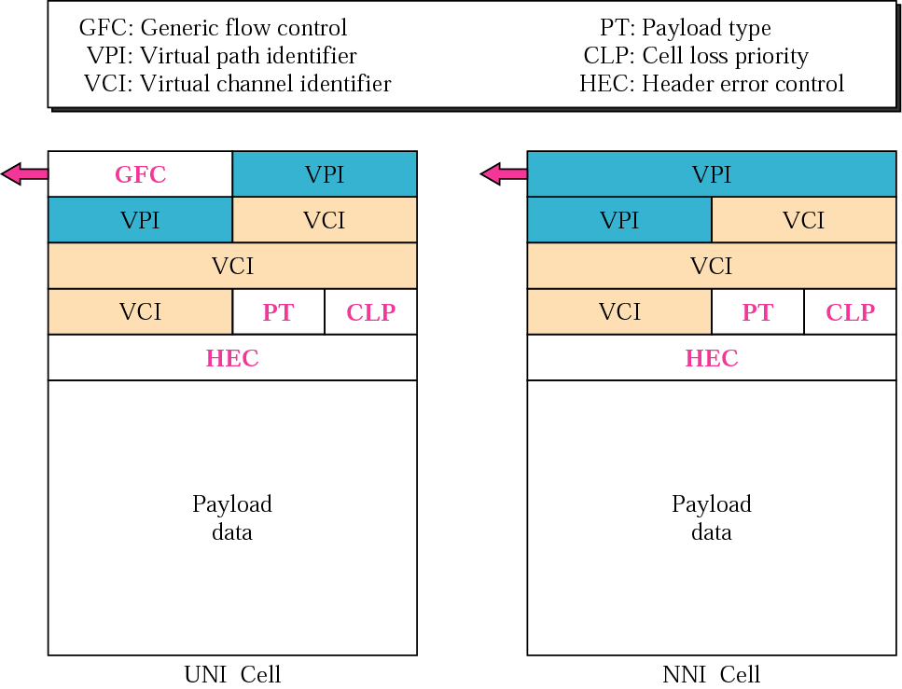
Figure 26-5
ATM headers

Slide 11
26.2
CARRING A
DATAGRAM
IN CELLS

Slide 12
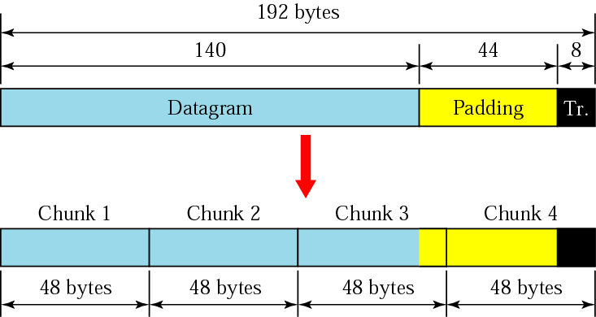
Figure 26-6
Fragmentation

Slide 13
Only the last cell carries
the 8-byte trailer
added to the IP datagram.
Padding can be added only to
the last cell or the last two cells.

Slide 14
The value of the PT field
is 000 in all cells
carrying an IP datagram
fragment except for the last cell;
the value is 001 in the last cell.

Slide 15
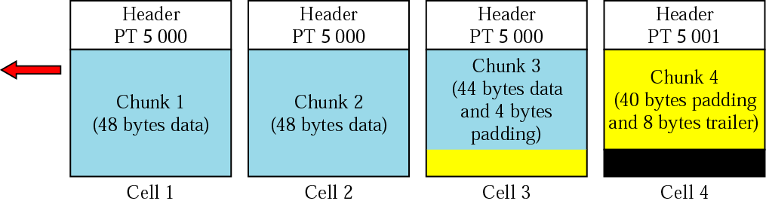
Figure 26-7
ATM cells

Slide 16
26.3
ROUTING
THE
CELLS

Slide 17
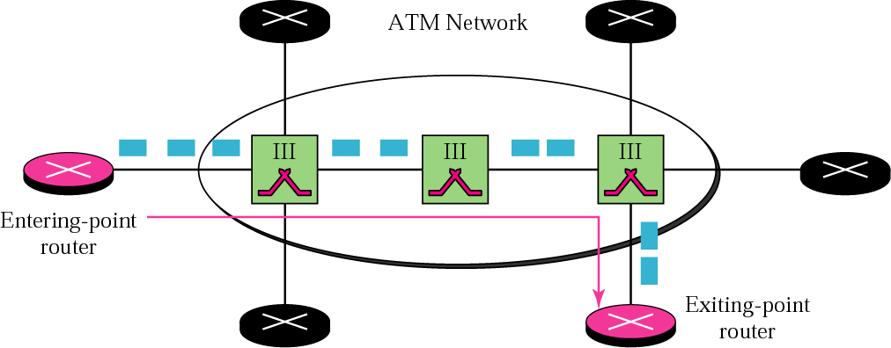
Figure 26-8
Entering-point and exiting-point routers

Slide 18
26.4
ATMARP

Slide 19
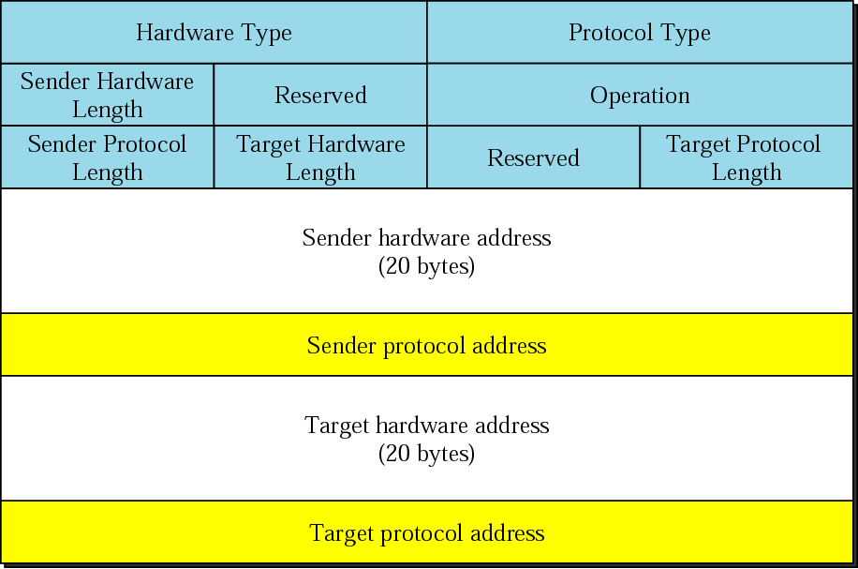
Figure 26-9
ARP packet

Slide 20
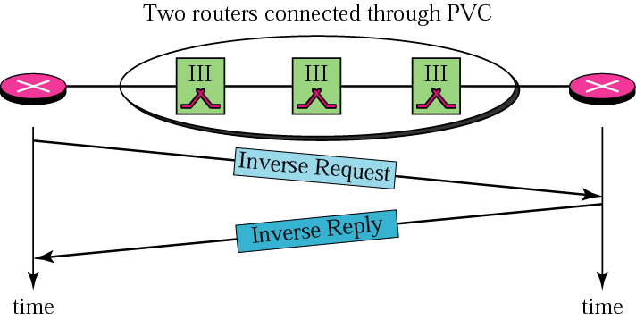
Figure 26-10
Binding with PVC

Slide 21
The inverse request and
inverse reply messages can bind
the physical address
to an IP address in
a PVC situation.

Slide 22
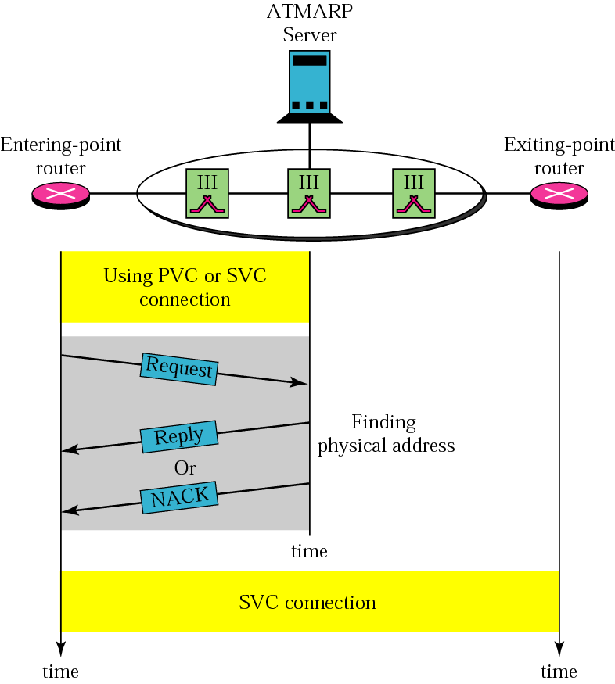
Figure 26-11
Binding with ATMARP

Slide 23
The request and reply
message can be used
to bind a physical address
to an IP address
in an SVC situation.

Slide 24
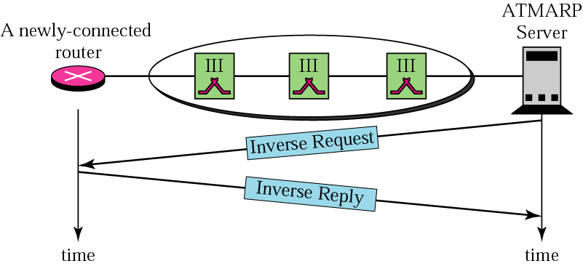
Figure 26-12
Building a table

Slide 25
The inverse request and inverse
reply can also be used to
build the server’s mapping table.

Slide 26
26.5
LOGICAL
IP SUBNET
(LIS)

Slide 27
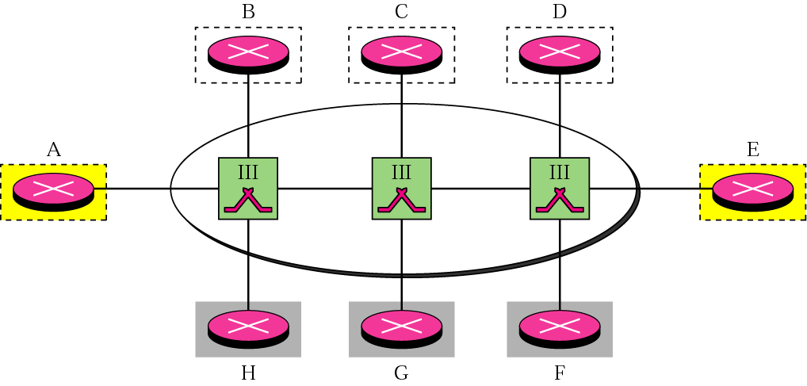
Figure 26-13
LIS

Slide 28
LIS allows an ATM network to
be divided into several logical subnets.
To use ATMARP,
we need a separate
server for each subnet.

