Slide 1
Chapter 28
Real-Time
Traffic
over the
Internet

Slide 2
CONTENTS
CHARACTERISTICS
RTP
RTCP

Slide 3
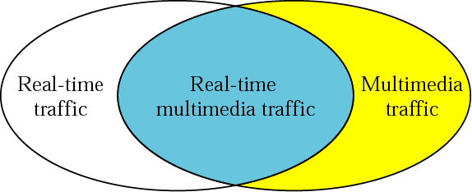
Figure 28-1
Real-time multimedia traffic

Slide 4

In real-time traffic, if we ignore
propagation delay,
the production, transmission,
and use of data takes
place at the same time.

Slide 5
Example 1
An example of non-real-time multimedia traffic is the downloading of a video from the Internet. The video has already been made; it’s a finished product. A client HTTP is used to download the video from an HTTP server and the user views the video at a later time. The production, transmission, and use all happen at different times. Figure 28.2 shows this situation

Slide 6
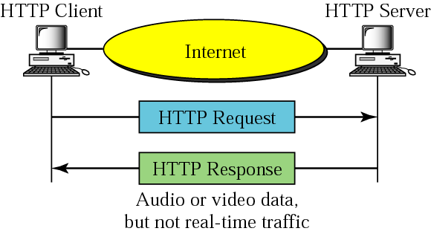
Figure 28-2
Non-real time multimedia traffic

Slide 7
Example 2
Now let us consider an example of real-time multimedia traffic. Consider a video conference in which a camera is connected to a server that transmits video information as it is produced. Everything that happens at the server site can be displayed on the computer at the client site. This is both multimedia (video) and real-time traffic (production and use at the same time). Figure 28.3 shows the situation.

Slide 8
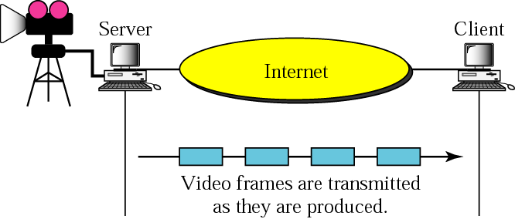
Figure 28-3
Real-time multimedia traffic

Slide 9
28.1
CHARACTERISTICS

Slide 10
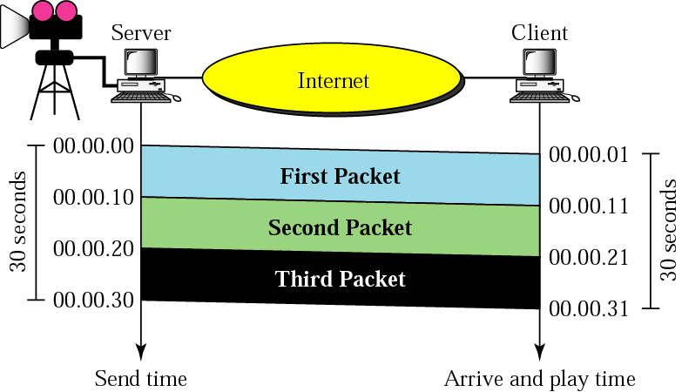
Figure 28-4
Time relationship

Slide 11
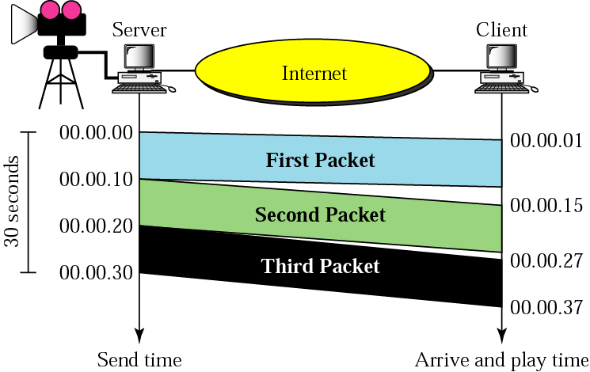
Figure 28-5
Jitter

Slide 12
Jitter is introduced in real-time
data by the
delay between packets.

Slide 13
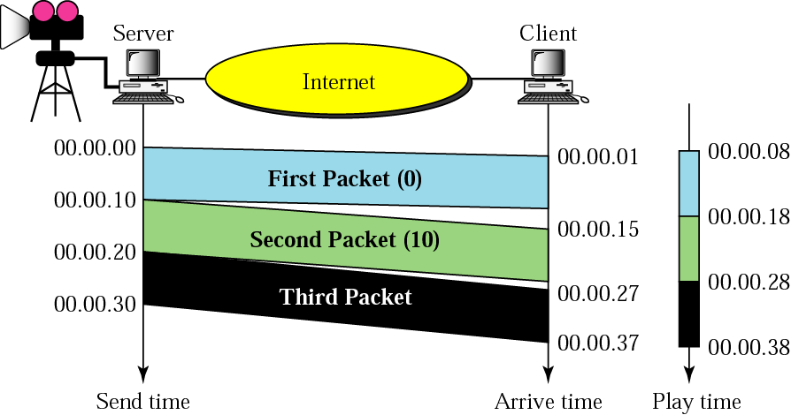
Figure 28-6
Timestamp

Slide 14
To prevent jitter,
we can timestamp the
packets and separate
the arrival time
from the playback time.

Slide 15
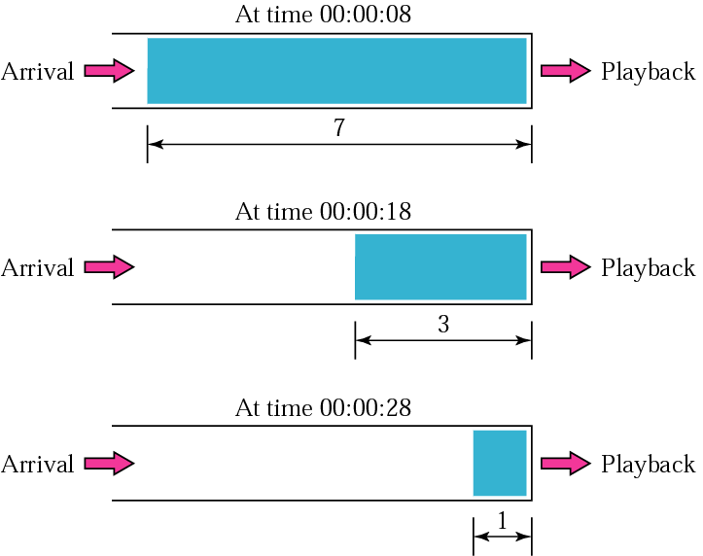
Figure 28-7
Playback buffer

Slide 16
A playback buffer is
required for real-time traffic.

Slide 17
A sequence number on
each packet is
required for real-time traffic.

Slide 18
Real-time traffic needs
the support of multicasting.

Slide 19
Translation means changing the
encoding of a payload to a lower
quality to match the bandwidth
of the receiving network.

Slide 20
Mixing means combining
several streams of traffic
into one stream.

Slide 21
TCP, with all its sophistication,
is not suitable
for real-time multimedia
traffic because
we cannot allow
retransmission of packets.

Slide 22
UDP is more suitable than
TCP for real-time traffic.
However, we need the services of
RTP, another transport layer
protocol to make up the
deficiencies of UDP.

Slide 23
28.2
RTP

Slide 24
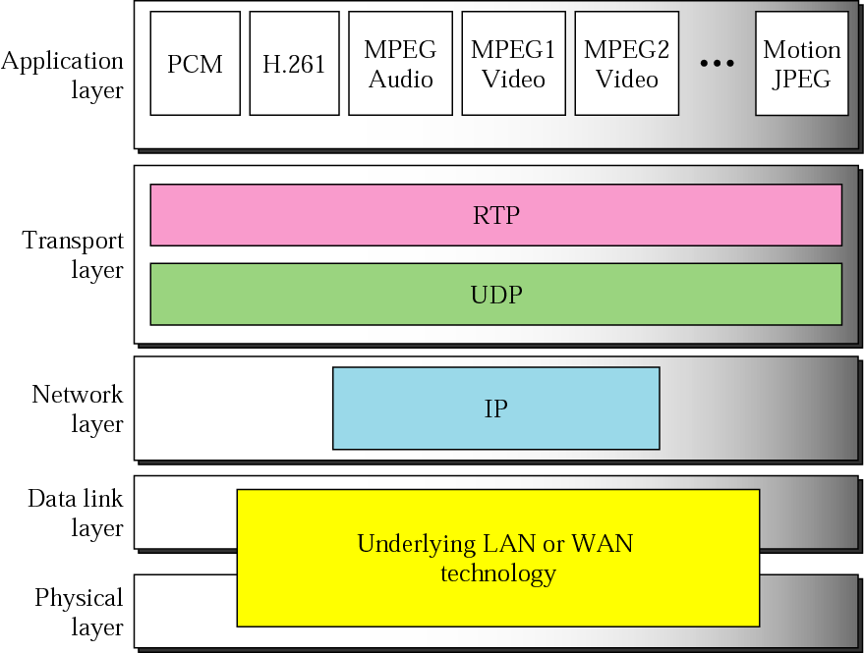
Figure 28-8
RTP

Slide 25
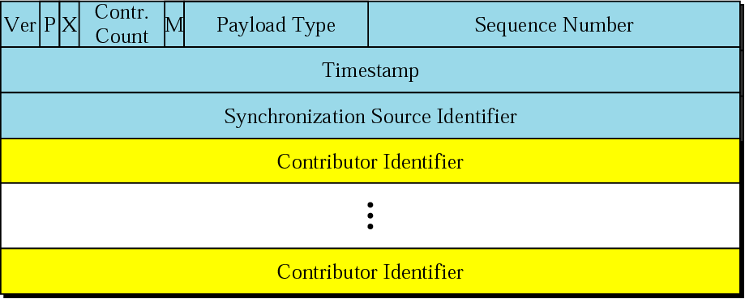
Figure 28-9
RTP packet header format

Slide 26
RTP uses
a temporary even-numbered
UDP port.

Slide 27
28.3
RTCP

Slide 28
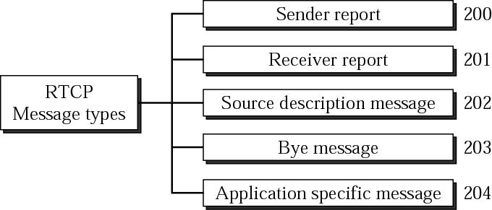
Figure 28-10
RTCP message types

Slide 29
RTCP uses an odd-numbered UDP
port number that follows
the port number selected
for RTP.

