Slide 1
Chapter 29
Internet
Security

Slide 2
CONTENTS
INTRODUCTION
PRIVACY
DIGITAL SIGNATURE
SECURITY IN THE INTERNET
APPLICATION LAYER SECURITY
TRANSPORT LAYER SECURITY: TLS
SECURITY AT THE IP LAYER: IPSEC
FIREWALLS

Slide 3
29.1
INTRODUCTION

Slide 4
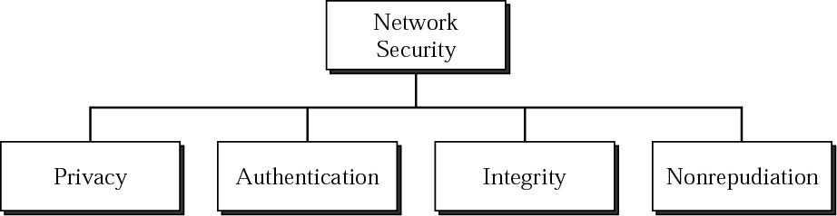
Figure 29-1
Aspects of security

Slide 5
29.2
PRIVACY

Slide 6
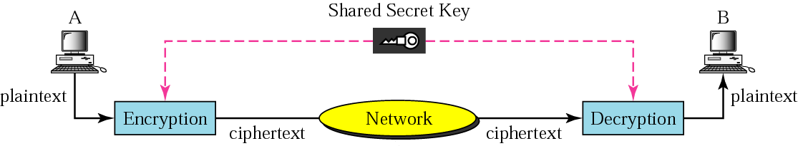
Figure 29-2
Secret-key encryption

Slide 7

In secret-key encryption,
the same key is used by the sender
(for encryption)
and the receiver
(for decryption).
The key is shared.

Slide 8
Secret-key encryption is often called
symmetric encryption because
the same key can
be used in both directions.

Slide 9
Secret-key encryption is
often used for long messages.

Slide 10
We discuss one secret-key
algorithm in Appendix E.

Slide 11
KDC
can solve the problem
of secret-key distribution.

Slide 12
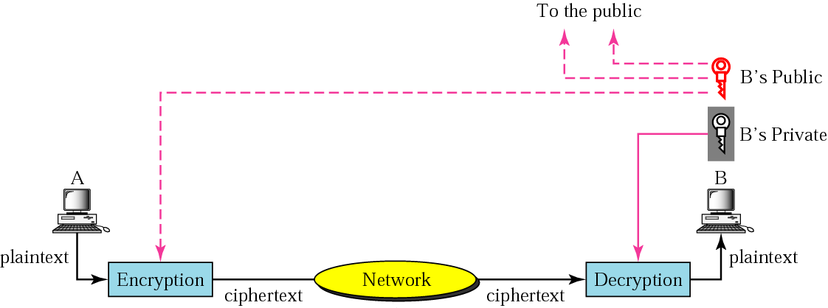
Figure 29-3
Public-key encryption

Slide 13
Public-key algorithms are more
efficient for short messages.

Slide 14
A
CA
can certify the binding between
a public key and the owner.

Slide 15
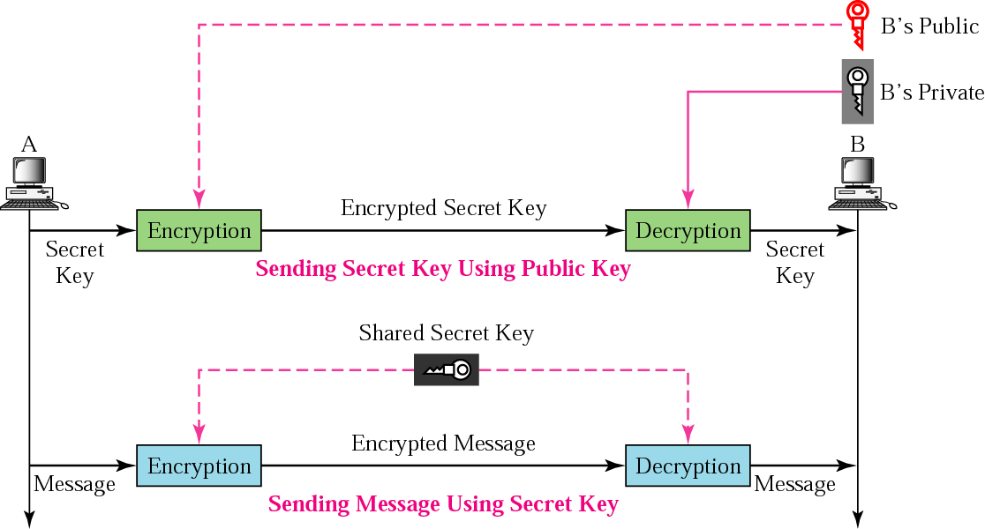
Figure 29-4
Combination

Slide 16
To have the advantages of both
secret-key and public-key
encryption, we can encrypt the secret key
using the public key and encrypt
the message using the secret key.

Slide 17
29.3
DIGITAL SIGNATURE

Slide 18
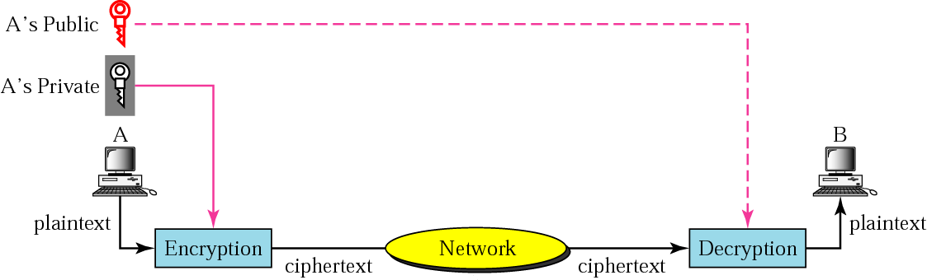
Figure 29-5
Signing the whole document

Slide 19
Digital signature cannot be
achieved using only secret keys.

Slide 20
Digital signature does not
provide privacy.
If there is a need for privacy,
another layer of
encryption/decryption
must be applied.

Slide 21
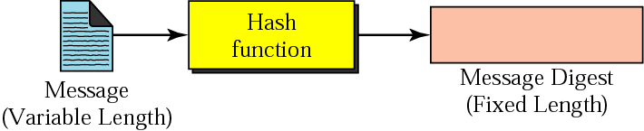
Figure 29-6
Signing the digest

Slide 22
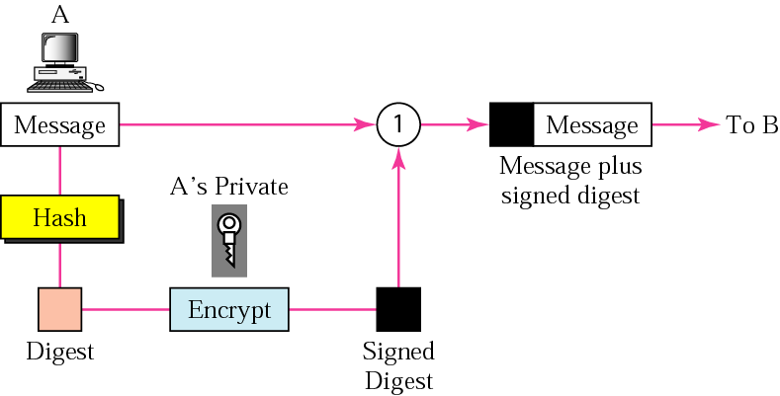
Figure 29-7
Sender site

Slide 23
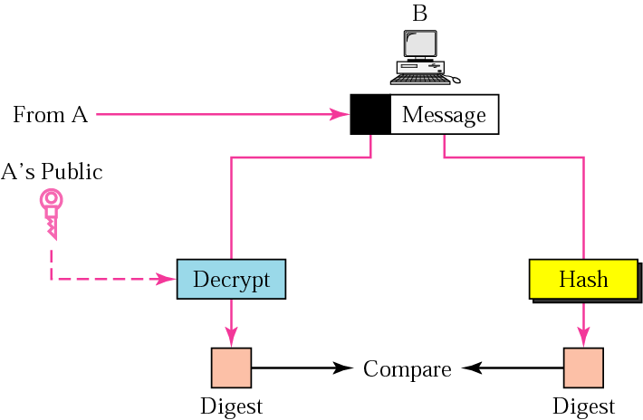
Figure 29-8
Receiver site

Slide 24
29.4
SECURITY IN THE
INTERNET

Slide 25
29.5
APPLICTION LAYER
SECURITY

Slide 26
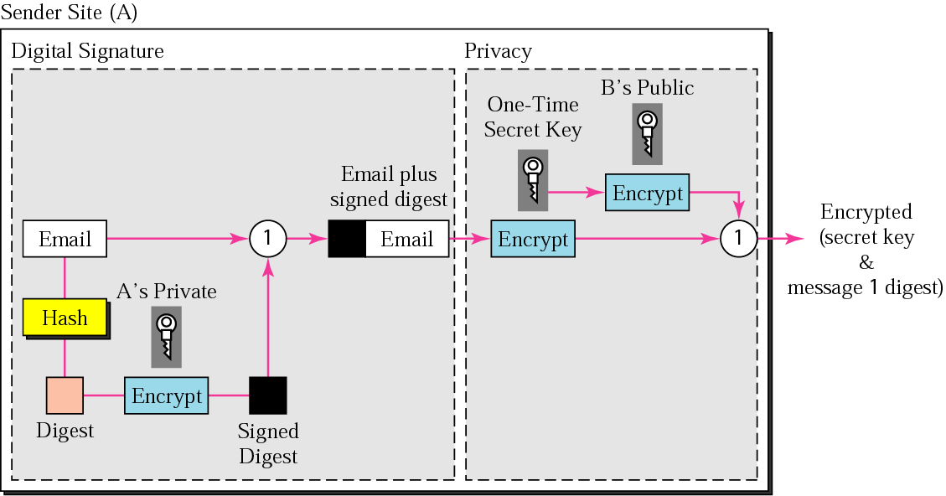
Figure 29-9
PGP at the sender site

Slide 27
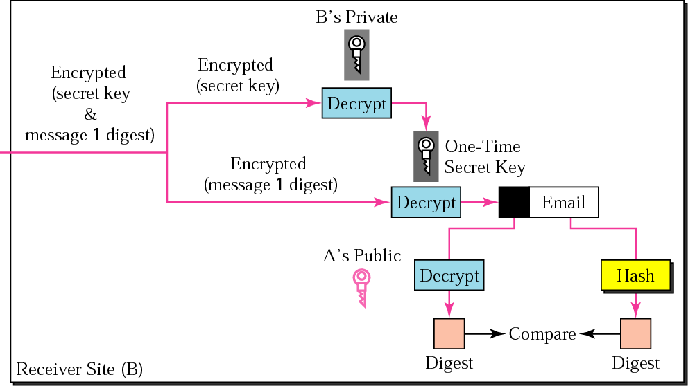
Figure 29-10
PGP at the receiver site

Slide 28
29.6
TRANSPORT LAYER
SECURITY
(TLS)

Slide 29
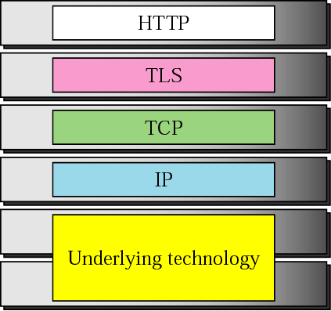
Figure 29-11
Position of TLS

Slide 30
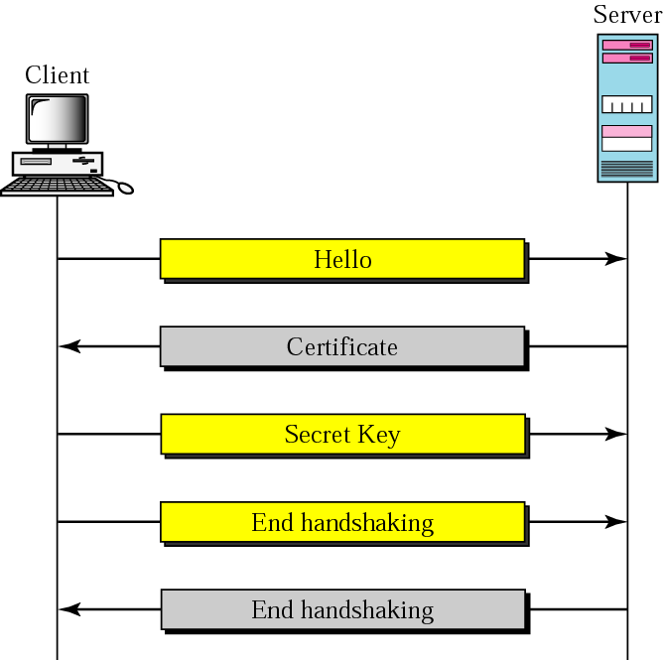
Figure 29-12
Handshake protocol

Slide 31
29.7
SECURITY AT THE
IP LAYER
(IPSec)

Slide 32
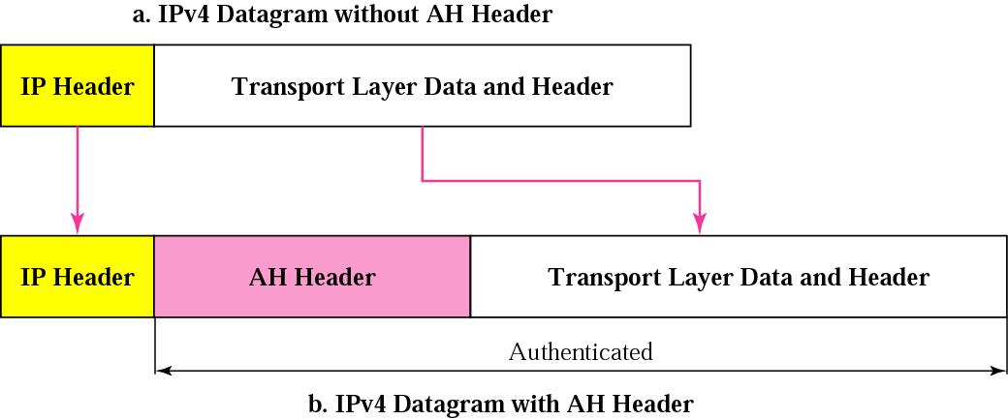
Figure 29-13
Authentication

Slide 33
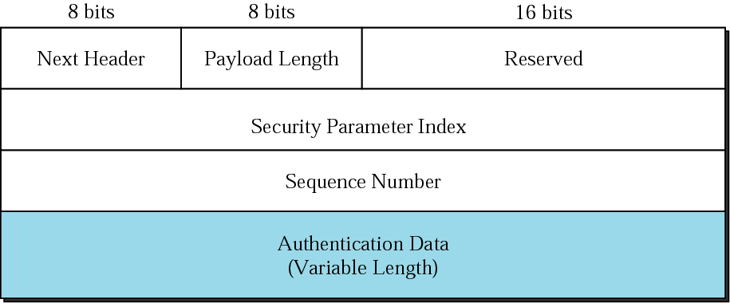
Figure 29-14
Header format

Slide 34
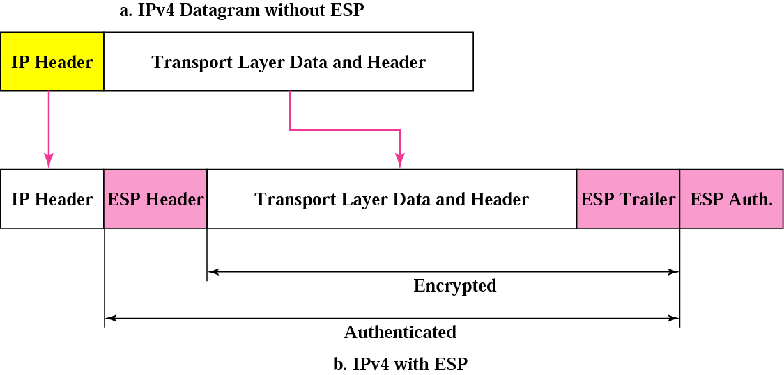
Figure 29-15
ESP

Slide 35
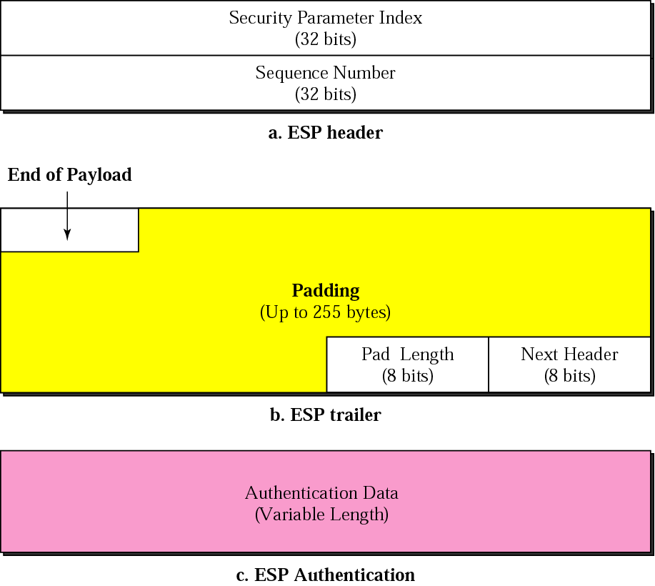
Figure 29-16
ESP format

Slide 36
29.8
FIREWALLS

Slide 37
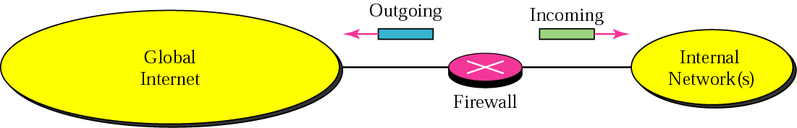
Figure 29-17
Firewall

Slide 38
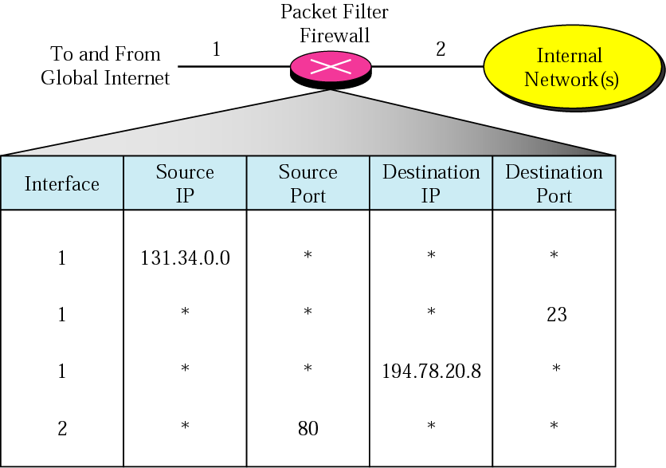
Figure 29-18
Packet-filter firewall

Slide 39
A packet-filter firewall filters
at the network or transport layer.

Slide 40
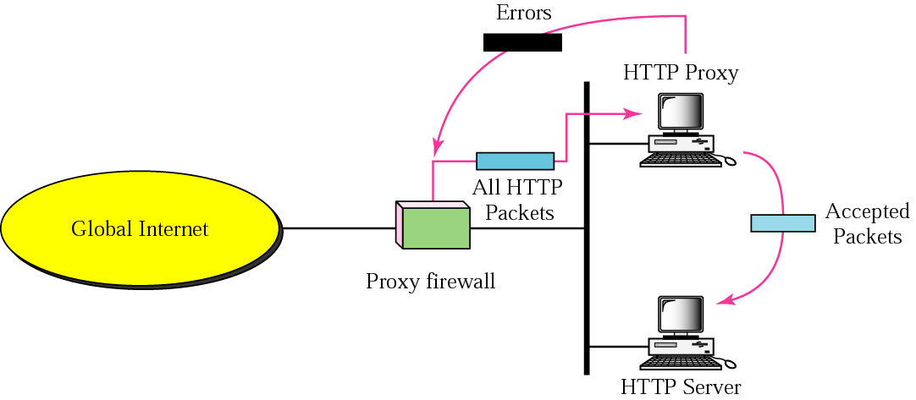
Figure 29-19
Proxy firewall

Slide 41
A proxy firewall
filters at the application layer.

