Slide 1
Chapter 31
Next Generation:
IPv6
and
ICMPv6

Slide 2
CONTENTS
IPv6
IPv6 ADDRESSES
IPv6 PACKET FORMAT
ICMPv6
TRANSITION FROM IPv4 TO IPv6

Slide 3
31.1
IPv6

Slide 4
31.2
IPv6 ADDRESSES

Slide 5
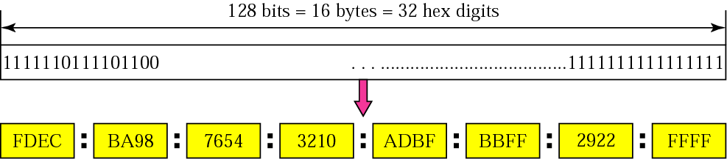
Figure 31-1
IPv6 address

Slide 6
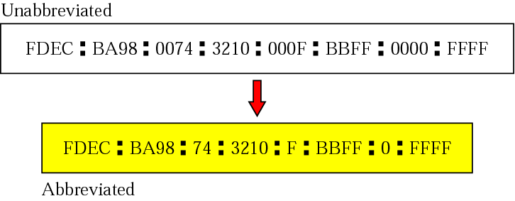
Figure 31-2
Abbreviated address

Slide 7
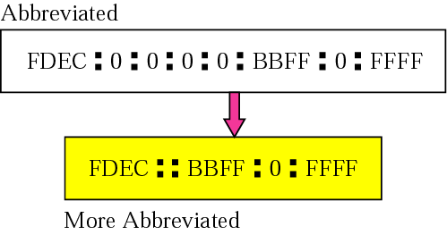
Figure 31-3
Abbreviated address with consecutive zeros

Slide 8

Figure 31-4
CIDR address

Slide 9
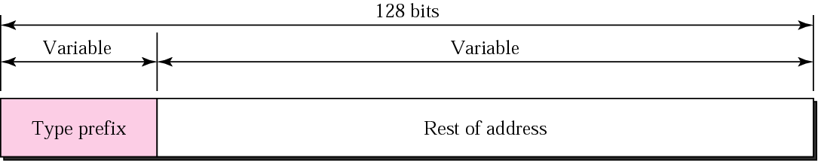
Figure 31-5
Address structure

Slide 10
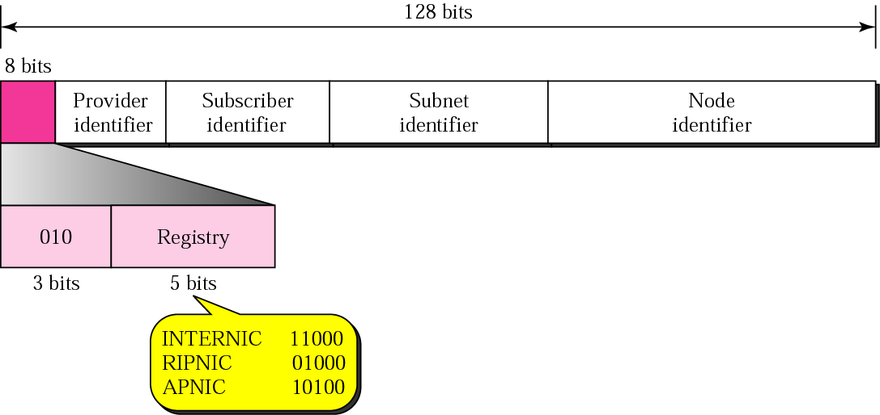
Figure 31-6
Provider-based address

Slide 11
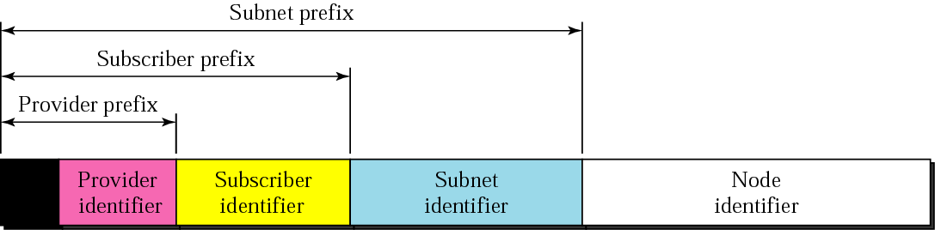
Figure 31-7
Address hierarchy

Slide 12

Figure 31-8
Unspecified address

Slide 13

Figure 31-9
Loopback address

Slide 14
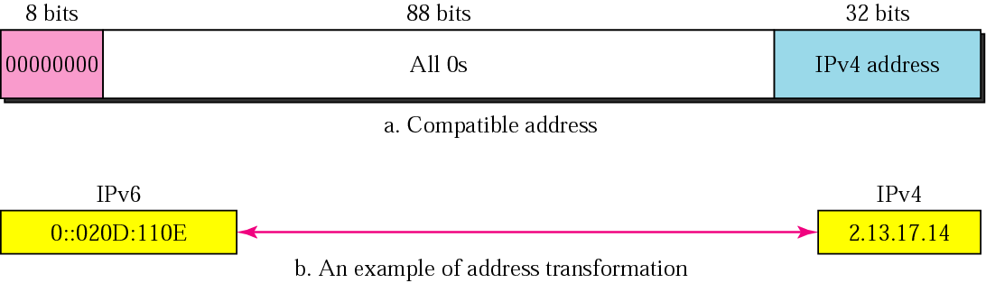
Figure 31-10
Compatible address

Slide 15
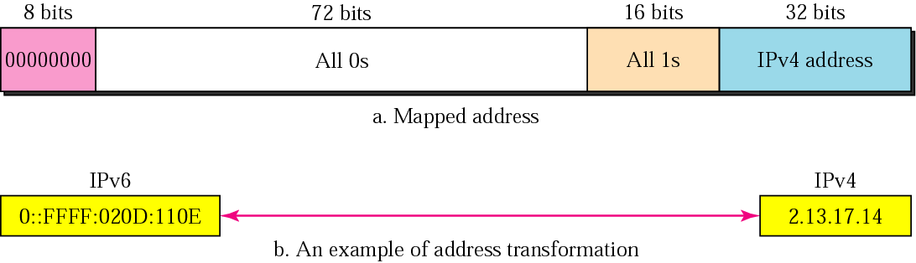
Figure 31-11
Mapped address

Slide 16
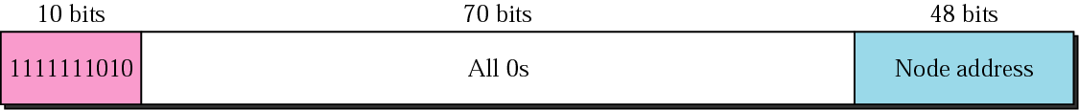
Figure 31-12
Link local address

Slide 17
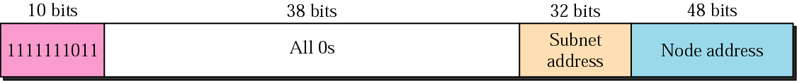
Figure 31-13
Site local address

Slide 18
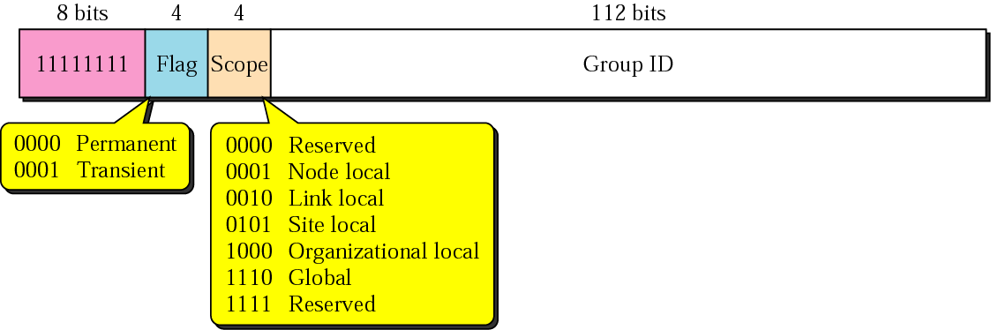
Figure 31-14
Multicast address

Slide 19
31.3
IPv6 PACKET FORMAT

Slide 20
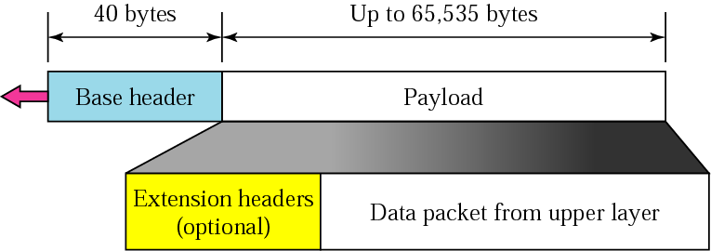
Figure 31-15
IPv6 datagram

Slide 21
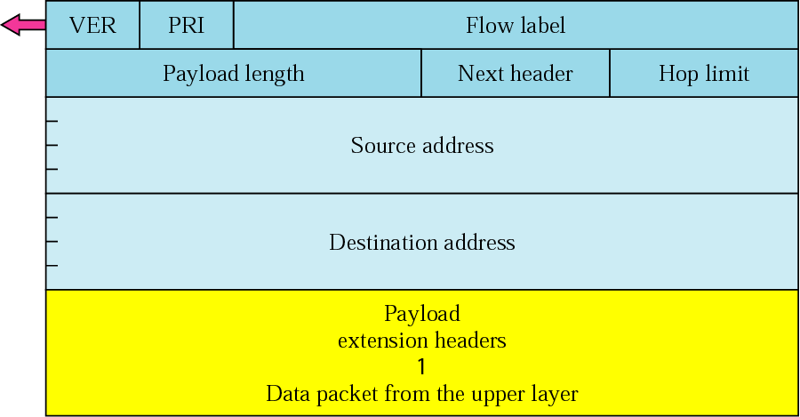
Figure 31-16
Format of an IPv6 datagram

Slide 22
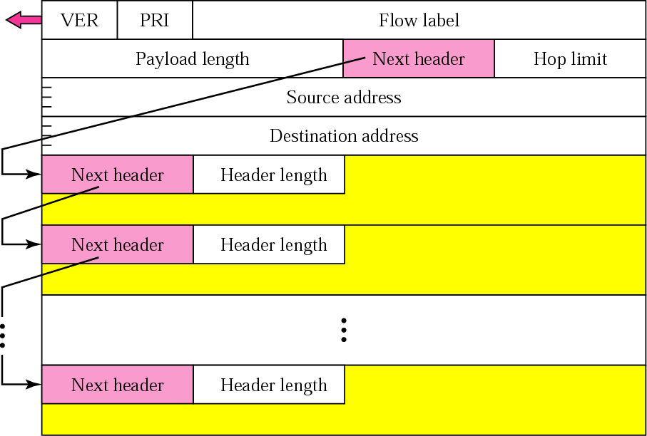
Figure 31-17
Extension header format

Slide 23
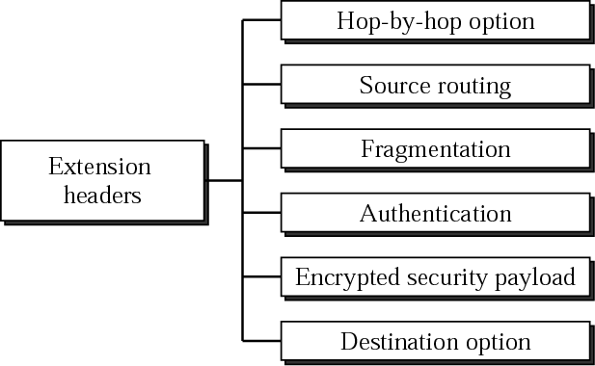
Figure 31-18
Extension header types

Slide 24

Figure 25-19
Hop-by-hop option header format

Slide 25
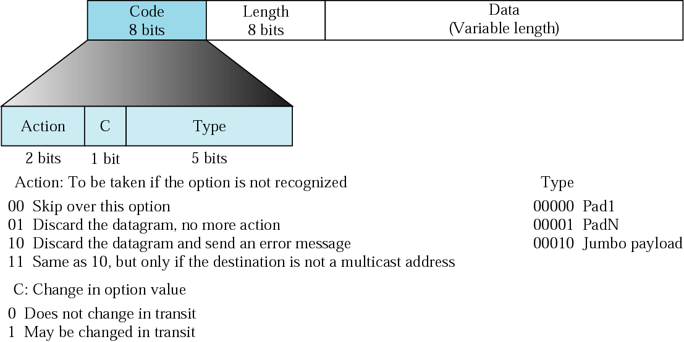
Figure 31-20
The format of options in a
hop-by-hop option header

Slide 26
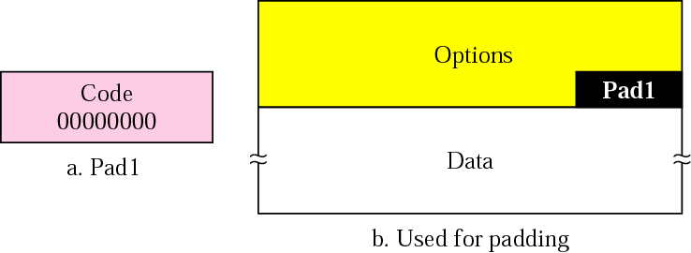
Figure 31-21
Pad 1

Slide 27

Figure 31-22
Pad N

Slide 28

Figure 31-23
Jumbo payload

Slide 29
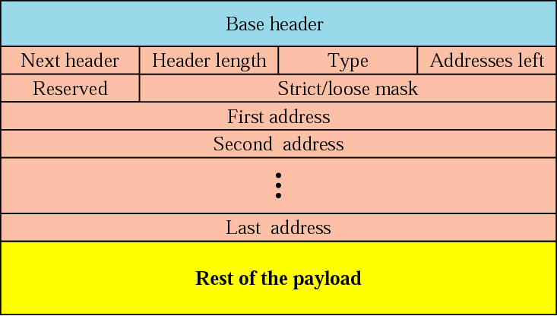
Figure 31-24
Source routing

Slide 30
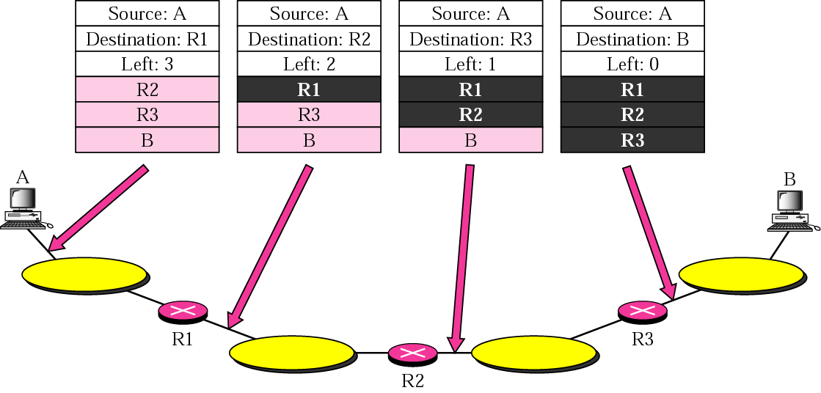
Figure 31-25
Source routing example

Slide 31
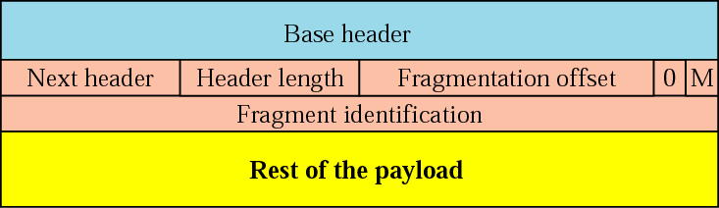
Figure 31-26
Fragmentation

Slide 32
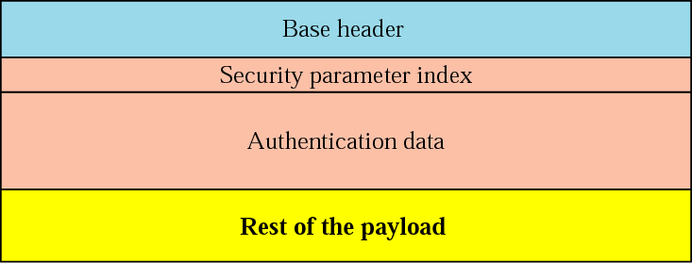
Figure 31-27
Authentication

Slide 33
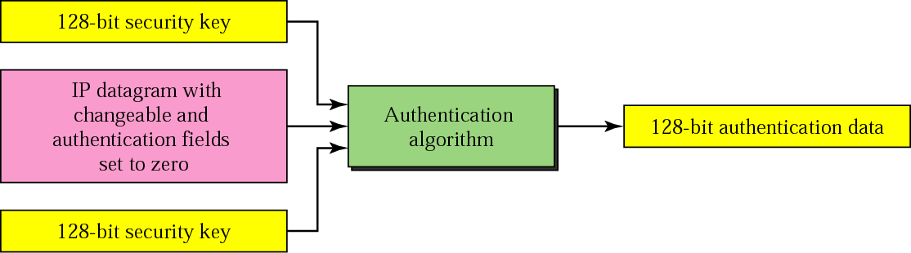
Figure 31-28
Calculation of authentication data

Slide 34

Figure 31-29
Encrypted security payload

Slide 35
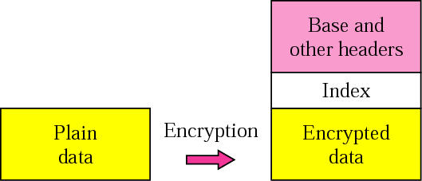
Figure 31-30
Transport mode encryption

Slide 36
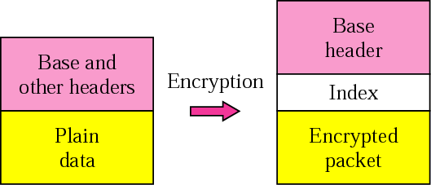
Figure 31-31
Tunnel-mode encryption

Slide 37
31.4
ICMPv6

Slide 38
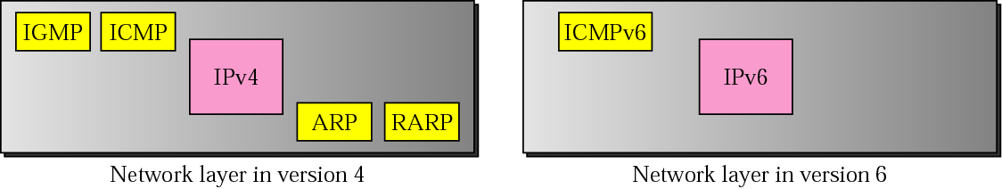
Figure 31-32
Comparison of network layers in
version 4 and version 6

Slide 39
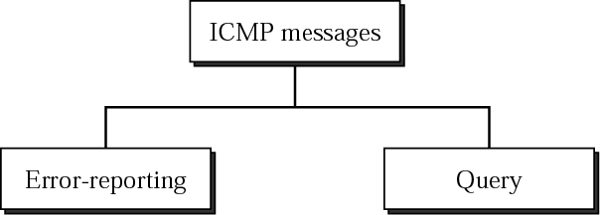
Figure 31-33
Categories of ICMPv6 messages

Slide 40
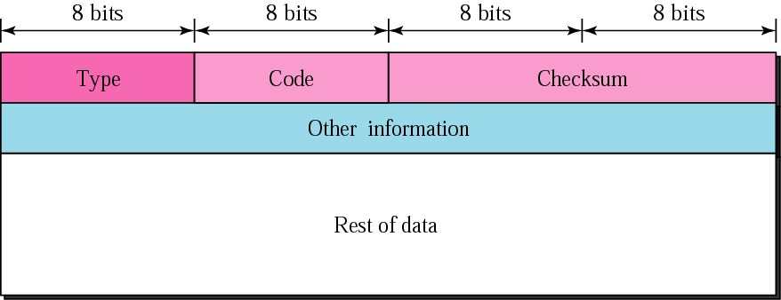
Figure 31-34
General format of ICMPv6 messages

Slide 41
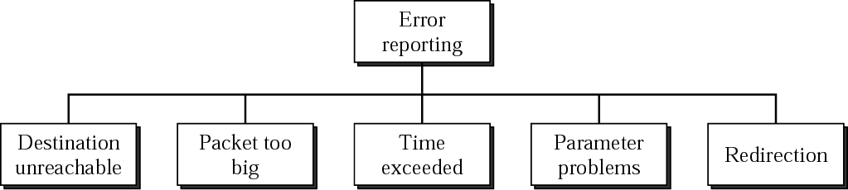
Figure 31-35
Error-reporting messages

Slide 42
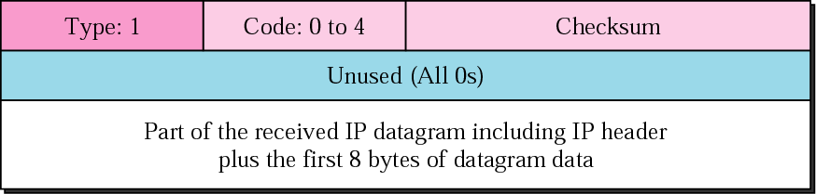
Figure 31-36
Destination-unreachable message format

Slide 43
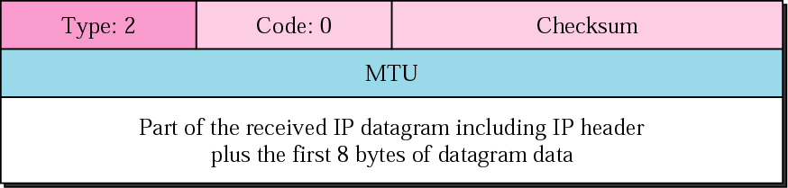
Figure 31-37
Packet-too-big message format

Slide 44
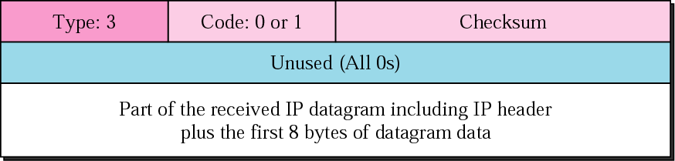
Figure 31-38
Time-exceeded message format

Slide 45
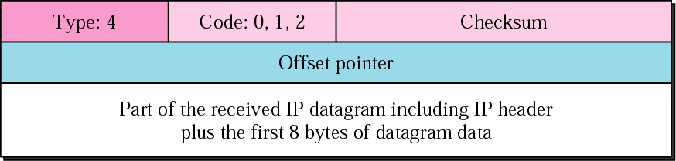
Figure 31-39
Parameter-problem message format

Slide 46
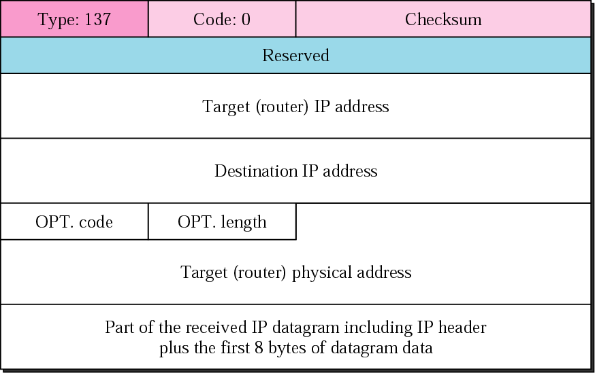
Figure 31-40
Redirection message format

Slide 47
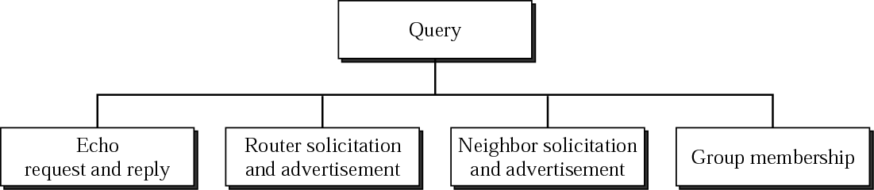
Figure 31-41
Query messages

Slide 48
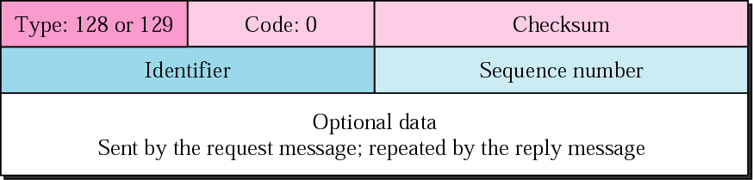
Figure 31-42
Echo request and reply messages

Slide 49
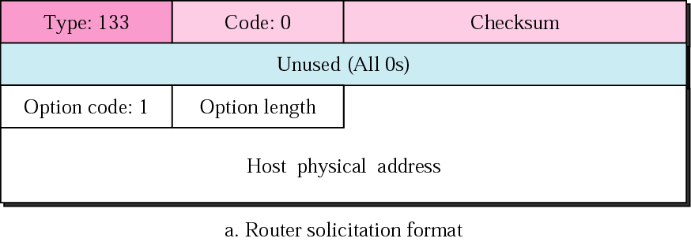
Figure 31-43.a
Router-solicitation message

Slide 50
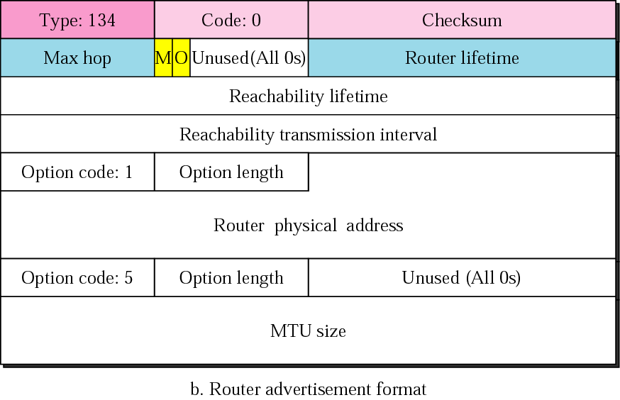
Figure 31-43.b
Router advertisement message

Slide 51
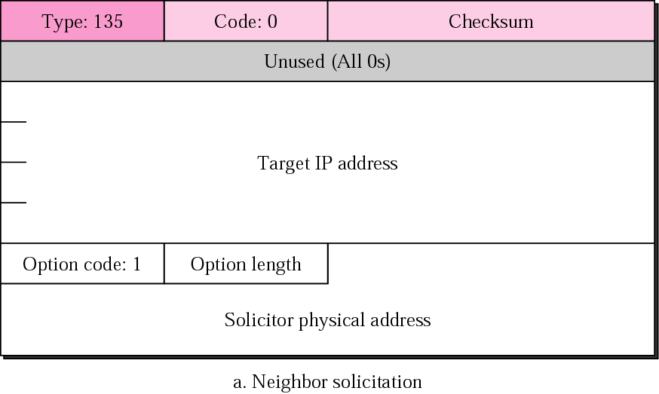
Figure 31-44, Part I
Neighbor-solicitation message

Slide 52
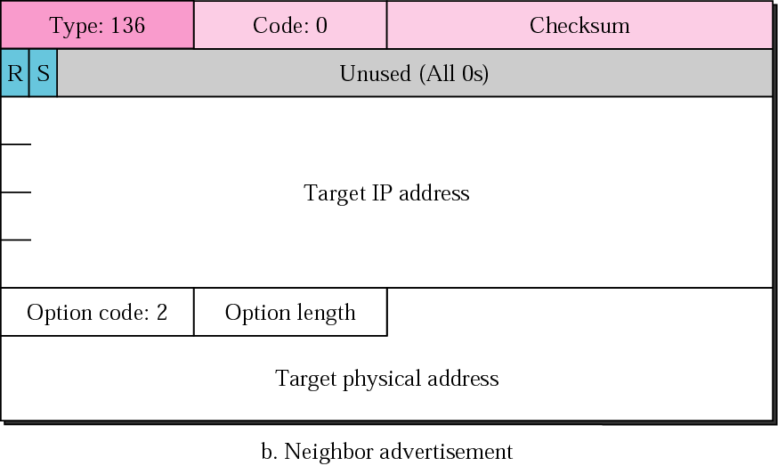
Figure 31-44, Part II
Neighbor-advertisement message

Slide 53
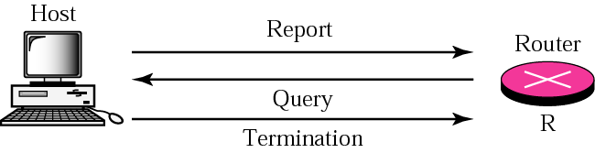
Figure 31-45
Group-membership messages

Slide 54
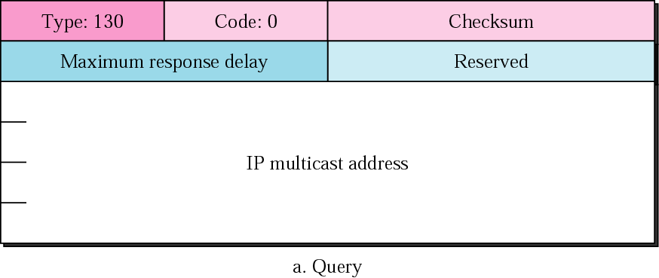
Figure 31-46.a
Group-membership message formats
(query)

Slide 55
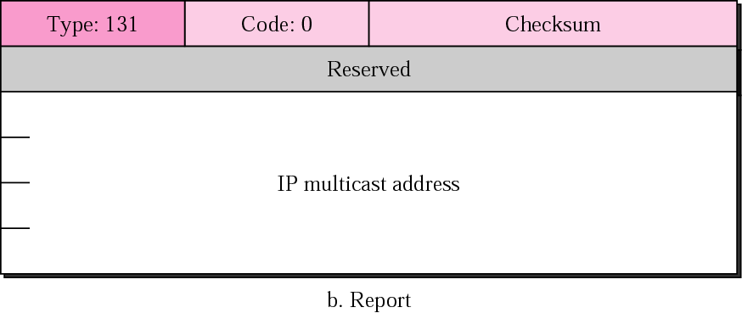
Figure 31-46.b
Group-membership message formats
(report)

Slide 56
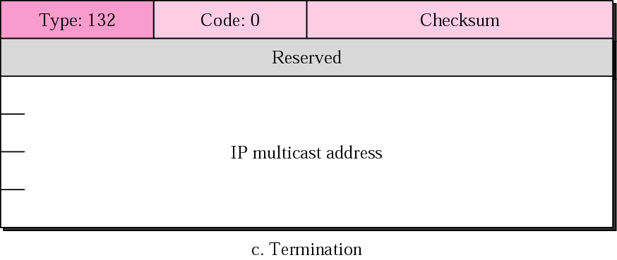
Figure 31-46.c
Group-membership message formats
(termination)

Slide 57
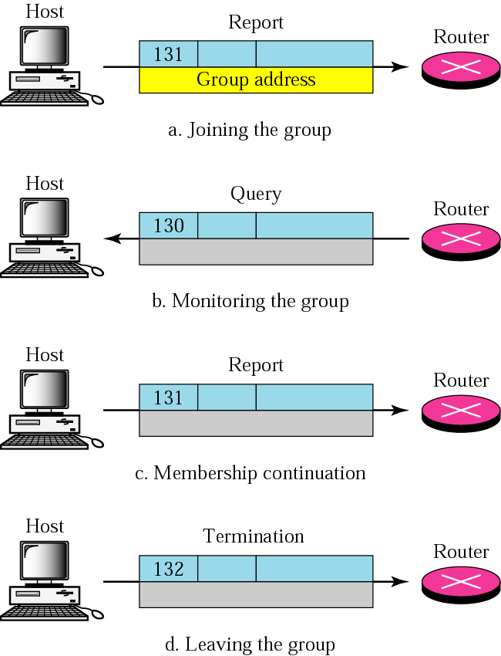
Figure 31-47
Four situations
of group-membership
operation

Slide 58
31.5
TRANSITION FROM
IPv4 TO IPv6

Slide 59
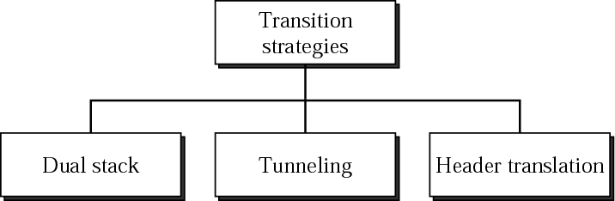
Figure 31-48
Three transition strategies

Slide 60
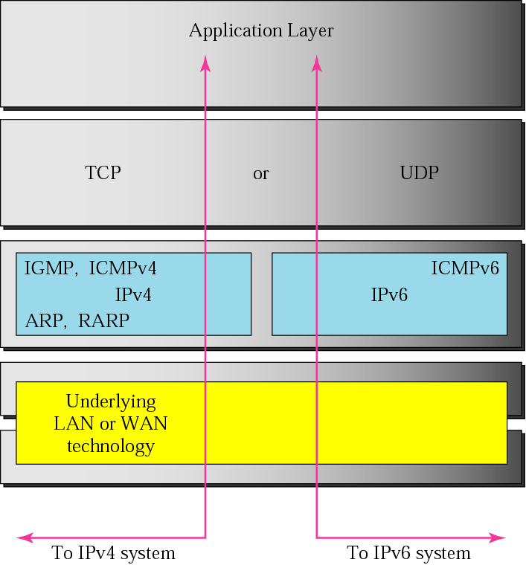
Figure 31-49
Dual stack

Slide 61
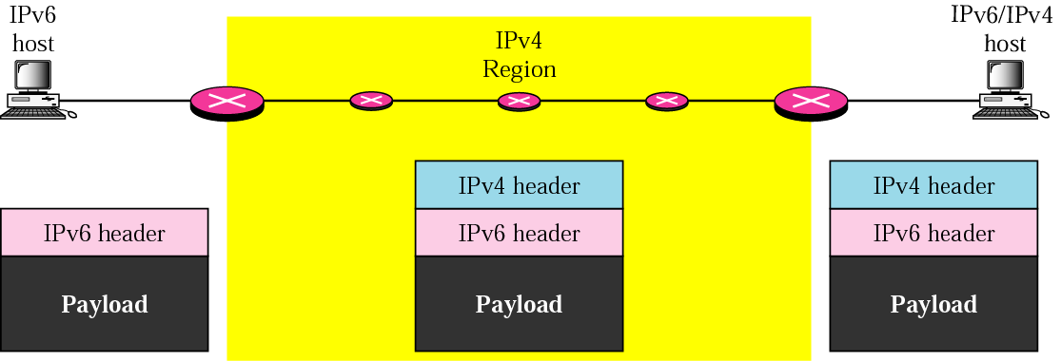
Figure 31-50
Automatic tunneling

Slide 62
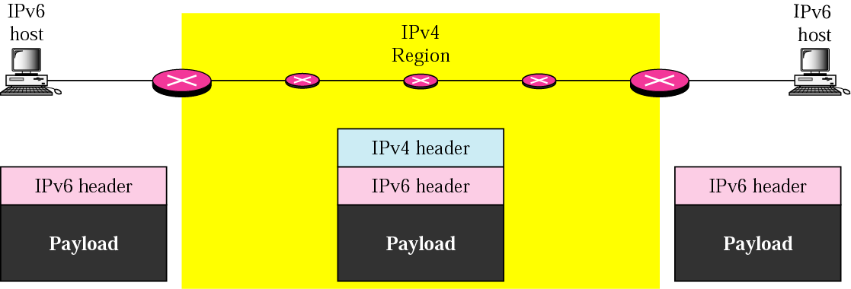
Figure 31-51
Configured tunneling

Slide 63
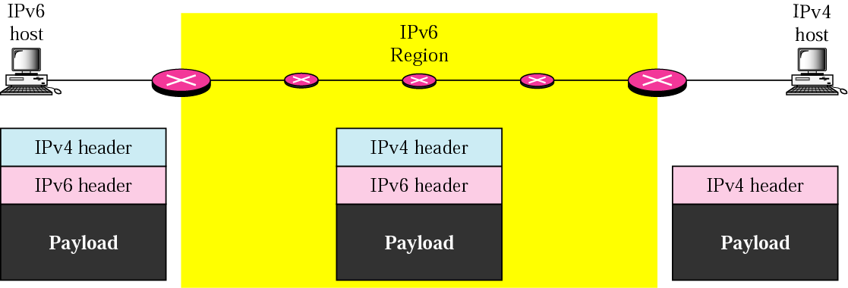
Figure 31-52
Header translation

