Slide 1
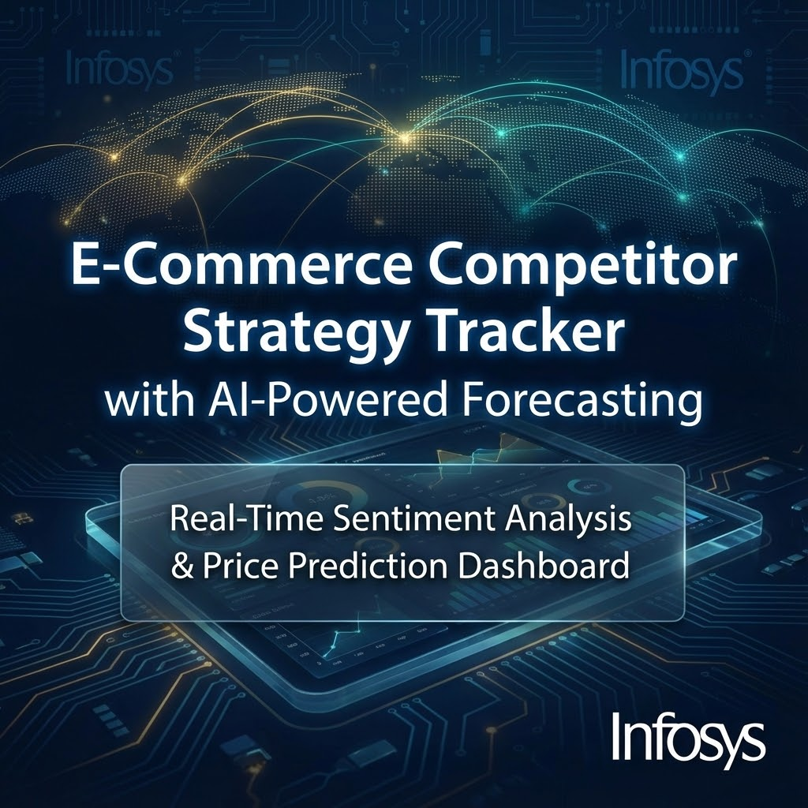
Presented by: DANAVASAN V
Mentor: Bhargavesh Dakka
Company: Infosys

Slide 2
Agenda
Problem Statement: E-commerce pricing and sentiment tracking challenges.
Domain & Dataset: E-commerce knowledge; iPhone 14 pricing/review data.
EDA: Time series price and sentiment review analysis.
Statistical Analysis: Stationarity testing (ADF, KPSS); Model selection.
AI Models & Forecasting: Chronos (Amazon) & Prophet (Meta) for forecasting; Llama 3.3 70B for sentiment.
Evaluation & Results: Performance metrics (MAPE, RMSE, MAE, R²); Chronos achieved 0.38% MAPE.
Dashboard Demo & Features.
Business Impact & Future Work.

Slide 3
Problem Statement
Challenges in E-Commerce Competitor Tracking
1️⃣ Price Inconsistency
iPhone 14 prices vary across platforms (Amazon, Flipkart, etc.).
Customers can't compare real-time prices or predict future price drops.
2️⃣ Sentiment Uncertainty
Thousands of reviews lack aggregated sentiment analysis.
Customers struggle to quickly assess product reputation; manual review reading is slow.
3️⃣ Lack of Forecasting Tools
No AI for price predictions or rating trend analysis.
Competitors' pricing strategies are unclear.
💡 Solution: An AI dashboard providing real-time sentiment analysis and price forecasting for informed purchases.

Slide 4
Domain Knowledge: E-Commerce Industry
E-Commerce Dynamics:
📊 Dynamic Pricing: Prices shift based on demand, competition, and inventory (includes flash sales/discounts).
💬 Review-Driven Trust: Customer ratings (1-5 stars) and sentiment affect purchasing and product reputation.
🔄 Cross-Platform Competition: Price wars and platform-specific offers/cashback between major platforms (e.g., Amazon vs Flipkart).
📈 Time Series Nature: Prices show temporal dependency (price at T influences T+1) and sequential, step-function patterns.
Why iPhone 14?
✅ High-value product (₹54,900 - ₹59,900)
✅ Frequent price changes in a competitive market
✅ Rich review data for sentiment analysis

Slide 5
Dataset Overview
DATA QUALITY
✅ No missing values
✅ Date format standardized
✅ Outliers detected & analyzed
✅ Clean data ready for modeling
📈 TIME SERIES PRICE DATA | 💬 CUSTOMER REVIEWS
Source: Scraped Amazon iPhone 14 pricing | Source: Flipkart iPhone 14 reviews
Records: 302 data points | Records: 61 customer reviews
Duration: Sept 2024 - Nov 2025 (447 days) | Features: review_text, rating, review_length
Features: date, current_price, rating, disc_ptg | Rating Range: 3.0 - 5.0 stars
Price Range: ₹54,900 - ₹59,900 | Purpose: Sentiment analysis using Llama 3.3 70B

Slide 6
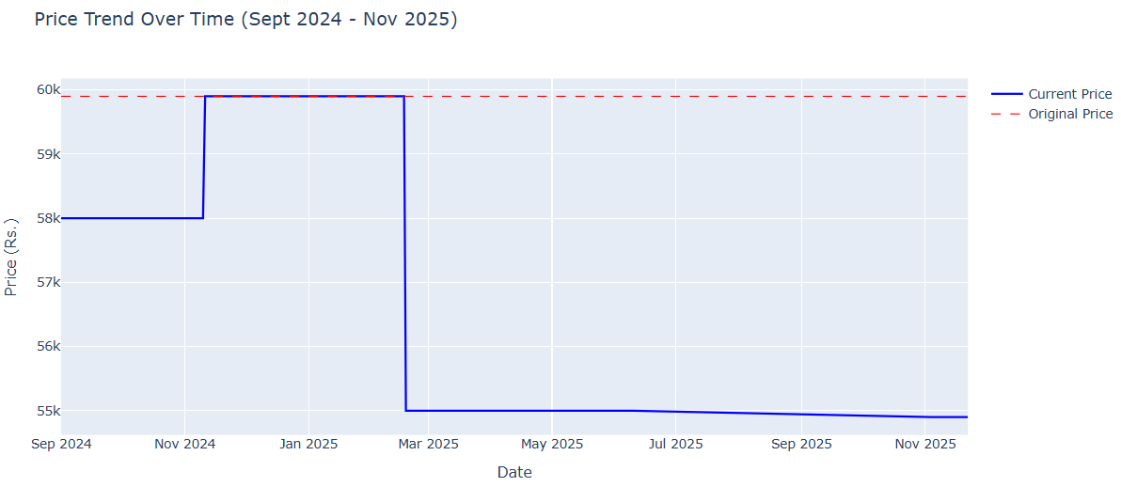
Exploratory Data Analysis: Time Series Price Data
INFERENCE:
Price has clear temporal dependencies (–5.34% overall trend), violating the independence assumption of traditional ML models. Time series models, Chronos (zero-shot learning for irregular patterns) and Prophet (interpretable trend/seasonality decomposition), were chosen. Both are suitable for sequential data and avoid the manual parameter tuning needed for ARIMA/SARIMA.

Slide 7
Exploratory Data Analysis: Time Series Price Data
📊 Univariate Analysis
Mean Price: ₹57,305 (Std Dev: ₹2,128 - moderate volatility)
Mean Rating: 4.59/5.0 (Std Dev: 0.040 - very stable)
📉 Price Trend Analysis
Overall trend: -5.34% (falling prices)
Trend shows sudden, discrete step-function transitions.
🔗 Bivariate Analysis
Price-Rating Correlation: 0.195 (weak)
Price changes minimally affect ratings; variables are mostly independent.
⏰ Temporal Dependencies (⭐ KEY INSIGHT)
Price at T influences price at T+1; sequential patterns exist.
Violates ML independence, justifying time series models (Chronos, Prophet).

Slide 8
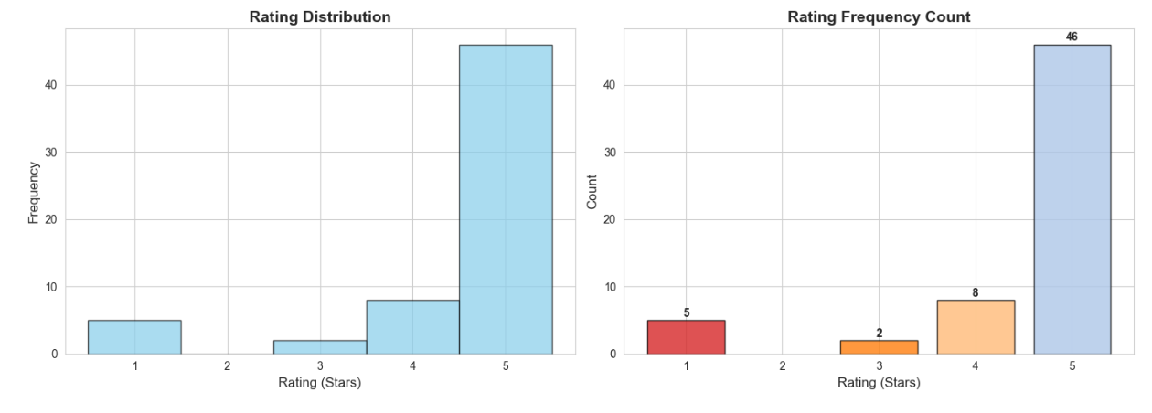
Exploratory Data Analysis: Customer Sentiment Data

Slide 9
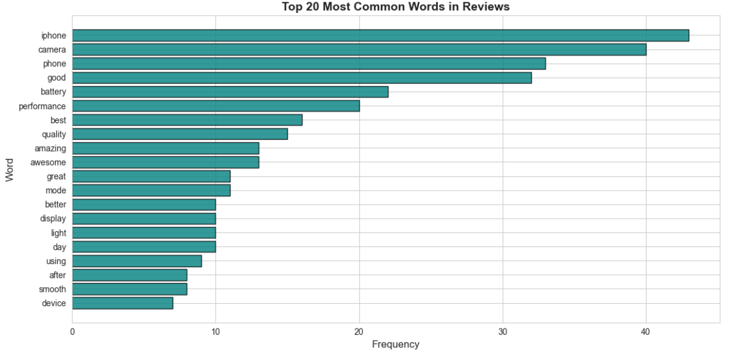
Exploratory Data Analysis: Customer Sentiment Data

Slide 10
Exploratory Data Analysis: Customer Sentiment Data
⭐ Rating Distribution
Heavily skewed towards 5-star (Mean: 4.52/5.0).
5-star reviews dominate.
📏 Text Length Patterns
Review length: 28 - 509 characters (Mean: ~250 characters)
Short vs. long, detailed feedback.
🔤 Common Keywords (Top Features)
Positive terms: "camera," "battery," "performance," "awesome," "excellent."
Feature mentions: "display," "processor," "design."
Focus on Quality & performance.
💡 Key Insight ⭐
Star ratings miss nuanced sentiment.
AI model (Llama 3.3 70B) needed for aspect-level feedback (e.g., "camera great BUT battery disappoints").

Slide 11
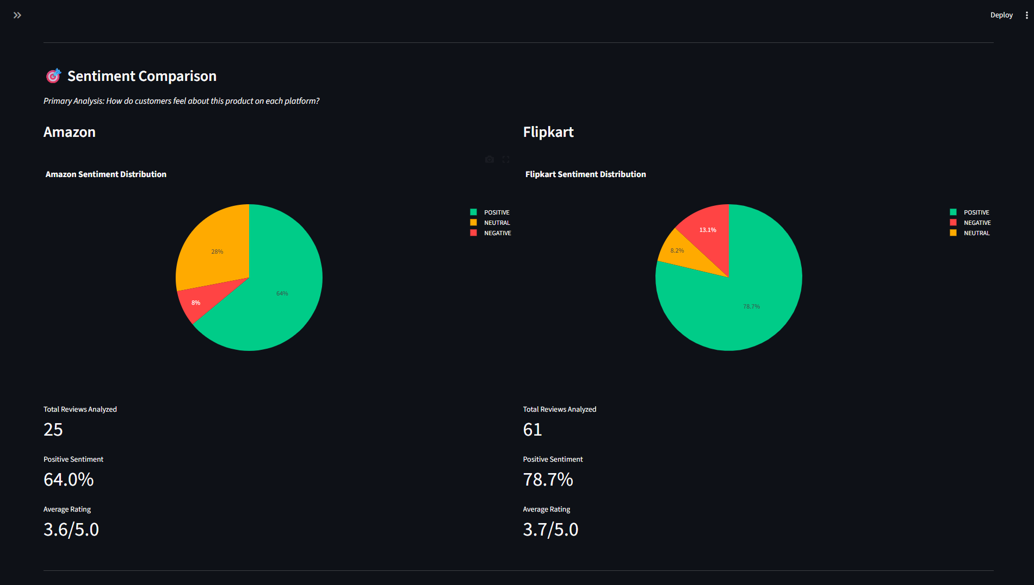
Cross-Platform Comparison: Amazon vs Flipkart

Slide 12
Cross-Platform Comparison: Amazon vs Flipkart
🎯 Sentiment Comparison
Amazon: 64% positive (25 reviews)
Flipkart: 78.7% positive (61 reviews)
Winner: Flipkart (14.7% higher positive sentiment)
💰 Price Comparison
Amazon: Rs.56,662 (Deal Score: 79/100)
Flipkart: Rs.55,049 (Deal Score: 97/100)
Best Deal: 🏆 FLIPKART (Save Rs.1,613)
📊 Insights Dashboard
Side-by-side sentiment pie charts
Real-time price tracking
Best deal recommendation
Deal score algorithm
Business Value:
✅ Find cheapest platform instantly
✅ Compare customer sentiment across platforms
✅ Data-driven purchase decisions

Slide 13
AI MODEL SELECTION
Three AI Models Selected:
1️⃣ Chronos (Amazon) - Price Forecasting
Type: Foundation model (zero-shot learning)
Size: Tiny variant (8M parameters)
Strength: Handles irregular patterns & step-functions
Training: Pre-trained on millions of time series
Why chosen: Non-stationary data, no tuning needed
2️⃣ Prophet (Meta) - Price Forecasting
Type: Additive model (trend + seasonality)
Components: Trend, yearly, weekly, monthly, holidays
Strength: Interpretable decomposition
Features: Indian e-commerce holidays
Why chosen: Explicit trend modeling, robust to outliers
3️⃣ Llama 3.3 70B (Meta) - Sentiment Analysis
Type: Large Language Model (LLM)
Size: 70 billion parameters
API: Groq (fast inference)
Strength: Context-aware sentiment extraction
Why chosen: Captures nuanced, aspect-level sentiment

Slide 14
Model Comparison Approach:
✅ Train both Chronos & Prophet on 80% data
✅ Test on 20% holdout data (61 points)
✅ Evaluate using 4 metrics: MAPE, RMSE, MAE, R²
✅ Select best performer for deployment

Slide 15
Model Evaluation & Performance Comparison
Metric | Chronos | Prophet | Winner
MAPE (%) | 0.38% | 24.48% | ✅ Chronos (64x better)
MAE (₹) | ₹211 | ₹13,448 | ✅ Chronos (63x better)
RMSE (₹) | ₹216 | ₹24,707 | ✅ Chronos (144x better)
R² Score | -21.15 | -290,408 | ✅ Chronos

Slide 16
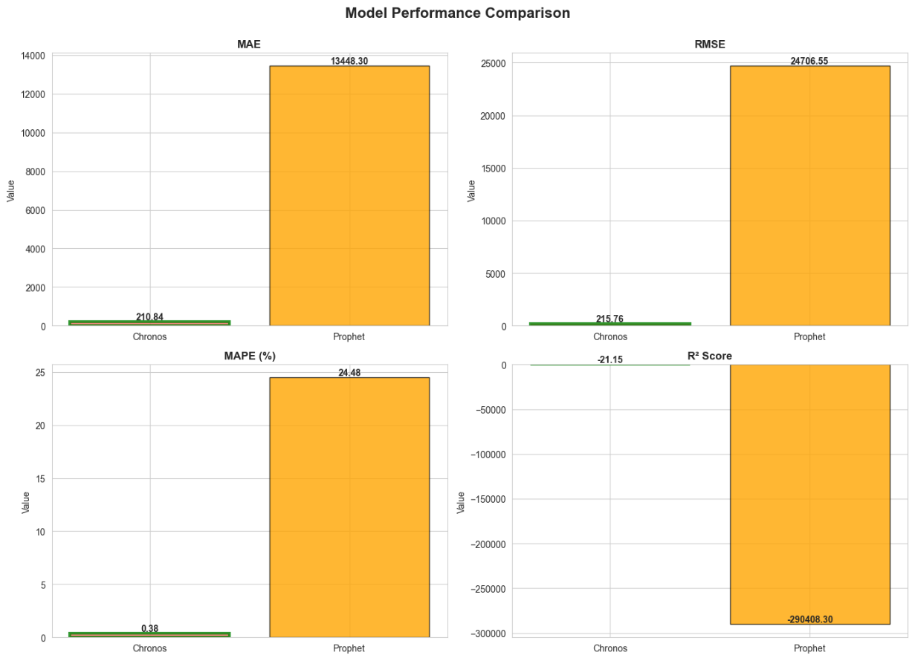

Slide 17
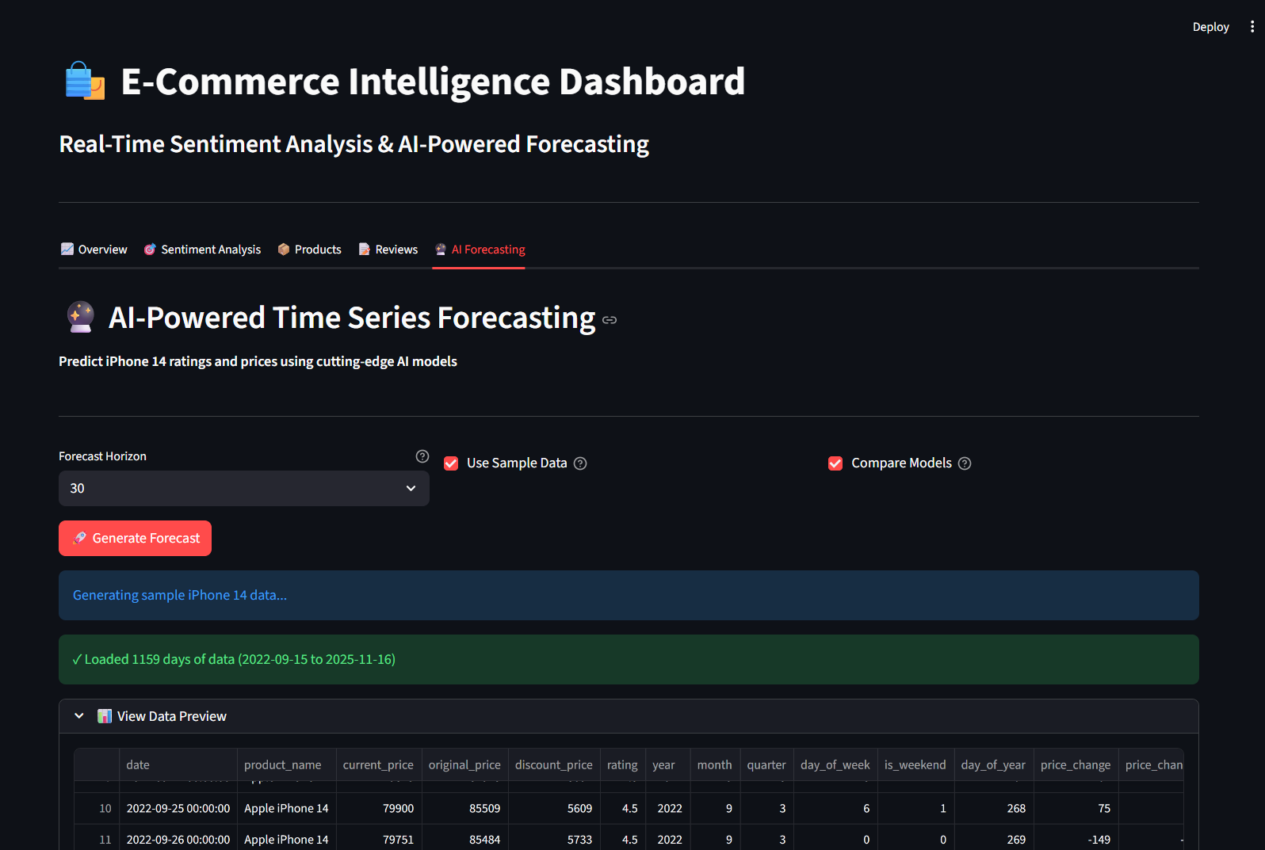
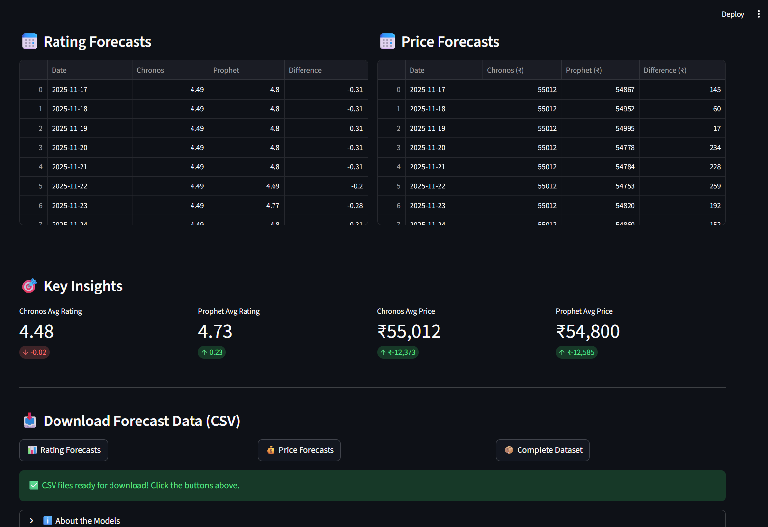

Slide 18
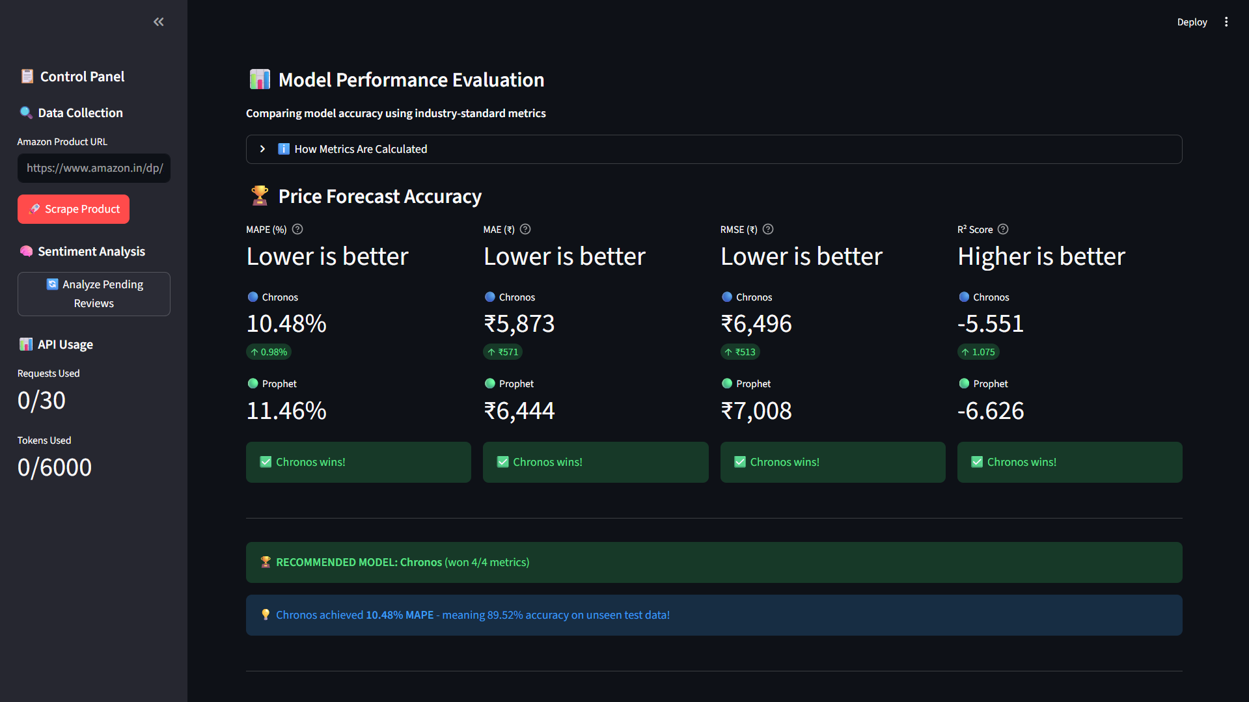

Slide 19
MODEL EVALUATION RESULTS
🏆 WINNER: CHRONOS
0.38% MAPE (99.62% Accuracy on unseen test data)
Won all 4 metrics
64x better than Prophet
Production-ready performance
Why Chronos Excelled:
Zero-shot learning handles irregular step-functions.
Pre-trained on millions of time series datasets.
No manual parameter tuning needed.
Robust to non-stationary data.

Slide 20
Dashboard Features:Real-Time Intelligence Platform
📊 1. Overview Dashboard
• Real-time sentiment statistics (Positive/Negative/Neutral %)
• Total products and reviews tracked
• Average rating and price trends
• Interactive sentiment distribution charts
💬 2. Sentiment Analysis Tab
• WordCloud visualization of common terms
• Sentiment breakdown by category
• Rating distribution analysis
• Temporal sentiment trends over time
📦 3. Products Tab
• All tracked products with current prices
• Historical price tracking
• Rating evolution over time
• Platform comparison (Amazon vs Flipkart)
📝 4. Reviews Tab
• Complete review listing with sentiment labels
• Filter by sentiment (Positive/Negative/Neutral)
• Review text with AI-generated sentiment
• Rating and timestamp information

Slide 21
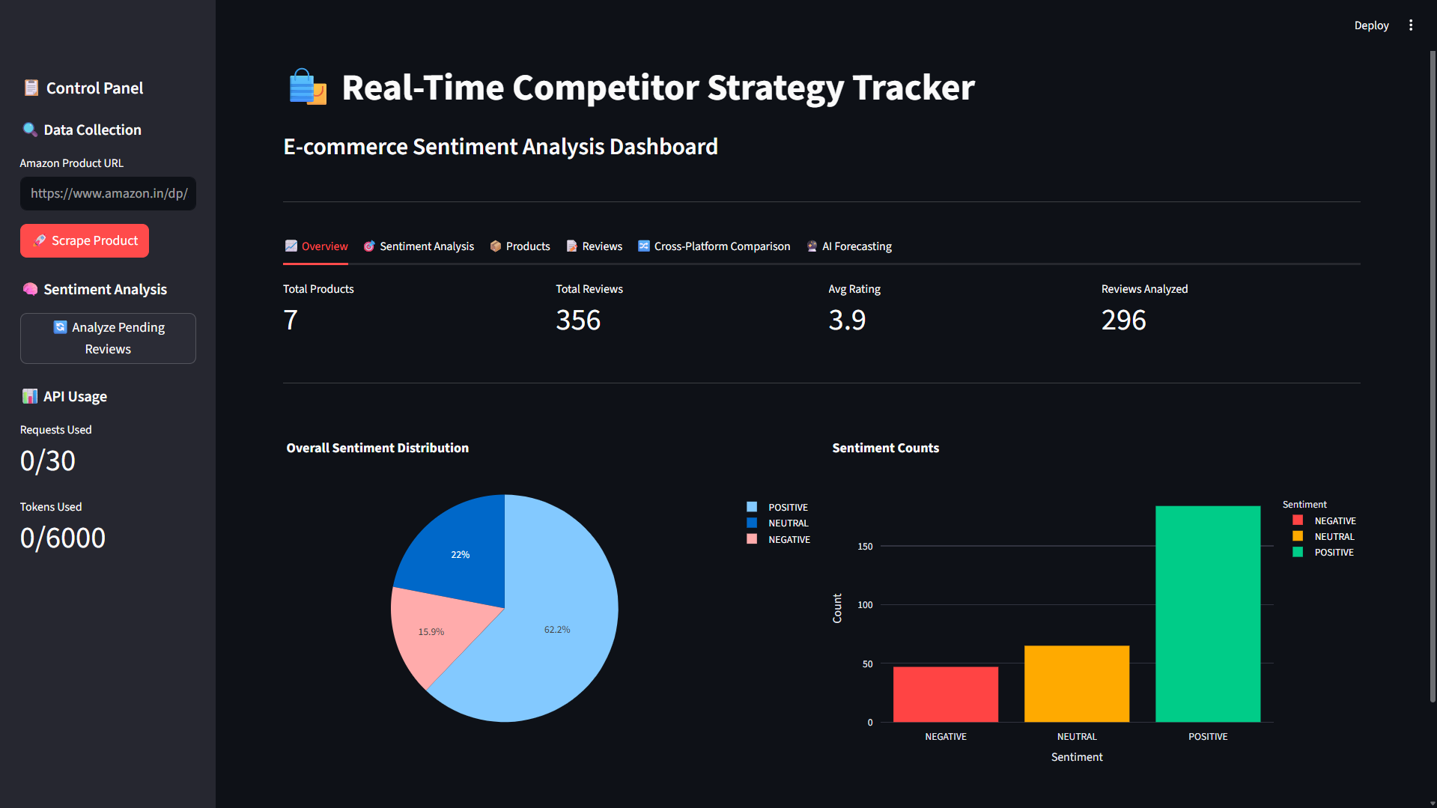

Slide 22
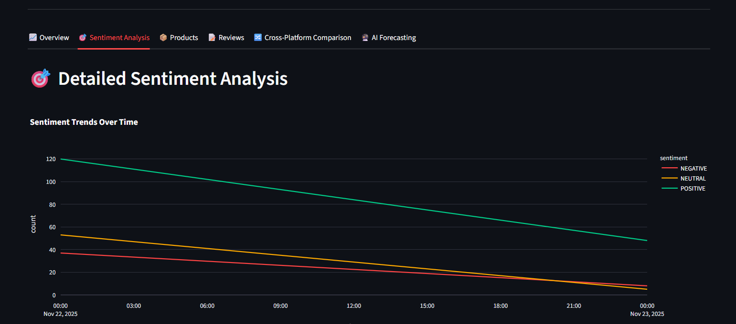

Slide 23
Smart Email Alert System
Automated Email Notifications
🚨 Sentiment Alerts: AI-powered warnings detect sentiment decline (e.g., 78% → 65%).
💰 Price Drop Alerts: Monitor price changes (e.g., Rs.56,000 → Rs.52,000), show savings and Deal Score (92/100), and recommend "BUY NOW."
✅ Key Features: Professional HTML emails, "View in Dashboard" buttons, and real-time SMTP delivery.
Result: Never miss deals or sentiment changes ✅

Slide 24
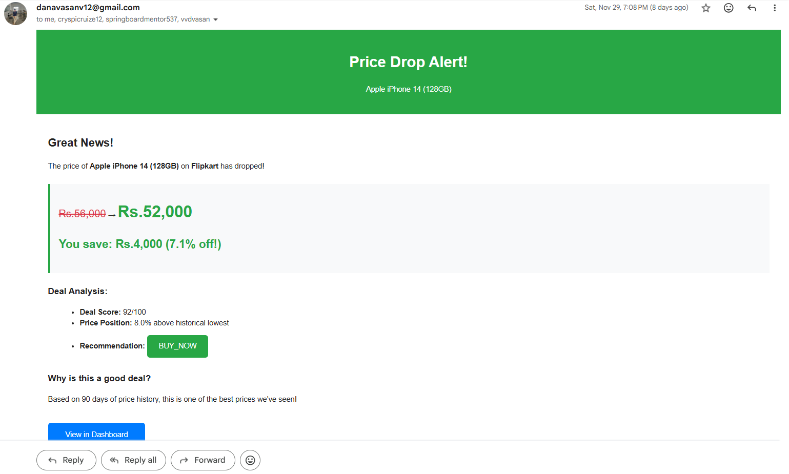
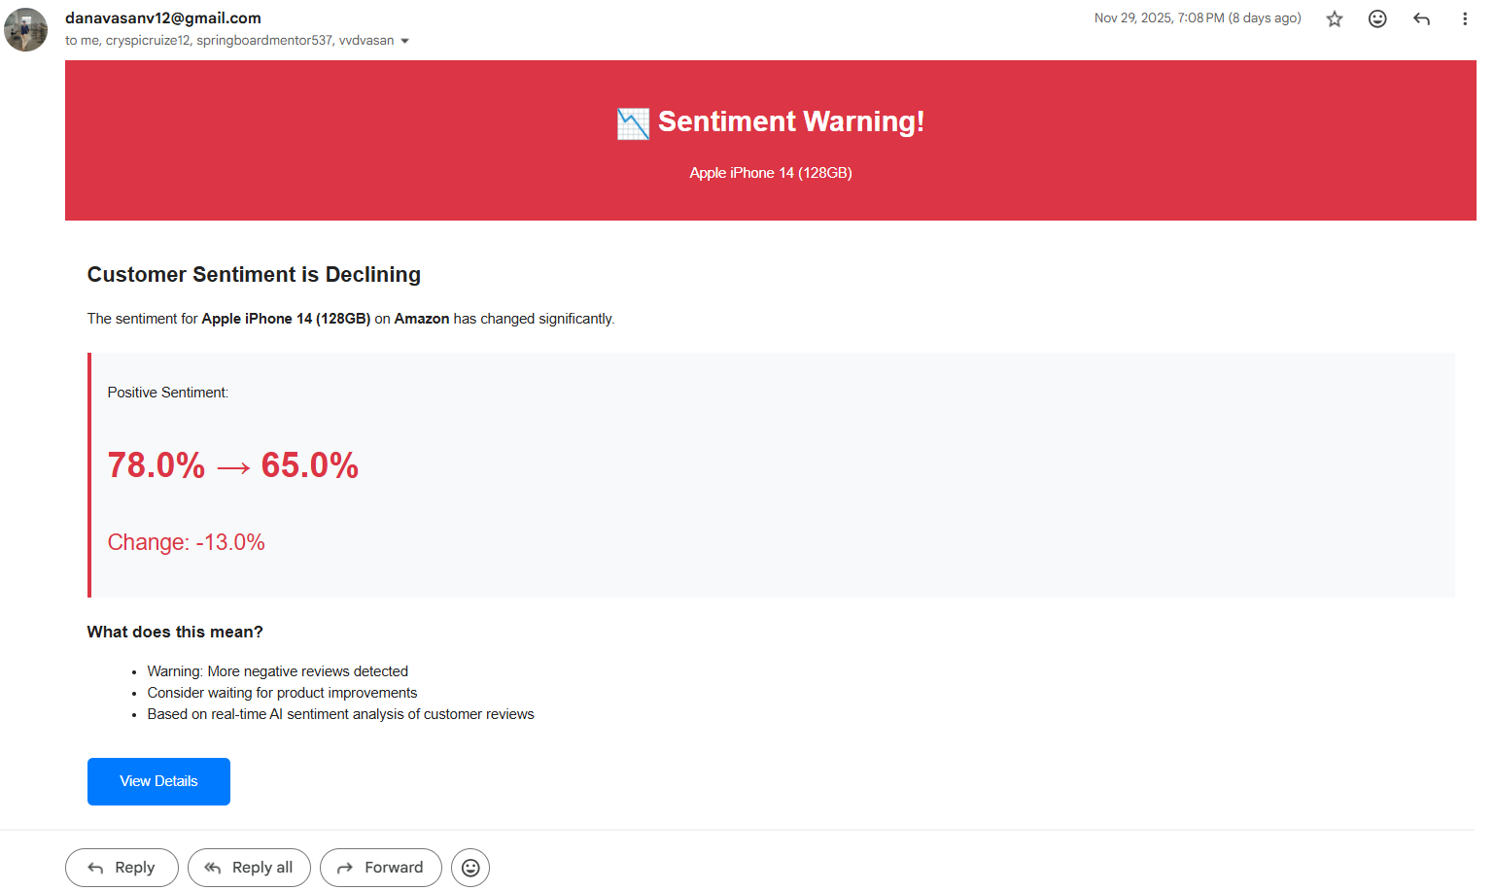

Slide 25
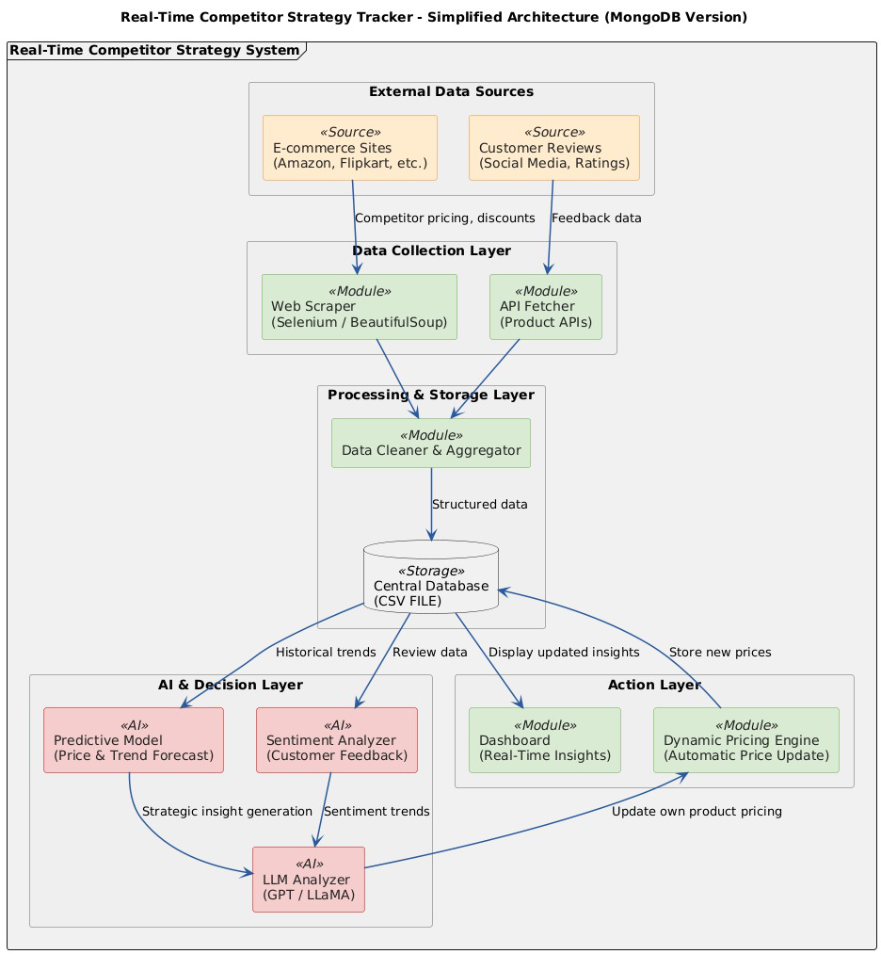
System Architecture

Slide 26
Tech Stack:
🎨 Frontend | 🤖 AI/ML Models | 🔧 Backend | 💾 Data Storage
• Streamlit (Python web framework) • Plotly (Interactive visualizations) • Matplotlib & Seaborn (Charts) | • Chronos (Amazon) - Time series forecasting • Prophet (Meta) - Trend analysis • Llama 3.3 70B (Meta) - Sentiment analysis via Groq API | • Python 3.8+ • Pandas, NumPy (Data processing) • Scikit-learn (Metrics calculation) • Statsmodels (Statistical tests) | • SQLite (Local database) • CSV exports (Data sharing)
🌐 External APIs
• Groq API (Llama 3.3 inference)
• Web scrapers (Amazon, Flipkart)

Slide 27
Project Results & Business Impact
🏆 Model Performance: 0.38% MAPE (99.62% accuracy).
💬 Sentiment Analysis: 86+ reviews analyzed.
💰 Price Intelligence: Rs.1,613 savings identified.
Business Value:
✅ Customers: Best deals.
✅ Businesses: Competitor insights.
✅ Platforms: Optimize strategies.

Slide 28
Project Results & Business Impact
🏆 Model Performance
Chronos: 0.38% MAPE (99.62% accuracy)
64x better than Prophet; Production-ready
💬 Sentiment Analysis
86+ reviews analyzed (Llama 3.3 70B)
Cross-platform comparison & real-time tracking
💰 Price Intelligence
Best deal detection (Saved Rs.1,613)
447 days historical tracking; Automated email alerts
📊 Dashboard Delivered
6 interactive tabs
Live evaluation metrics
One-click forecasting & email system
Business Value:
✅ Customers: Find best deals instantly
✅ Businesses: Track competitor strategies
✅ Platforms: Optimize pricing & sentiment

Slide 29
FUTURE WORK & ENHANCEMENTS
📱 Expand Product Coverage
Support multiple products (laptops, TVs, mobiles)
Multi-category tracking
🌐 More Platforms
Add Myntra, Snapdeal, Amazon Global
International price comparison
🤖 Enhanced AI
Aspect-based sentiment (camera, battery, display)
90-day price forecasting
Automated review summarization
🔔 Advanced Notifications
• WhatsApp alerts
• SMS notifications
• Custom alert rules per user
☁️ Cloud Deployment
• Deploy on AWS/Azure
• API for third-party integration
• Mobile app development

Slide 30
Technical Architecture Flow:
Dashboard → AI → Database → Alerts
🎨 Streamlit | Plotly
🤖 Chronos | Prophet | Llama 3.3
🔧 Python | Pandas | Scikit-learn
💾 SQLite | SMTP

Slide 31
Conclusion
✅ AI-powered competitor tracking
✅ 0.38% MAPE accuracy
✅ Complete dashboard + notifications
✅ Production-ready system
🎯 Successfully built an end-to-end AI system that combines
time series forecasting, NLP sentiment analysis, and
real-time competitor tracking - ready for deployment!

Slide 32
Thank You!

