Slide 1
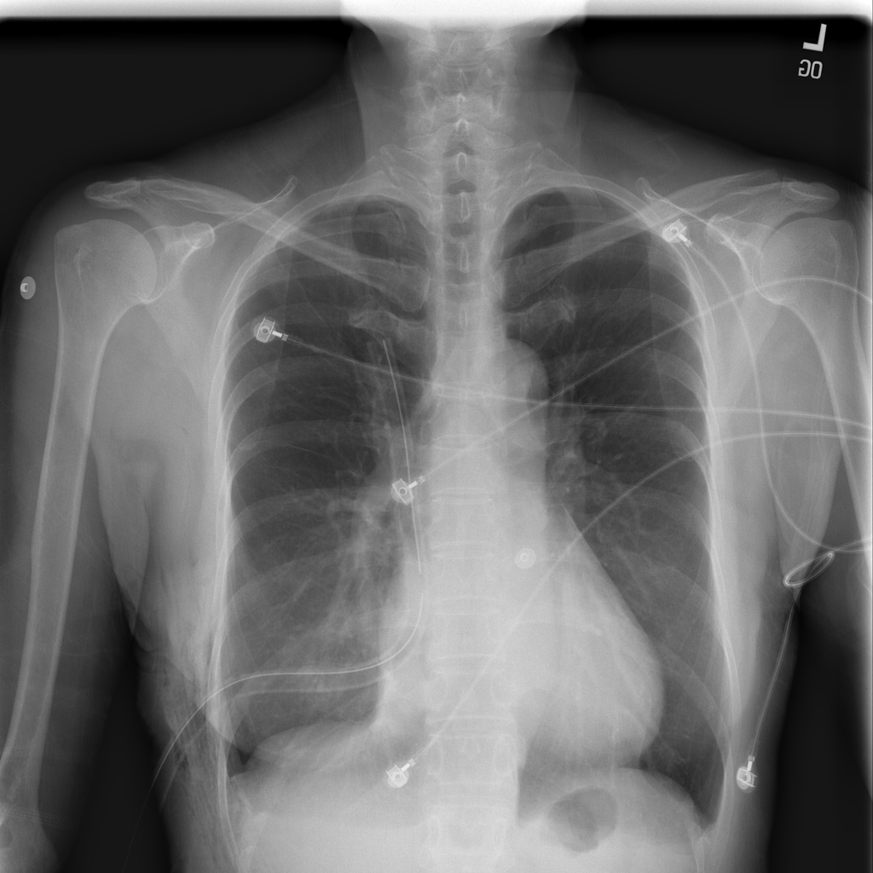
Our Codex
journey
CHEST X-RAY RESEARCH
10 MILESTONES
10 project milestones
Chest X-Ray Assistant | 3 November 2026
NIH X-ray example (illustration)
Notes:
Overview of work completed in Codex. The project and trained probes existed before this work. No pretrained encoder or MedGemma weights were trained in these Codex experiments.

Slide 2
01. Understanding the existing project
01 / CODEX PROJECT PROGRESS
Architecture mapped
Read Python modules and notebook cells.
Traced Streamlit, backend and training.
Reviewed prompts, tests and saved outputs.
Mapped local images, probes and features.
Verified scope
Initial exploration was read-only.
No database or separate REST API found.
Agent orchestration was not implemented.
Separated historical docs from current code.
Notes:
Sources: README.md, backend/, frontend/app.py, training/, prompt_engineering/, tests/, old_experiments/, notebooks/, existing PDF guide. Initial read-only analysis changed no project files.

Slide 3
02. Combined probe on Streamlit
02 / CODEX PROJECT PROGRESS
Existing trained classifier
Frozen MedSigLIP produces 1,152 features.
Softmax and sigmoid probes both vote.
Eight scores feed a learned final layer.
Streamlit was switched to this saved model.
Internal success; outside failure
Internal four-class test: 95.74%.
Internal test size: 2,791 images.
NIH outside test: 7/200 correct (3.5%).
NIH used the full four-class output.
Notes:
Sources: backend/predict.py::CombinedProbe, training/train_combined_probe.py, outputs/combined_model_metrics.csv. The combined probe was already trained; Codex integrated it into Streamlit. The 7/200 NIH result was measured earlier in this conversation with the exact app preprocessing and saved probe. These are different cohorts, not a controlled estimate of a single change.

Slide 4
03. Why successful code gave wrong answers
03 / CODEX PROJECT PROGRESS
Confirmed findings
Outside-data performance dropped sharply.
Both base probes made similar NIH errors.
High confidence did not ensure correctness.
The page bypassed existing review checks.
Evaluation and input issues
Earlier probe comparisons reused training photos.
Two-label evaluation differed from the UI.
Training and upload cleaning were inconsistent.
Dataset-source shortcuts remained a hypothesis.
Notes:
Sources: read-only root cause analysis; backend/predict.py, backend/xray_check.py, frontend/app.py, training/train_probe.py, prompt_engineering/photos.py and run_prompts.py. Cached features reproduced 2672/2791 accuracy; training/inference combination outputs matched. External failure was confirmed, but the exact causal share of source, age, view and preprocessing was not independently established.

Slide 5
04. Zero-shot MedSigLIP + MedGemma
04 / CODEX PROJECT PROGRESS
New sequential workflow
Clean the same image for both models.
MedSigLIP matches two text descriptions.
It supplies a label or similarity evidence.
MedGemma sees the image and that evidence.
What makes it different
MedGemma produces the final label.
There is no trained probe in this workflow.
Both pretrained models remain frozen.
This is hint-based, not numeric averaging.
The workflow was connected to Streamlit.
Notes:
Sources: backend/zero_shot_ensemble.py, backend/medgemma.py, frontend/app.py. Text descriptions: a normal chest x-ray; a chest x-ray showing pneumonia. Scores are cosine similarities, not calibrated confidence probabilities. This differs from both the earlier trained combined probe and the later frozen numeric fusion.

Slide 6
05. Prompt development and comparisons
05 / CODEX PROJECT PROGRESS
Internal experiment: 20 / 40 / 140
Compared label_hint and similarity_hint.
Validation: 70% versus 85%.
Selected similarity_hint before testing.
Internal test: 122/140 (87.14%).
MedSigLIP alone also scored 122/140.
NIH pilot: same 40 images
label_hint: 28/40 (70%).
similarity_hint: 27/40 (67.5%).
MedGemma without hint: 26/40 (65%).
MedSigLIP alone: 25/40 (62.5%).
No reliable hint gain shown on this sample.
Notes:
Sources: outputs/zero_shot_ensemble/final_metrics.json and outputs/nih_zero_shot_ensemble_20_each/baseline_comparison_metrics.json. Internal splits were balanced, disjoint original Training/Validation/Testing samples. label_hint was not evaluated on the 140-image final internal set because similarity_hint won validation. Pilot paired exact McNemar p-values versus no-hint MedGemma: 0.6875 for label_hint; 1.0 for similarity_hint. Pilot 40 cases were later part of the protected 200-image NIH set.

Slide 7
06. Criteria prompts and error review
06 / CODEX PROJECT PROGRESS
Original criteria prompts
Asked for findings, then a final label.
Validation no-hint accuracy: 52.5%.
Validation hint accuracy: 55%.
Pneumonia sensitivity: only 5% / 25%.
Longer outputs often still ended Normal.
Softening did not solve the bias
Removed the default-to-Normal instruction.
Both softened versions: 62.5% accuracy.
Their sensitivity: 25% / 30%.
Saved image IDs and full raw responses.
Criteria prompts did not replace the default.
Notes:
Sources: backend/zero_shot_ensemble.py::PROMPTS_V2 and PROMPTS_V2_SOFTENED; outputs/criteria_ensemble_v2_softened/final_metrics.json and validation_truth_table.csv. Figures here are on the old internal validation cohort of 20 Normal and 20 Pneumonia, not NIH. The strict prompts detected 0/10 and 2/10 development pneumonia cases. Raw descriptions and final labels sometimes conflicted. No image findings were independently clinically adjudicated.

Slide 8
07. New NIH splits without patient overlap
07 / CODEX PROJECT PROGRESS
Same source and file format
Downloaded selected original NIH PNGs.
Dev: 100 Normal + 100 Pneumonia.
Validation: 100 Normal + 100 Pneumonia.
Protected final: 100 + 100, unchanged.
Seed 42; one selected image per patient.
Leakage checks passed
Zero image overlap across all split pairs.
Zero patient overlap across all split pairs.
Dev/validation used Pneumonia-only labels.
Normal meant exact label No Finding.
Final test retained its co-labeled cases.
Notes:
Sources: training/prepare_nih_splits.py, training/assert_nih_splits.py, data/external/NIH_development/manifests/step0_check.json and split_plan.json. Both dev and validation have 200 unique patients. Final patient exclusions applied to all candidate images. Original PNGs retrieved through pinned alkzar90/NIH-Chest-X-ray-dataset mirror using byte ranges and ZIP CRC checks. Final set contains 85 co-labeled pneumonia cases and had earlier project exposure. NIH Clinical Center is the data provider; original source https://nihcc.app.box.com/v/ChestXray-NIHCC; Wang et al., CVPR 2017.

Slide 9
08. Frozen scoring and threshold selection
08 / CODEX PROJECT PROGRESS
Numeric score workflow
MedSigLIP: Pneumonia minus Normal cosine.
MedGemma: first-token log-probability margin.
The Pneumonia first token represents P.
Fusion averages dev-standardized scores.
Thresholds frozen at 80% dev sensitivity.
Dev evidence and validation choice
Dev AUC: MedSigLIP 0.7690.
Dev AUC: MedGemma 0.7595.
Dev AUC: Fusion 0.7653.
All AUC intervals excluded chance (0.5).
Validation chose MedSigLIP: 75% sens / 61% spec.
Notes:
Sources: backend/frozen_scores.py; training/score_frozen_nih.py; outputs/frozen_nih_threshold/step1_summary.json, step2_dev_auc.json, thresholds.json, step4_validation.json. Dev AUC 95% CIs: MedSigLIP 0.7021-0.8311; MedGemma 0.6906-0.8252; Fusion 0.6969-0.8293. Fusion minus MedSigLIP -0.0037, paired CI -0.0165 to +0.0097. Bootstrap: 2000 class-stratified resamples, seed 42. Dev-only population SD (ddof=0). Tokens: Normal 15585; Pneumonia first token 236791. Greedy sign agreement 200/200 dev and all 198 non-tied validation cases. Fixed thresholds: -0.1631323341280222, -5.25, -0.629323617337661. Validation winner selection: highest specificity with sensitivity >=0.75; MedSigLIP accuracy 68%. No validation parameter fitting.

Slide 10
09. Final test: sensitivity, many false alarms
09 / CODEX PROJECT PROGRESS
Method | Accuracy | Sensitivity | Specificity | AUC
MedSigLIP | 57% | 92% | 22% | 0.7554
MedGemma | 58% | 94% | 22% | 0.7794
Fusion | 57.5% | 93% | 22% | 0.7718
Greedy MedGemma | 72% | 84% | 60% | n/a
Final test: 200 NIH images (100 Normal + 100 Pneumonia). Frozen thresholds and dev scaling.
Every thresholded method produced 78 false alarms among 100 Normal images. No retuning.
Prior test-set exposure is recorded. MedSigLIP remained the validation-selected winner.
Notes:
Source: outputs/frozen_nih_threshold/step6_final_test.json. Final test 200 NIH cases, 100 per class. Same frozen thresholds and dev scaling as validation; no retuning or winner reselection. Counts [TP,FN,TN,FP]: MedSigLIP [92,8,22,78], MedGemma [94,6,22,78], Fusion [93,7,22,78], greedy [84,16,60,40]. AUC CIs from 2000 stratified bootstrap resamples; sensitivity/specificity CIs Wilson. All score signs matched greedy answers; no parse failures or non-finite scores. McNemar two-sided p versus greedy: 9.2477e-6, 6.1696e-5, 2.4904e-5. Thresholded methods had lower accuracy than greedy. The final set was used in earlier experiments and contains co-labeled positives; it is not a pristine untouched external benchmark.

Slide 11
10. Deliverables and current application
10 / CODEX PROJECT PROGRESS
Saved project artifacts
PowerPoints are in ppts/.
CSV truth tables contain per-image answers.
JSON files hold frozen metrics and settings.
Cached scores prevent repeated inference.
Tests verify parsing, splits and statistics.
Current Streamlit workflow
Zero-shot MedSigLIP supplies hint evidence.
MedGemma produces the final answer.
similarity_hint remains the default prompt.
Threshold fusion is a separate evaluation.
No pretrained model weights were updated.
Notes:
Sources: frontend/app.py, backend/zero_shot_ensemble.py, ppts/, outputs/frozen_nih_threshold/, tests/test_frozen_scoring.py, tests/test_frozen_thresholds.py, tests/test_nih_split_preparation.py. Existing presentations: combined_model_changes_and_results.pptx and combined_model_changes_and_results_styled.pptx. This summary adds codex_project_journey_10_milestones.pptx without changing app code, model weights or experiment settings.

