Slide 1
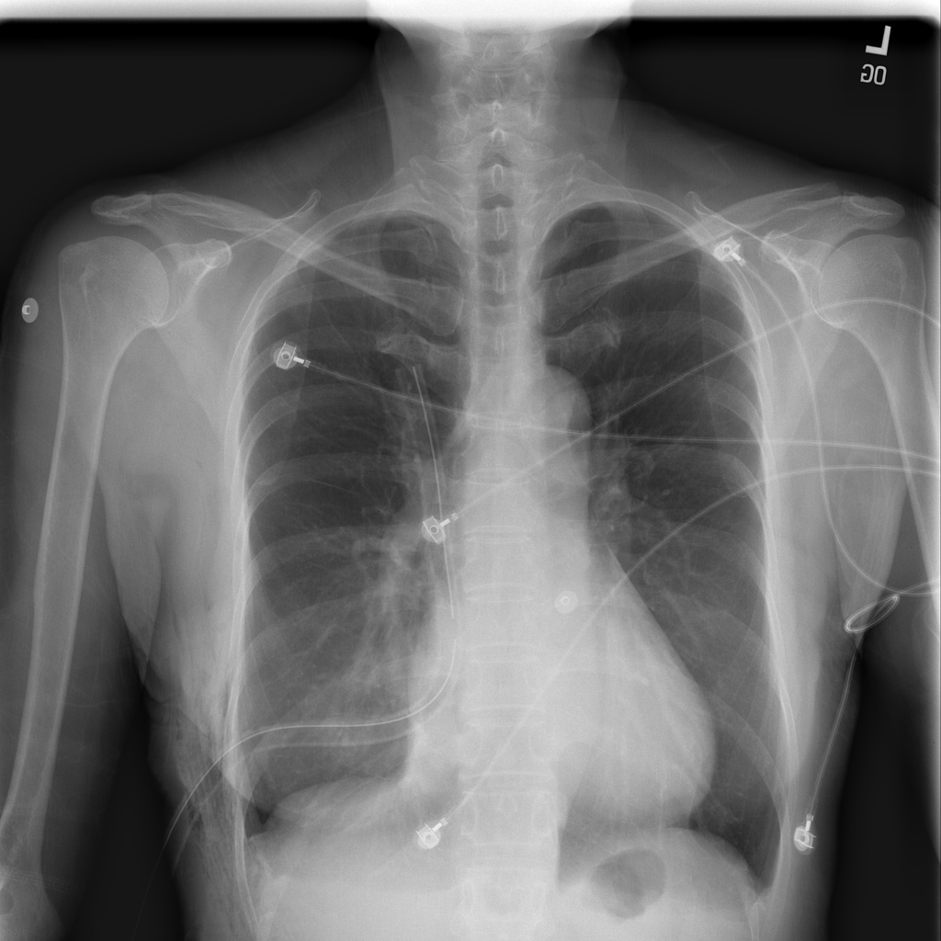
Combined
MedSigLIP
CHEST X-RAY RESEARCH
MODEL EVALUATION
Model changes, accuracy & outside testing
Chest X-Ray Classification | 2 November 2026
NIH chest X-ray example

Slide 2
What changed from the previous model?
01 / MODEL EVOLUTION
Previous: one linear probe
Frozen MedSigLIP extracts 1,152 features.
One linear layer predicts four classes.
The original version used softmax.
A later version used sigmoid + BCE loss.
New: combine both probes
Reuse the softmax and sigmoid probes.
Keep both probes and MedSigLIP frozen.
Join their eight output scores.
Train one final layer for four classes.

Slide 3
How the combined model works
02 / ARCHITECTURE
Shared image features
Upload -> grayscale and border cleaning.
MedSigLIP produces 1,152 features.
Normalize the feature vector.
Each probe applies its own saved scaling.
Learned combination
Softmax probe: 4 scores.
Sigmoid probe: 4 independent scores.
Concatenate: 8 inputs -> 4 outputs.
Only 36 new parameters are learned.
Final softmax scores sum to 1.

Slide 4
Internal test: a small accuracy gain
03 / INTERNAL BENCHMARK
Model / task | Validation | Test | Test cases | Test F1*
4-class softmax | 96.19% | 95.63% | 2,791 | 95.64%
4-class sigmoid | 95.34% | 94.52% | 2,791 | 94.55%
4-class combined | 95.94% | 95.74% | 2,791 | 95.75%
2-class softmax | 99.40% | 98.35% | 1,393 | 98.35%
2-class sigmoid | 98.99% | 98.49% | 1,393 | 98.49%
Combined gain | vs softmax | +0.11 pp | vs sigmoid | +1.22 pp
* Macro F1 | Saved metrics | Same dataset | 4-class task | 2-class differs

Slide 5
The prompt pipeline comparison
04 / PROMPT EVALUATION
Combined model: no prompts
Validation: 40/40 correct (100%).
Test: 139/140 correct (99.29%).
The runner selects Normal/Pneumonia
from the combined model scores.
This is a restricted two-label evaluation.
MedGemma: prompts + examples
Validation: 35/40 correct (87.5%).
Test: 123/140 correct (87.86%).
Classifier training overlaps this photo set.
Only 41 test cases were unseen by it.
Combined on those 41: 41/41 correct.

Slide 6
NIH outside images: 7/200 correct
05 / EXTERNAL VALIDATION
Actual / predicted | Covid-19 | Normal | Pneumonia | Tuberculosis
Normal (100) | 92 | 7 | 0 | 1
Pneumonia (100) | 97 | 3 | 0 | 0
Overall accuracy | 3.50% | 7 correct | 200 cases | 4-class output
Class metrics | Precision | Recall | F1 | Support
Normal | 70.00% | 7.00% | 12.73% | 100
Pneumonia | 0.00% | 0.00% | 0.00% | 100
2-class macro* | 35.00% | 3.50% | 6.36% | * labels only

Slide 7
What these results establish
06 / FINDINGS
Observed behavior
Internal four-class accuracy: 95.74%.
Outside NIH accuracy: 3.50%.
189/200 NIH images predicted Covid-19.
No NIH image predicted Pneumonia.
11/200 triggered the below-80% warning.
High internal accuracy did not transfer.
Scope and evidence
NIH run used Streamlit model + cleaning;
the browser UI itself was not automated.
Streamlit now loads the combined probe.
Sources: training/ and backend/ code;
outputs/*metrics.csv and prompt logs;
NIH evaluation in this conversation.
Research prototype; not a diagnosis.

