Slide 1

University Recommender
Amitha Narasimha Murthy Neeti Narayan Vivekanandh Vel Rathinam

Slide 2
The Problem
Data:
642 records
Each observation concerns one university with a given academic emphasis
Decision:
Clustering universities according to the user’s requirements
Goal:
Serve as a university guide for aspiring students
Students get a fair idea of the universities that match their requirements based on the test scores; this will help them save unnecessary application fee
The current application is for aspiring bachelor students. It can be extended to other levels of education

Slide 3
Importance of the Application
I’ll join that university only if I get financial aid
I don’t care about aid as long as the university is good!

Slide 4
Every student has different decision criteria
Available online forums - Word of mouth (Eg: Edulix)

Slide 5
Data Preprocessing
The original dataset (in .data format) was obtained from the UCI Machine Learning Repository (285 instances)
Missing values, duplicates and multi-valued attributes exist in the original dataset
The data file is converted to csv format
The information on missing data values have been calculated and duplicates removed
Normalization: Multi valued attribute is reduced to atomic attributes for each observation

Slide 6
Handling nominal attributes
- Each value in the nominal attribute is mapped to a single feature in the feature matrix
- Used the Dict Vectorizer implementation from the Scikit-learn package to transform nominal attributes to numerical attributes
Dataset
Feature matrix
City | Temperature
Chennai | 35
Bangalore | 21
Delhi | 26
City = Chennai | City = Bangalore | City = Delhi | Temperature
1 | 0 | 0 | 35
0 | 1 | 0 | 21
0 | 0 | 1 | 26

Slide 7
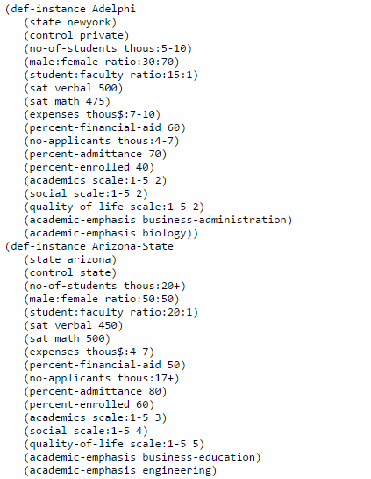
UCI University dataset

Slide 8
Attribute Information
University-name
State
Control (private or state)
SAT verbal
SAT math
Expenses (in thousands)
Percent financial aid
Academics (on a scale of 1 to 5)
Social (on a scale of 1 to 5)
Quality of life (on a scale of 1 to 5)
Academic emphasis

Slide 9
Implementation
Clustering
K-means, DBSCAN and weighted DBSCAN
Attribute Weight assignment
Assign weights to attributes to reflect user preferences
about the relative importance of each attribute
UI
User test scores and other attribute preferences are taken as input; based on which the weights are assigned dynamically

Slide 10
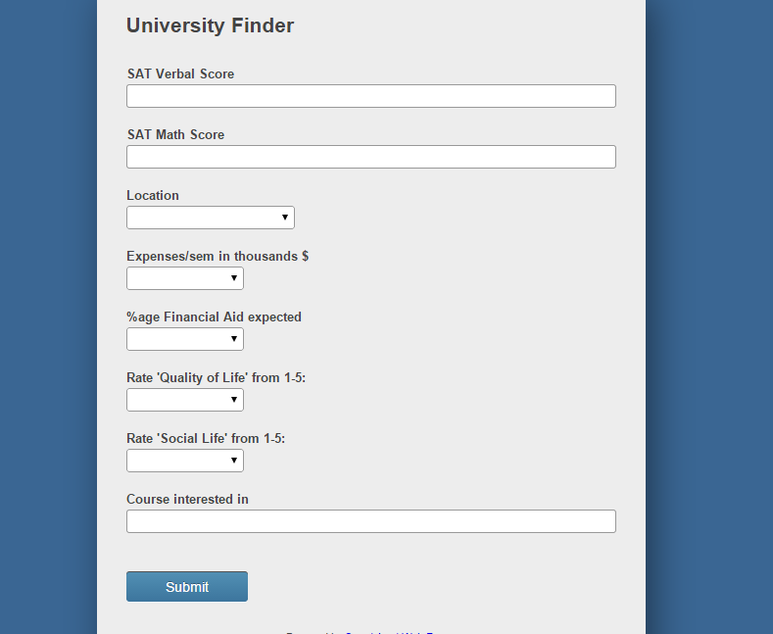
User Interface

Slide 11
Input
Test sample
State | Control | SAT Verbal | SAT Math | Expenses | Financial Aid | Academic | Social | Quality of life | Academic Emphasis
California | Private | 650 | 780 | 30 | 70 | 5 | 1 | 3 | Engineering

Slide 12
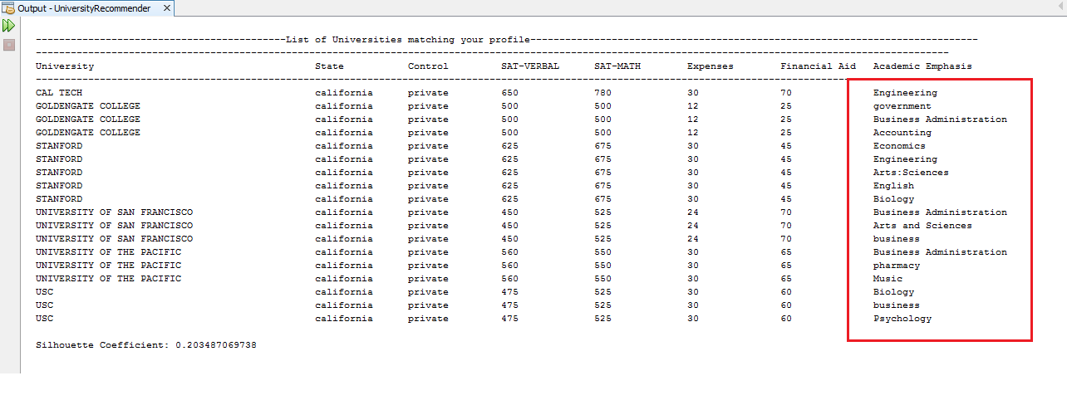
Result: k-means

Slide 13
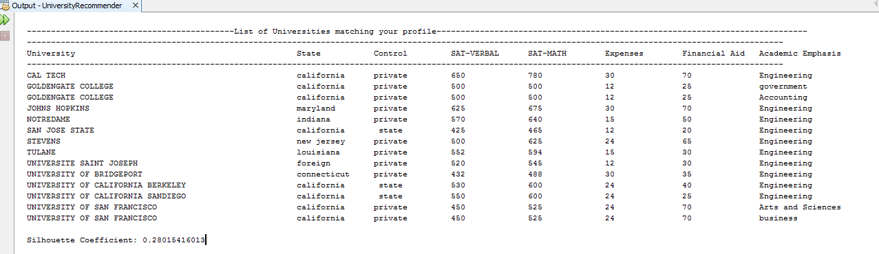
Result: DBSCAN

Slide 14
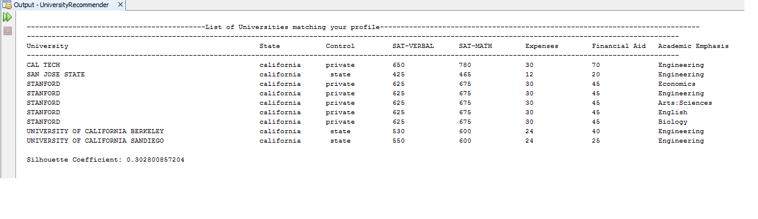
Result: Weighted DBSCAN

Slide 15
Validation
Ground truth unavailable
Used only the data to measure cluster quality
Consider a record i in the dataset as the test sample; Check if the test sample falls in the same cluster as record i
Internal index - Silhouette Coefficient
Calculate correlation between clustering results and distance matrix

Slide 16
Future work
To integrate Label Ranking algorithm to rank the relevance of the universities in the result to the given input
To continuously learn from alumni/current student profiles and use it to
update the information in the existing dataset
Use it as training data for Label ranking algorithm

