Slide 1
MACHINE LEARNING PROJECT ON
PREDICTION OF LOAN
T VENKAT PRAVEEN
CSE-18Q91A05N5

Slide 2
CONTENT
INTRODUCTION
PROBLEM STATEMENT
IMPLEMENTATION
ARCHITECTURAL DIAGRAMS
UML DIAGRAMS
COMPARISION
CONCLUSION

Slide 3
INTRODUCTION
A web app that deploys a machine learning model which predicts if the loan can be approved based on certain attributes and previous financial history. The data given by the users will be available in the admin portal which can be used for further analysis and betterment of model. The data can also be used by the banks(if integrated) to extend their loan campaigns. This is build using flask.

Slide 4
PROBLEM STATEMENT
As we can see that the usual process for loan eligibility process is too long like the customers first apply for the loan and then the bank will check for the customer eligibility for loan or not. However, the usual process takes a lots of time. Hence, we want to automate the loan eligibility based on customer information, which makes work faster.

Slide 5
IMPLEMENTATION
Collection of data.
Preprocessing and cleaning of data.
Modelling with various algorithm to obtain the most suitable algorithm for this current case.
Backend
Developing easy to use UI and integrating with the backend.
Having the data collected from users accessible in admin portal which can be used to improve the model.

Slide 6
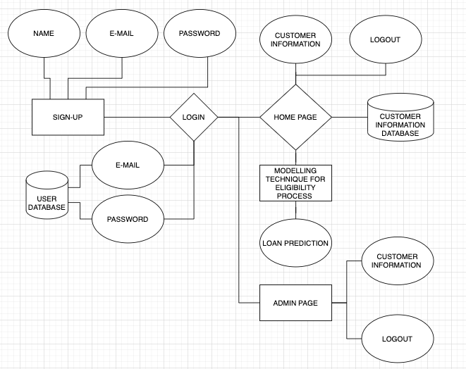
E.R DIAGRAM

Slide 7
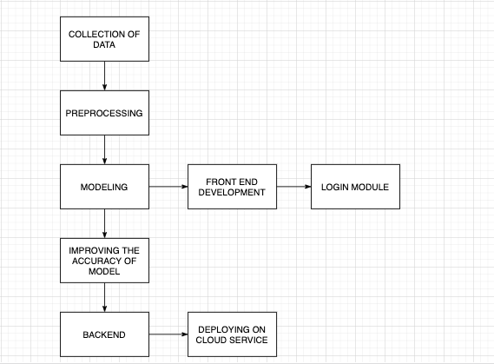
ARCHITECTURE DESIGN

Slide 8
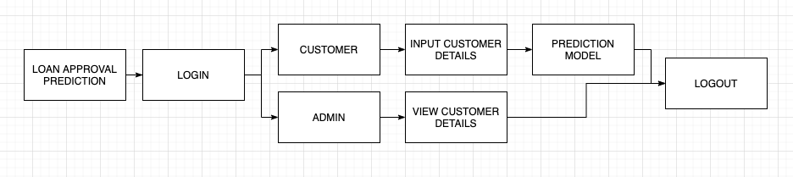
PIPE AND FILTER ARCHITECTURE

Slide 9
COMPARISION
 | EXISTING SYSTEM | PROPOSED SYSTEM
WEBSITE | NO | YES
AUTHENTICATION | NO | YES
DATABASE | NO | YES
CLOUD SERVICE | NO | YES

Slide 10
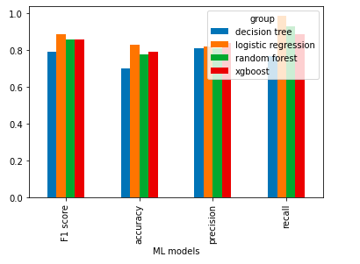
ML MODELLING RESULTS

Slide 11
CONCLUSION
So here, it can be concluded with confidence that the Logistic Regression model is extremely efficient and gives a better result when compared to other models. It works correctly and fulfills all requirements of bankers.
This system properly and accurately calculate the result. It predicts the loan is approved
or rejected to loan applicant or customer very accurately.

Slide 12
REFERENCES:
https://www.kaggle.com/
https://www.pythonanywhere.com/forums/
https://flask.palletsprojects.com/en/1.1.x/
https://help.pythonanywhere.com/pages/Flask/

Slide 13
THANK YOU
T VENKAT PRAVEEN
CSE-18Q91A05N5

