Slide 1
ML/AI Strategy for TeknoVe
Delivering an ML/AI Strategy, AI for Business Leaders, Udacity
Venkat Venkatachalam, Sep-2021

Slide 2
Executive Summary
Purpose of Project
The project study has been conducted as a part of course AI for Business Leaders. The project is about delivering a AI/ML strategy for TeknoVe, a Irish-headquartered manufacturer of electric vechicles with global operations. The project is very critical for TeknoVe to deliver a data driven strategy to solve some of its critical business problems.
Methodology
Analysis conducted over 4 weeks
Over ten(10) potential use cases underwent thorough assessment for feasibility and impact
Incorporated both technical knowledge and user feedback
Path Forward
Two (2) use cases identified for implementation
Needs and requirements to be successful
Next steps

Slide 3
I began with five use case ideas
UC1: Computer Vision Quality Control
Description: TeknoVe’s scale of production givens rise to flaws inevitable which are fixed via a manual inspection process. TeknoVe’s board, based on recent success with using Computer Vision (CV) in crop monitoring and in semiconductor manufacturing, has pressed for the company to implement CV as a part of the quality control process.
UC2: AI-Enabled Predictive Maintenance
Description: TeknoVe being a futiristic tech company believes that the “check engine light” should never go on for the customers. Engine failures must be predicted in advance along with its likely causes and customer should be alerted ahead of time. This will help improve customer sastisfaction and reduce roadside service program costs.
UC3: Production Schedule Optimizer
Description: TeknoVe manufactures several different type of EVs and batteries in each of its facilities. It takes considerable amount of time, effort and cost to reconfigure a factory and produce a different EV model and further the company does not want to produce more of a model than what the market demands. TeknoVe is looking to leverage past production data and demand predictions to develop a optimization model.

Slide 4
I began with five use case ideas
UC4: Supplier Risk Predictive Intelligence
Description: TeknoVe’s supplier network is constatnly changing to acocmodate for company’s pace of innovation, its global presence and geo political risks associated with maintaing a cost effective supply-chain. TeknoV’s procurement team is tasked with identifying geo political risks and react in real time to ensure minimal supply side risks and delays.
UC5: Buyer Propensity Analyzer
Description: TeknoVe owns and operates its own dealerships located in modern, urban areas with concentrated populations. With significant data around sales history, TeknoVe is looking at putting up new dealership stores in areas based on data driven exploration of demographic data and sales figures from existing locations to predict demand for he newer areas.

Slide 5
I assessed feasibility vs. impact for all cases
UC 3
Key criteria assessed
Revenue/Sales
Costs
Technology
Paradigm shift
Global Footprint
UC 4
UC 1
UC 5
Impact
UC 2
Feasibility

Slide 6
Transforming our business using ML/AI with these top two use cases
UC3: Production Schedule Optimizer
Description: TeknoVe manufactures several different type of EVs and batteries in each of its facilities. It takes considerable amount of time, effort and cost to reconfigure a factory and produce a different EV model and further the company does not want to produce more of a model than what the market demands. TeknoVe is looking to leverage past production data and demand predictions to develop a optimization model.
UC5: Buyer Propensity Analyzer
Description: TeknoVe owns and operates its own dealerships located in modern, urban areas with concentrated populations. With significant data around sales history, TeknoVe is looking at putting up new dealership stores in areas based on data driven exploration of demographic data and sales figures from existing locations to predict demand for he newer areas.
By executing on these two projects I believe we can drive marketshare for our business by increasing sales and revene and become a top Electric Vehicle manufacturer in the business.

Slide 7
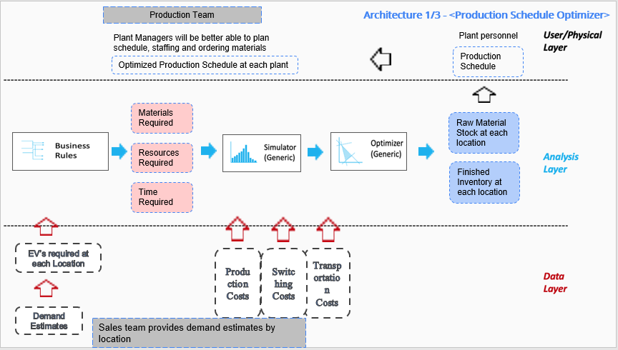
UC3: Production Schedule Optimizer - Deep Dive
Process Today
EV models produced based on stock
If demand is different or supply chain issues occur, different model is produced.
Factory is reconfigured as per requirements
Inventory is shipped to different locations based on demand.
Architecture
Process Tomorrow
Market demand estimated using demand prediction model
Production optimizer uses Inventory, demand and operational costs to optimize production schedule and reduce costs
Minimum inventory is held at locations
Preffered EV model production increased at desired locations
The impact of UC3 will be transformational thanks to AI/ML

Slide 8
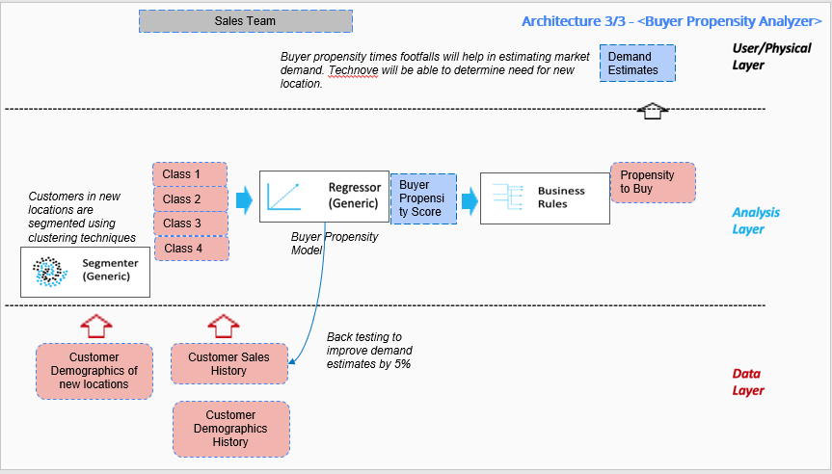
UC5: Buyer Propensity Analyzer - Deep Dive
Process Today
Dealerships are in modern urban locations.
Flagship stores in dense residential areas. Offers personal buying experience.
Uses Buyer Propensity model to predict sales, achieves 5% improvement by back testing.
Finshed EVs stocked according to demand estimates.
Architecture
Process Tomorrow
Customers in new locations segmented using Clustering techniques.
Customer interactions and customer demographics are fed into Propensity model.
Propensity model will predict the likelihood of a customer buying an EV.
Demand estimates are refined by applying back testing to determine need for new locations.
The impact of UC5 will mae TeknoVe a market leader thanks to AI/ML

Slide 9
Risks/Mitigations
 | UC3: Production Schedule Optimizer | UC5: Buyer propensity Analyzer
Accuracy a. Production plan numbers b. Demand Estimates | Concerns: Sales forecasts have been inaccurate and can lead to excessive numbers and cost overruns. Plan: Track and monitor sales forecasts fed into the Optimization model for accuracy. | Concerns: Demand estimates went for a toss when demographics changed. Plan: Ensure that demographics are tracked and updated in the model when new locations are added.
Underfitting/Overfitting a. Underfitting due to Market demographic bias. b. | Concerns: As new locations are added, change in demogrpahics will cause data drift. Plan: C-Suite must consider developing the Buyer Propensity model to mitigate the risk. | Concerns: As new locations are added, change in demographics will cause a bias and data drift. Plan: Track, monitor and update demographics of new locations in the model.
Ethical Concerns a. Unfair Bias or b. Discrimnation | Concerns: No reasons for bias. Plan: None. | Concerns: The model can lead to age discrimination related bias and will project new store locations only in places with millennial crowd. Plan:Technove must closely monitor model performance and balance ethical considerations.

Slide 10
Feedback Thus Far
Illustrative Verbatim Quotes
Proposed Next Steps
Implement Buyer Propensity Model
Implement Production Schedule Optimizer
Identify new store locations
Predict Market demand
Minimize switching and inventory costs
“Production Schedule Optimizer will transform the way Technove manufactures EV”
“Production Schedule Optimizer will fundamentally change how plant production schedules are managed and controlled”
Proposed Timeline
“Buyer Propensity Analyzer will fundamentally change the way TechnoVe looks at marketing”
“Buyer Propensity Analyzer will use a data driven predictive approach to help TehcnoVe indetify new store locations as opposed to concentrating only on urban clusters”
“Buyer Propensity Model will help TechnoVe acquire a targeted and precise marketing strategy”
Month 1
Implement Buyer Propensity Model for new locations
Back Testing to improve 5% accuracy
Month 2
Predict Demand for new locations
Implement Production Schedule Optimizer.
Month 3
Optimize Teknove production schedule for EV models

