Slide 1
ROBOTIC ARM BASED ON MUSCULAR MOVEMENTS

Slide 2
SELECTED THEME:ROBOTIC HAND BASED ON MUSCULAR MOVEMENT
There are 1.2 Billion people in india in that 2.1 percent i.e,21 million people are physically
Handicapped. Among them half of the people below the poverty line who can't efford the implants are remaining unhappy due this disability. This robotic hand based on muscular movement can help sort out their problems. due this physical disability they feel sad about their condition and fail to complete some of their daily needs . They feel very difficult to do things like holdingthings,eating,drinking
Brushing etc....
When we move or try to move our fingers and wrist certain muscles of the hand moves or contract and release this very common mechanism of human body this mechansim we use as main key role of project . Which cost less and can be effordable by the needs and poor

Slide 3
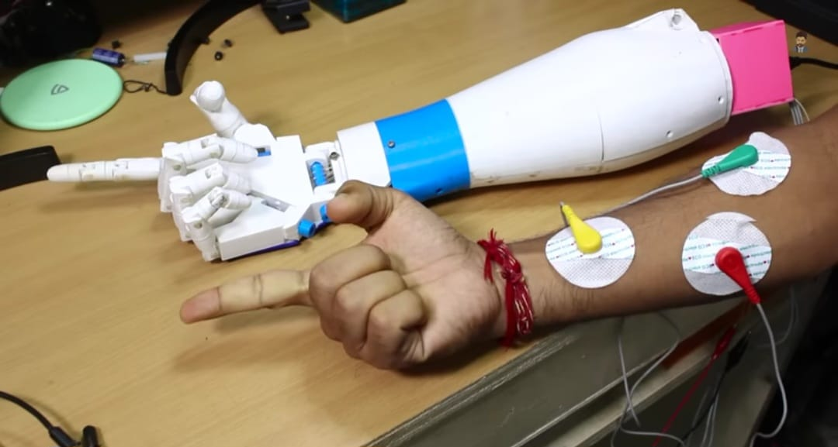
ROBOTIC HAND BASED ON MUSCULAR MOVEMENT:
The robotic hand present in the picture works on principle of muscular movements .there are ECG cable sensor are connected to our hand that detects the muscular movement and send the electric signals the circuit where the signals are read and understood and processed by ECG module and action takes place i.e, the servo motors connected to the circuit get the instructions and start to work according to our finger movement or muscle movement

Slide 4
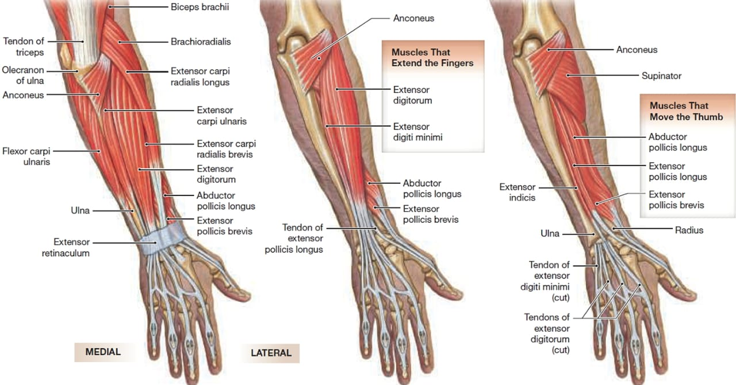
MUSCULAR MOVEMENTS :
The primary movement of the fingers are FLEXION and EXTENSION.FLEXION is used to grab and hold ,while EXTENSION is used to reach out . The intrinsic muscles of the hand provide fine motor control by flexing,extending ,abducting, and adducting the finger and the thumb segments. The muscles the fingers are the palm and the forepalm.

Slide 5
BLOCK DIAGRAM:
SM 1
SM-SERVO MOTOR (MG995
ECG-ELECTRO CARDIOGRAM
PCB-PRINTED CIRCUIT BOARD
PCB
9V/12V
POWER SUPPLY
SM 2
SM 3
AD8232 ECG SENSOR
SM 4
SM 5

Slide 6
LITERATURE SURVEY
Almassri, Ahmed M., et al. "Pressure sensor: State of the art, design, and application for robotic hand." Journal of Sensors 2015 (2015).
APA
Almassri, A. M., Wan Hasan, W. Z., Ahmad, S. A., Ishak, A. J., Ghazali, A. M., Talib, D. N., & Wada, C. (2015). Pressure sensor: State of the art, design, and application for robotic hand. Journal of Sensors, 2015.
Chicago
Almassri , Ahmed M., W. Z. Wan Hasan, Siti Anom Ahmad, Asnor J. Ishak, A. M. Ghazali, D. N. Talib, and Chikamune Wada. "Pressure sensor: State of the art, design, and application for robotic hand." Journal of Sensors 2015 (2015).
Harvard
Almassri , A.M., Wan Hasan, W.Z., Ahmad, S.A., Ishak, A.J., Ghazali, A.M., Talib, D.N. and Wada, C., 2015. Pressure sensor: State of the art, design, and application for robotic hand. Journal of Sensors, 2015.
Vancouver
Almassri AM, Wan Hasan WZ, Ahmad SA, Ishak AJ, Ghazali AM, Talib DN, Wada C. Pressure sensor: State of the art, design, and application for robotic hand. Journal of Sensors. 2015 Dec;2015.

Slide 7
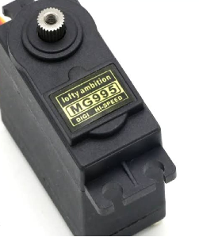
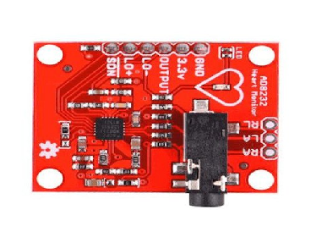
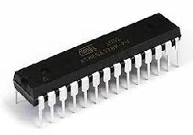
COMPONENTS :
MG995 SERVO MOTOR
AD8232 ECG SENSOR
ATMEGA328 MICROCONTROLLER

Slide 8
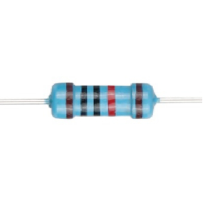
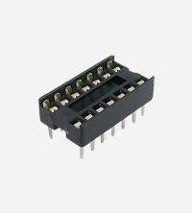
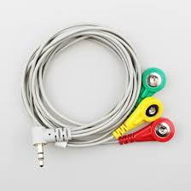
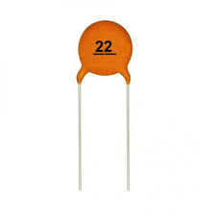
RESISTOR
CAPACITOR
ECG CABLE
IC BASE

Slide 9
WORKING:
MG995SERVOMOTOR
MG995 Metal Gear Servo Motor is a high-speed standard servo can rotate approximately 180 degrees (60 in each direction) used for airplane, helicopter, RC-cars and many RC model. Provides 10kg/cm at 4.8V, and 12kgcm at 6V. It is a Digital Servo Motor which receives and processes PWM signal faster and better.

Slide 10
AD8232ECG SENSOR
The AD8232 is an integrated signal conditioning block for ECG and other biopotential measurement applications. It is designed to extract, amplify, and filter small biopotential signals in the presence of noisy conditions, such as those created by motion or remote electrode placement.

Slide 11
ATMEGA328
The ATMEGA328 is a single-chip microcontroller created by Atmel in the megaAVR family (later Microchip Technology acquired Atmel in 2016). It has a modified Harvard architecture 8-bit RISC processor core.

Slide 12
10KRESISTOR
A 10k resistor is a fundamental electronic component that plays a vital role in circuits by limiting the flow of electric current. Its resistance value is 10,000 ohms. These resistors are identified by a color code, typically brown-black-orange-gold, where each color represents a digit or multiplier.

Slide 13
22pFCAPACITOR
A 22pF 50V disc type Ceramic Capacitor. Use this capacitor for power decoupling, having a smooth power in your circuit, timing circuits, etc. It is always a good idea to put one of these next to the power pins of a microcontroller.

Slide 14
IC BASE
An IC base, also known as an integrated circuit socket, is a component used to connect integrated circuits (ICs) to printed circuit boards (PCBs). IC bases are used to hold an IC or other device and make electrical connections between the device and a circuit board.

Slide 15
PROGRAM CODE:-
#include <Servo.h>
#define THRESHOLD 150 //In order to determine the state of the hand (opened/closed)
#define EMGPIN 3 //Analog pin connected to Muscle Sensor V3 Board
#define LITTLEPIN 2 //Digital pin used by Little servo
#define RINGPIN 3 //Digital pin used by Ring servo
#define MIDDLEPIN 4 //Digital pin used by Middle servo
#define INDEXPIN 5 //Digital pin used by Index servo
#define THUMBPIN 6 //Digital pin used by Thumb servo
//Constants used to open and close the fingers
#define LITTLE 1
#define RING 2
#define MIDDLE 3
#define INDEX 4
#define THUMB 5
Servo servoLittleFinger; // Define servo fingers
Servo servoRingFinger; // Define servo fingers
Servo servoMiddleFinger; // Define servo fingers
Servo servoIndexFinger; // Define servo fingers
Servo servoThumbFinger; // Define servo fingers

Slide 16
int finger;
// Motion routines for handopen and handclose
void openhand(){for(finger = 1; finger < 6; finger++){openFinger(finger);}}
void closehand(){for(finger = 1; finger < 6 ; finger++){closeFinger(finger);}}
// You have to rewrite properly the functions to open and close the fingers
// according of your assembly
// In my case, middle and index fingers are opened when servo is at 170 degrees and the others when servo is at 0 degrees
// I have used Towardpro MG996R servos
void openFinger(int finger){
if(finger==LITTLE){servoLittleFinger.write(0);} // Little finger
else if(finger==RING){servoRingFinger.write(170);}// Ring finger
else if(finger==MIDDLE){servoMiddleFinger.write(170);}// Middle finger
else if(finger==INDEX){servoIndexFinger.write(170);}// Index finger
else if(finger==THUMB){servoThumbFinger.write(0);}//Thumb finger
}

Slide 17
void closeFinger(int finger){
if(finger==LITTLE){servoLittleFinger.write(170);} // Little finger
else if(finger==RING){servoRingFinger.write(0);}// Ring finger
else if(finger==MIDDLE){servoMiddleFinger.write(0);}// Middle finger
else if(finger==INDEX){servoIndexFinger.write(0);}// Index finger
else if(finger==THUMB){servoThumbFinger.write(170);}//Thumb finger
}
void setup(){
Serial.begin(115200); //BAUDRATE set to 115200, remember it to set monitor serial properly (used this BaudRate and "NL&CR" option to visualize the values correctly)
servoLittleFinger.attach(LITTLEPIN); // Set Little finger servo to digital pin 3
servoRingFinger.attach(RINGPIN); // Set Ring finger servo to digital pin 5
servoMiddleFinger.attach(MIDDLEPIN); // Set Middle finger servo to digital pin 6
servoIndexFinger.attach(INDEXPIN); // Set Index finger servo to digital pin 9
servoThumbFinger.attach(THUMBPIN); // Set Thumb finger servo to digital pin 10
}//end setup

Slide 18
void loop() {// Nothing to do here, all is done in the interrupt function
int value = analogRead(EMGPIN); //Sampling analog signal
if(value>THRESHOLD) //If the value of the sample is greater than THRESHOLD means that the hand has been closed
{closehand();}
else //Otherwise the hand is open
{openhand();}
Serial.println(value); //You can use serial monitor to set THRESHOLD properly, comparing the values shown when you open and close your hand
}

Slide 19
THANK YOU.....

