Slide 1
Delivery
Challenge

Slide 2
Structure project
The application has to be built by principle three layer (Model, View, Controller)
Project structure
Web Application project
Controllers
View
Model
Common project with common data structure (i.e. Interfaces for models), helpers …
Web services project
Business tier project
DataAccess tier project (e.g. Repository pattern)
Test project for mock and unitTests

Slide 3
Approach development
The development process (what have been done, what problems\questions we have got) should be informed to product owner every week (eg. every Friday). Working by SCRUM.
New demands from product owner should be protocoled.
Every day should be organized daily meeting where will be discussed tasks for this day and what tasks have finished the day before.
The tasks should be covered by priorities.
Should be created project plan where every task progress can be tracked.
Should be provided test environment for checking status of application
In the project have to be involved product owner, developers, designers, QAs.
Should be organized daily deploy a new version on the test environment and backup existed
Branches for a big features or developers

Slide 4
Development process from planning to go-live
Information Gathering. Good understanding business goals, purpose, goals and content. Get information where the application will be hosted and keep it in mind for test hosting. How many users will use it and by which browsers.
Planning. Defining version control application, task priority, amount of phases, what technologies will be involved. Dead line of sprint. Defining count of required developers and QA's for this project, choosing bug tracking system.
Design. Drawing prototypes (mock-ups) of application, which has to evaluated by Product Owner and after choosing one be prepared to start development process the first version of product.
Development. Development process should be built by principle of priority tasks. After execution every feature, the feature should be reviewed and tested by developers and QA’s. First of all has to be created basic functionality of application. For daily tested application should organized a virtual machine where application will be hosted with full accessed for QA.
Testing and Delivery. After finished the first phase the application, the application should be again completely tested. Normally it takes from 2 days to 2 weeks. All before created test cases have to be run again. After final approval, the application can be delivered, before create existed database and application back up to quick restore worked version.
Maintenance. Providing new versions, hotfixes. Solving the problem of hosting application, handle bugs and adding new requirements in tracking system.

Slide 5
Concept of developing web portal
The project will be divided on three layer (MVC) and built on ASP.NET MVC 5 because we can cover tests (use TDD methodology) and enables clean separation of concerns, scalable the application. It has lots of documentation and information surrounding it. It includes a very powerful URL mapping. It is highly extensible and pluggable. For binding controllers, repository and mapping database will be used Unity Framework (DI\IoC).
Database will be relational, MS SQL Server 2014. This database is good compatible with MS technologies and ORM. The databases will be hosted on the machine separated from the hosted web application. Provides security like user-defined server roles. Strong query optimization.
For ORM will be taken EntityFramework 6. Easy to work with LINQ query, flexible and scalable. Supporting DataAnnotation validation.
The web application will consist Moq 4 and nUnit dependency injection. Classes are more modular, as they depend only on the interface of passed-in dependencies. Testing is simplified.
Also will be involved HTML 5, JQueryUI 1.12, Knockout 3.4.2, bootstap to work with data on client side and build powerful controls. All framework are powerful and open source (MIT license).
Web application will be hosted on IIS. IIS is perfect to manage settings web application. Access to the machine will be provided to administrator.
The application has to have Logger to collect errors during work. As the Logger will be taken Log4Net. Easy in implementation and proved to be a reliable assistant in logging.

Slide 6
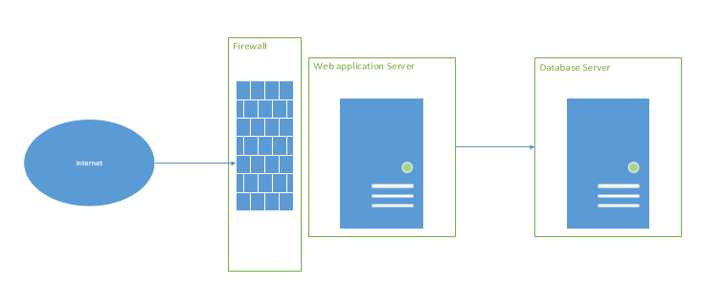
Basic schema

Slide 7
Risks of failing or running out of time
High impact of developing perfect architecture. Don’t spend so much time of developing perfect architecture.
Covering all features by unit\mockup test. Covering should include important features and no need to cover the application more than 60-70%
Don't following of project plan.
Impossibility to manage newly arrived tasks and planned
No reports about problems
A key member is leaving the team
No reports about current state of project
No right evaluating tasks
Project team misunderstand requirements. This is a reason why report current status is so important.
Choosing not fit technology components
Not the right person to assign a task. We have to know strengths and weakness of every team member.

