Slide 1
Time Series
“The Art of Forecasting”
Notes:
1

Slide 2
Learning Objectives
Describe what forecasting is
Explain time series & its components
Smooth a data series
  Moving average
  Exponential smoothing
Forecast using trend models Simple Linear Regression Auto-regressive
Notes:
2
As a result of this class, you will be able to...

Slide 3

What Is Forecasting?
Process of predicting a future event
Underlying basis of
all business decisions
  Production
  Inventory
  Personnel
  Facilities
Notes:
4

Slide 4
Forecasting Approaches
Qualitative Methods
Quantitative Methods
Used when situation is vague & little data exist
  New products
  New technology
Involve intuition, experience
e.g., forecasting sales on Internet
Notes:
5

Slide 5
Forecasting Approaches
Qualitative Methods
Quantitative Methods
Used when situation is vague & little data exist
  New products
  New technology
Involve intuition, experience
e.g., forecasting sales on Internet
Used when situation is ‘stable’ & historical data exist
  Existing products
  Current technology
Involve mathematical techniques
e.g., forecasting sales of color televisions
Notes:
6

Slide 6
Quantitative Forecasting
Select several forecasting methods
‘Forecast’ the past
Evaluate forecasts
Select best method
Forecast the future
Monitor continuously forecast accuracy
Notes:
7

Slide 7
Quantitative Forecasting Methods
Notes:
8

Slide 8
Quantitative Forecasting Methods
Quantitative
Forecasting
Notes:
9

Slide 9
Quantitative Forecasting Methods
Quantitative
Forecasting
Time Series
Models
Notes:
10

Slide 10
Quantitative Forecasting Methods
Quantitative
Forecasting
Time Series
Causal
Models
Models
Notes:
11

Slide 11
Quantitative Forecasting Methods
Quantitative
Forecasting
Time Series
Causal
Models
Models
Moving
Exponential
Trend
Average
Smoothing
Models
Notes:
12

Slide 12
Quantitative Forecasting Methods
Quantitative
Forecasting
Time Series
Causal
Models
Models
Moving
Exponential
Trend
Regression
Average
Smoothing
Models
Notes:
13

Slide 13
Quantitative Forecasting Methods
Quantitative
Forecasting
Time Series
Causal
Models
Models
Moving
Exponential
Trend
Regression
Average
Smoothing
Models
Notes:
15

Slide 14
What is a Time Series?
Set of evenly spaced numerical data
  Obtained by observing response variable at regular time periods
Forecast based only on past values
  Assumes that factors influencing past, present, & future will continue
Example
  Year: 1995 1996 1997 1998 1999
  Sales: 78.7 63.5 89.7 93.2 92.1
Notes:
16

Slide 15
Time Series vs.
Cross Sectional Data
Time series data is a sequence of observations
  collected from a process
  with equally spaced periods of time.

Slide 16

Time Series vs.
Cross Sectional Data
Contrary to restrictions placed on cross-sectional data, the major purpose of forecasting with time series is to extrapolate beyond the range of the explanatory variables.

Slide 17

Time Series vs.
Cross Sectional Data
Time series is dynamic, it does change over time.

Slide 18
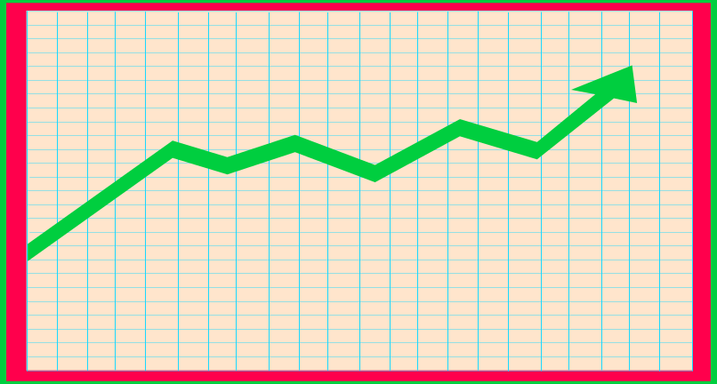
Time Series vs.
Cross Sectional Data
When working with time series data, it is paramount that the data is plotted so the researcher can view the data.

Slide 19
Time Series Components
Notes:
17

Slide 20
Time Series Components
Trend
Notes:
18

Slide 21
Time Series Components
Trend
Cyclical
Notes:
19

Slide 22
Time Series Components
Trend
Cyclical
Seasonal
Notes:
20

Slide 23
Time Series Components
Trend
Cyclical
Seasonal
Irregular
Notes:
21

Slide 24

Trend Component
Persistent, overall upward or downward pattern
Due to population, technology etc.
Several years duration
Response
Mo., Qtr., Yr.
© 1984-1994 T/Maker Co.
Notes:
22

Slide 25
Trend Component
Overall Upward or Downward Movement
Data Taken Over a Period of Years
Sales
Upward trend
Time

Slide 26
Cyclical Component
Repeating up & down movements
Due to interactions of factors influencing economy
Usually 2-10 years duration
Cycle
Response
Mo., Qtr., Yr.
Notes:
23

Slide 27
Cyclical Component
Upward or Downward Swings
May Vary in Length
Usually Lasts 2 - 10 Years
Sales
Cycle
Time

Slide 28

Seasonal Component
Regular pattern of up & down fluctuations
Due to weather, customs etc.
Occurs within one year
Summer
Response
© 1984-1994 T/Maker Co.
Mo., Qtr.
Notes:
24

Slide 29
Seasonal Component
Upward or Downward Swings
Regular Patterns
Observed Within One Year
Winter
Sales
Time (Monthly or Quarterly)

Slide 30
Irregular Component
Erratic, unsystematic, ‘residual’ fluctuations
Due to random variation or unforeseen events
  Union strike
  War
Short duration &
nonrepeating
© 1984-1994 T/Maker Co.
Notes:
25

Slide 31

Random or Irregular Component
Erratic, Nonsystematic, Random, ‘Residual’ Fluctuations
Due to Random Variations of
  Nature
  Accidents
Short Duration and Non-repeating

Slide 32
Time Series Forecasting
Notes:
27

Slide 33
Time Series Forecasting
Time
Series
Notes:
28

Slide 34
Time Series Forecasting
Time
Series
Trend?
Notes:
29

Slide 35
Time Series Forecasting
Time
Series
Smoothing
No
Methods
Trend?
Notes:
30

Slide 36
Time Series Forecasting
Time
Series
Smoothing
No
Yes
Trend
Methods
Trend?
Models
Notes:
31

Slide 37
Time Series Forecasting
Time
Series
Smoothing
No
Yes
Trend
Methods
Trend?
Models
Moving
Exponential
Average
Smoothing
Notes:
32

Slide 38
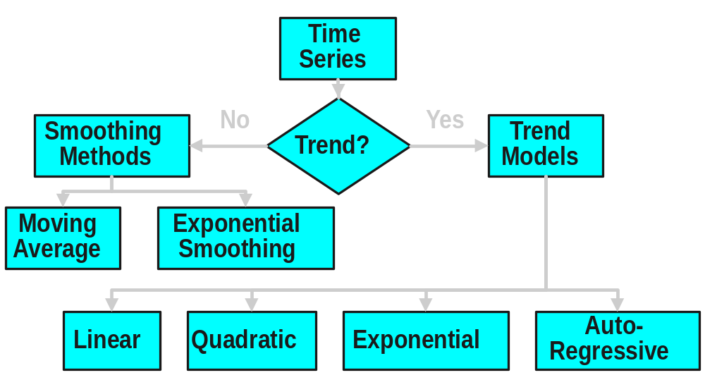
Time Series Forecasting
Notes:
33

Slide 39
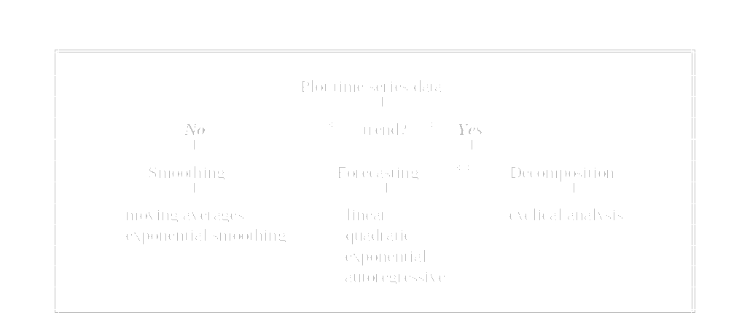
Time Series Analysis

Slide 40
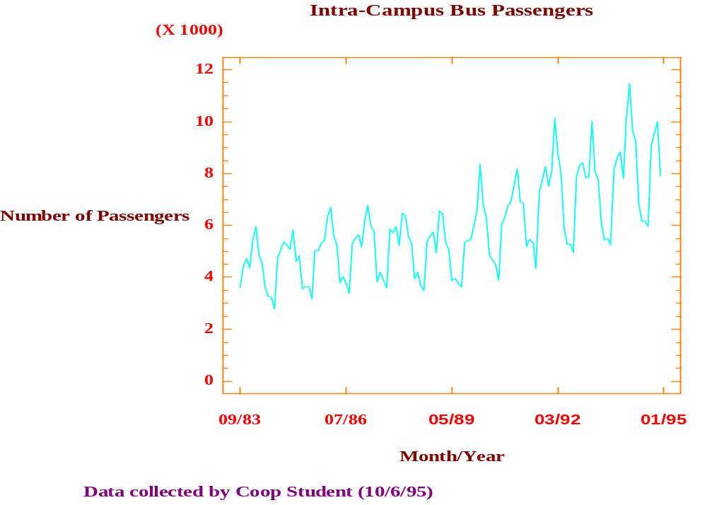
Plotting Time Series Data

Slide 41
Moving Average Method
Notes:
34

Slide 42
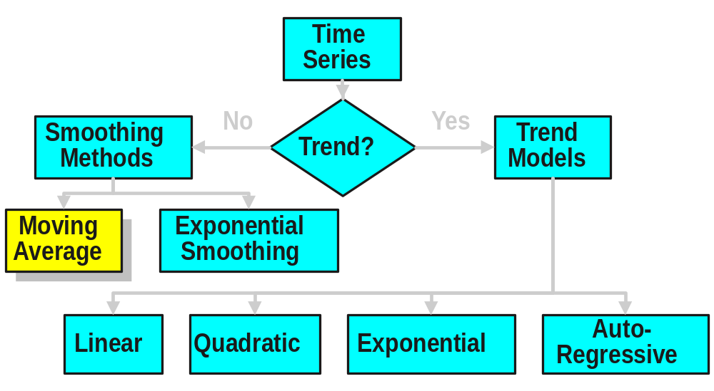
Time Series Forecasting
Notes:
35

Slide 43
Moving Average Method
Series of arithmetic means
Used only for smoothing
  Provides overall impression of data over time
Notes:
36

Slide 44
Moving Average Method
Series of arithmetic means
Used only for smoothing
  Provides overall impression of data over time
  Used for elementary forecasting
Notes:
37

Slide 45
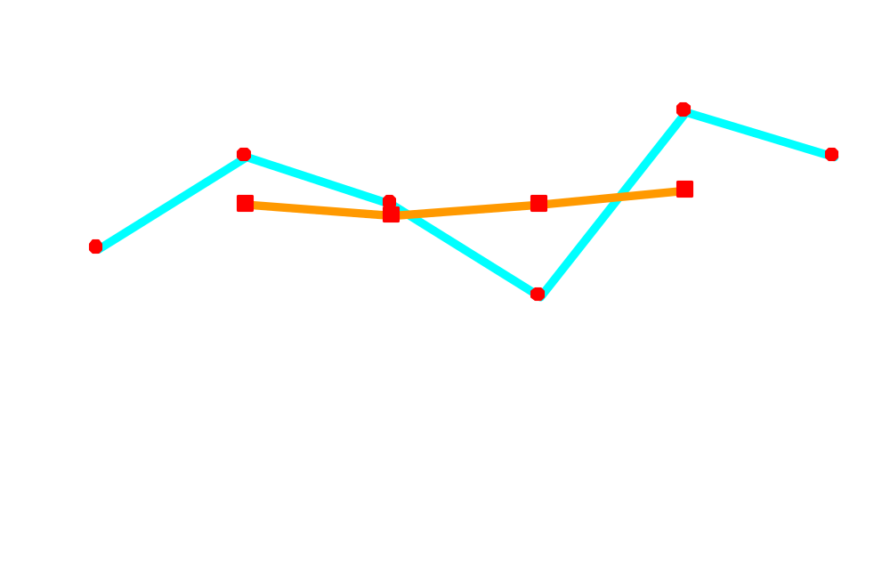
Moving Average Graph
Sales
Actual
Year
Notes:
53

Slide 46

Moving Average
[An Example]
You work for Firestone Tire. You want to smooth random fluctuations using a 3-period moving average.
1995 20,000
1996 24,000
1997 22,000
1998 26,000
1999 25,000
Notes:
54

Slide 47
Moving Average
[Solution]
Year Sales MA(3) in 1,000
1995 20,000 NA
1996 24,000 (20+24+22)/3 = 22
1997 22,000 (24+22+26)/3 = 24
1998 26,000 (22+26+25)/3 = 24
1999 25,000 NA
Notes:
55

Slide 48
Moving Average
Year Response Moving Ave
1994 2 NA
1995 5 3
1996 2 3
1997 2 3.67
1998 7 5
1999 6 NA
Sales
8
6
4
2
0
94 95 96 97 98 99

Slide 49
Exponential Smoothing Method
Notes:
56

Slide 50
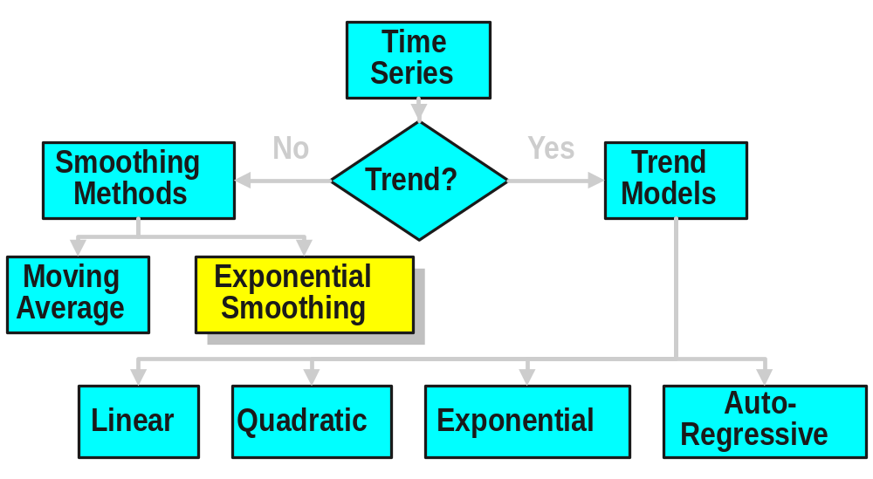
Time Series Forecasting
Notes:
57

Slide 51
Exponential Smoothing Method
Form of weighted moving average
  Weights decline exponentially
  Most recent data weighted most
Requires smoothing constant (W)
  Ranges from 0 to 1
  Subjectively chosen
Involves little record keeping of past data
Notes:
58

Slide 52


Exponential Smoothing
[An Example]
You’re organizing a Kwanza meeting. You want to forecast attendance for 1998 using exponential smoothing
(α = .20). Past attendance (00) is:
1995 4
1996 6
1997 5
1998 3
1999 7
© 1995 Corel Corp.
Notes:
63

Slide 53
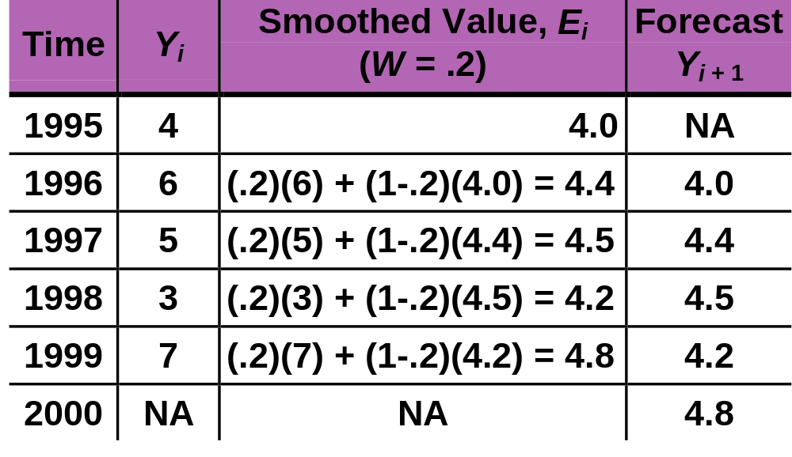
Exponential Smoothing
E_{i} = W·Y_{i} + (1 - W)·E_{i-1}
^
Notes:
81

Slide 54
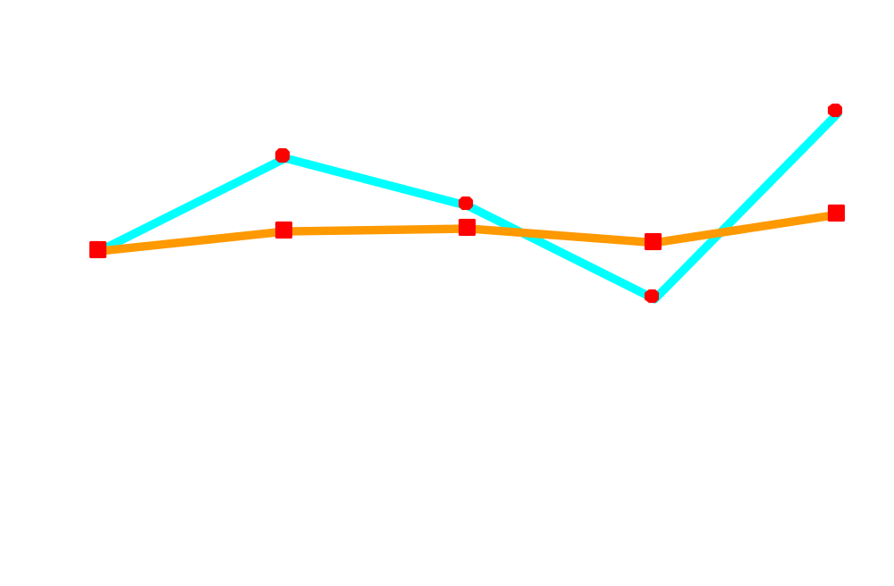
Exponential Smoothing [Graph]
Attendance
Actual
Year
Notes:
82

Slide 55
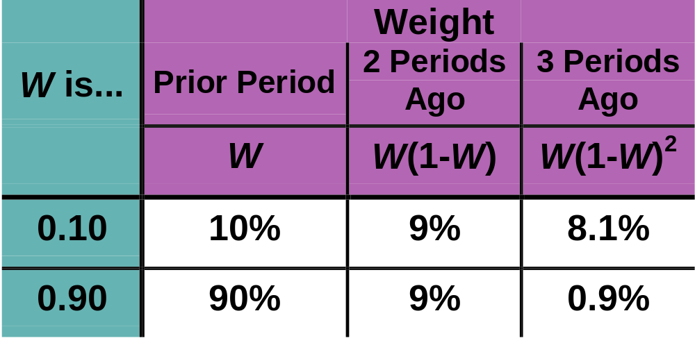
Forecast Effect of Smoothing Coefficient (W)
^
Y_{i+1} = W·Y_{i} + W·(1-W)·Y_{i-1} + W·(1-W)²·Y_{i-2} +...
Notes:
86

Slide 56
Linear Time-Series Forecasting Model
Notes:
87

Slide 57
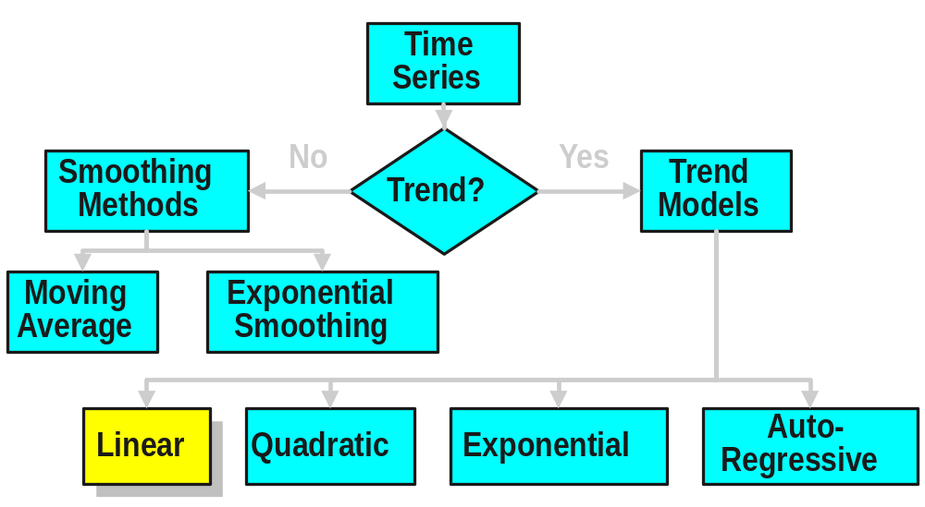
Time Series Forecasting
Notes:
88

Slide 58
Linear Time-Series Forecasting Model
Used for forecasting trend
Relationship between response variable Y & time X is a linear function
Coded X values used often
  Year X: 1995 1996 1997 1998 1999
  Coded year: 0 1 2 3 4
  Sales Y: 78.7 63.5 89.7 93.2 92.1
Notes:
89

Slide 59
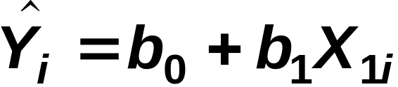
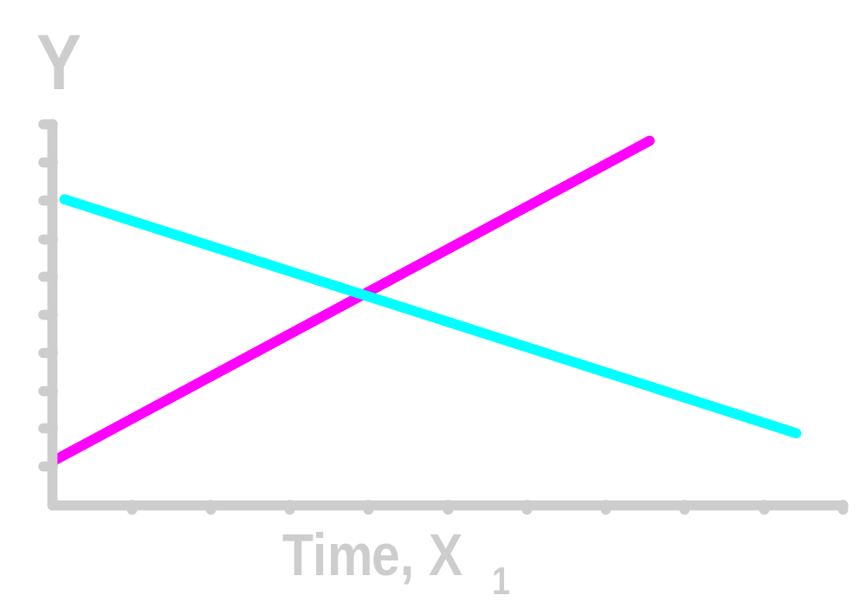
Linear Time-Series Model
b₁ > 0
b₁ < 0
Notes:
90

Slide 60

Linear Time-Series Model [An Example]
You’re a marketing analyst for Hasbro Toys. Using coded years, you find Y_{i} = .6 + .7X_{i}.
1995 1
1996 1
1997 2
1998 2
1999 4
Forecast 2000 sales.
^
Notes:
91

Slide 61
Linear Time-Series [Example]
Year Coded Year Sales (Units)
1995 0 1
1996 1 1
1997 2 2
1998 3 2
1999 4 4
2000 5 ?
2000 forecast sales: Y_{i} = .6 + .7·(5) = 4.1
The equation would be different if ‘Year’ used.
^
Notes:
92

Slide 62
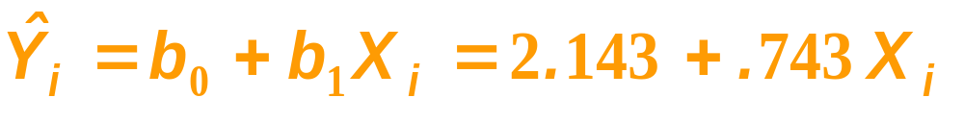
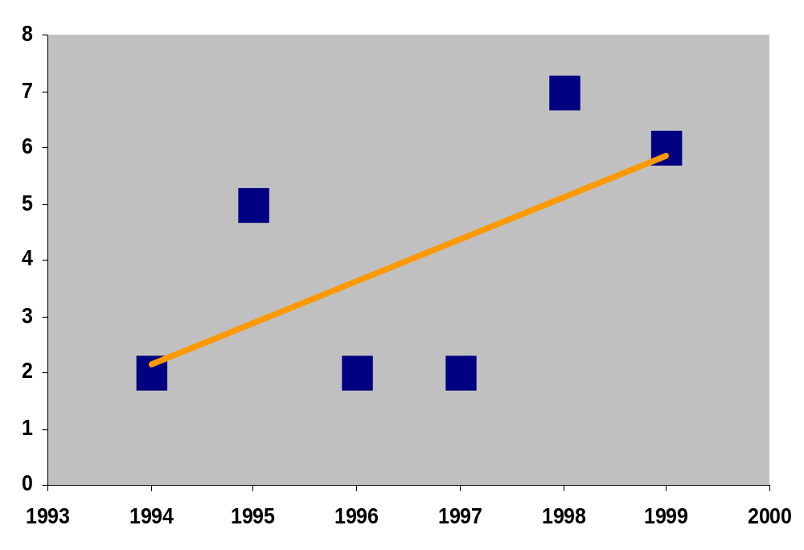
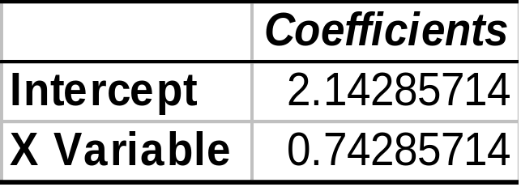
The Linear Trend Model
Year Coded Sales
94 0 2
95 1 5
96 2 2
97 3 2
98 4 7
99 5 6
Projected to year 2000
Excel Output

Slide 63
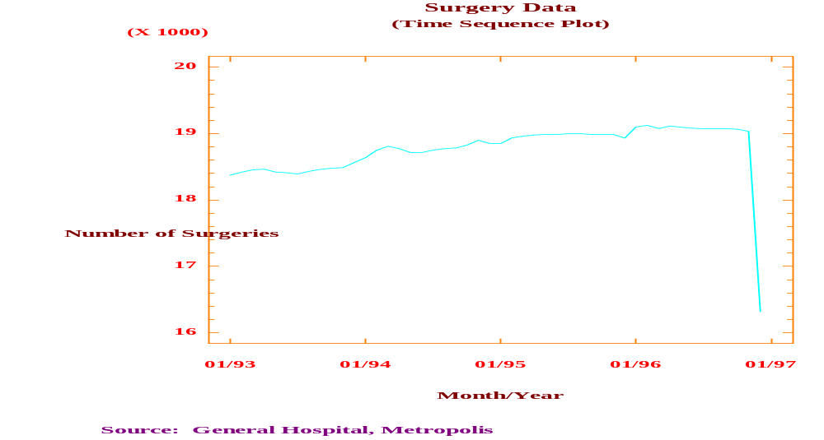
Time Series Plot

Slide 64
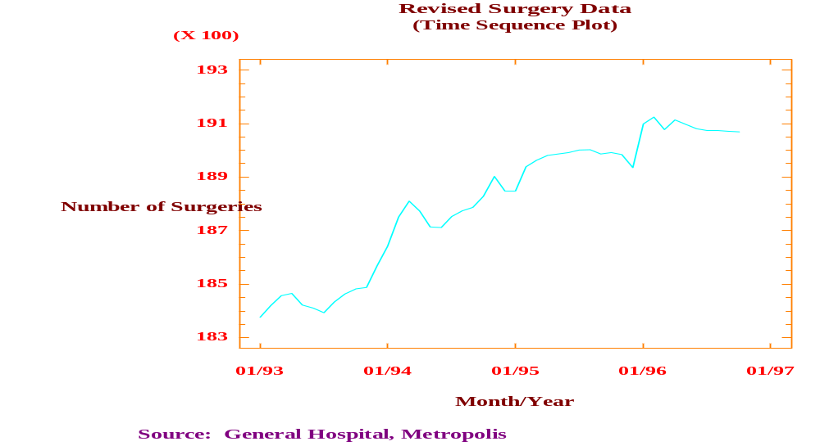
Time Series Plot [Revised]

Slide 65
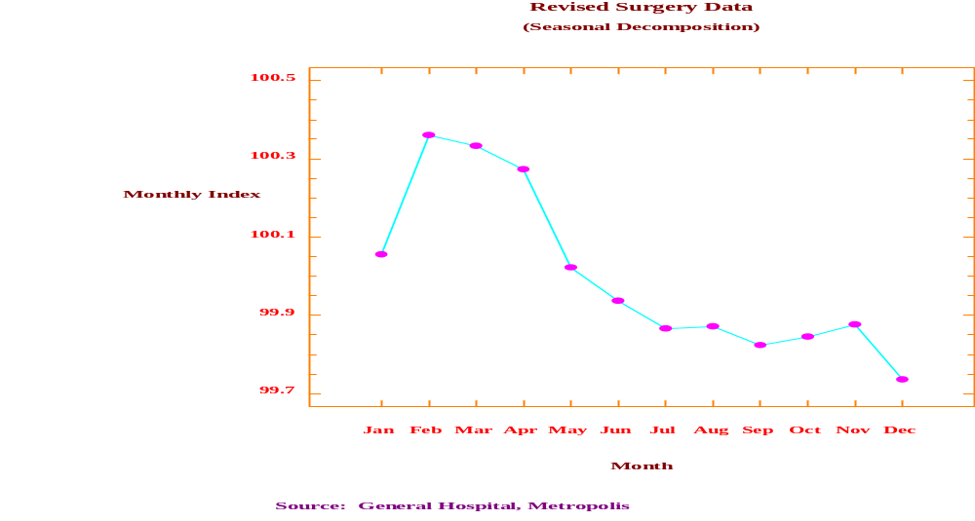
Seasonality Plot

Slide 66
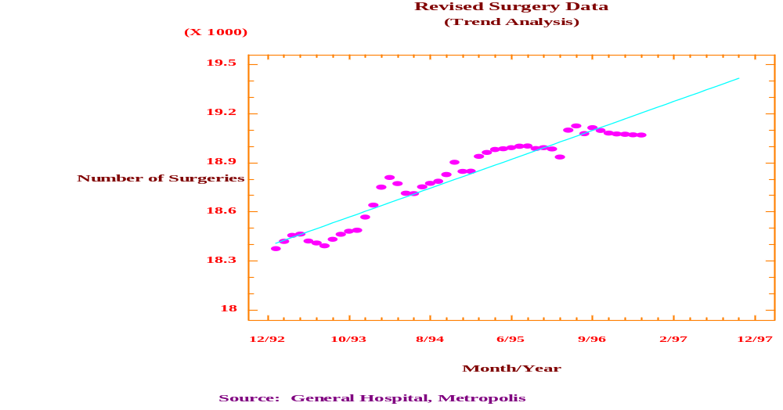
Trend Analysis

Slide 67
Quadratic Time-Series Forecasting Model
Notes:
93

Slide 68
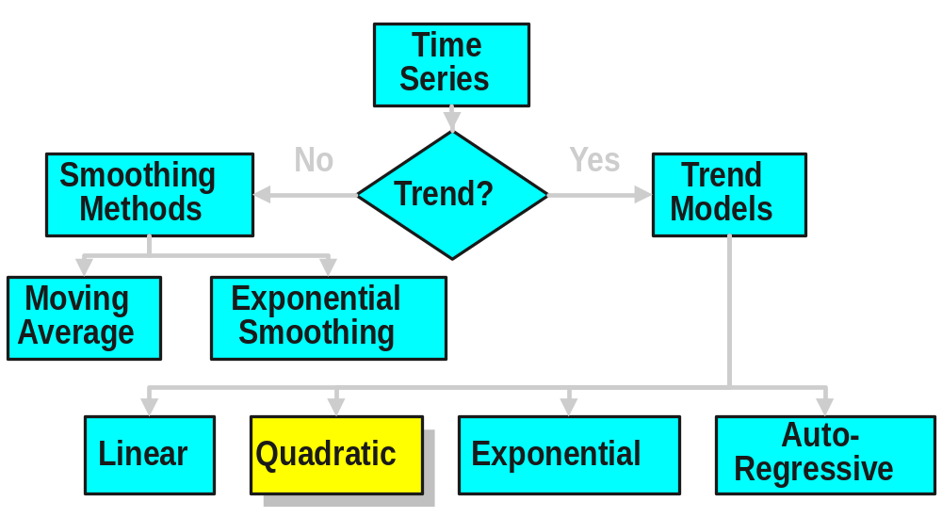
Time Series Forecasting
Notes:
94

Slide 69
Quadratic Time-Series Forecasting Model
Used for forecasting trend
Relationship between response variable Y & time X is a quadratic function
Coded years used
Notes:
95

Slide 70
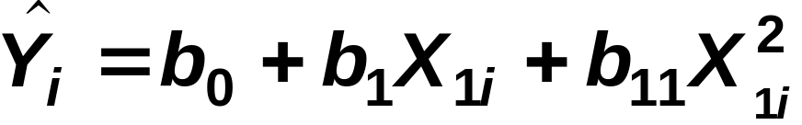
Quadratic Time-Series Forecasting Model
Used for forecasting trend
Relationship between response variable Y & time X is a quadratic function
Coded years used
Quadratic model
Notes:
96

Slide 71
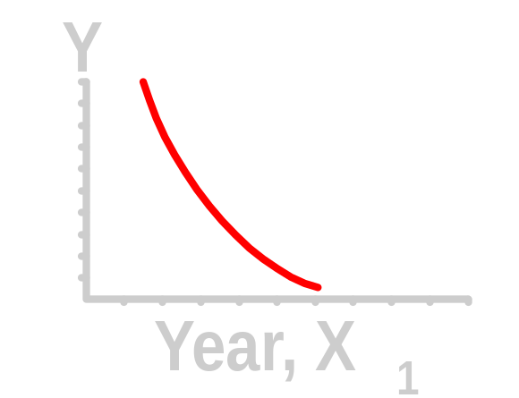
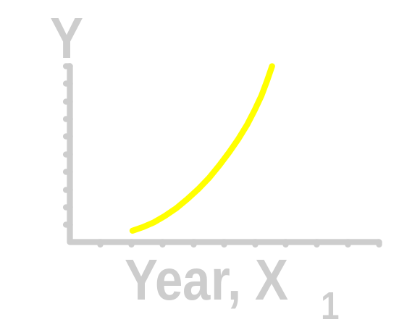
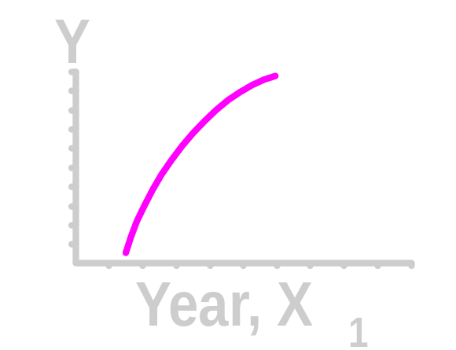
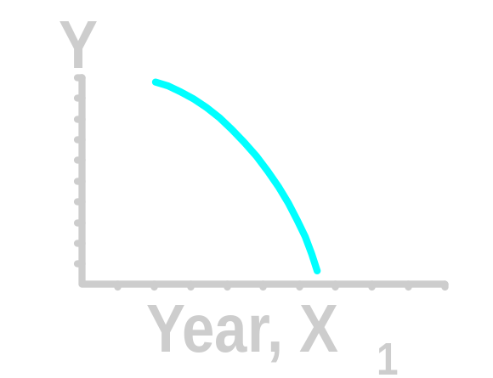
Quadratic Time-Series Model Relationships
b₁₁ > 0
b₁₁ > 0
b₁₁ < 0
b₁₁ < 0
Notes:
97

Slide 72
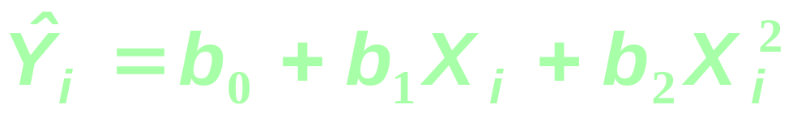
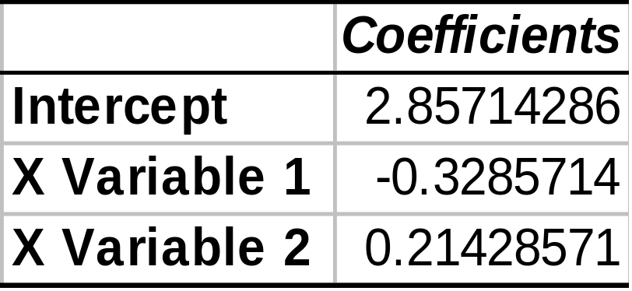
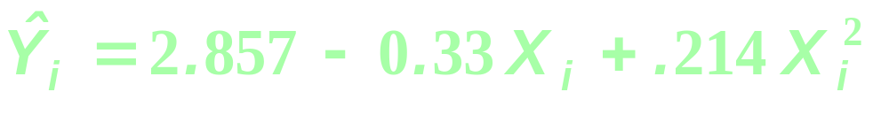
Quadratic Trend Model
Year Coded Sales
94 0 2
95 1 5
96 2 2
97 3 2
98 4 7
99 5 6
Excel Output

Slide 73
Exponential Time-Series Model
Notes:
98

Slide 74
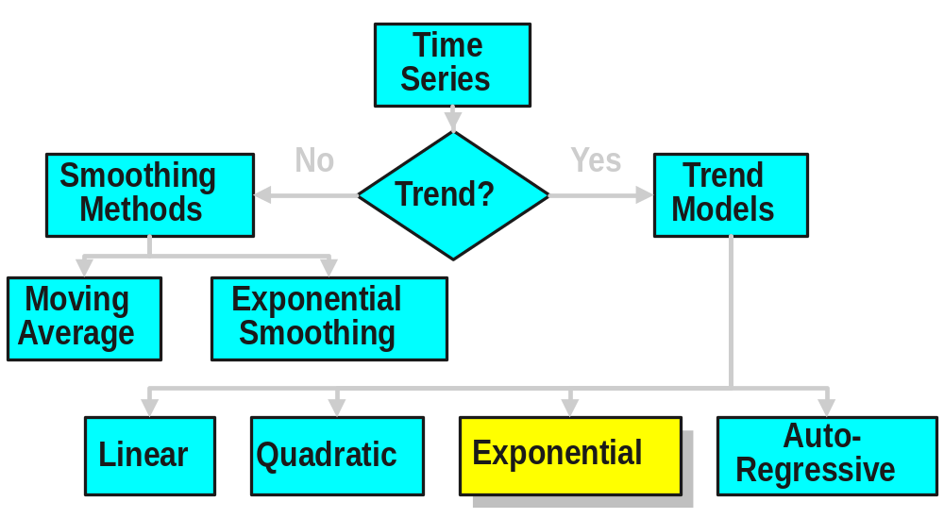
Time Series Forecasting
Notes:
99

Slide 75
Exponential Time-Series Forecasting Model
Used for forecasting trend
Relationship is an exponential function
Series increases (decreases) at increasing (decreasing) rate
Notes:
100

Slide 76
Exponential Time-Series Forecasting Model
Used for forecasting trend
Relationship is an exponential function
Series increases (decreases) at increasing (decreasing) rate
Notes:
101

Slide 77
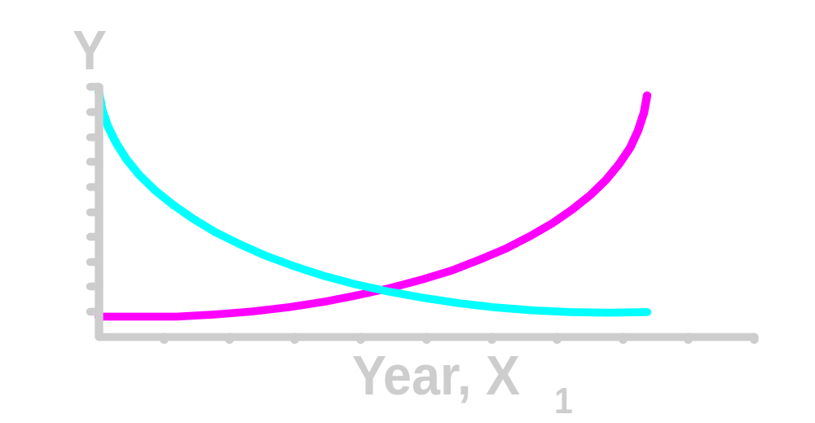
Exponential Time-Series Model Relationships
b₁ > 1
0 < b₁ < 1
Notes:
102

Slide 78
Exponential Weight [Example Graph]
Sales
8
6
4
2
0
Data
Smoothed
94 95 96 97 98 99
Year

Slide 79
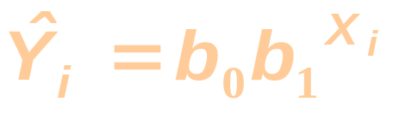
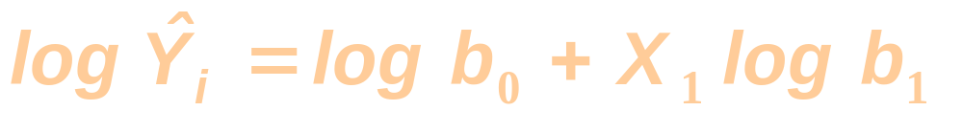
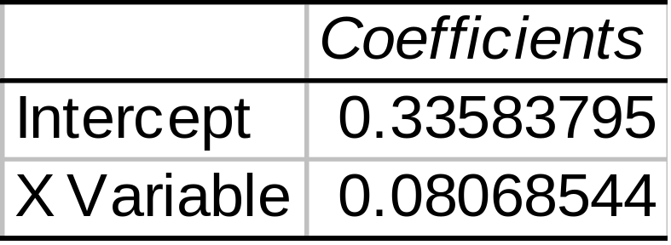
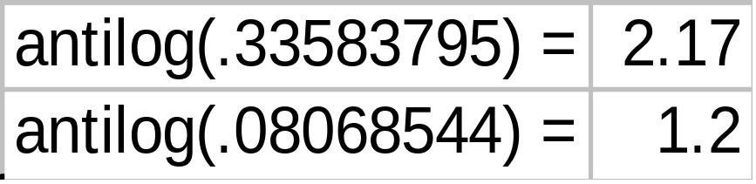
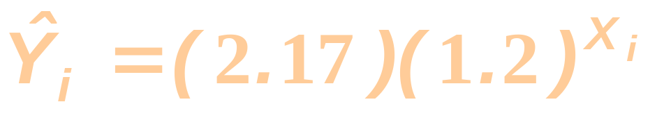
Exponential Trend Model
or
Year Coded Sales
94 0 2
95 1 5
96 2 2
97 3 2
98 4 7
99 5 6
Excel Output of Values in logs

Slide 80
Autoregressive Modeling
Notes:
103

Slide 81
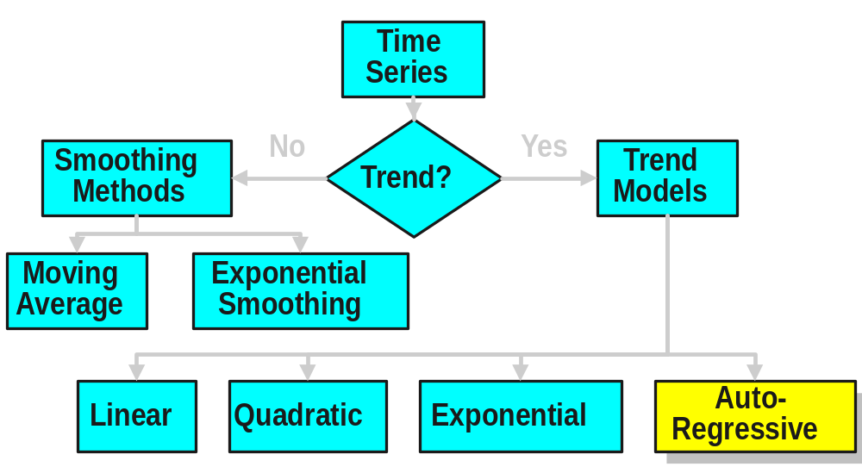
Time Series Forecasting
Notes:
104

Slide 82
Autoregressive Modeling
Used for forecasting trend
Like regression model
  Independent variables are lagged response variables Y_{i-1}, Y_{i-2}, Y_{i-3} etc.
Assumes data are correlated with past data values
  1st Order: Correlated with prior period
Estimate with ordinary least squares
Notes:
105

Slide 83
Time Series Data Plot

Slide 84
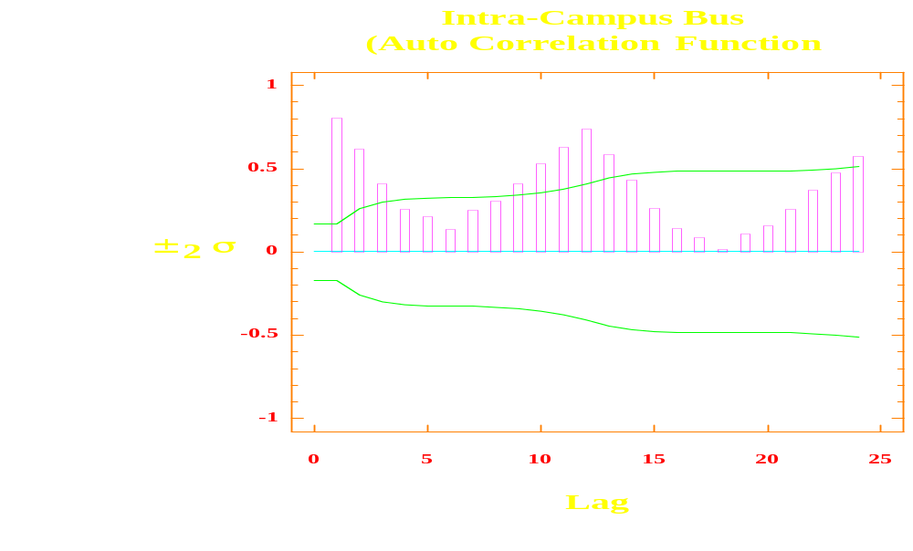
Auto-correlation Plot

Slide 85
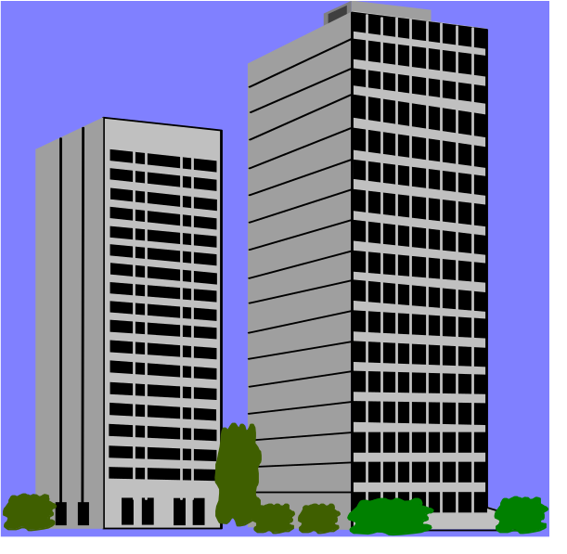
Autoregressive Model [An Example]
The Office Concept Corp. has acquired a number of office units (in thousands of square feet) over the last 8 years. Develop the 2nd order Autoregressive models.
Year Units
92 4
93 3
94 2
95 3
96 2
97 2
98 4
99 6

Slide 86
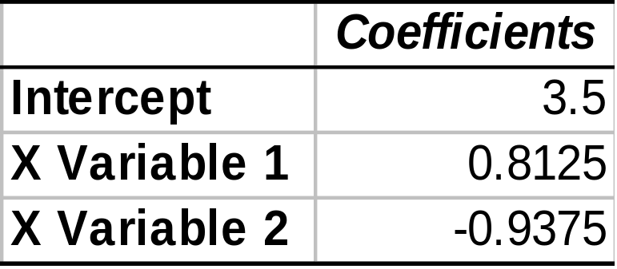
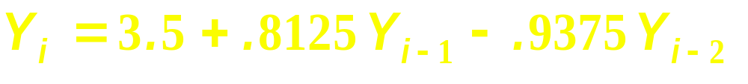
Autoregressive Model [Example Solution]
Develop the 2nd order table
Use Excel to run a regression model
Year Y_{i} Y_{i-1} Y_{i-2}
92 4 --- ---
93 3 4 ---
94 2 3 4
95 3 2 3
96 2 3 2
97 2 2 3
98 4 2 2
99 6 4 2
Excel Output

Slide 87
Evaluating Forecasts
Notes:
112

Slide 88
Quantitative
Forecasting Steps
Select several forecasting methods
‘Forecast’ the past
Evaluate forecasts
Select best method
Forecast the future
Monitor continuously forecast accuracy
☞
Notes:
113

Slide 89
Forecasting Guidelines
No pattern or direction in forecast error
  e_{i} = (Actual Y_{i} - Forecast Y_{i})
  Seen in plots of errors over time
Smallest forecast error
  Measured by mean absolute deviation
Simplest model
  Called principle of parsimony
Notes:
114

Slide 90

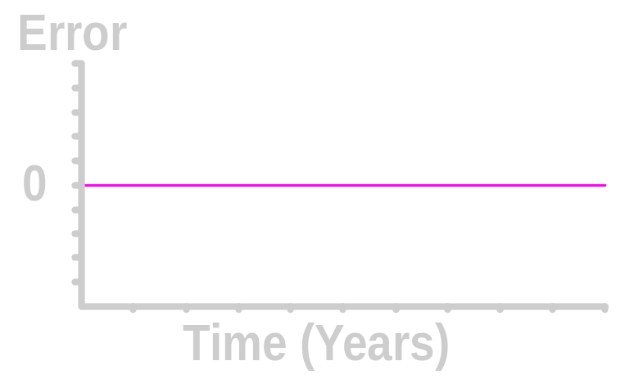
Pattern of Forecast Error
Trend Not Fully Accounted for
Desired Pattern
Notes:
115

Slide 91
Residual Analysis
e
e
0
0
T
T
Random errors
Cyclical effects not accounted for
e
e
0
0
T
T
Trend not accounted for
Seasonal effects not accounted for

Slide 92
Principal of Parsimony
Suppose two or more models provide good fit for data
Select the Simplest Model
  Simplest model types:
    least-squares linear
    least-square quadratic
    1st order autoregressive
  More complex types:
    2nd and 3rd order autoregressive
    least-squares exponential

Slide 93
Summary
Described what forecasting is
Explained time series & its components
Smoothed a data series
  Moving average
  Exponential smoothing
Forecasted using trend models
Notes:
121

Slide 94
Source of Elaborate Slides
Prentice Hall, Inc
Levine, et. all, First Edition

Slide 95


ANOVA

Slide 96
End of Chapter
Notes:
81

