Slide 1
Landmarks of Britain

Slide 2
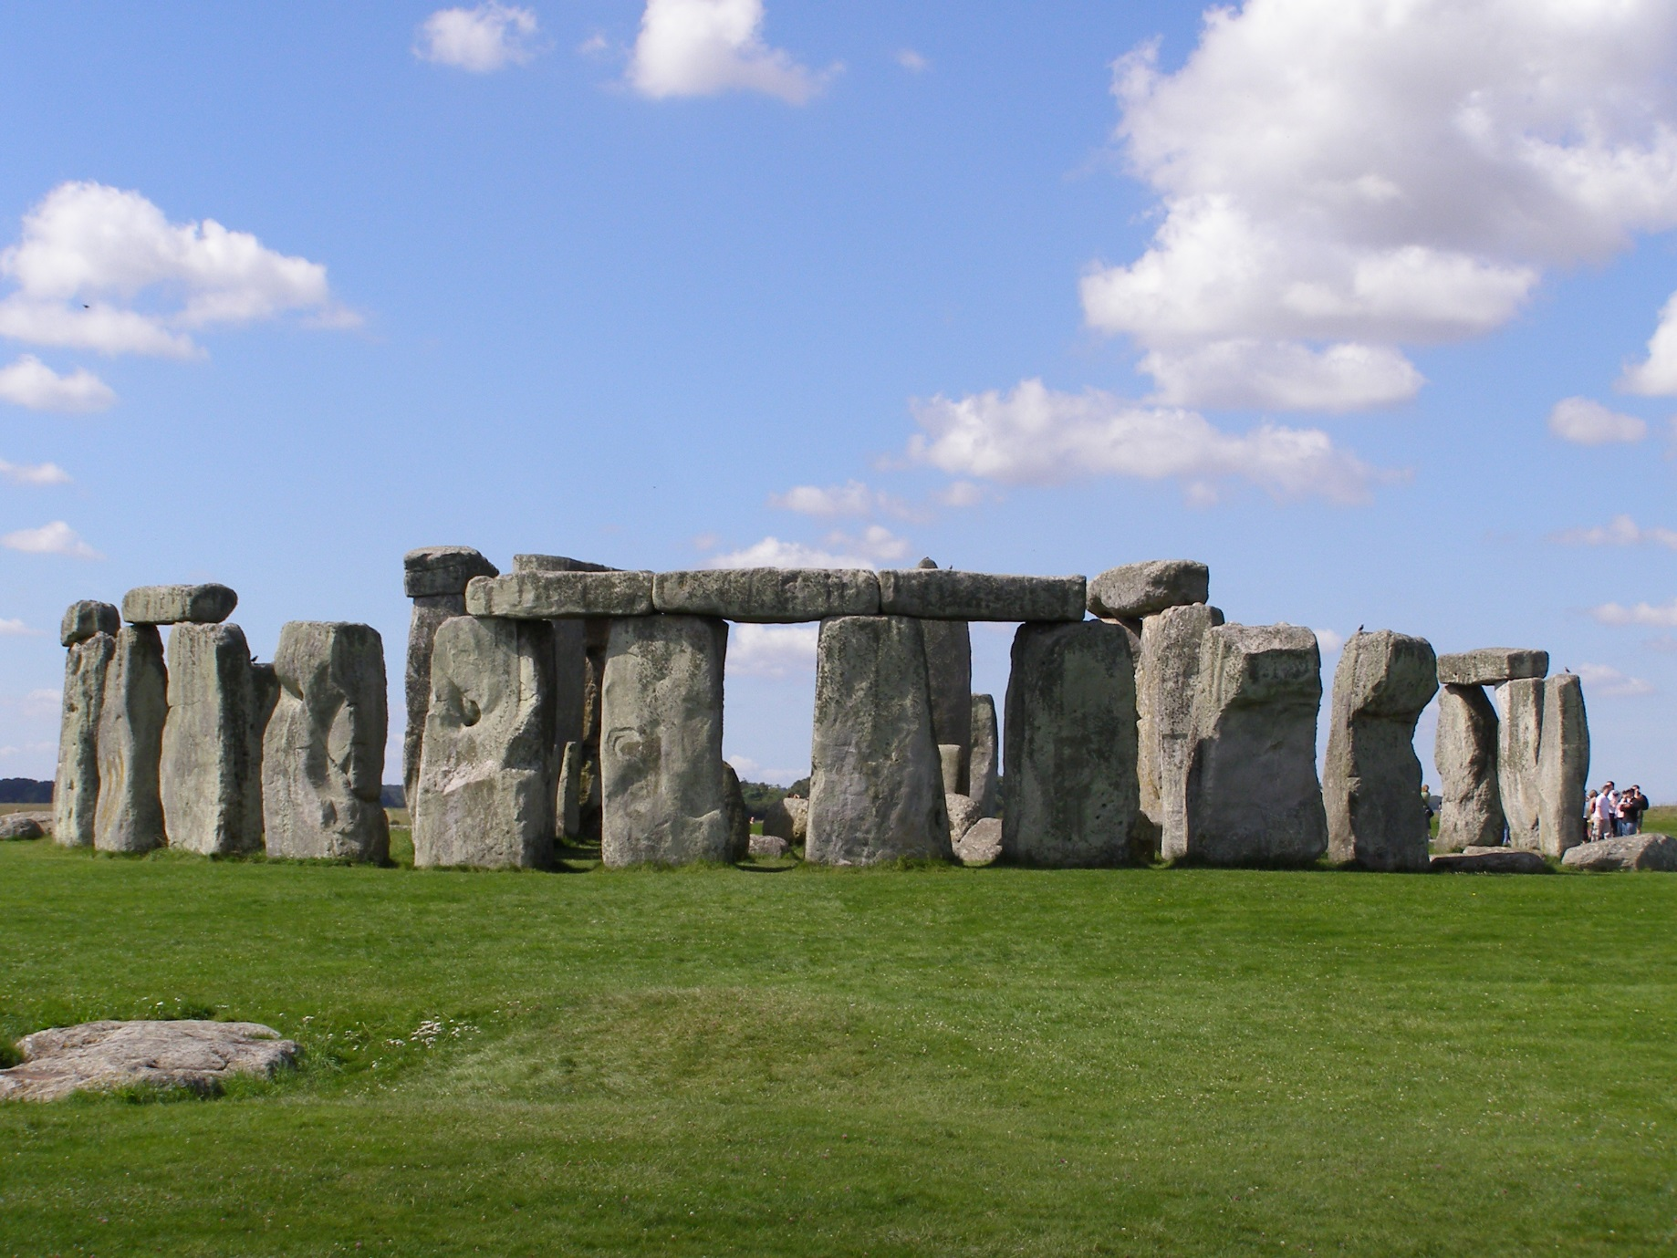
Stonehenge

Slide 3
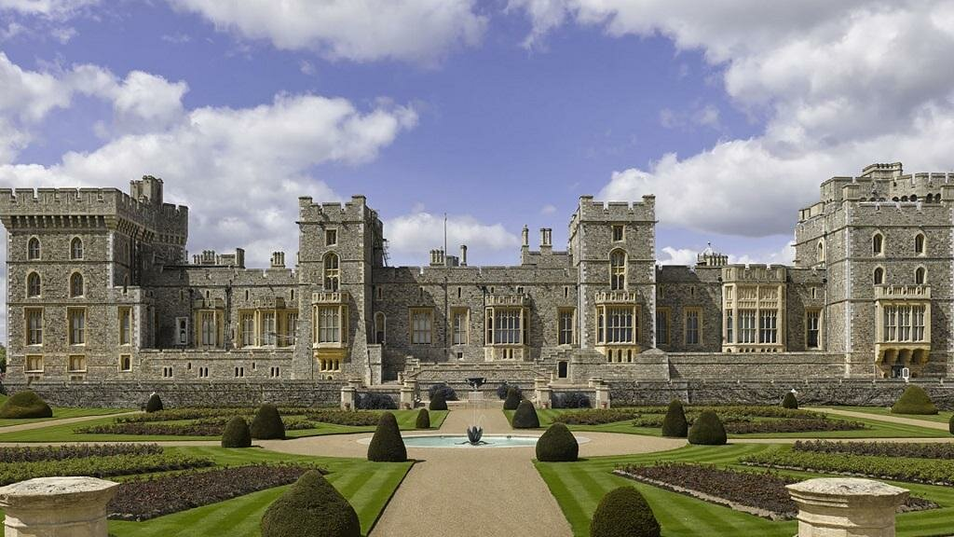
Windsor Castle

Slide 4
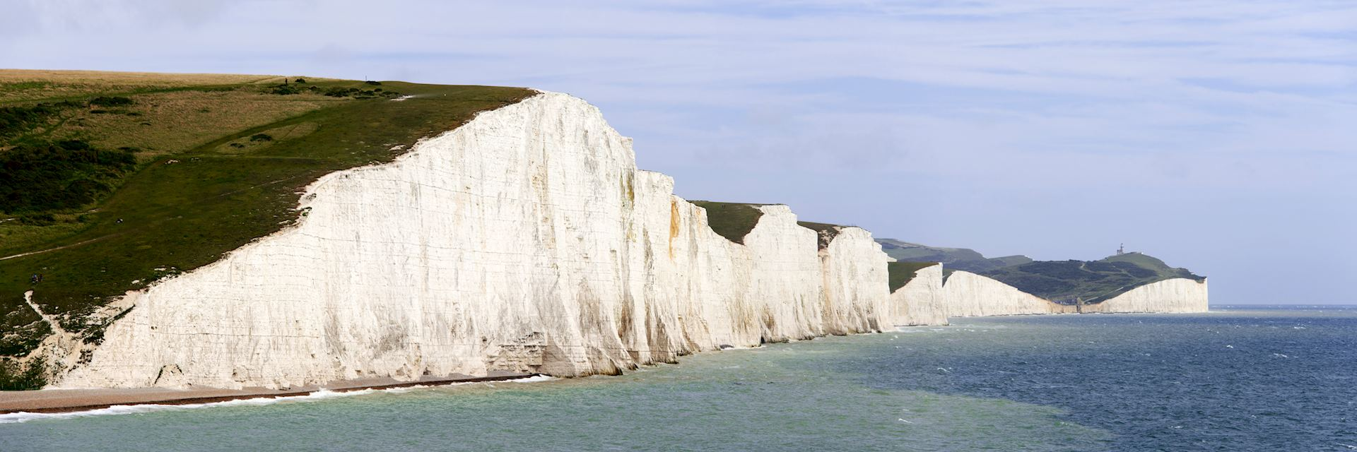
The White Cliffs of Dover

Slide 5
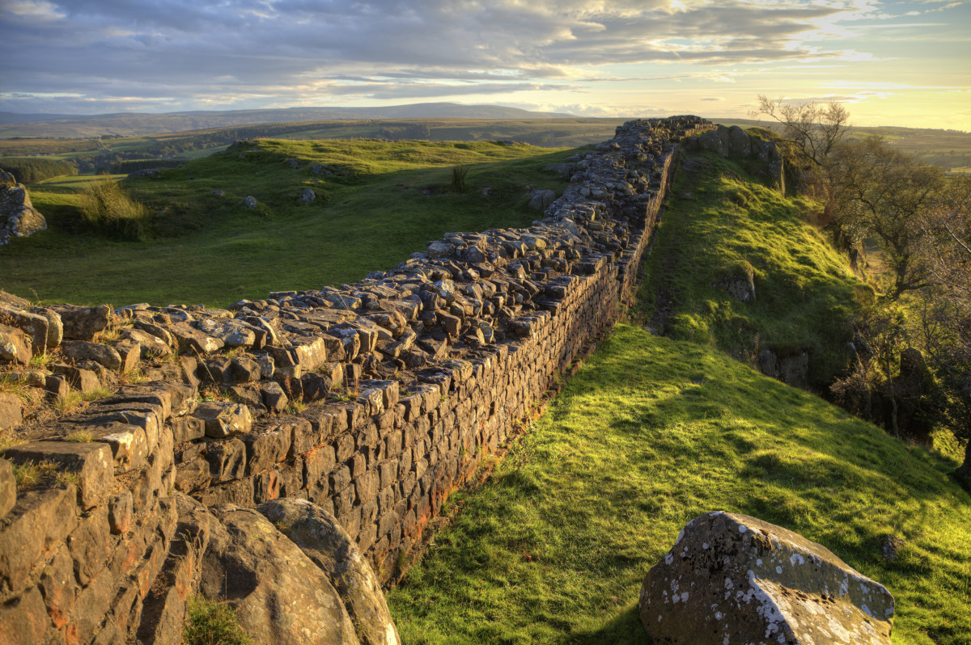
Hadrians Wall

Slide 6
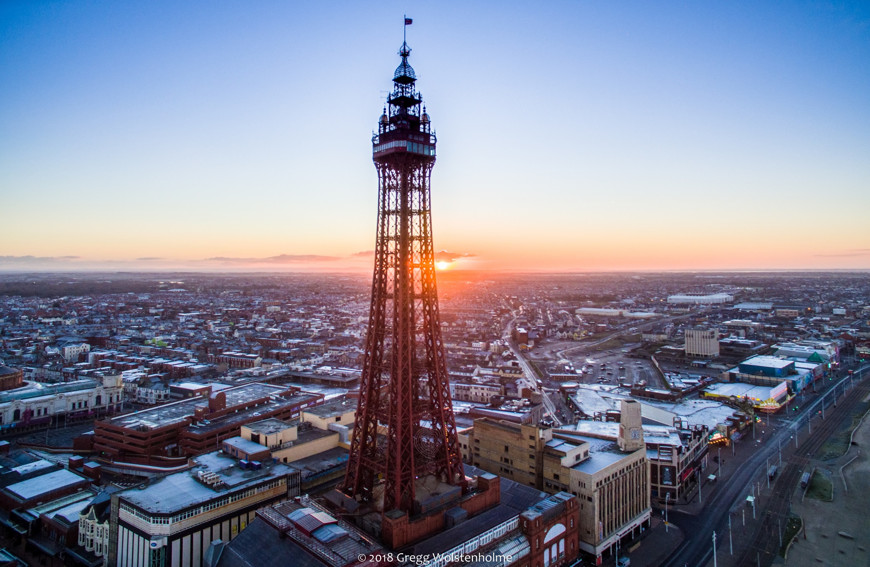
Blackpool Tower

Slide 7
Thanks for attention!

