Slide 1
Final project
Veronika Vallusova
vallusova@ksu.edu

Slide 2
Content
1. DataSet
2. Regression Analysis
3. Classification
4. Clustering

Slide 3
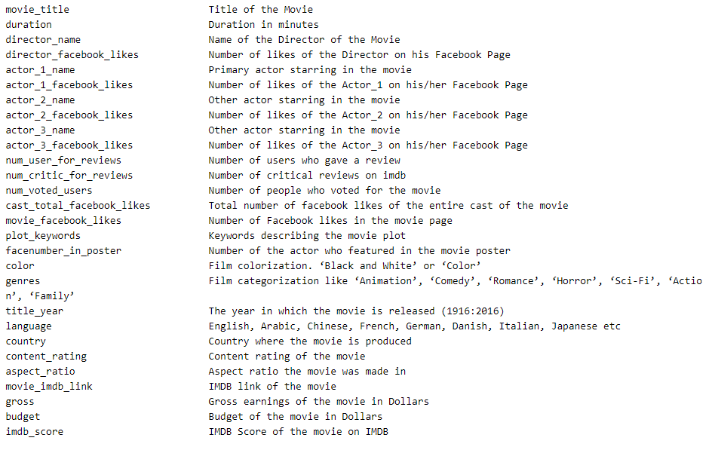
1. DataSet

Slide 4
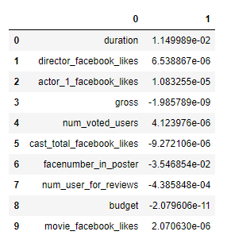
2. Regression analysis
Linear Regression
Multiple regression model
Regression model based on regularization
Feature selection
Random Forest
Important observations:
director_facebook_likes
num_voted_users
cast_total_facebook_likes
Notes:
From the data we can see prediction of linear regression. We can see for which variable should we focus on and on which not.
0 duration 1.149989e-02
1 director_facebook_likes 6.538867e-06
2 actor_1_facebook_likes 1.083255e-05
3 gross -1.985789e-09
4 num_voted_users 4.123976e-06
5 cast_total_facebook_likes -9.272106e-06
6 facenumber_in_poster -3.546854e-02
7 num_user_for_reviews -4.385848e-04
8 budget -2.079606e-11
9 movie_facebook_likes 2.070630e-06
From linear regression we can see that there is big linear regression with director_facebook_likes and also high linear regression with num_voted_users and low linear regression with cast_total_facebook_likes. I would focus on the two variables with the higher linear regression.

Slide 5
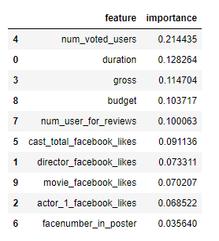
3. Classification
Decision Tree
KNeighborsClassifier
Logistic Regression
Random Forest
Feature selection
Important observations:
num_voted_users
Duration
gross
Notes:
It is possible to use lots of different analyses and method. For my analysis I used more different analysis and I got the higher accuracy 76% by using Random Forest. From classification analyses I got almost same result. The most importance features are num_voted_users and duration. Accuracy is almost 76% using random forest analyze. It means, that lots of data were correctly classified. We can say that variables num_voted_users and movie duration are the most important.

Slide 6
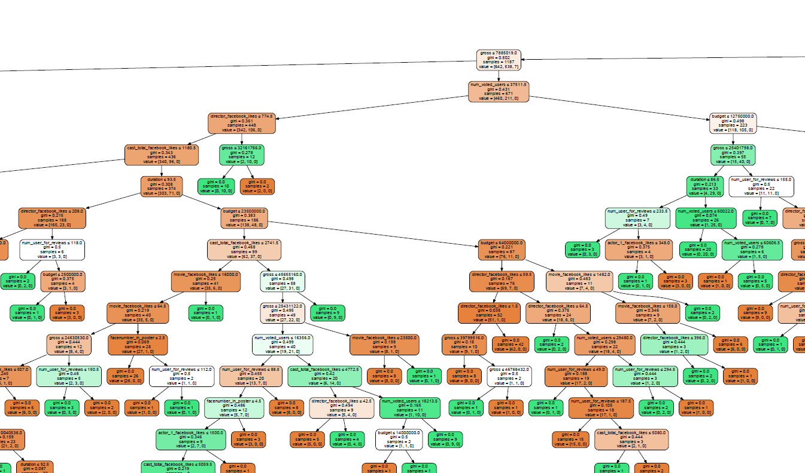
4. Clustering
K-Mean clustering
DecisionTreeClassifier
AgglomerativeClustering
Important observations:
Duration
num_voted_users
num_critic_for_reviews
Notes:
I divided all data to two different clusters. Firstly using K-Mean and secondly using Agglomerative clustering analysis. From K-Mean cluster we can see which observation belong to which cluster. K-Mean give me more data about each variable than Agglomerative analysis. Using Agglomerative analysis we can see distance between different clusters. There are 2697 observations in the first cluster and 3879 observation in the second cluster.

Slide 7
Questions?

Slide 8
Thank you for your attention.

