Slide 1
Graphics & Animation
Color Models

Slide 2
Color Models Introduction
A color model is an abstract way to define primary, secondary and tertiary colors of a color system.
Primary colors: The basic colors with which you (in theory) can mix all colors. With RGB these are red, green and blue. With CMY these are cyan, magenta and yellow.
Secondary colors: The colors you get when you mix two primary colors.
Tertiary colors: The colors you get when you mix three primary colors.

Slide 3
History of Color Theory
Isaac Newton developed the initial concept of the color circle or the color wheel in his 1704 book, entitled Opticks. Newton transitioned individual spectral colors, observed in his prism experiments, into a closed color circle.
In 1766, over 60 years after Isaac Newton’s writings on the color circle, Moses Harris published his Natural System of Colours book. In his book, Harris described the RYB color model and demonstrated the wide variety of colors that resulted from combinations of the three primary colors. His observations built upon the writings of Newton as well as Jacob Christoph Le Blon’s patented three-color separation printing process of 1719.

Slide 4
History of Color Theory
In 1810, Johann Wolfgang von Goethe published Zur Farbenlehre (translated into English as Theory of Colours) that became the foundation for color theory in regard to the RYB color model. In 1840, Charles Eastlake published an English translation of Goethe’s Zur Farbenlehre book and entitled it Theory of Colours.
In 1854, Charles Martel published “The Principles of Harmony and Contrast of Colours, and their Application to the Arts” in which he diagrammed a color wheel with 12 main color units of Red, Reddish Orange, Orange, Orange Yellow, Yellow, Yellowish Green, Green, Greenish Blue, Blue, Violet Blue, Violet, and Violet Red, with six zones in each color unit. This resulted in a total of 72 segments for his color wheel based on the RYB color model.

Slide 5
Color Model Types
RGB Color Model: RGB stands for Red, Green and Blue. These colors are the most distinguishable colors to the human eye, originally explored by Isaac Newton in 1666. The RGB color model is termed as an additive color model in which the combination of the Red, Green, and Blue primary lights produces White light. The RGB color model is used in various technologies producing color images, such as conventional photography and the display of images in electronic systems.

Slide 6
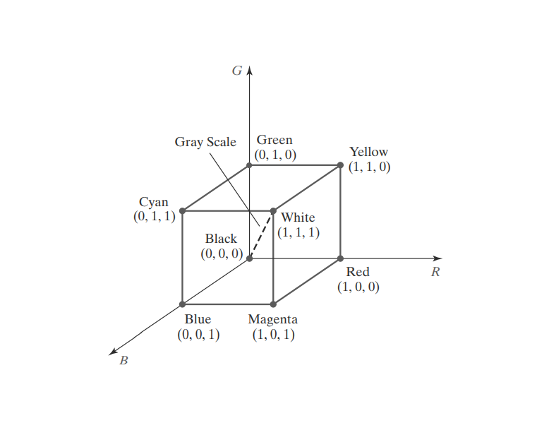
RGB Color Model
RED 630 nm
Green 530 nm
Blue 450 nm
By comparing intensities in a light source, we perceive the color of the light. This theory of vision is the basis for displaying color output on a video monitor using the three primaries red, green, and blue, which is referred to as the RGB color model.

Slide 7
Color Model Types
RYB Color Model: Also know as “The Pigment Color Wheel/Model” was fully summarized by Johann Wolfgang von Goethe in 1810. He created the RYB (red-yellow-blue) color wheel from physiological studies of colors and perception. Later in early 1990s, CMYK printing was introduced to yield the ability to print many different colors, combined with half-toning.
CMY or CMYK Color Model: Cyan, Magenta, and Yellow (CMY) with Key (plate) which is usually black make CMYK model. The CMYK color model is termed as a subtractive color model in which the starting point begins with a White or light surface.

Slide 8
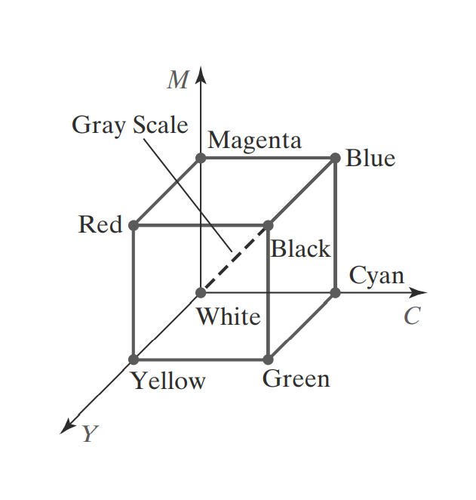
CMYK Color Model
A subtractive color model can be formed with the three primary colors cyan, magenta, and yellow

Slide 9
Color Model Types
Grayscale Model: It contains values of light intensity.
HSV Model: HSV stands for Hue, Saturation and Value. This model is also sometimes called HSB, where the B stands for Brightness.
Pantone Model (PMS): Pantone is a color space that do not represent a specific color model. (https://www.pantone.com/color-finder). Developed by Pantone LLC in 1956, headquartered in Carlstadt, New Jersey.

Slide 10

Grayscale
From Black (0) to White (255)

Slide 11
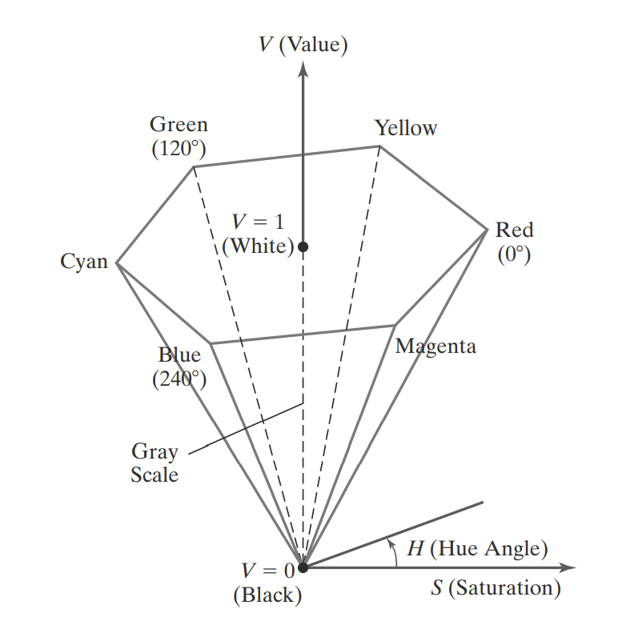
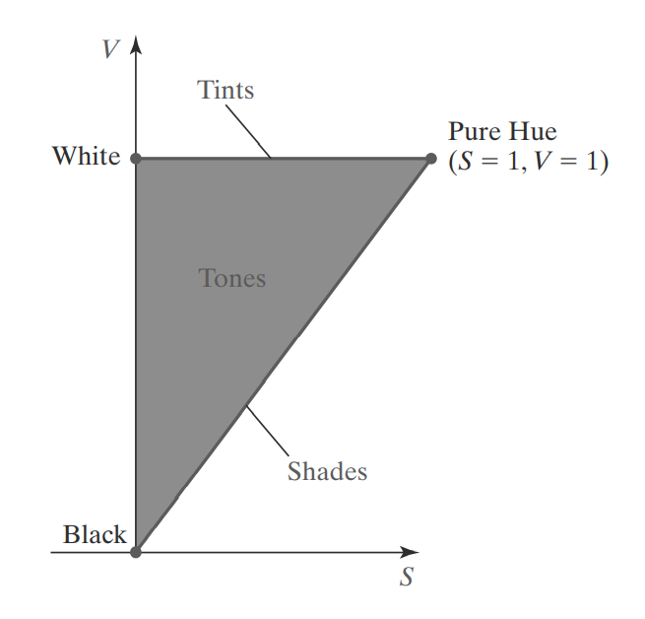
HSV

Slide 12
Color Model vs Color Spaces
A color model is an abstract way to define primary, secondary and tertiary colors of a color system. E.g. Red, Green, and Blue (RGB) or Cyan, Magenta, Yellow (CMY)
A color space is the set of colors which be displayed or reproduced in a medium like printer or screens. For example, most common screen (monitors or TVs) color space is sRGB.

Slide 13
Questions?

