Slide 1
MBSA PROJECT
Group Members -
Vidya Sagar S20200020312 sagarreddy.v20@iiits.in
Sheik Vazeer Ahamed S20200020301 vazeerahamed.sk20@iiits.in
P. Manoj Arun Kumar S20200020293 arunkumar.p20@iiits.in
PARAMETER ESTIMATION OF WEIBULL DISTRIBUTION USING MAXIMUM LIKELIHOOD ESTIMATION

Slide 2
TABLE OF CONTENT
01
PROBLEM STATEMENT
04
Parameter Estimation
02
Literature Review
05
Results
03
Weibull Distribution
06
Kullback - Leibler Divergence

Slide 3
PROBLEM STATEMENT
The Weibull distribution, an extreme value distribution, is frequently used to model survival,
reliability, wind speed, and other data. One reason for this is its flexibility; it can mimic various
distributions like the exponential or normal. The two-parameter Weibull has a shape (γ) and scale (β) parameter.
Parameter estimation has been an ongoing search to find efficient, unbiased, and minimal variance estimators.
Two popular methods for estimating the parameters of the Weibull distribution are maximum likelihood estimation (MLE) and Bayesian estimation. In this report we are providing CRB, and detailed step-by-step procedure for performing parameter estimation using MLE of two-parameters using Newton Raphson method. We also applied Monte-Carlo for better estimation.

Slide 4
Comparison Between the Bayesian and the Classical Estimators of
Weibull Distribution.
Weibull Distribution for Estimating the Parameters
LITERATURE REVIEW
Maximum Likelihood Estimation: Numerical Solution
for Weibull Distribution
Parameter Estimation for the Two-Parameter Weibull
Distribution
Maximum Likelihood Estimation:
Numerical Solution for Weibull Distribution

Slide 5
WEIBULL DISTRIBUTION
In this report we explore the use of the two-parameter Weibull distribution in reliability analysis and apply maximum
likelihood estimation to estimate the parameters of the distribution. We also generate synthetic data from the Windmill
dataset to evaluate the performance of different estimation methods. Specifically, we calculate the Cramer-Rao bound
for the two-parameter Weibull distribution, estimate the shape and scale parameters of the distribution using the method
of moments, and apply Monte-Carlo simulation to obtain a more accurate estimate of the parameters.
The two-parameter Weibull distribution,
If T ~ Weibull (γ,β) then its density function is defined as:
ft∕γ,β = tγ-1 exp -t , for γ>0 , and β>0
Where t is the failure time, is the scale parameter, and is the shape parameter. The scale parameter determines
the location of the distribution, and the shape parameter determines the shape of the distribution.
Here, γ,β are unknown parameters, we are estimating the unknown parameters.

Slide 6
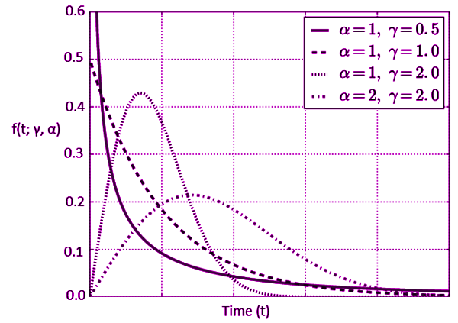
PLOTS
Alpha and Gamma are the
shape and scale parameters

Slide 7
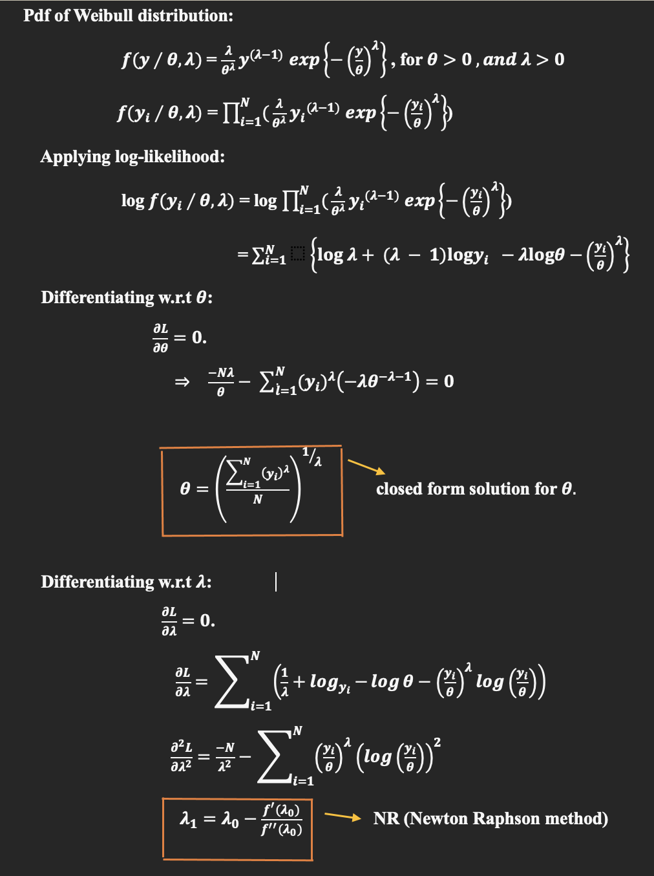
Parameter Estimation

Slide 8
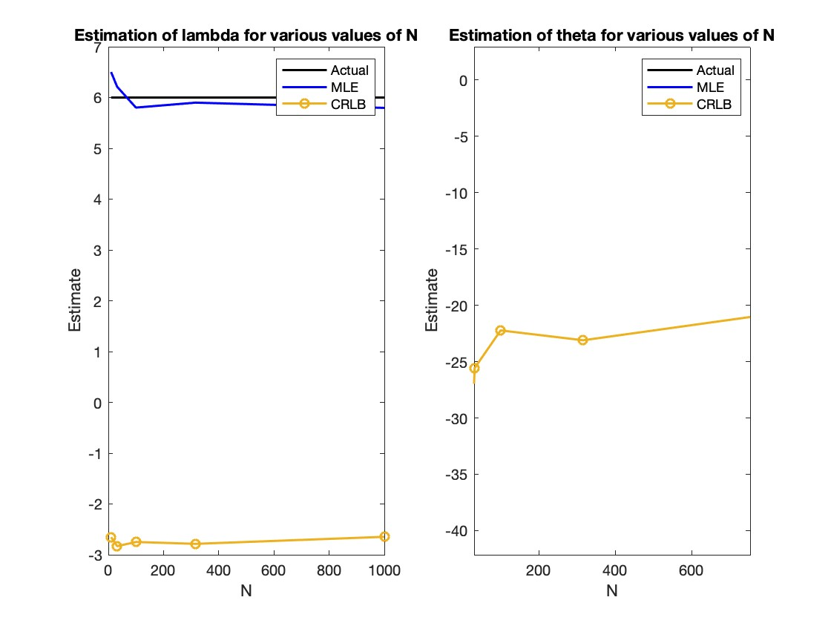
Results

Slide 9
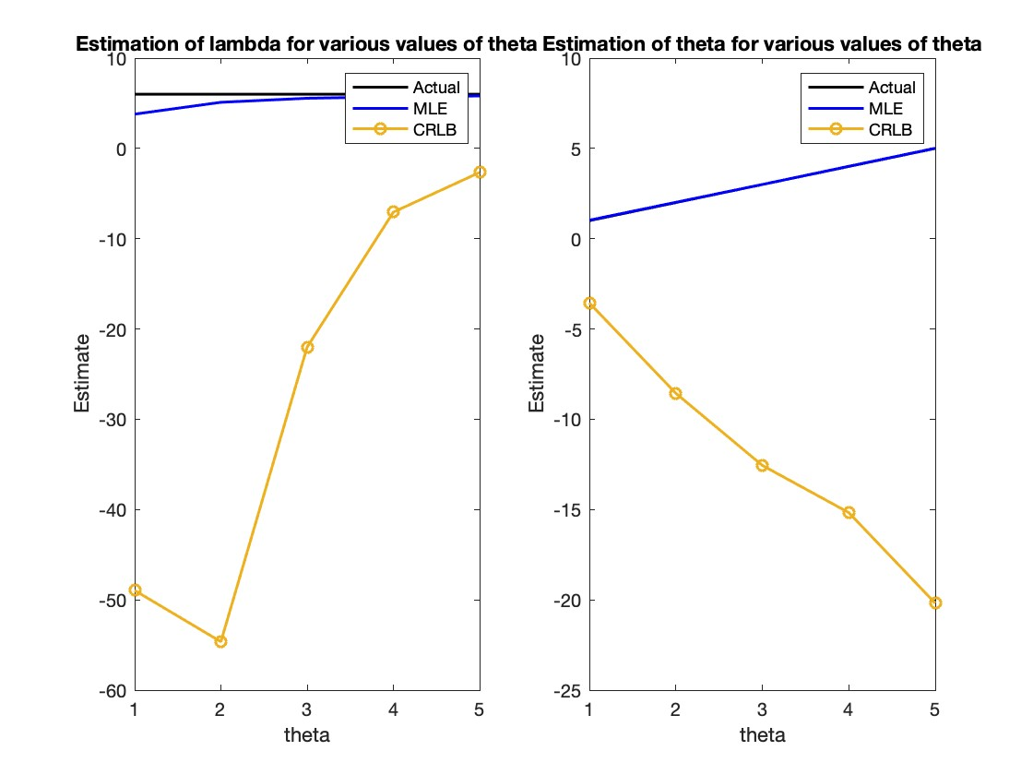

Slide 10
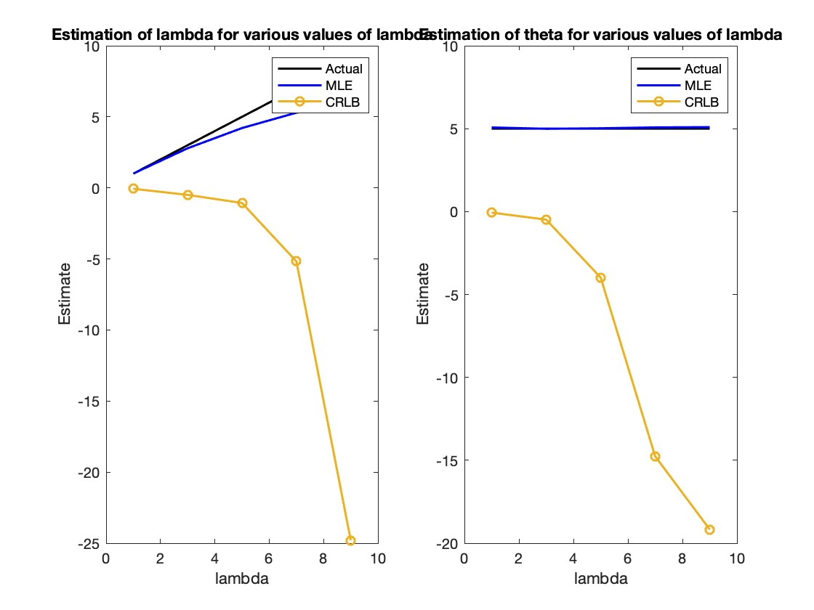

Slide 11
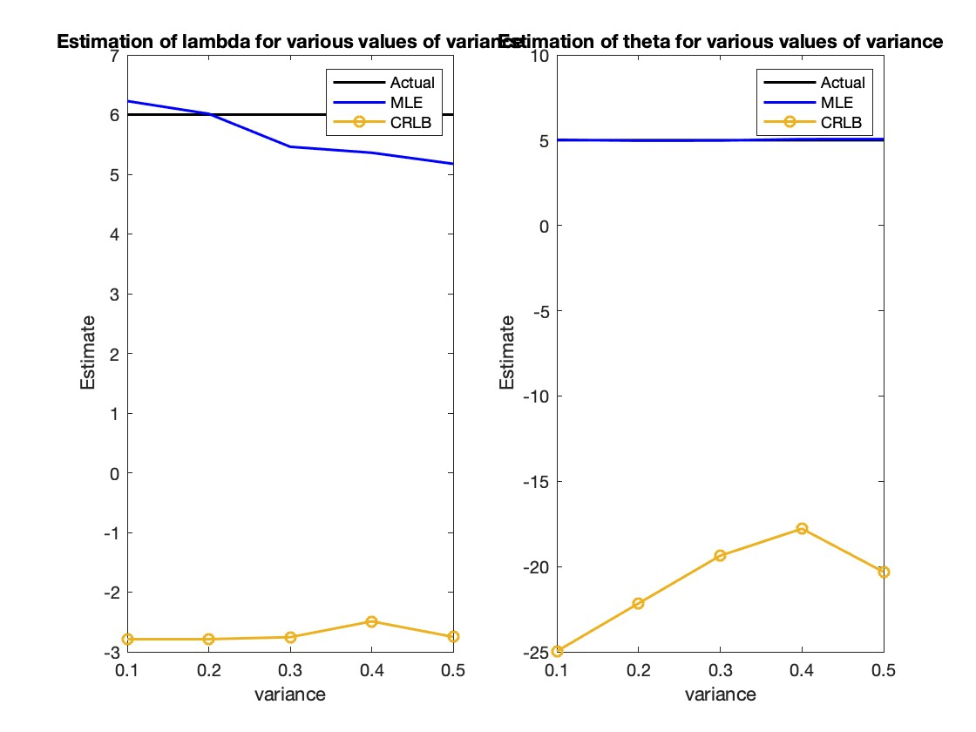

Slide 12
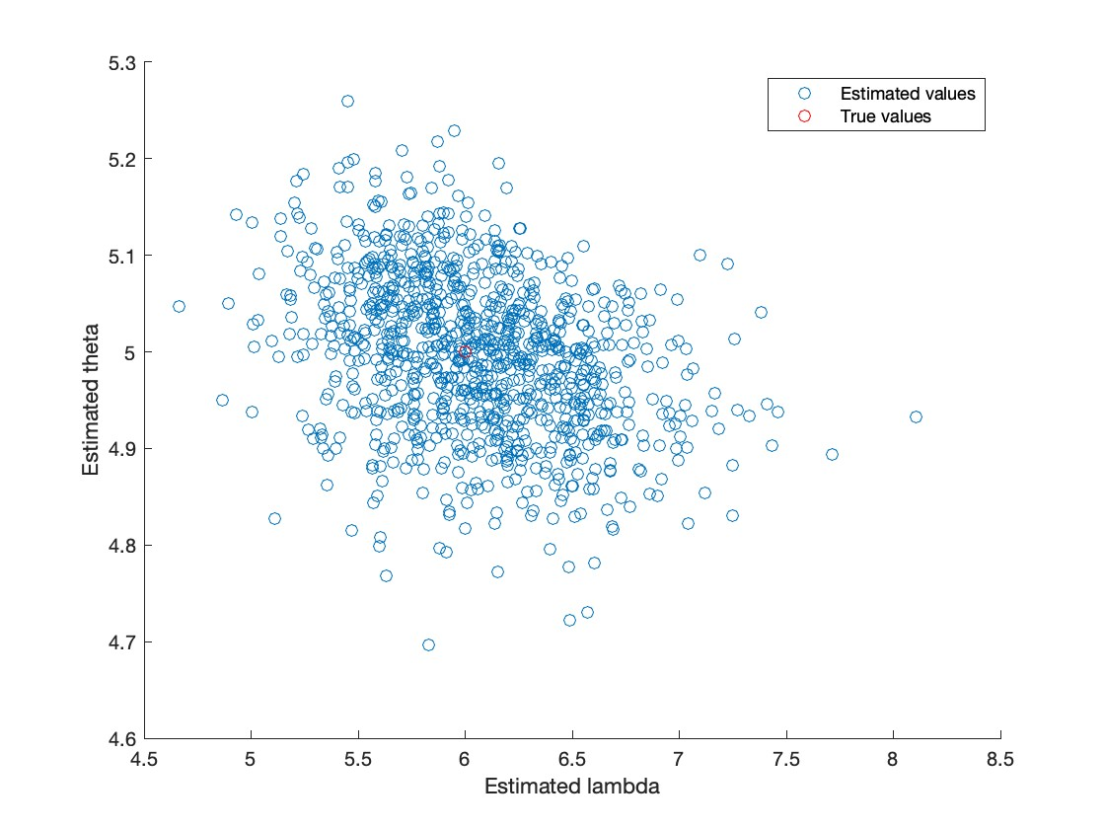

Slide 13
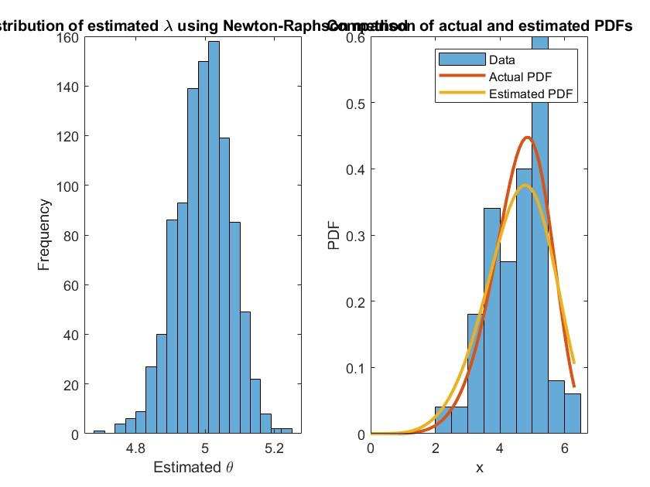

Slide 14
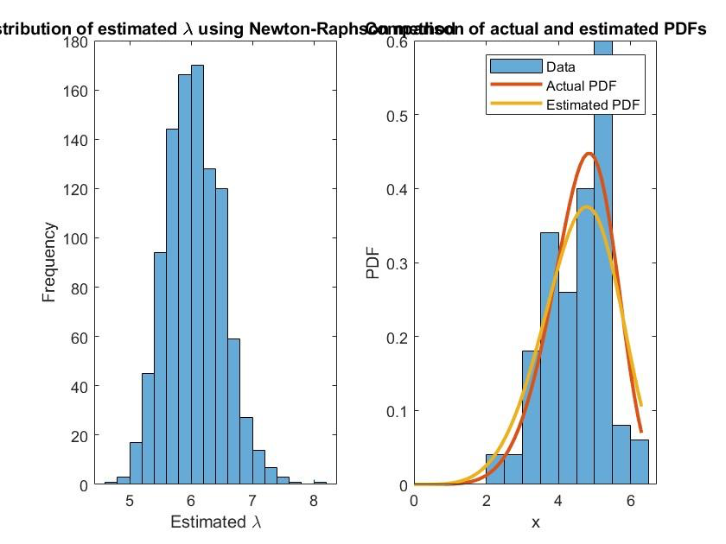

Slide 15
Kullback–Leibler divergence
In simple terms, KL divergence measures how different one probability
distribution is from another. It is often used in statistics, information theory,
and machine learning to compare two probability distributions.
The KL divergence is not a true distance metric, since it is not symmetric and does not satisfy
the triangle inequality. However, it is a useful measure in many applications, such as in data compression,
model selection, and hypothesis testing.

Slide 16
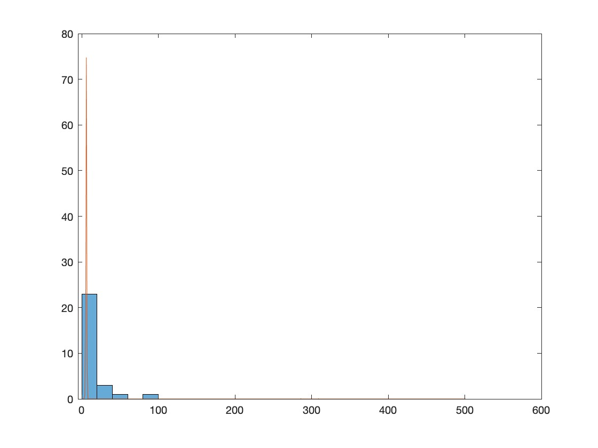
Dist = 0
When we apply for the
Kullback–Leibler divergence

