Slide 1
More Performance Optimizations for Sitefinity Val Vieyra
Join the conversation on Twitter at #PRGRSummit

Slide 2
About Me

Slide 3
Agenda
What are we taking about?
What does Sitefinity do out of the box?
What do we actually want to happen?
What are we limited by?
Lets start making this happen
Lets make it better
LETS SEE IT WORK!

Slide 4
What are we talking about?
PERFORMANCE

Slide 5
What are we talking about?
PERFORMANCE
What are we gaining?

Slide 6
What are we talking about?
PERFORMANCE
What are we gaining?
Server side performance

Slide 7
What are we talking about?
PERFORMANCE
What are we gaining?
Server side performance
CPU Cycles

Slide 8
What are we talking about?
PERFORMANCE
What are we gaining?
Server side performance
CPU Cycles
What we are NOT gaining

Slide 9
What are we talking about?
PERFORMANCE
What are we gaining?
Server side performance
CPU Cycles
What we are NOT gaining
Client side performance

Slide 10
What are we talking about?
PERFORMANCE
What are we gaining?
Server side performance
CPU Cycles
What we are NOT gaining
Client side performance
Code performance

Slide 11
What does Sitefinity do out of the box?

Slide 12
What does Sitefinity do out of the box?
.NET Application
Notes:
What gets compiled?
Page Nodes
What gets cached?
Html pages

Slide 13
What does Sitefinity do out of the box?
.NET Application
Page Compilation
Notes:
What gets compiled?
Page Nodes
What gets cached?
Html pages

Slide 14
What does Sitefinity do out of the box?
.NET Application
Page Compilation
All those pages
Notes:
What gets compiled?
Page Nodes
What gets cached?
Html pages

Slide 15
What does Sitefinity do out of the box?
.NET Application
Page Compilation
All those pages
Cache those results
Notes:
What gets compiled?
Page Nodes
What gets cached?
Html pages

Slide 16
What does Sitefinity do out of the box?
.NET Application
Page Compilation
All those pages
Cache those results
ASPX => HTML
Notes:
What gets compiled?
Page Nodes
What gets cached?
Html pages

Slide 17
What does Sitefinity do out of the box?
.NET Application
Page Compilation
All those pages
Cache those results
ASPX => HTML
Every frontend page
Notes:
What gets compiled?
Page Nodes
What gets cached?
Html pages

Slide 18
What does Sitefinity do out of the box?
.NET Application
Page Compilation
All those pages
Cache those results
ASPX => HTML
Every frontend page
Stored in memory
Notes:
What gets compiled?
Page Nodes
What gets cached?
Html pages

Slide 19
What does Sitefinity do out of the box?
.NET Application
Page Compilation
All those pages
Cache those results
ASPX => HTML
Every frontend page
Stored in memory
ON DEMAND!
Notes:
What gets compiled?
Page Nodes
What gets cached?
Html pages

Slide 20
What we want Sitefinity to do!
.NET Application
Page Compilation
All those pages
Cache those results
ASPX => HTML
Every frontend page
Stored in memory
ON DEMAND!
BEFORE OUR USERS GET THERE!
Notes:
What gets compiled?
Page Nodes
What gets cached?
Html pages

Slide 21
What are we limited by?
Session
Server-side Cookies
*Global.asax

Slide 22
What are we limited by?

Slide 23
What are we limited by?
Session

Slide 24
What are we limited by?
Session
Server-side Cookies

Slide 25
What are we limited by?
Session
Server-side Cookies
*Global.asax

Slide 26
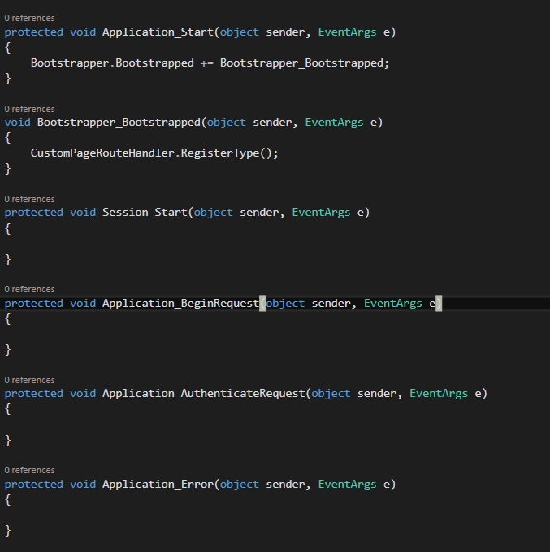
What are we limited by?
Session
Server-side Cookies
*Global.asax

Slide 27
What are we limited by?
Session
Server-side Cookies
*Global.asax

Slide 28
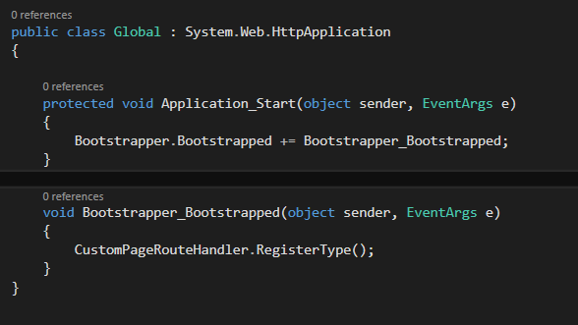
What are we limited by?
Session
Server-side Cookies
*Global.asax

Slide 29
Lets start making this happen

Slide 30
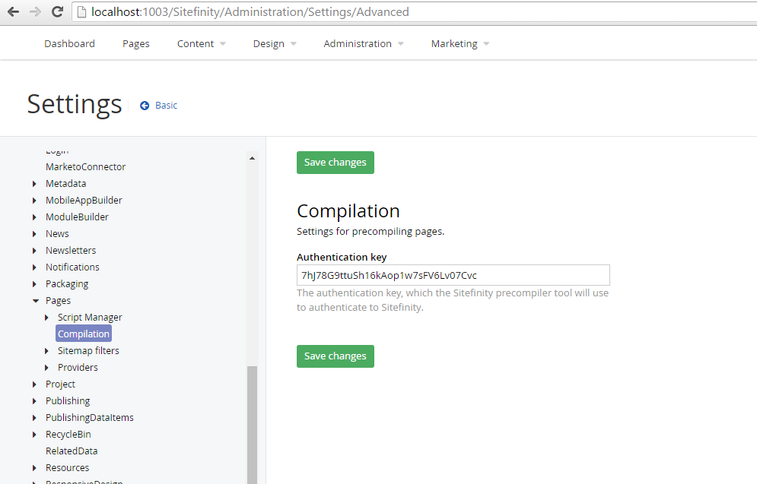

Slide 31
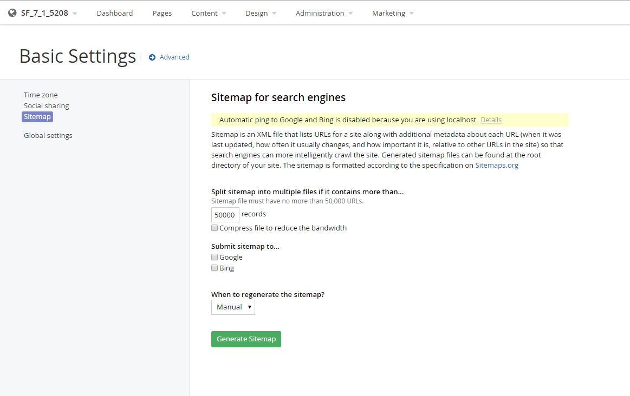

Slide 32
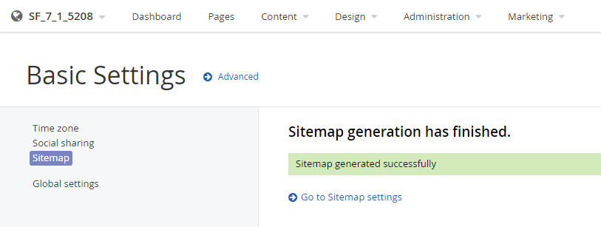

Slide 33
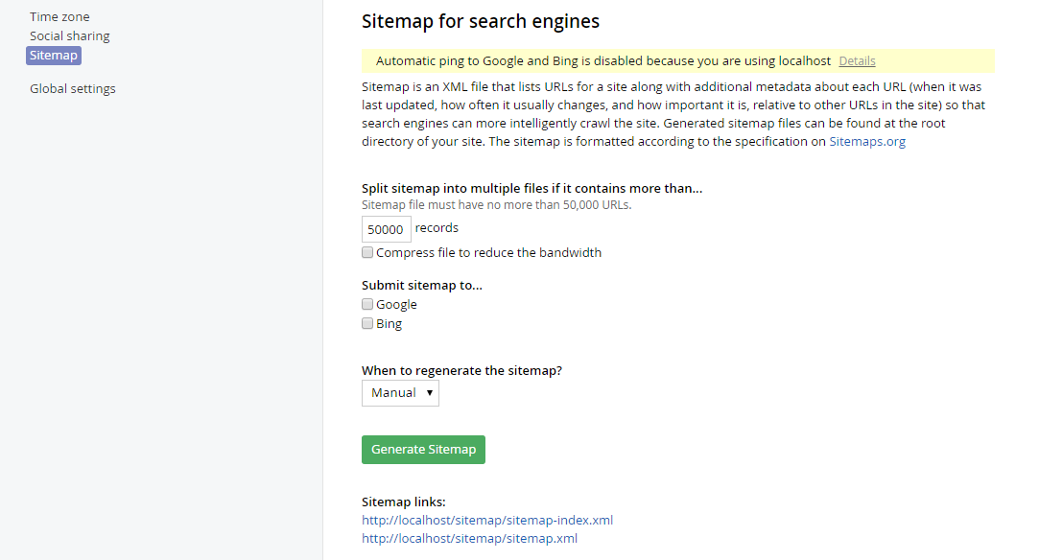

Slide 34
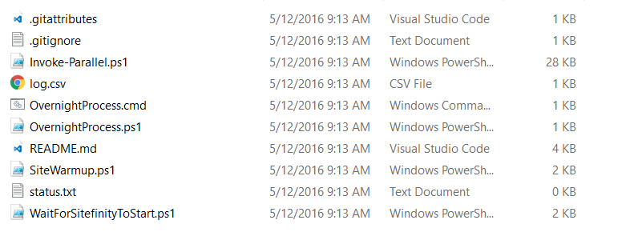

Slide 35
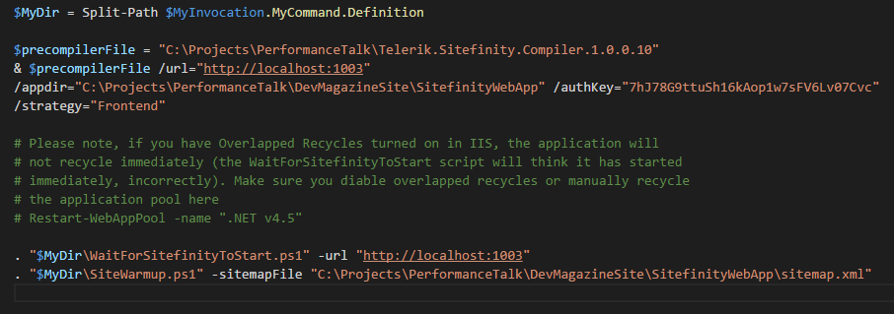

Slide 36
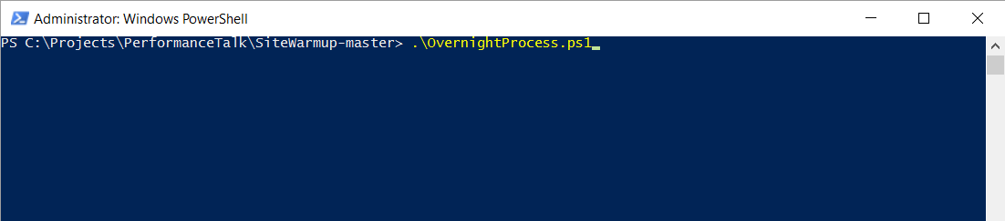
Notes:
Set execution policy
Run as admin

Slide 37
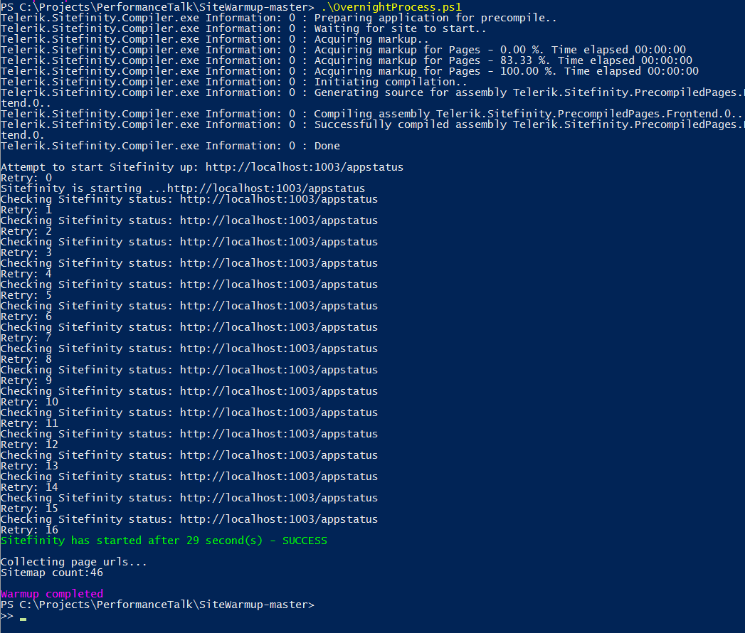

Slide 38
DEMO

Slide 39
Lets make it better

Slide 40
Lets make this better
Cache Timeout
Wait for output cache to fill
Disable vary by user agent
Vary by parameter

Slide 41
Useful Links
My Github https://github.com/vvieyra/Dallas-Summit
Precompiler Download http://docs.sitefinity.com/for-developers-sitefinity-precompiler-tool
Warmup Script https://github.com/avisra/SiteWarmup
CustomPageRouteHandler https://gist.github.com/avisra/5e52a31b7892b7ec1598
Quick Key Generator http://randomkeygen.com/

