Slide 1


Bank of Baroda Hackathon - 2022
Technology Partner
Your Team Name : LJMU_WARRIORS
Your team bio : A group of passionate data scientists having expertise in natural language processing, computer vision and system design
Date : 20-09-2022

Slide 2
Problem Statement
Banks handle large volumes of cheques in the clearing process, leaving the system vulnerable to perpetrators, causing processing delays and human errors that are frequently misinterpreted as account holders' negligence.
Cheque fraud is a type of criminal act that involves the illegal use of cheques to illegally acquire or borrow funds that do not exist within the account balance or legal ownership of the account-holder. The Reserve Bank of India (RBI) has directed banks to implement a system known as Positive Pay beginning in January 2021 in order to reduce cheque-related fraud.
Solution
The proposed idea focuses on automatic cheque processing, which adds an extra layer of security to positive pay by automating the process of bank cheque leaf verification and fraud detection.

Slide 3
Challenges & Target User Segment
With PPS, RBI is augmenting customer safety in high value cheque payments and reduce the fraud occurrences on account of tempering cheque leaves.
This proposal targets PPS transactions
Current and target check clearing transaction distribution
Share of CTS and PPS (India)
 | By volume | By Value
Current cheque clearing system CTS | 2% of total retail payments | 15% of total retail payments
PPS(>5 lakhs,saving A/C >10 lakhs, other) | 20% of total cheques issued | 80% of total cheques issued

Slide 4
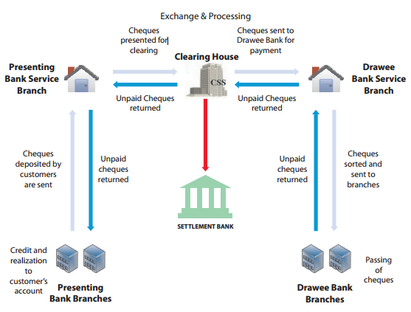
Current Cheque clearing workflow
Cheque clearing cycle has been a
manual process to till date resulting
in delayed transactions, Frauds and
customer dissatisfactions.
Manual cheque clearing cycle
requires human resources and
cost more
Current proposal augments the
highlighted portion of the check
clearing cycle

Slide 5
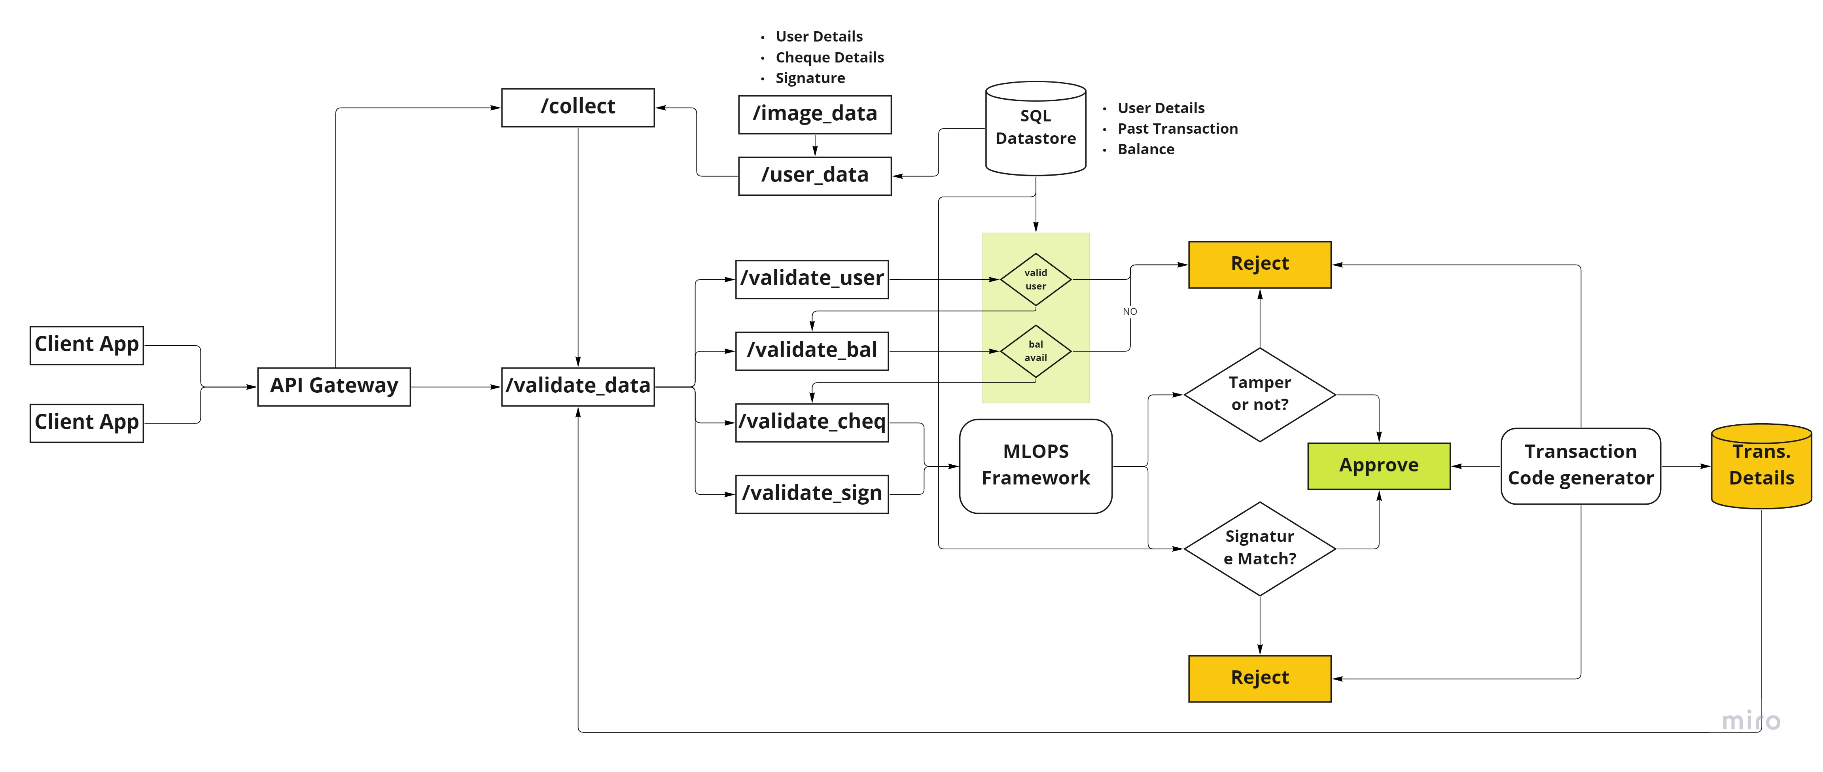
Proposed Solution Design

Slide 6
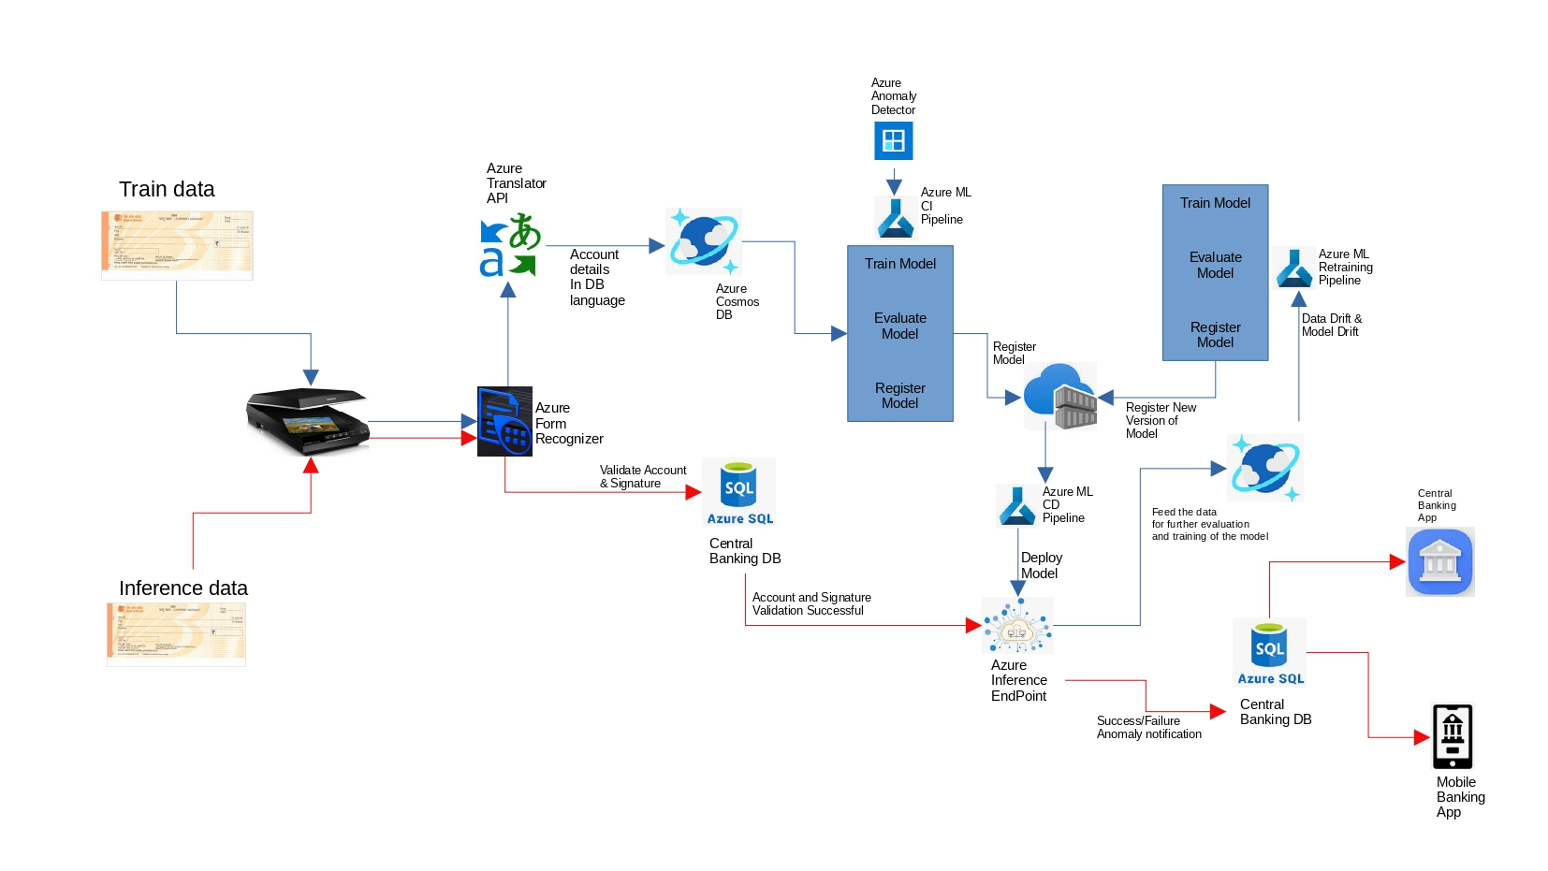

Solution architecture- Azure stack
Mobile camera

Slide 7
Solution Workflow
Data Collection
User data collected directly from authenticated mobile application.
Cheque image is collected using the App’s camera access feature.
Azure form recognizer is used to extract the cheque information from the image.
Model Training and Governance
Azure anomaly detector to train the model.
Azure ML Studio - to evaluate the model, implement CICD pipeline, monitor for model and data drift and retrain the model.
Azure Container Registry - to register the trained model.
Front-end App
Mobile Banking App - to authenticate the user login and capture cheque using camera feature.
API to transfer image and user details to the backend database.
Model inference - app makes call to model API and populate the predicted results back to SQL database for the corresponding request id.
Validation results will be updated on the Mobile banking app.
Data Transformation
Azure Translate API to translate regional languages to English
Model Deployment
Azure ML Studio - deploy the candidate model.
Azure Inference Endpoint - to make realtime inference from the incoming data.
Monitoring and Logging
Realtime data is validated with trained data for model and data drift.
Threshold values are set to trigger model retraining.
Data Storage
Azure Cosmos DB and SQL DB are used to store the image and transaction related features
Microservices
Microservice code pattern is managed under Azure Repository

Slide 8
Solution Advantages:
Mobile App Inbuilt solution - user don’t have to download new software packages to use this solution.
End to End Azure Stack - solution can be implemented end to end using Azure tech stack
Multilingual Support - Azure Translate SDK can be used to translate regional languages
Highly Scalable with low latency - Azure’s Cosmos DB / SQL database solution can be leveraged for deployment.
Modular Code Pattern - microservice based deployment is adopted to scale the service on demand and add new services like advanced fraud detection in future.
Custom ML models - models can be developed and deployed based on the requirements.
Notes:
Implementing ‘Positive Pay’ will increase safety in cheque payments and will reduce instances of fraud occurring on account of tampering of cheques.
If Positive Pay facility is not used, any claim raised against the particular cheque will not be accepted under dispute resolution mechanism at RBI.

Slide 9
References
https://economictimes.indiatimes.com/wealth/save/what-is-positive-pay-system-for-cheques-how-does-it-work/articleshow/92762477.cms
https://nanonets.com/blog/positive-pay/#what-is-positive-pay
https://indianexpress.com/article/explained/positive-pay-system-bank-cheque-rs-50000-7111239/
https://testbook.com/current-affairs/positive-pay-system-for-high-value-cheques/
https://www.npci.org.in/PDF/cts/notified-documents/CTS_Fraud_Awareness_Training_Mumbai_15_Sep_15.pdf
https://www.bankofbaroda.in/-/media/project/bob/countrywebsites/india/pdfs/key-features-and-confirmation-format-for-branchess.pdf
Notes:
Azure tools or resources which are likely to be used by you for the prototype, if your idea gets selected
Azure cognitive services> Computer Vision · Extract rich information from images and video · Text extraction (OCR) · Image understanding · Spatial analysis.
Form recogniser> https://formrecognizer.appliedai.azure.com/studio?source=acom
Azure machine learning studio
GitHub - Azure/ImageSimilarityUsingCntk: Deep Neural Network based Image Similarity ranking on Azure using CNTK
Azure cognitive services
Azure data bricks and azure data factory
Azure data warehouse

Slide 10
Thank You
Team member names:
Amar Kumar
Satyanarayana M
Vijay Venugopal

