Slide 1
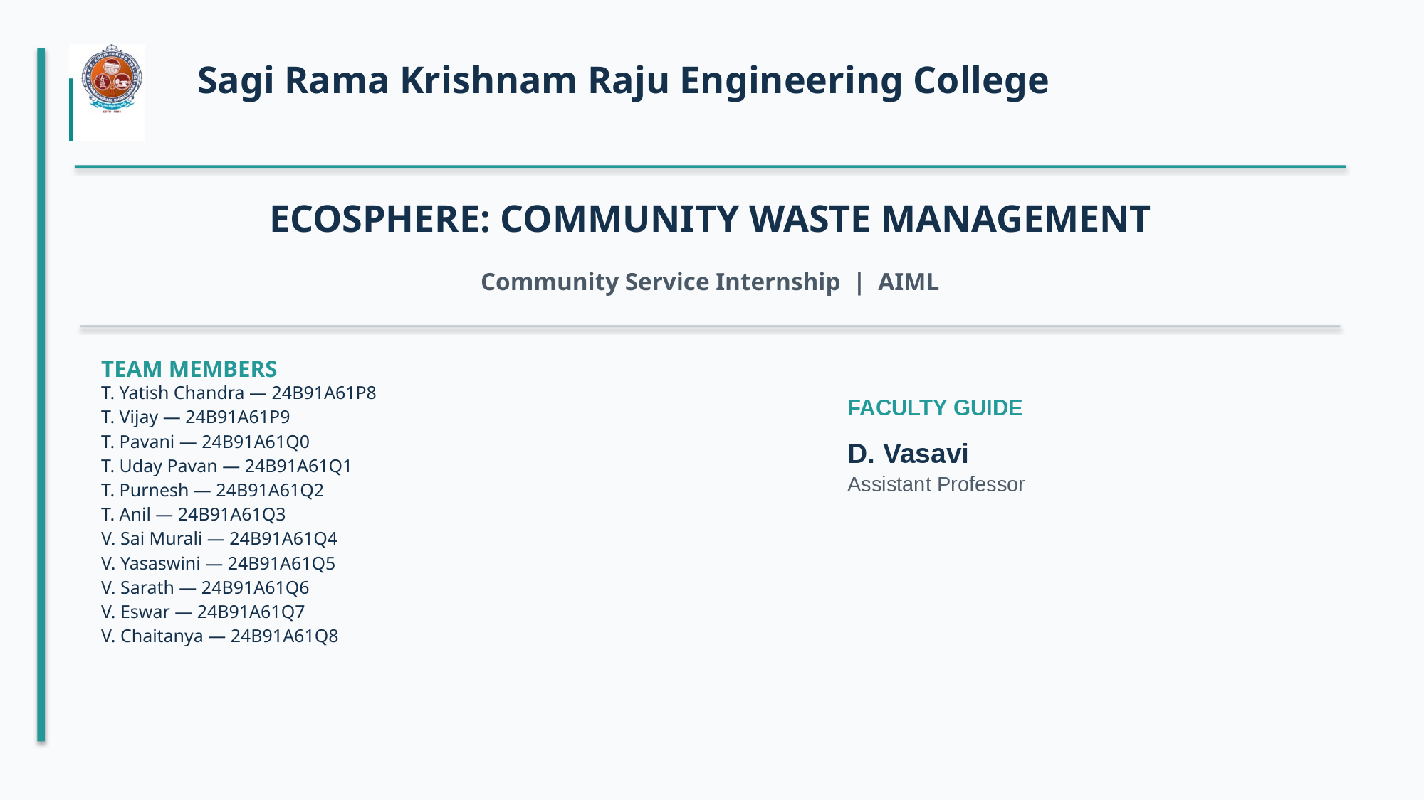

Slide 2
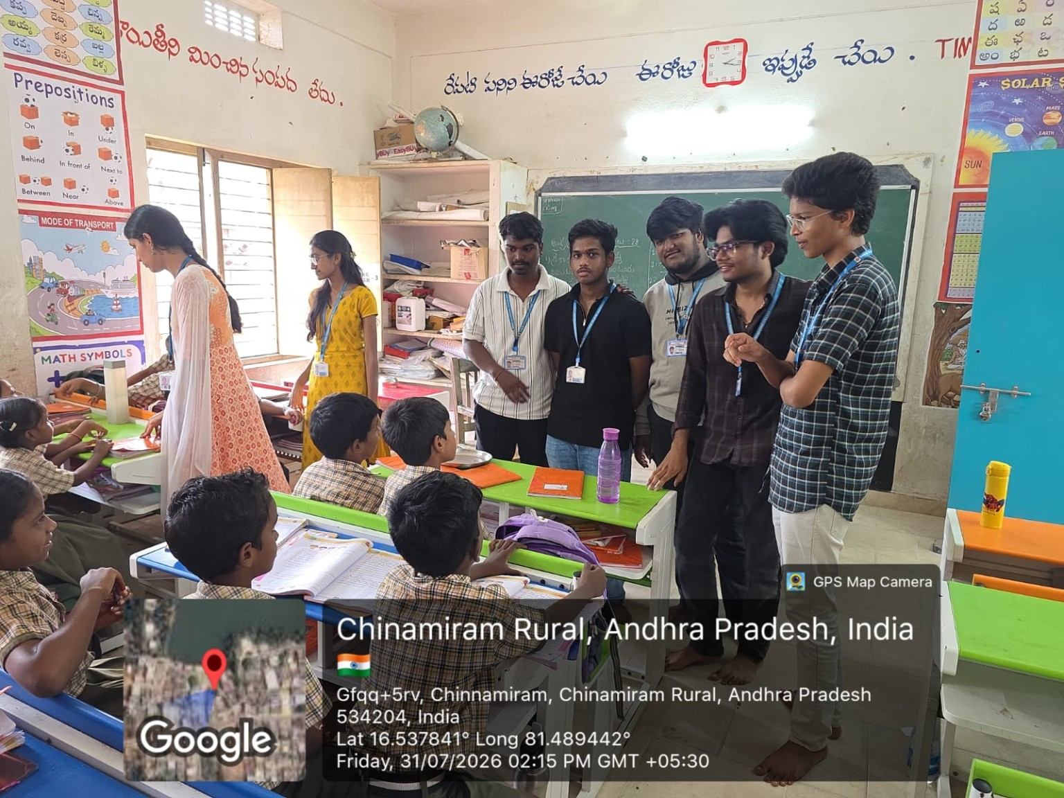
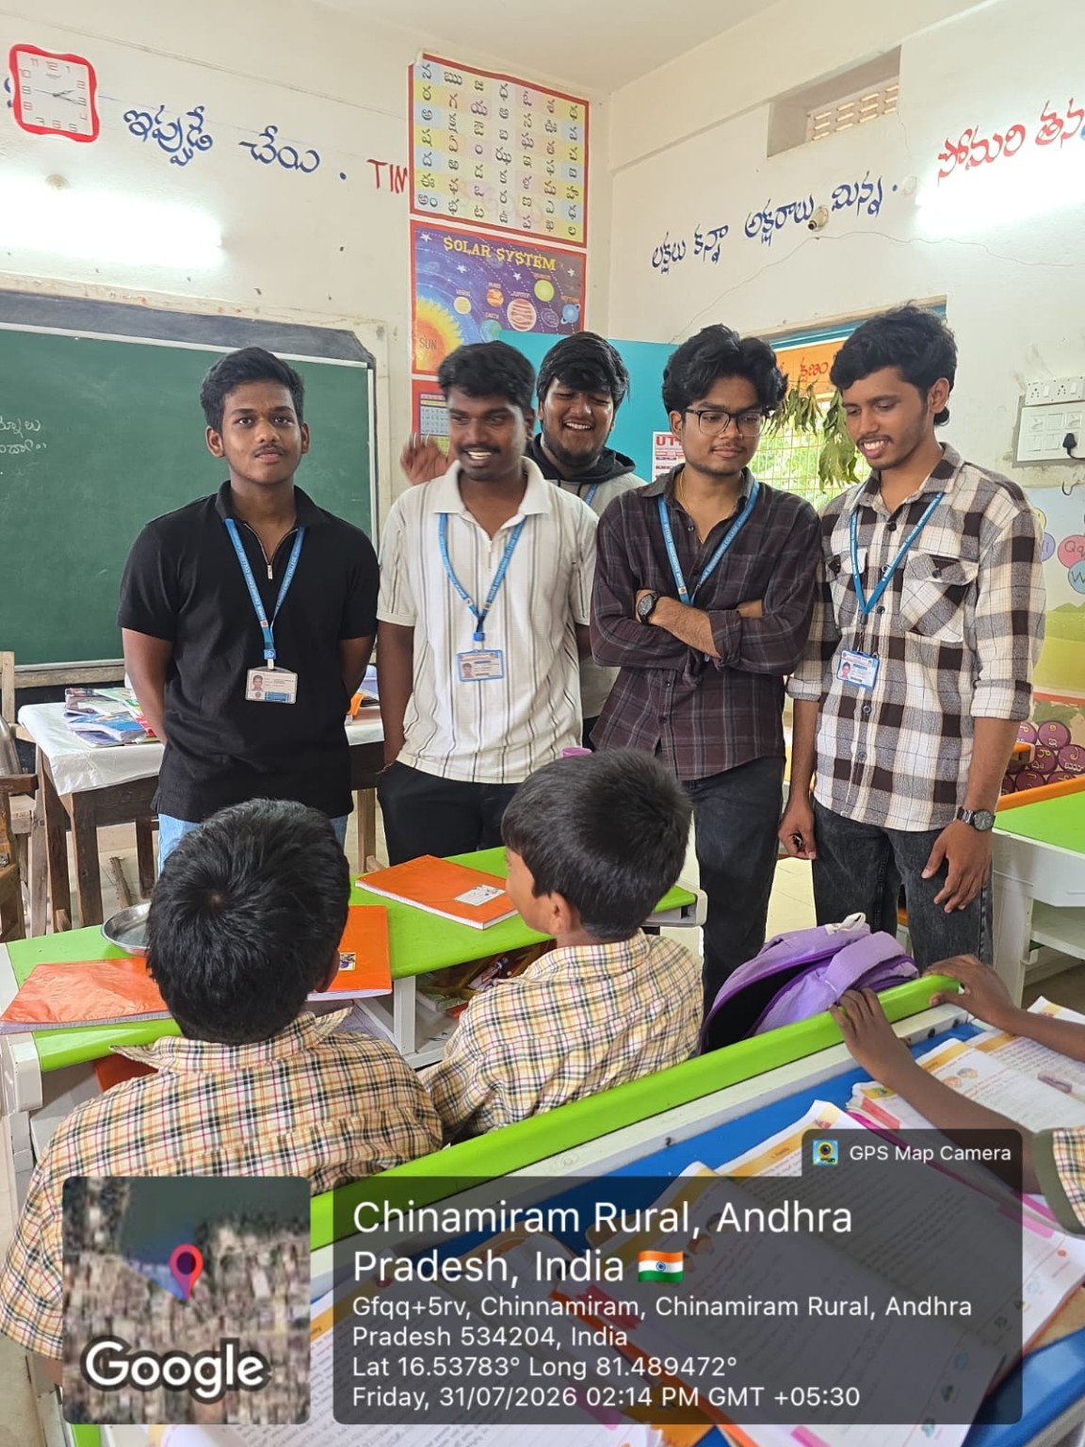
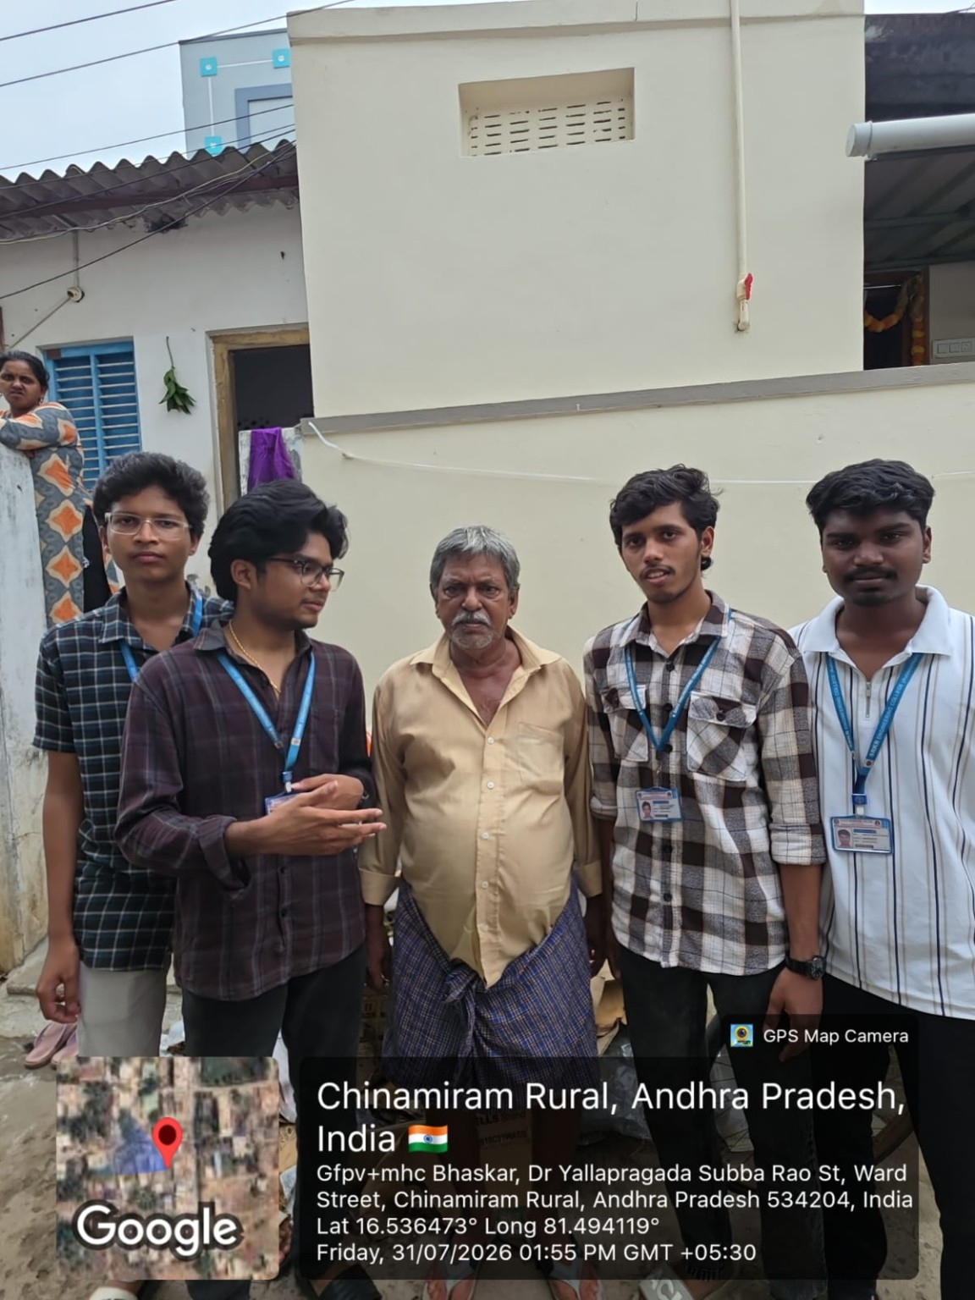
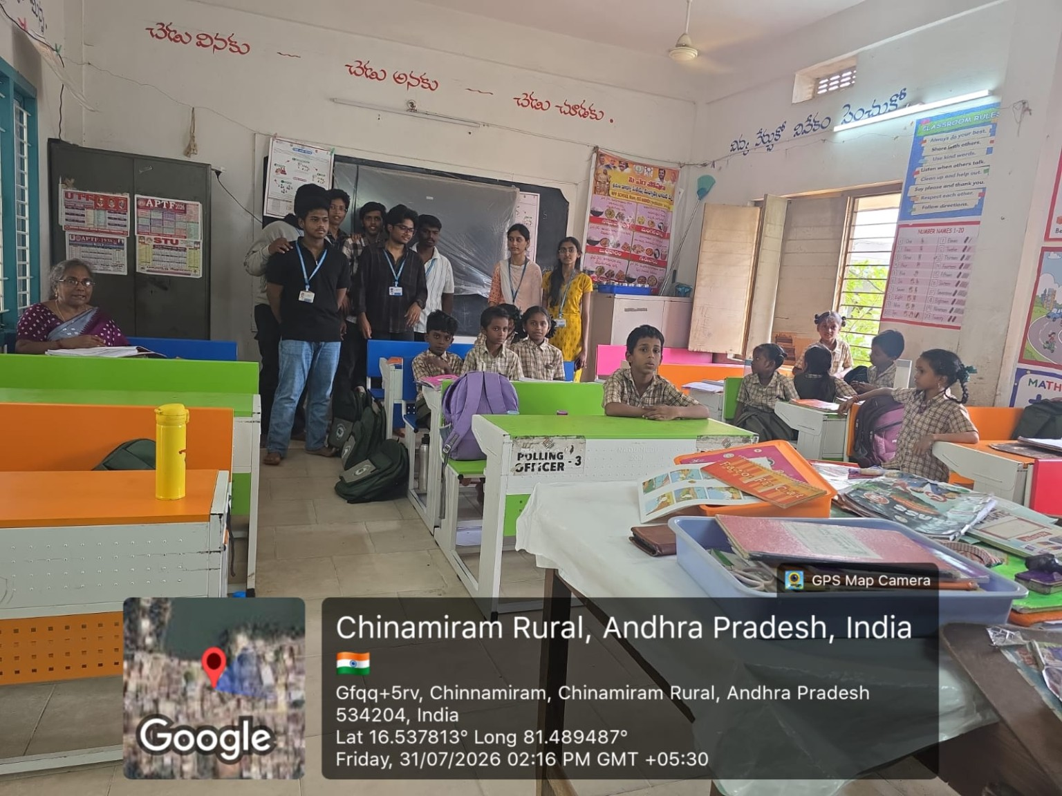
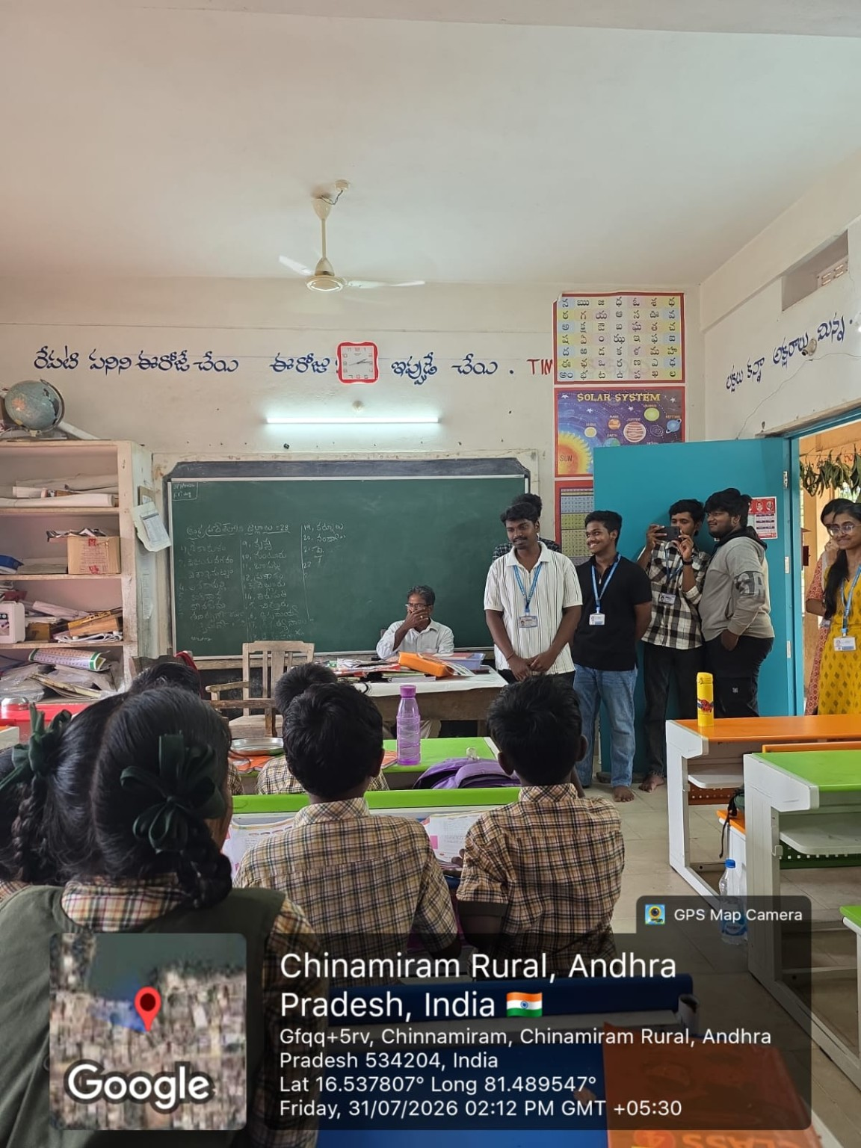
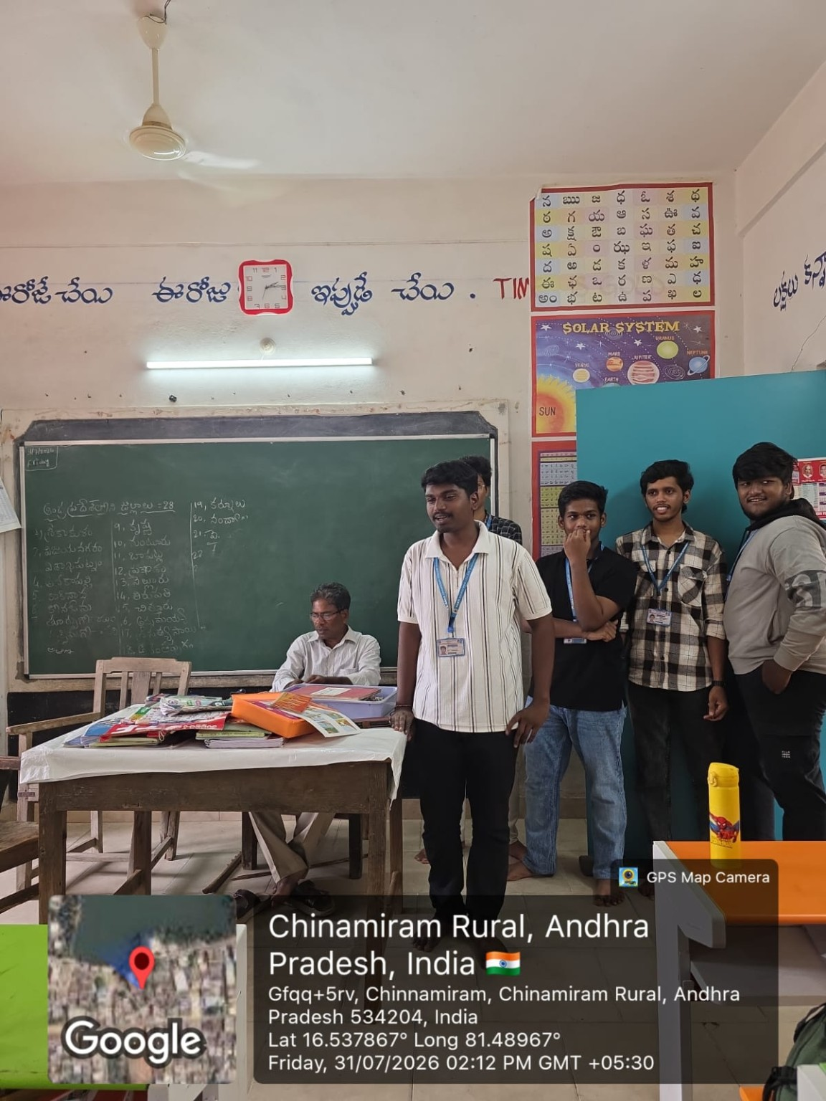
01 · INTRODUCTION
Waste management and the community
COMMUNITY VISIT · CHINAMIRAM RURAL
COMMUNITY CONTEXT
• Mixed waste is difficult to sort correctly.
• Accumulated waste affects cleanliness and public health.
• Residents need a simple way to report waste.
• Location details help identify the affected area.
• ECOSPHERE connects reporting with follow-up.

Slide 3
02 · OBJECTIVES
Core objectives and system capabilities
CLASSIFY
REPORT
RESPOND
Identify waste categories from user-uploaded photos using an AI-assisted classification workflow.
Capture photo, location and description so residents can report waste accumulation.
Route reports to the appropriate municipal workflow and track progress.
VERIFY
ENCOURAGE
Record before-and-after photos and update complaint status.
Introduce responsible participation through transparent points and rewards.

Slide 4
03 · PROBLEM IDENTIFICATION
From waste problems to community needs
OBSERVED PROBLEM
COMMUNITY NEED
ECOSPHERE RESPONSE
• Mixed waste is hard to separate.
• Waste accumulation may go unreported.
• Complaint progress can be unclear.
• Cleanup results may lack photo evidence.
• Simple guidance for waste categories.
• Photo, location and description fields.
• Clear complaint status updates.
• Evidence that cleanup has occurred.
• AI-assisted waste classification.
• Structured complaint submission.
• Municipal assignment and status tracking.
• Before-and-after photo verification.

Slide 5
04 · METHODOLOGY
How the project will be carried out
1. Upload
2. Classify
3. Report
4. Forward
5. Act
6. Verify
7. Review
User adds waste photo.
System predicts category.
Location and description are submitted.
Report reaches authorized municipal workflow.
Workers are assigned; status is updated.
Before/after photos document cleanup.
Dashboard summarizes activity.
The system is software-only. Municipal forwarding and worker assignment depend on an authorized integration or operational workflow.

Slide 6
05 · FIELD ACTIVITIES
Authentic evidence from the community visit

Slide 7
06 · SDG MAPPING
Alignment with the Sustainable Development Goals
SDG 12 · RESPONSIBLE CONSUMPTION
SDG 11 · SUSTAINABLE CITIES
SDG 9 · INNOVATION
Encourages waste separation, responsible disposal and awareness of waste categories.
Supports cleaner neighbourhoods through structured reporting and cleanup follow-up.
Applies digital tools and AI-assisted classification to a community management challenge.

Slide 8
07 · OUTCOMES
Project outcomes and potential social impact
SYSTEM OUTPUTS
USER AND COMMUNITY BENEFITS
• Predict a likely waste category from an uploaded photo.
• Record reports with location and description.
• Track complaint status through each stage.
• Compare before-and-after cleanup photos.
• Summarize activity in the admin dashboard.
• Make waste reporting easier for residents.
• Show clearer progress on reported issues.
• Encourage responsible community participation.
• Offer points for eligible, verified reports.
• Provide useful information for local planning.

Slide 9
08 · CHALLENGES
Challenges and practical solutions
CHALLENGE
SOLUTION
DEPENDENCY
• Incorrect photo classification
• Incomplete location or description
• Delayed municipal action
• False or duplicate complaints
• Allow users to confirm or correct the predicted category.
• Request required location and description details.
• Show status updates and escalation options.
• Use verification and administrator review.
• Classification quality depends on training examples.
• GPS access and connectivity may vary.
• Municipal action needs an authorized workflow.
• Rewards need clear eligibility and review rules.

Slide 10
09 · CONCLUSION
Conclusion and future scope
WHAT ECOSPHERE PROPOSES
FUTURE ENHANCEMENTS
ECOSPHERE brings together six connected functions:
• AI-assisted waste classification
• Resident reporting with location details
• Municipal complaint follow-up
• Status tracking and photo verification
• Separate user and administrator dashboards
• Add charts for total, pending and resolved complaints.
• Compare reports across waste categories.
• Introduce transparent user credit points and rewards.
• Add notifications and complaint escalation.
• Improve model accuracy and authorized municipal integration.

Slide 11
10 · SOURCES
References and acknowledgements
REFERENCES
ACKNOWLEDGEMENTS
1. Community visit observations from Chinamiram Rural.
2. ECOSPHERE – Community Waste Management project concept and proposed workflow.
3. United Nations Sustainable Development Goals: SDGs 9, 11 and 12.
4. AI image classification and digital complaint-management concepts used in the project design.
We sincerely thank D. Vasavi, Assistant Professor, for guidance and support.
We also thank SRKR Engineering College and the Department of Computer Science and Engineering, along with the community members of Chinamiram Rural, for supporting the Community Service Internship and sharing their time during the visit.

