Slide 1
Ingesting Self-Scan Data

Slide 2
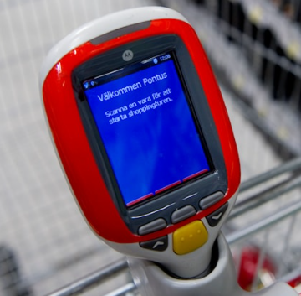
Overview & Scope
Self-Scan Device :
An Hand held device which the Customer can pick up while entering the Store
Enables the Customer to scan the items (shopping cart) as he/she walks across different Aile in the Store (able to see the Price, offers and Discount if any as the items are being scanned)
Faster Checkout – without having to wait in the Queue
Data :
All Customer actions – Addition / deletion of Item, Quantity, Price & Timestamp are captured
Scope :
Ingest the data (From Kafka), Perform Data Validation, Store the Data in databse, Perform Data Engineering and Create Summary Data
Notes:
Greekgadgetsguru
Lewis George Hilsenteger

Slide 3
Sample Data, Table Definition, Data Validation
S.No | Table | Column | DataType | Sample Data | Mandatory (M) | Validation | Short Info
 |  |  |  |  | Optional (O)
 | F_SELF_SCAN_CART_EVENTS
 |  | D_STORE_KEY | Number(20) | 1021 | M |  | Store Id
 |  | D_DATE_KEY | Number(8) | 20201124 | M | YYYYMMDD | To be derived from Unix Timestamp Inside Properties tag, before trackingType
 |  | D_CUSTOMER_KEY | Number(20) | 4914130 | O |  | UserId Doublehash this value using SHA256 Hashing technique
 |  | APP_NAME | Varchar2(30) | appName | O
 |  | APP_VERSION | Varchar2(30) | 1.10.1.1 | M
 |  | TRACKING_TYPE | Varchar2(30) | ScreenView | O
 |  | SCREEN_NAME | Varchar2(30) | HHTCart | O
 |  | NAVIGATION_TYPE | Varchar2(30) | Automatic | O
 |  | TRIP_START_TIME | Timestamp | 20190302091047 | M | Convert from UNIX Timestamp | shoppingTripStartedTimestamp
 |  | TRIP_END_TIME | Timestamp | 20190302091110 | M | Convert from UNIX Timestamp | shoppingTripEndedTimestamp
 |  | D_PRODUCT_KEY | Number(20) | 23567372 | M |  | ean inside shoppingCartEvents
 |  | PRODUCT_NAME | Varchar2(100) | Mascarpone | O |  | productName inside shoppingCartEvents
 |  | EVENT_TIMESTAMP | Timestamp | 20190302091110 | M | Convert from UNIX Timestamp | timestamp inside shoppingCartEvents
 |  | ITEM_ADDED_IND | Number(1) | 1 | M |  | 1 - if added = true (inside shoppingCartEvents) 0 - if added = false (inside shoppingCartEvents)
Notes:
Greekgadgetsguru
Lewis George Hilsenteger

Slide 4
Data Engineering
Create Summary Table
Total Transaction Value by Store
Total Transaction Value by Product
Total Transaction Value by Hour of the Day
Notes:
Greekgadgetsguru
Lewis George Hilsenteger

Slide 5
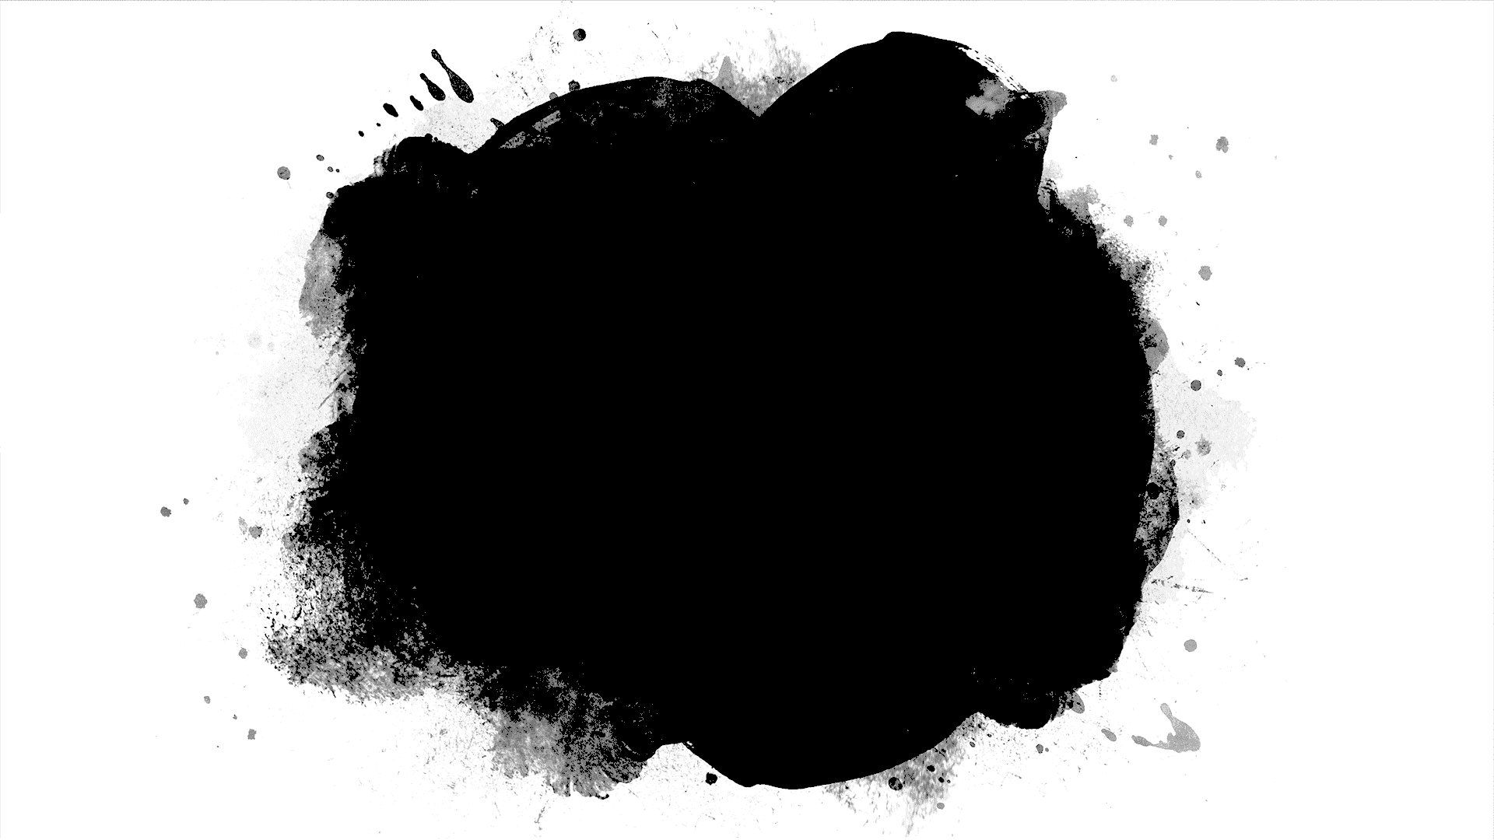
Thank You!
Notes:
Greekgadgetsguru
Lewis George Hilsenteger

