Slide 1
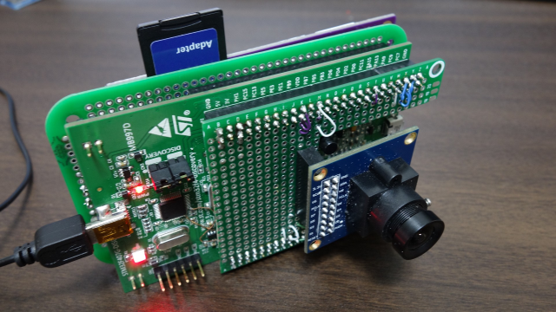
How to Create Digital Camera with STM32F4 Discovery Board
Takeshi. I

Slide 2
Outline
Overview
Device Control and Hardware Connection
Dataflow
Software Architecture
Software Design
Appendix
Hardware Configurations
Port Map

Slide 3
Overview

Slide 4
Policy
This is just a hobby project
Cortex-M (STM32) is not the best choice for digital cameras
Better to use more powerful SoC such as Cortex-A (e.g. Raspberry Pi)
Little effort on hardware work
Use discovery board
Do not pursue performance
Many people already worked on this

Slide 5
Code and Documents
https://github.com/take-iwiw/DigitalCamera_STM32

Slide 6

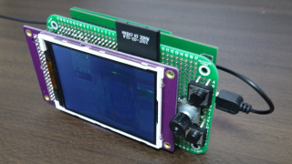
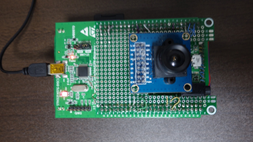
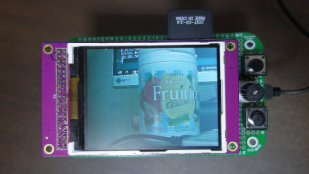
Photos
Videos
https://www.youtube.com/watch?v=CgX3bM4v_aU

Slide 7
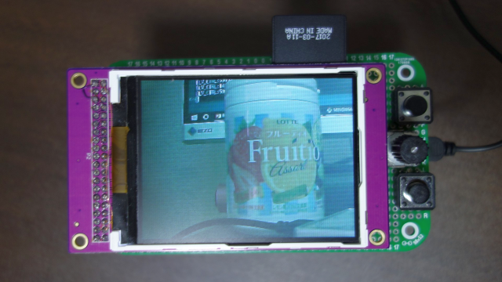
Control
SD Card
Capture button
Button
Movie Record @ Liveview mode
Movie Play/Pause @ Playback mode
Dial
JPEG Quality @ Liveview mode
Next content @ Playback mode
Mode change button

Slide 8
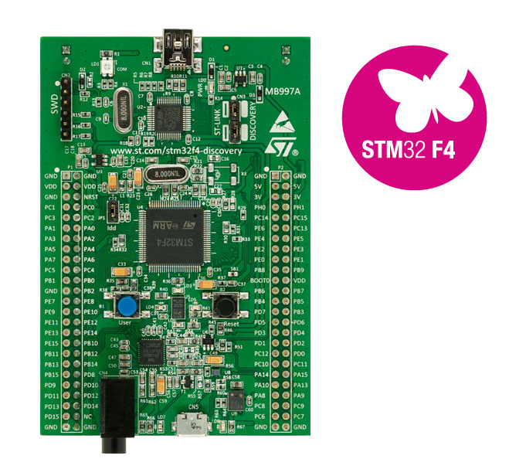
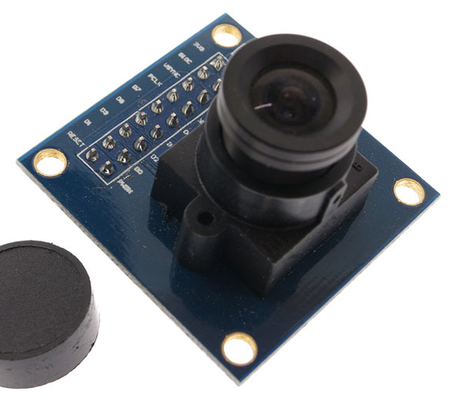
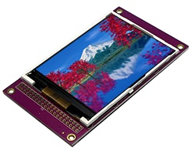
Key Components
STM32F4 Discovery Board
STM32F407VGT (Cortex-M4)
1-Mbyte Flash memory
192-Kbyte RAM
Display module
3.2 inch LCD
ILI9341 controller
16-bit parallel I/F
SD Card socket
Camera module
OV7670
Without FIFO

Slide 9
Specifications
Still photo capture
JPEG (*.jpg)
QVGA (320x240)
Movie record
Motion JPEG (*.avi)
QVGA (320x240)
Around 5 fps
Playback
JPEG (up to 2560x1920)
RGB565 (320x240)
Motion JPEG (around 10 fps)
Media
SD Card (FAT32 format only?, 8GB ~ 16GB of SD card works well)

Slide 10
Device Control and Hardware Connection

Slide 11
Display module (1) – Access sequence
Write sequence of ILI9341
Read sequence of ILI9341
*ILI9341 datasheet
Summary of ILI9341access sequence
CS (Chip Select) is low during access
Write access: latch at WRX rising
Read access: latch at RDX rising
Command access: DCX is low
Data access: DCX is high
This is the same access sequence as SRAM
Regard DCX as address bit, then
Access LCD module as 1-bit SRAM

Slide 12
Display module (2) – FSMC function on STM32
STM32 has a function called FSMC (flexible static memory controller), which can be used to control LCD as well
*AN2790 Application note
RS = DCX
FSMC is assigned from 0x60000000 on STM32
LCD access via FSMC is the same as accessing
* (volatile uint16_t*)0x6000_0000 for command
* (volatile uint16_t*)0x6002_0000 for data
The following is the config for this
Memory Data Width = 16bit
RS(DCX) is connected to A16
CS is connected to NE1 (use FSMC bank1)
Note (why 0x60020000???)
In 16-bit mode, data address issued to the memory is HADDR[25:1] >> 1
Therefore, in order to set A16 pin to high, CPU needs to access 0x6002_0000 (17-th bit is high)
STM32F407 memory map

Slide 13
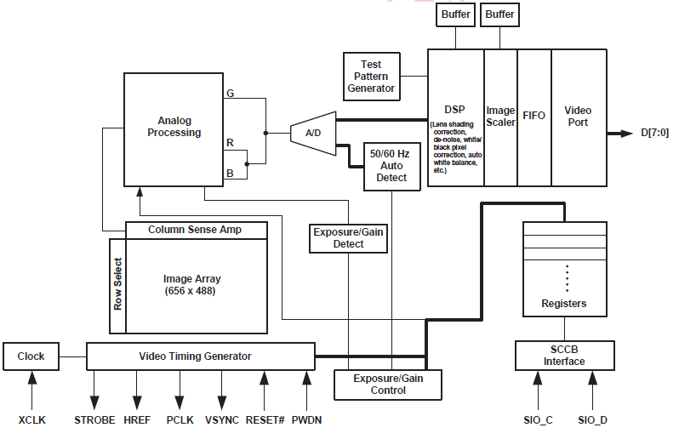
Camera module– OV7670 Interface
*OV7670 datasheet
Control I/F
SCCB (SIO_C, SIO_D)
Clock supply
Supply around 24MHz clock (XCLK)
Sync
OV7670 outputs PCLK, HREF and VSYNC
Pixel data
OV7670 outputs 8bit data (D[7:0]
Use I2C (SCCB is similar to I2C, but NAK)
(Note: need a trick in implementation)
Use MCO (microcontroller clock output) with appropriate pre-scaler
Use DCMI (Digital Camera Interface)

Slide 14
Other devices
SD Card
Use SPI
(wanted to use SDIO, but some pins are shared with DCMI)
Buttons
Use GPIO
Dial (Rotary Encoder)
Use TIMER as an external incremental encoder

Slide 15
Hardware Connection
STM32F4 Discovery
Camera (OV7670)
I2C
SCL/SDA
MCO
MCLK
DCMI
pclk, vsync, href
D[0:7]
FSMC
LCD (ILI9341)
CS, RS, WR, RD
D[0:15]
SD Card
SPI
CS, SCK, MOSI, MISO
GPIO
TIMER
A/B
* Be careful of unused on-board devices and function pins
- must avoid using important function pins (e.g. debug pins(SWD))
- some pins might be pulled-up or pulled-down on board
- disable unused devices (e.g. CS for LIS302dl must be always High)
Button
Rotary encoder

Slide 16
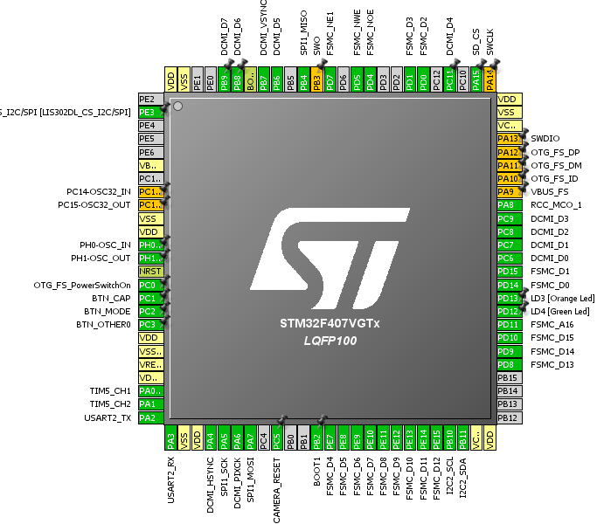
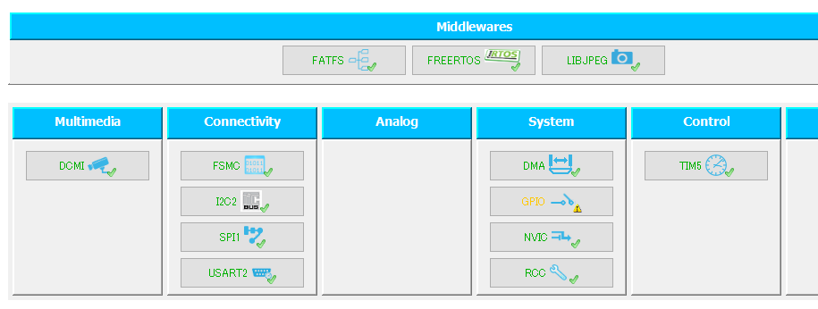
Port map and used-modules in STM32

Slide 17
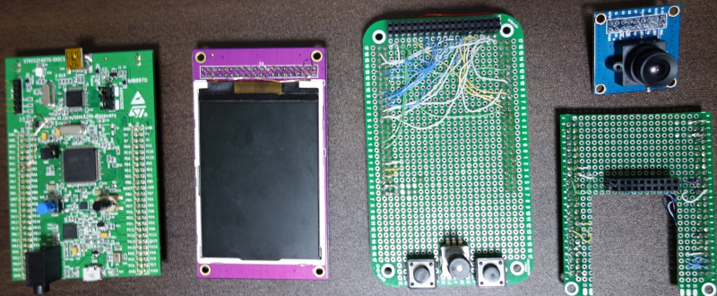
Breakout boards
breakout board for LCD
(connected to the bottom side of Discovery board)
breakout board for Camera
(connected to the front side of Discovery board)
Note1: Wire USART2 on STM32
Note2: Use low profile socket for camera breakout board

Slide 18
Dataflow

Slide 19
Main ideas for dataflow
Liveview
Both ILI9341 and OV7670 support RGB565 format
So, directly transfer pixel data from OV7670 to ILI9341 using DMA
Still photo capture
[Problem]
Not enough space for frame buffer memory (320x240x2)
[Solution A]
Increase H blanking time, then encode jpeg line by line
See the picture on the right
-> rejected because of too complex control
[Solution B]
Use RAM in ILI9341 as frame buffer
See the picture on the following page
-> adopt this idea
Movie record
Repeat still photo capture every frame
The key point is to start/stop capture from camera frame by frame (do not use continuous capture), so that pixel data in Display is not corrupt during encoding
Encode line(0) during here
Line(0)
…
H blanking
Line(1)
H blanking
Line(2)
H blking
Line(239)
H blking
V blanking
1 frame from camera

Slide 20
Dataflow - Liveview
STM32F4 Discovery
Camera (OV7670)
I2C
SCL/SDA
MCO
MCLK
DCMI
pclk, vsync, href
D[0:7]
DMA
FSMC
LCD (ILI9341)
RGB565
CS, RS, WR, RD
D[0:15]
GRAM
SD Card
SPI
CS, SCK, MOSI, MISO
GPIO
TIMER
A/B
Button
Rotary encoder

Slide 21
Dataflow – Still photo capture (JPEG)
STM32F4 Discovery
Camera (OV7670)
I2C
SCL/SDA
MCO
MCLK
DCMI
pclk, vsync, href
Stop capture from camera during encoding so that GRAM in LCD is kept clean
D[0:7]
libjpeg
FSMC
LCD (ILI9341)
RGB888
CS, RS, WR, RD
Use GRAM in LCD as frame buffer
D[0:15]
GRAM
JPEG
SD Card
SPI
CS, SCK, MOSI, MISO
GPIO
TIMER
img.jpg
A/B
Button
Rotary encoder

Slide 22
Dataflow – Movie recording (Motion JPEG) - 1
STM32F4 Discovery
Repeat 1 and 2
Camera (OV7670)
I2C
SCL/SDA
MCO
MCLK
DCMI
pclk, vsync, href
D[0:7]
RGB565
FSMC
LCD (ILI9341)
DMA
(copy only one frame)
CS, RS, WR, RD
D[0:15]
GRAM
updated
SD Card
SPI
CS, SCK, MOSI, MISO
GPIO
TIMER
A/B
Button
Rotary encoder

Slide 23
Dataflow – Movie recording (Motion JPEG) - 2
STM32F4 Discovery
Repeat 1 and 2
Camera (OV7670)
I2C
SCL/SDA
MCO
MCLK
DCMI
pclk, vsync, href
Stop capture from camera during encoding so that GRAM in LCD is kept clean
D[0:7]
libjpeg
FSMC
LCD (ILI9341)
RGB888
CS, RS, WR, RD
D[0:15]
GRAM
JPEG
SD Card
SPI
CS, SCK, MOSI, MISO
GPIO
TIMER
img.avi
frame00.jpg
frame01.jpg
A/B
Img.avi is motion jpeg format, which is a combination of several jpeg files
…
frameXX.jpg
Button
Rotary encoder

Slide 24
Software Architecture

Slide 25
Software Development Environment
Software Development Environment
IDE: sw4STM32
Tools: HAL with STM32 CubeMX
Libraries (Middlewares)
FreeRTOS
FatFS
LibJPEG
Porting and modification needed (not described in this document)
FatFS porting to use SPI
LibJPEG modification to use appropriate buffer size
printf (putc, getc) porting to use UART

Slide 26
Software Architecture (1) - Policy
Software architecture policy
Try to abstract device access
Create my own HAL layer (Display, Camera), which is different from “HAL” from STM32 (call this Stm32HAL)
STM32HAL abstracts hardware access on SoC such as GPIO
“My” HAL abstracts external device access such as display (more like BSP)
Application layer never access driver layer nor Stm32HAL directly
No need to modify this layer when I use another device
Application layer
HAL (Hardware Abstraction Layer)
Able to reuse the same device driver for another application or project as long as on STM32HAL
Driver layer

Slide 27
Software Architecture (2) - Overview
Libraries
Application
ModeMgr
FreeRTOS
DebugMonitor
FatFS
LiveviewCtrl
PlaybackCtrl
LibJPEG
Service
HAL
Camera
Display
Input
File
Modules in red ink has a task
Communication b/w tasks is message
Driver
OV7670
ILI9341
STM32HAL

Slide 28
Software Architecture (3) - Responsibility
Application
ModeMgr: controls mode (Liveview and Playback), runs sequence during mode change
LiveviewCtrl, PlaybackCtrl: main process in each mode, including enc/dec process
DebugMonitor: offers test command on terminal (UART). Able to access any module exceptionally
HAL
Display: abstracts ILI9341 driver
Camera: abstracts OV7670 driver
Service
Input: notifies key/dial device status to application (like “C” in MVC)
File: easy access to filesystem(FatFS)
Driver
ILI9341: is a device driver for ILI9341
OV7670: is a device driver for OV7670

Slide 29
Software Design

Slide 30
APIs
Module | Queue ID | Command
ModeMgr | QUEUE_MODE_MGR
LiveviewCtrl | QUEUE_LIVEVIEW_CTRL | CMD_START CMD_STOP
PlaybackCtrl | QUEUE_CAPTURE_CTRL | CMD_START CMD_STOP
Input | QUEUE_INPUT | CMD_REGISTER CMD_UNREGISTER

Slide 31
Input
Module X
Input
1.
ModuleX registers input event
CMG_REGISTER (key1)
loop
2.
Input periodically checks input device status
check all input devices
CMD_NOTIFY_INPUT
(key1, status)
3.
if key1 status changed, send status to ModuleX
sleep(50msec)
The input module abstracts input devices
Button(GPIO) → Key
Rotary Encoder → Dial
Don’t use interrupt to check input device status
To avoid disturbing other critical process such as camera control
4.
ModuleX unregisters input event when no longer needed
CMG_UNREGISTER (key1)

Slide 32
Mode Manager
1. Inactivate LiveviewCtrl
2. Activate PlaybackCtrl
boot
Mode key pressed
Liveview mode
Playback mode
Mode key pressed
1. Inactivate PlaybackCtrl
2. Activate LiveviewCtrl

Slide 33
LiveviewCtrl : State Machine
boot
Not in liveview mode
INACTIVE
CMD_START
CMD_STOP
LIveview
ACTIVE
Encode done
CMD_NOTIFY_INPUT
(OTHER0_KEY)
CMD_NOTIFY_INPUT
(OTHER0_KEY)
CMD_NOTIFY_INPUT
(KEY_CAP)
SINGLE_CAPTURING
MOVIE_RECORDING
JPEG capture
AVI(Motion JPEG) record every frame

Slide 34
LiveviewCtrl : Liveview sequence
Input
KEY_MODE
KEY_MODE
ModeMgr
CMD_START
COMP
CMD_STOP
COMP
LiveviewCtrl
start_capture()
- continuous
- destination is Display
Initialize()
stop_capture()
Camera
HAL_DCMI_Stop() seems a blocking function until next vsync interrupt
Display
HW:VSYNC
HW: Camera
Frame(0)
Frame(1)
Frame(2)
Transferred by DMA
HW: Display
Frame(0)
Frame(1)
Frame(2)

Slide 35
LiveviewCtrl : JPEG Capture sequence
Input
loop(240 (=height))
KEY_CAP
jpegEncLine()
LiveviewCtrl
start_capture()
- continuous
- destination is Display
stop_capture()
Camera
Stop liveview
Restart Liveview
readOneLine()
Display
f_open()
f_close()
File
Jpeg file created
HW:VSYNC
Use GRAM in Display as a frame buffer
HW: Camera
Frame(n-1)
Frame(n)
Frame(n+2)
HW: Display
Frame(n-1)
Frame(n)
Frame(n+2)

Slide 36
LiveviewCtrl : Movie Record sequence
Input
loop(240 (=height))
loop(240 (=height))
KEY_REC
loop(240 (=height))
jpegEncLine()
jpegEncLine()
jpegEncLine()
LiveviewCtrl
start_capture()
- single
start_capture()
- single
stop_capture()
Camera
readOneLine()
readOneLine()
readOneLine()
Display
f_open()
File
FrameReady
FrameReady
HW:VSYNC
Display keeps frame image data until each frame encode done as it is Single mode
HW: Camera
Frame(n)
Frame(n+1)
Frame(n+2)
HW: Display
Frame(n)
Frame(n+1)
Frame(n+2)

Slide 37
PlaybackCtrl : StateMachine
boot
Not in playback mode
INACTIVE
CMD_START
CMD_STOP
If jpeg: display jpeg
If avi : change status
ACTIVE
CMD_NOTIFY_INPUT (DIAL)
New content is movie
Reached the end of movie ||
CMD_NOTIFY_INPUT (DIAL)
MOVIE_PLAYING
Display next jpeg in motion jpeg file every frame
CMD_NOTIFY_INPUT
(OTHER0_KEY)
CMD_NOTIFY_INPUT
(OTHER0_KEY)
MOVIE_PAUSE

Slide 38
Hardware Configurations

Slide 39
FSMC (for LCD(ILI9341))
FSMC_NORSRAM_TimingTypeDef Timing;
/** Perform the SRAM1 memory initialization sequence
*/
hsram1.Instance = FSMC_NORSRAM_DEVICE;
hsram1.Extended = FSMC_NORSRAM_EXTENDED_DEVICE;
/* hsram1.Init */
hsram1.Init.NSBank = FSMC_NORSRAM_BANK1;
hsram1.Init.DataAddressMux = FSMC_DATA_ADDRESS_MUX_DISABLE;
hsram1.Init.MemoryType = FSMC_MEMORY_TYPE_SRAM;
hsram1.Init.MemoryDataWidth = FSMC_NORSRAM_MEM_BUS_WIDTH_16;
hsram1.Init.BurstAccessMode = FSMC_BURST_ACCESS_MODE_DISABLE;
hsram1.Init.WaitSignalPolarity = FSMC_WAIT_SIGNAL_POLARITY_LOW;
hsram1.Init.WrapMode = FSMC_WRAP_MODE_DISABLE;
hsram1.Init.WaitSignalActive = FSMC_WAIT_TIMING_BEFORE_WS;
hsram1.Init.WriteOperation = FSMC_WRITE_OPERATION_ENABLE;
hsram1.Init.WaitSignal = FSMC_WAIT_SIGNAL_DISABLE;
hsram1.Init.ExtendedMode = FSMC_EXTENDED_MODE_DISABLE;
hsram1.Init.AsynchronousWait = FSMC_ASYNCHRONOUS_WAIT_DISABLE;
hsram1.Init.WriteBurst = FSMC_WRITE_BURST_DISABLE;
hsram1.Init.PageSize = FSMC_PAGE_SIZE_NONE;
/* Timing */
Timing.AddressSetupTime = 2;
Timing.AddressHoldTime = 15;
Timing.DataSetupTime = 4;
Timing.BusTurnAroundDuration = 1;
Timing.CLKDivision = 16;
Timing.DataLatency = 17;
Timing.AccessMode = FSMC_ACCESS_MODE_A;
Need tuning depending on display device spec

Slide 40
DCMI (for Camera(OV7670))
hdcmi.Instance = DCMI;
hdcmi.Init.SynchroMode = DCMI_SYNCHRO_HARDWARE;
hdcmi.Init.PCKPolarity = DCMI_PCKPOLARITY_RISING;
hdcmi.Init.VSPolarity = DCMI_VSPOLARITY_HIGH;
hdcmi.Init.HSPolarity = DCMI_HSPOLARITY_LOW;
hdcmi.Init.CaptureRate = DCMI_CR_ALL_FRAME;
hdcmi.Init.ExtendedDataMode = DCMI_EXTEND_DATA_8B;
hdcmi.Init.JPEGMode = DCMI_JPEG_DISABLE;
hdma_dcmi.Instance = DMA2_Stream1;
hdma_dcmi.Init.Channel = DMA_CHANNEL_1;
hdma_dcmi.Init.Direction = DMA_PERIPH_TO_MEMORY;
hdma_dcmi.Init.PeriphInc = DMA_PINC_DISABLE;
hdma_dcmi.Init.MemInc = DMA_MINC_DISABLE;
hdma_dcmi.Init.PeriphDataAlignment = DMA_PDATAALIGN_WORD;
hdma_dcmi.Init.MemDataAlignment = DMA_MDATAALIGN_WORD;
hdma_dcmi.Init.Mode = DMA_NORMAL;
hdma_dcmi.Init.Priority = DMA_PRIORITY_LOW;
hdma_dcmi.Init.FIFOMode = DMA_FIFOMODE_DISABLE;

Slide 41
Port Map

Slide 42
Port Map
## IO
PA00 = ROTARY_A (TIM5_CH1) ! pulled-up on board
PA01 = ROTARY_B (TIM5_CH2)
PA02 = USART2 (TX)
PA03 = USART2 (RX)
PA04 = CAMERA_HS(DCMI_HSYNC)
PA05 = SD_CARD(SPI1_SCK)
PA06 = CAMERA_PCLK(DCMI_PIXCK)
PA07 = SD_CARD(SPI1_MOSI)
PA08 = CAMERA_MCLK(MCO1)
PA09 = [VBUS_FS]
PA10 = [OTG_FS_ID]
PA11 = [OTG_FS_DM]
PA12 = [OTG_FS_DP]
PA13 = [SWDIO]
PA14 = [SWCLKDebug]
PA15 = SD_CARD(SPI1_NSS(SW control))
PB00 = N/A
PB01 = N/A
PB02 = [BOOT]
PB03 = [SWO]
PB04 = SD_CARD(SPI1_MISO)
PB05 = N/A
PB06 = CAMERA_D5(DCMI_D5)
PB07 = CAMERA_VS(DCMI_VSYNC)
PB08 = CAMERA_D6(DCMI_D6)
PB09 = CAMERA_D7(DCMI_D7)
PB10 = CAMERA(I2C2_SCL)
PB11 = CAMERA(I2C2_SDA)
PB12 = N/A
PB13 = N/A
PB14 = N/A
PB15 = N/A
PC00 = [OTG_FS_PowerSW] !Don't use
PC01 = BUTTON1
PC02 = BUTTON2
PC03 = BUTTON3
PC04 = N/A
PC05 = CAMERA_RESET
PC06 = CAMERA_D0(DCMI_D0)
PC07 = CAMERA_D1(DCMI_D1)
PC08 = CAMERA_D2(DCMI_D2)
PC09 = CAMERA_D3(DCMI_D3)
PC10 = [CS43L22_SCLK] !Don't use
PC11 = CAMERA_D4(DCMI_D4)
PC12 = [CS43L22_SDIN] !Don't use
PC13 = N/A
PC14 = [OSC32_IN]
PC15 = [OSC32_IN]
PD00 = LCD_D2(FSMC_D2)
PD01 = LCD_D3(FSMC_D3)
PD02 = N/A
PD03 = N/A
PD04 = LCD_RD(FSMC_NOE)
PD05 = LCD_WD(FSMC_NWE)
PD06 = N/A
PD07 = LCD_CS(FSMC_NE1)
PD08 = LCD_D13(FSMC_D13)
PD09 = LCD_D14(FSMC_D14)
PD10 = LCD_D15(FSMC_D15)
PD11 = LCD_RS(FSMC_A16)
PD12 = LED
PD13 = LED
PD14 = LED, LCD_D0(FSMC_D0)
PD15 = LED, LCD_D1,(FSMC_D1)
PE00 = [LIS302DL_INT1] !Don't use
PE01 = [LIS302DL_INT2] !Don't use
PE02 = [LIS302DL_CS] !Always HIGH
PE03 = N/A
PE04 = N/A
PE05 = N/A
PE06 = N/A
PE07 = LCD_D4(FSMC_D4)
PE08 = LCD_D5(FSMC_D5)
PE09 = LCD_D6(FSMC_D6)
PE10 = LCD_D7(FSMC_D7)
PE11 = LCD_D8(FSMC_D8)
PE12 = LCD_D9(FSMC_D9)
PE13 = LCD_D10(FSMC_D10)
PE14 = LCD_D11(FSMC_D11)
PE15 = LCD_D12(FSMC_D12)
## Function
USART2 = TERMINAL
SPI1 = SD CARD
I2C2 = CAMERA(OV7670)
FSMC = LCD(ILI9341)
DCMI = CAMERA(OV7670)
TIMER5_CH1/2 = Rotary Encoder
## DMA
DMA1_5 = USART2_RX
DMA2_1 = CAMERA(DCMI->FSMC(LCD))
## OSC
PH0 = OSC_IN (external 8MHz)
PH1 = OSC_OUT (external 8MHz)
## Note
LCD_RESET = VDD
CAMERA_PWDN = GND

Slide 43
backup

Slide 44
APIs
Module | Queue ID | COMMAND
modeMgr | QUEUE_MODE_MGR | NOTIFY_EXIT
liveviewCtrl | QUEUE_LIVEVIEW_CTRL | START STOP
captureCtrl | QUEUE_CAPTURE_CTRL | START
playbackCtrl | QUEUE_CAPTURE_CTRL | START STOP
input | QUEUE_INPUT | REGIST UNREGIST
When a control module exits (by itself?), the control module sends this message
modeMgr sends these messages when mode changed
Any module which wants to be notified input status calls this

Slide 45
Software structure (to be)
Application layer
HAL (Hardware Abstraction Layer)
Driver layer
OV7670
ILI9341

Slide 46
Software structure
app
modeMgr
liveviewCtrl
+ init()
+ enter()
+ exit()
captureCtrl
+ init()
+ enter()
+ exit()
playbackCtrl
+ init()
+ enter()
+ exit()
debugMonitor
library
hal
camera
display
input
FatFS
libJPEG
driver
ov7670
ili9341
STM32 lib

Slide 47
Software structure
Modules in red ink has each task
Communication is done by message queue instead of function call
app
modeMgr
liveviewCtrl
captureCtrl
playbackCtrl
debugMonitor
Middleware
hal
camera
display
input
FatFS
libJPEG
driver
ov7670
ili9341
STM32 lib

Slide 48
Software structure (current test program)
main()
OV7670
ILI9341

Slide 49
Overview (HW)
test

Slide 50
Overview (HW)
test

Slide 51
Overview (HW)
test

