Slide 1

Bioinformatic approaches to regulatory genomics and epigenomics
376-​1347-00L - 2022 | week 07
Pierre-Luc Germain

Slide 2
Today’s plan
(launch install)
Debriefing on the assignment
DNA accessibility
ATAC-seq analysis (practical)
Nucleosome positioning

Slide 3
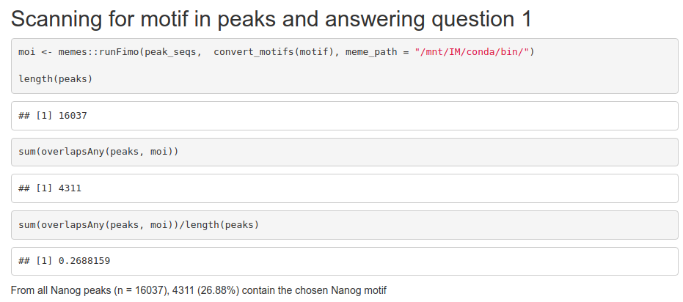
Debriefing on the assignment
TF: Nanog

Slide 4
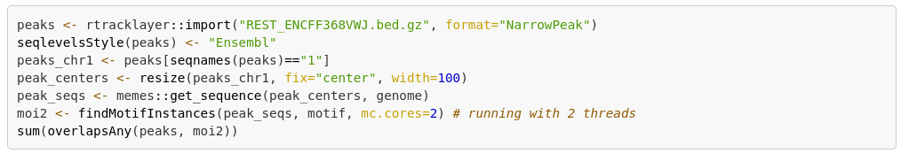
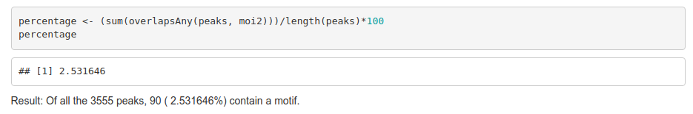
Debriefing on the assignment
TF: REST
What’s the problem here?

Slide 5
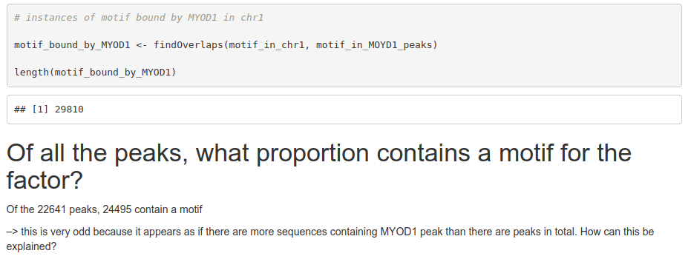
Debriefing on the assignment
TF: MYOD1

Slide 6
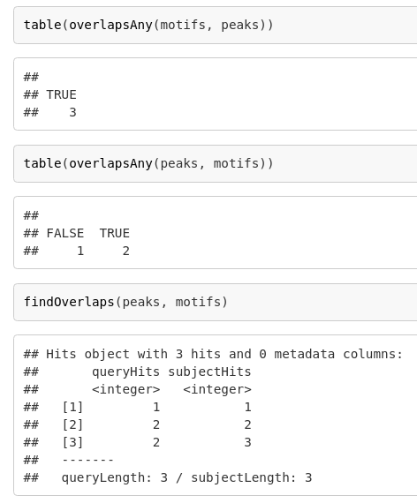

Debriefing on the assignment

Slide 7
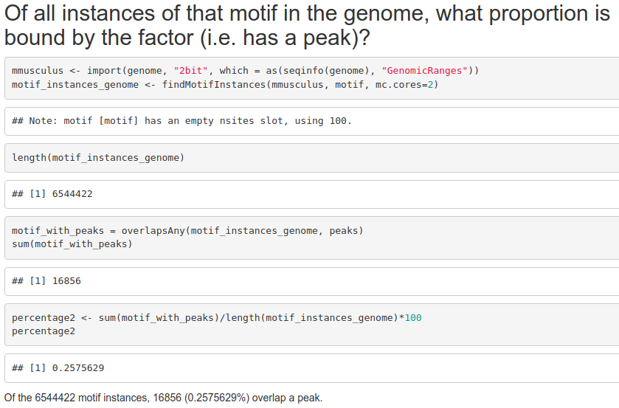
TF: GATA1
Of the 9675 GATA1 peaks, 7277 (~75%) contain a GATA1 motif, but…

Slide 8
Debriefing on the assignment – wrapping up
The proportion of binding sites that show the motif depends on the TF (ranging from roughly 20 to 95%)
The proportion of (genome-wide) motif instances that are bound by the factor is typically very very small
This means that something else determines whether a stretch of DNA will be bound

Slide 9
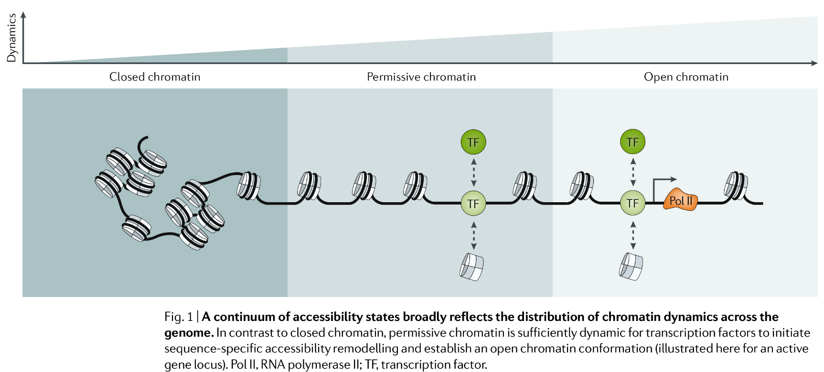
DNA accessibility, which is associated to lower nucleosome density, reflects activity
(Klemm, Shipony and Greenleaf, 2019)

Slide 10
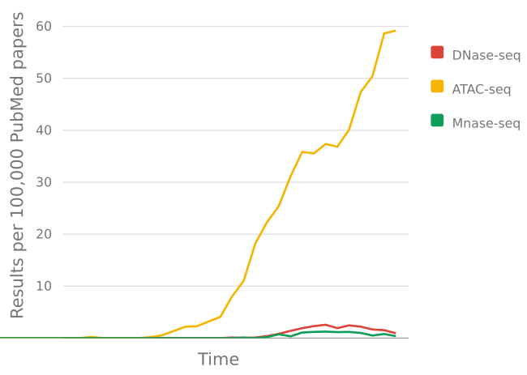
Returning to our very brief history of genetics & genomics
…
1900 - Rediscovery of Mendel’s work (1860s)
1913 - Chromosomes are linear arrays of genes
1941 - the one-gene-one-enzyme hypothesis
1944 - DNA is the genetic material
1951 - First protein sequenced
1977 - DNA sequencing
1977 - Eukaryotic genes are spliced
1995 - First bacterial genomes sequenced
2000 - Next Generation Sequencing (NGS)
2001 - Draft of the human genome
2003 - RNA-seq
2006 - ChIP-seq
2008 - DNAse-seq, MNase-seq
2012 - ATAC-seq
…
Accessibility
assays

Slide 11
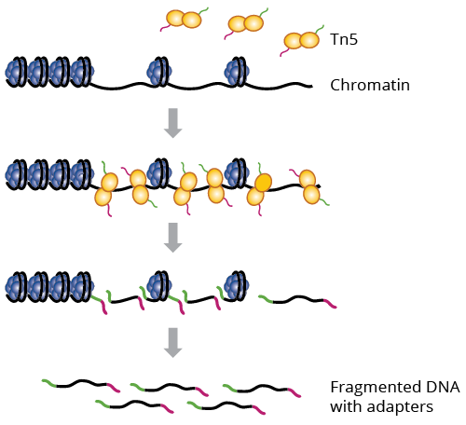
ATAC-seq
ATAC-seq recently became extremely popular due to its information content and low material requirement (i.e. # cells)

Slide 12
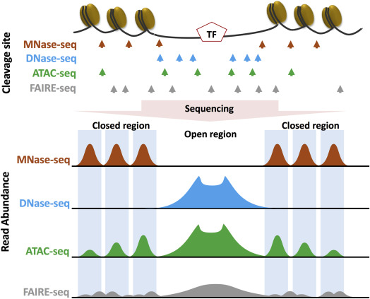
Chromatin accessibility assays
Nucleosome positions
DNase1-hypersensitive sites (DHS) → regulatory elements
Both
(Hsu et al., Epigenetics in Human Disease, 2018)

Slide 13
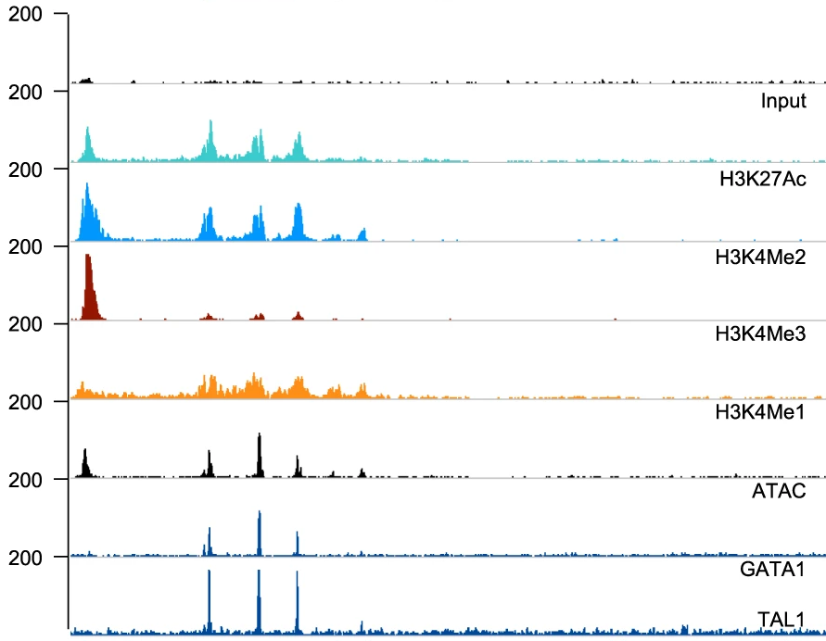
ATAC signal tells us that something is happening, it just doesn’t tell us what exactly…
ChIP-seq
ChIP-seq
(Adapted from Fox et al., Nat Comm 2020)

Slide 14
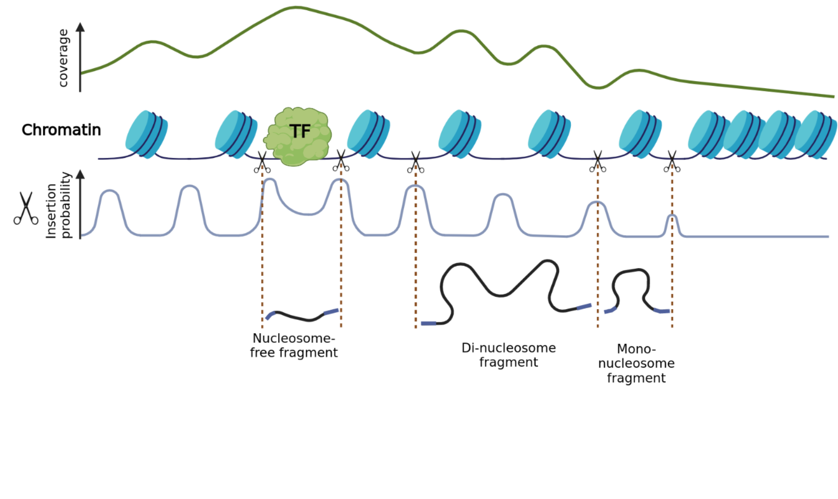
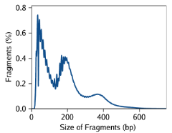
ATACseq
% fragments
NF mono- di-
(CC BY-SA plger, made with Biorender)

Slide 15
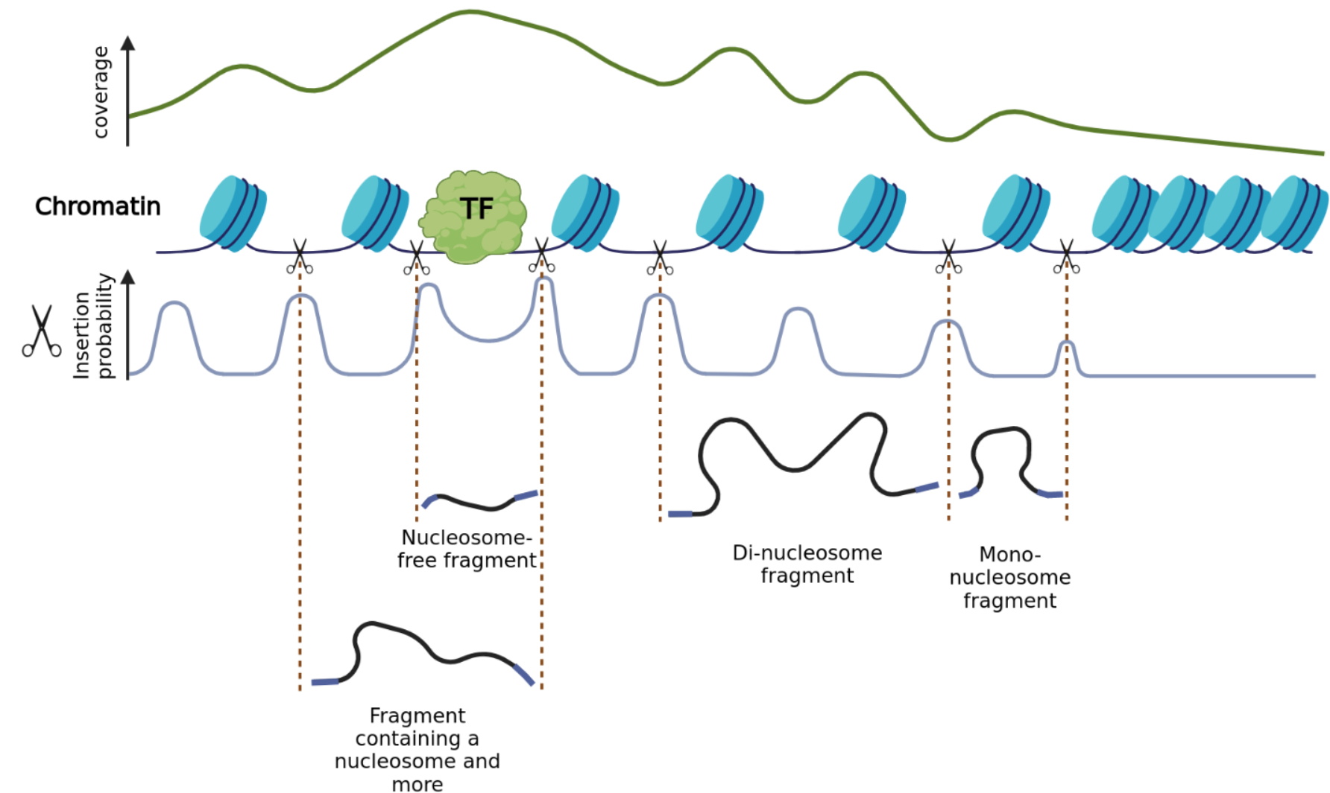
ATACseq
NF mono- di-
(CC BY-SA plger, made with Biorender)

Slide 16
This means that once we have the data, we can split the fragments according to size in order to obtain specific information about different kinds of chromatin signals
Nucleosome-free signal → Transcription factors
Nucleosome
signal

Slide 17
Practical

Slide 18
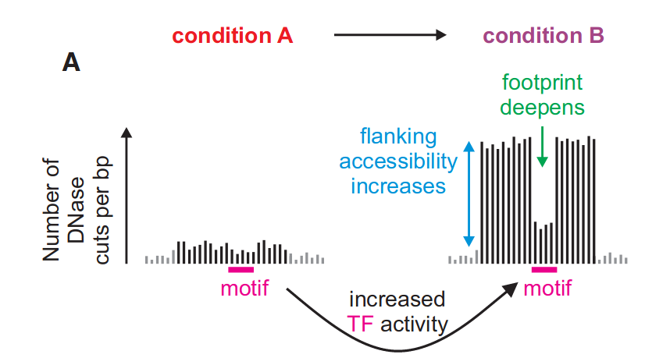
Estimating TF activity from accessibility and footprints
(Baek, Goldstein and Hager, Cell Reports 2017)

Slide 19
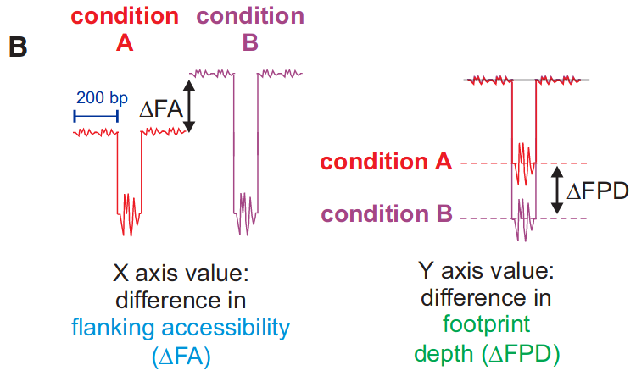
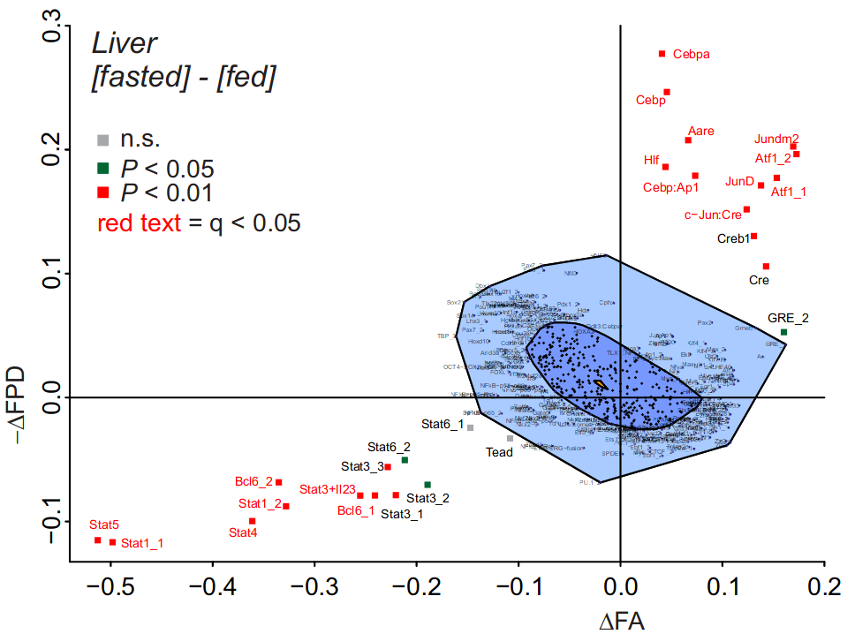
Estimating TF activity from accessibility and footprints
(Baek, Goldstein and Hager, Cell Reports 2017)

Slide 20
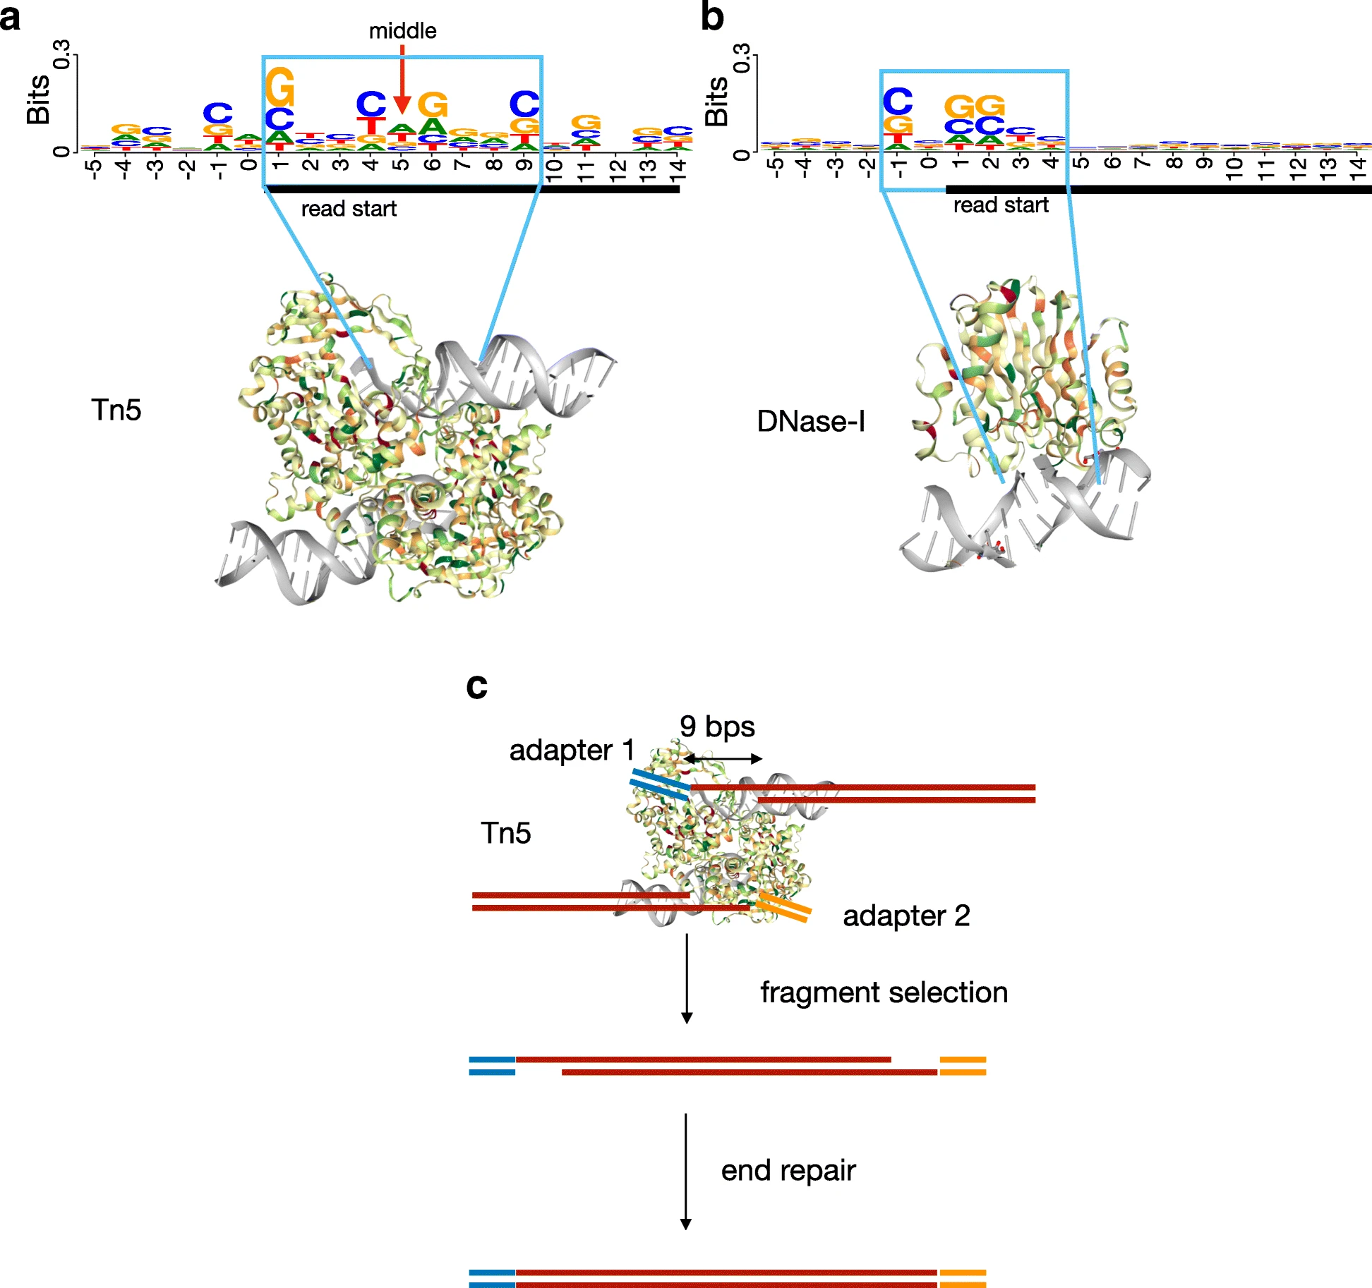
“Shifting” ATAC-seq
alignments
(adapted from Zhijian et al.,
Genome Biology 2019)
From a given ATAC-seq insertion site, the exact region that is accessible is a few nucleotides from the start of the read
When doing high-resolution things like footprinting, one therefore typically shifts the cut sites by +4/-5nt, so that it is placed in the middle of where the Tn5 was binding
(For most other purposes, this is too fine-grained to make a difference)

Slide 21
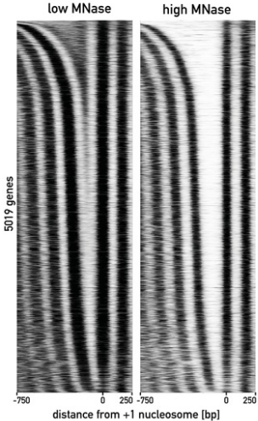
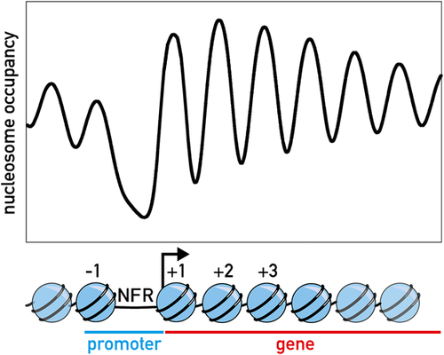
Nucleosome positioning
(Kubik, Bruzzone and Shore, 2017)

Slide 22
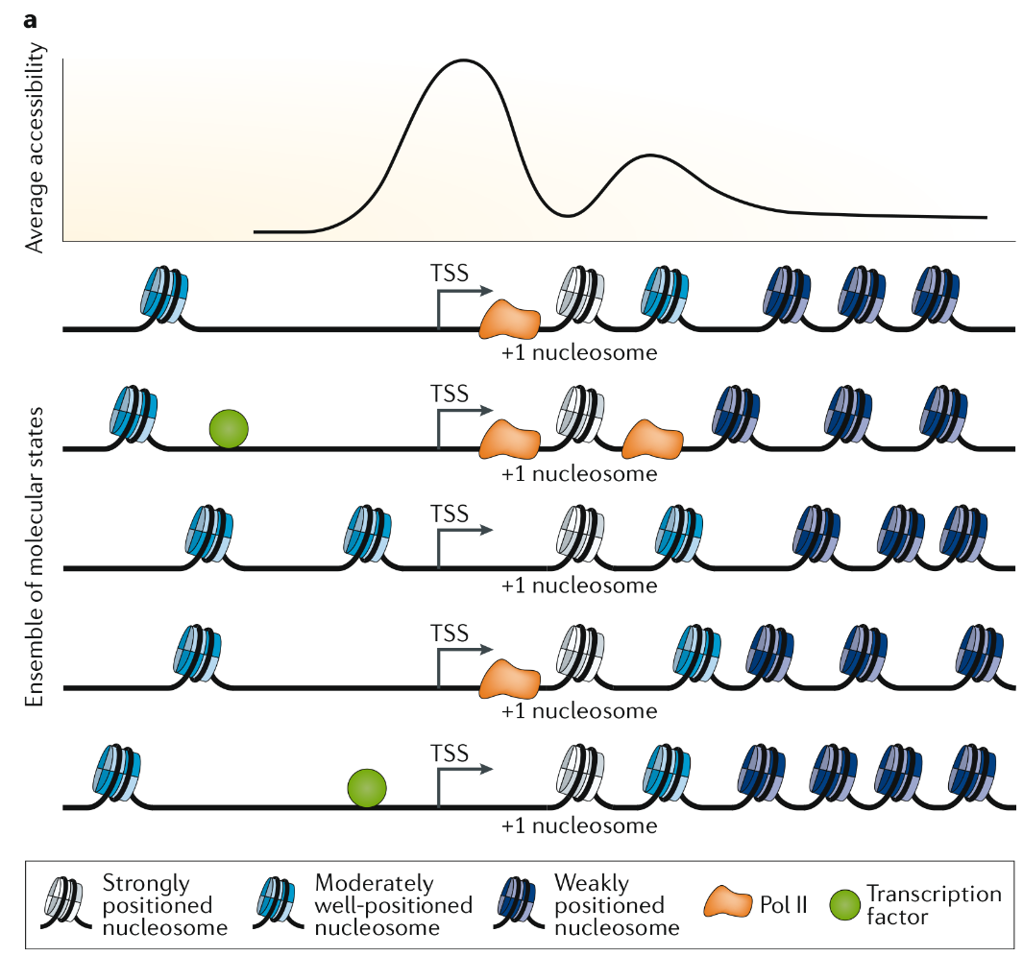
(Klemm, Shipony and Greenleaf, 2019)

Slide 23
Assignment
Due to holidays we’re seeing each other next time on the 29th!
In the same dataset of ATAC on chr19, plot the insertion (i.e. ‘cuts’) profile of, respectively, nucleosome-free and nucleosome-containing fragments, around the high-confidence motifs of two factors. You can choose your own factors of interest, or for instance use REST and the glucocorticoid receptor (search “GCR”)
Expected form of the answer: 2 figures (one for each factor), each containing the heatmaps of the two signals around the motifs
Don't forget to render your markdown and push it as assignment.html !

