Slide 1

Bioinformatic approaches to regulatory genomics and epigenomics
376-​1347-00L - 2022 | week 03
Pierre-Luc Germain

Slide 2
Plan for today
Debriefing on the assignments
Overview of NGS basic analysis pipelines, file formats, etc.

Slide 3
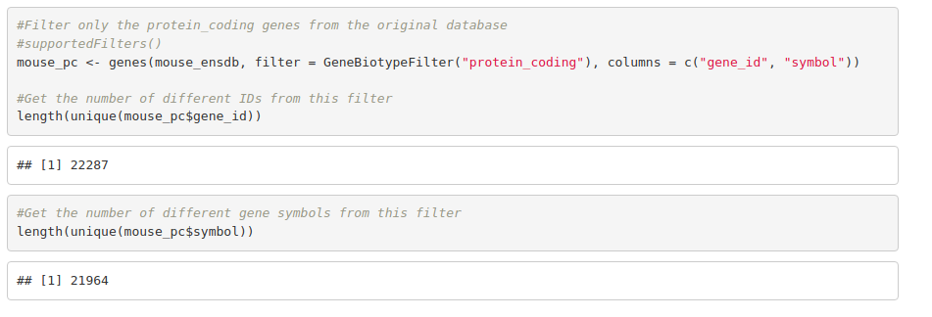
How many protein-coding gene IDs, and how many gene symbols, does the mouse annotation have?

Slide 4
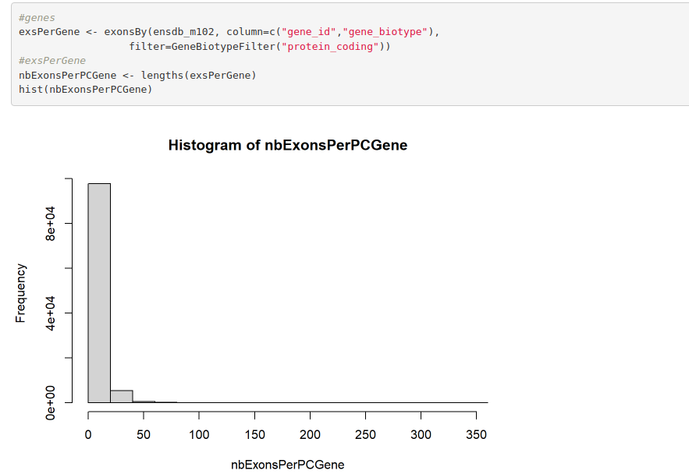

Slide 5
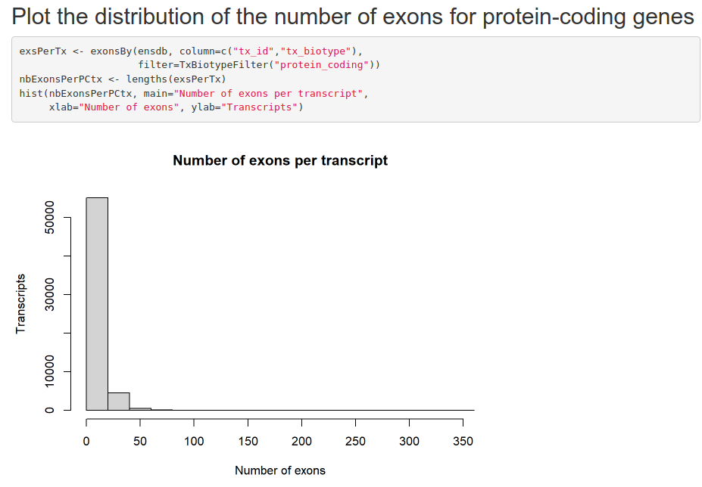

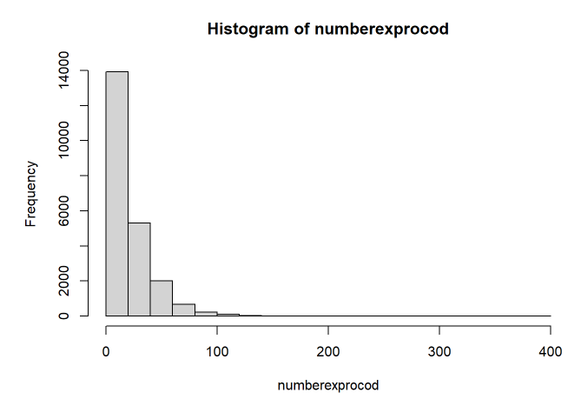

Slide 6
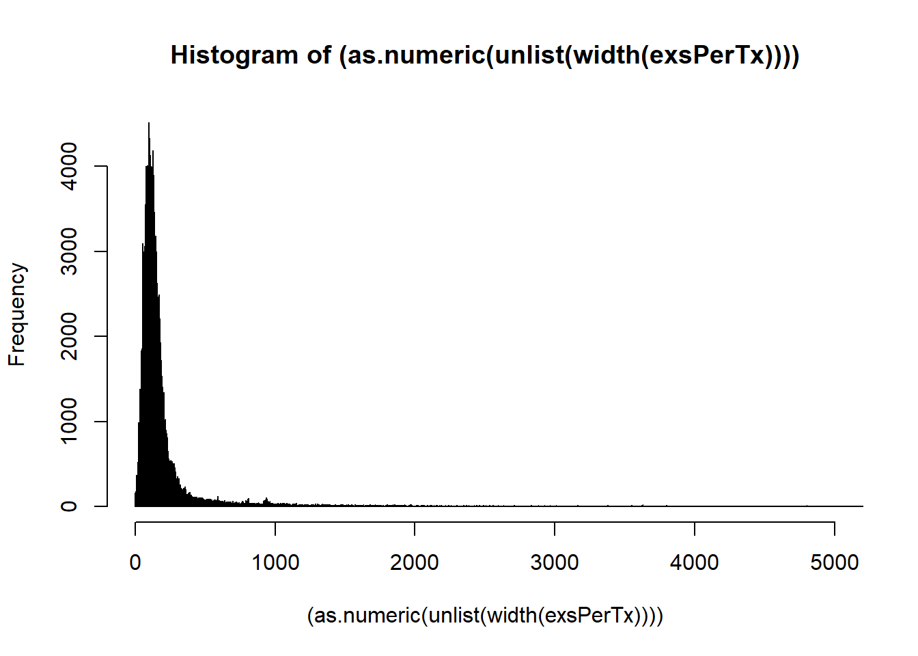
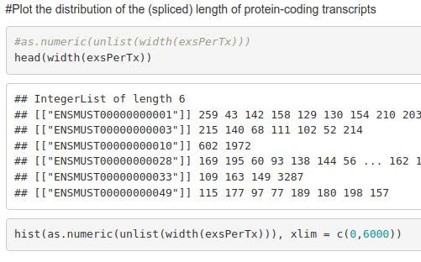
Plot the distribution of the (spliced) length of protein-coding transcripts

Slide 7

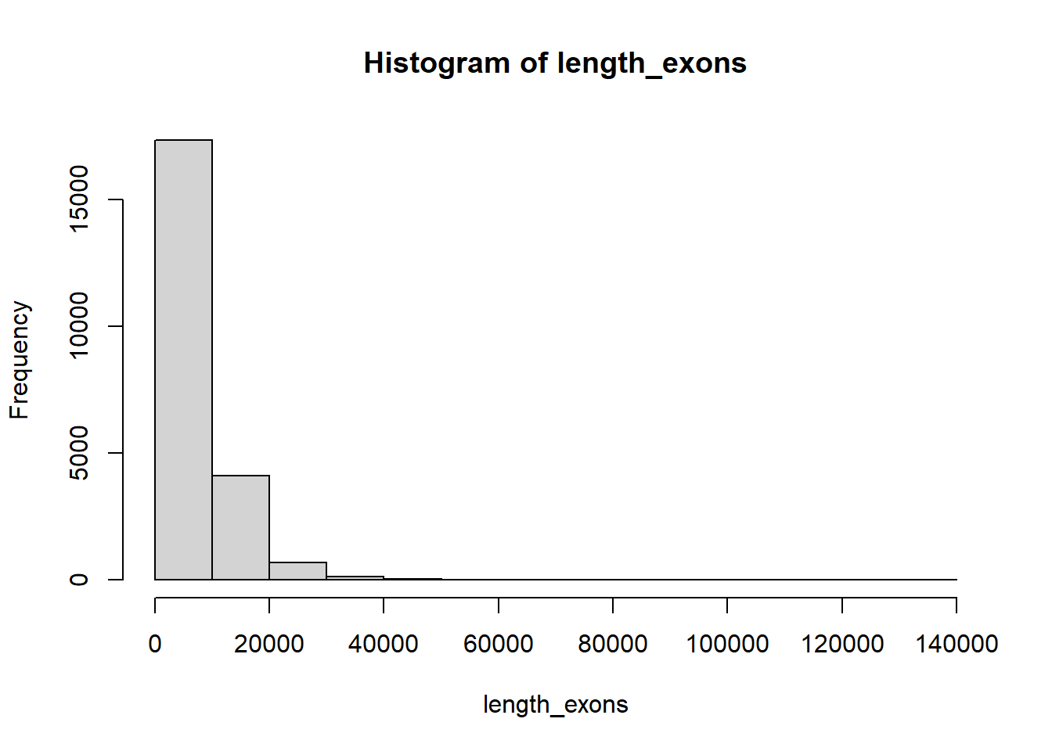
Plot the distribution of the (spliced) length of protein-coding transcripts

Slide 8
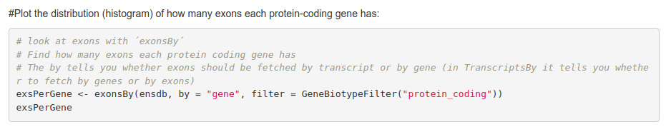
misc…

Slide 9

Next Generation Sequencing (NGS)
Shotgun sequencing:
Large DNA molecule
fragmentation
sequencing

Slide 10

Next Generation Sequencing (NGS)
RNA sequencing:
RNA molecules
cDNA
fragmentation
sequencing & alignment

Slide 11


Next Generation Sequencing:
one technology to rule them all
Genomics
& meta-genomics
Epigenomics
& chromatin
conformation
Transcriptomic, translatomics, epi-transcriptomics
A lot of convergence in terms of analysis tools and techniques
~80% of sequencing
market share

Slide 12
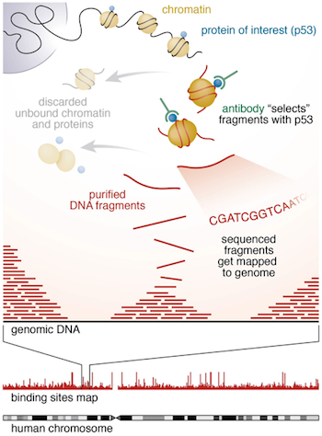
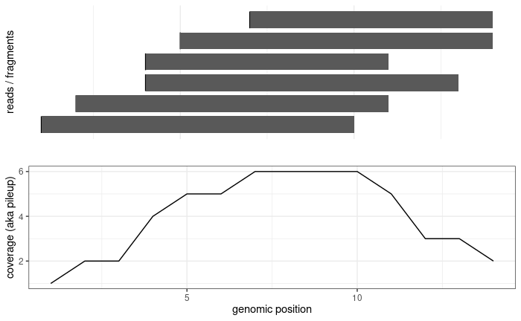
read
fragment
adapter
adapter
Single-end
sequencing:
read
fragment
Paired-end
sequencing:
read1
read2
fragment

Slide 13
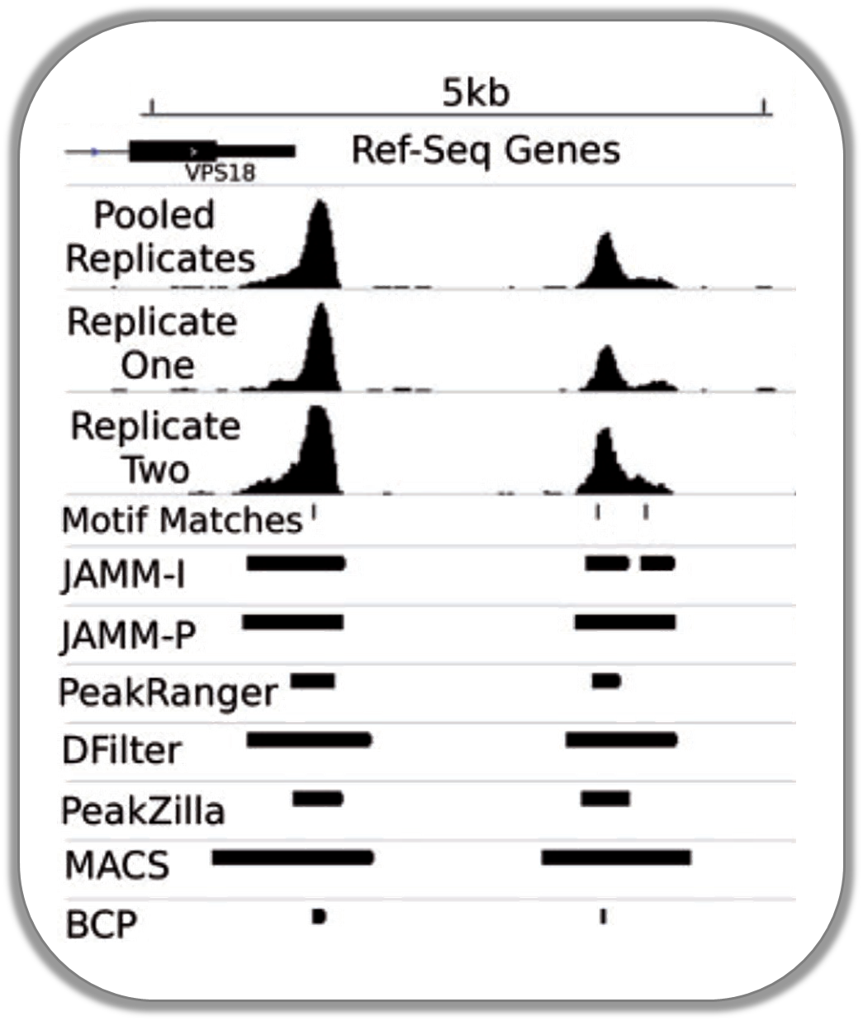
Peak calling
coverage
?
?
TF binding site
Enrichment over input?
input
(Ibrahim et al., NAR 2014)

Slide 14
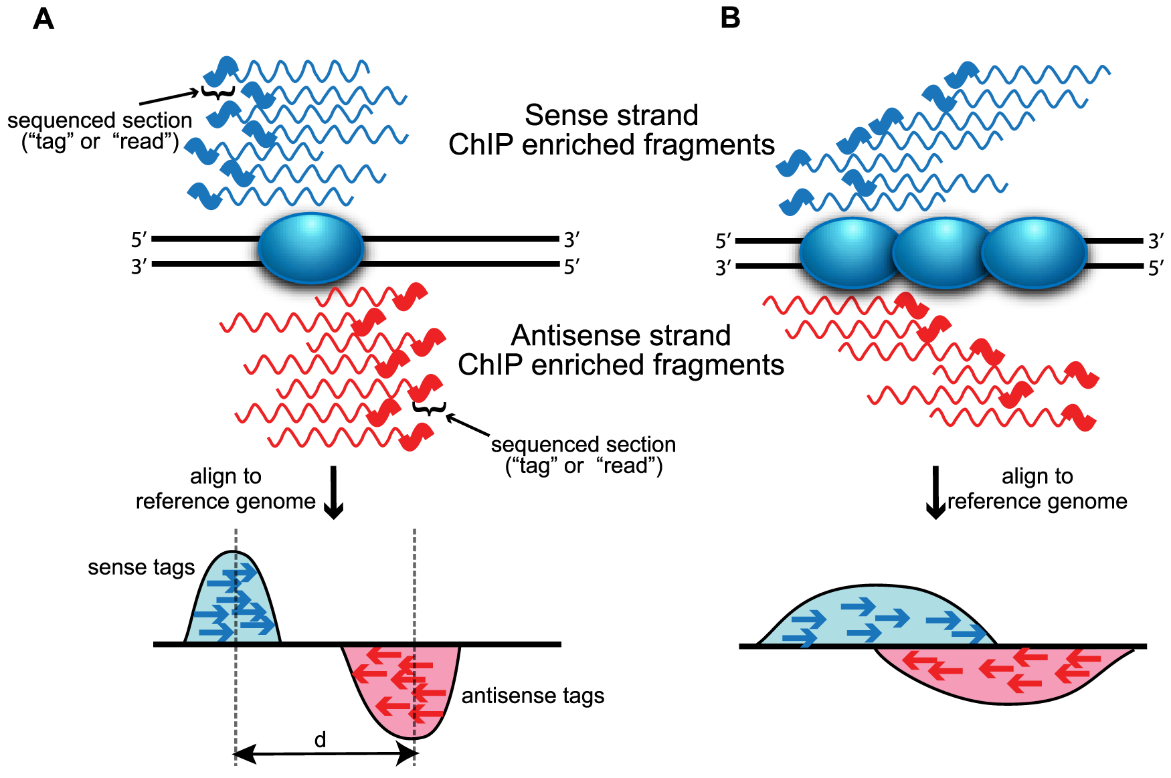
(Wilbanks et al., PLoS One 2010)

Slide 15
Overview of a primary analysis pipeline (ChIP-seq and the likes)
MACS2/csaw
genomic regions
*.bed, *.bb
*.bigbed
(and others)
genome sequence
*.fa / *.fasta
genome indices
indexing
peak calling
aligned reads
*.sam
*.bam
raw reads
*.fastq(.gz)
(QC &
trimming)
alignment
quantification
featureCounts
coverage
tracks
*.wig
*.bw
*.bigwig
computecoverage
fastqc/
trimmomatic/Rfastp
bowtie2
/Rsubread
(QC,
mark duplicates)
bamCoverage
(deepTools)

Slide 16
Alternative toolsets for (DNA) primary analysis
The most standard one:
fastqc
trimmomatic
bowtie2
picard
deeptools
Pure R-based
rfastp QuasR
Rsubread
Downstream analysis (R)
epiwraps

Slide 17
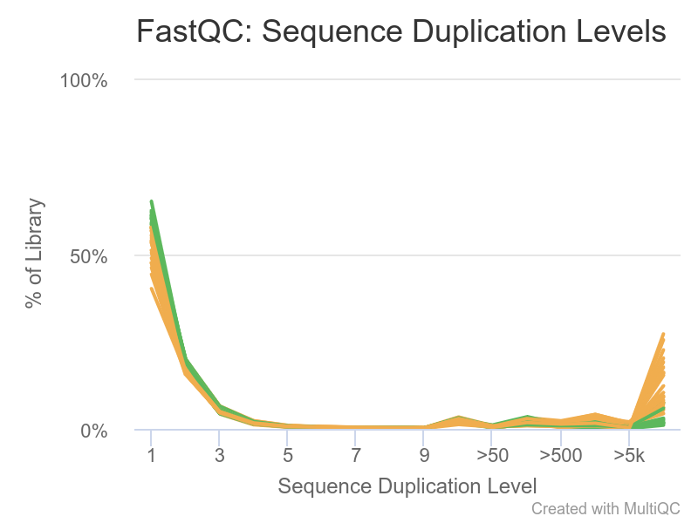
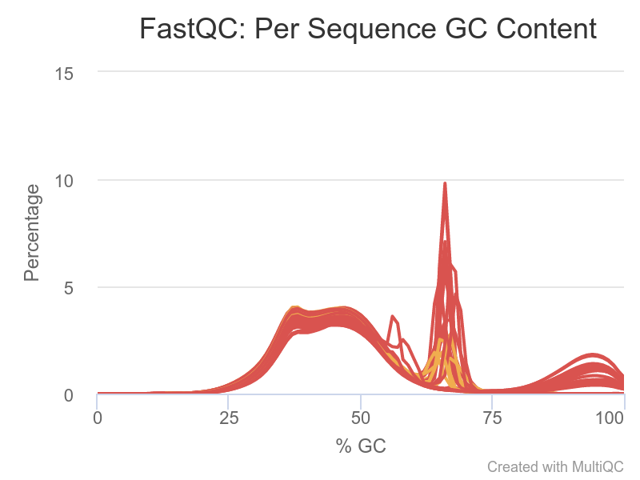
Example (rather extreme) QC problems
There are some sequences that are present thousands of times
Most reads have a more or less normal distribution centered a bit below 50% (genome-dependent)
A high % of reads has a very specific GC content
A certain % of the reads has an extremely high GC content

Slide 18
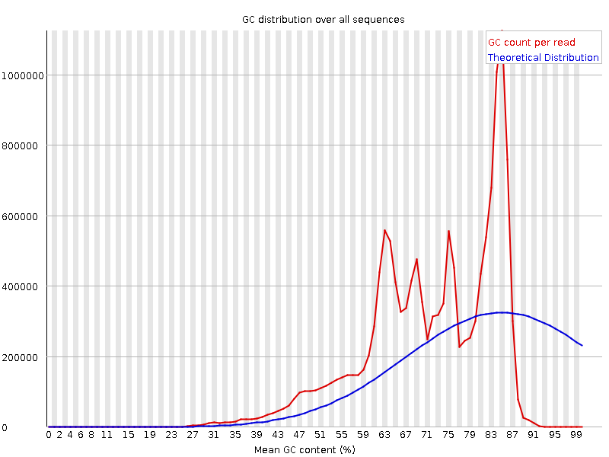
Example (rather
extreme)
QC problems:
Bias from
overamplification

Slide 19

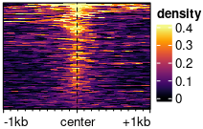
Visualizations available in epiwraps
Signal across one genomic region: plotSignalTracks
Signal across several genomic regions: signal2Matrix → plotEnrichedHeatmaps
coverage
← genomic coordinates →
(Based on the Gviz R package)
(Mainly based on the EnrichedHeatmap R package, itself based on ComplexHeatmap)

Slide 20
Assignment
Download a mouse ChIPseq dataset
Download and process it from the raw data, obtaining:
bam file, along with number and percentage of mapped reads
bigwig file
peaks
How many peaks do you find?
Plot the signal round one of the peaks
Please make sure that you name your final file assignment.html !!
Suggested dataset:
p300 in mESC:
https://www.encodeproject.org/files/ENCFF001LJN/@@download/ENCFF001LJN.fastq.gz
the corresponding input control would be:
https://www.encodeproject.org/files/ENCFF001KEU/@@download/ENCFF001KEU.fastq.gz

