Slide 1

Bioinformatic approaches to regulatory genomics and epigenomics
376-​1347-00L - 2022 | week 04
Pierre-Luc Germain

Slide 2
Plan for today
Recap of last week
Visualizing epigenomic signals
Functional elements
Finding data from the literature

Slide 3
Overview of a primary analysis pipeline (ChIP-seq and the likes)
MACS2/csaw
genomic regions
*.bed, *.bb
*.bigbed
(and others)
genome sequence
*.fa / *.fasta
genome indices
indexing
peak calling
aligned reads
*.sam
*.bam
raw reads
*.fastq(.gz)
(QC &
trimming)
alignment
quantification
featureCounts
coverage
tracks
*.wig
*.bw
*.bigwig
computecoverage
fastqc/
trimmomatic/Rfastp
bowtie2
/Rsubread
(QC,
mark duplicates)
bamCoverage
(deepTools)

Slide 4
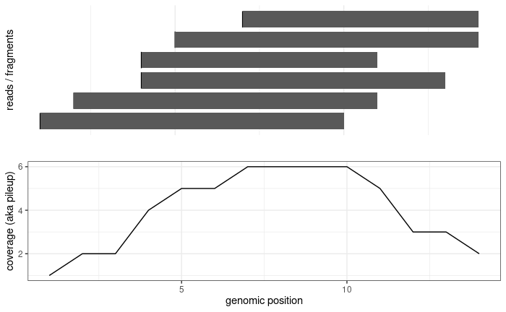
Recap
read1
read2
fragment

Slide 5

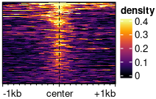
Visualizations available in epiwraps
Signal across one genomic region: plotSignalTracks
Signal across several genomic regions: signal2Matrix → plotEnrichedHeatmaps
coverage
← genomic coordinates →
(Based on the Gviz R package)
(Mainly based on the EnrichedHeatmap R package, itself based on ComplexHeatmap)

Slide 6
Read extension in coverage track generation
read1
fragment
read1
fragment
read1
fragment
Coverage without
read extension
Coverage with
read extension

Slide 7
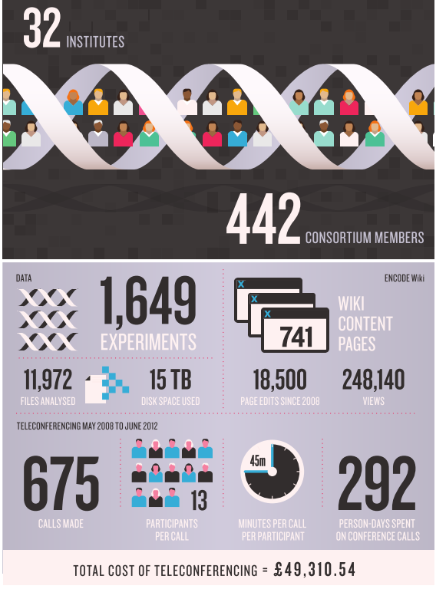
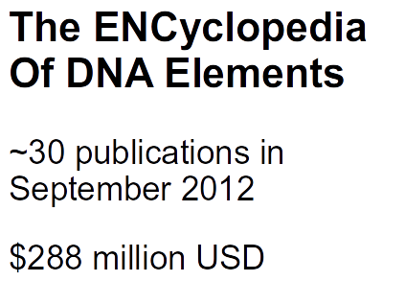
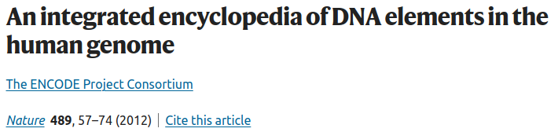
… then an ENCODE2, 3, now working towards the 5…

Slide 8
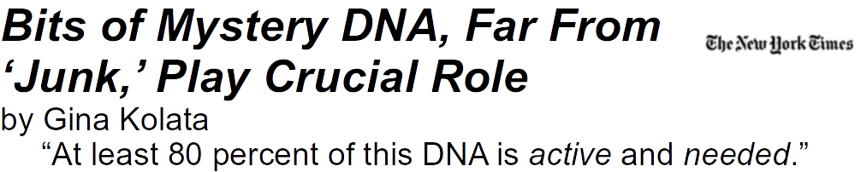

The evolutionary arguments for junk:
1% protein-coding
~4 to 10% evolutionarily conserved
>50% transposable elements
Onions have a 5 times bigger genome
The very angry response:
Graur et al., GBE 2013
(For more on the topic, see Germain, Ratti and Boem 2014; Ratti and Germain in print.)

Slide 9
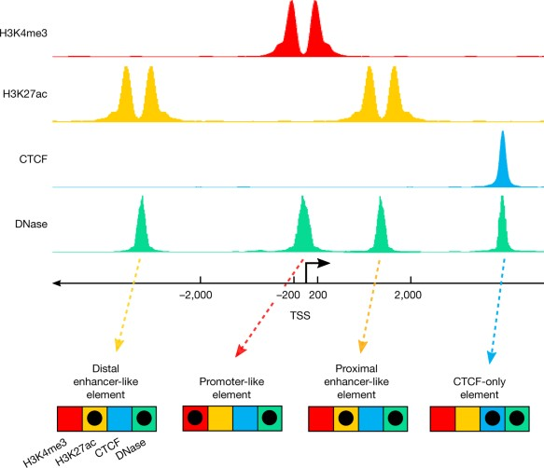
A signature-based encyclopedia of DNA elements
segmentation
enh
prom
enh
ENCODE’s “signature strategy”:
Different types of functional genetic elements are associated with different chemical signatures
We can identify functional elements by identifying these signatures genome-wide

Slide 10

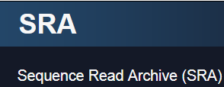

Generic repositories for NGS data
https://www.ncbi.nlm.nih.gov/geo/
https://www.ebi.ac.uk/ena/
https://www.ncbi.nlm.nih.gov/sra

Slide 11



Quality-controlled and uniformly processed human and mouse NGS datasets
www.roadmapepigenomics.org
www.encodeproject.org
(hematopoietic system)

Slide 12
Assignment
Complete last week’s assignment
Find and download the peak-level data (i.e. bed-like format) for the following histone modifications in mouse embryonic stem cells (mESC) from ENCODE:
H3K4me3, H3K4me1, H3K27ac, and H3K27me3
Of the p300 peaks you identified last week, what proportion overlap each of the marks?

