Slide 1
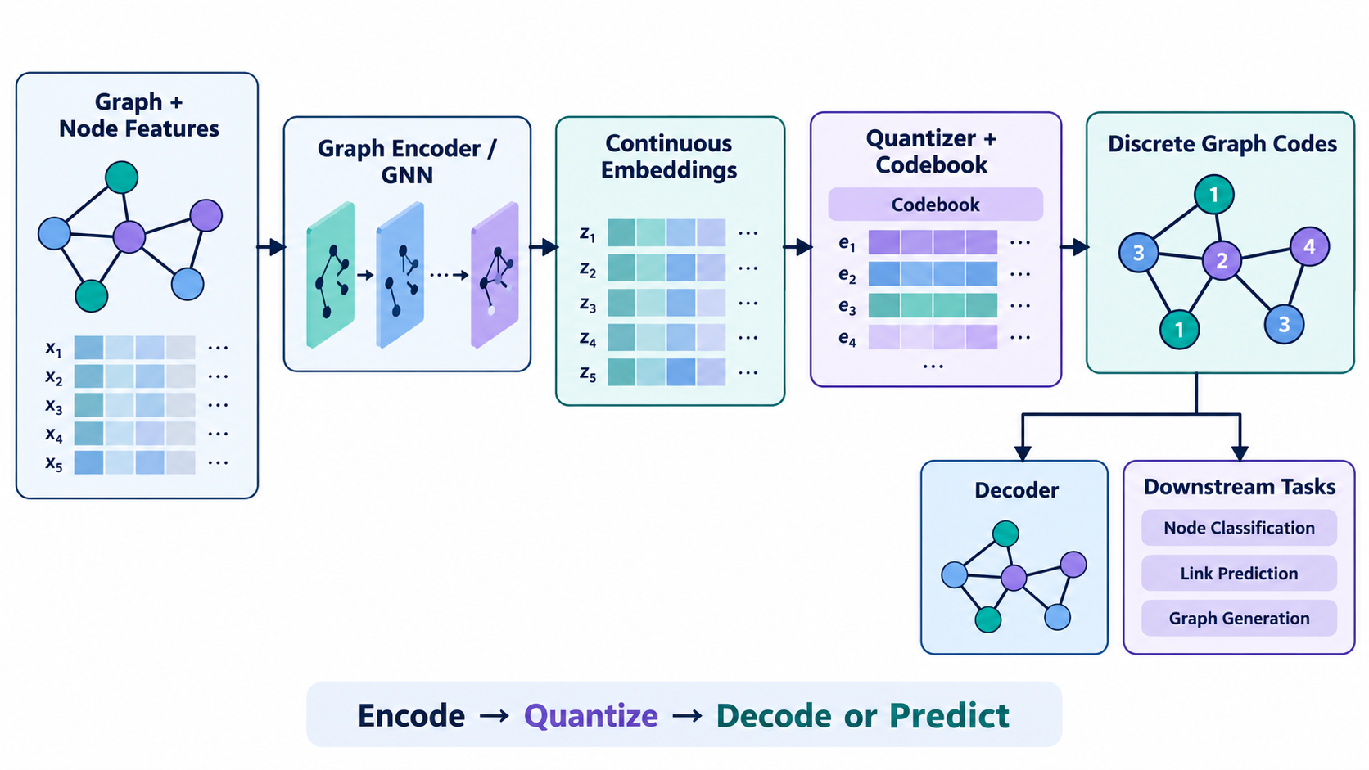
ANIMATION BUILD SEQUENCE
How a graph becomes discrete codes
1. Start with the graph
Nodes, edges, and features are the raw input.
Graph input
Apply Morph transition between these slides
01
Notes:
Animation step 1: 1. Start with the graph. Nodes, edges, and features are the raw input. Advance to the next slide using Morph. Source: Lin et al., https://arxiv.org/abs/2502.00681

Slide 2
ANIMATION BUILD SEQUENCE
How a graph becomes discrete codes
2. Encode the structure
A GNN turns neighborhoods and topology into latent vectors.
Encoder
Apply Morph transition between these slides
02
Notes:
Animation step 2: 2. Encode the structure. A GNN turns neighborhoods and topology into latent vectors. Advance to the next slide using Morph. Source: Lin et al., https://arxiv.org/abs/2502.00681

Slide 3
ANIMATION BUILD SEQUENCE
How a graph becomes discrete codes
3. Quantize the vectors
A codebook maps continuous vectors to discrete codes.
Quantizer
Apply Morph transition between these slides
03
Notes:
Animation step 3: 3. Quantize the vectors. A codebook maps continuous vectors to discrete codes. Advance to the next slide using Morph. Source: Lin et al., https://arxiv.org/abs/2502.00681

Slide 4
ANIMATION BUILD SEQUENCE
How a graph becomes discrete codes
4. Read the discrete graph
The code sequence becomes a compact graph representation.
Discrete codes
Apply Morph transition between these slides
04
Notes:
Animation step 4: 4. Read the discrete graph. The code sequence becomes a compact graph representation. Advance to the next slide using Morph. Source: Lin et al., https://arxiv.org/abs/2502.00681

Slide 5
ANIMATION BUILD SEQUENCE
How a graph becomes discrete codes
5. Use the codes
The same representation supports decoding and downstream tasks.
Downstream tasks
Apply Morph transition between these slides
05
Notes:
Animation step 5: 5. Use the codes. The same representation supports decoding and downstream tasks. Advance to the next slide using Morph. Source: Lin et al., https://arxiv.org/abs/2502.00681

