Slide 1
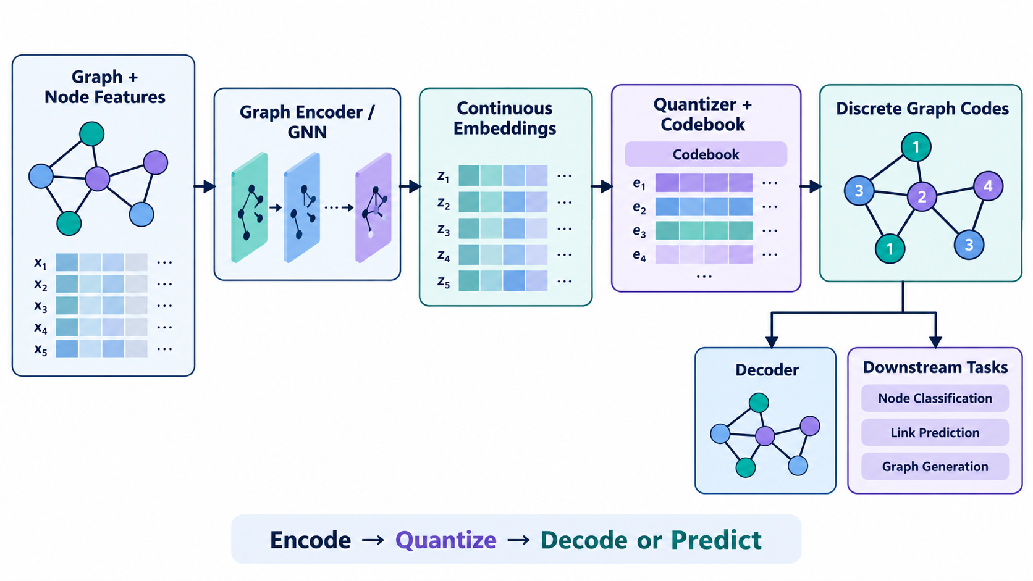
CMPE 255 • SHORT STORY
When Graphs Learn
to Speak in Tokens
Quantized Graph Representation Learning for data mining and graph–LLM systems
Encode • Quantize • Decode or Predict
Based on Lin et al., arXiv:2502.00681v2
Notes:
Opening: Graphs are rich relational objects, but ordinary embeddings are continuous, expensive, and hard to connect to language models. This deck explains the discrete-code alternative. Source: https://arxiv.org/abs/2502.00681

Slide 2
01 • MOTIVATION
Why quantize graph representations?
Continuous embeddings work well, but they create three recurring problems at scale.
01
Memory pressure
The design question
A dense vector for every entity becomes expensive as graphs grow.
Can a graph be compressed into a small vocabulary of useful discrete codes?
02
Limited interpretability
Individual dimensions rarely have a clear human meaning.
03
A weak graph–language interface
Arbitrary continuous vectors are not naturally token sequences.
CMPE 255 • Quantized Graph Representation Learning
02
Notes:
Explain the motivation in plain language. Quantization is not only about compression: it also offers a possible interface between graph encoders and token-based language models. Source: https://arxiv.org/abs/2502.00681

Slide 3
02 • CORE IDEA
The QGR architecture
A graph encoder creates a latent representation; the quantizer turns it into discrete codes; a decoder or task head tests what survived.
CMPE 255 • Quantized Graph Representation Learning
03
Notes:
Walk left to right: graph input, encoder, continuous latent vectors, quantizer and codebook, then discrete graph codes. The codes can be decoded or used directly for downstream tasks. Source: Lin et al., arXiv:2502.00681v2.

Slide 4
03 • DESIGN SPACE
Four quantization strategies
The choice of quantizer controls the balance between compression, stability, and information loss.
Vector quantization
Assign each latent vector to its nearest learned prototype. Risk: codebook collapse.
Residual vector quantization
Use several codebooks in sequence; later codes capture the remaining error.
Finite scalar quantization
Project into a few dimensions and round each dimension to fixed levels.
Anchor selection and assignment
Represent entities using structurally important real nodes, especially in knowledge graphs.
CMPE 255 • Quantized Graph Representation Learning
04
Notes:
The survey groups current methods into vector quantization, residual vector quantization, finite scalar quantization, and anchor selection/assignment. Emphasize that each choice changes the compression–fidelity trade-off. Source: https://arxiv.org/html/2502.00681

Slide 5
04 • TRAINING OBJECTIVES
What should the codes preserve?
Quantization is a representation mechanism. The objective function decides what information the model is rewarded for keeping.
Node level
Edge level
Graph level
Feature reconstruction
Link prediction
Contrastive learning
Recover node attributes from the discrete codes.
Preserve connectivity, distances, or semantic relationships.
Keep codes compatible across masked or perturbed graph views.
Strong systems often combine objectives: attributes + topology + graph-level invariance.
CMPE 255 • Quantized Graph Representation Learning
05
Notes:
Use this slide to connect QGR to data mining. Node objectives protect features, edge objectives protect graph structure, and graph-level objectives encourage stable representations across views. Source: Lin et al., arXiv:2502.00681v2.

Slide 6
05 • GRAPH–LANGUAGE INTEGRATION
Why connect graph codes to LLMs?
LLMs already process discrete sequences. QGR provides a possible interface for relational data.
Graph side
Language side
Encode neighborhoods and topology
Quantize into short code sequences
Preserve structure with graph objectives
Reuse the LLM vocabulary
Or add learned graph tokens
Fine-tune for graph and text tasks
Potential applications: node classification • knowledge-graph link prediction • molecule–text retrieval • generation
CMPE 255 • Quantized Graph Representation Learning
06
Notes:
Clarify the limitation: token-like codes are not automatically meaningful language. Evaluation must show that the LLM uses graph structure instead of shortcuts. Examples in the survey include Dr.E, SSQR, ReaLM, and UniMoT. Source: https://arxiv.org/html/2502.00681

Slide 7
06 • METRICS
How should QGR systems be evaluated?
A useful benchmark reports task quality and the cost of obtaining it.
Task quality
Accuracy, F1, MRR, Hits@K, regression error
Compression
Code length, vocabulary size, memory, inference cost
Robustness
Noise, missing features, graph perturbations, distribution shift
Code usage
Utilization, frequency imbalance, sensitivity to codebook size
For graph–LLM systems, also test whether predictions respond to meaningful edge changes.
CMPE 255 • Quantized Graph Representation Learning
07
Notes:
Stress that accuracy alone can hide a large memory or inference cost. For graph–LLM systems, add counterfactual edge-removal tests and generalization to unseen entities or structures. These are recommended evaluation dimensions based on the survey taxonomy.

Slide 8
07 • CRITICAL READING
Ablations that reveal what matters
The key causal question is whether quantization itself created the improvement.
Representation and training
Systems and scale
Continuous embeddings vs. quantized codes
Vector vs. residual vs. scalar quantization
Different codebook sizes and code lengths
Reconstruction-only vs. combined objectives
With vs. without code-dependence modeling
With vs. without the LLM
Random vs. learned vs. domain-informed codebooks
Robustness as graphs become larger or noisier
Ablations separate the contribution of the quantizer from the contribution of the surrounding model.
CMPE 255 • Quantized Graph Representation Learning
08
Notes:
This slide gives your own critical perspective. Good ablations prevent a paper from attributing gains to quantization when they may come from a larger encoder, extra pretraining, or a stronger downstream model.

Slide 9
08 • CONCLUSION
My takeaway
Discrete graph codes are most valuable as an interface.
They can make graph representations more compact and easier to route into retrieval, generation, and language-model pipelines.
QGR compresses graph structure into a finite vocabulary.
Training objectives determine whether codes preserve attributes, topology, or graph-level meaning.
Discreteness does not guarantee interpretability; code usage and counterfactual tests still matter.
Graphs may not become text, but graph models and language models can share a useful vocabulary.
CMPE 255 • Quantized Graph Representation Learning
09
Notes:
Close with the short story: QGR is not magic interpretability. Its promise is a compact, reusable interface between relational structure and token-based models. Invite questions.

Slide 10
09 • SOURCES
References
Primary survey
Lin et al. “A Survey of Quantized Graph Representation Learning: Connecting Graph Structures with Large Language Models.” arXiv:2502.00681, revised January 2026.
Related work
Grover and Leskovec. “node2vec: Scalable Feature Learning for Networks.” KDD 2016.
Galkin et al. “NodePiece: Compositional and Parameter-Efficient Representations of Large Knowledge Graphs.” ICLR 2022.
Xia et al. “Mole-BERT: Rethinking Pre-training Graph Neural Networks for Molecules.” ICLR 2023.
Paper link: arxiv.org/abs/2502.00681
CMPE 255 • Quantized Graph Representation Learning
10
Notes:
References used in the deck. Verify venue details against official proceedings or OpenReview before final submission.

