Slide 1
Distributed Random Forest in Structured Streaming of Apache Spark
Nikos Tzimos
Vasilis Vittis

Slide 2
Why dealing with real time classification problems?
Data too large to fit to memory
Detection Problems
Quick Answer for Prediction
Distributed Environment
Streaming Classification
THE IMPORTANCE

Slide 3
Already Established Algorithms
Adaptive Random Forests for evolving data stream classification -- Heitor Gomes
Mining high-speed data streams -- Pedro Domingos
Adaptive Random Forest (Hoeffding Tree)
Introduces Hoeffding Tree
1
1
Random forests algorithm for evolving data stream classification
Hoeffding Bound
Parallel implementation and Weighted Voting
VFDT System
2
2
CPU time and RAM-hours of a parallel implementation of ARF
Very Fast Decision Tree learner
Parallel implementation
Parallel implementation
Drift adaptation
Refinements of VFDT
3
3
3
3
Background trees - a more permissive threshold to detect warnings
Ties, G-computation, Poor attributes
https://link.springer.com/article/10.1007/s10994-017-5642-8
https://dl.acm.org/doi/10.1145/347090.347107
Notes:
ARF : is able to obtain high classification in data streams with different characteristics without further hyperparameter tuning. Since it is a sustainable off-the-shelf learner for the challenging task of evolving data stream classification, it is going to be useful for both practical applications and as a benchmark for future algorithms proposals in the field
Drift adaptation : we propose a drift adaptation strategy that does not simply reset base models whenever a drift is detected. In fact, it start training a background tree after a warning has been detected and only replace the primary model if the drift occurs. This strategy can be adapted to other ensembles as it is not dependent on the base model. We present experiments with ADWIN and Page Hinkley Test (PHT) (Page 1954)
Hoeffding Bound : Consider a real-valued random variable r whose range is R (e.g., for a probability the range is one, and for an information gain the range is log c, where c is the number of classes). Suppose we have made n independent observations of this variable, and computed their mean r. The Hoeffding bound states that, with probability 1 − δ, the true mean of the variable is at least r −ε , where ε = …
Ties : When two or more attributes have very similar G’s, potentially many examples will be required to decide between them with high confidence. This is presumably wasteful, because in this case it makes little difference which attribute is chosen. Thus VFDT can optionally decide that there is effectively a tie and split on the current best attribute if ∆G < < τ , where τ is a user-specified threshold
G computation : The most significant part of the time cost per example is recomputing G. It is inefficient to recompute G for every new example, because it is unlikely that the decision to split will be made at that specific point. Thus VFDT allows the user to specify a minimum number of new examples nmin that must be accumulated at a leaf before G is recomputed. This effectively reduces the global time spent on G computations by a factor of nmin, and can make learning with VFDT nearly as fast as simply classifying the training examples. Notice, however, that it will have the effect of implementing a smaller δ than the one specified by the user, because examples will be accumulated beyond the strict minimum required to choose the correct attribute with confidence 1 − δ. (This increases the time required to build a node, but our experiments show that the net effect is still a large speedup.) Because δ shrinks exponentially fast with the number of examples, the difference could be large, and the δ input to VFDT should be correspondingly larger than the target
Poor attributes: Memory usage is also minimized by dropping early on attributes that do not look promising. As soon as the difference between an attribute’s G and the best one’s becomes greater than , the attribute can be dropped from consideration, and the memory used to store the corresponding counts can be freed.

Slide 4
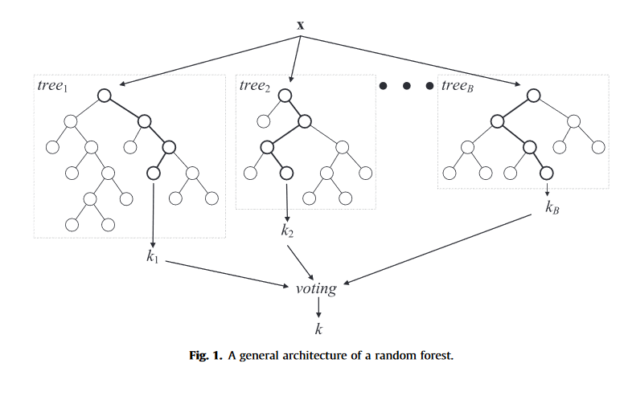
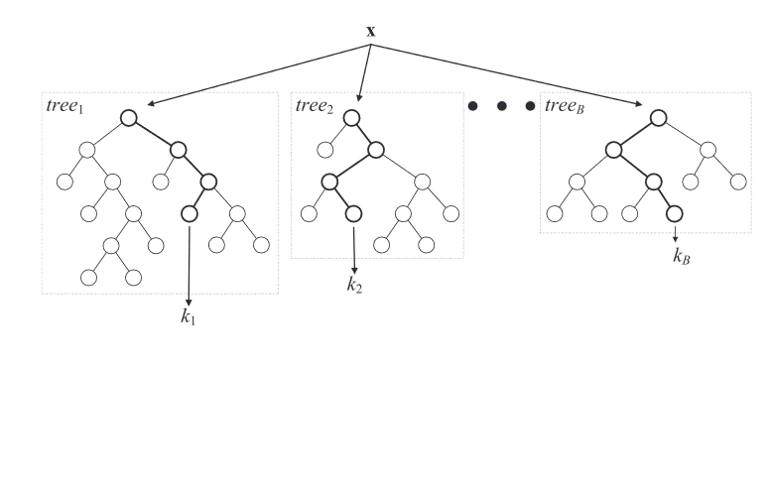
Random Forest - Theory
Properties
Schematic
Collection of weak learners
Weighted / Majority Voting
Injecting the “right randomness”
Random samples with Replacement (Bagging)
Randomly select k-features

Slide 5
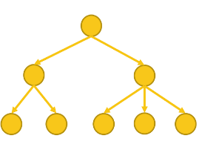
Random Forest - Practice
Job1
Node1
Node2
Node k
…
Hoeffding Tree 1
Hoeffding Tree 2
Hoeffding Tree k
Producer Source
Input stream
TupleId | Prediction1
TupleId | Prediction2
TupleId | Predictionk
Job2
Groupby(TupleId)
Consumer Sink
Weighted Voting
Output stream

Slide 6
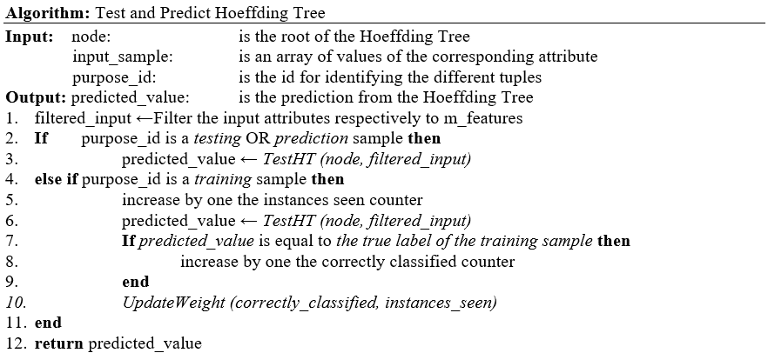
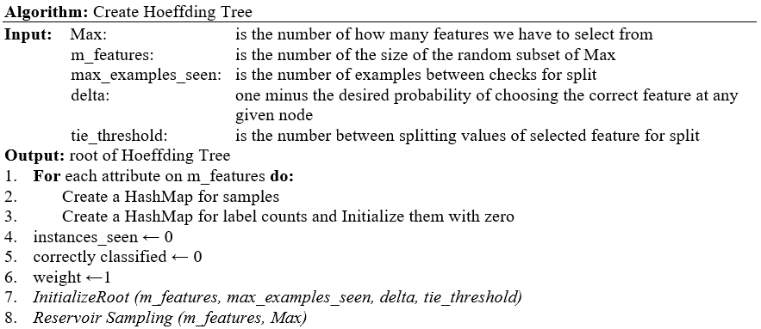
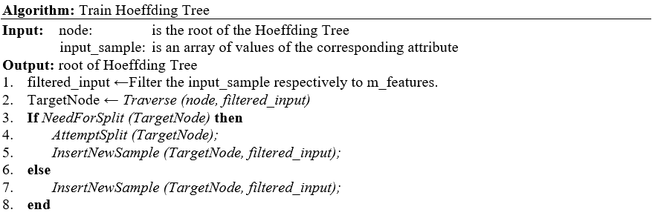


Hoeffding Tree
Continuous Values
Splitting based on range and not based on distinct values of features
Key Inputs
delta
tie threshold
Reservoir Sampling (Randomly select
k-features)
Algorithm
Two factor split It may needs to split but fail attempting it
Hoeffding Bound
$$ε= \sqrt{\frac{R^{2}\ln\left(\frac{1}{delta}\right)}{2n}}$$
Update Weight
$$w_{h}=\frac{correctly classified}{instances seen}$$
Notes:
A model which has to process a fraction of incoming tuples in order to find the best attribute at an internal node of the tree. In order to know the sufficient number of tuples with which we can conclude to the best splitting attribute, we need to set the statistical Hoeffding Bound.

Slide 7
Hoeffding Tree
Input Tuple
-2 | 1 | 4 | 0
4 | -1 | 7 | 1
-2 | -6 | 2 | 1
-3 | 4 | 3 | 0
-1 | 2 | 3 | 0
features
label
Attr1 | Attr2 | Attr3 | Label
nmin = 1
nmin = 2
nmin = 3
MAX_EXAMPLES_SEEN = 4
nmin = 4
1.Need For Split?
If (nmin = MAX_EXAMPLES_SEEN AND Node is NOT Homogeneous)
Attr2 < 2
Attr2 > 2
YES
Attr1 | Attr2 | Attr3 | Label
Attr1 | Attr2 | Attr3 | Label
2. Attempt the Split
nmin = 1
-2 | -6 | 2 | 1
nmin = 1
-3 | 4 | 3 | 0
Find the best 2 Attributes based on their Information Gain (Ga & Gb)
nmin = 2
4 | -1 | 7 | 1
nmin = 2
-1 | 2 | 3 | 0
If (Ga – Gb > Hoeffding Bound OR Ga - Gb < tie threshold)
nmin = 3
YES
MAX_EXAMPLES_SEEN = 4
MAX_EXAMPLES_SEEN = 4
3. Do the Split ✓

Slide 8
Project Pipelining
CLASSIFIER
Job2
.GroupBy(idHT)
AGGREGATION
.flatMapGroupsWithState (HoeffdingTree)
.GroupBy(key_tuple, purpose_id)
<tuple,0>
<tuple,1>
…
<tuple,N>
.filter (predict samples)
.filter (testing samples)
Test Source
.PoissonDistribution(6.0)
Training sample*
Testing sample*
Predict sample*
Training Source
State
Query 1
Prediction
Query 2
Testing
.flatMap
.flatMap
Predict Source
State does not exist
State exists
1. Weighted Voting
1. Accumulator
Create HT
Train/Test HT
2. Confusion Matrix
2. Result
Train/Test HT
Fraud, No Fraud
Monitor Model
Job1
*<key_tuple, prediction, true_label, purpose_id, idHT, weightHT>

Slide 9
Input Format
(attr1,attr2,..,attrN,keyTuples,purporseId)
Flat Map
ANALYSIS
Multiplies the input so that it can be used by all base learners of RF
Input
Output Format
(attr1,attr2,..,attrN,keyTuples,purporseId,idHT)
Scope
Append the idHT so that we can then apply the groupby function
Output
GroupBy

Slide 10
Project Pipelining
CLASSIFIER
Job2
.GroupBy(idHT)
AGGREGATION
.flatMapGroupsWithState (HoeffdingTree)
.GroupBy(key_tuple, purpose_id)
<tuple,0>
<tuple,1>
…
<tuple,N>
.filter (predict samples)
.filter (testing samples)
Test Source
.PoissonDistribution(6.0)
Training sample*
Testing sample*
Predict sample*
Training Source
State
Query 1
Prediction
Query 2
Testing
.flatMap
.flatMap
Predict Source
State does not exist
State exists
1. Weighted Voting
1. Accumulator
Create HT
Train/Test HT
2. Confusion Matrix
2. Result
Train/Test HT
Fraud, No Fraud
Monitor Model
Job1
*<key_tuple, prediction, true_label, purpose_id, idHT, weightHT>

Slide 11
Flat Map with State
Get the state(Random Forest)
Update the state
Filtering tuples
Testing and predicting tuples
ANALYSIS – two cases
First micro-batch of stream
Initialize the state(Random Forest)
Filtering tuples
Testing and predicting tuples
First Case – State exist
Keep only testing and predicting tuples
Output format
(keyTuples,res,label,idHT,purporseId,weightTree)
weightTree = correctly_classified / instances_seen
Second Case – State does not exist
Output
11

Slide 12
Project Pipelining
CLASSIFIER
Job2
.GroupBy(idHT)
AGGREGATION
.flatMapGroupsWithState (HoeffdingTree)
.GroupBy(key_tuple, purpose_id)
<tuple,0>
<tuple,1>
…
<tuple,N>
.filter (predict samples)
.filter (testing samples)
Test Source
.PoissonDistribution(6.0)
Training sample*
Testing sample*
Predict sample*
Training Source
State
Query 1
Prediction
Query 2
Testing
.flatMap
.flatMap
Predict Source
State does not exist
State exists
1. Weighted Voting
1. Accumulator
Create HT
Train/Test HT
2. Confusion Matrix
2. Result
Train/Test HT
Fraud, No Fraud
Monitor Model
Job1
*<key_tuple, prediction, true_label, purpose_id, idHT, weightHT>

Slide 13
Infeasible to keep the entire stream
“Leverage” Bagging
Appropriate online bootstrap aggregating process
Approximates the original random sampling with replacement by weighting instances according to a Poisson(λ = 1) distribution
ANALYSIS
Stream application
Use Poisson (λ = 6)
The practical effect of increasing the probability of assigning higher weights of tuples
Increase the diversity of the weights
Reduce the losses of input tuples(out-of-bag-error)
Online bootstrap
Leverage Bagging
Notes:
For λ = 1 we see that 37% of the values are zero, 37% are one, and 26% are values greater than one. Using a weight of Poisson(1) we are taking out 37% of the examples, and repeating 26% of the examples, in a similar way to non streaming bagging. For λ = 6 we see that 0.25% of the values are zero, 45% are lower than six, 16% are six, and 39% are values greater than six. Using a value of λ > 1 for Poisson(λ) we are increasing the diversity of the weights and modifying the input space of the classifiers inside the ensemble

Slide 14
Project Pipelining
CLASSIFIER
Job2
.GroupBy(idHT)
AGGREGATION
.flatMapGroupsWithState (HoeffdingTree)
.GroupBy(key_tuple, purpose_id)
<tuple,0>
<tuple,1>
…
<tuple,N>
.filter (predict samples)
.filter (testing samples)
Test Source
.PoissonDistribution(6.0)
Training sample*
Testing sample*
Predict sample*
Training Source
State
Query 1
Prediction
Query 2
Testing
.flatMap
.flatMap
Predict Source
State does not exist
State exists
1. Weighted Voting
1. Accumulator
Create HT
Train/Test HT
2. Confusion Matrix
2. Result
Train/Test HT
Fraud, No Fraud
Monitor Model
Job1
*<key_tuple, prediction, true_label, purpose_id, idHT, weightHT>

Slide 15
Weighted Voting
Performance Metrics
Job2
GroupBy keyTuple
Predicting tuples
Weigthed Voting
ANALYSIS
Scope
Separation between predicted and testing tuples
GroupBy
Predicting tuples
Predicted label
Filtering
Performance Metrics
Accumulator
Query1 result
Query2 result
Notes:
Confusion Matrix : the number of True Positive (TP), False Positive (FP), False Negative (FN) and True Negative (TN) samples were computed.
− Recall (or Sensitivity-true positive rate) of a tuple is its ability to determine the fraud cases correctly. This is also obvious through its calculation: 𝑇𝑃𝑅 = 𝑇𝑃/ 𝑇𝑃+𝐹𝑁
− Also, the misclassification of a transaction as non-fraud is quite serious and is desirable to be as low as possible. This is estimated through the false negative rate or 1 – TPR.
− Specificity is the True Negative rate, 𝑇𝑁𝑅 = 𝑇𝑁 /𝑇𝑁+𝐹𝑃 and is the ability of a test to determine the non-fraud cases correctly.
−The exact opposite of Specificity, misclassifying a non-fraud transaction as fraud is not as severe, and it is measured by the inverse of Specificity (1-TNR).
−Precision (positive predictive value) is calculated as: 𝑃𝑃𝑉 = 𝑇𝑃 /𝑇𝑃+𝐹𝑃 . Precision can be interpreted as the ability of the classifier not to label as positive a sample that is negative.
− F1 score is defined as the combination of Sensitivity and Precision as it is calculated using these two metrics: 𝐹1 = 𝑃𝑃𝑉𝑇𝑃𝑅 /𝑃𝑃𝑉+𝑇𝑃𝑅 = 2𝑇𝑃/ 2𝑇𝑃+𝐹𝑃+𝐹𝑁 .
Weighted voting

Slide 16
The life of a Tuple
Job2 - Aggregate
Consumer Sink
keyTuple | res | label | idHT | weightTree | purposeId
2 | 1 | 1 | 1 | 0,8699 | testing
2 | 1 | 1 | 2 | 0,7699 | testing
Producer Sink
Attr1 | Attr2 | Attr3 | Label | keyTuple | purposeId
-2 | -6 | 2 | 1 | 2 | testing
Job1
Attr1 | Attr2 | Attr3 | Label | keyTuple | purposeId | idHT
-2 | -6 | 2 | 1 | 2 | testing | 1
-2 | -6 | 2 | 1 | 2 | testing | 2
-2 | -6 | 2 | 1 | … | … | …
-2 | -6 | 2 | 1 | 2 | testing | k
FlatMap
Hoeffding Tree1
Hoeffding Tree2
…
Groupby(idHT).flatMapGroupsWithState
Leverage
Bagging
-2 | -6 | 2 | 1 | 1 | 2
-2 | -6 | 2 | 1 | 1 | 2
-2 | -6 | 2 | 1 | 2 | 2
-2 | -6 | 2 | 1 | 2 | 2
-2 | -6 | 2 | 1 | 2 | 2
-2 | -6 | 2 | 1 | 2 | 2
2 ←Poisson(λ=6)
4 ←Poisson(λ=6)
Notes:
Output Job1 : keyTuple,res,label,purposeId,idT,weightTree

Slide 17
Swiss banknote counterfeit detection
Data Sets
1
2
3
Credit Card Fraud Detection
Give Me Some Credit
Contains 200 entries with 100 in each class and 6 attributes.
The goal is to identify genuine and counterfeit banknotes
Contains 150.000 borrowers with 10 attributed each
It is used for determining whether or not a loan should be granted
Consists of 284.807 online transactions where only 0.172% (492) of all transactions is classified as fraud
There are 28 features

Slide 18
Experimental
Results
Sensitivity: ability to determine the fraud cases correctly
Specificity: ability to determine the non-fraud cases correctly
Precision: classifies non-fraud as fraud
F1_score: combination of precision and Sensitivity

Slide 19
Thank you!

