Slide 1
DATABASE AND ANALYTICS PROGRAMMING PROJECT PRESENTATION (Air Quality Index) Michael Dunne – 15420892 Omkar Tawade – 19232136 Suraj Karyamapudi – 19232632 Vivek Kumar - 19201885

Slide 2
Introduction
An in depth look at Air quality in the cities of Gujarat, Kerala, Bengal and Assam
Air Pollution ranks as 6th highest killer in South Asia (climate change)
Our Objective here is to ask can we provide insightful information on this topic using analytically programming techniques.
Can we identify key cities that stand out for Air pollution
All technologies used include JSON, MongoDB, Python etc…

Slide 3
JSON DESCRIPTION
It stands for JavaScript Object Notation.
It was designed for human-readable data interchange.
JSON format is used for serializing and transmitting structured data over network connection.
Web services and APIs use JSON format to provide public data.

Slide 4
MongoDB DESCRIPTION
It is an open-source document database and leading NoSQL database.
It is a Schema less database.
It can store unstructured data.
It is easy to scale.

Slide 5
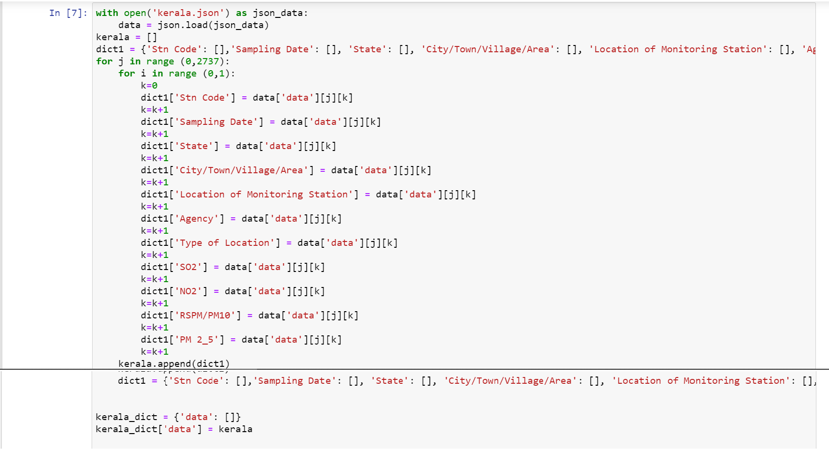
JSON PARSING

Slide 6
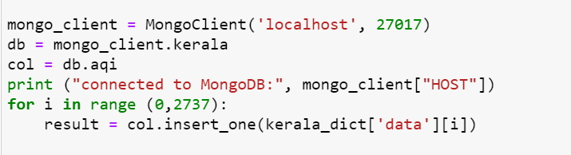
UPLOADING DATA TO MongoDB

Slide 7
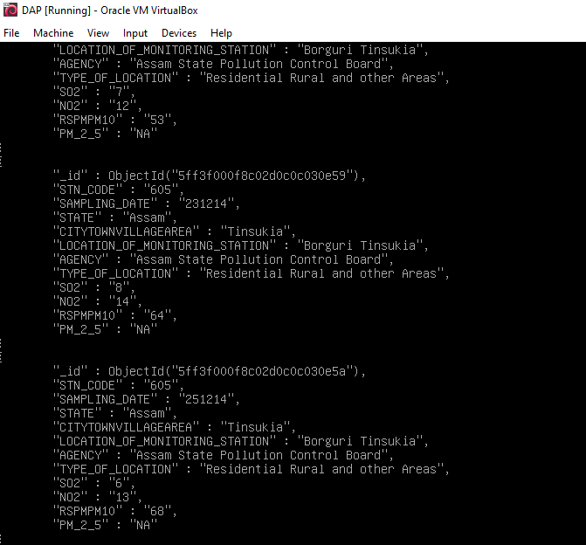
Fetching Data from MongoDB
We can view data stored in mongo DB on mongo DB shell by using few commands. (For example, we used db.airqualityindex.find().print(forEachjson) on mongo DB shell)

Slide 8
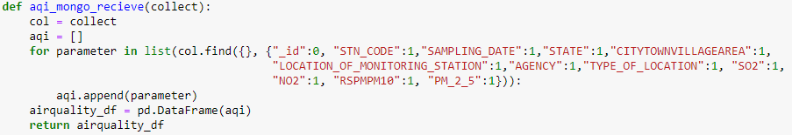

Slide 9
Uploading data to Postgres
PostgreSQL is a powerful, open source object-relational database system with over 30 years of active development that has earned it a strong reputation for reliability, feature robustness, and performance.
Each member of our group generated one CSV file each consisting the structured air quality index of respective states.
We merged the data of all four CSV files using Python and stored in local directory.
Next process was establishing the connection to postgres and creating a database.
After creating a database, we created a table using PostgreSQL query.

Slide 10
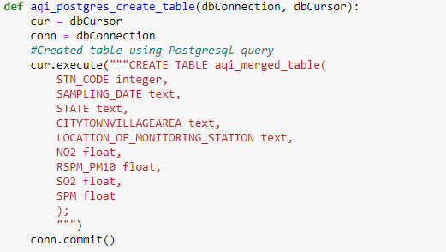
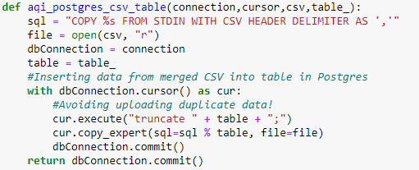

Slide 11
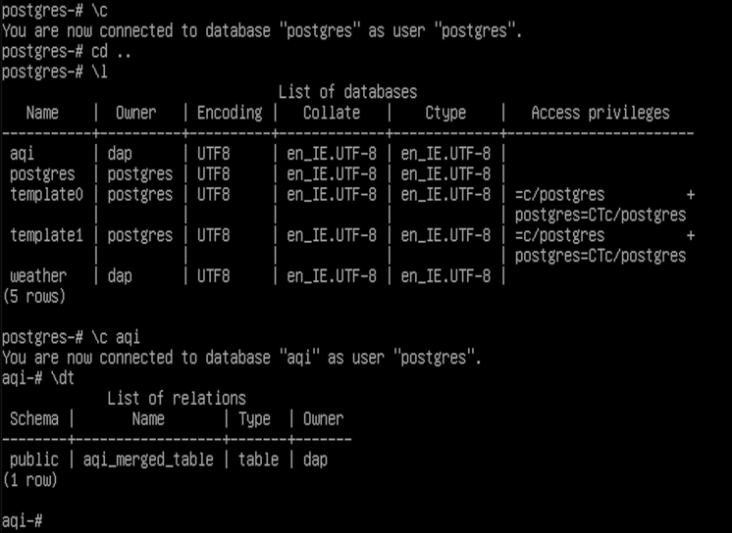

Slide 12
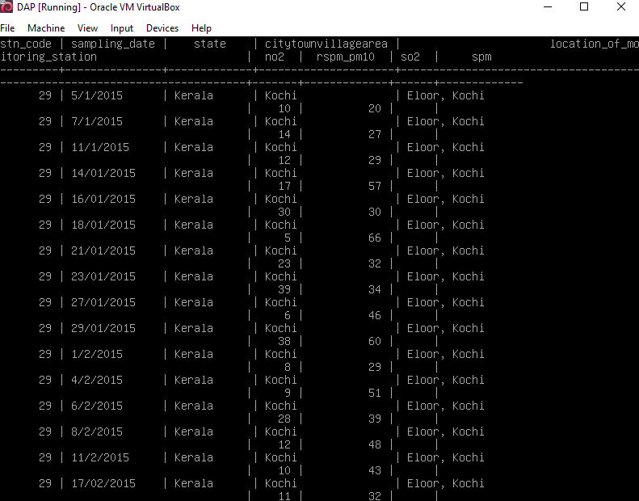

Slide 13
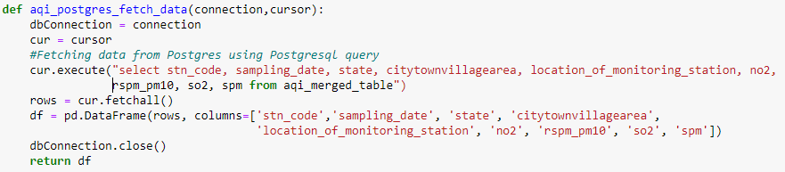
Fetching data from Postgres
There are two ways to fetch the data from Postgres.
First method is to use one query to fetch all data from Postgres to Python.
Second method is to use selective queries and store data of these queries in different variables.
We have used the first method to avoid increase of the number of variables.

Slide 14
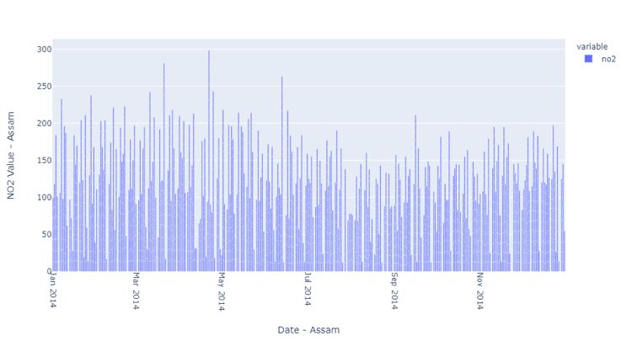
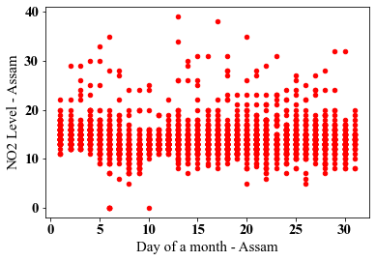
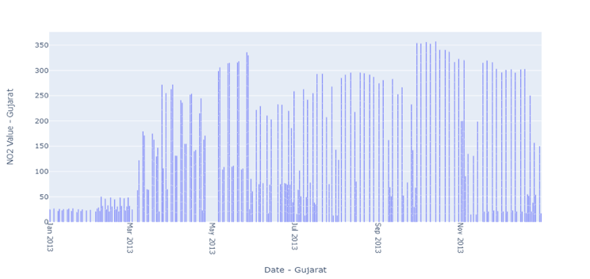
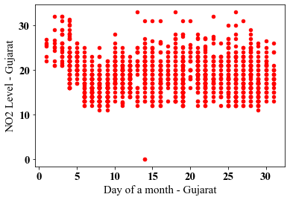
NO₂ Emissions

Slide 15
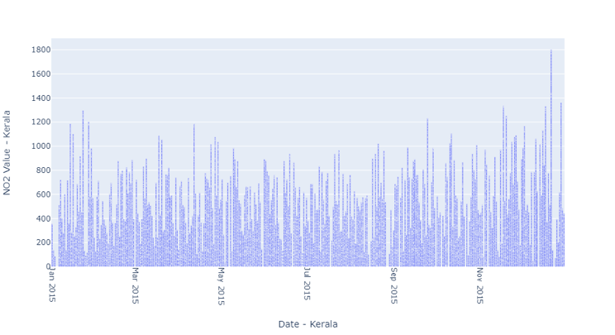
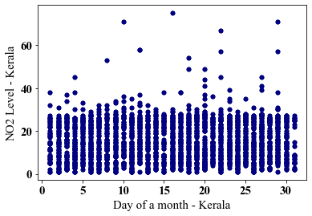
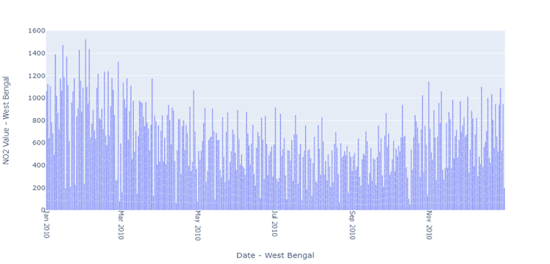
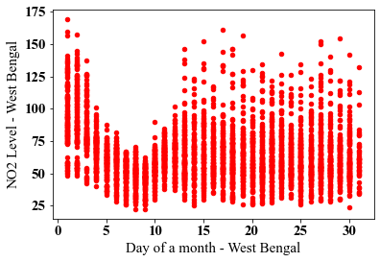
NO₂ Emissions

Slide 16
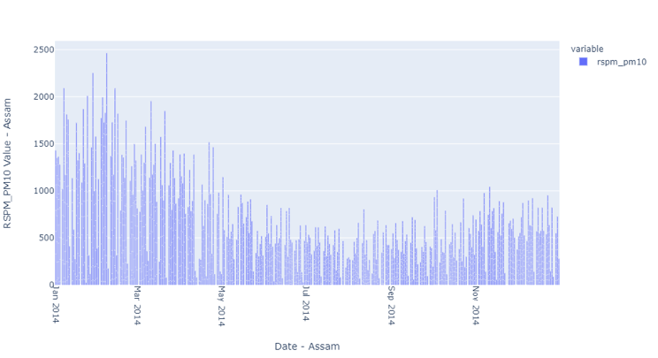
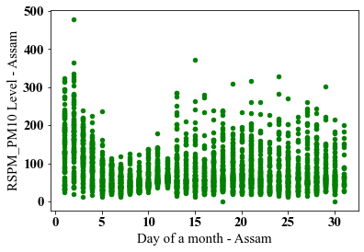
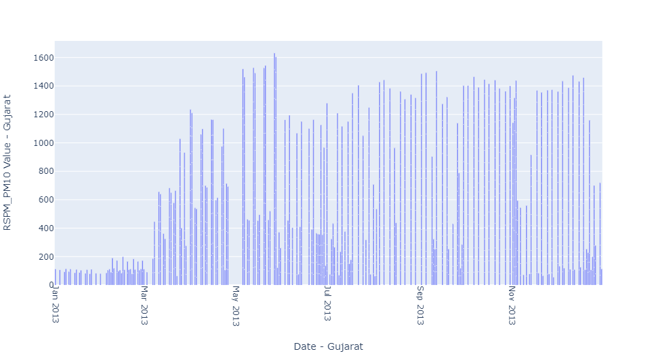
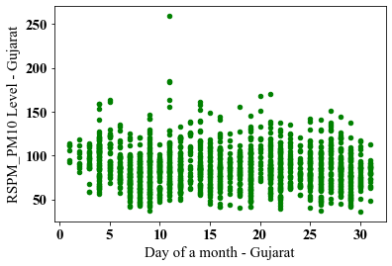
RSPM/PM10

Slide 17
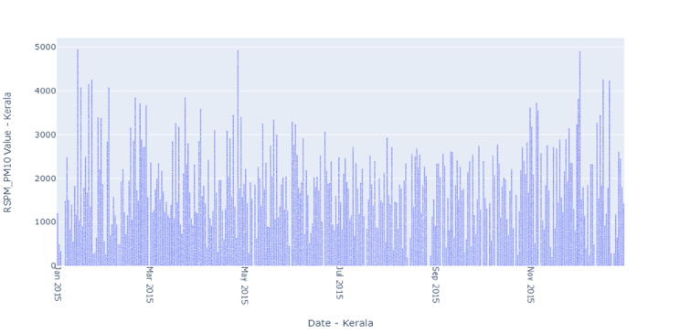
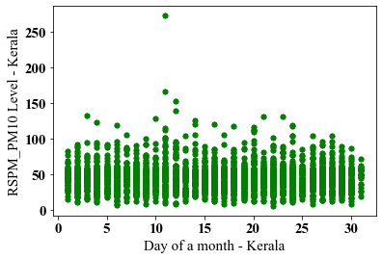
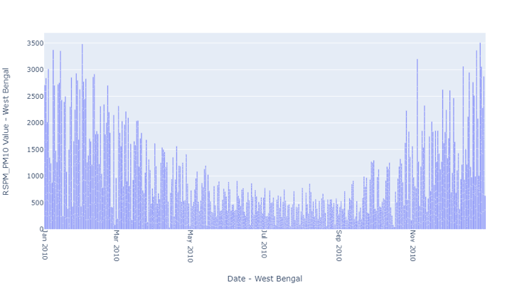
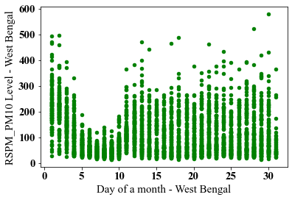
RSPM/PM10

Slide 18
Analysis of S02
Otherwise Known as Sulphur Dioxide
Emitted from Vehicle Burning of Fossil Fuels
From the our finding we can see that emissions are major in the developed states like west Bengal and Gujarat
Less Developed Assam is relatively lesser in SO2

Slide 19
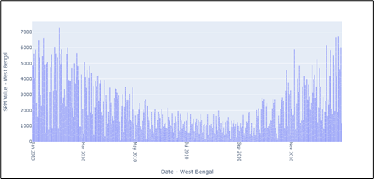
Analysis of SPM
Known as Suspended Particulate Matter
Particles that have combusted in the air due to fossil fuels
We can see that West Bengal has produced gigantic amounts of SPM compared to Gujarat.

Slide 20
CONCLUSION
From this report we have found that pollution is gradually getting worse across all regions.
The need of electrifying public transport is vital to reducing emissions
Major companies need to be held more accountable for actions.
Renewable resources like wind, solar and wave power are an example of sustainable power for a greener environment

Slide 21

Thank you for watching!

