Slide 1
◆
AI-Powered
User Story Creator
PO Copilot
From EPIC to Developer-Ready Stories in Minutes
April 2026

Slide 2
What is PO Copilot?
PO Copilot is an AI agent that converts rough requirements into developer-ready Agile User Stories — fully structured, estimation-ready, and pushed directly to Jira.
Claude AI
Jira
Figma
Confluence
Story generation & AI reasoning
EPIC analysis & story publishing
UI design cross-referencing
BRD / PRD / doc ingestion
How it works
Input
(EPIC / Brief)
AI Analysis
(Jira + Figma + Docs)
DoR Gate
(Quality Check)
PO Review
& Approval
Jira Push
(Auto-filed)
▶
▶
▶
▶
Two Modes of Operation
📋 Epic Stories Mode
✏️ Single Story Mode
Provide a Jira EPIC → agent generates a full sprint backlog with story points
Describe a story in plain language → agent clarifies, generates, and pushes one DoR-ready story
PO Copilot · Powered by Claude · Jira · Figma · Confluence

Slide 3
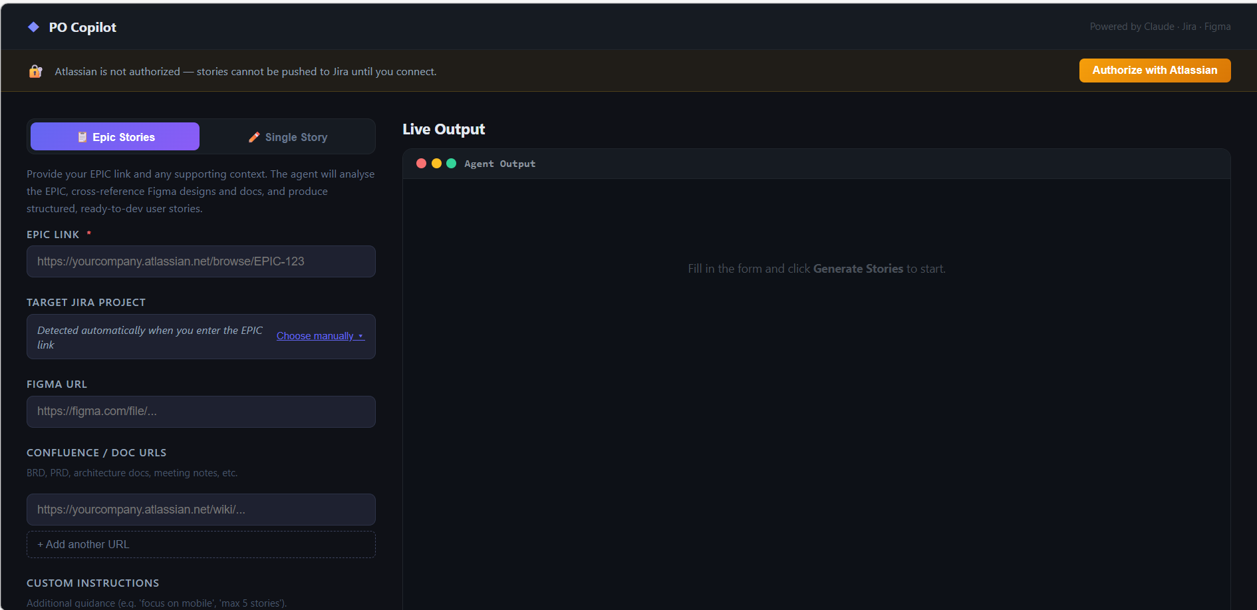
📋 Epic Stories Mode — Generating a Full Sprint Backlog
What you provide:
• Jira EPIC link (required)
• Figma design URL (optional)
• Confluence / BRD / PRD URLs (optional)
• Custom instructions, e.g. "focus on mobile"
What the agent does:
1. Selects target sprint → reads EPIC & all linked docs
2. Reviews existing stories to avoid duplication
3. Generates story outline → writes full stories
4. Runs Definition of Ready (DoR) gate check
5. PO reviews: approve all [AA], individual [A] or reject [R]
6. Approved stories pushed to Jira with story points
📊 Story points estimated via 4-factor Fibonacci rubric: effort × complexity × risk × AC count
PO Copilot · Powered by Claude · Jira · Figma · Confluence

Slide 4
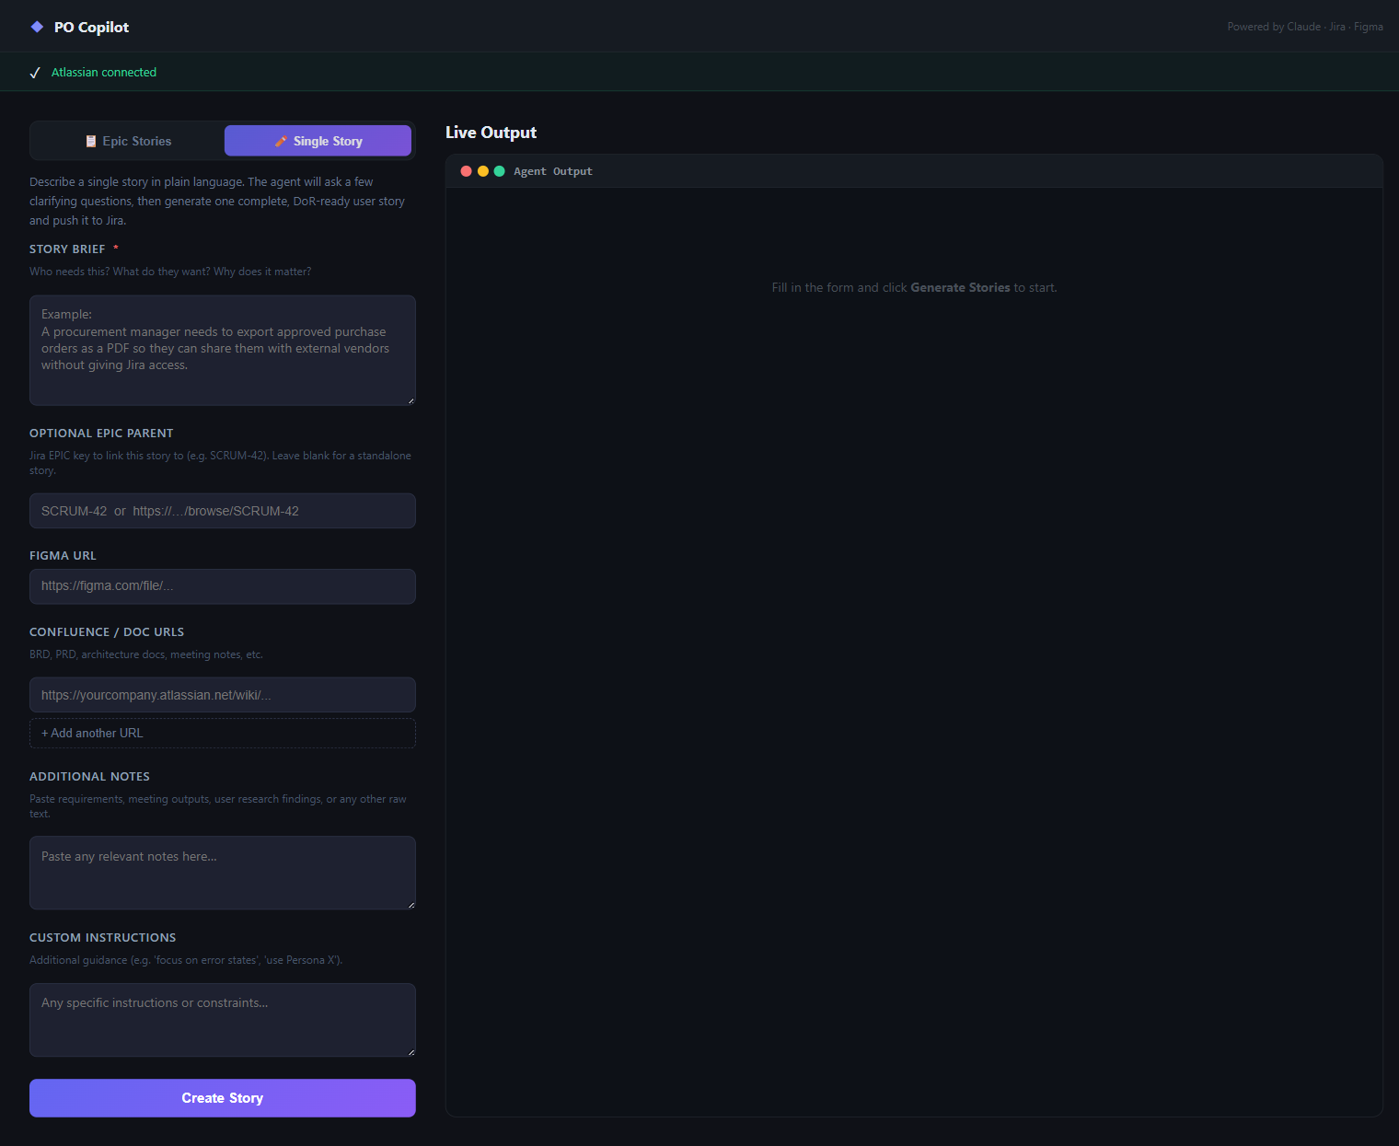
✏️ Single Story Mode — One Story from Plain Language
What you provide:
• Story brief in plain language (required)
• Optional parent EPIC key or URL
• Figma URL, Confluence / BRD / PRD docs
• Any raw notes or meeting outputs
What the agent does:
1. Asks 2–3 targeted clarifying questions
(skipped when brief + Figma + BRD all provided)
2. Writes a structured User Story (As a… I want… So that…)
3. Generates full Acceptance Criteria in Gherkin format
4. Estimates story points with inline rationale
5. PO approves → story pushed directly to Jira
💡 Ideal for one-off stories raised outside a sprint cycle, bug-adjacent work, or ad-hoc requests
PO Copilot · Powered by Claude · Jira · Figma · Confluence

Slide 5
Key Benefits & Summary
⚡ Speed
✅ Quality Gate
🎯 Story Points
Full sprint backlog from a Jira EPIC in minutes, not days
Built-in DoR check — no story reaches Jira without meeting standards
Fibonacci estimate with 4-factor rationale: effort × complexity × risk × AC count
🔐 PO Control
🔗 Deep Context
🧩 Flexible
Nothing pushed to Jira without explicit PO approval
Reads EPIC, Figma, Confluence docs, and prior sprint stories for full context
EPIC backlog generation or one-off standalone stories — same quality gate
PO Copilot · Powered by Claude · Jira · Figma · Confluence

