Slide 1
CIFAKE - REAL AND AI-GENERATED SYNTHETIC IMAGES
COMPUTER VISION 462 MSDSP, SPRING 2025
GROUP10
ABHINAY KUMAR SINGH | ANUBHAV BHATNAGAR | VIVEK MISHRA

Slide 2
PROBLEM STATEMENT & PROPOSAL
With the rise of AI-generated content, distinguishing between real and synthetic images is a growing challenge. This project aims to analyze and classify images from the CIFAKE dataset to improve detection accuracy, helping mitigate misinformation and deepfake threats.
Analyze this dataset to develop a classification model for distinguishing real and synthetic images.

Slide 3
DATASET: CIFAKE
50,000 real and 50,000 AI-generated .jpg format labelled images designed for deepfake detection training.
10,000 real and 10,000 AI-generated in .jpg format labelled designed for model testing.
The image used is low resolution is (i.e. more difficult to differentiate hence model is expected to be conservative)
Dataset Link: https://www.kaggle.com/datasets/birdy654/cifake-real-and-ai-generated-synthetic-images/data

Slide 4
EDA APPROACH
Distribution of real vs. fake images: Check class imbalance:
Look for patterns in AI-generated images using
Sample image check
Clustering with EfficientNet Embeddings
HOG feature extraction
Canny Edge Detection
Sobel Filter
Ben Graham Filters
Conclusion: Low natural separation between classes, hence a strong need for a Feature Extractor
Model | Adjusted Rand Index (ARI) | Normalized Mutual Information (NMI)
EfficientNetV2-S embeddings | 0.0033 | 0.0024
Histogram Oriented Gradients (HOG) embeddings | 0.0446 | 0.0348
Canny embeddings | 0.0273 | 0.0198
*Detailed Outputs in Appendix Section

Slide 5
LITERATURE REVIEW
Paper and Authors | Major datasets used? | High-Level Architectural Details | Performance Metrics | Takeaways Relevant for Our Design
Detection of AI-Created Images Using Pixel-Wise Feature Extraction (Martin-Rodriguez et al., 2023) | Custom pixel-wise dataset | Feature extraction using pixel-wise statistical differences, CNN-based classifier | 90.2% accuracy on synthetic vs. real classification | Pixel-wise feature extraction can enhance CNN classification; useful for detecting fine-grained artifacts in CIFAKE.
Online Detection of AI-Generated Images (Epstein et al., 2023) | Various public datasets (GAN-based images) | Ensemble of CNNs trained on various GAN-generated datasets, binary classifier | Average F1-score of 87% across tested models | Using an ensemble of CNNs trained on various AI generators can improve robustness against different AI models.
GenImage: A Million-Scale Benchmark for Detecting AI-Generated Images (Zhu et al., 2023) | GenImage (1M+ real & AI-generated images) | Pretrained CNNs (EfficientNet, ResNet) fine-tuned on GenImage dataset | Best performing model (EfficientNet) achieved 96.5% accuracy | Fine-tuning EfficientNet or ResNet on CIFAKE-like datasets could yield high accuracy for our classification task.
The Adversarial AI-Art (Li et al., 2024) | ARIA (140,000+ AI-generated & real images) | Hybrid deep learning model combining CNN and adversarial training methods | Hybrid model achieved 92.3% detection rate under adversarial conditions | Adding adversarial training techniques may help make our model more resilient to adversarially modified images.
AI-Generated Image Detection: Passive or Watermark? (Guo et al., 2025) | Mixed datasets (Passive & Watermark-based AI detection) | Comparative study of passive detection methods (CNN-based) vs. watermark-based detection | Passive detection models: 85% accuracy; Watermark-based: 99% detection success rate | Exploring a hybrid approach that integrates both passive (CNN-based) and watermark-based detection could be beneficial.
*Refer to Bibliography in Appendix Section for details

Slide 6
MODELS APPLIED FOR CLASSIFICATION PROBLEM
Base CNN Model
ResNet, (Base Model & Modified)
EfficientNet (Base Model and Modified)
MobileNet (Base Model and Modified)
Transfer Learning to leverage pre-trained models
Evaluating models based on accuracy, precision, recall
Computational efficiency vs. accuracy trade-offs

Slide 7
MODEL ARCHITECHTRE BASELINE 1: CNN
ReLU activation function used across layers for fast computation, prevention of exploding/vanishing gradients and introduction of nonlinearity
Progressive capture of details - broad to minute details in each block
Convolutional layer (Conv2D)
(256 filters, 3x3)
MaxPooling2D
(2x2)
Convolutional layer (Conv2D)
(128 filters, 3x3)
Dropout (0.2)
MaxPooling2D
(2x2)
Convolutional layer (Conv2D)
(64 filters, 3x3)
Dropout (0.2)
MaxPooling2D
(2x2)
Input layer (Conv2D)
(32 filters, 3x3), (32 x 32 x 3)
Dropout (0.2)
MaxPooling2D
(2x2)
Dropout (0.2)
Flatten
Dense (64)
Dense (64)
Dense (1 - Sigmoid)

Slide 8
MODEL ARCHITECHTRE BASELINE 2: OTS PRETRAINED MODEL WITH NEURAL NETWORK CLASSIFIER
Can a pretrained model perform classification by itself?
Finetuned pretrained model
(32 x 32 x RGB), Untrainable
GlobalAveragePooling2D
Dropout (0.5)
Dense (256, ReLU)
Dropout (0.5)
Dense (2, Softmax)
This can either be ResNet50 or MobileNet or EfficientNetV2-S with ImageNet weights

Slide 9
MODEL ARCHITECHTRE OTS PRETRAINED MODEL WITH RANDOM FOREST CLASSIFIER
Check whether there is a need for a customized feature extractor
Random Forest is often more robust as a classifier than neural network Dense layers (less prone to overfitting)
Finetuned pretrained model
(32 x 32 x RGB), Untrainable
Convert embeddings to 2D numpy matrices
Random Forest Classifier
(200 learners)
This can either be ResNet50 or EfficientNetV2-S with ImageNet weights

Slide 10
MODEL ARCHITECHTRE FINETUNED PRETRAINED MODEL
Moderate customization allowed (20 layers of the feature extractor are customized)
Use of a neural network based classifier
Finetuned pretrained model
(32 x 32 x RGB), Last 20 layers are trainable
GlobalAveragePooling2D
Dropout (0.5)
Dense (256, ReLU)
Dropout (0.5)
Dense (2, Softmax)
This can either be ResNet50 or MobileNet or EfficientNetV2-S with ImageNet weights

Slide 11
MODEL IMPLEMENTATION
Data Storage in Google Drive
Models were run on Local machine with GPU and Google cloud
4 models tested, CNN, Restnet, EfficientNet and MobileNet
For each of the pretrained model 3 cases were tested.
Case1: Use custom dense layer for classifier layer the base pretrained model
Case2: Use Random forest as classifier for the base pretrained model
Case3: Expose last 20 inner layers of model for trainning

Slide 12
EVALUATION CRITERION
Training dataset: Accuracy, Precision, Recall, Validation loss over epochs during training
Testing dataset: Accuracy, Precision, Recall, Validation loss
AUC curve
Accuracy vs. Resource trade off

Slide 13
RESULTS & FINDINGS
CNN MODEL
Results showed accuracy close to 95% and AUC around 94%.
Outcome: Accepted for final evaluation
PRETRAINED MODELS (EfficientNet, MobileNet, RestNet)
Custom Classifier: Accuracy was 50% for both train and test data for all the three pretrained models. Outcome: Rejected
Random Forest classifier: Training accuracy was upwards of 95% but testing accuracy was 50%. Outcome: Rejected
Inner layers exposed to training: Accuracy was upwards of 90% in all cases.
Outcome: Accepted for final evaluation

Slide 14
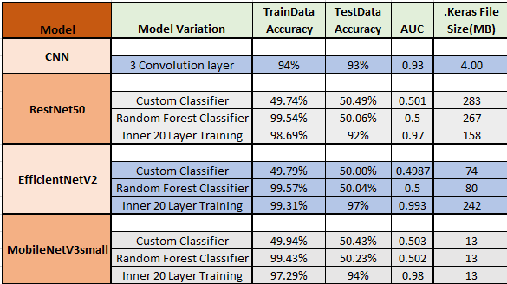
RESULTS EVALUATION
EfficientNet is most accurate
EfficientNet High on resources
MobileNet is close second with low resource requirements hence clear winner
*Refer to Results in Appendix Section for details

Slide 15
NEXT STEPS
Results with High accuracy and low resource indicate high potential for testing this project on wider dataset and deploy it in a form of a mobile App where end user may take a screenshot and immediately test if the image is fake or a real one.

Slide 16
APPENDIX
BIBLIOGRAPHY
EDA RESULTS
MODEL TRAINING
RESULTS

Slide 17
BIBLIOGRAPHY
Bird, Jordan J., and Ahmad Lotfi. 2024. “CIFAKE: Image Classification and Explainable Identification of AI-Generated Synthetic Images.” IEEE Access 12: 15642–50. https://doi.org/10.1109/access.2024.3356122.
Epstein, David C., Ishan Jain, Oliver Wang, and Richard Zhang. 2023. “Online Detection of AI-Generated Images.” 2023 IEEE/CVF International Conference on Computer Vision Workshops (ICCVW), October, 382–92. https://doi.org/10.1109/iccvw60793.2023.00045.
Guo, Moyang, Yuepeng Hu, Zhengyuan Jiang, Zeyu Li, Amir Sadovnik, Arka Daw, and Neil Gong. 2025. AI-Generated Image Detection: Passive or Watermark?, January. https://doi.org/10.48550/arXiv.2411.13553.
Krizhevsky, Alex, and Geoffrey Hinton. 2009. Learning Multiple Layers of Features from Tiny Images, April, 1–60. https://www.cs.utoronto.ca/~kriz/learning-features-2009-TR.pdf.
Li, Yuying, Zeyan Liu, Junyi Zhao, Liangqin Ren, Fengjun Li, Jiebo Luo, and Bo Luo. 2024. “The Adversarial AI-Art: Understanding, Generation, Detection, and Benchmarking.” Lecture Notes in Computer Science, 311–31. https://doi.org/10.1007/978-3-031-70879-4_16.
Martin-Rodriguez, Fernando, Rocio Garcia-Mojon, and Monica Fernandez-Barciela. 2023. “Detection of AI-Created Images Using Pixel-Wise Feature Extraction and Convolutional Neural Networks.” Sensors 23 (22): 9037. https://doi.org/10.3390/s23229037.
Zhu, Mingjian, Hanting Chen, Qiangyu Yan, Xudong Huang, Guanyu Lin, Wei Li, Zhijun Tu, Hailin Hu, Jie Hu, and Yunhe Wang. 2023. GenImage: A Million-Scale Benchmark for Detecting AI-Generated Image, June. https://doi.org/10.48550/arXiv.2306.08571.

Slide 18
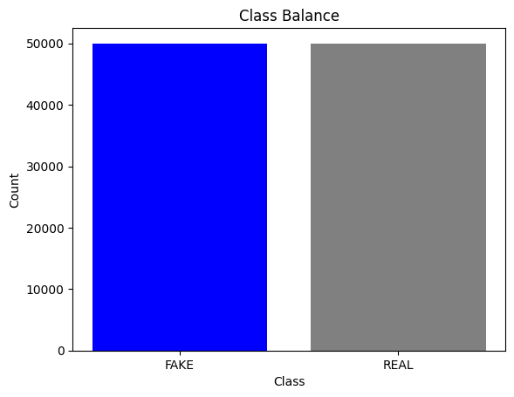
II. EDA RESULTS
100,000 train images (50% real, 50% fake)
20,000 test images (50% real, 50% fake)
Real images originally from the CIFAR-10 dataset
Fake images were generated by running CIFAR-10 images through StableDiffusion
Sources: Bird & Lotfi (2024), Krizhevsky & Hinton (2009)

Slide 19
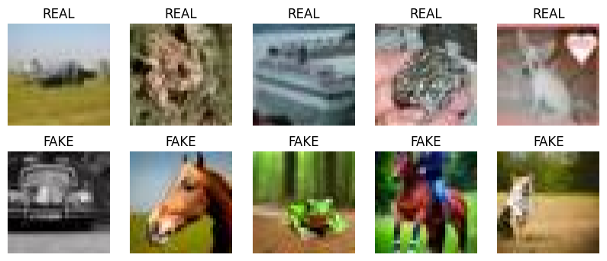
II. EDA RESULTS SAMPLE OF RAW IMAGES (32 X 32, RGB)

Slide 20
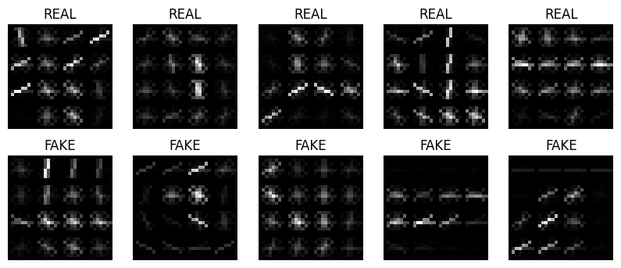
II. EDA RESULTS HISTOGRAM ORIENTED GRADIENTS (HOG) OUTPUTS

Slide 21
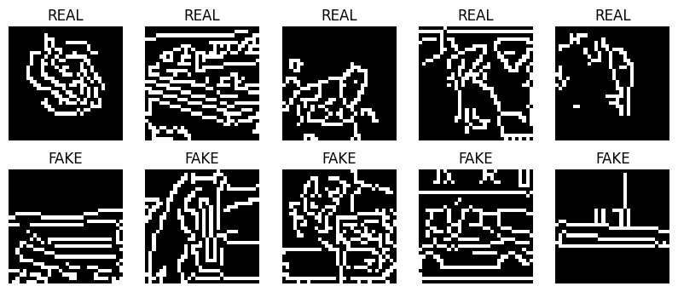
II. EDA RESULTS CANNY SHAPE OUTPUTS

Slide 22
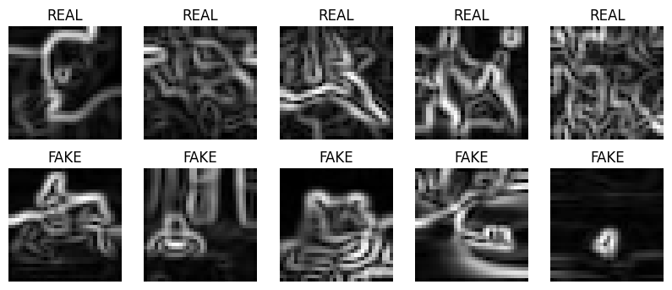
II. EDA RESULTS FILTER BASED DIFFERENCES
SOBEL FILTER

Slide 23
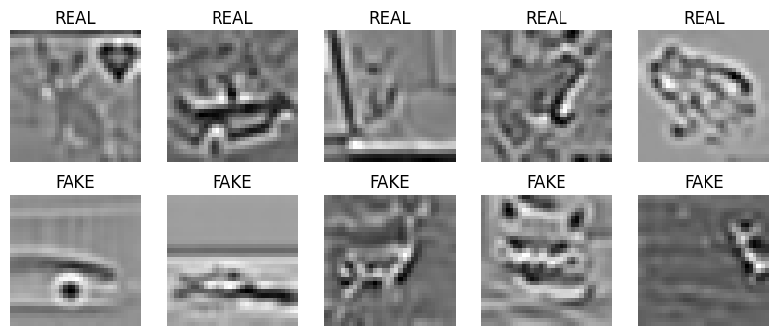
II. EDA RESULTS EXTRACTING FILTER BASED DIFFERENCES
THE BEN GRAHAM METHOD (GAUSSIAN BLUR + LAPLACIAN FILTER)

Slide 24
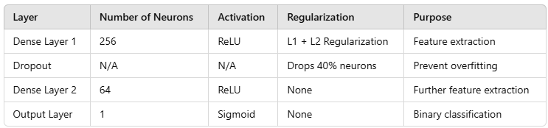
III. MODEL TRAINING CUSTOM LAYER: Added on top of pretrained model

Slide 25
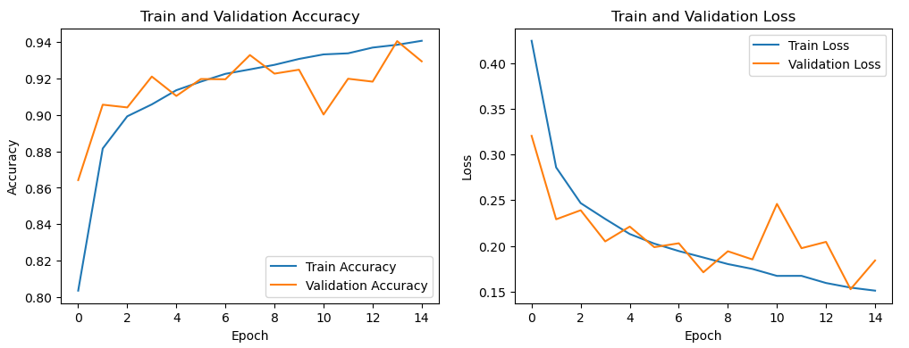
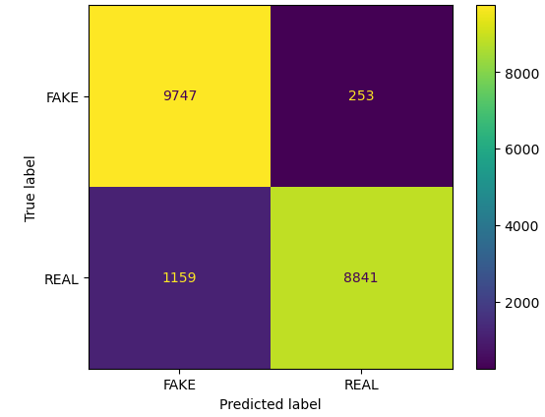
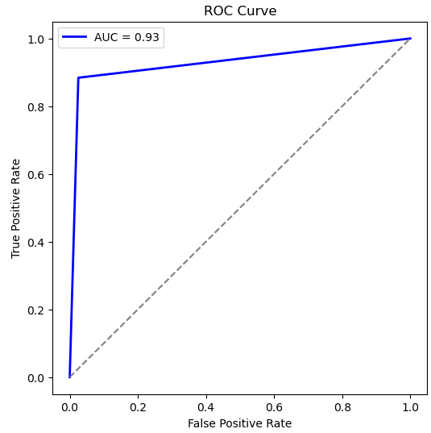
IV. RESULTS CNN MODEL

Slide 26
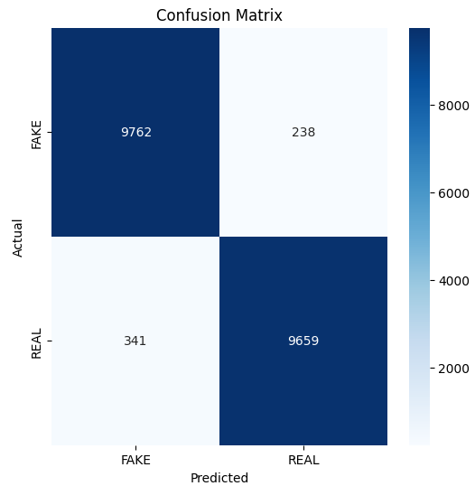
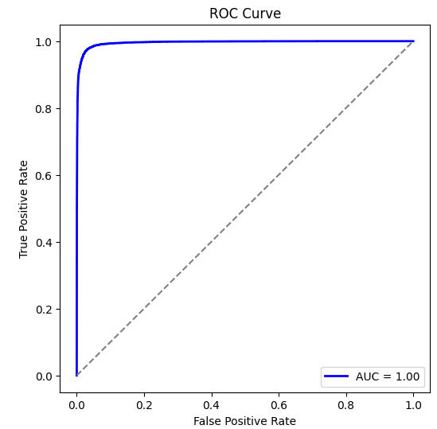
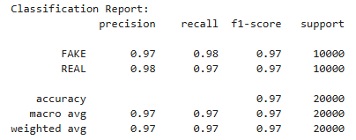
IV. RESULTS EfficientnetV2 (20layers trainable) MODEL

Slide 27
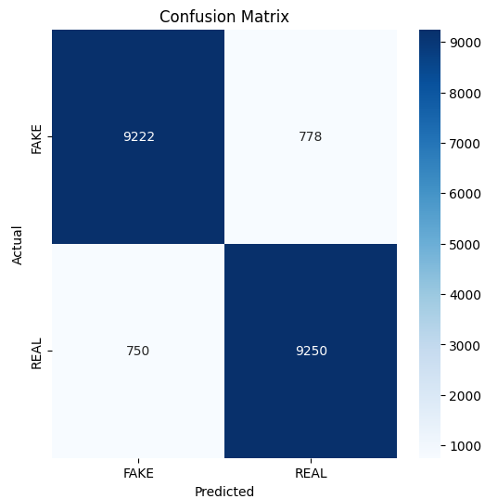
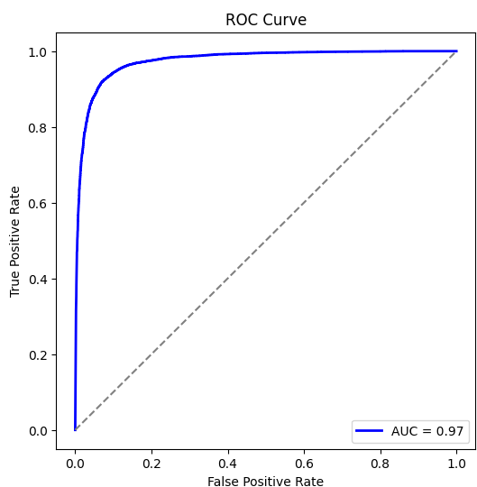
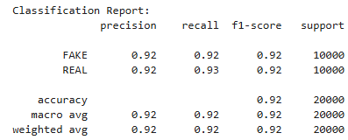
IV. RESULTS ResNet50 (20layers trainable) MODEL

Slide 28
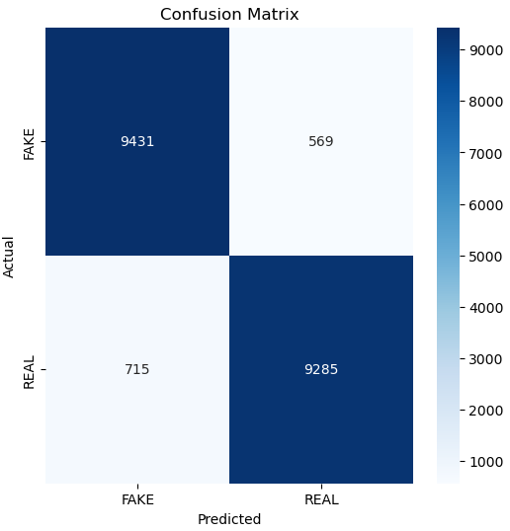
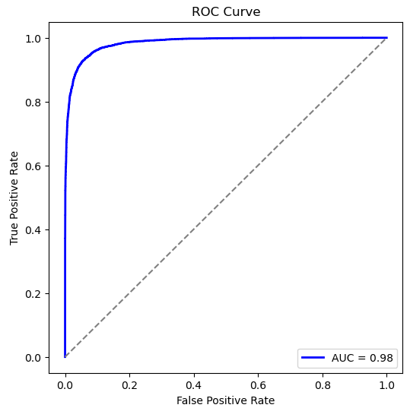
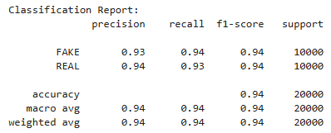
IV. RESULTS MobileNet (20layers trainable) MODEL

