Slide 1
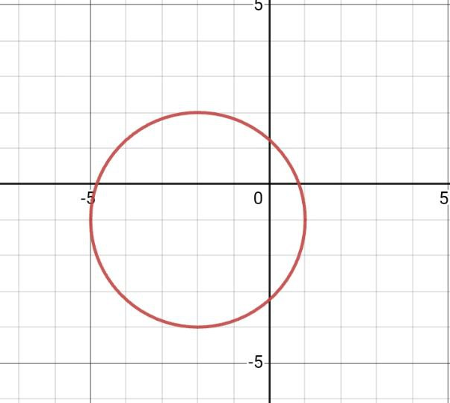
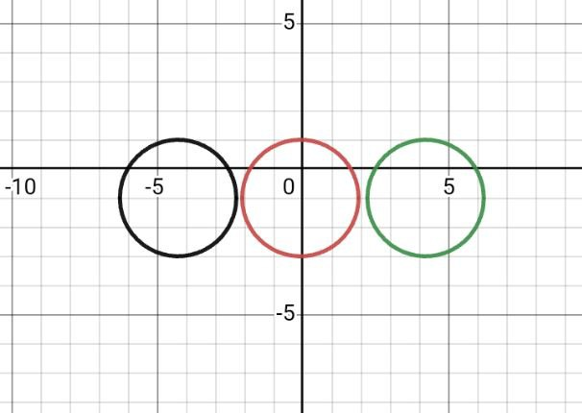
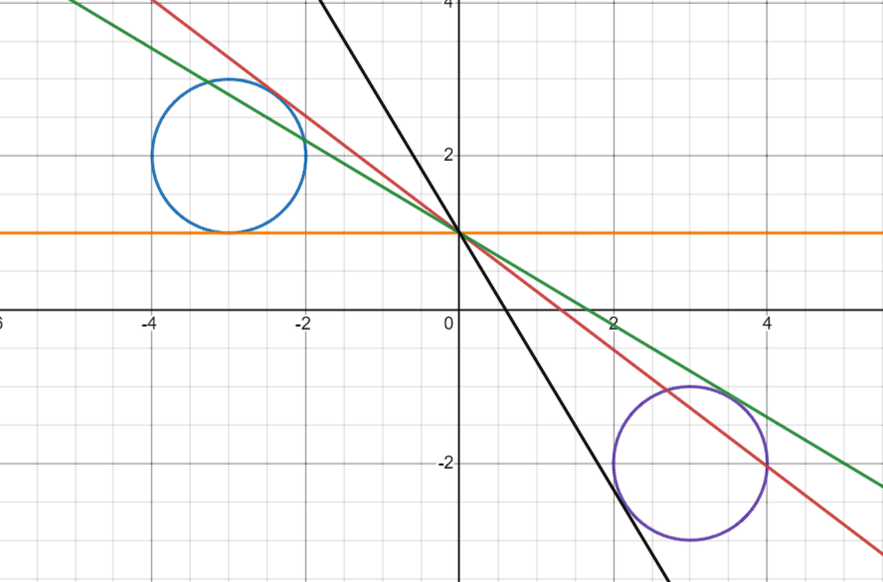



$${(y+1)}^{2}+{(x+2)}^{2}=9$$
$${(x−a)}^{2}+{(y+1)}^{2}=4$$
$${(x−a)}^{2}+{(y+1)}^{2}=4$$
.
(1)
.
(2)
.
(3)
.
(4)

Slide 2
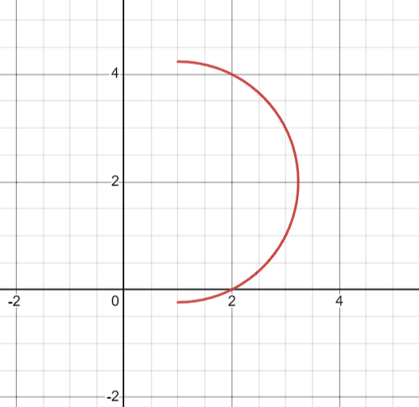
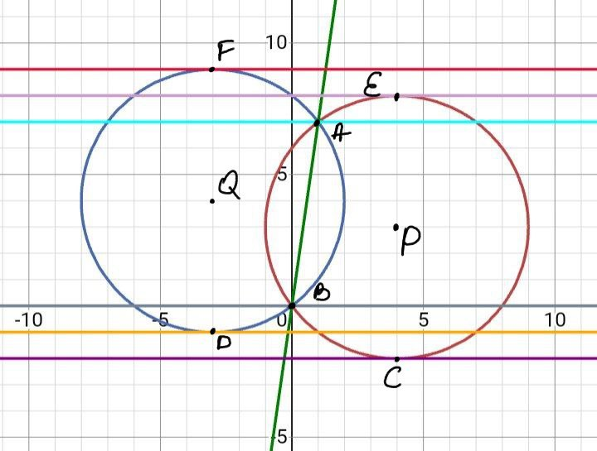

y
$${\left(x−1\right)}^{2}+{\left(y−2\right)}^{2}=5$$
x

Slide 3
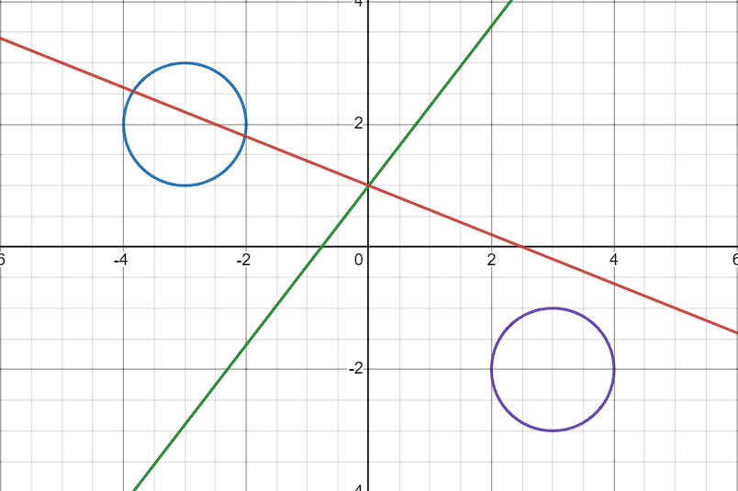
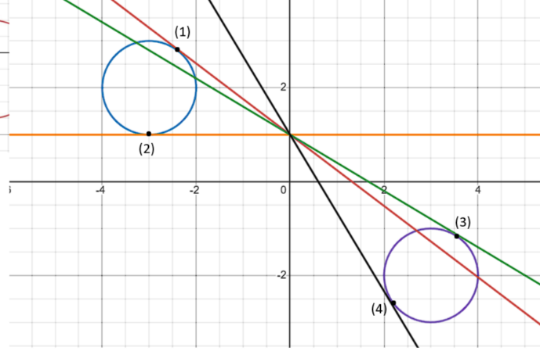
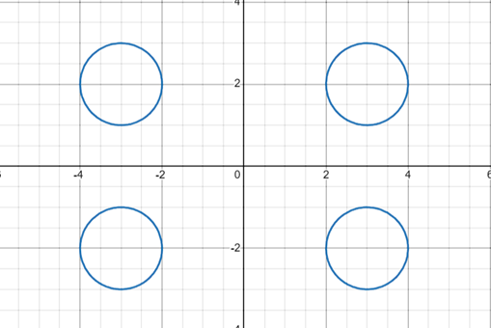
x
y
x
y

Slide 4
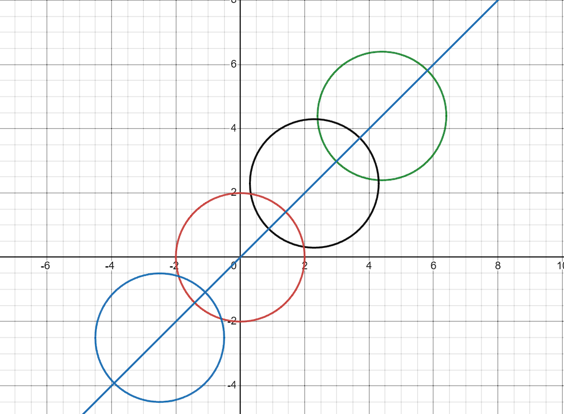
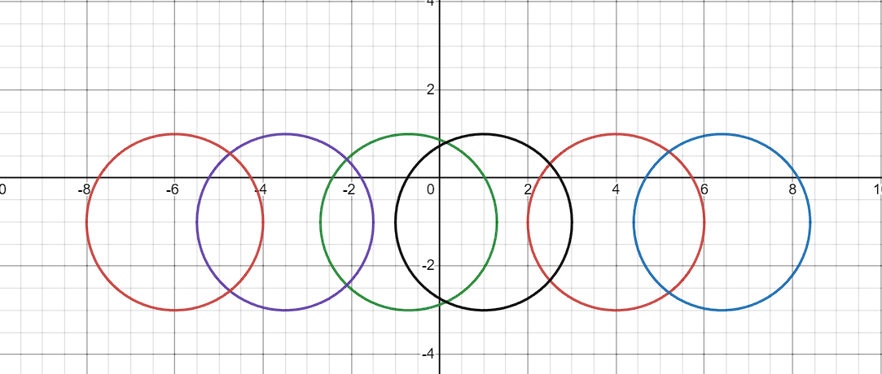


y
${(x−a)}^{2}+{(y−a)}^{2}=4$
x
y
$${(x−a)}^{2}+{(y+1)}^{2}=4$$
x

Slide 5
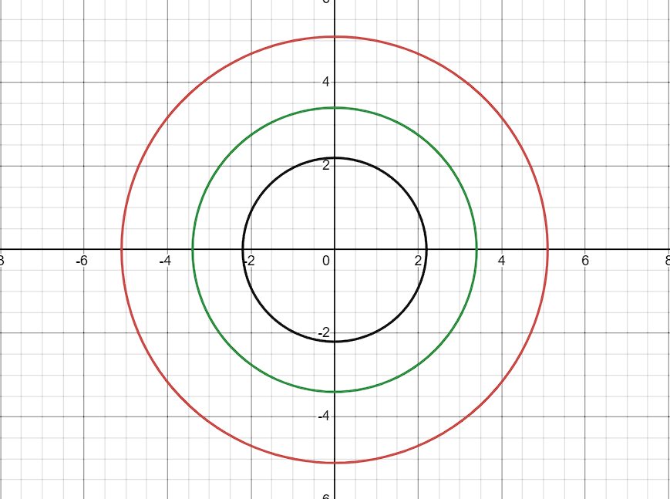
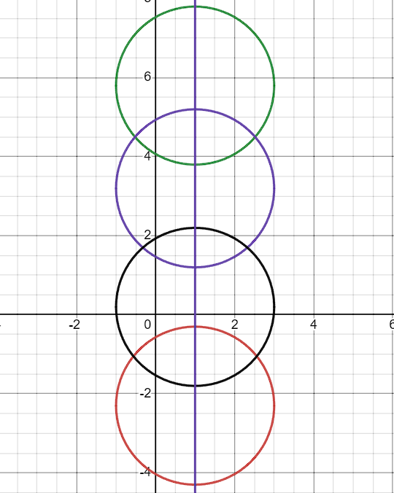
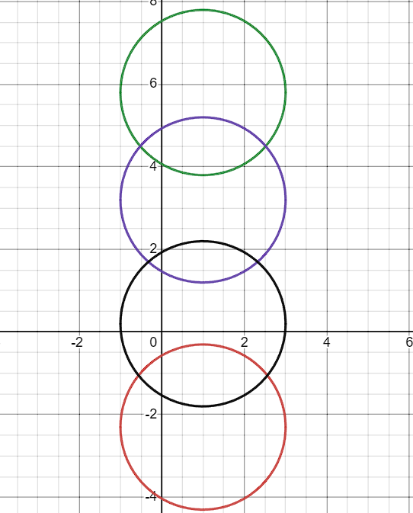
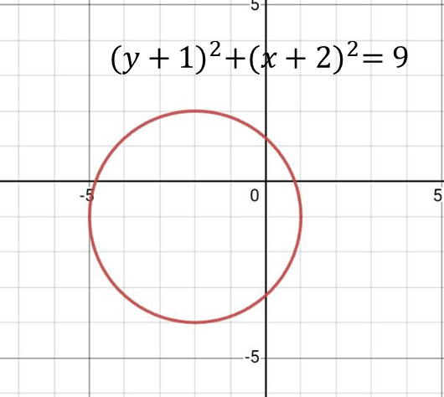
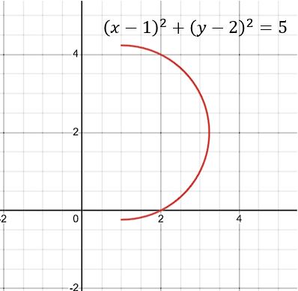



y
y
$x^{2}+y^{2}=a^{2}$
y
y
x
x
y
x
$${\left(x−1\right)}^{2}+{\left(y−a\right)}^{2}=4$$
y
x
x
$${\left(x−1\right)}^{2}+{\left(y−a\right)}^{2}=4$$

Slide 6
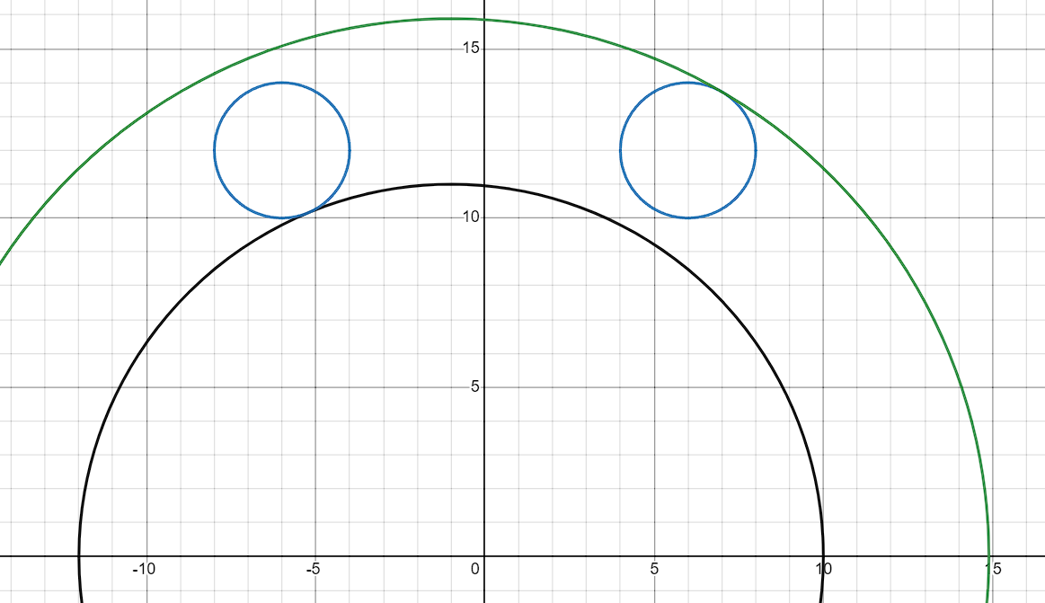



y
(1)
.
P
.
.
(2)
$$O_{2}$$
$$O_{1}$$
.
$$P_{1}$$
(3)
(3)
.
x
O

Slide 7
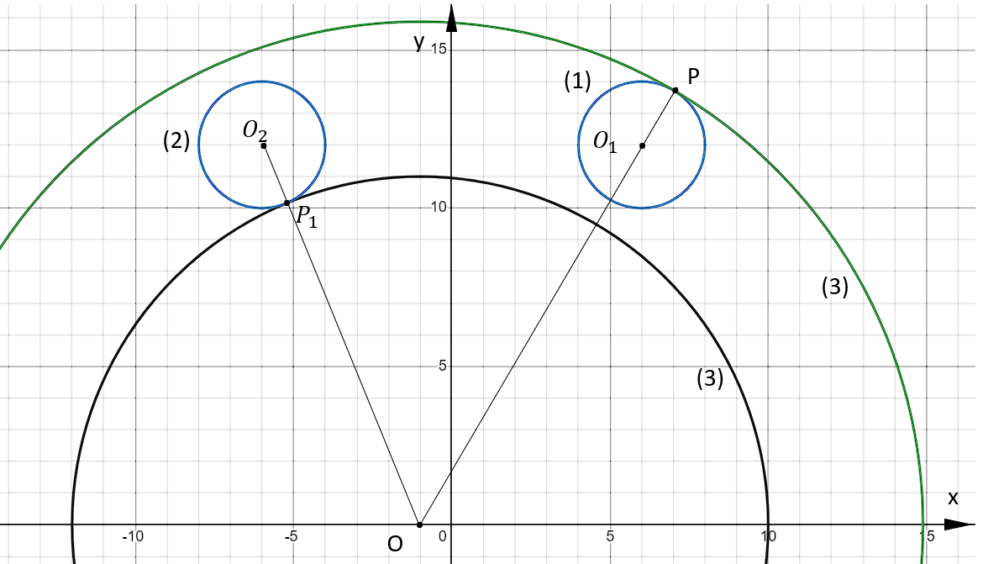
.
.
K
H

Slide 8
