Slide 1
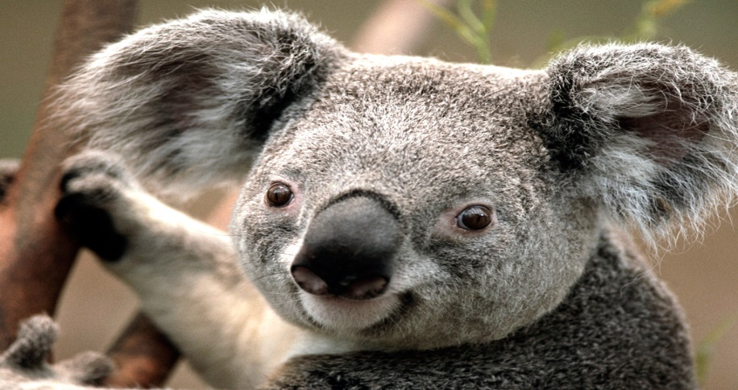
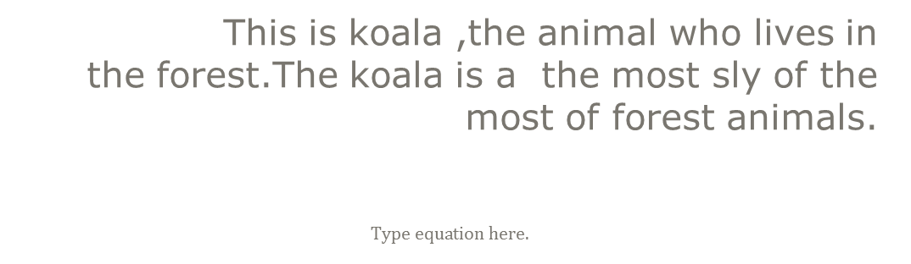
Koala.
This is koala ,the animal who lives in
the forest.The koala is a the most sly of the most of forest animals.
.

