Slide 1
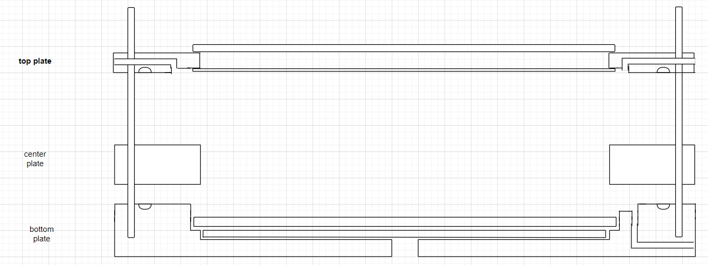

Slide 2
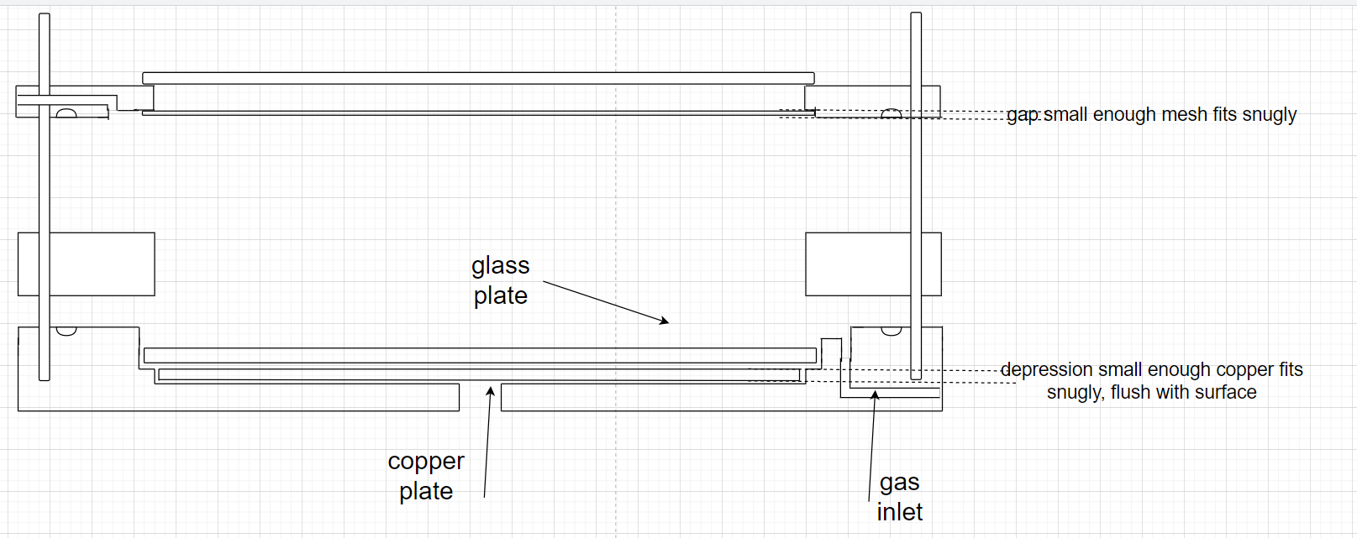

Slide 3
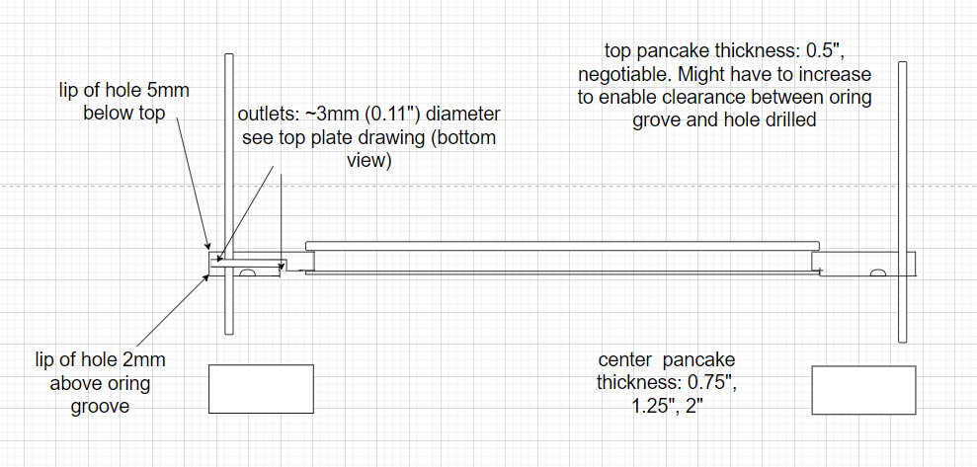

Slide 4
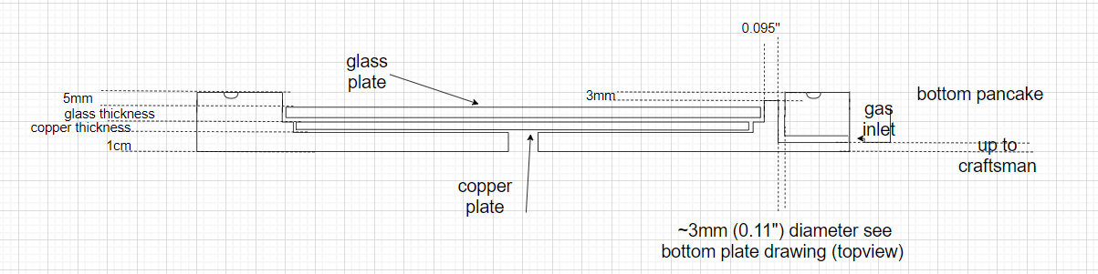

Slide 5
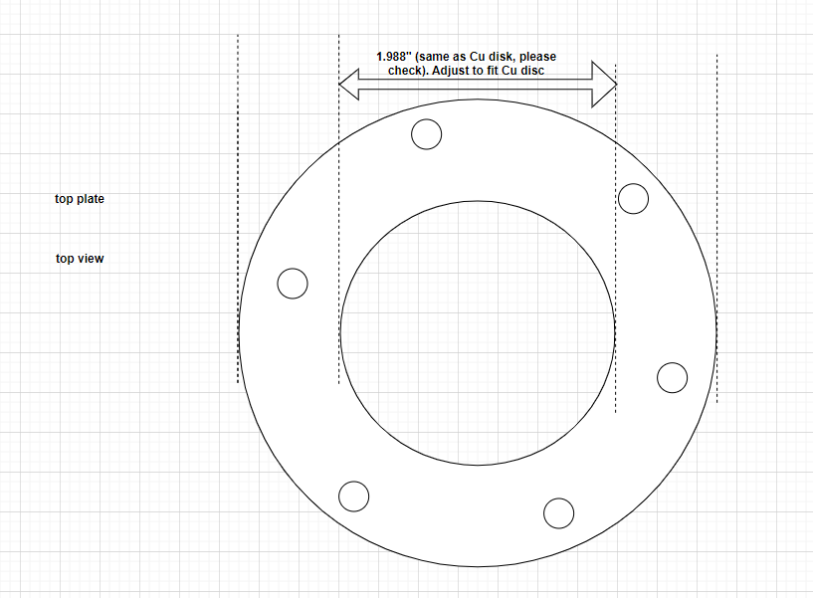

Slide 6
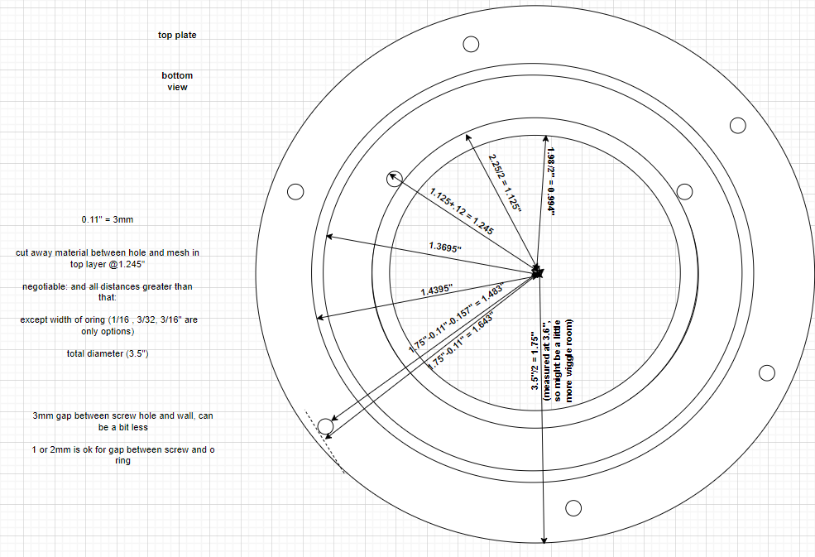

Slide 7
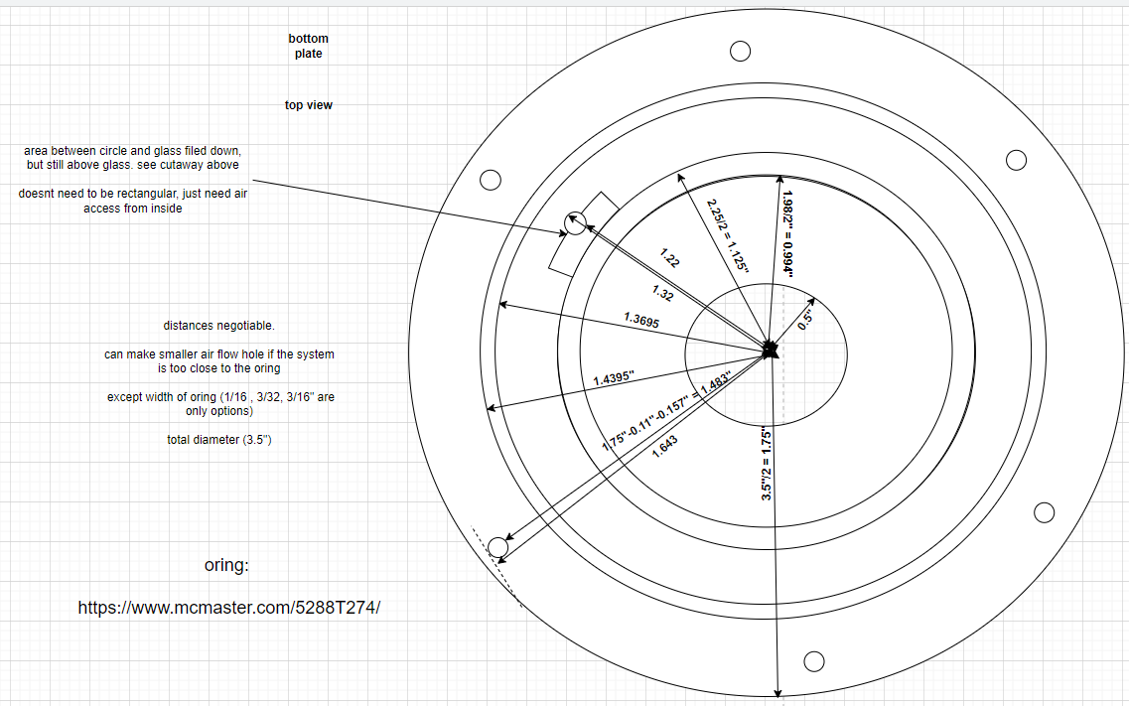

Slide 8
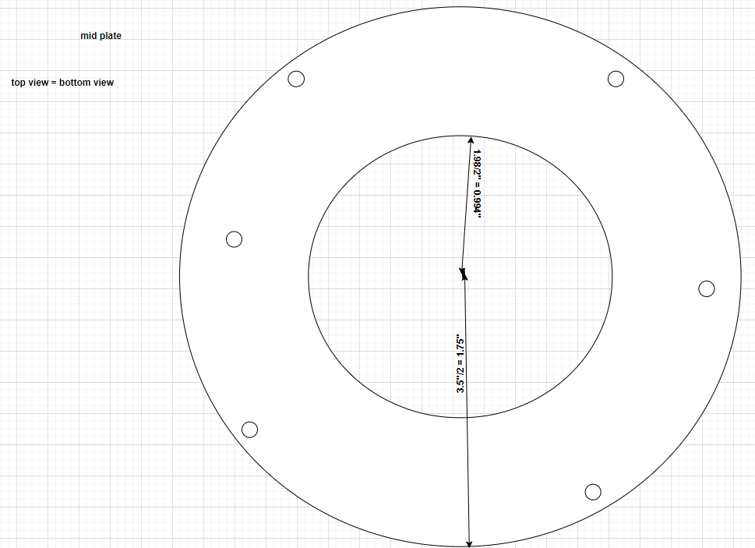

Slide 9

Compression Nut
Support Pylon
Sight Glass
Gas/Electrode Outlet
Reactor Cap
Packing Chamber
O-ring Groove
Stainless Steel Mesh (Cathode)
Reactor Height Extender
Borosilicate Barrier
Copper Electrode
Reactor Base
Gas Inlet
Steel Screw for High Voltage Connector

Slide 10
Compression Nut
Support Pylon
Sight Glass
Gas/Electrode Outlet
Reactor Cap
Packing Chamber
O-ring Groove
Stainless Steel Mesh (Cathode)
Reactor Height Extender
Borosilicate Barrier
Copper Electrode
Reactor Base
Gas Inlet
Steel Screw for High Voltage Connector

Slide 11
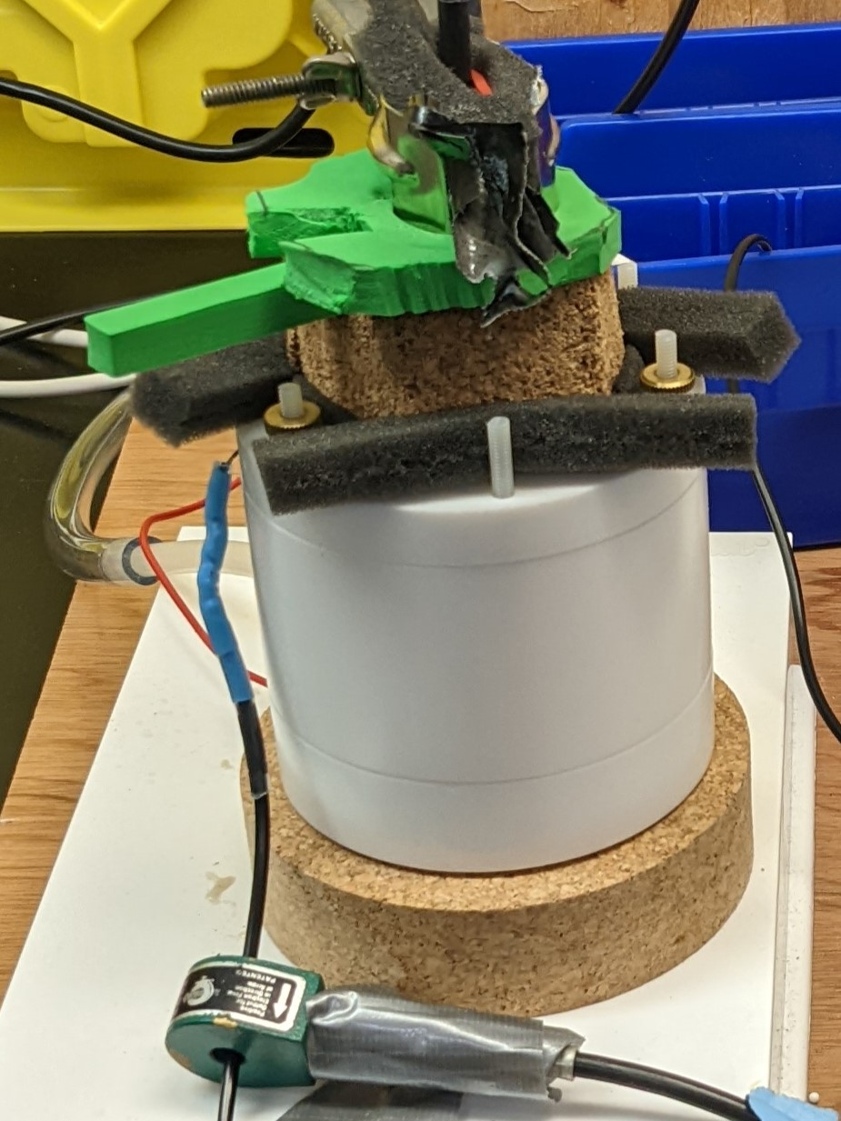

Slide 12
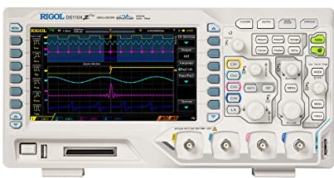
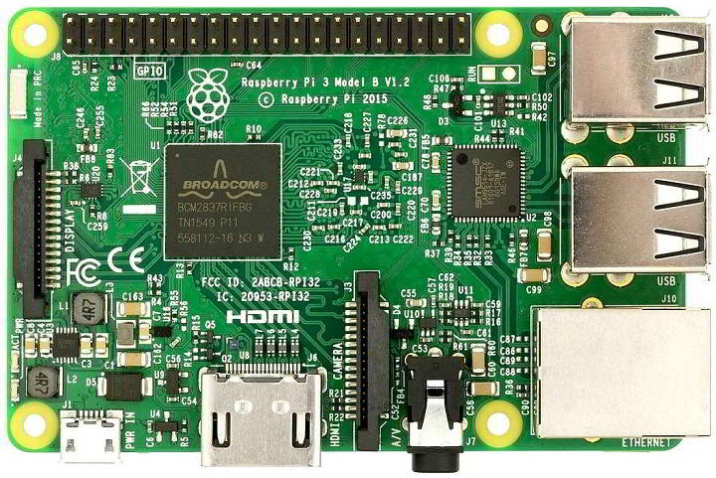
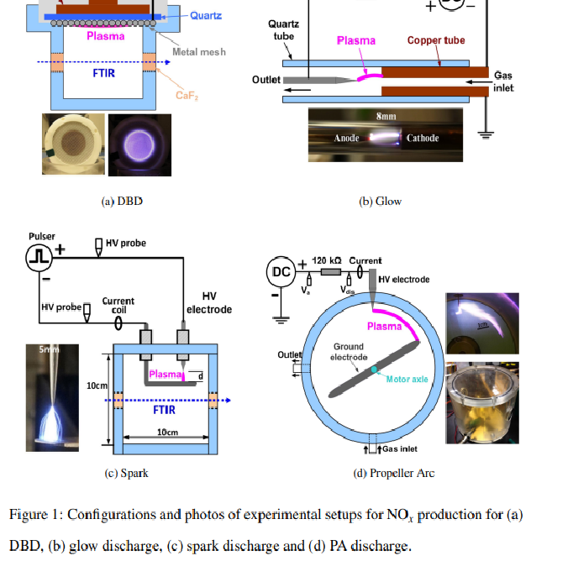
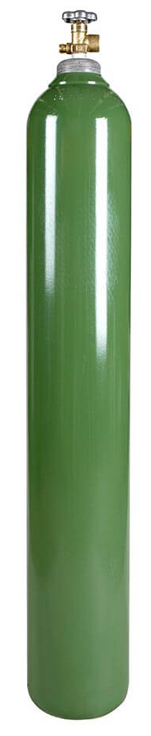
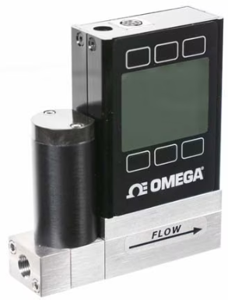
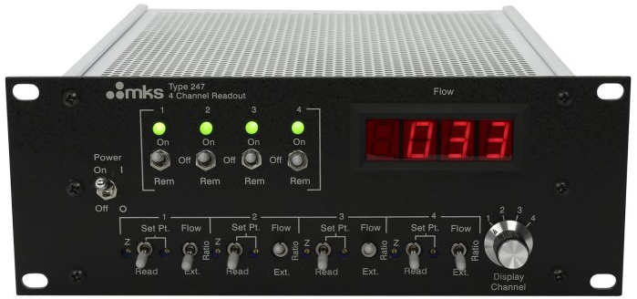
Raspberry Pi
HV Probe
OES
NS Pulser
He Tank
-
Light Shield (Cork, Foam)
+
Flow
controller
Amp Meter
Flow
Interface

Slide 13
Raspberry Pi
HV Probe
Optical Emission Spectrometer
ns Pulser
-
+
HV Probe
Flow
controller
Ammeter

Slide 14
Raspberry Pi
HV Probe
Optical Emission Spectrometer
ns Pulser
-
+
HV Probe
Mass Flow
Controller
Ammeter

Slide 15
Raspberry Pi
HV Probe
Optical Emission Spectrometer
ns Pulser
-
+
HV Probe
Packed Bed DBD
Mass Flow
Controller
Ammeter

Slide 16





















$$+$$
Electrode “a”
$$+$$
$$+$$
$$−$$
$$V_{a}≥0$$
$$−$$
$$V_{a}=0$$
$$−$$
$$V_{a}={−V}_{p,t_{b}}$$
$$V_{p}(t)$$
$$+$$
$$V_{p,t_{a}}>0$$
$$+$$
$$V_{p,t_{b}}<0$$
$$+$$
$$+$$
$$V_{b}≥0$$
$$+$$
$$V_{b}=V_{p,t_{a}}$$
$$+$$
$$V_{b}=0$$
$$−$$
$$−$$
$$−$$
$$−$$
Electrode “b”
$$−$$
$$−$$

