Slide 1
College chat bot
Presented By:
1. Vivian Dsouza – St Joseph Engineering College -AIML

Slide 2
OUTLINE
Problem Statement (Should not include solution)
Proposed System/Solution
System Development Approach (Technology Used)
Result
Conclusion
Future Scope
References

Slide 3
Problem Statement
The current communication and information retrieval systems in our college are outdated and do not effectively cater to the dynamic needs of the academic community. Students, faculty, and staff often face difficulties in accessing essential information, obtaining quick responses to queries, and navigating through the students Perspective.

Slide 4
Proposed Solution
1. 24/7 Availability
Problem Solved: Limited office hours and the need for immediate responses to student queries.
Benefit: The chatbot provides round-the-clock assistance, ensuring that students can get answers to their questions at any time, reducing the need for them to wait for office hours or email responses.
2. Improved Student Engagement
Problem Solved: Difficulty in engaging with students and providing them with timely information about courses, events, and other college activities.
Benefit: The chatbot can actively engage with students, providing them with personalized information and reminders about important dates, events, and deadlines, thereby enhancing their overall college experience.
3. Efficient Query Handling
Problem Solved: High volume of repetitive questions that staff need to address manually, leading to inefficiencies and delays.
Benefit: The chatbot can handle a large volume of common inquiries simultaneously, freeing up staff to focus on more complex tasks and improving the overall efficiency of the administrative process.

Slide 5
Proposed Solution
4. Personalized Assistance
Problem Solved: Generic and one-size-fits-all responses to student queries.
Benefit: The chatbot can provide personalized responses based on the student's profile and previous interactions, making the information more relevant and useful to each individual student.
5. Data Collection and Insights
Problem Solved: Lack of insights into student needs and concerns.
Benefit: The chatbot can collect data on student interactions, which can be analyzed to identify common issues, areas for improvement, and trends in student inquiries. This data-driven approach can help the institution make informed decisions and improve its services.

Slide 6
System Approach
IBM Cloud Account Requirement: IBM Cloud account to access Watson Assistant.
Watson Assistant Service Cloud-Based: No local hardware needed for the service.
Internet Connection & Web Browser: Needed for service access and configuration.
Development Environment Operating System: Windows, macOS, or Linux.
Hardware: Multi-core processor, 8 GB RAM, and 20 GB free storage.
Internet Connection: For accessing cloud services.

Slide 7
Result
Implementing a college chatbot using IBM Watson Assistant provides continuous 24/7 support, enhancing student engagement by offering personalized information on courses, admissions, events, and deadlines. It efficiently handles repetitive queries, freeing staff for complex tasks, thus improving administrative processes. Personalized responses ensure relevant interactions, and data collected from these interactions offer valuable insights into student needs, aiding in informed decision-making and service improvement. Overall, the chatbot enhances student support and optimizes institutional resources.

Slide 8
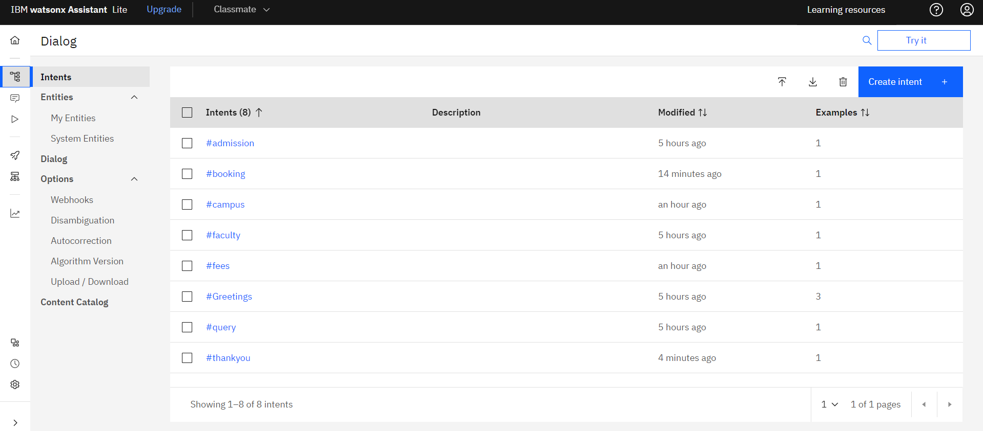
Result

Slide 9
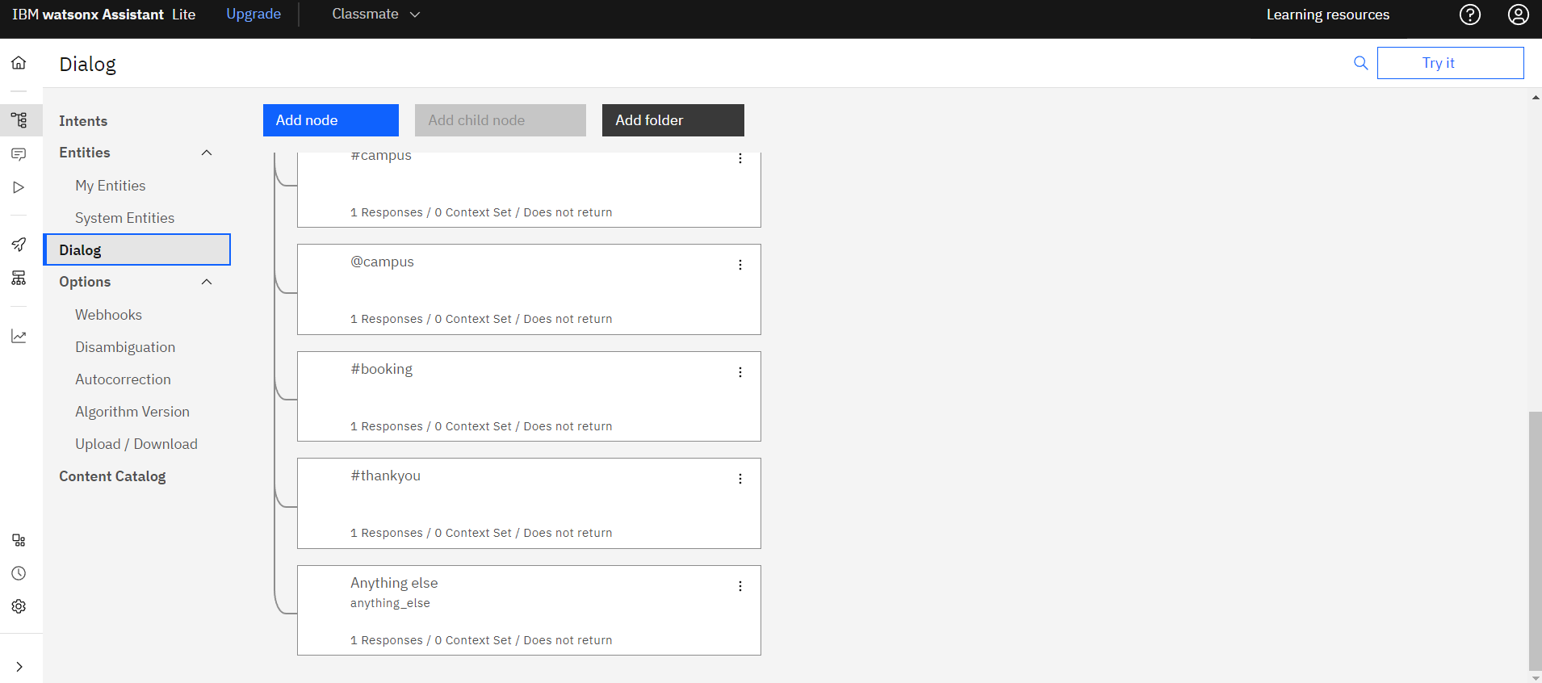
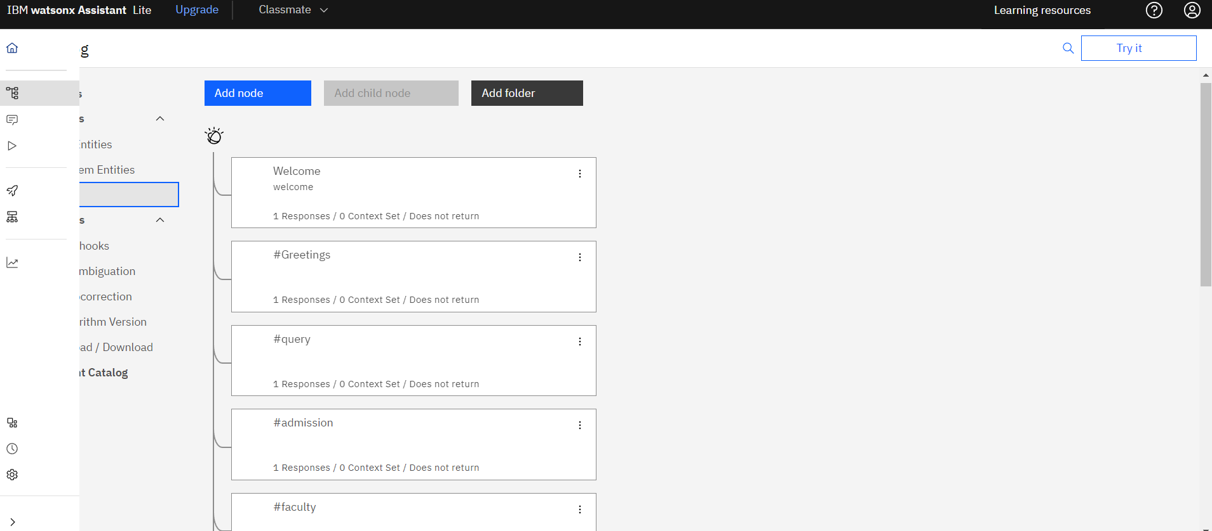

Slide 11
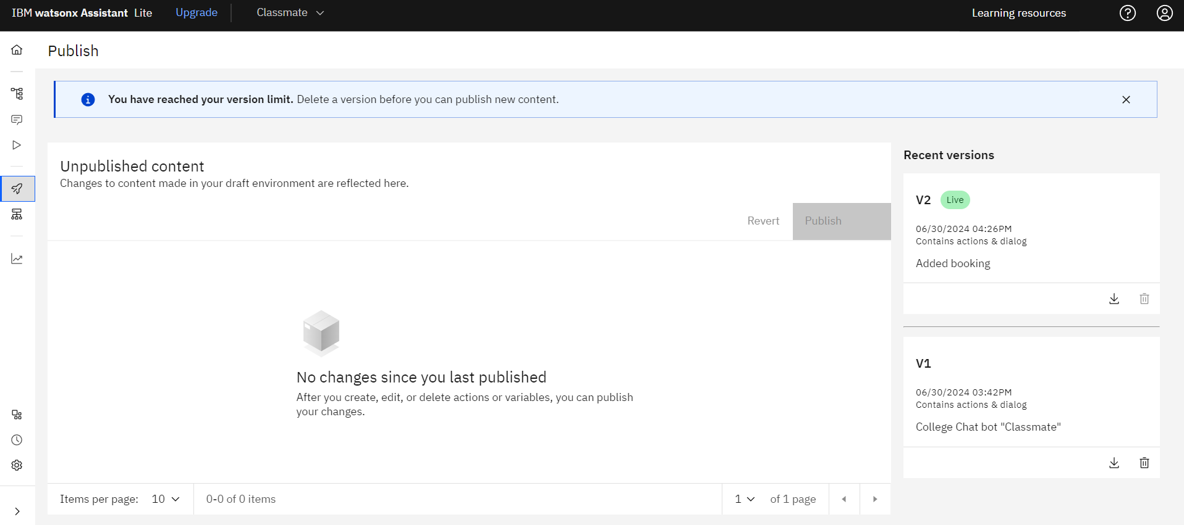

Slide 12
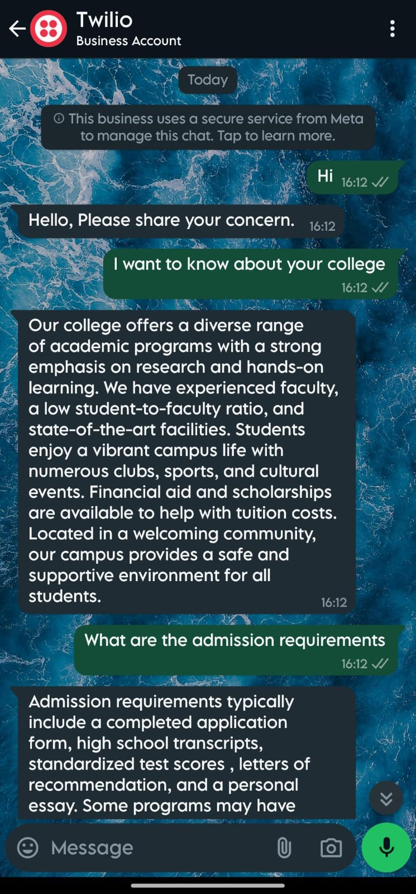
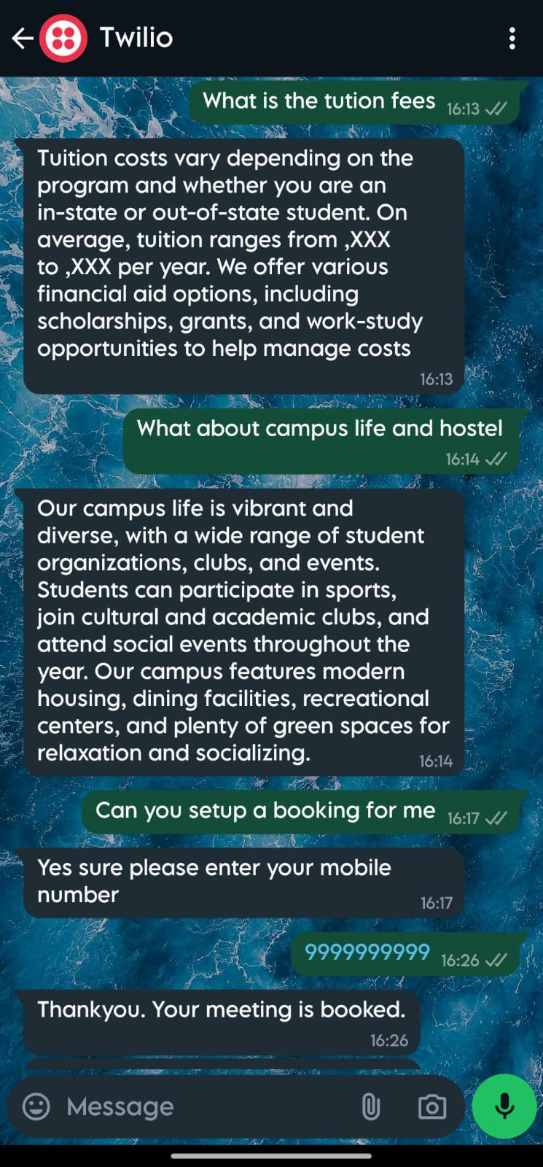
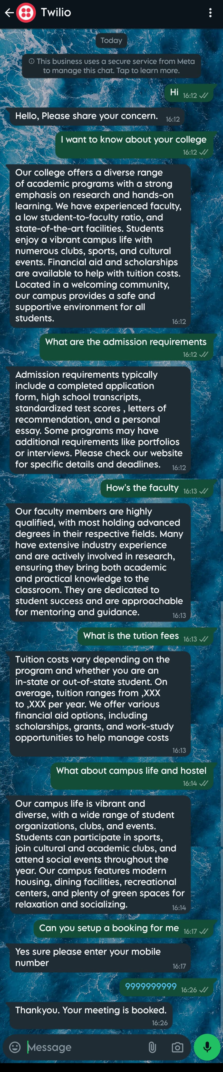

Slide 13
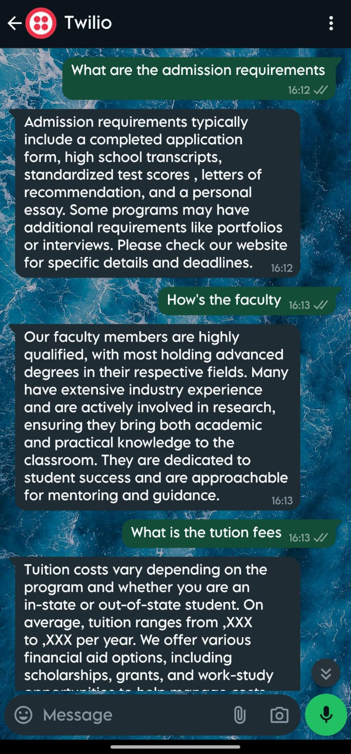
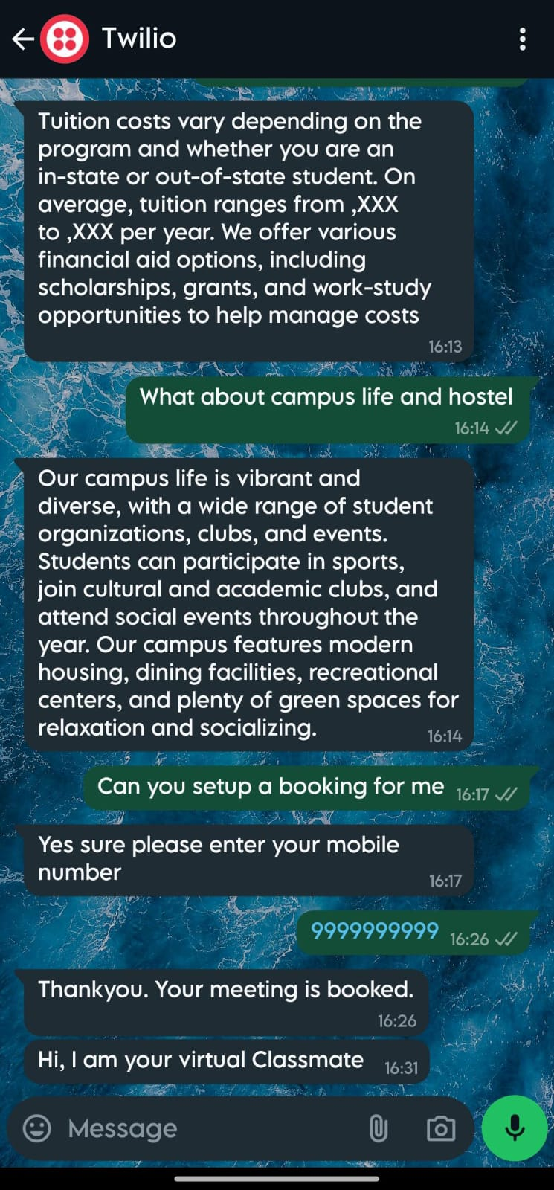

Slide 14
Conclusion
In summary, deploying a college chatbot with IBM Watson Assistant enhances student support through 24/7 availability, personalized interactions, and efficient query handling. It optimizes administrative processes by automating repetitive tasks and provides valuable data insights for informed decision-making. This strategic implementation benefits both students and the institution, fostering a more responsive and efficient educational environment.

Slide 15
Future scope
Personalized Assistance: Incorporating machine learning algorithms can enable the chatbot to analyze user preferences and behaviors, offering personalized recommendations and tailored assistance throughout the admission journey.
Multilingual Support: Integrating language translation features can make the chatbot accessible to a wider audience, including international students, thus diversifying the applicant pool and enhancing the college's global reach.
Virtual Tours and Events: Enhancing the chatbot with virtual tour functionalities and event reminders can provide prospective students with immersive experiences, allowing them to explore campus facilities and participate in online admission events.

Slide 16
References
IBM watsonx Assistant tutorial

Slide 17
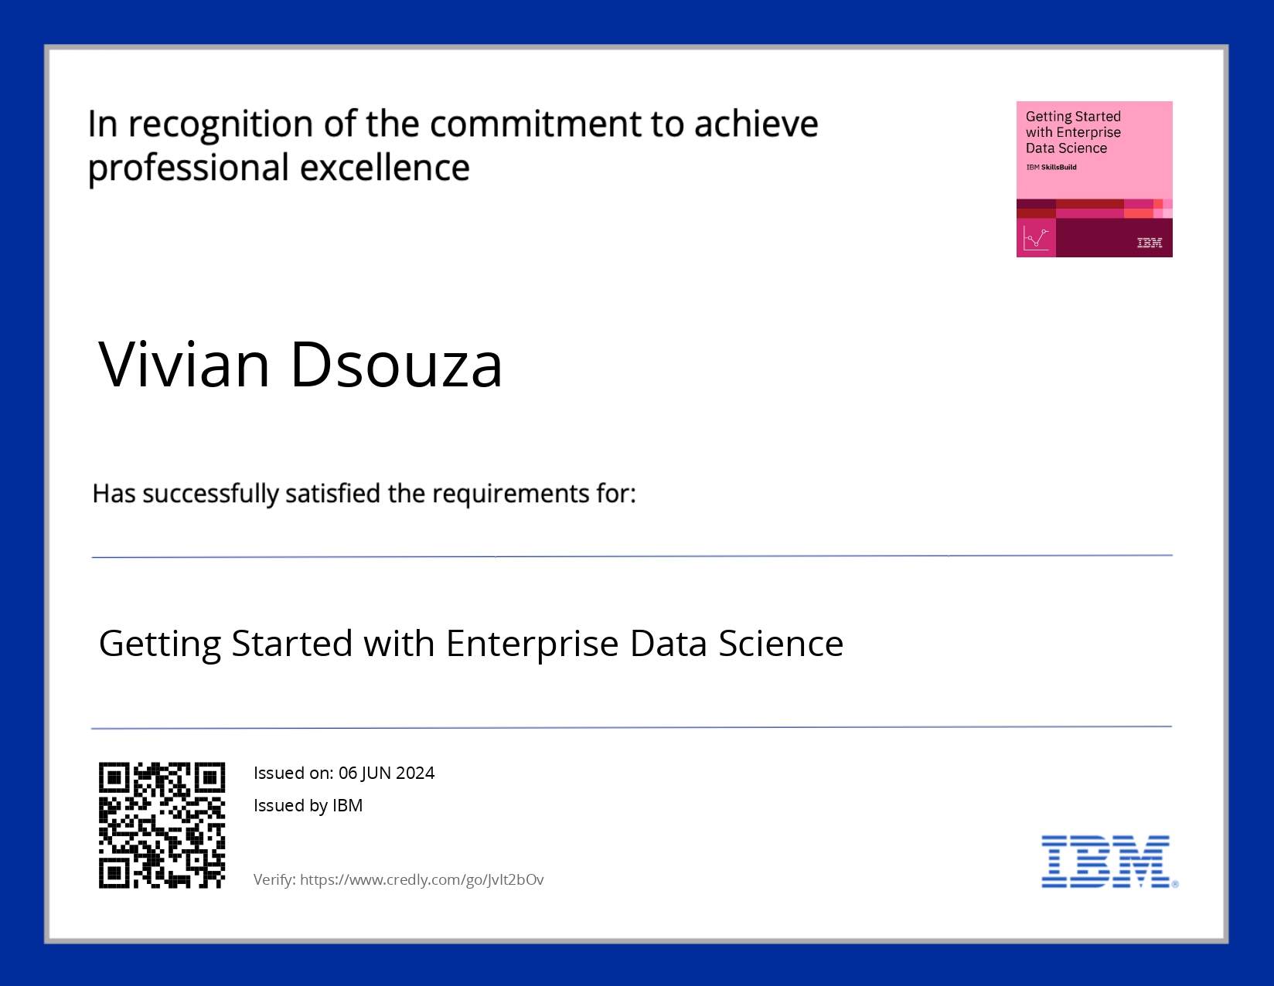
course certificate 1

Slide 18

course certificate 2

Slide 19
THANK YOU

