Slide 1
Agile & Scrum 101
Mar 2015
Kevin Shi

Slide 2
Agile & Scrum 101
Sub Topics
What is Agile?
What is Scrum?
More details of Scrum

Slide 3
What is Agile?
Agile refers to a new software development process/methodology, which is based on iterative development and doesn’t refuse the changing of requirement.
Main Features:
e.g., iteration development, increment improvement, allow requirement changing, frequent release…
Methods in Agile
e.g., Scrum, XP, Crystal, ASD, TDD…
Scrum is one of Agile method

Slide 4
Manifesto for Agile SW Dev
Individuals and interactions over processes and tools
Working software over comprehensive documentation
Customer collaboration over contract negotiation
Responding to change over following a plan
http://agilemanifesto.org/

Slide 5
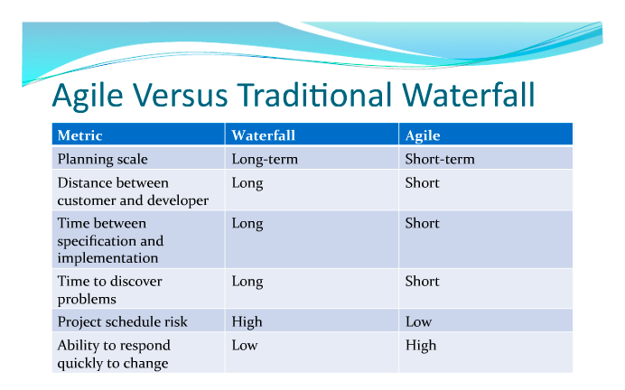
Agile v.s. Waterfall http://www.joygroup.nl/news/project-process-and-management-agile-vs-waterfall

Slide 6
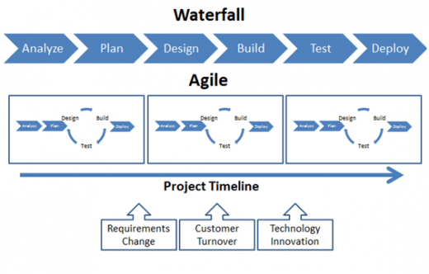
Agile VS Waterfall (cont.) http://diginimo.com/agile-waterfall-advantages-disadvantages

Slide 7
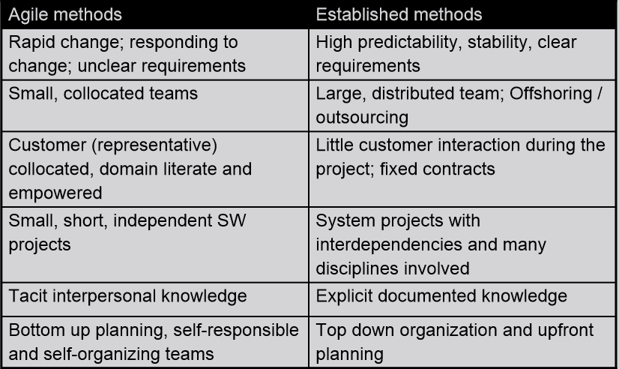
Agile VS Waterfall (cont.)

Slide 8
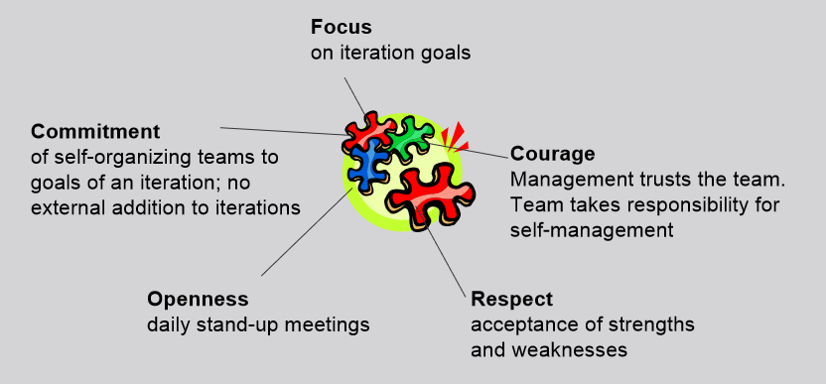
The ‘Scrum’ Agile Method
Scrum is a project management wrapper for existing engineering practices. It can easily be combined with other methods and is applicable for most types of projects.

Slide 9
Scrum Roles
Product Owner:
manages the vision, the ROI, and the release, decides about dates and functionality of releases, updates and prioritizes requirements (Product Backlog), monitors the project against its ROI goals
Team
manages the development iteration (Sprint), commits to results to be achieved in each iteration
Scrum Master
manages the process, replaces (classical) project leader not leading the project, but making the process work removes impediment
Notes:
The Product Owner represents the stakeholders and is the voice of the customer

Slide 10
Scrum Team
Self-organizing
Cross-functional with no roles
Seven plus or minus two
Responsible for committing to work
Authority to do whatever is needed to meet commitment
Open, collocated space
Resolution of Conflicts
Everyone’s opinion is important and needs to be understood and taken into account
Notes:
Henrik Kniberg defines cross-functional team this way: "Cross-functional just means that the team as a whole has all skills needed to build the product, and that each team member is willing to do more than just their own thing

Slide 11
Scrum Implementation
Basic Elements
Product-Backlog: Prioritized List of all requirements
Sprint(30 Days, or defines to other period, usually 2~4 weeks): Estimation of realization efforts
Sprint-Backlog: List of activities for the sprint
Sprint-Review: Presentation of results of the Sprint, Review of Process
Daily Scrum-Meeting with all team members

Slide 12
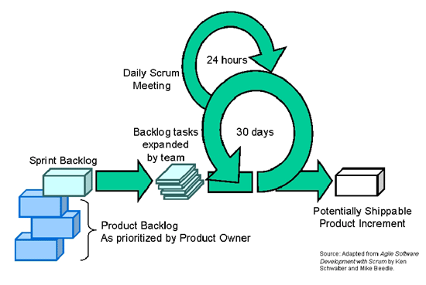
Scrum Implementation (cont.)
One Figure
http://www.methodsandtools.com/archive/archive.php?id=18

Slide 13
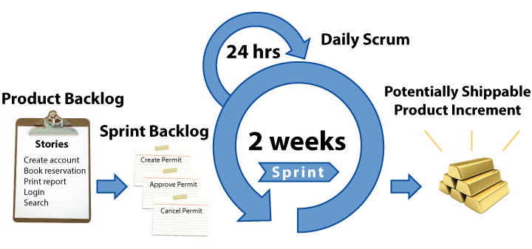
Scrum Implementation (cont.)
Another Alike Figure
http://www.agilenutshell.com/scrum

Slide 14
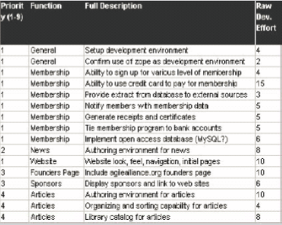
Product Backlog
List of work items/user stories: Functionality, Technology, Issues More detail on higher priority backlog
Emergent, prioritized, estimated Product Owner responsible for priority, anyone can contribute
One list for multiple teams,
maintained and posted visibly
Derived from Vision or business
plan
Product Owner is responsible
for priority
Anyone can contribute

Slide 15
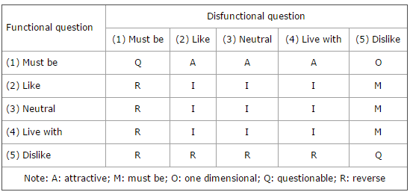
Tips of Priority
MoSCoW
Must, Should, Could, Won’t
http://en.wikipedia.org/wiki/MoSCoW_method
Kano Analysis
http://www2.warwick.ac.uk/fac/sci/wmg/ftmsc/modules/modulelist/peuss/sessions/design_for_six_sigma_dfss/dmadv/measure/voc/kano/

Slide 16
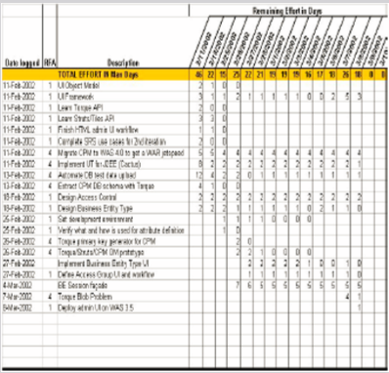
Sprint Backlog
Tasks to turn product backlog into working product functionality
Tasks are estimated in hours Usual task duration is between 1 and 16 hours. Tasks with >16 hours are broken down later
Team members sign up for
tasks They are not assigned!
The Iteration Backlog is updated
daily Any team member can
add, delete or change the
Iteration Backlog. Update work
remaining as more is known,
as items are worked.

Slide 17
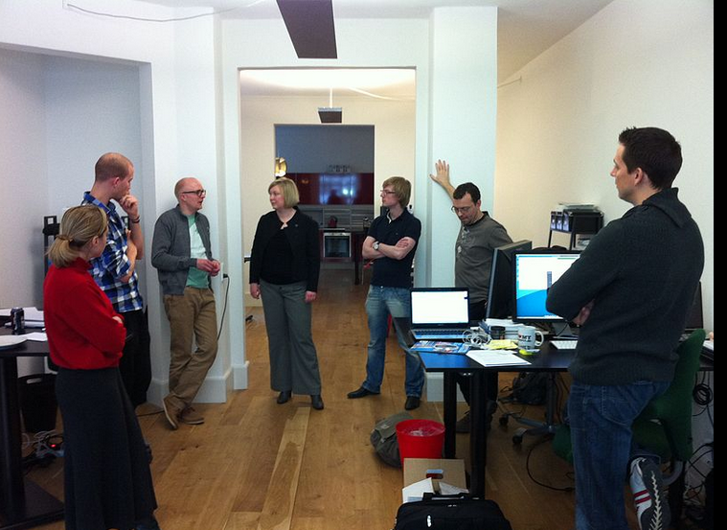
Daily Scrums
Daily 15 minute status meeting
Same place and time every day Meeting room
Three questions:
What have you done since the last meeting ?
What will you do before the next meeting ?
What is in your way?
Impediments and Decision
http://en.wikipedia.org/wiki/Scrum_(software_development)

Slide 18
Project Monitoring
Using 30 days Sprint as example
1 day Sprint planning meeting
1 Day Sprint review and retrospective
28 days Development

Slide 19
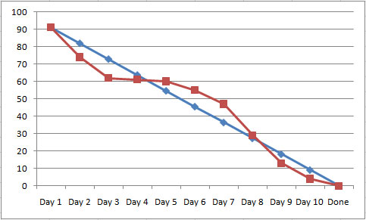
Burndown Chart
The estimated time to complete a task is updated and tracked on a daily basis
Teams are measured by meeting goals, not by how many hours they take to meet the goal
Scrum is results-oriented, not effort-driven
http://certschool.com/blog/agile-burn-down-charts/

Slide 20
Quality Measures
Product and Sprint
Burn Down Charts
Build success rate
Test coverage Successful
Unit and Integration Tests
Coding convention compliance
Error rates

Slide 21
Further Topics
Agile Testing
Continuous Integrations

