Slide 1
Automation for data preparation
For UI QA Team
- Vivian Wang

Slide 2
Automation for data preparation
Ⅰ. Scope
Data preparation
Performance and specifc requirement
Risk
Ⅲ. Tools, config and script
must option | Configuration | Run
Server | Where What | Tool Command Results
Local | Where How | Tool Script
Ⅱ. Webtop API
Http Request
GET and POST
Post request and response
You can also find doc on
BJ Wiki: http://bjwiki.laszlochina.laszlosystems.com/index.php/Initiatives_on_UI_QA

Slide 3
Test Scope
Data preparation
Webtop API

Slide 4
Scope
Data preparation
1
Create 100 contacts with all kinds of information
Test the order of tasks with different Priority/Status/Name
2
3
Check icons of all types of event categories

Slide 5
Scope
Performance and specific requirements
1
Test the maximum of data
Eg. Add 200 alias and check if it’s still work
Create over 200 events and check the performance of calendar
2

Slide 6
Risk
NOT applicable for..
UI test
Why not?
Where：
Webtop server
How：
Simply call webtop API
Add alias vs. Check alias list
Add event vs. Check event list
Add time zone vs. Check time zone
…

Slide 7
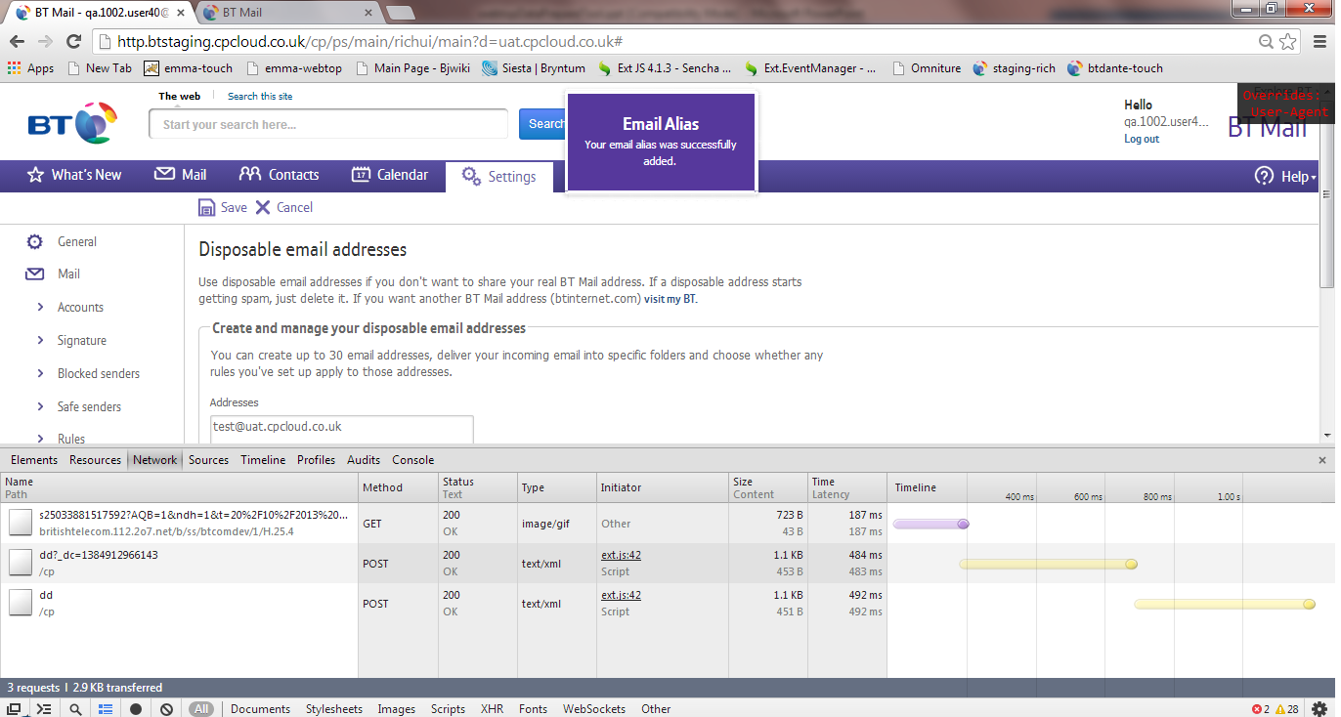
From UI

Slide 8
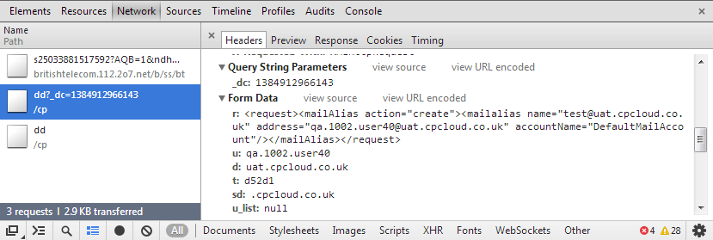
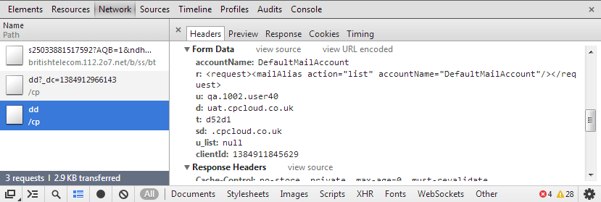
POST requests

Slide 9
Webtop API
Data preparation
Webtop API

Slide 10
Webtop API
From End User site
Webtop
API
handle the HTTP request in server layer
return the response to client site
QA/UI
Browser
Client
Webtop
Applink
Server
SQL
etc.
Backend

Slide 11
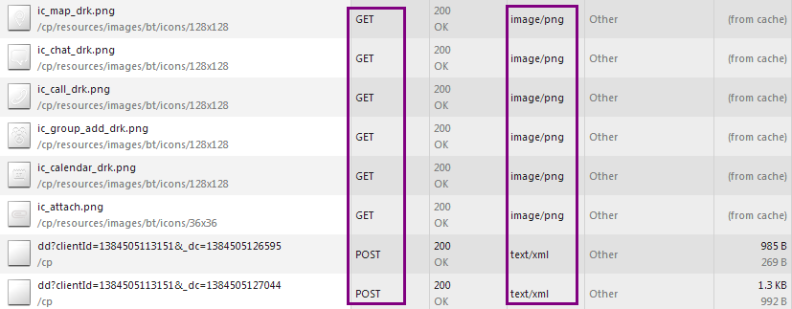
Webtop API
HTTP request: GET and POST etc.

Slide 12
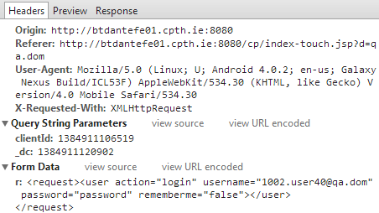
Webtop API
POST request

Slide 13
Webtop API
POST response – Succesful
<response tokenExpiry="1259810" sessionId="EbrEnwSE-13" token="dd8e2528f8dfa97dda84faafdd99cec0042f6a71cc574ba91e11632b68c73005d700be252ae49df0c6ed18703d87b198e67585d360d8c0e5e5c7a3fd92fdfc84">
<user action="login">
<common><string_userId value="1002.user40@qa.dom" /><string_userName value="1002.user40@qa.dom" /><string_userFullName value="1002.user40@qa.dom" /><string_userEmail value="1002.user40@qa.dom" /></common><contacts><number_maxGroupSize value="50" /><number_maxContactFields value="20" /><number_maxContactListEntries value="300" /></contacts></user></response>

Slide 14
Webtop API
POST response – Failed
<response sessionId="HhUNSkT1-17"><user action="login">
<error code="AUTHENTICATION_FAILURE">
<message key="sdk.common.error.authenticationFailure" /></error></user></response>

Slide 15






Scope
Think:
Are there any other requirements?
Contacts
Calendar
Tasks
Settings
Mails
What user do is just send requests from client to our server

Slide 16
Tool, Configuration and Script
Data preparation
Webtop API

Slide 17




Basic Tools
Server run
Server edit
Local run
Local edit

Slide 18
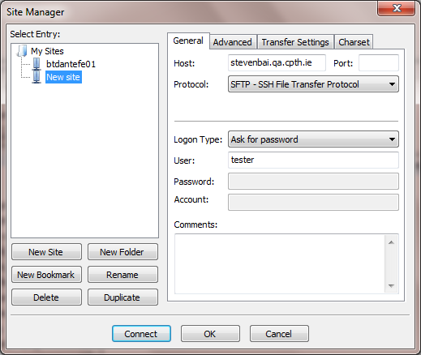
Server - Files

Slide 19
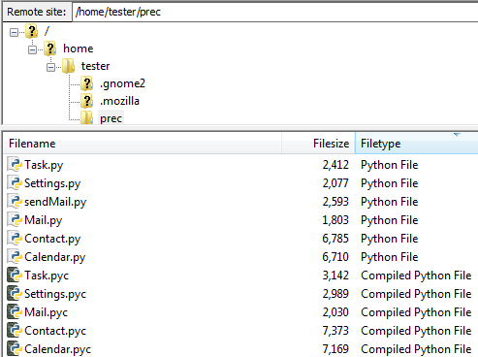
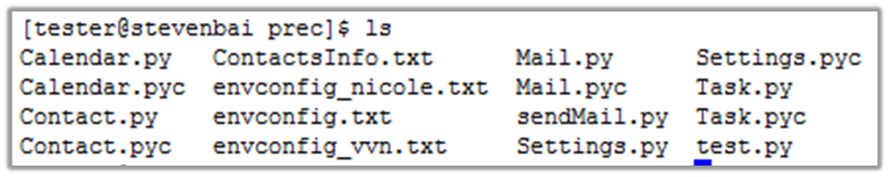
Server - Files
.py – python file
.pyc – compiled file
Also include configuration files:

Slide 20

Server - Config
Config value – Between :and#
env:btdante# one word of environment(btdante or btstaging)
port:8080# port
build:1002# build number (or build990)
uid:40 41 46# user number
feature:contact calendar mail task settings# which features you want to run?
setting:setGmt8 addAlias# settings -> setGmt8/addAlias
simpleContacts:2# how many simple contacts you want to create
fullInfoCntcts:2# how many contacts with full info
groups:3# how many contact groups
amount:5# how many mails
allDay:2# how many all day events you want to create (currently created in the day after 6 days)
taskAmount:1# Note! Each one contains 3*3=9 tasks (High/Normal/Low, incomplete/complete/nees action)
aliasAmount:3# how many amount you want to create

Slide 21

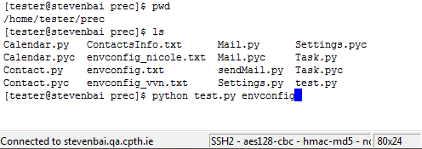
Server Run
SSH command $
Path /home/tester/prec
Run python test.py [your_envconfig]

Slide 22
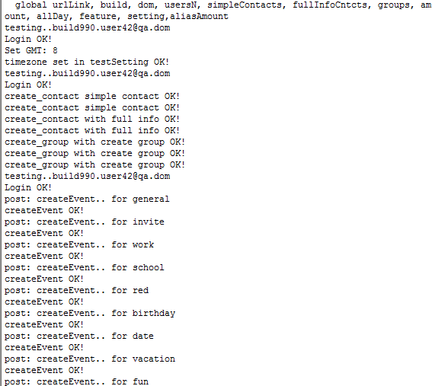
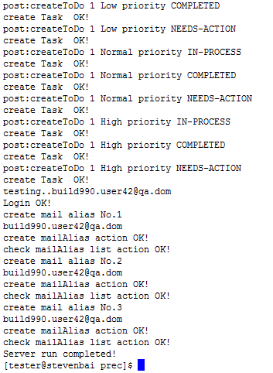
Server Run

Slide 23

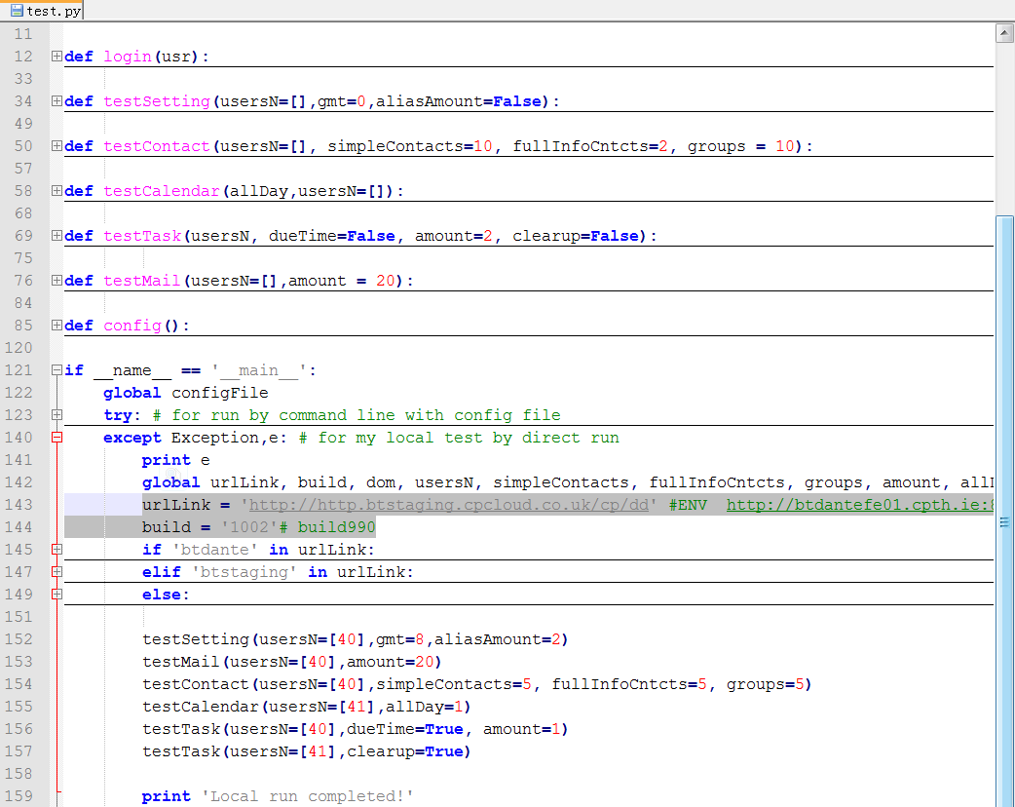
Local Run
Configuration
Configuration

Slide 24

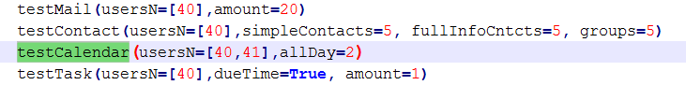
Local Run – Only one feature
Server <Config file>
feature:calendar # which features you want to run?
allDay:2# how many all day events you want to
def testCalendar(usersN=[],allDay):
for usr in usersN:
login(usr)
calendar = Calendar.Calendar(opener,urlLink,CURRENT_USER)
calendar.CreateSingleEvent(categories=True)
calendar.CreateSingleEvent(categories=False,allDay=1,nextWeek=True)
calendar.CreateRecurrentingEvent(freq='d') # freq='d' or freq='w' means for daily/weekly
calendar.CreateRecurrentingEvent(freq='w') # freq='d' or freq='w' means for daily/weekly
calendar.CreateCalendar(calendarN=5)
Local <Configuration>

Slide 25
Results analyses
Advice:
If you want to try some script..
Bug – need to report!!
Script problem – check it manually – debug
API bad formed – script raise exception - debug
Wrong API – check it manually - check every single request
API all passed but UI error – check request with tool (like addAlias)
Network issue – check it manually

Slide 26
Q&A

