Slide 1
Python Language Introduction - Basic Syntax
By Vivian Wang
2014.01

Slide 2
Language introduction
Why Python
Easy syntax & quick to learn
Clean coding style
Objective language
Standard library
Rich extensions
Across systems
Open source
World wide communities
Compatible to others
Etc.

Slide 3
Language introduction
What can Python do for us
Automation
API (send mails, check urls, http request, logs)
UI (selenium web components)
Daily work
Fetch information (all kinds of Jira)
Paperwork (XML, Excel, Json or even report)
File cleaning
Daily life
Financial calculate
Web development and configuration.
Django MVC model, CGI, Sockets, ODBC, etc.

Slide 4
Language introduction
Stage 1 - Objective
Install Python and get to use command line
Basic syntax
Data format
Input and output
Basic build-in functions
Internal logic - Statements
Try to script in command line
Practice one – Input/output format, operate variables in logic
Practice two – get familiar with different format of variables

Slide 5
Language introduction
Python2 and Python3
“Hello, world!” needs brackets since Python3.0
Syntax are different between Python 3.x and Python
Python 3.0+, Python 2.6, Python 2.7:
>>> print("Hello, world!")
Hello, world!
Python 2.6-, Python 2.6, Python 2.7:
>>> print "Hello, world!"
Hello, world!
without brackets
before 2.6 | 2.6 | 2.7 | 3 | 3.x
 | with brackets

Slide 6

Language introduction
Python 2.x
Final version
Mid-2010
More mature and stable
Rich extensions
Python 3.x
Current version: 3.3
Next release: 3.4
In early 2014
Improve standard library
Note:
If you are confidence enough to do whatever you want in Python3.x..
Some existing 3rd party packages are not yet compatible with Python3; if you need to use such packages, you can download Python 2.7.x instead

Slide 7
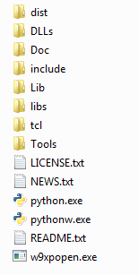
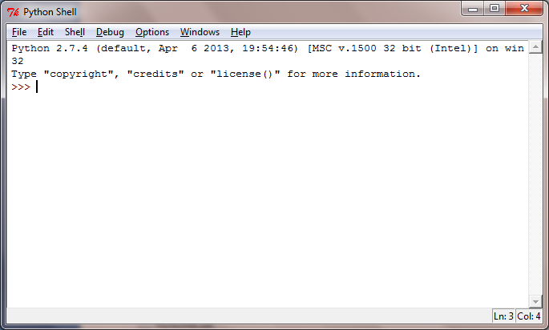
Environment
Interpreter
Windows: C:\Python27
IDLE - Python GUI

Slide 8
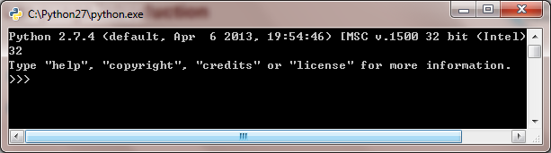
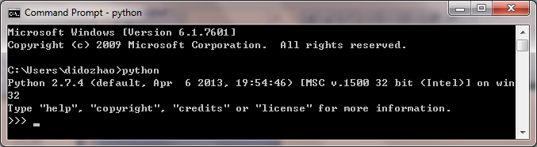
Language introduction
Python command line
Windows command line C:\Users\xxx>python

Slide 9
Language introduction
Tutorial
Language style
Tab, coding standard
Data structures
Number, String
List, Tuple, Dicts
Raw_input(‘’) , etc
Statements
If elif else,
for , range,
break, continue, pass , etc
Language Reference
http://docs.python.org/2/reference/index.html

Slide 10
Language introduction
Data structures
Number and operation
+ - * / % ** //
String and format
‘ ’ “ “ ‘’’ ‘’’
+ %s
Split(), find(), replace(), upper(), lower()
Raw_input()
Internal storage
a=1, b=a, a=a+1, b?

Slide 11
Language introduction
Data structures
List: []
mutable
len(), index(), append(), pop(), sorted()
Map(func,list), zip()
Tuple: ()
immutable
Dict : {:}
mutable
tuple[key] = value
Items(), keys(), values(), len()
Internal storage
import copy, copy.copy()

Slide 12
Language introduction
Statements
If elif else
While + terminal condition
For
In string, list, tuple
In multiple sequences
range()
Pass, break, continue
while/for + if

Slide 13
Practice makes perfect!
Pick up something to practice
Calculator
Input format ‘243 + 45’, ‘345 / 7’
Output format ‘243 + 45 = 298’, ‘345 / 7 = 49.285714285714285’
Financial product rate
Input format ‘6M 100000 24’, ‘3Y 50000 12’
Output format ‘total amount is …’
Try to save the rates into a list/dict
Try to input parameters as a string/list/tuple
Reference:
‘Python core programming’ book
The Python Community: http://www.python.org/
A Byte of Python: http://sebug.net/paper/python/
 | Interest%
3M | 2.85
6M | 3.05
1Y | 3.25
2Y | 3.75
3Y | 4.25
5Y | 4.75

Slide 14
Module and Library Reference - Take a Glimpse
By Vivian Wang
2014.01

Slide 15

Part 1
Object-Oriented Python

Slide 16
Object-Oriented python
Tutorial
Functions, Classes and Objects
Numeric, sequence, file objects, etc.
Int(), str(), len(), max(), split(), map(), etc.
Modules and name space
import
if __name__ == '__main__':
Language Reference
http://docs.python.org/2/reference/index.html

Slide 17
Object-Oriented python
Functions, Classes and Objects
Objects
Numeric, sequence, file objects, etc.
File object – file=open(‘D:\\a.txt’,’r’), file.write(‘blabla’), file.close()
Functions
Upper/lower(), find(), replace(), split(), append(), Items(), read/write()
Attributes
Class
__init__
Self
Scope
global

Slide 18
Object-Oriented python
Modules and name space
Name space
if __name__ == '__main__':
E.g.) Modules.py
Modules
interpreter and import
E.g.) Import.py

Slide 19

Part 2
Libraries

Slide 20
Libraries
Tutorial
Operation system services - os, logging, thread, etc.
Internet data handling - email , etc
Structured markup processing tools - xml.(etree, dom, sax) , etc
Internet protocols and support
urllib, httplib, urlparse , etc
HTTPServer(Base, Simple, CGI) , etc
Real examples
Individual Script: a) fetchJira.py; b) maxiMail.py
Individual run by 3rd party (Selenium webdriver): wedriverTest.py
Multiple scripts: How Cgi script infect front-end page
Library Reference
http://docs.python.org/2/library/index.html#library-index

Slide 21
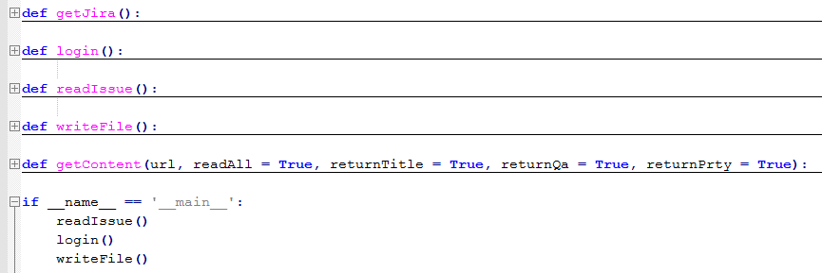
Examples - Fetch Information from Jira
Read issue list from an individual file
Login on the right Jira and check on the HTML
Write information and save in another file
fetchJira.py

Slide 22
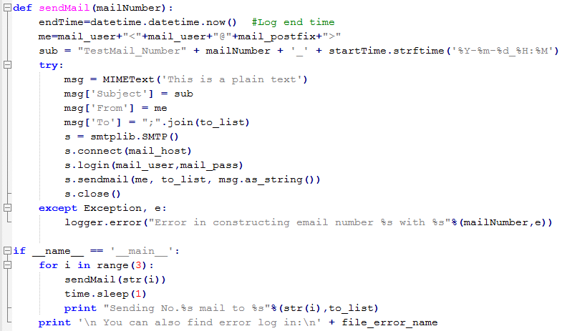
Examples - Send mails
Send mails
Make log file to track the maximum value
maxiMail.py

Slide 23
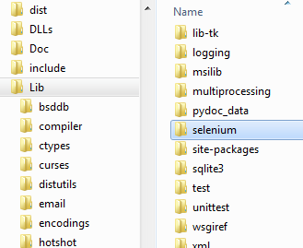
Examples – UI test by 3rd party
Third party package: Selenium C:\Python27\Lib
Note: Chrome driver
Environment Variable:
webdriver.chrome.driver - chromedriver.exe
chromedriver.exe
wedriverTest.py
from selenium import webdriver
chromeDriver=webdriver.Chrome()
chromeDriver.get(url)
input = chromeDriver.find_element_by_id('kw')
input.send_keys('webdriver')
button = chromeDriver.find_element_by_id('su')
button.submit()

Slide 24
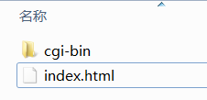
Examples – Interaction with web server
Server:
Python –m CGIHTTPServer 8080
Index.html
<html>
call cgi script: xxx.py
Xxx.py
Client
http://127.0.0.1:8080
BaseHTTPServer
SimpleHTTPServer
CGIHTTPServer
friends1.py

Slide 25
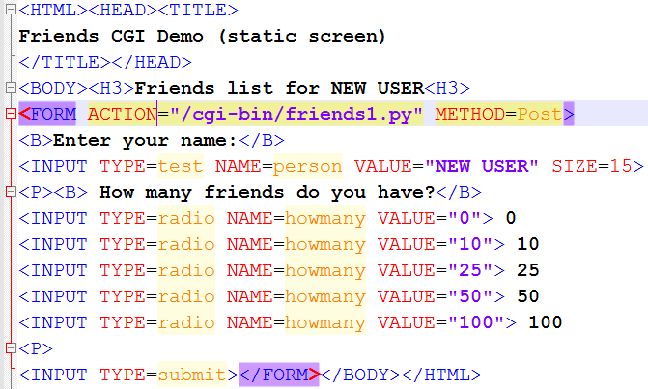
Examples – Interaction with web server
Index.html

Slide 26
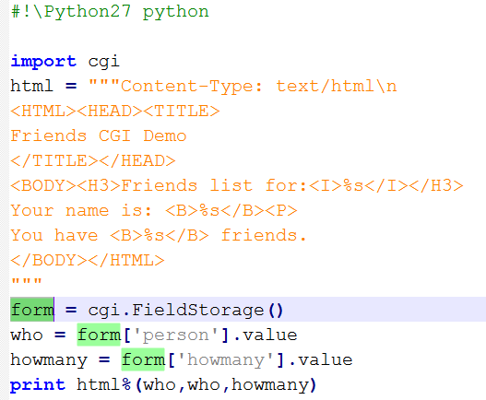
Examples – Interaction with web server
Cgi script – friends1.py

Slide 27
Open web platform & Webtop API - Real Interaction
By Vivian Wang
2014.01

Slide 28
Webtop API
These 2 structures are only for precondition, NOT for automation
If you try to make them as automation scripts, remember to add verify functions.

Slide 29
Webtop API
Structure A
Entry: Test.py
External config file
Modules:
Mail.py
Contact.py
Calendar.py
Task.py
Settings.py

Slide 30
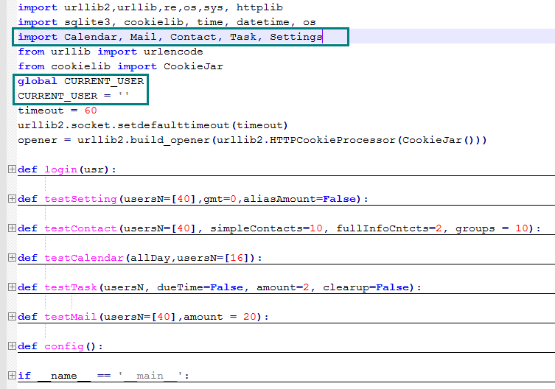
Webtop API
Overview:
Test.py
Modules
External config

Slide 31
Webtop API
test.py __name__ == '__main__'
get config file | get a file object
define global variables | a) parase config file b) define a dictionary (see variable type)
def login(user) | define an internal function for a single user
Call test modules one by one | if 'setGmt8' in setting: testSetting(usersN,gmt=8) if 'addAlias' in setting: testSetting(usersN,gmt=-1,aliasAmount=params['aliasAmount']) if 'contact' in feature: testContact(usersN,simpleContacts, fullInfoCntcts, groups) …
define test for each module def testMail() def testContact() def testCalendar() def testTask() def testSettings() | each single test function: a) login for all users one by one b) module object instantiation = get a module object c) call module functions for object

Slide 32
Webtop API
get config file | get a file object
define global variables | a) parase config file b) define a dictionary (see variable type)
params = {}
for line in conf.readlines():
param = line.split(':')[0]
config.txt
Env :btdante# one word of environment(btdante or btstaging)
Port :8080# port
Build :990# build number
Uid :42 45# user number
Feature :contact calendar mail task settings# which features
Setting :setGmt8 addAlias# settings -> setGmt8/addAlias
simpleContacts :2# how many simple contacts you want to create
fullInfoCntcts :2# how many contacts with full info
Groups :3# how many contact groups
aliasAmount :3# how many amount you want to create
…… :……

Slide 33
Webtop API
params[param] = line.split(':')[1].split('#')[0]
feature:contact calendar mail task settings# which features you want to run?
global feature = params['feature']
feature-> [‘contact’, ‘calendar’, ‘mail’, ‘task’, ‘settings’]
usersN = params['uid'].split(' ')
simpleContacts = int(params['simpleContacts'])
fullInfoCntcts = int(params['fullInfoCntcts'])
groups = int(params['groups'])
amount = int(params['amount'])
allDay = int(params['allDay'])
feature = params['feature']
setting = params['setting']
taskAmount = int(params['taskAmount'])
aliasAmount = params['aliasAmount']
Config file | variable type
user | list
dom | string
environment | string
feature | list
settings | list
aliasAmount | string
…

Slide 34
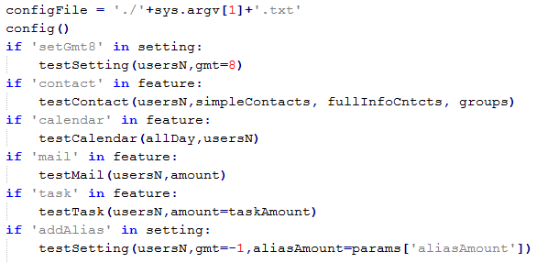
Webtop API
Run on remote server:
Call test modules one by one | if 'setGmt8' in setting: testSetting(usersN,gmt=8) …
Steps:
Get config file from command line
Parase and define global variables
Call test functions by config

Slide 35
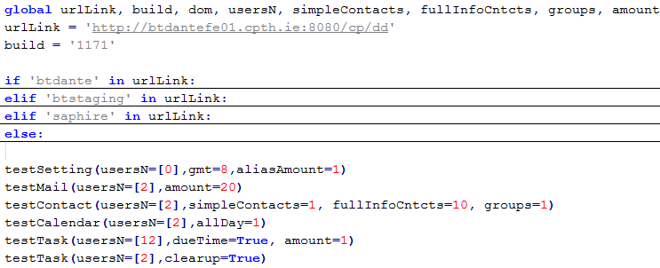
Webtop API
Run locally:
Call test modules one by one | testSetting(usersN,gmt=8) …
Steps:
Define global varaibles
Define variables value
Call test functions

Slide 36
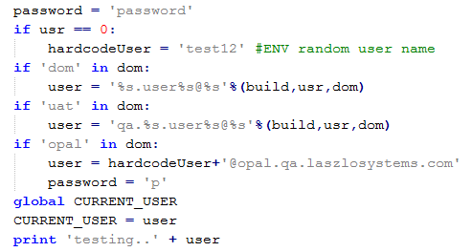
Webtop API
def login(user) | define an internal function for a single user
Steps:
Define (global) variables
Form request data
Send request
Receive response

Slide 37
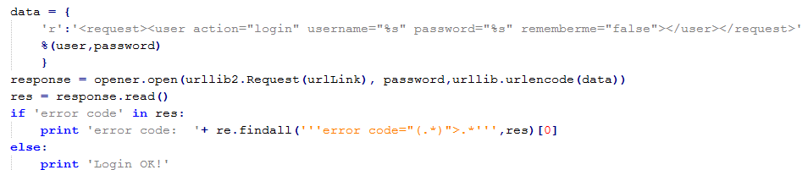
Webtop API
def login(user) | define an internal function for a single user
Steps:
Define (global) variables
Form request data
Send request
Receive response
Return

Slide 38
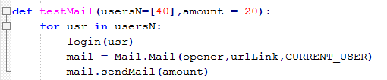
Webtop API
define test for each module def testMail() def testContact() def testCalendar() def testTask() def testSettings() | each single test function: a) login for all users one by one b) module object instantiation = get a module object c) call module functions for object
Steps:
Loop for all users
Login for each single account
Model object installation
Call test function
import Calendar, Mail, Contact, Task, Settings

Slide 39
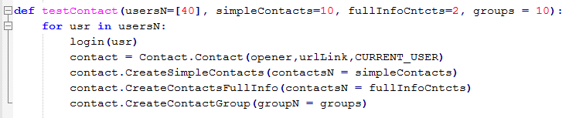
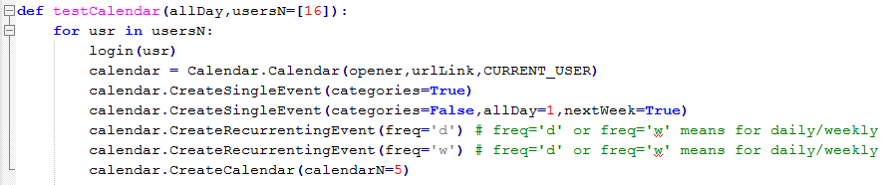
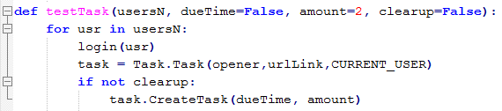
Webtop API
All functions are looked the same?!

Slide 40
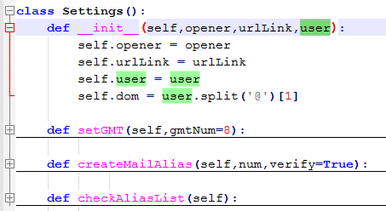
Webtop API
independent modules
Mail.py | Contact.py | Calenar.py | Settings.py
class Mail | class Contact | class Calendar | class Settings
__init__: pass golbal variables (requestURL,user)
sendMail() | CreateSimpleContacts() | CreateCalendar() | getGMT()
saveDraft() | CreateContactsFullInfo() | CreateSingleEvent() | createMailAlias()
markMail() | CreateContactGroup() | CreateRecurrentEvent() | checkAliasList()
… | … | … | …
Common steps:
Pass variables
Set variables
Encapsulate test function
Each function: pair of request/response

Slide 41
Webtop API
Structure B
Entry: Test.py
External config file
Modules: Mail.py, Contact.py, Calendar.py, Task.py, Settings.py
Nodes operations
Data module

