Slide 1
Java project: ‘Find anagrams in text’
Final Java Core project
20.04.2016

Slide 2
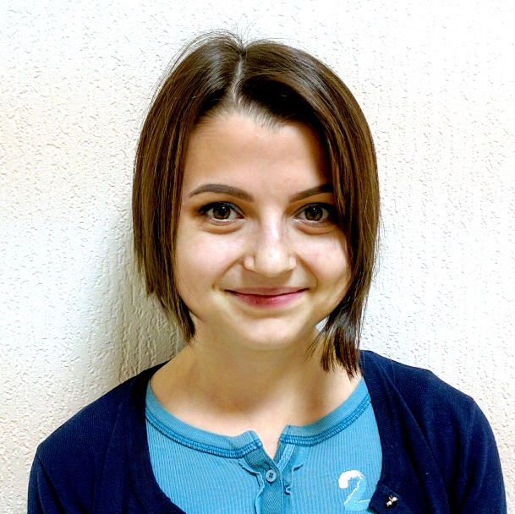

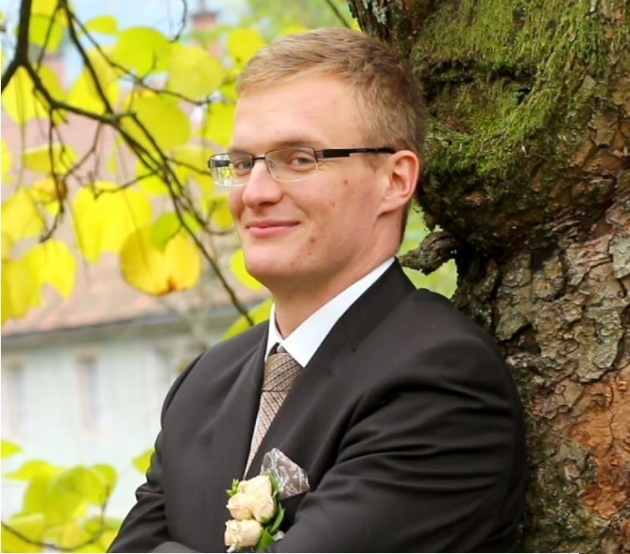
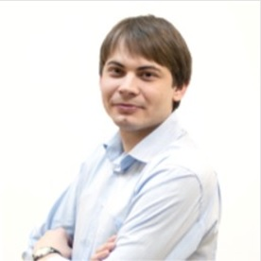
Team#8
Valentin Vrakin
Konstantin Petrov
Roman Burko
Mentor: Tatiana Mokhnenko

Slide 3
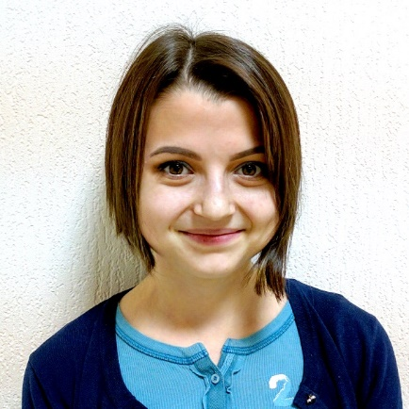

Team#8 - Victory
A team of active, hard-working and sporty people.
We are so different but we are united by one idea.
The idea of studying, improving and progress.
The team “Victory” always wins in the peaceful war of the self development

Slide 4
Task
Implement algorithm for finding anagrams in the text
An anagram is a rearrangement of the letters of one word or phrase to form another word or phrase.
Example: mary, army.
Anagram Algorithm

Slide 5
Project UML diagram

Slide 6
Algorithm flow diagram

Slide 7

Thank you for your attention

