Slide 1
Search Box4
Revision
Add Words
Help
English To Welsh
Welsh to English
Welsh to English
Practise Words
English Word
Welsh Word
Word Type
Abbey
Abaty
NM
Dry
Sych
Other
Elephant
The words displayed are just a sample of some of the words in the dictionary
Clicking on this will open a tab of the practice words
Eliffnt
NM
Navigation bar
To Employ
Cyflogi
V
Funeral
Angladd
NM
Machine
Periant
NM
Slow
Araf
Other
With
Gyda
Other
Young
Ifanc
Other

Slide 2
Search Box
Revision
Add Words
Help
English To Welsh
English To Welsh
Welsh to English
Welsh to English
Practise Words
English To Welsh
Practise Words
Click the search box to input text [SE-UC-1]
English Word
Welsh Word
Word Type
Abbey – nm
abaty
Abaty
Click to order dictionary by welsh words [SE-UC-1]
Abbey
NM
Dry – other
sych
Dry
Sych
Other
Elephant
Eliffnt
NM
Elephant – nm
eliffnt
To Employ
Cyflogi
V
employ – V
cyflogi
Funeral
Angladd
NM
Funeral –nm
angladd
Machine
Periant
NM
Slow
Araf
Other
Machine – nm
periant
With
Gyda
Other
Young
Ifanc
Other
Click the button to add the word to the practice list [SE-UC-4]

Slide 3
E
Revision
Add Words
Help
English To Welsh
Welsh to English
English To Welsh
Welsh to English
Practise Words
English Word
Welsh Word
Word Type
Elephant – nm
eliffnt
Elephant
Eliffnt
NM
employ – V
cyflogi
Employ
Cyflogi
V
As the user begins to add text into the box the dictionary will only show relevant words [SE-UC-1]

Slide 4
Search Box
Revision
Add Words
Help
Dictionary where users can just scroll through English words and there translations
English To Welsh
Welsh to English
English To Welsh
Welsh to English
Practise Words
English Word
Welsh Word
Word Type
NM
Abbey – nm
abaty
Abbey
Abaty
Abbey
Abaty
NM
Dry – other
sych
Dry
Sych
Other
Elephant
Eliffnt
Click to close tab [SE-UC-4]
NM
Elephant – nm
eliffnt
Click the button to remove from practice words [SE-UC-4]
To Employ
Cyflogi
V
employ – V
cyflogi
Funeral
Angladd
NM
Funeral –nm
angladd
Machine
Periant
NM
Slow
Araf
Other
Machine – nm
periant
With
Gyda
Other
Young
Ifanc
Other

Slide 5
Search Box
Revision
Add Words
Help
Dictionary where users can just scroll through English words and there translations
Welsh To English
Welsh to English
English To Welsh
English to Welsh
Practise Words
English Word
Welsh Word
Word Type
Abbey
Abaty
NM
Abaty
Abbey
Dry
Sych
Other
Sych
Dry
Click to order words by English [SE-UC-1]
Elephant
Eliffnt
NM
Eliffnt
Elephant
To Employ
Cyflogi
V
Cyflogi
To Employ
Funeral
Angladd
NM
Angladd
Funeral
Machine
Periant
NM
Periant
Machine
Slow
Araf
Other
Araf
Slow
With
Gyda
Other
Gyda
With
Young
Ifanc
Other
Ifanc
Young

Slide 6
Home
Revision
Add Words
Help
Screen shot of page
Screen shot of page
Screen shot of page
Screen shot of page
Flashcards
Match the words
Test
Pick the correct word
[SE-UC-6]
[SE-UC-7]
[SE-UC-8]
[SE-UC-9]
Click to go to desired page

Slide 7
Home
Revision
Add Words
Help
Click to return to revision home page [SE-UC-5]
Abbey
Translate
Next
Press to move onto the next flashcard [SE-UC-6]
Press to flip the flashcard and show the welsh word [SE-UC-6]

Slide 8
Home
Revision
Add Words
Help
Abaty
Translate
Next
Translate back to English [SE-UC-6]

Slide 9
Home
Revision
Add Words
Help
Funeral
Previous
Translate
Menu
Return to previous flashcard

Slide 10
Home
Revision
Add Words
Help
Anglad
Previous
Translate
Menu

Slide 11
Home
Revision
Add Words
Help
With
Ifanc
Click the button to select the word [SE-UC-7]
Slow
Araf
Young
Gyda
Click the button to select the correct translation [SE-UC-7]
Abbey
Abaty

Slide 12
Home
Revision
Add Words
Help
With
Ifanc
Slow
Araf
Young
Gyda
Abbey
Abaty

Slide 13
Home
Revision
Add Words
Help
With
Ifanc
Slow
Araf
Young
Gyda
Abbey
Abaty

Slide 14
Home
Revision
Add Words
Help
With
Ifanc
Slow
Araf
Young
Gyda
Abbey
Abaty

Slide 15
Home
Revision
Add Words
Help
With
Ifanc
Slow
Araf
Young
Gyda
Abbey
Abaty

Slide 16
Home
Revision
Add Words
Help
With
Ifanc
Slow
Araf
Young
Gyda
Abbey
Abaty

Slide 17
Home
Revision
Add Words
Help
With
Ifanc
Slow
Araf
Young
Gyda
Abbey
Abaty

Slide 18
Home
Revision
Add Words
Help
With
Ifanc
Slow
Araf
Young
Gyda
Abbey
Abaty

Slide 19
Home
Revision
Add Words
Help
With
Ifanc
Slow
Araf
Young
Gyda
Abbey
Abaty

Slide 20
Home
Revision
Add Words
Help
With
Congratulations you got 4 out of 4 words right
Ifanc
Slow
Araf
Young
Gyda
Try Again
Abbey
Abaty
Return to revision menu

Slide 21
Home
Revision
Add Words
Help
Young
The user will be given an English word where they have to click the correct translation [SE-UC-9]
Random word
Random word
Random word
Random word
Ifanc
Random word

Slide 22
Home
Revision
Add Words
Help
English Word 1
Correct!
Next Word
Correct word

Slide 23
Home
Revision
Add Words
Help
English Word 1
Incorrect!
Correct word: Ifanc
Next Word
Correct word

Slide 24
Home
Revision
Add Words
Help
Slow
Random word
Random word
Random word
Araf
Random word
Random word

Slide 25
Home
Revision
Add Words
Help
English Word 1
Correct!
Try Again
Correct word
Return to revision menu

Slide 26
Home
Revision
Add Words
Help
English Word 1
Incorrect!
Correct word: Araf
Try Again
Correct word
Return to revision menu

Slide 27
Home
Revision
Add Words
Help
Slow
User will type in there answer by clicking on the box [SE-UC-8]
Submit

Slide 28
Home
Revision
Add Words
Help
Slow
Click the button to submit your answer [SE-UC-8]
Araf
Submit

Slide 29
Home
Revision
Add Words
Help
CORRECT!
Slow
Araf
Next question!
Submit

Slide 30
Home
Revision
Add Words
Help
School
User will type in there answer by clicking on the box

Slide 31
Home
Revision
Add Words
Help
School
Click the button to submit your answer
Gwaith
Submit

Slide 32
Home
Revision
Add Words
Help
Incorrect
Slow
Araf
Reveal Answer
Submit
Try Again
Return to revision menu

Slide 33
Home
Revision
Add Words
Help
Ysgol
Slow
Araf
Try Again
Submit
Return to revision menu

Slide 34
Home
Revision
Add Words
Help
Dictionary where users can just scroll through English words and there translations
English To Welsh
Reverse
Add Words
English Word
Welsh Word
Abbey – nm
abaty
Word Type
English Word – word type
Welsh Word
Abbey
Abaty
NM
Dry – other
sych
English Word – word type
Welsh Word
Dry
Sych
Other
Elephant
Eliffnt
NM
English – Input Text
Elephant – nm
eliffnt
English Word – word type
Welsh Word
To Employ
Cyflogi
V
Welsh – Input Text
employ – V
cyflogi
English Word – word type
Welsh Word
Funeral
Angladd
NM
Drop down-list of word type
Funeral –nm
angladd
English Word – word type
Welsh Word
Machine
Periant
NM
Slow
Araf
Other
Submit Word
Machine – nm
periant
English Word – word type
Welsh Word
With
Gyda
Other
[SE-UC-3]
Young
Ifanc
Other

Slide 35
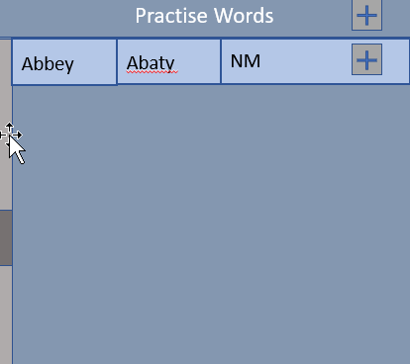
Home
Revision
Add Words
Help
Home Help
The home page is where you will find the main dictionary, to look through all of the words in the dictionary use the scroll bar located on the sides. You will be able to access a number of functions through the home page such as Practice words, to do this click the practice words tab to open it up, to add a word to the list just click the button next to it! To remove the word just click the word that is in the list.
You can also change the ordering of the words to welsh to English by clicking the button labelled ‘Welsh to English’.
Revision Help
Add Words Help
[SE-UC-2]

Slide 36
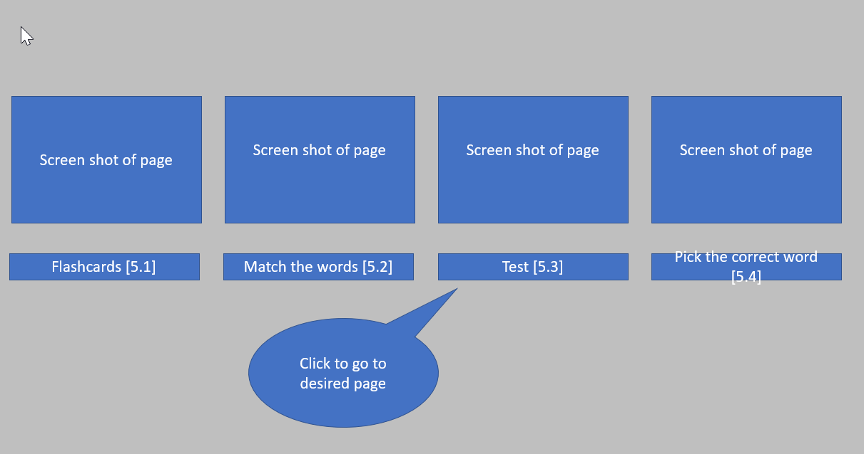
Home
Revision
Add Words
Help
Home Help
To get started with the revision features on the application simply click the Revision option on the navigation bar, this will show all of the options that you can chose in the revision menu!
Revision Help
Add Words Help
[SE-UC-2]

Slide 37
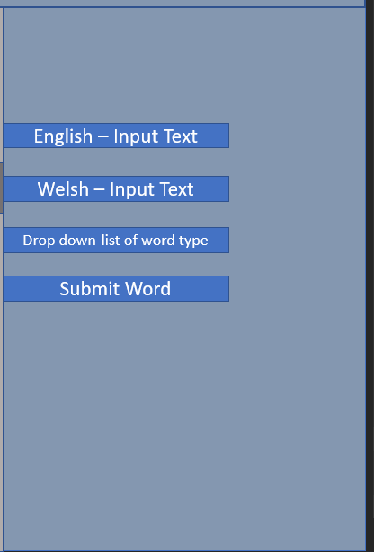
Home
Revision
Add Words
Help
Home Help
To add a word first you must select the page on the navigation bar, you will then be presented with a form to fill out. Simply fill out all the fields with your English word, Welsh word and the word type and press the submit button. The word can then be found in the dictionary.
Revision Help
Add Words Help
[SE-UC-2]

